Slide 1
University Of Science And Technology Houari Boumediene
Faculty of Computer Science
Module : TIC
Information and Communication Technologies
Student: Si Lounis Anis
Group: 3
Academic Year: 2025/2026

Slide 2
Introduction
TIC play a fundamental role in modern society
They enable the creation, storage, and exchange of information
Used in education, business, and communication
The objective of this presentation : present TIC and modern digital tools

Slide 3
Definition & Components of TIC
Definition of TIC: tools to collect, process, store, and share information
Components of TIC
Software
Hardware
Networks
applications, operating systems
computers, smartphones
Internet,
communication protocols

Slide 4




Google Services
Google Workspace
Google Drive
Google Docs
Google Sheets
Gmail

Slide 5




Microsoft Tools
Microsoft
Microsoft Office:
  Word
  Excel
  PowerPoint
Used in education and companies
Improve productivity and organization

Slide 6

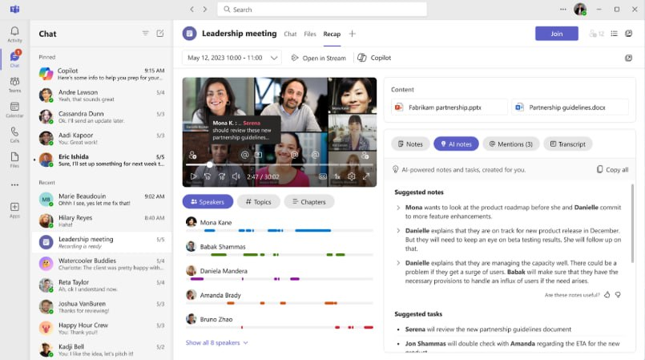
Microsoft Teams
Chat, voice, and video meetings
File sharing
Integration with Office tools
Organized teamwork

Slide 7


Git & GitHub
Version control systems
Git: track changes and versions
GitHub: code hosting and collaboration
Used for teamwork and projects
GitHub

Slide 8

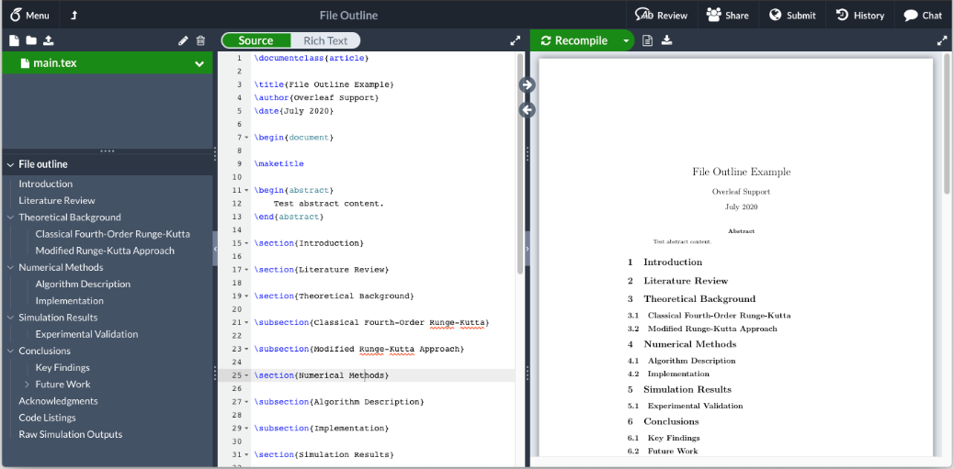
LaTeX
LaTeX: academic document preparation system
High-quality PDF output
Overleaf: online collaborative LaTeX editor

Slide 9
Advantages of TIC
Fast communication
Easy access to information
Better collaboration
Increased productivity
Data storage and sharing

Slide 10
Disadvantages of TIC
Cybersecurity and privacy issues
High cost of technology
Technical problems
Health issues
Dependence on technology

Slide 11
Conclusion
TIC transformed education and work
Tools like Google, Microsoft, GitHub, LaTeX are essential
Improve efficiency and collaboration
Must be used responsibly

