Slide 1
The Transformer-based
MS/MS Spectrum Refining Model
컴퓨터소프트웨어학부 심승현

Slide 2
Contents
▶ Background of study
▶ Inputs of Transformer
▶ Implementation

Slide 3
Background

Slide 4
Background
Protein
∙∙∙EKPAARKAI∙∙∙

Slide 5
Background
Protein
∙∙∙EKPAARKAI∙∙∙
digestion
Peptide
PAAR

Slide 6
Background
Protein
∙∙∙EKPAARKAI∙∙∙
digestion
Peptide
PAAR
Fragmentation
b-ion Fragments
y-ion Fragments
P, PA, PAA
R, AR, AAR

Slide 7
Background
Protein
∙∙∙EKPAARKAI∙∙∙
digestion
Peptide
PAAR
Fragmentation
b-ion Fragments
y-ion Fragments
P, PA, PAA
R, AR, AAR
Mass spectrometry
Intensity
m/z

Slide 8
Background
Protein
∙∙∙EKPAARKAI∙∙∙
digestion
Peptide
PAAR
Fragmentation
b-ion Fragments
y-ion Fragments
P, PA, PAA
R, AR, AAR
Mass spectrometry
Intensity
▶ Noises Disturb analysis
noise
noise
noise
noise
m/z

Slide 9
Background
Protein
∙∙∙EKPAARKAI∙∙∙
digestion
Peptide
PAAR
Fragmentation
b-ion Fragments
y-ion Fragments
P, PA, PAA
R, AR, AAR
Mass spectrometry
Intensity
▶ Project goal :
Detect noises,
and get rid of them
noise
noise
noise
noise
m/z

Slide 10
Background
Protein
∙∙∙EKPAARKAI∙∙∙
digestion
Peptide
PAAR
Fragmentation
b-ion Fragments
y-ion Fragments
P, PA, PAA
R, AR, AAR
Mass spectrometry
Intensity
▶ Project goal :
Detect noises,
and get rid of them
m/z

Slide 11
Methods
▶ Adapt deep learning to achieve goal,
especially, use Transformer

Slide 12
Inputs of Transformer
▶ The basic transformer model
prediction
‘thank you .’
Encoder
Decoder
train data
truth
‘obrigado .’
‘thank you .’

Slide 13
Inputs of Transformer
▶ The basic transformer model
▶ Transformer model in out project
prediction
prediction
‘thank you .’
???
Encoder
Decoder
Encoder
Decoder
train data
truth
train data
truth
‘obrigado .’
‘thank you .’
???
???

Slide 14
Inputs of Transformer
▶ We need two inputs,
input for encoder,
input for decoder
prediction
???
Encoder
Decoder
train data
truth
???
???

Slide 15
Inputs of Transformer
▶ We will use peak informations
what is it?
prediction
???
Encoder
Decoder
train data
truth
???
???

Slide 16
Inputs of Transformer
Protein
▶ We will use peak informations
∙∙∙EKPAARKAI∙∙∙
digestion
Peptide
This is spectrum !
PAAR
Fragmentation
b-ion Fragments
y-ion Fragments
P, PA, PAA
R, AR, AAR
Mass spectrometry
Intensity
m/z

Slide 17
Inputs of Transformer
Intensity
m/z
these are peaks !

Slide 18
Inputs of Transformer
Intensity
peak1 : 70 264
264
70
m/z

Slide 19
Inputs of Transformer
Intensity
peak1 : 70 264
peak2 : 89 196
196
89
m/z

Slide 20
Inputs of Transformer
Intensity
peak1 : 70 264
peak2 : 89 196
peak3 : 102 57
57
102
m/z

Slide 21
Inputs of Transformer
Intensity
peak1 : 70 264
peak2 : 89 196
peak3 : 102 57
…
peak10 : 421 375
375
421
m/z

Slide 22
Inputs of Transformer
Intensity
peak1 : 70 264
peak2 : 89 196
peak3 : 102 57
…
peak10 : 421 375
m/z
▶ We will use this kind of peak informations

Slide 23
Inputs of Transformer
▶ We will use peak informations
what is it?
prediction
???
peak1 : 70 264
peak2 : 89 196
peak3 : 102 57
…
peak10 : 421 375
Encoder
Decoder
▶ We will use this kind of peak informations
train data
truth
???
???

Slide 24
Inputs of Transformer
▶ We will use peak informations
what is it?
prediction
???
peak1 : 70 264
peak2 : 89 196
peak3 : 102 57
…
peak10 : 421 375
Encoder
Decoder
▶ We will use this kind of peak informations
train data
truth
???
???
▶ So, what will be the actual data?
dataset file in .mgf extenstion

Slide 25
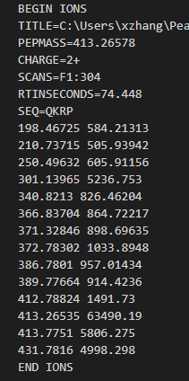
What is .mgf File ?
▶ This is peak informations of a single spectrum. let’s see it!
i
spectrum 1
▶ .mgf extension file has peak informations,
for multiple spectrums
m/z
i
spectrum 2
m/z
i
spectrum 3
m/z
∙∙∙

Slide 26
What is .mgf File ?
▶ This is peak informations of a single spectrum. let’s see it!
▶ Begin/End of a single spectrum

Slide 27
What is .mgf File ?
▶ This is peak informations of a single spectrum. let’s see it!
▶ Spectrum name

Slide 28
What is .mgf File ?
▶ This is peak informations of a single spectrum. let’s see it!
▶ $m/z$ value

Slide 29
What is .mgf File ?
▶ This is peak informations of a single spectrum. let’s see it!
▶ Charge of peptide

Slide 30
What is .mgf File ?
▶ This is peak informations of a single spectrum. let’s see it!
▶ Peptide sequence
Consists of amino acid

Slide 31
What is .mgf File ?
▶ This is peak informations of a single spectrum. let’s see it!
▶ Peak informations

Slide 32
What is .mgf File ?
▶ This is peak informations of a single spectrum. let’s see it!
▶ Peak informations
peak1 : 70 264
peak2 : 89 196
peak3 : 102 57
…
peak10 : 421 375

Slide 33

What is .mgf File ?
▶ This is peak informations of a single spectrum. let’s see it!
▶ Peak informations
$m/z$ of fragments
m/z
peak1 : 70 264
peak2 : 89 196
peak3 : 102 57
…
peak10 : 421 375

Slide 34
What is .mgf File ?
▶ This is peak informations of a single spectrum. let’s see it!
▶ Peak informations
intensity
peak1 : 70 264
peak2 : 89 196
peak3 : 102 57
…
peak10 : 421 375
intensity of fragments

Slide 35
What is .mgf File ?
▶ This is peak informations of a single spectrum. let’s see it!
▶ Peak informations
$m/z$ of fragments
peak1 : 70 264
peak2 : 89 196
peak3 : 102 57
…
peak10 : 421 375
intensity of fragments

Slide 36
What is .mgf File ?
▶ .mgf extension file has
peak informations for multiple spectrums

Slide 37
Read .mgf File
▶ Read .mgf file, and extract data for transformer inputs !
prediction
???
Encoder
Decoder
train data
truth
???
???

Slide 38
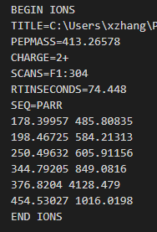
Encoder Input
▶ First, encoder input
For encoder input, we will put m/z value and intensity in a special form
Encoder
train data
???

Slide 39

Encoder Input
▶ First, encoder input
For encoder input, we will put m/z value and intensity in a special form
Encoder
train data
???
$m/z$
intensity

Slide 40
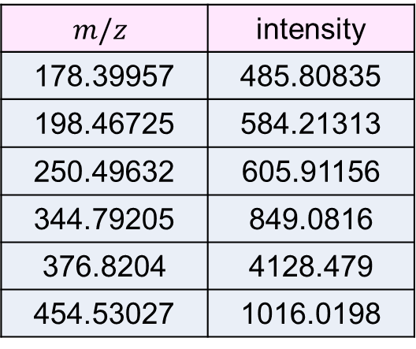
Encoder Input
▶ First, encoder input
For encoder input, we will put m/z value and intensity in a special form
$$m/z$$ | intensity
178.39957 | 485.80835
198.46725 | 584.21313
250.49632 | 605.91156
344.79205 | 849.0816
376.8204 | 4128.479
454.53027 | 1016.0198
Encoder
train data
???

Slide 41
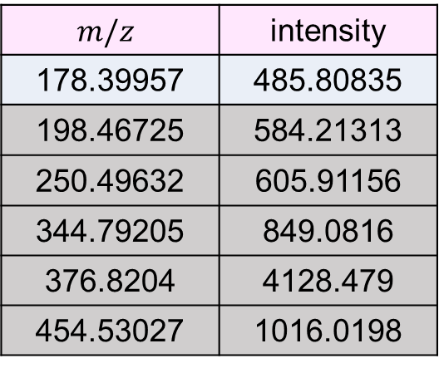
Encoder Input
▶ First, encoder input
For encoder input, we will put m/z value and intensity in a special form
$$m/z$$ | intensity
178.39957 | 485.80835
198.46725 | 584.21313
250.49632 | 605.91156
344.79205 | 849.0816
376.8204 | 4128.479
454.53027 | 1016.0198
Encoder
178 | 39
train data
???

Slide 42
Encoder Input
▶ First, encoder input
For encoder input, we will put m/z value and intensity in a special form
normalize
$$m/z$$ | intensity
178.39957 | 485.80835
198.46725 | 584.21313
250.49632 | 605.91156
344.79205 | 849.0816
376.8204 | 4128.479
454.53027 | 1016.0198
Encoder
178 | 39
train data
???

Slide 43
Encoder Input
▶ First, encoder input
For encoder input, we will put m/z value and intensity in a special form
normalize
$$m/z$$ | intensity
178.39957 | 485.80835
198.46725 | 584.21313
250.49632 | 605.91156
344.79205 | 849.0816
376.8204 | 4128.479
454.53027 | 1016.0198
Encoder
178 | 39
train data
???
Find max value

Slide 44
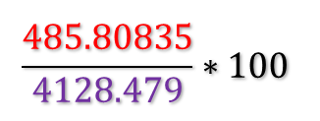
Encoder Input
▶ First, encoder input
For encoder input, we will put m/z value and intensity in a special form
normalize
$$m/z$$ | intensity
178.39957 | 485.80835
198.46725 | 584.21313
250.49632 | 605.91156
344.79205 | 849.0816
376.8204 | 4128.479
454.53027 | 1016.0198
Encoder
178 | 39 | 11
$$\frac{485.80835}{4128.479}∗100$$
train data
???
Find max value

Slide 45
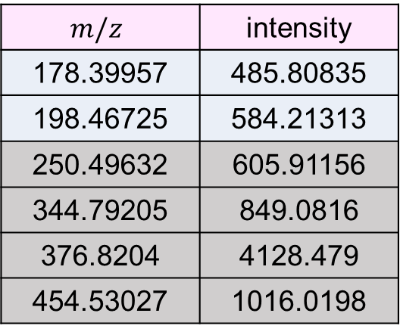
Encoder Input
▶ First, encoder input
For encoder input, we will put m/z value and intensity in a special form
$$m/z$$ | intensity
178.39957 | 485.80835
198.46725 | 584.21313
250.49632 | 605.91156
344.79205 | 849.0816
376.8204 | 4128.479
454.53027 | 1016.0198
Encoder
178 | 39 | 11
198 | 46
train data
???

Slide 46
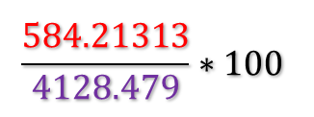
Encoder Input
▶ First, encoder input
For encoder input, we will put m/z value and intensity in a special form
$$m/z$$ | intensity
178.39957 | 485.80835
198.46725 | 584.21313
250.49632 | 605.91156
344.79205 | 849.0816
376.8204 | 4128.479
454.53027 | 1016.0198
Encoder
178 | 39 | 11
198 | 46 | 14
$$\frac{584.21313}{4128.479}∗100$$
train data
???

Slide 47

Encoder Input
▶ First, encoder input
For encoder input, we will put m/z value and intensity in a special form
$$m/z$$ | intensity
178.39957 | 485.80835
198.46725 | 584.21313
250.49632 | 605.91156
344.79205 | 849.0816
376.8204 | 4128.479
454.53027 | 1016.0198
Encoder
178 | 39 | 11
198 | 46 | 14
250 | 49 | 14
train data
???

Slide 48
Encoder Input
▶ First, encoder input
For encoder input, we will put m/z value and intensity in a special form
$$m/z$$ | intensity
178.39957 | 485.80835
198.46725 | 584.21313
250.49632 | 605.91156
344.79205 | 849.0816
376.8204 | 4128.479
454.53027 | 1016.0198
Encoder
178 | 39 | 11
198 | 46 | 14
250 | 49 | 14
344 | 79 | 20
376 | 82 | 100
454 | 53 | 24
train data
???

Slide 49
Encoder Input
▶ First, encoder input
For encoder input, we will put m/z value and intensity in a special form
178 | 39 | 11
198 | 46 | 14
250 | 49 | 14
344 | 79 | 20
376 | 82 | 100
454 | 53 | 24
$$m/z$$ | intensity
178.39957 | 485.80835
198.46725 | 584.21313
250.49632 | 605.91156
344.79205 | 849.0816
376.8204 | 4128.479
454.53027 | 1016.0198
Encoder
train data
???

Slide 50


Encoder Input
▶ First, encoder input
For encoder input, we will put m/z value and intensity in a special form
$H^{+}$
1.0073 |  | 1.0100
19.0178 |  | 1.0200
178 | 39 | 11
198 | 46 | 14
250 | 49 | 14
344 | 79 | 20
376 | 82 | 100
454 | 53 | 24
$H_{3}O^{+}$
$$m/z$$ | intensity
178.39957 | 485.80835
198.46725 | 584.21313
250.49632 | 605.91156
344.79205 | 849.0816
376.8204 | 4128.479
454.53027 | 1016.0198
Encoder
train data
???

Slide 51
Encoder Input
▶ First, encoder input
For encoder input, we will put m/z value and intensity in a special form
$H^{+}$
1 | 0 | 101
19 | 1 | 102
178 | 39 | 11
198 | 46 | 14
250 | 49 | 14
344 | 79 | 20
376 | 82 | 100
454 | 53 | 24
$H_{3}O^{+}$
$$m/z$$ | intensity
178.39957 | 485.80835
198.46725 | 584.21313
250.49632 | 605.91156
344.79205 | 849.0816
376.8204 | 4128.479
454.53027 | 1016.0198
Encoder
train data
???

Slide 52

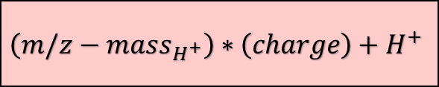
Encoder Input
▶ First, encoder input
For encoder input, we will put m/z value and intensity in a special form
1 | 0 | 101
19 | 1 | 102
178 | 39 | 11
198 | 46 | 14
250 | 49 | 14
344 | 79 | 20
376 | 82 | 100
454 | 53 | 24
$$m/z$$ | intensity
178.39957 | 485.80835
198.46725 | 584.21313
250.49632 | 605.91156
344.79205 | 849.0816
376.8204 | 4128.479
454.53027 | 1016.0198
Encoder
train data
???
peptide mass + $H^{+}$
$$\left(m/z−mass_{H^{+}}\right)∗\left(charge\right)+H^{+}$$

Slide 53
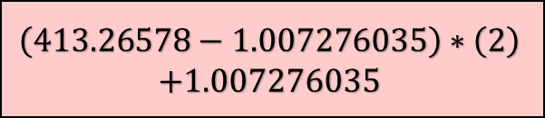
Encoder Input
▶ First, encoder input
For encoder input, we will put m/z value and intensity in a special form
1 | 0 | 101
19 | 1 | 102
178 | 39 | 11
198 | 46 | 14
250 | 49 | 14
344 | 79 | 20
376 | 82 | 100
454 | 53 | 24
$$m/z$$ | intensity
178.39957 | 485.80835
198.46725 | 584.21313
250.49632 | 605.91156
344.79205 | 849.0816
376.8204 | 4128.479
454.53027 | 1016.0198
Encoder
train data
???
peptide mass + $H^{+}$
$$\left(m/z−mass_{H^{+}}\right)∗\left(charge\right)+H^{+}$$
$$\left(413.26578−1.007276035\right)∗\left(2\right)$$
$$+1.007276035$$

Slide 54
Encoder Input
▶ First, encoder input
For encoder input, we will put m/z value and intensity in a special form
1 | 0 | 101
19 | 1 | 102
178 | 39 | 11
198 | 46 | 14
250 | 49 | 14
344 | 79 | 20
376 | 82 | 100
454 | 53 | 24
825.524283965 |  | 1.0020
$$m/z$$ | intensity
178.39957 | 485.80835
198.46725 | 584.21313
250.49632 | 605.91156
344.79205 | 849.0816
376.8204 | 4128.479
454.53027 | 1016.0198
Encoder
train data
???
peptide mass + $H^{+}$
$$\left(m/z−mass_{H^{+}}\right)∗\left(charge\right)+H^{+}$$
825.524283965

Slide 55

Encoder Input
▶ First, encoder input
For encoder input, we will put m/z value and intensity in a special form
$H^{+}$
1 | 0 | 101
19 | 1 | 102
178 | 39 | 11
198 | 46 | 14
250 | 49 | 14
344 | 79 | 20
376 | 82 | 100
454 | 53 | 24
825 | 52 | 102
$H_{3}O^{+}$
$$m/z$$ | intensity
178.39957 | 485.80835
198.46725 | 584.21313
250.49632 | 605.91156
344.79205 | 849.0816
376.8204 | 4128.479
454.53027 | 1016.0198
Encoder
train data
???
peptide mass + $H^{+}$

Slide 56
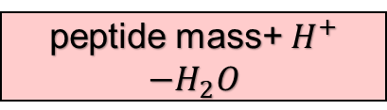
Encoder Input
▶ First, encoder input
For encoder input, we will put m/z value and intensity in a special form
$H^{+}$
1 | 0 | 101
19 | 1 | 102
178 | 39 | 11
198 | 46 | 14
250 | 49 | 14
344 | 79 | 20
376 | 82 | 100
454 | 53 | 24
825 | 52 | 102
$H_{3}O^{+}$
$$m/z$$ | intensity
178.39957 | 485.80835
198.46725 | 584.21313
250.49632 | 605.91156
344.79205 | 849.0816
376.8204 | 4128.479
454.53027 | 1016.0198
Encoder
train data
???
peptide mass+ $H^{+}$
$$−H_{2}O$$
825.524283965 - 18.0105647

Slide 57
Encoder Input
▶ First, encoder input
For encoder input, we will put m/z value and intensity in a special form
$H^{+}$
1 | 0 | 101
19 | 1 | 102
178 | 39 | 11
198 | 46 | 14
250 | 49 | 14
344 | 79 | 20
376 | 82 | 100
454 | 53 | 24
825 | 52 | 102
$H_{3}O^{+}$
$$m/z$$ | intensity
178.39957 | 485.80835
198.46725 | 584.21313
250.49632 | 605.91156
344.79205 | 849.0816
376.8204 | 4128.479
454.53027 | 1016.0198
Encoder
train data
???
peptide mass+ $H^{+}$
$$−H_{2}O$$
807.513719265

Slide 58
Encoder Input
▶ First, encoder input
For encoder input, we will put m/z value and intensity in a special form
$H^{+}$
1 | 0 | 101
19 | 1 | 102
178 | 39 | 11
198 | 46 | 14
250 | 49 | 14
344 | 79 | 20
376 | 82 | 100
454 | 53 | 24
807.513719265 |  | 1.0100
825 | 52 | 102
$H_{3}O^{+}$
$$m/z$$ | intensity
178.39957 | 485.80835
198.46725 | 584.21313
250.49632 | 605.91156
344.79205 | 849.0816
376.8204 | 4128.479
454.53027 | 1016.0198
Encoder
train data
???
peptide mass+ $H^{+}$
$$−H_{2}O$$
807.513719265

Slide 59
Encoder Input
▶ First, encoder input
For encoder input, we will put m/z value and intensity in a special form
0 | 0 | CHARGE
0 | 0 | 0
1 | 0 | 101
19 | 1 | 102
178 | 39 | 11
198 | 46 | 14
250 | 49 | 14
344 | 79 | 20
376 | 82 | 100
454 | 53 | 24
807 | 51 | 101
825 | 52 | 102
$H^{+}$
1 | 0 | 101
19 | 1 | 102
178 | 39 | 11
198 | 46 | 14
250 | 49 | 14
344 | 79 | 20
376 | 82 | 100
454 | 53 | 24
807 | 51 | 101
825 | 52 | 102
$H_{3}O^{+}$
$$m/z$$ | intensity
178.39957 | 485.80835
198.46725 | 584.21313
250.49632 | 605.91156
344.79205 | 849.0816
376.8204 | 4128.479
454.53027 | 1016.0198
Encoder
train data
???
peptide mass+ $H^{+}$
$$−H_{2}O$$

Slide 60
Encoder Input
Provide charge information to model
0 | 0 | CHARGE
0 | 0 | 0
1 | 0 | 101
19 | 1 | 102
178 | 39 | 11
198 | 46 | 14
250 | 49 | 14
344 | 79 | 20
376 | 82 | 100
454 | 53 | 24
807 | 51 | 101
825 | 52 | 102
1 | 0 | 101
19 | 1 | 102
178 | 39 | 11
198 | 46 | 14
250 | 49 | 14
344 | 79 | 20
376 | 82 | 100
454 | 53 | 24
807 | 51 | 101
825 | 52 | 102
Encoder
train data
???

Slide 61
Encoder Input
Provide charge information to model
0 | 0 | CHARGE
0 | 0 | 0
1 | 0 | 101
19 | 1 | 102
178 | 39 | 11
198 | 46 | 14
250 | 49 | 14
344 | 79 | 20
376 | 82 | 100
454 | 53 | 24
807 | 51 | 101
825 | 52 | 102
Origin point
Encoder
train data
???

Slide 62
Encoder Input
Encoder
train data
???
0 | 0 | CHARGE
0 | 0 | 0
1 | 0 | 101
19 | 1 | 102
178 | 39 | 11
198 | 46 | 14
250 | 49 | 14
344 | 79 | 20
376 | 82 | 100
454 | 53 | 24
807 | 51 | 101
825 | 52 | 102
▶ This matrix is input for encoder !

Slide 63
Decoder input
▶ Transformer basically provides truth for decoder input
prediction
‘thank you .’
Encoder
Decoder
Decoder
train data
truth
truth
‘obrigado .’
‘thank you .’
???

Slide 64
Decoder input
▶ Transformer basically provides truth for decoder input
Decoder
Decoder
truth
truth
‘thank you .’
???
What is truth?

Slide 65
Decoder input
▶ Transformer basically provides truth for decoder input
Decoder
truth
???

Slide 66
Decoder input
▶ Transformer basically provides truth for decoder input
P
A
R
R
Decoder
mass of possible fragments
of sequence
truth
???

Slide 67
Decoder input
b-ion
P
A
R
R
y-ion

Slide 68
Decoder input
b-ion
P
A
R
R
y-ion
▶ Get every possible fragments
b-ion | P | PA | PAR
y-ion | R | RR | ARR
b-ion | P | PA | PAR | PARR
y-ion | R | RR | ARR | PARR

Slide 69
Decoder input
b-ion
P
A
R
R
y-ion
▶ Get every possible fragments
b-ion | P | PA | PAR | PARR
y-ion | R | RR | ARR | PARR
Table is given!
A : 71.03
P : 97.05
R : 156.10
▶ Calculate mass for every fragments
b-ion : mass+1.00
y-ion : mass+19.01

Slide 70
Decoder input
b-ion
P
A
R
R
y-ion
▶ Get every possible fragments
b-ion | P | PA | PAR | PARR
y-ion | R | RR | ARR | PARR
Table is given!
A : 71.03
P : 97.05
R : 156.10
▶ Calculate mass for every fragments
b-ion : mass+1.00 | 98.05
y-ion : mass+19.01

Slide 71
Decoder input
b-ion
P
A
R
R
y-ion
▶ Get every possible fragments
b-ion | P | PA | PAR | PARR
y-ion | R | RR | ARR | PARR
Table is given!
A : 71.03
P : 97.05
R : 156.10
▶ Calculate mass for every fragments
b-ion : mass+1.00 | 98.05 | 169.08
y-ion : mass+19.01

Slide 72
Decoder input
b-ion
P
A
R
R
y-ion
▶ Get every possible fragments
b-ion | P | PA | PAR | PARR
y-ion | R | RR | ARR | PARR
Table is given!
A : 71.03
P : 97.05
R : 156.10
▶ Calculate mass for every fragments
b-ion : mass+1.00 | 98.05 | 169.08 | 325.18
y-ion : mass+19.01

Slide 73
Decoder input
b-ion
P
A
R
R
y-ion
▶ Get every possible fragments
b-ion | P | PA | PAR | PARR
y-ion | R | RR | ARR | PARR
Table is given!
A : 71.03
P : 97.05
R : 156.10
▶ Calculate mass for every fragments
b-ion : mass+1.00 | 98.05 | 169.08 | 325.18 | 481.28
y-ion : mass+19.01

Slide 74
Decoder input
b-ion
P
A
R
R
y-ion
▶ Get every possible fragments
b-ion | P | PA | PAR | PARR
y-ion | R | RR | ARR | PARR
Table is given!
A : 71.03
P : 97.05
R : 156.10
▶ Calculate mass for every fragments
b-ion : mass+1.00 | 98.05 | 169.08 | 325.18 | 481.28
y-ion : mass+19.01 | 175.11

Slide 75
Decoder input
b-ion
P
A
R
R
y-ion
▶ Get every possible fragments
b-ion | P | PA | PAR | PARR
y-ion | R | RR | ARR | PARR
Table is given!
A : 71.03
P : 97.05
R : 156.10
▶ Calculate mass for every fragments
b-ion : mass+1.00 | 98.05 | 169.08 | 325.18 | 481.28
y-ion : mass+19.01 | 175.11 | 331.21 | 402.24 | 499.29

Slide 76
Decoder input
b-ion : mass+1.00 | 98.05 | 169.08 | 325.18 | 481.28
y-ion : mass+19.01 | 175.11 | 331.21 | 402.24 | 499.29
output tensor
0 | 0 | CHARGE
0 | 0 | 0

Slide 77
Decoder input
b-ion : mass+1.00 | 98.05 | 169.08 | 325.18 | 481.28
y-ion : mass+19.01 | 175.11 | 331.21 | 402.24 | 499.29
output tensor
0 | 0 | CHARGE
0 | 0 | 0
98 | 5 | 50

Slide 78
Decoder input
b-ion : mass+1.00 | 98.05 | 169.08 | 325.18 | 481.28
y-ion : mass+19.01 | 175.11 | 331.21 | 402.24 | 499.29
output tensor
0 | 0 | CHARGE
0 | 0 | 0
98 | 5 | 50
169 | 8 | 50

Slide 79
Decoder input
b-ion : mass+1.00 | 98.05 | 169.08 | 325.18 | 481.28
y-ion : mass+19.01 | 175.11 | 331.21 | 402.24 | 499.29
output tensor
0 | 0 | CHARGE
0 | 0 | 0
98 | 5 | 50
169 | 8 | 50
175 | 11 | 50

Slide 80
Decoder input
b-ion : mass+1.00 | 98.05 | 169.08 | 325.18 | 481.28
y-ion : mass+19.01 | 175.11 | 331.21 | 402.24 | 499.29
output tensor
0 | 0 | CHARGE
0 | 0 | 0
98 | 5 | 50
169 | 8 | 50
175 | 11 | 50
325 | 18 | 50
331 | 21 | 50
402 | 24 | 50
481 | 28 | 50
499 | 29 | 50
▶ This is decoder input matrix

Slide 81
Summary

Slide 82
Summary
prediction
???
Encoder
Decoder
train data
truth
???
???

Slide 83
Summary
prediction
.mgf extension
database file
???
Encoder
Decoder
train data
truth
???
???

Slide 84
Summary
prediction
.mgf extension
database file
???
Encoder
Decoder
train data
truth
???
???

Slide 85
Summary
prediction
.mgf extension
database file
???
0 | 0 | CHARGE
0 | 0 | 0
1 | 0 | 101
19 | 1 | 102
178 | 39 | 11
198 | 46 | 14
250 | 49 | 14
344 | 79 | 20
376 | 82 | 100
454 | 53 | 24
807 | 51 | 101
825 | 52 | 102
Encoder
Decoder
peak
informations
train data
truth
???
???

Slide 86
Summary
prediction
.mgf extension
database file
???
Encoder
Decoder
train data
truth
???
???

Slide 87
Summary
prediction
.mgf extension
database file
???
Encoder
Decoder
mass of possible fragments
produced from sequence
train data
truth
???
???

Slide 88
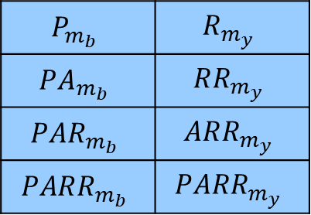
Summary
prediction
.mgf extension
database file
0 | 0 | CHARGE
0 | 0 | 0
98 | 5 | 50
169 | 8 | 50
175 | 11 | 50
325 | 18 | 50
331 | 21 | 50
402 | 24 | 50
481 | 28 | 50
499 | 29 | 50
???
$$P_{m_{b}}$$ | $$R_{m_{y}}$$
$$PA_{m_{b}}$$ | $$RR_{m_{y}}$$
$$PAR_{m_{b}}$$ | $$ARR_{m_{y}}$$
$$PARR_{m_{b}}$$ | $$PARR_{m_{y}}$$
P
A
R
R
Encoder
Decoder
mass of possible fragments
produced from sequence
train data
truth
???
???

Slide 89
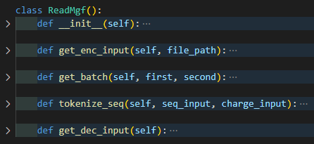
Implement

Slide 90
Implement
▶ get_enc_input function returns encoder input tensor
▶ get_dec_input function returns decoder input tensor

Slide 91

Implement
▶ get_enc_input function returns encoder input tensor
▶ get_dec_input function returns decoder input tensor
usage

Slide 92
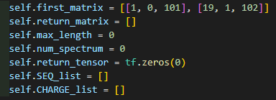
Implement
▶ Variables we’ll use

Slide 93

Implement
▶ m/z value of $H^{+}, H_{3}O^{+}$
0 | 0 | CHARGE
0 | 0 | 0
1 | 0 | 101
19 | 1 | 102
178 | 39 | 11
198 | 46 | 14
250 | 49 | 14
344 | 79 | 20
376 | 82 | 100
454 | 53 | 24
807 | 51 | 101
825 | 52 | 102
※ Encoder input matrix

Slide 94
Implement
▶ m/z value of $H^{+}, H_{3}O^{+}$
0 | 0 | CHARGE
0 | 0 | 0
1 | 0 | 101
19 | 1 | 102
178 | 39 | 11
198 | 46 | 14
250 | 49 | 14
344 | 79 | 20
376 | 82 | 100
454 | 53 | 24
807 | 51 | 101
825 | 52 | 102
※ Encoder input matrix

Slide 95
Implement
▶ m/z value of $H^{+}, H_{3}O^{+}$
0 | 0 | CHARGE
0 | 0 | 0
1 | 0 | 101
19 | 1 | 102
178 | 39 | 11
198 | 46 | 14
250 | 49 | 14
344 | 79 | 20
376 | 82 | 100
454 | 53 | 24
807 | 51 | 101
825 | 52 | 102
Convert to Tensor
※ Encoder input matrix

Slide 96
Implement
▶ m/z value of $H^{+}, H_{3}O^{+}$
0 | 0 | CHARGE
0 | 0 | 0
1 | 0 | 101
19 | 1 | 102
178 | 39 | 11
198 | 46 | 14
250 | 49 | 14
344 | 79 | 20
376 | 82 | 100
454 | 53 | 24
807 | 51 | 101
825 | 52 | 102
length
※ Encoder input matrix

Slide 97
Implement
▶ m/z value of $H^{+}, H_{3}O^{+}$
num_spectrum
0 | 0 | CHARGE
0 | 0 | 0
1 | 0 | 101
19 | 1 | 102
178 | 39 | 11
198 | 46 | 14
250 | 49 | 14
344 | 79 | 20
376 | 82 | 100
454 | 53 | 24
807 | 51 | 101
825 | 52 | 102
0 | 0 | CHARGE
0 | 0 | 0
1 | 0 | 101
19 | 1 | 102
178 | 39 | 11
198 | 46 | 14
250 | 49 | 14
344 | 79 | 20
376 | 82 | 100
454 | 53 | 24
807 | 51 | 101
825 | 52 | 102
0 | 0 | CHARGE
0 | 0 | 0
1 | 0 | 101
19 | 1 | 102
178 | 39 | 11
198 | 46 | 14
250 | 49 | 14
344 | 79 | 20
376 | 82 | 100
454 | 53 | 24
807 | 51 | 101
825 | 52 | 102
0 | 0 | CHARGE
0 | 0 | 0
1 | 0 | 101
19 | 1 | 102
178 | 39 | 11
198 | 46 | 14
250 | 49 | 14
344 | 79 | 20
376 | 82 | 100
454 | 53 | 24
807 | 51 | 101
825 | 52 | 102
0 | 0 | CHARGE
0 | 0 | 0
1 | 0 | 101
19 | 1 | 102
178 | 39 | 11
198 | 46 | 14
250 | 49 | 14
344 | 79 | 20
376 | 82 | 100
454 | 53 | 24
807 | 51 | 101
825 | 52 | 102
0 | 0 | CHARGE
0 | 0 | 0
1 | 0 | 101
19 | 1 | 102
178 | 39 | 11
198 | 46 | 14
250 | 49 | 14
344 | 79 | 20
376 | 82 | 100
454 | 53 | 24
807 | 51 | 101
825 | 52 | 102
0 | 0 | CHARGE
0 | 0 | 0
1 | 0 | 101
19 | 1 | 102
178 | 39 | 11
198 | 46 | 14
250 | 49 | 14
344 | 79 | 20
376 | 82 | 100
454 | 53 | 24
807 | 51 | 101
825 | 52 | 102
length
※ Encoder input matrix

Slide 98
Implement
▶ m/z value of $H^{+}, H_{3}O^{+}$
num_spectrum
0 | 0 | CHARGE
0 | 0 | 0
1 | 0 | 101
19 | 1 | 102
178 | 39 | 11
198 | 46 | 14
250 | 49 | 14
344 | 79 | 20
376 | 82 | 100
454 | 53 | 24
807 | 51 | 101
825 | 52 | 102
0 | 0 | CHARGE
0 | 0 | 0
1 | 0 | 101
19 | 1 | 102
178 | 39 | 11
198 | 46 | 14
250 | 49 | 14
344 | 79 | 20
376 | 82 | 100
454 | 53 | 24
807 | 51 | 101
825 | 52 | 102
0 | 0 | CHARGE
0 | 0 | 0
1 | 0 | 101
19 | 1 | 102
178 | 39 | 11
198 | 46 | 14
250 | 49 | 14
344 | 79 | 20
376 | 82 | 100
454 | 53 | 24
807 | 51 | 101
825 | 52 | 102
0 | 0 | CHARGE
0 | 0 | 0
1 | 0 | 101
19 | 1 | 102
178 | 39 | 11
198 | 46 | 14
250 | 49 | 14
344 | 79 | 20
376 | 82 | 100
454 | 53 | 24
807 | 51 | 101
825 | 52 | 102
0 | 0 | CHARGE
0 | 0 | 0
1 | 0 | 101
19 | 1 | 102
178 | 39 | 11
198 | 46 | 14
250 | 49 | 14
344 | 79 | 20
376 | 82 | 100
454 | 53 | 24
807 | 51 | 101
825 | 52 | 102
0 | 0 | CHARGE
0 | 0 | 0
1 | 0 | 101
19 | 1 | 102
178 | 39 | 11
198 | 46 | 14
250 | 49 | 14
344 | 79 | 20
376 | 82 | 100
454 | 53 | 24
807 | 51 | 101
825 | 52 | 102
0 | 0 | CHARGE
0 | 0 | 0
1 | 0 | 101
19 | 1 | 102
178 | 39 | 11
198 | 46 | 14
250 | 49 | 14
344 | 79 | 20
376 | 82 | 100
454 | 53 | 24
807 | 51 | 101
825 | 52 | 102
length
※ Encoder input matrix

Slide 99
Implement

Slide 100
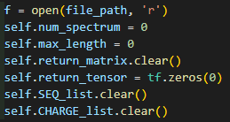
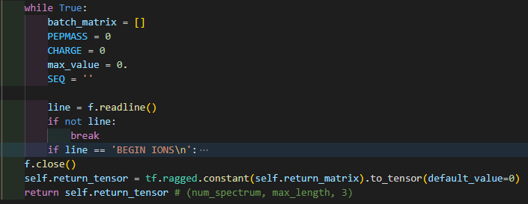
Implement
▶ open file and initialize variables

Slide 101
Implement
Read until the end
Produce return_matrix
Convert to Tensor

Slide 102
Implement

Slide 103
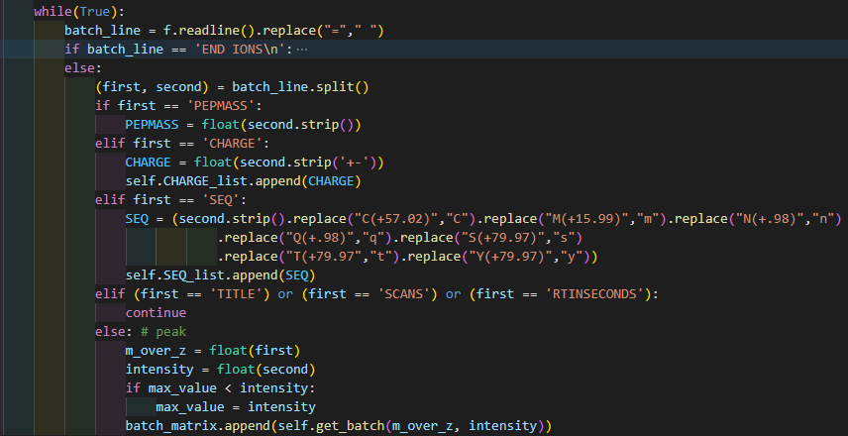
Implement

Slide 104
Implement

Slide 105
Implement
Ignore these tokens

Slide 106
Implement
PEPMASS = 413.26578

Slide 107
Implement
CHARGE = 2

Slide 108
Implement
CHARGE = 2
CHARGE_list = [2, 4, 1, ...]

Slide 109
Implement
SEQ = ‘PARR’
SEQ_list =
[‘PARR’, ‘ABCD’, ... ]

Slide 110
Implement
SEQ = SCHE

Slide 111
Implement
peak informations
m_over_z = 178.39957
intensity = 485.80835

Slide 112
Implement
find max value
for normalization
m_over_z = 178.39957
intensity = 485.80835

Slide 113

Implement
m_over_z = 178.39957
intensity = 485.80835
return [178, 39, 485.80835]

Slide 114
Implement
batch_matrix
return [178, 39, 485.80835]
[[178, 39, 485.80835]]

Slide 115
Implement
batch_matrix
178 | 39 | 485.80835
198 | 46 | 584.21313
205 | 49 | 605.91156
344 | 79 | 849.0816
376 | 82 | 4128.479
454 | 53 | 1016.0198
return [178, 39, 485.80835]

Slide 116
Implement
batch_matrix
178 | 39 | 485.80835
198 | 46 | 584.21313
205 | 49 | 605.91156
344 | 79 | 849.0816
376 | 82 | 4128.479
454 | 53 | 1016.0198

Slide 117
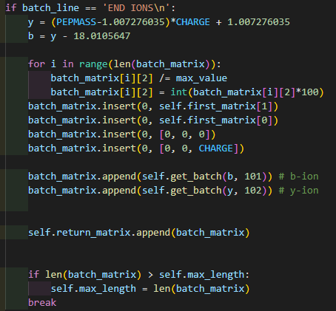
Implement
batch_matrix
178 | 39 | 485.80835
198 | 46 | 584.21313
205 | 49 | 605.91156
344 | 79 | 849.0816
376 | 82 | 4128.479
454 | 53 | 1016.0198

Slide 118
Implement
batch_matrix
178 | 39 | 485.80835
198 | 46 | 584.21313
205 | 49 | 605.91156
344 | 79 | 849.0816
376 | 82 | 4128.479
454 | 53 | 1016.0198
b | b | b
y | y | y

Slide 119
Implement
batch_matrix
178 | 39 | 485.80835
198 | 46 | 584.21313
205 | 49 | 605.91156
344 | 79 | 849.0816
376 | 82 | 4128.479
454 | 53 | 1016.0198
b | b | b
y | y | y
Normalization

Slide 120
Implement
batch_matrix
178 | 39 | 11
198 | 46 | 14
205 | 49 | 14
344 | 79 | 20
376 | 82 | 100
454 | 53 | 24
b | b | b
y | y | y
Normalization

Slide 121
Implement
batch_matrix
Charge and origin
information
178 | 39 | 11
198 | 46 | 14
205 | 49 | 14
344 | 79 | 20
376 | 82 | 100
454 | 53 | 24
b | b | b
y | y | y
Normalization

Slide 122
Implement
batch_matrix
0 | 0 | CHARGE
0 | 0 | 0
1 | 0 | 101
19 | 1 | 102
178 | 39 | 11
198 | 46 | 14
205 | 49 | 14
344 | 79 | 20
376 | 82 | 100
454 | 53 | 24
b | b | b
y | y | y

Slide 123
Implement
batch_matrix
0 | 0 | CHARGE
0 | 0 | 0
1 | 0 | 101
19 | 1 | 102
178 | 39 | 11
198 | 46 | 14
205 | 49 | 14
344 | 79 | 20
376 | 82 | 100
454 | 53 | 24
807 | 51 | 101
825 | 52 | 102

Slide 124
Implement
batch_matrix
0 | 0 | CHARGE
0 | 0 | 0
1 | 0 | 101
19 | 1 | 102
178 | 39 | 11
198 | 46 | 14
205 | 49 | 14
344 | 79 | 20
376 | 82 | 100
454 | 53 | 24
807 | 51 | 101
825 | 52 | 102
Append this matrix to return_matrix

Slide 125
Implement
batch_matrix
0 | 0 | CHARGE
0 | 0 | 0
1 | 0 | 101
19 | 1 | 102
178 | 39 | 11
198 | 46 | 14
205 | 49 | 14
344 | 79 | 20
376 | 82 | 100
454 | 53 | 24
807 | 51 | 101
825 | 52 | 102
Append this matrix to return_matrix
Return_matrix will have
multiple spectrum data!

Slide 126
Implement
batch_matrix
0 | 0 | CHARGE
0 | 0 | 0
1 | 0 | 101
19 | 1 | 102
178 | 39 | 11
198 | 46 | 14
205 | 49 | 14
344 | 79 | 20
376 | 82 | 100
454 | 53 | 24
807 | 51 | 101
825 | 52 | 102
Find the biggest length,
to create tensor

Slide 127
Implement

Slide 128
Implement
return matrix
batch matrix 1
,
batch matrix 2
,
batch matrix 3

Slide 129
Implement
return matrix
return tensor
batch matrix 1
0 | 0 | 0
This is input of Encoder !
,
batch matrix 2
,
batch matrix 3
0 | 0 | 0
0 | 0 | 0
padding with 0

Slide 130
Implement

Slide 131
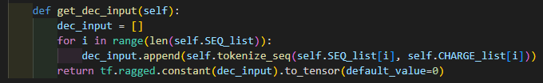
Implement

Slide 132
Implement
SEQ_list =
[‘PARR’, ‘ABCD’, ... ]
CHARGE_list =
[4, 3, 1, 2 ... ]

Slide 133
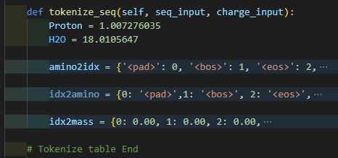
Implement
SEQ_list =
[‘PARR’, ‘ABCD’, ... ]
CHARGE_list =
[4, 3, 1, 2 ... ]

Slide 134
Implement
‘PARR’
4

Slide 135
Implement
‘PARR’
4
mass table

Slide 136
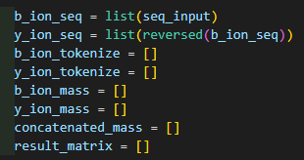
Implement
‘PARR’
b_ion_seq = [‘P’, ‘A’, ‘R’, ‘R’]
y_ion_seq = [‘R’, ‘R’, ‘A’, ‘P’]

Slide 137
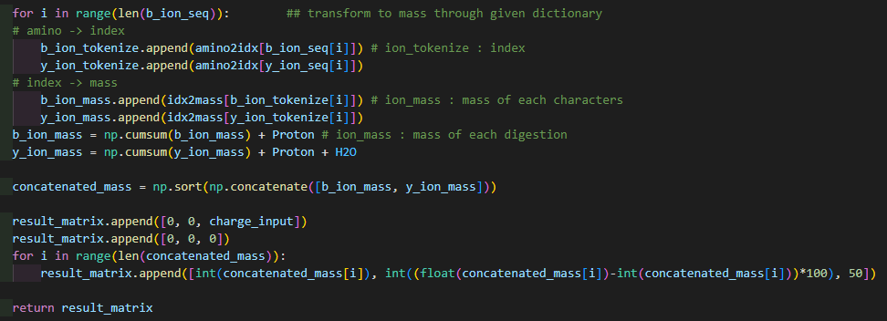
Implement
b_ion_seq = [‘P’, ‘A’, ‘R’, ‘R’]
y_ion_seq = [‘R’, ‘R’, ‘A’, ‘P’]

Slide 138

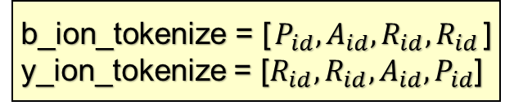
Implement
b_ion_seq = [‘P’, ‘A’, ‘R’, ‘R’]
y_ion_seq = [‘R’, ‘R’, ‘A’, ‘P’]
b_ion_tokenize = [$P_{id}, A_{id}, R_{id}, R_{id}$]
y_ion_tokenize = [$R_{id}, R_{id}, A_{id}, P_{id}$]
b_ion_mass = [$P_{m}, A_{m}, R_{m}, R_{m}$]
y_ion_mass = [$R_{m}, R_{m}, A_{m}, P_{m}$]

Slide 139
Implement
b_ion_seq = [‘P’, ‘A’, ‘R’, ‘R’]
y_ion_seq = [‘R’, ‘R’, ‘A’, ‘P’]
b_ion_tokenize = [$P_{id}, A_{id}, R_{id}, R_{id}$]
y_ion_tokenize = [$R_{id}, R_{id}, A_{id}, P_{id}$]
b_ion_mass = [$P_{m}, A_{m}, R_{m}, R_{m}$]
y_ion_mass = [$R_{m}, R_{m}, A_{m}, P_{m}$]
np.cumsum([1, 2, 3, 4])
= [1, 3, 6, 10]

Slide 140
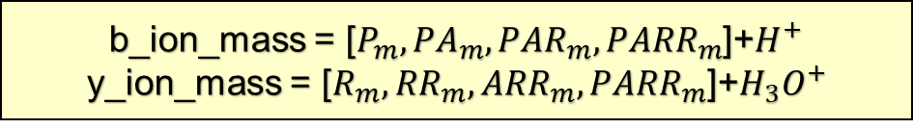
Implement
b_ion_mass = [$P_{m}, {PA}_{m}, {PAR}_{m}, {PARR}_{m}$]+$H^{+}$
y_ion_mass = [$R_{m}, {RR}_{m}, {ARR}_{m}, {PARR}_{m}$]+$H_{3}O^{+}$
np.cumsum([1, 2, 3, 4])
= [1, 3, 6, 10]

Slide 141
Implement
b_ion_mass = [$P_{m}, {PA}_{m}, {PAR}_{m}, {PARR}_{m}$]+$H^{+}$
y_ion_mass = [$R_{m}, {RR}_{m}, {ARR}_{m}, {PARR}_{m}$]+$H_{3}O^{+}$
Concatenate and sort
in ascending order

Slide 142
Implement
b_ion_mass = [$P_{m}, {PA}_{m}, {PAR}_{m}, {PARR}_{m}$]+$H^{+}$
y_ion_mass = [$R_{m}, {RR}_{m}, {ARR}_{m}, {PARR}_{m}$]+$H_{3}O^{+}$
b-ion : mass+1.00 | 98.05 | 169.08 | 325.18 | 481.28
y-ion : mass+19.01 | 175.11 | 331.21 | 402.24 | 499.29
Concatenate and sort
in ascending order

Slide 143
Implement
b-ion : mass+1.00 | 98.05 | 169.08 | 325.18 | 481.28
y-ion : mass+19.01 | 175.11 | 331.21 | 402.24 | 499.29
98.05 | 169.08 | 175.11 | 325.18 | 331.21 | 402.24 | 481.28 | 499.29

Slide 144
Implement
result matrix
98.05 | 169.08 | 175.11 | 325.18 | 331.21 | 402.24 | 481.28 | 499.29

Slide 145
Implement
result matrix
0 | 0 | CHARGE
98.05 | 169.08 | 175.11 | 325.18 | 331.21 | 402.24 | 481.28 | 499.29

Slide 146
Implement
result matrix
0 | 0 | CHARGE
0 | 0 | 0
98.05 | 169.08 | 175.11 | 325.18 | 331.21 | 402.24 | 481.28 | 499.29

Slide 147
Implement
result matrix
0 | 0 | CHARGE
0 | 0 | 0
98 | 5 | 50
98.05 | 169.08 | 175.11 | 325.18 | 331.21 | 402.24 | 481.28 | 499.29

Slide 148
Implement
result matrix
0 | 0 | CHARGE
0 | 0 | 0
98 | 5 | 50
169 | 8 | 50
98.05 | 169.08 | 175.11 | 325.18 | 331.21 | 402.24 | 481.28 | 499.29

Slide 149
Implement
result matrix
0 | 0 | CHARGE
0 | 0 | 0
98 | 5 | 50
169 | 8 | 50
175 | 11 | 50
98.05 | 169.08 | 175.11 | 325.18 | 331.21 | 402.24 | 481.28 | 499.29

Slide 150
Implement
result matrix
0 | 0 | CHARGE
0 | 0 | 0
98 | 5 | 50
169 | 8 | 50
175 | 11 | 50
325 | 18 | 50
331 | 21 | 50
402 | 24 | 50
481 | 28 | 50
499 | 29 | 50
98.05 | 169.08 | 175.11 | 325.18 | 331.21 | 402.24 | 481.28 | 499.29

Slide 151
Implement
result matrix
0 | 0 | CHARGE
0 | 0 | 0
98 | 5 | 50
169 | 8 | 50
175 | 11 | 50
325 | 18 | 50
331 | 21 | 50
402 | 24 | 50
481 | 28 | 50
499 | 29 | 50

Slide 152
Implement
result matrix
result matrix
0 | 0 | CHARGE
0 | 0 | 0
98 | 5 | 50
169 | 8 | 50
175 | 11 | 50
325 | 18 | 50
331 | 21 | 50
402 | 24 | 50
481 | 28 | 50
499 | 29 | 50
result matrix
0 | 0 | CHARGE
0 | 0 | 0
98 | 5 | 50
169 | 8 | 50
175 | 11 | 50
325 | 18 | 50
331 | 21 | 50
402 | 24 | 50
481 | 28 | 50
499 | 29 | 50
result matrix
0 | 0 | CHARGE
0 | 0 | 0
98 | 5 | 50
169 | 8 | 50
175 | 11 | 50
325 | 18 | 50
331 | 21 | 50
402 | 24 | 50
481 | 28 | 50
499 | 29 | 50
result matrix
0 | 0 | CHARGE
0 | 0 | 0
98 | 5 | 50
169 | 8 | 50
175 | 11 | 50
325 | 18 | 50
331 | 21 | 50
402 | 24 | 50
481 | 28 | 50
499 | 29 | 50
result matrix
0 | 0 | CHARGE
0 | 0 | 0
98 | 5 | 50
169 | 8 | 50
175 | 11 | 50
325 | 18 | 50
331 | 21 | 50
402 | 24 | 50
481 | 28 | 50
499 | 29 | 50
0 | 0 | CHARGE
0 | 0 | 0
98 | 5 | 50
169 | 8 | 50
175 | 11 | 50
325 | 18 | 50
331 | 21 | 50
402 | 24 | 50
481 | 28 | 50
499 | 29 | 50

Slide 153
Implement
result matrix
result matrix
0 | 0 | CHARGE
0 | 0 | 0
98 | 5 | 50
169 | 8 | 50
175 | 11 | 50
325 | 18 | 50
331 | 21 | 50
402 | 24 | 50
481 | 28 | 50
499 | 29 | 50
result matrix
0 | 0 | CHARGE
0 | 0 | 0
98 | 5 | 50
169 | 8 | 50
175 | 11 | 50
325 | 18 | 50
331 | 21 | 50
402 | 24 | 50
481 | 28 | 50
499 | 29 | 50
result matrix
0 | 0 | CHARGE
0 | 0 | 0
98 | 5 | 50
169 | 8 | 50
175 | 11 | 50
325 | 18 | 50
331 | 21 | 50
402 | 24 | 50
481 | 28 | 50
499 | 29 | 50
result matrix
0 | 0 | CHARGE
0 | 0 | 0
98 | 5 | 50
169 | 8 | 50
175 | 11 | 50
325 | 18 | 50
331 | 21 | 50
402 | 24 | 50
481 | 28 | 50
499 | 29 | 50
result matrix
0 | 0 | CHARGE
0 | 0 | 0
98 | 5 | 50
169 | 8 | 50
175 | 11 | 50
325 | 18 | 50
331 | 21 | 50
402 | 24 | 50
481 | 28 | 50
499 | 29 | 50
0 | 0 | CHARGE
0 | 0 | 0
98 | 5 | 50
169 | 8 | 50
175 | 11 | 50
325 | 18 | 50
331 | 21 | 50
402 | 24 | 50
481 | 28 | 50
499 | 29 | 50
▶ Convert to Tensor, and this is input of decoder !

Slide 154
Next meeting
▶ Transformer model for our project

Slide 155
Thank you

