Slide 1
Creating Tensor with .mgf File
컴퓨터소프트웨어학부 심승현

Slide 2
What is .mgf File ?

Slide 3
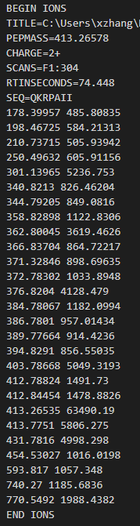
What is .mgf File ?
▶ Contains data about peptide distribution
This is a single spectrum

Slide 4
What is .mgf File ?
▶ Begin/End of sequence

Slide 5
What is .mgf File ?
▶ Spectrum name

Slide 6
What is .mgf File ?
▶ $m/z$ value

Slide 7
What is .mgf File ?
▶ Charge

Slide 8
What is .mgf File ?
▶ Peptide sequence
Consists of amino acid

Slide 9
What is .mgf File ?
▶ $m/z$ and intensity of fragment ions

Slide 10
What is .mgf File ?

Slide 11
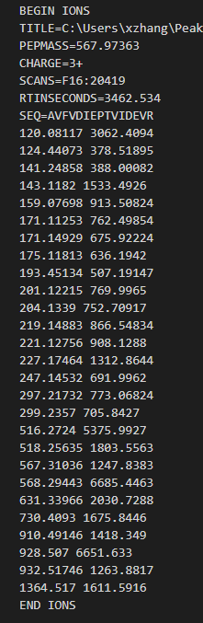
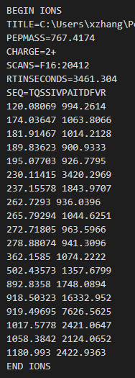
What is .mgf File ?
▶ .mgf file contains multiple spectrums

Slide 12
Create tensor with .mgf file
▶ Given .mgf file, we need to create data to apply deep learning
We will create tf.tensor !

Slide 13
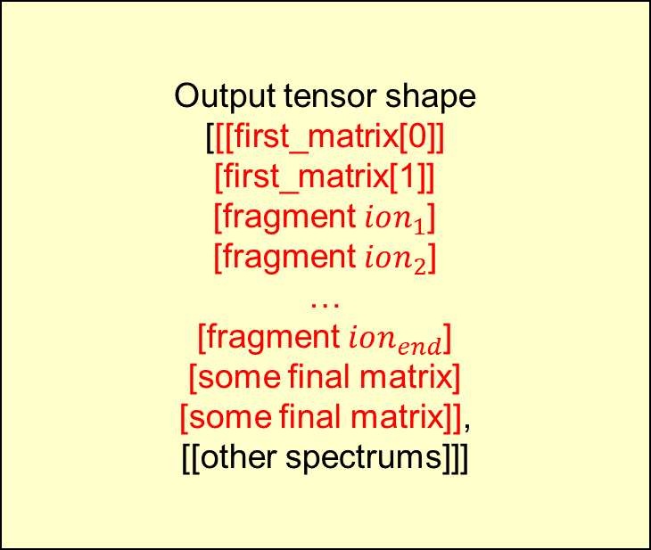
Create tensor with .mgf file
▶ Output tensor shape
Output tensor shape
[[[first_matrix[0]]
[first_matrix[1]]
[fragment $ion_{1}$]
[fragment $ion_{2}$]
…
[fragment $ion_{end}$]
[some final matrix]
[some final matrix]],
[[other spectrums]]]
[[[1, 0, 1.01]
[19, 1, 1.02],
[198, 46, 0.09],
[250, 49, 1],
…
[807, 51, 0.03],
[824, 51, 1.01]
[807, 51, 1.02]],
[[other spectrums]]]

Slide 14
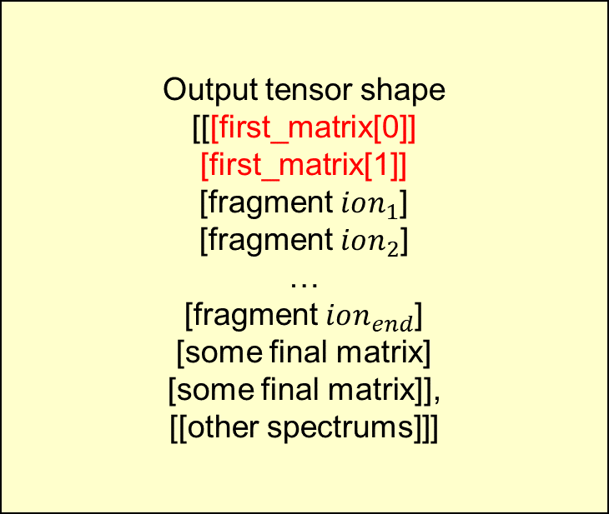
Create tensor with .mgf file
▶ Output tensor shape
Output tensor shape
[[[first_matrix[0]]
[first_matrix[1]]
[fragment $ion_{1}$]
[fragment $ion_{2}$]
…
[fragment $ion_{end}$]
[some final matrix]
[some final matrix]],
[[other spectrums]]]
[[[1, 0, 1.01]
[19, 1, 1.02],
[198, 46, 0.09],
[250, 49, 1],
…
[807, 51, 0.03],
[824, 51, 1.01]
[807, 51, 1.02]],
[[other spectrums]]]
Fixed value for
every spectrums

Slide 15
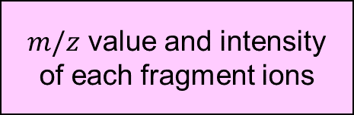
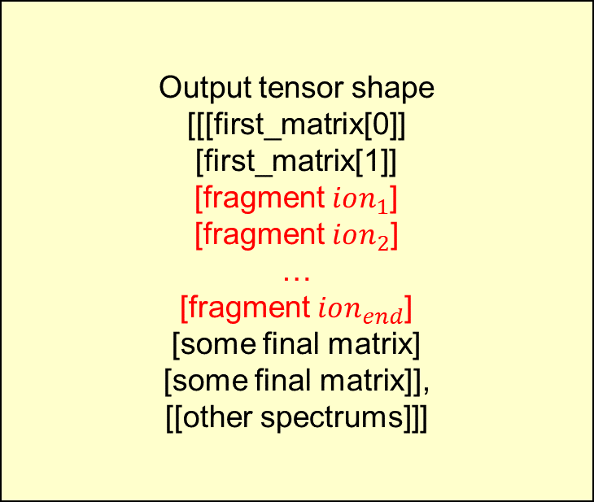
Create tensor with .mgf file
▶ Output tensor shape
Output tensor shape
[[[first_matrix[0]]
[first_matrix[1]]
[fragment $ion_{1}$]
[fragment $ion_{2}$]
…
[fragment $ion_{end}$]
[some final matrix]
[some final matrix]],
[[other spectrums]]]
[[[1, 0, 1.01]
[19, 1, 1.02],
[198, 46, 0.09],
[250, 49, 1],
…
[807, 51, 0.03],
[824, 51, 1.01]
[807, 51, 1.02]],
[[other spectrums]]]
$m/z$ value and intensity
of each fragment ions

Slide 16

Create tensor with .mgf file
▶ Output tensor shape
Output tensor shape
[[[first_matrix[0]]
[first_matrix[1]]
[fragment $ion_{1}$]
[fragment $ion_{2}$]
…
[fragment $ion_{end}$]
[some final matrix]
[some final matrix]],
[[other spectrums]]]
[[[1, 0, 1.01]
[19, 1, 1.02],
[198, 46, 0.09],
[250, 49, 1],
…
[807, 51, 0.03],
[824, 51, 1.01]
[807, 51, 1.02]],
[[other spectrums]]]
$m/z$ = 198.46725
intensity = 584.21313
$m/z$ value and intensity
of each fragment ions

Slide 17
Create tensor with .mgf file
▶ Output tensor shape
Output tensor shape
[[[first_matrix[0]]
[first_matrix[1]]
[fragment $ion_{1}$]
[fragment $ion_{2}$]
…
[fragment $ion_{end}$]
[some final matrix]
[some final matrix]],
[[other spectrums]]]
[[[1, 0, 1.01]
[19, 1, 1.02],
[198, 46, 0.09],
[250, 49, 1],
…
[807, 51, 0.03],
[824, 51, 1.01]
[807, 51, 1.02]],
[[other spectrums]]]
$m/z$ = 198.46725
intensity = 584.21313
$m/z$ value and intensity
of each fragment ions

Slide 18
Create tensor with .mgf file
▶ Output tensor shape
Output tensor shape
[[[first_matrix[0]]
[first_matrix[1]]
[fragment $ion_{1}$]
[fragment $ion_{2}$]
…
[fragment $ion_{end}$]
[some final matrix]
[some final matrix]],
[[other spectrums]]]
[[[1, 0, 1.01]
[19, 1, 1.02],
[198, 46, 0.09],
[250, 49, 1],
…
[807, 51, 0.03],
[824, 51, 1.01]
[807, 51, 1.02]],
[[other spectrums]]]
$m/z$ = 198.46725
intensity = 584.21313
$m/z$ value and intensity
of each fragment ions

Slide 19
Create tensor with .mgf file
▶ Output tensor shape
Output tensor shape
[[[first_matrix[0]]
[first_matrix[1]]
[fragment $ion_{1}$]
[fragment $ion_{2}$]
…
[fragment $ion_{end}$]
[some final matrix]
[some final matrix]],
[[other spectrums]]]
[[[1, 0, 1.01]
[19, 1, 1.02],
[198, 46, 0.09],
[250, 49, 1],
…
[807, 51, 0.03],
[824, 51, 1.01]
[807, 51, 1.02]],
[[other spectrums]]]
$m/z$ = 198.46725
intensity = 584.21313
$m/z$ value and intensity
of each fragment ions

Slide 20

Create tensor with .mgf file
▶ Output tensor shape
Output tensor shape
[[[first_matrix[0]]
[first_matrix[1]]
[fragment $ion_{1}$]
[fragment $ion_{2}$]
…
[fragment $ion_{end}$]
[some final matrix]
[some final matrix]],
[[other spectrums]]]
[[[1, 0, 1.01]
[19, 1, 1.02],
[198, 46, 0.09],
[250, 49, 1],
…
[807, 51, 0.03],
[824, 51, 1.01]
[807, 51, 1.02]],
[[other spectrums]]]
$m/z$ = 198.46725
intensity = 584.21313
$m/z$ value and intensity
of each fragment ions
$m/z$ = 250.49328
intensity = 6491.1948

Slide 21
Create tensor with .mgf file
▶ Output tensor shape
Output tensor shape
[[[first_matrix[0]]
[first_matrix[1]]
[fragment $ion_{1}$]
[fragment $ion_{2}$]
…
[fragment $ion_{end}$]
[some final matrix]
[some final matrix]],
[[other spectrums]]]
[[[1, 0, 1.01]
[19, 1, 1.02],
[198, 46, 0.09],
[250, 49, 1],
…
[807, 51, 0.03],
[824, 51, 1.01]
[807, 51, 1.02]],
[[other spectrums]]]
$m/z$ = 198.46725
intensity = 584.21313
$m/z$ value and intensity
of each fragment ions
$m/z$ = 250.49328
intensity = 6491.1948
The biggest intensity
in this spectrum

Slide 22
Create tensor with .mgf file
▶ Output tensor shape
Output tensor shape
[[[first_matrix[0]]
[first_matrix[1]]
[fragment $ion_{1}$]
[fragment $ion_{2}$]
…
[fragment $ion_{end}$]
[some final matrix]
[some final matrix]],
[[other spectrums]]]
[[[1, 0, 1.01]
[19, 1, 1.02],
[198, 46, 0.09],
[250, 49, 1],
…
[807, 51, 0.03],
[824, 51, 1.01]
[807, 51, 1.02]],
[[other spectrums]]]
$m/z$ = 198.46725
intensity = 584.21313
$m/z$ value and intensity
of each fragment ions
$m/z$ = 250.49328
intensity = 6491.1948
The biggest intensity
in this spectrum
divide every intensity
with this value
( normalize )

Slide 23

Create tensor with .mgf file
▶ Output tensor shape
Output tensor shape
[[[first_matrix[0]]
[first_matrix[1]]
[fragment $ion_{1}$]
[fragment $ion_{2}$]
…
[fragment $ion_{end}$]
[some final matrix]
[some final matrix]],
[[other spectrums]]]
[[[1, 0, 1.01]
[19, 1, 1.02],
[198, 46, 0.09],
[250, 49, 1],
…
[807, 51, 0.03],
[824, 51, 1.01]
[807, 51, 1.02]],
[[other spectrums]]]
$m/z$ = 198.46725
intensity = 584.21313
6491.1948 / 584.21313
$≅$ 0.09
$m/z$ value and intensity
of each fragment ions
$m/z$ = 250.49328
intensity = 6491.1948

Slide 24
Create tensor with .mgf file
▶ Output tensor shape
Output tensor shape
[[[first_matrix[0]]
[first_matrix[1]]
[fragment $ion_{1}$]
[fragment $ion_{2}$]
…
[fragment $ion_{end}$]
[some final matrix]
[some final matrix]],
[[other spectrums]]]
[[[1, 0, 1.01]
[19, 1, 1.02],
[198, 46, 0.09],
[250, 49, 1],
…
[807, 51, 0.03],
[824, 51, 1.01]
[807, 51, 1.02]],
[[other spectrums]]]
$m/z$ = 198.46725
intensity = 584.21313
6491.1948 / 584.21313
$≅$ 0.09
$m/z$ value and intensity
of each fragment ions
$m/z$ = 250.49328
intensity = 6491.1948

Slide 25

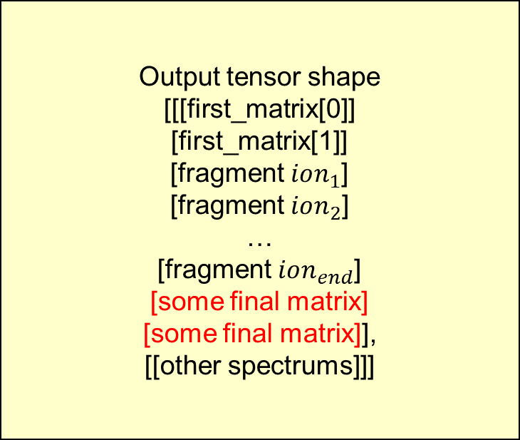
Create tensor with .mgf file
▶ Output tensor shape
Output tensor shape
[[[first_matrix[0]]
[first_matrix[1]]
[fragment $ion_{1}$]
[fragment $ion_{2}$]
…
[fragment $ion_{end}$]
[some final matrix]
[some final matrix]],
[[other spectrums]]]
[[[1, 0, 1.01]
[19, 1, 1.02],
[198, 46, 0.09],
[250, 49, 1],
…
[807, 51, 0.03],
[824, 51, 1.01]
[807, 51, 1.02]],
[[other spectrums]]]
Depends on
PEPMASS, CHARGE

Slide 26
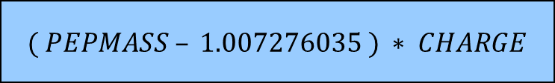
Create tensor with .mgf file
▶ Output tensor shape
Output tensor shape
[[[first_matrix[0]]
[first_matrix[1]]
[fragment $ion_{1}$]
[fragment $ion_{2}$]
…
[fragment $ion_{end}$]
[some final matrix]
[some final matrix]],
[[other spectrums]]]
[[[1, 0, 1.01]
[19, 1, 1.02],
[198, 46, 0.09],
[250, 49, 1],
…
[807, 51, 0.03],
[824, 51, 1.01]
[807, 51, 1.02]],
[[other spectrums]]]
$$( PEPMASS – 1.007276035 ) ∗ CHARGE$$
Depends on
PEPMASS, CHARGE

Slide 27
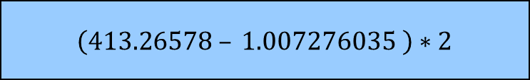
Create tensor with .mgf file
▶ Output tensor shape
Output tensor shape
[[[first_matrix[0]]
[first_matrix[1]]
[fragment $ion_{1}$]
[fragment $ion_{2}$]
…
[fragment $ion_{end}$]
[some final matrix]
[some final matrix]],
[[other spectrums]]]
[[[1, 0, 1.01]
[19, 1, 1.02],
[198, 46, 0.09],
[250, 49, 1],
…
[807, 51, 0.03],
[824, 51, 1.01]
[807, 51, 1.02]],
[[other spectrums]]]
$$( PEPMASS – 1.007276035 ) ∗ CHARGE$$
$$\left(413.26578 – 1.007276035 \right)∗2$$
Depends on
PEPMASS, CHARGE

Slide 28
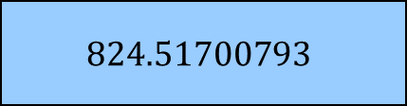
Create tensor with .mgf file
▶ Output tensor shape
Output tensor shape
[[[first_matrix[0]]
[first_matrix[1]]
[fragment $ion_{1}$]
[fragment $ion_{2}$]
…
[fragment $ion_{end}$]
[some final matrix]
[some final matrix]],
[[other spectrums]]]
[[[1, 0, 1.01]
[19, 1, 1.02],
[198, 46, 0.09],
[250, 49, 1],
…
[807, 51, 0.03],
[824, 51, 1.01]
[807, 51, 1.02]],
[[other spectrums]]]
$$( PEPMASS – 1.007276035 ) ∗ CHARGE$$
$$\left(413.26578 – 1.007276035 \right)∗2$$
$$824.51700793$$
Depends on
PEPMASS, CHARGE

Slide 29
Create tensor with .mgf file
▶ Output tensor shape
Output tensor shape
[[[first_matrix[0]]
[first_matrix[1]]
[fragment $ion_{1}$]
[fragment $ion_{2}$]
…
[fragment $ion_{end}$]
[some final matrix]
[some final matrix]],
[[other spectrums]]]
[[[1, 0, 1.01]
[19, 1, 1.02],
[198, 46, 0.09],
[250, 49, 1],
…
[807, 51, 0.03],
[824, 51, 1.01]
[807, 51, 1.02]],
[[other spectrums]]]
$$( PEPMASS – 1.007276035 ) ∗ CHARGE$$
$$\left(413.26578 – 1.007276035 \right)∗2$$
$$824.51700793$$
Depends on
PEPMASS, CHARGE

Slide 30
Create tensor with .mgf file
▶ Output tensor shape
Output tensor shape
[[[first_matrix[0]]
[first_matrix[1]]
[fragment $ion_{1}$]
[fragment $ion_{2}$]
…
[fragment $ion_{end}$]
[some final matrix]
[some final matrix]],
[[other spectrums]]]
[[[1, 0, 1.01]
[19, 1, 1.02],
[198, 46, 0.09],
[250, 49, 1],
…
[807, 51, 0.03],
[824, 51, 1.01]
[807, 51, 1.02]],
[[other spectrums]]]
$$( PEPMASS – 1.007276035 ) ∗ CHARGE$$
$$\left(413.26578 – 1.007276035 \right)∗2$$
$$824.51700793$$
Depends on
PEPMASS, CHARGE

Slide 31
Create tensor with .mgf file
▶ Output tensor shape
Output tensor shape
[[[first_matrix[0]]
[first_matrix[1]]
[fragment $ion_{1}$]
[fragment $ion_{2}$]
…
[fragment $ion_{end}$]
[some final matrix]
[some final matrix]],
[[other spectrums]]]
[[[1, 0, 1.01]
[19, 1, 1.02],
[198, 46, 0.09],
[250, 49, 1],
…
[807, 51, 0.03],
[824, 51, 1.01]
[807, 51, 1.02]],
[[other spectrums]]]
Depends on
PEPMASS, CHARGE
Fixed value

Slide 32
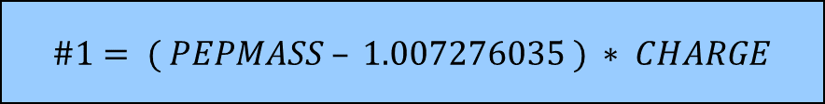
Create tensor with .mgf file
▶ Output tensor shape
Output tensor shape
[[[first_matrix[0]]
[first_matrix[1]]
[fragment $ion_{1}$]
[fragment $ion_{2}$]
…
[fragment $ion_{end}$]
[some final matrix]
[some final matrix]],
[[other spectrums]]]
[[[1, 0, 1.01]
[19, 1, 1.02],
[198, 46, 0.09],
[250, 49, 1],
…
[807, 51, 0.03],
[824, 51, 1.01]
[807, 51, 1.02]],
[[other spectrums]]]
$$\#1= ( PEPMASS – 1.007276035 ) ∗ CHARGE$$
Depends on
PEPMASS, CHARGE

Slide 33
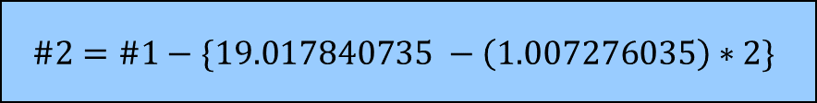
Create tensor with .mgf file
▶ Output tensor shape
Output tensor shape
[[[first_matrix[0]]
[first_matrix[1]]
[fragment $ion_{1}$]
[fragment $ion_{2}$]
…
[fragment $ion_{end}$]
[some final matrix]
[some final matrix]],
[[other spectrums]]]
[[[1, 0, 1.01]
[19, 1, 1.02],
[198, 46, 0.09],
[250, 49, 1],
…
[807, 51, 0.03],
[824, 51, 1.01]
[807, 51, 1.02]],
[[other spectrums]]]
$$\#1= ( PEPMASS – 1.007276035 ) ∗ CHARGE$$
$$\#2=\#1−\{19.017840735 −\left(1.007276035\right)∗2\}$$
Depends on
PEPMASS, CHARGE

Slide 34
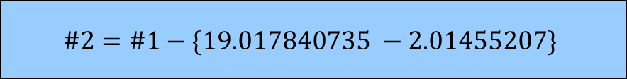
Create tensor with .mgf file
▶ Output tensor shape
Output tensor shape
[[[first_matrix[0]]
[first_matrix[1]]
[fragment $ion_{1}$]
[fragment $ion_{2}$]
…
[fragment $ion_{end}$]
[some final matrix]
[some final matrix]],
[[other spectrums]]]
[[[1, 0, 1.01]
[19, 1, 1.02],
[198, 46, 0.09],
[250, 49, 1],
…
[807, 51, 0.03],
[824, 51, 1.01]
[807, 51, 1.02]],
[[other spectrums]]]
$$\#1= ( PEPMASS – 1.007276035 ) ∗ CHARGE$$
$$\#2=\#1−\{19.017840735 −2.01455207\}$$
Depends on
PEPMASS, CHARGE

Slide 35

Create tensor with .mgf file
▶ Output tensor shape
Output tensor shape
[[[first_matrix[0]]
[first_matrix[1]]
[fragment $ion_{1}$]
[fragment $ion_{2}$]
…
[fragment $ion_{end}$]
[some final matrix]
[some final matrix]],
[[other spectrums]]]
[[[1, 0, 1.01]
[19, 1, 1.02],
[198, 46, 0.09],
[250, 49, 1],
…
[807, 51, 0.03],
[824, 51, 1.01]
[807, 51, 1.02]],
[[other spectrums]]]
$$\#1= ( PEPMASS – 1.007276035 ) ∗ CHARGE$$
$$\#2=\#1−\{17.003288665\}$$
Depends on
PEPMASS, CHARGE

Slide 36

Create tensor with .mgf file
▶ Output tensor shape
Output tensor shape
[[[first_matrix[0]]
[first_matrix[1]]
[fragment $ion_{1}$]
[fragment $ion_{2}$]
…
[fragment $ion_{end}$]
[some final matrix]
[some final matrix]],
[[other spectrums]]]
[[[1, 0, 1.01]
[19, 1, 1.02],
[198, 46, 0.09],
[250, 49, 1],
…
[807, 51, 0.03],
[824, 51, 1.01]
[807, 51, 1.02]],
[[other spectrums]]]
$$\#1= ( PEPMASS – 1.007276035 ) ∗ CHARGE$$
$$\#2=824.51700793−17.003288665$$
Depends on
PEPMASS, CHARGE

Slide 37

Create tensor with .mgf file
▶ Output tensor shape
Output tensor shape
[[[first_matrix[0]]
[first_matrix[1]]
[fragment $ion_{1}$]
[fragment $ion_{2}$]
…
[fragment $ion_{end}$]
[some final matrix]
[some final matrix]],
[[other spectrums]]]
[[[1, 0, 1.01]
[19, 1, 1.02],
[198, 46, 0.09],
[250, 49, 1],
…
[807, 51, 0.03],
[824, 51, 1.01]
[807, 51, 1.02]],
[[other spectrums]]]
$$\#1= ( PEPMASS – 1.007276035 ) ∗ CHARGE$$
$$\#2=824.51700793−17.003288665$$
$$\#2=807.513719265$$
Depends on
PEPMASS, CHARGE

Slide 38
Create tensor with .mgf file
▶ Output tensor shape
Output tensor shape
[[[first_matrix[0]]
[first_matrix[1]]
[fragment $ion_{1}$]
[fragment $ion_{2}$]
…
[fragment $ion_{end}$]
[some final matrix]
[some final matrix]],
[[other spectrums]]]
[[[1, 0, 1.01]
[19, 1, 1.02],
[198, 46, 0.09],
[250, 49, 1],
…
[807, 51, 0.03],
[824, 51, 1.01]
[807, 51, 1.02]],
[[other spectrums]]]
$$\#1= ( PEPMASS – 1.007276035 ) ∗ CHARGE$$
$$\#2=\#1−\{17.003288665\}$$
$$\#2=807.513719265$$
Depends on
PEPMASS, CHARGE

Slide 39
Create tensor with .mgf file
▶ Output tensor shape
Output tensor shape
[[[first_matrix[0]]
[first_matrix[1]]
[fragment $ion_{1}$]
[fragment $ion_{2}$]
…
[fragment $ion_{end}$]
[some final matrix]
[some final matrix]],
[[other spectrums]]]
[[[1, 0, 1.01]
[19, 1, 1.02],
[198, 46, 0.09],
[250, 49, 1],
…
[807, 51, 0.03],
[824, 51, 1.01]
[807, 51, 1.02]],
[[other spectrums]]]
$$\#1= ( PEPMASS – 1.007276035 ) ∗ CHARGE$$
$$\#2=\#1−\{17.003288665\}$$
$$\#2=807.513719265$$
Depends on
PEPMASS, CHARGE

Slide 40
Create tensor with .mgf file
▶ Output tensor shape
Output tensor shape
[[[first_matrix[0]]
[first_matrix[1]]
[fragment $ion_{1}$]
[fragment $ion_{2}$]
…
[fragment $ion_{end}$]
[some final matrix]
[some final matrix]],
[[other spectrums]]]
[[[1, 0, 1.01]
[19, 1, 1.02],
[198, 46, 0.09],
[250, 49, 1],
…
[807, 51, 0.03],
[824, 51, 1.01]
[807, 51, 1.02]],
[[other spectrums]]]
Depends on
PEPMASS, CHARGE
Fixed value

Slide 41
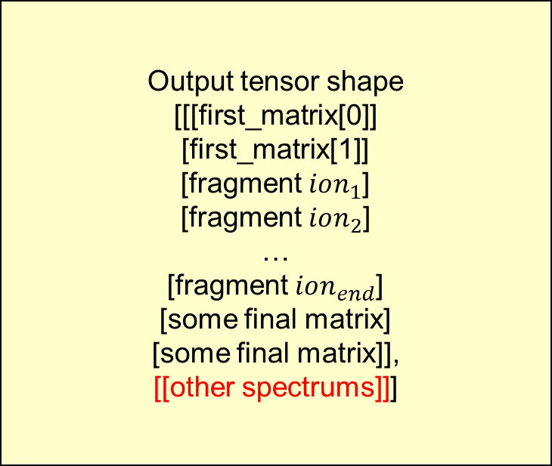
Create tensor with .mgf file
▶ Output tensor shape
Output tensor shape
[[[first_matrix[0]]
[first_matrix[1]]
[fragment $ion_{1}$]
[fragment $ion_{2}$]
…
[fragment $ion_{end}$]
[some final matrix]
[some final matrix]],
[[other spectrums]]]
[[[1, 0, 1.01]
[19, 1, 1.02],
[198, 46, 0.09],
[250, 49, 1],
…
[807, 51, 0.03],
[824, 51, 1.01]
[807, 51, 1.02]],
[[other spectrums]]]

Slide 42
Create tensor with .mgf file
▶ Output tensor shape
3
Output tensor shape
[[[first_matrix[0]]
[first_matrix[1]]
[fragment $ion_{1}$]
[fragment $ion_{2}$]
…
[fragment $ion_{end}$]
[some final matrix]
[some final matrix]],
[[other spectrums]]]
[[[1, 0, 1.01]
[19, 1, 1.02],
[198, 46, 0.09],
[250, 49, 1],
…
[807, 51, 0.03],
[824, 51, 1.01]
[807, 51, 1.02]],
[[other spectrums]]]
number of
peaks
number of
spectrums

Slide 43
Create tensor with .mgf file
▶ Output tensor shape
3
Output tensor shape
[[[first_matrix[0]]
[first_matrix[1]]
[fragment $ion_{1}$]
[fragment $ion_{2}$]
…
[fragment $ion_{end}$]
[some final matrix]
[some final matrix]],
[[other spectrums]]]
[[[1, 0, 1.01]
[19, 1, 1.02],
[198, 46, 0.09],
[250, 49, 1],
…
[807, 51, 0.03],
[824, 51, 1.01]
[807, 51, 1.02]],
[[other spectrums]]]
number of
peaks
number of
spectrums
output tensor
(number of spectrums, max[number of peaks], 3)

Slide 44
Create tensor with .mgf file
▶ Output tensor shape
3
Output tensor shape
[[[first_matrix[0]]
[first_matrix[1]]
[fragment $ion_{1}$]
[fragment $ion_{2}$]
…
[fragment $ion_{end}$]
[some final matrix]
[some final matrix]],
[[other spectrums]]]
[[[1, 0, 1.01]
[19, 1, 1.02],
[198, 46, 0.09],
[250, 49, 1],
…
[807, 51, 0.03],
[824, 51, 1.01]
[807, 51, 1.02]],
[[other spectrums]]]
number of
peaks
number of
spectrums
output tensor
(number of spectrums, max[number of peaks], 3)
+ padding

Slide 45
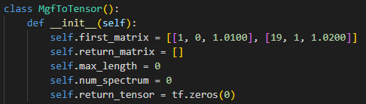
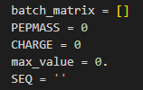
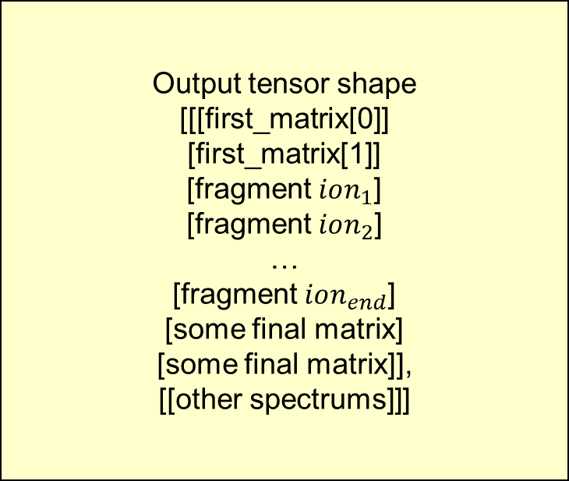
class MgfToTensor()
▶ Variables and data structures
Output tensor shape
[[[first_matrix[0]]
[first_matrix[1]]
[fragment $ion_{1}$]
[fragment $ion_{2}$]
…
[fragment $ion_{end}$]
[some final matrix]
[some final matrix]],
[[other spectrums]]]

Slide 46

class MgfToTensor()
▶ Variables and data structures
Output tensor shape
[[[first_matrix[0]]
[first_matrix[1]]
[fragment $ion_{1}$]
[fragment $ion_{2}$]
…
[fragment $ion_{end}$]
[some final matrix]
[some final matrix]],
[[other spectrums]]]

Slide 47
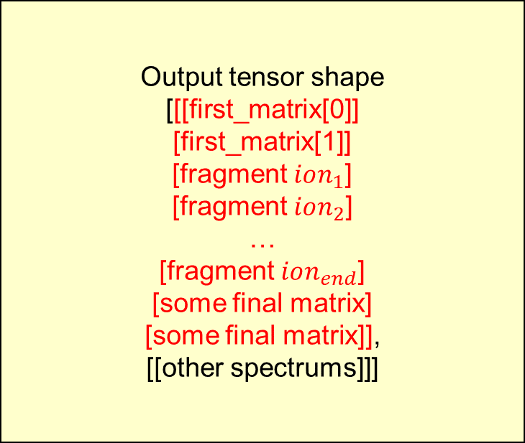
class MgfToTensor()
▶ Variables and data structures
Output tensor shape
[[[first_matrix[0]]
[first_matrix[1]]
[fragment $ion_{1}$]
[fragment $ion_{2}$]
…
[fragment $ion_{end}$]
[some final matrix]
[some final matrix]],
[[other spectrums]]]

Slide 48
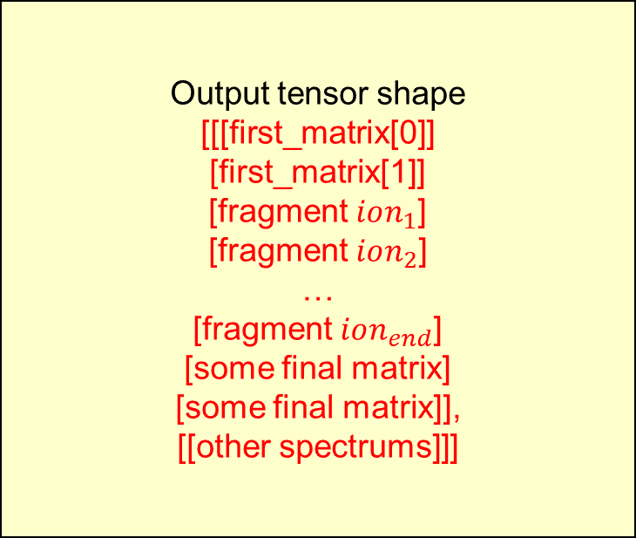
class MgfToTensor()
▶ Variables and data structures
Output tensor shape
[[[first_matrix[0]]
[first_matrix[1]]
[fragment $ion_{1}$]
[fragment $ion_{2}$]
…
[fragment $ion_{end}$]
[some final matrix]
[some final matrix]],
[[other spectrums]]]

Slide 49
class MgfToTensor()
▶ Variables and data structures
Output tensor shape
[[[first_matrix[0]]
[first_matrix[1]]
[fragment $ion_{1}$]
[fragment $ion_{2}$]
…
[fragment $ion_{end}$]
[some final matrix]
[some final matrix]],
[[other spectrums]]]
Convert to Tensor

Slide 50
class MgfToTensor()
▶ Variables and data structures
▶ max_length : maximum number of peaks
▶ num_spectrum : number of spectrums
▶ PEPMASS, CHARGE, SEQ : given pepmass, charge, sequence
▶ max_value : the biggest intensity value for a single spectrue

Slide 51

class MgfToTensor()
▶ open file (.mgf file)

Slide 52
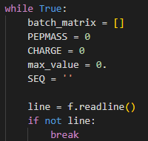
class MgfToTensor()
▶ read lines until the end

Slide 53

class MgfToTensor()
▶ BEGIN IONS encountered,

Slide 54

class MgfToTensor()
Code when END IONS encountered
Lines in spectrum

Slide 55
class MgfToTensor()
Code when END IONS encountered
Lines in spectrum

Slide 56
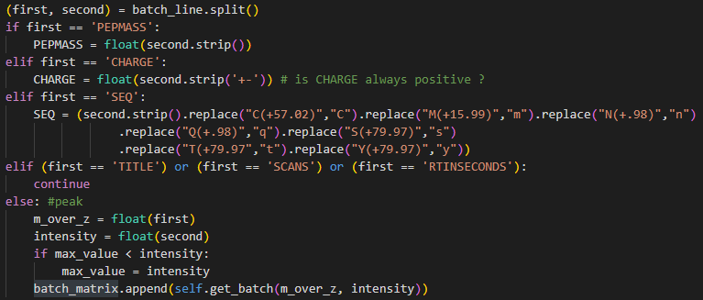
class MgfToTensor()
Code when END IONS encountered

Slide 57
class MgfToTensor()
( ‘TITLE’ , ‘C:\Users\...’ )
Code when END IONS encountered
split into tokens

Slide 58
class MgfToTensor()
Code when END IONS encountered
ignore TITLE, SCANS, RTINSECONDS

Slide 59
class MgfToTensor()
Code when END IONS encountered
store PEPMASS, CHARGE, SEQ

Slide 60
class MgfToTensor()
Code when END IONS encountered
Peaks
m/z, intensity

Slide 61
class MgfToTensor()
Code when END IONS encountered
Peaks
m/z, intensity
string -> float

Slide 62
class MgfToTensor()
Code when END IONS encountered
Peaks
m/z, intensity
string -> float
store maximum intensity value,
for normalization

Slide 63
class MgfToTensor()
Code when END IONS encountered
Peaks
m/z, intensity
string -> float

Slide 64

class MgfToTensor()
Code when END IONS encountered
Peaks
m/z, intensity
string -> float

Slide 65

class MgfToTensor()
Code when END IONS encountered
Peaks
m/z, intensity
string -> float
$m/z$ = 198.46725
intensity = 584.21313

Slide 66
class MgfToTensor()
Code when END IONS encountered
Peaks
m/z, intensity
string -> float
$m/z$ = 198.46725
intensity = 584.21313

Slide 67
class MgfToTensor()
Code when END IONS encountered
Peaks
m/z, intensity
string -> float
$m/z$ = 198.46725
intensity = 584.21313

Slide 68
class MgfToTensor()
Code when END IONS encountered
Peaks
m/z, intensity
string -> float
$m/z$ = 198.46725
intensity = 584.21313

Slide 69

class MgfToTensor()
Code when END IONS encountered
Peaks
m/z, intensity
string -> float
$m/z$ = 262.7293
intensity = 936.0396

Slide 70
class MgfToTensor()
Code when END IONS encountered
Peaks
m/z, intensity
string -> float
$m/z$ = 262.7293
intensity = 936.0396
[262, 72, 936.0396]

Slide 71
class MgfToTensor()
Code when END IONS encountered

Slide 72
class MgfToTensor()
Code when END IONS encountered

Slide 73
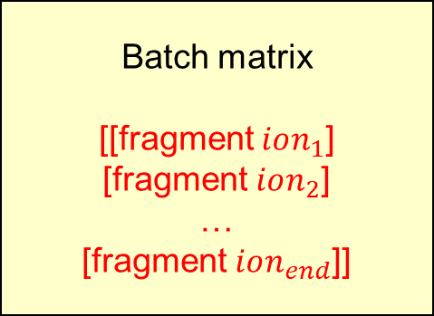
class MgfToTensor()
Code when END IONS encountered
Batch matrix
[[fragment $ion_{1}$]
[fragment $ion_{2}$]
…
[fragment $ion_{end}$]]

Slide 74
class MgfToTensor()
Code when END IONS encountered
Batch matrix
[[fragment $ion_{1}$]
[fragment $ion_{2}$]
…
[fragment $ion_{end}$]]

Slide 75
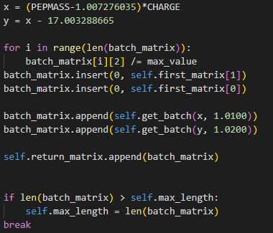

class MgfToTensor()
Batch matrix
[[fragment $ion_{1}$]
[fragment $ion_{2}$]
…
[fragment $ion_{end}$]]

Slide 76
class MgfToTensor()
Batch matrix
[[fragment $ion_{1}$]
[fragment $ion_{2}$]
…
[fragment $ion_{end}$]]
▶ Calculate final matrix with PEPMASS and CHARGE

Slide 77
class MgfToTensor()
Batch matrix
[[fragment $ion_{1}$]
[fragment $ion_{2}$]
…
[fragment $ion_{end}$]]
▶ max_value : biggest value of intensity, in current spectrum
▶ Normalize Intensity

Slide 78
class MgfToTensor()
Batch matrix
[[fragment $ion_{1}$]
[fragment $ion_{2}$]
…
[fragment $ion_{end}$]]
▶ Add first matrix, and final matrix to Batch matrix

Slide 79
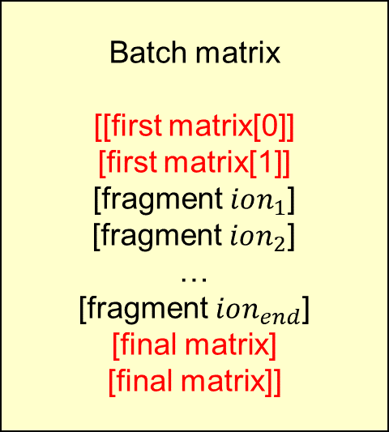
class MgfToTensor()
Batch matrix
[[first matrix[0]]
[first matrix[1]]
[fragment $ion_{1}$]
[fragment $ion_{2}$]
…
[fragment $ion_{end}$]
[final matrix]
[final matrix]]
▶ Add first matrix, and final matrix to Batch matrix

Slide 80
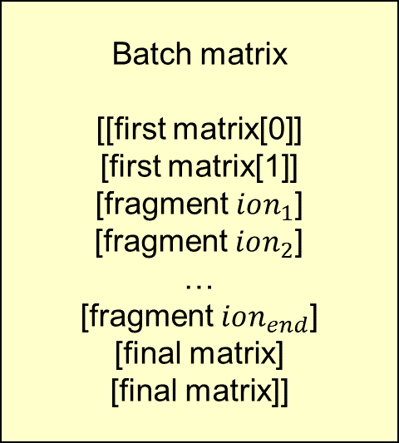
class MgfToTensor()
Batch matrix
[[first matrix[0]]
[first matrix[1]]
[fragment $ion_{1}$]
[fragment $ion_{2}$]
…
[fragment $ion_{end}$]
[final matrix]
[final matrix]]
▶ Add Batch matrix to Return matrix

Slide 81

class MgfToTensor()
Return matrix
[[batch matrix 1],
[batch matrix 2],
…
batch matrix n]
$n=$ number of spectrums
▶ Add Batch matrix to Return matrix

Slide 82
class MgfToTensor()
Return matrix
[[batch matrix 1],
[batch matrix 2],
…
batch matrix n]
$n=$ number of spectrums
▶ Store the biggest number of fragment ions, to make tensor

Slide 83
class MgfToTensor()
▶ We have complete return matrix,
having every information about spectrums in .mgf file
Return matrix
[[batch matrix 1],
[batch matrix 2],
…
batch matrix n]
$n=$ number of spectrums

Slide 84

class MgfToTensor()
▶ We have complete return matrix,
having every information about spectrums in .mgf file
Return matrix
[[batch matrix 1],
[batch matrix 2],
…
batch matrix n]
$n=$ number of spectrums

Slide 85
class MgfToTensor()
▶ We have complete return matrix,
having every information about spectrums in .mgf file
Return matrix
[[batch matrix 1],
[batch matrix 2],
…
batch matrix n]
$n=$ number of spectrums
Transform into tensor,
padding with value 0

Slide 86
class MgfToTensor()
▶ We have complete return matrix,
having every information about spectrums in .mgf file
Return matrix
[[batch matrix 1],
[batch matrix 2],
…
batch matrix n]
$n=$ number of spectrums
Transform into tensor,
padding with value 0
We can use this tensor
as an input of some deep learning model

Slide 87
Thank you

