Slide 1
Algorithms on Strings, Trees, and Sequences
Part III
Chapter 11.
Core String Edits, Alignments, and Dynamic Programming
컴퓨터소프트웨어학부 심승현

Slide 2
Contents
▶ Edit distance between two strings
▶ String alignment
▶ Dynamic programming calculation of edit distance
▶ Edit graphs
▶ Weighted edit distance
▶ String similarity
▶ Local alignment
▶ Gaps

Slide 3
Summary : Chapter 10
▶ The first fact of biological sequence analysis
In biomolecular sequences, ( e.g. DNA, RNA, amino acid sequences )
High sequence similarity usually implies significant functional or structural similarity
Redundancy, and similarity is the important feature

Slide 4
Summary : Chapter 10
▶ The first fact of biological sequence analysis
In biomolecular sequences, ( e.g. DNA, RNA, amino acid sequences )
High sequence similarity usually implies significant functional or structural similarity
▶ The converse of first fact is not true, i.e. the high similarity of function or structure
doesn’t necessarily mean high sequence similarity.

Slide 5
Chapter 11
Chapter 11.
Core String Edits, Alignments, and Dynamic Programming

Slide 6
Introduction
▶ Chapter 11 is about the inexact matching, alignment problems,
and some other relative techniques.
Inexact matching is to find strings, or sequences
that approximately matches to another strings or sequences
Alignment problem is to align some strings,
to find mutual similarity or redundance

Slide 7
The Edit Distance Between Two Strings
▶ Edit distance between two strings means “ How far is from one string to other string? “
Measures the converting step from one string to the other string

Slide 8
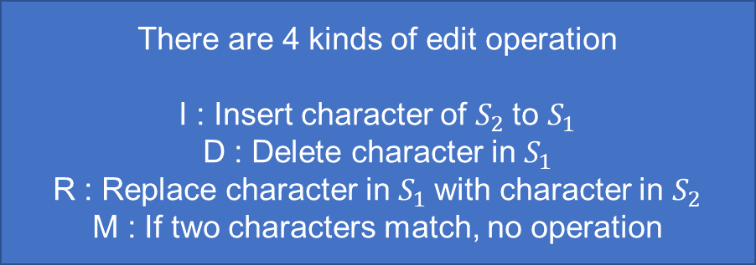
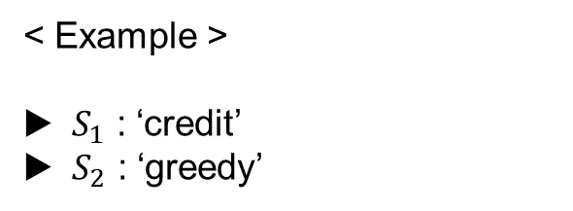
The Edit Distance Between Two Strings
There are 4 kinds of edit operation
I : Insert character of $S_{2}$to $S_{1}$
D : Delete character in $S_{1}$
R : Replace character in $S_{1}$with character in $S_{2}$
M : If two characters match, no operation
< Example >
▶ $S_{1}$ : ‘credit’
▶ $S_{2}$ : ‘greedy’
R | M | I | M | M | R | D
c | r |  | e | d | i | t
g | r | e | e | d | y

Slide 9
The Edit Distance Between Two Strings
There are 4 kinds of edit operation
I : Insert character of $S_{2}$to $S_{1}$
D : Delete character in $S_{1}$
R : Replace character in $S_{1}$with character in $S_{2}$
M : If two characters match, no operation
< Example >
▶ $S_{1}$ : ‘credit’
▶ $S_{2}$ : ‘greedy’
R | M | I | M | M | R | D
c | r |  | e | d | i | t
g | r | e | e | d | y
This is called edit transcript !

Slide 10

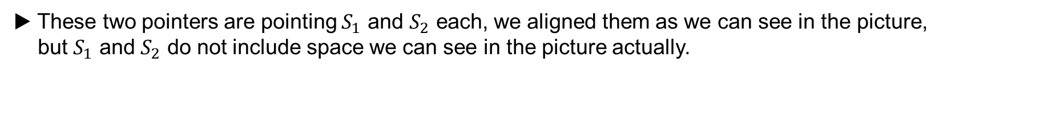
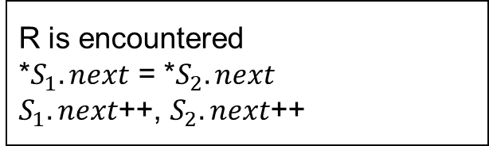

The Edit Distance Between Two Strings
There are 4 kinds of edit operation
I : Insert character of $S_{2}$to $S_{1}$
D : Delete character in $S_{1}$
R : Replace character in $S_{1}$with character in $S_{2}$
M : If two characters match, no operation
$$S_{1}.next$$
< Example >
▶ $S_{1}$ : ‘credit’
▶ $S_{2}$ : ‘greedy’
R | M | I | M | M | R | D
c | r |  | e | d | i | t
g | r | e | e | d | y
R is encountered
*$S_{1}.next$ = *$S_{2}.next$
$S_{1}.next$++, $S_{2}.next$++
$$S_{2}.next$$
▶ These two pointers are pointing $S_{1}$ and $S_{2}$ each, we aligned them as we can see in the picture,
but $S_{1}$ and $S_{2}$ do not include space we can see in the picture actually.

Slide 11
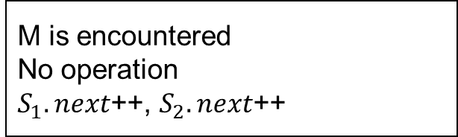
The Edit Distance Between Two Strings
There are 4 kinds of edit operation
I : Insert character of $S_{2}$to $S_{1}$
D : Delete character in $S_{1}$
R : Replace character in $S_{1}$with character in $S_{2}$
M : If two characters match, no operation
$$S_{1}.next$$
< Example >
▶ $S_{1}$ : ‘credit’
▶ $S_{2}$ : ‘greedy’
R | M | I | M | M | R | D
g | r |  | e | d | i | t
g | r | e | e | d | y
M is encountered
No operation
$S_{1}.next$++, $S_{2}.next$++
$$S_{2}.next$$

Slide 12
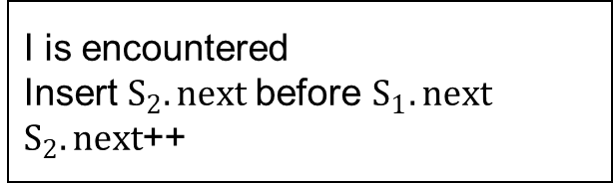
The Edit Distance Between Two Strings
There are 4 kinds of edit operation
I : Insert character of $S_{2}$to $S_{1}$
D : Delete character in $S_{1}$
R : Replace character in $S_{1}$with character in $S_{2}$
M : If two characters match, no operation
$$S_{1}.next$$
increment 1 character!
< Example >
▶ $S_{1}$ : ‘credit’
▶ $S_{2}$ : ‘greedy’
R | M | I | M | M | R | D
g | r |  | e | d | i | t
g | r | e | e | d | y
I is encountered
Insert $S_{2}.next$before $S_{1}.next$
$S_{2}.next$++
$$S_{2}.next$$

Slide 13
The Edit Distance Between Two Strings
There are 4 kinds of edit operation
I : Insert character of $S_{2}$to $S_{1}$
D : Delete character in $S_{1}$
R : Replace character in $S_{1}$with character in $S_{2}$
M : If two characters match, no operation
$$S_{1}.next$$
< Example >
▶ $S_{1}$ : ‘credit’
▶ $S_{2}$ : ‘greedy’
R | M | I | M | M | R | D
g | r | e | e | d | i | t
g | r | e | e | d | y
M is encountered
No operation
$S_{1}.next$++, $S_{2}.next$++
$$S_{2}.next$$

Slide 14
The Edit Distance Between Two Strings
There are 4 kinds of edit operation
I : Insert character of $S_{2}$to $S_{1}$
D : Delete character in $S_{1}$
R : Replace character in $S_{1}$with character in $S_{2}$
M : If two characters match, no operation
$$S_{1}.next$$
< Example >
▶ $S_{1}$ : ‘credit’
▶ $S_{2}$ : ‘greedy’
R | M | I | M | M | R | D
g | r | e | e | d | i | t
g | r | e | e | d | y
M is encountered
No operation
$S_{1}.next$++, $S_{2}.next$++
$$S_{2}.next$$

Slide 15
The Edit Distance Between Two Strings
There are 4 kinds of edit operation
I : Insert character of $S_{2}$to $S_{1}$
D : Delete character in $S_{1}$
R : Replace character in $S_{1}$with character in $S_{2}$
M : If two characters match, no operation
$$S_{1}.next$$
< Example >
▶ $S_{1}$ : ‘credit’
▶ $S_{2}$ : ‘greedy’
R | M | I | M | M | R | D
g | r | e | e | d | i | t
g | r | e | e | d | y
R is encountered
*$S_{1}.next$ = *$S_{2}.next$
$S_{1}.next$++, $S_{2}.next$++
$$S_{2}.next$$

Slide 16
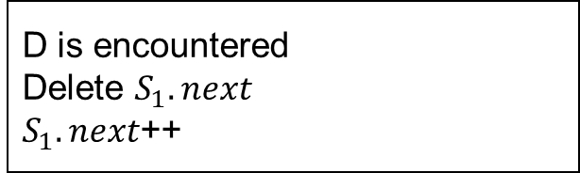
The Edit Distance Between Two Strings
There are 4 kinds of edit operation
I : Insert character of $S_{2}$to $S_{1}$
D : Delete character in $S_{1}$
R : Replace character in $S_{1}$with character in $S_{2}$
M : If two characters match, no operation
$$S_{1}.next$$
< Example >
▶ $S_{1}$ : ‘credit’
▶ $S_{2}$ : ‘greedy’
R | M | I | M | M | R | D
g | r | e | e | d | y | t
g | r | e | e | d | y
D is encountered
Delete $S_{1}.next$
$S_{1}.next$++
$$S_{2}.next$$

Slide 17
The Edit Distance Between Two Strings
There are 4 kinds of edit operation
I : Insert character of $S_{2}$to $S_{1}$
D : Delete character in $S_{1}$
R : Replace character in $S_{1}$with character in $S_{2}$
M : If two characters match, no operation
$$S_{1}.next$$
< Example >
▶ $S_{1}$ : ‘credit’
▶ $S_{2}$ : ‘greedy’
R | M | I | M | M | R | D
g | r | e | e | d | y | t
g | r | e | e | d | y
Edit operation finished
$$S_{2}.next$$

Slide 18
The Edit Distance Between Two Strings
There are 4 kinds of edit operation
I : Insert character of $S_{2}$to $S_{1}$
D : Delete character in $S_{1}$
R : Replace character in $S_{1}$with character in $S_{2}$
M : If two characters match, no operation
< Example >
▶ $S_{1}$ : ‘credit’
▶ $S_{2}$ : ‘greedy’
R | M | I | M | M | R | D
c | r |  | e | d | i | t
g | r | e | e | d | y
This is called edit transcript !
▶ Edit distance between two strings is the minimum number of edit operations
We define optimal transcript as an edit transcript that uses the minimum number of edit operations

Slide 19
The Edit Distance Between Two Strings
There are 4 kinds of edit operation
I : Insert character of $S_{2}$to $S_{1}$
D : Delete character in $S_{1}$
R : Replace character in $S_{1}$with character in $S_{2}$
M : If two characters match, no operation
< Example >
▶ $S_{1}$ : ‘credit’
▶ $S_{2}$ : ‘greedy’
R | M | I | M | M | R | D
c | r |  | e | d | i | t
g | r | e | e | d | y
This is called edit transcript !
▶ There are various ways aligning these strings, there can be multiple optimal transcripts
We call them cooptimal transcripts

Slide 20
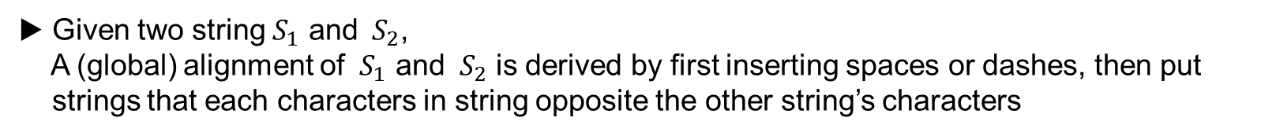
String Alignments
▶ Given two string $S_{1}$ and $S_{2}$,
A (global) alignment of $S_{1}$ and $S_{2}$ is derived by first inserting spaces or dashes, then put
strings that each characters in string opposite the other string’s characters
 |  | _
 |  |  |  |  |  | _
c | r | _ | e | d | i | t
g | r | e | e | d | y | _
▶ c opposite g
▶ e and t opposite space

Slide 21
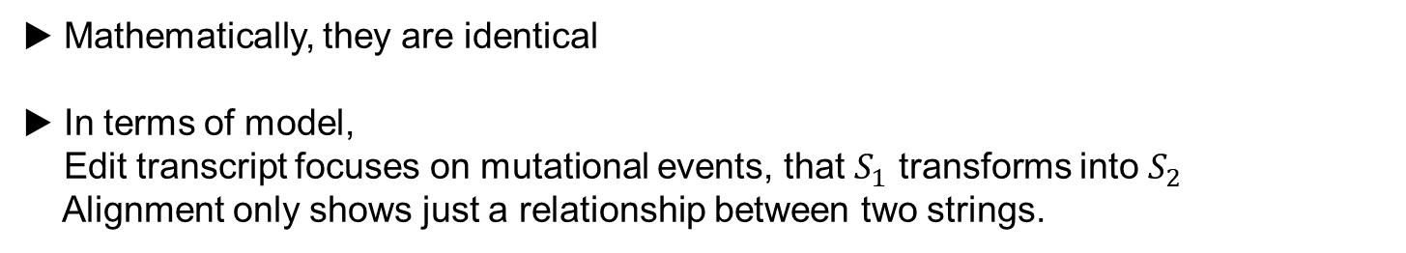
Comparing Edit Transcript and String Alignments
▶ Mathematically, they are identical
▶ In terms of model,
Edit transcript focuses on mutational events, that $S_{1}$ transforms into $S_{2}$
Alignment only shows just a relationship between two strings.

Slide 22
Dynamic Programming Calculation of Edit Distance
▶ Computing edit distance of two strings
▷ Dynamic programming approach, to divide a problem and solve through them
▷ Specific application to edit distance problem

Slide 23
Dynamic Programming Approach
▶ The recurrence relation
▶ Tabular computation of edit distance
▶ The traceback

Slide 24
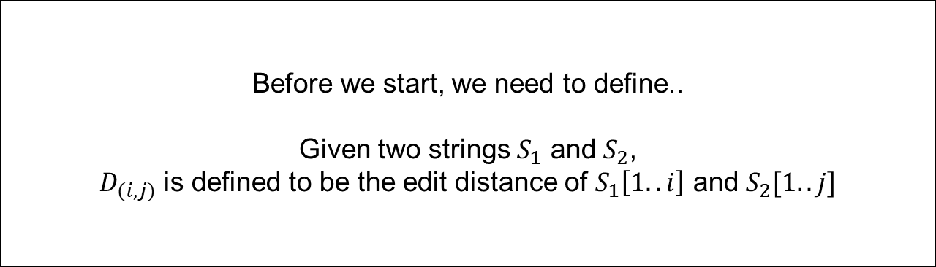
Dynamic Programming Approach
▶ The recurrence relation
▶ Tabular computation of edit distance
▶ The traceback
Before we start, we need to define..
Given two strings $S_{1}$ and $S_{2}$,
$D_{(i, j)}$ is defined to be the edit distance of $S_{1}\left[1..i\right]$ and $S_{2}[1..j]$

Slide 25
Dynamic Programming Approach : The Recurrence Relation
▶ Base condition
▶ Recurrence relation

Slide 26
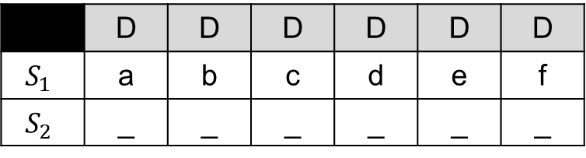

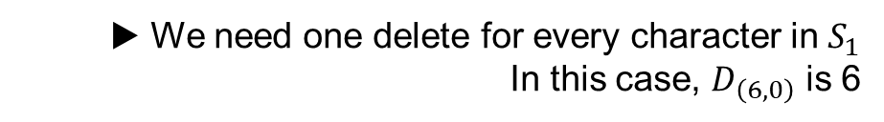
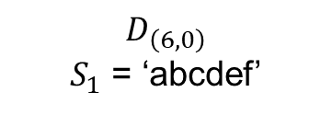
Dynamic Programming Approach : The Recurrence Relation
$$D_{\left(i, 0\right)}=i$$
$$D_{\left(0, j\right)}= \text{j}$$
▶ Base condition
 | D | D | D | D | D | D
$$S_{1}$$ | a | b | c | d | e | f
$$S_{2}$$ | _ | _ | _ | _ | _ | _
$$D_{\left(6, 0\right)}$$
$S_{1}$ = ‘abcdef’
▶ We need one delete for every character in $S_{1}$
In this case, $D_{\left(6, 0\right)}$ is 6

Slide 27

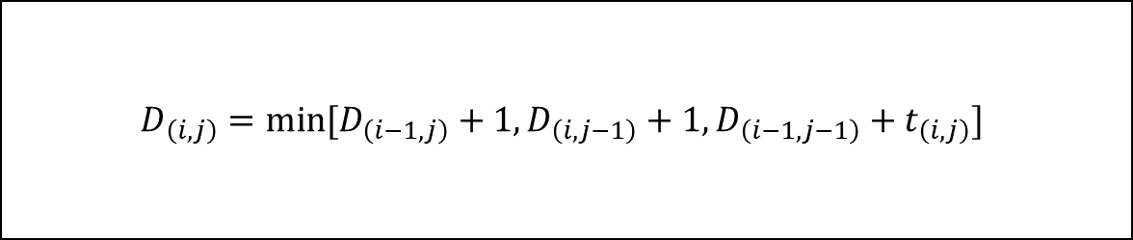
Dynamic Programming Approach : The Recurrence Relation
$$D_{\left(i,j\right)}=min⁡[D_{\left(i−1,j\right)}+1, D_{\left(i,j−1\right)}+1,D_{\left(i−1,j−1\right)}+t_{\left(i,j\right)}]$$
▶ Recurrence relation
※ $t_{\left(i,j\right)}$ = 0 if $S_{1}\left(i\right)$ = $S_{2}\left(j\right)$, otherwise 1

Slide 28

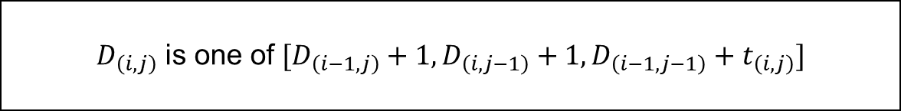
Dynamic Programming Approach : The Recurrence Relation
$$D_{\left(i,j\right)}=min⁡[D_{\left(i−1,j\right)}+1, D_{\left(i,j−1\right)}+1,D_{\left(i−1,j−1\right)}+t_{\left(i,j\right)}]$$
▶ Recurrence relation
※ $t_{\left(i,j\right)}$ = 0 if $S_{1}\left(i\right)$ = $S_{2}\left(j\right)$, otherwise 1
This relation is built on these two lemmas,
$D_{\left(i,j\right)}$ is one of $[D_{\left(i−1,j\right)}+1, D_{\left(i,j−1\right)}+1,D_{\left(i−1,j−1\right)}+t_{\left(i,j\right)}]$
Lemma 11.3.1 :
$D_{\left(i,j\right)}$ $≤$ $min[D_{\left(i−1,j\right)}+1, D_{\left(i,j−1\right)}+1,D_{\left(i−1,j−1\right)}+t_{\left(i,j\right)}]$
Lemma 11.3.2 :

Slide 29
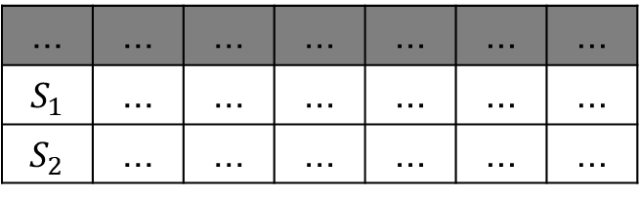

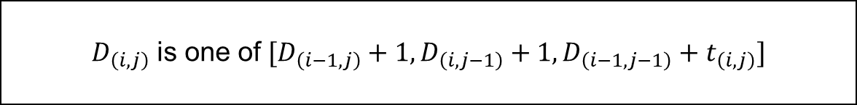

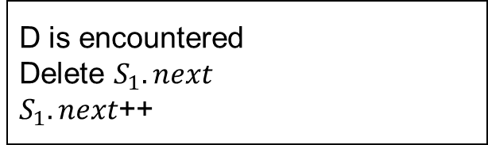
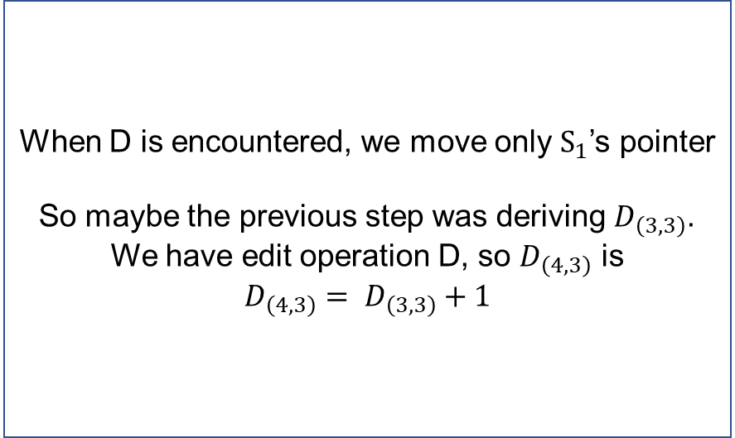
Dynamic Programming Approach : The Recurrence Relation
$D_{\left(i,j\right)}$ is one of $[D_{\left(i−1,j\right)}+1, D_{\left(i,j−1\right)}+1,D_{\left(i−1,j−1\right)}+t_{\left(i,j\right)}]$
▶ Lemma 11.3.1
※ $t_{\left(i,j\right)}$ = 0 if $S_{1}\left(i\right)$ = $S_{2}\left(j\right)$, otherwise 1
When D is encountered, we move only $S_{1}$’s pointer
So maybe the previous step was deriving $D_{\left(3,3\right)}$.
We have edit operation D, so $D_{\left(4,3\right)}$ is
$$D_{\left(4,3\right)}= D_{\left(3,3\right)}+1$$
$i=4, j=3$, symbol = D
... | ... | ... | ... | ... | ... | ...
$S_{1}$ | ... | ... | ... | ... | ... | ...
$S_{2}$ | ... | ... | ... | ... | ... | ...
D is encountered
Delete $S_{1}.next$
$S_{1}.next$++

Slide 30
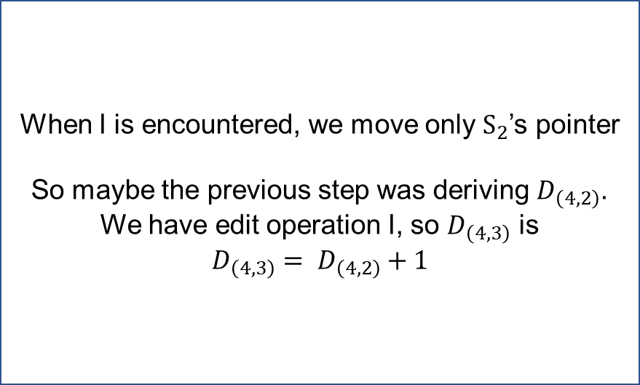

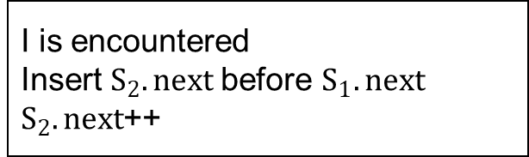
Dynamic Programming Approach : The Recurrence Relation
$D_{\left(i,j\right)}$ is one of $[D_{\left(i−1,j\right)}+1, D_{\left(i,j−1\right)}+1,D_{\left(i−1,j−1\right)}+t_{\left(i,j\right)}]$
▶ Lemma 11.3.1
When I is encountered, we move only $S_{2}$’s pointer
So maybe the previous step was deriving $D_{\left(4,2\right)}$.
We have edit operation I, so $D_{\left(4,3\right)}$ is
$$D_{\left(4,3\right)}= D_{\left(4,2\right)}+1$$
$i=4, j=3$, symbol = I
... | ... | ... | ... | ... | ... | ...
$S_{1}$ | ... | ... | ... | ... | ... | ...
$S_{2}$ | ... | ... | ... | ... | ... | ...
I is encountered
Insert $S_{2}.next$before $S_{1}.next$
$S_{2}.next$++

Slide 31
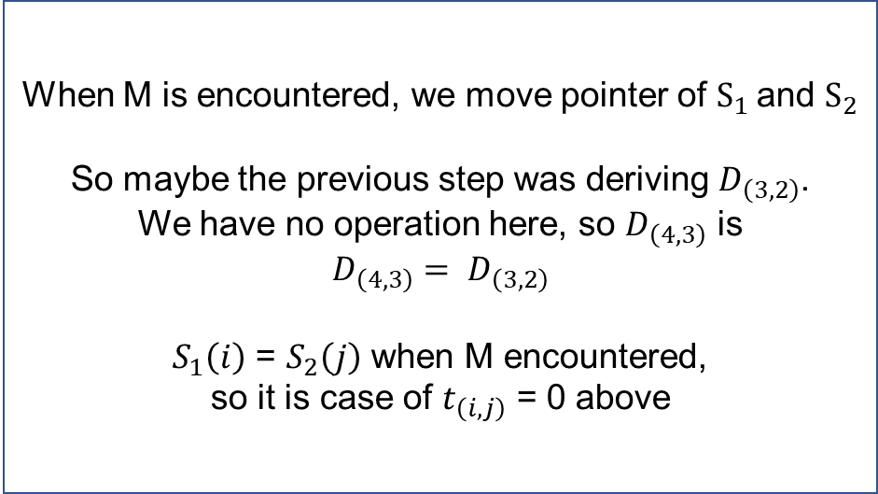


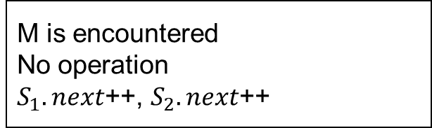
Dynamic Programming Approach : The Recurrence Relation
$D_{\left(i,j\right)}$ is one of $[D_{\left(i−1,j\right)}+1, D_{\left(i,j−1\right)}+1,D_{\left(i−1,j−1\right)}+t_{\left(i,j\right)}]$
▶ Lemma 11.3.1
※ $t_{\left(i,j\right)}$ = 0 if $S_{1}\left(i\right)$ = $S_{2}\left(j\right)$, otherwise 1
When M is encountered, we move pointer of $S_{1}$and $S_{2}$
So maybe the previous step was deriving $D_{\left(3,2\right)}$.
We have no operation here, so $D_{\left(4,3\right)}$ is
$$D_{\left(4,3\right)}= D_{\left(3,2\right)}$$
$S_{1}\left(i\right)$ = $S_{2}\left(j\right)$ when M encountered,
so it is case of $t_{\left(i,j\right)}$ = 0 above
$i=4, j=3$, symbol = M
... | ... | ... | ... | ... | ... | ...
$S_{1}$ | ... | ... | ... | ... | ... | ...
$S_{2}$ | ... | ... | ... | ... | ... | ...
M is encountered
No operation
$S_{1}.next$++, $S_{2}.next$++

Slide 32


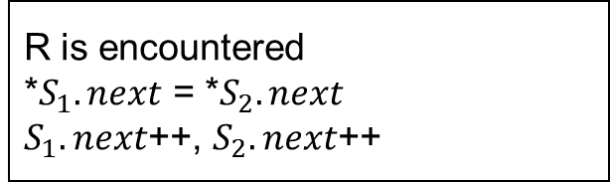
Dynamic Programming Approach : The Recurrence Relation
$D_{\left(i,j\right)}$ is one of $[D_{\left(i−1,j\right)}+1, D_{\left(i,j−1\right)}+1,D_{\left(i−1,j−1\right)}+t_{\left(i,j\right)}]$
▶ Lemma 11.3.1
※ $t_{\left(i,j\right)}$ = 0 if $S_{1}\left(i\right)$ = $S_{2}\left(j\right)$, otherwise 1
When R is encountered, we move pointer of $S_{1}$and $S_{2}$
So maybe the previous step was deriving $D_{\left(3,2\right)}$.
We have no operation here, so $D_{\left(4,3\right)}$ is
$$D_{\left(4,3\right)}= D_{\left(3,2\right)}+1$$
$S_{1}\left(i\right)$ $≠$ $S_{2}\left(j\right)$ when R encountered,
so it is case of $t_{\left(i,j\right)}$ = 1 above
$i=4, j=3$, symbol = R
... | ... | ... | ... | ... | ... | ...
$S_{1}$ | ... | ... | ... | ... | ... | ...
$S_{2}$ | ... | ... | ... | ... | ... | ...
R is encountered
*$S_{1}.next$ = *$S_{2}.next$
$S_{1}.next$++, $S_{2}.next$++

Slide 33
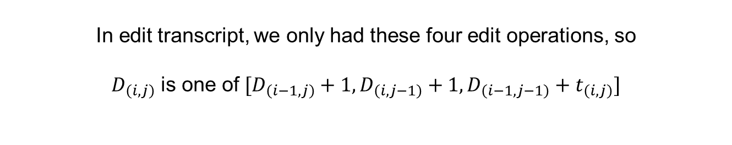
Dynamic Programming Approach : The Recurrence Relation
$D_{\left(i,j\right)}$ is one of $[D_{\left(i−1,j\right)}+1, D_{\left(i,j−1\right)}+1,D_{\left(i−1,j−1\right)}+t_{\left(i,j\right)}]$
▶ Lemma 11.3.1
※ $t_{\left(i,j\right)}$ = 0 if $S_{1}\left(i\right)$ = $S_{2}\left(j\right)$, otherwise 1
In edit transcript, we only had these four edit operations, so
$D_{\left(i,j\right)}$ is one of $[D_{\left(i−1,j\right)}+1, D_{\left(i,j−1\right)}+1,D_{\left(i−1,j−1\right)}+t_{\left(i,j\right)}]$

Slide 34

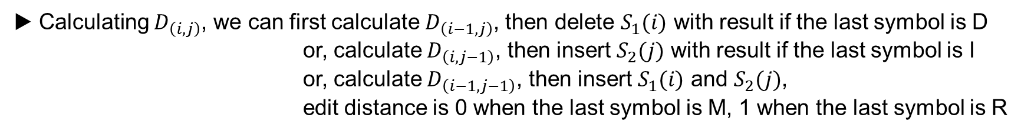
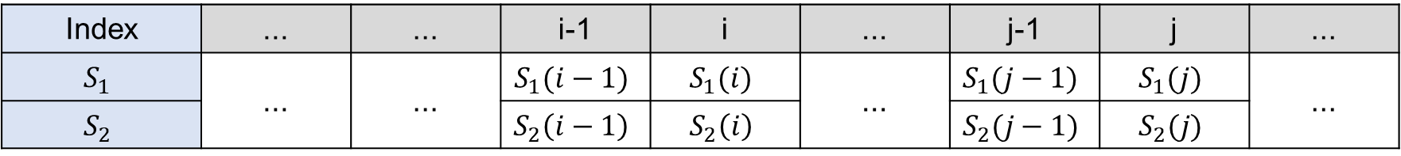
Dynamic Programming Approach : The Recurrence Relation
$D_{\left(i,j\right)}$ $≤$ $min[D_{\left(i−1,j\right)}+1, D_{\left(i,j−1\right)}+1,D_{\left(i−1,j−1\right)}+t_{\left(i,j\right)}]$
▶ Lemma 11.3.2
※ $t_{\left(i,j\right)}$ = 0 if $S_{1}\left(i\right)$ = $S_{2}\left(j\right)$, otherwise 1
Index | ... | ... | i-1 | i | ... | j-1 | j | ...
$$S_{1}$$ | ... | ... | $$S_{1}(i−1)$$ | $$S_{1}(i)$$ | ... | $$S_{1}(j−1)$$ | $$S_{1}(j)$$ | ...
$$S_{2}$$ | ... | ... | $$S_{2}\left(i−1\right)$$ | $$S_{2}\left(i\right)$$ |  | $$S_{2}(j−1)$$ | $$S_{2}(j)$$
▶ Calculating $D_{\left(i,j\right)}$, we can first calculate $D_{\left(i−1,j\right)}$, then delete $S_{1}(i)$ with result if the last symbol is D
or, calculate $D_{\left(i,j−1\right)}$, then insert $S_{2}(j)$ with result if the last symbol is I
or, calculate $D_{\left(i−1,j−1\right)}$, then insert $S_{1}(i)$ and $S_{2}(j)$,
edit distance is 0 when the last symbol is M, 1 when the last symbol is R

Slide 35
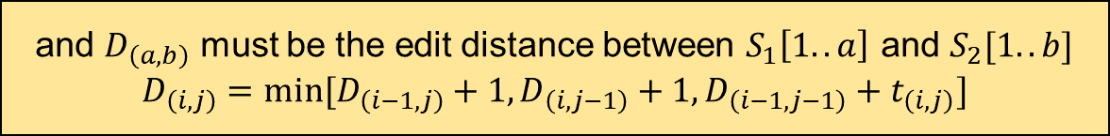
Dynamic Programming Approach : The Recurrence Relation
$D_{\left(i,j\right)}$ $≤$ $min[D_{\left(i−1,j\right)}+1, D_{\left(i,j−1\right)}+1,D_{\left(i−1,j−1\right)}+t_{\left(i,j\right)}]$
▶ Lemma 11.3.2
※ $t_{\left(i,j\right)}$ = 0 if $S_{1}\left(i\right)$ = $S_{2}\left(j\right)$, otherwise 1
Index | ... | ... | i-1 | i | ... | j-1 | j | ...
$$S_{1}$$ | ... | ... | $$S_{1}(i−1)$$ | $$S_{1}(i)$$ | ... | $$S_{1}(j−1)$$ | $$S_{1}(j)$$ | ...
$$S_{2}$$ | ... | ... | $$S_{2}\left(i−1\right)$$ | $$S_{2}\left(i\right)$$ |  | $$S_{2}(j−1)$$ | $$S_{2}(j)$$
and $D_{\left(a,b\right)}$ must be the edit distance between $S_{1}\left[1..a\right]$ and $S_{2}[1..b]$
$D_{\left(i,j\right)}$ $=$ $min[D_{\left(i−1,j\right)}+1, D_{\left(i,j−1\right)}+1,D_{\left(i−1,j−1\right)}+t_{\left(i,j\right)}]$
▶ Calculating $D_{\left(i,j\right)}$, we can first calculate $D_{\left(i−1,j\right)}$, then delete $S_{1}(i)$ with result if the last symbol is D
or, calculate $D_{\left(i,j−1\right)}$, then insert $S_{2}(j)$ with result if the last symbol is I
or, calculate $D_{\left(i−1,j−1\right)}$, then insert $S_{1}(i)$ and $S_{2}(j)$,
edit distance is 0 when the last symbol is M, 1 when the last symbol is R

Slide 36

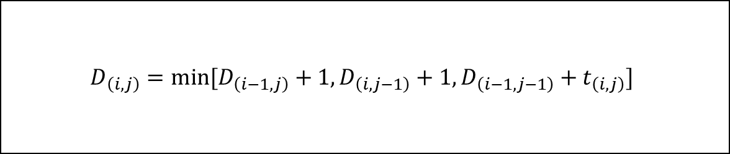
Dynamic Programming Approach : The Recurrence Relation
▶ So, we proved this recurrence relation
$$D_{\left(i,j\right)}=min⁡[D_{\left(i−1,j\right)}+1, D_{\left(i,j−1\right)}+1,D_{\left(i−1,j−1\right)}+t_{\left(i,j\right)}]$$
※ $t_{\left(i,j\right)}$ = 0 if $S_{1}\left(i\right)$ = $S_{2}\left(j\right)$, otherwise 1

Slide 37







Dynamic Programming Approach : Tabular Computation
▶ Recurrence relation we obtained before has exploding time complexity
$$D_{\left(i,j\right)}$$
$$D_{\left(i−1,j\right)}$$
$$D_{\left(i,j−1\right)}$$
$$D_{\left(i−1,j−1\right)}$$
...
...
$$D_{\left(i−1,j−1\right)}$$
$$D_{\left(i,j−2\right)}$$
$$D_{\left(i−1,j−2\right)}$$
※ We calculate the same value
already called before
...
This problem arises since this method is top-down approach
So, let’s see bottom-up approach !

Slide 38
Dynamic Programming Approach : Tabular Computation
▶ Build a table, and fill in the table successively,

Slide 39
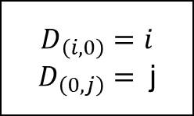
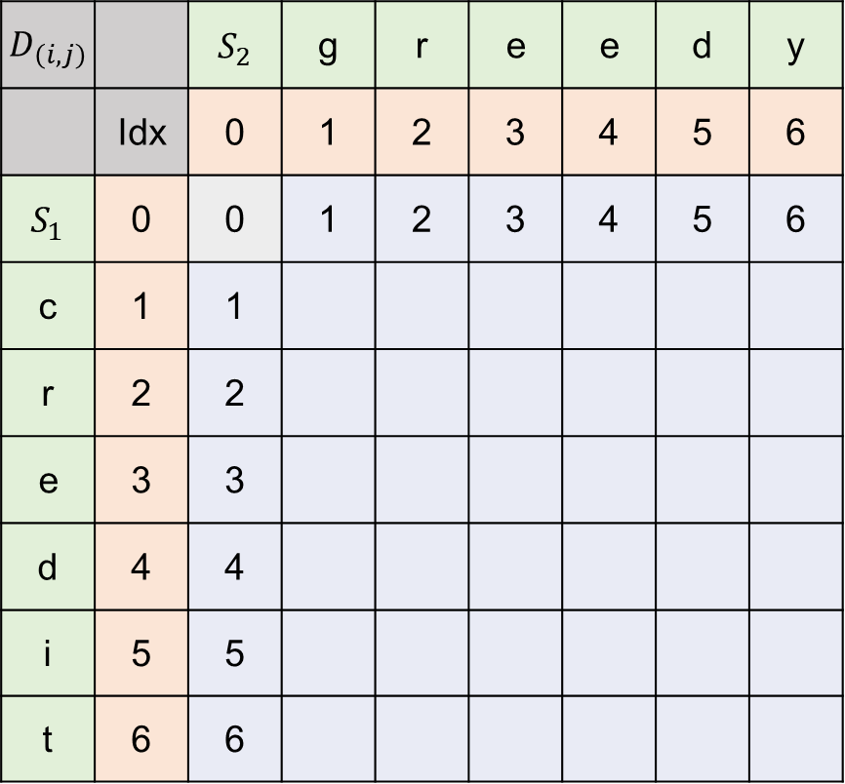
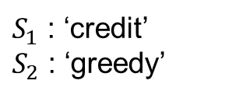
Dynamic Programming Approach : Tabular Computation
$D_{\left(i,j\right)}$ |  | $S_{2}$ | g | r | e | e | d | y
 | Idx | 0 | 1 | 2 | 3 | 4 | 5 | 6
$S_{1}$ | 0 | 0 | 1 | 2 | 3 | 4 | 5 | 6
c | 1 | 1
r | 2 | 2
e | 3 | 3
d | 4 | 4
i | 5 | 5
t | 6 | 6
▶ Base condition
▶ Orange are indexes.
$$D_{\left(i, 0\right)}=i$$
$$D_{\left(0, j\right)}= \text{j}$$
▶ These values (sky) are
derived by the base condition.
$S_{1}$ : ‘credit’
$S_{2}$ : ‘greedy’

Slide 40
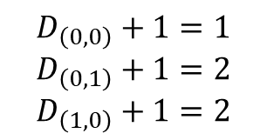
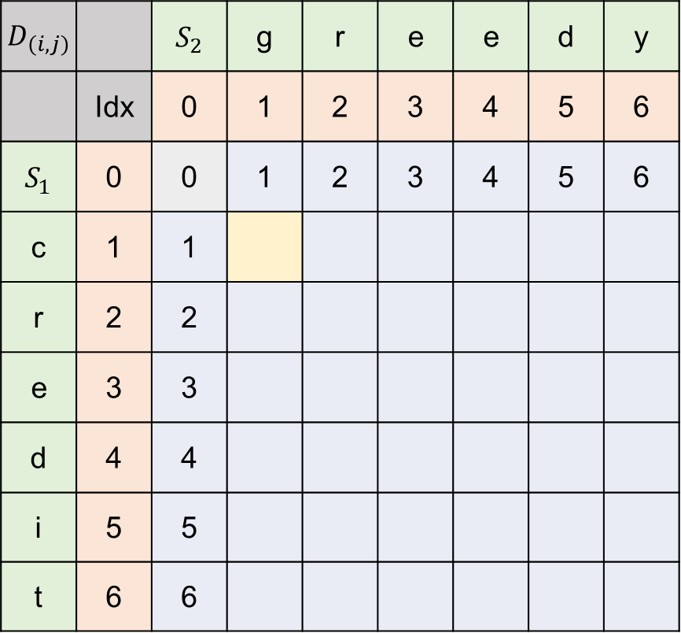


Dynamic Programming Approach : Tabular Computation
$D_{\left(i,j\right)}$ |  | $S_{2}$ | g | r | e | e | d | y
 | Idx | 0 | 1 | 2 | 3 | 4 | 5 | 6
$S_{1}$ | 0 | 0 | 1 | 2 | 3 | 4 | 5 | 6
c | 1 | 1
r | 2 | 2
e | 3 | 3
d | 4 | 4
i | 5 | 5
t | 6 | 6
▶ Base condition
▶ g and c is mismatch, $t_{\left(1,1\right)}$=1
$$D_{\left(i, 0\right)}=i$$
$$D_{\left(0, j\right)}= \text{j}$$
▶ min value for $D_{\left(1,1\right)}$ is one of
$$D_{\left(0,0\right)}+1=1$$
$$D_{\left(0,1\right)}+1=2$$
$$D_{\left(1,0\right)}+1=2$$
$S_{1}$ : ‘credit’
$S_{2}$ : ‘greedy’

Slide 41

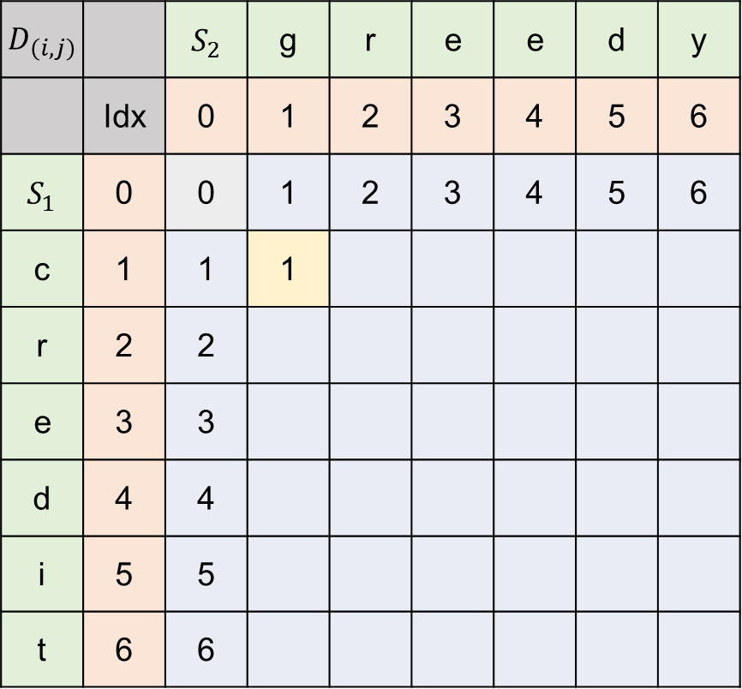
Dynamic Programming Approach : Tabular Computation
$D_{\left(i,j\right)}$ |  | $S_{2}$ | g | r | e | e | d | y
 | Idx | 0 | 1 | 2 | 3 | 4 | 5 | 6
$S_{1}$ | 0 | 0 | 1 | 2 | 3 | 4 | 5 | 6
c | 1 | 1 | 1
r | 2 | 2
e | 3 | 3
d | 4 | 4
i | 5 | 5
t | 6 | 6
▶ Base condition
▶ g and c is mismatch, $t_{\left(1,1\right)}$=1
$$D_{\left(i, 0\right)}=i$$
$$D_{\left(0, j\right)}= \text{j}$$
▶ min value for $D_{\left(1,1\right)}$ is one of
$$D_{\left(0,0\right)}+1=1$$
$$D_{\left(0,1\right)}+1=2$$
$$D_{\left(1,0\right)}+1=2$$
$S_{1}$ : ‘credit’
$S_{2}$ : ‘greedy’
▶ So $D_{\left(1,1\right)}$ = $D_{\left(0,0\right)}+1=1$

Slide 42

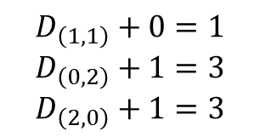
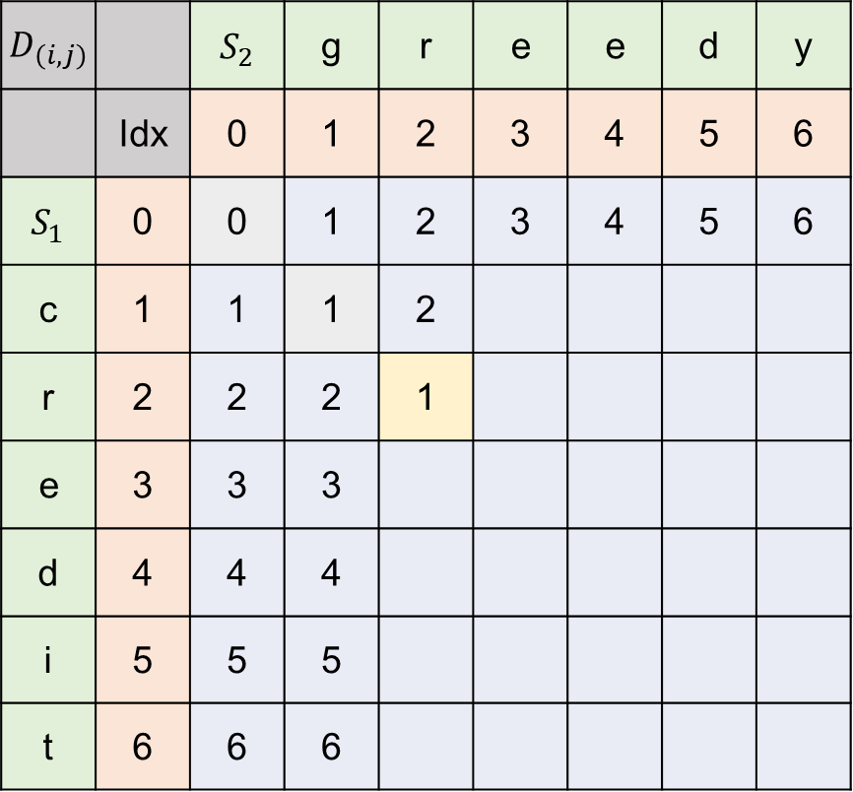


Dynamic Programming Approach : Tabular Computation
$D_{\left(i,j\right)}$ |  | $S_{2}$ | g | r | e | e | d | y
 | Idx | 0 | 1 | 2 | 3 | 4 | 5 | 6
$S_{1}$ | 0 | 0 | 1 | 2 | 3 | 4 | 5 | 6
c | 1 | 1 | 1 | 2
r | 2 | 2 | 2 | 1
e | 3 | 3 | 3
d | 4 | 4 | 4
i | 5 | 5 | 5
t | 6 | 6 | 6
▶ Base condition
▶ r and r is match, $t_{\left(2,2\right)}$= 0
$$D_{\left(i, 0\right)}=i$$
$$D_{\left(0, j\right)}= \text{j}$$
▶ min value for $D_{\left(2,2\right)}$ is one of
$$D_{\left(1,1\right)}+0=1$$
$$D_{\left(0,2\right)}+1=3$$
$$D_{\left(2,0\right)}+1=3$$
$S_{1}$ : ‘credit’
$S_{2}$ : ‘greedy’
▶ So $D_{\left(2,2\right)}$ = $D_{\left(1,1\right)}+1=1$

Slide 43

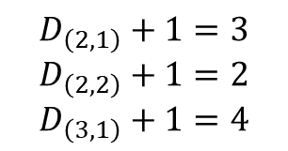
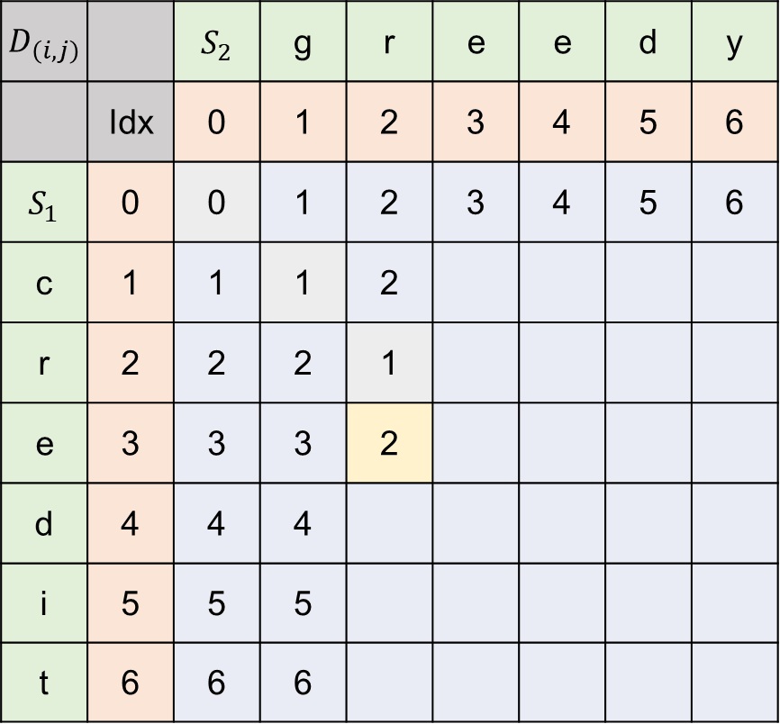


Dynamic Programming Approach : Tabular Computation
$D_{\left(i,j\right)}$ |  | $S_{2}$ | g | r | e | e | d | y
 | Idx | 0 | 1 | 2 | 3 | 4 | 5 | 6
$S_{1}$ | 0 | 0 | 1 | 2 | 3 | 4 | 5 | 6
c | 1 | 1 | 1 | 2
r | 2 | 2 | 2 | 1
e | 3 | 3 | 3 | 2
d | 4 | 4 | 4
i | 5 | 5 | 5
t | 6 | 6 | 6
▶ Base condition
▶ e and r is match, $t_{\left(3,2\right)}$= 1
$$D_{\left(i, 0\right)}=i$$
$$D_{\left(0, j\right)}= \text{j}$$
▶ min value for $D_{\left(3,2\right)}$ is one of
$$D_{\left(2,1\right)}+1=3$$
$$D_{\left(2,2\right)}+1=2$$
$$D_{\left(3,1\right)}+1=4$$
$S_{1}$ : ‘credit’
$S_{2}$ : ‘greedy’
▶ So $D_{\left(3,2\right)}$ = $D_{\left(2,2\right)}+1=2$

Slide 44
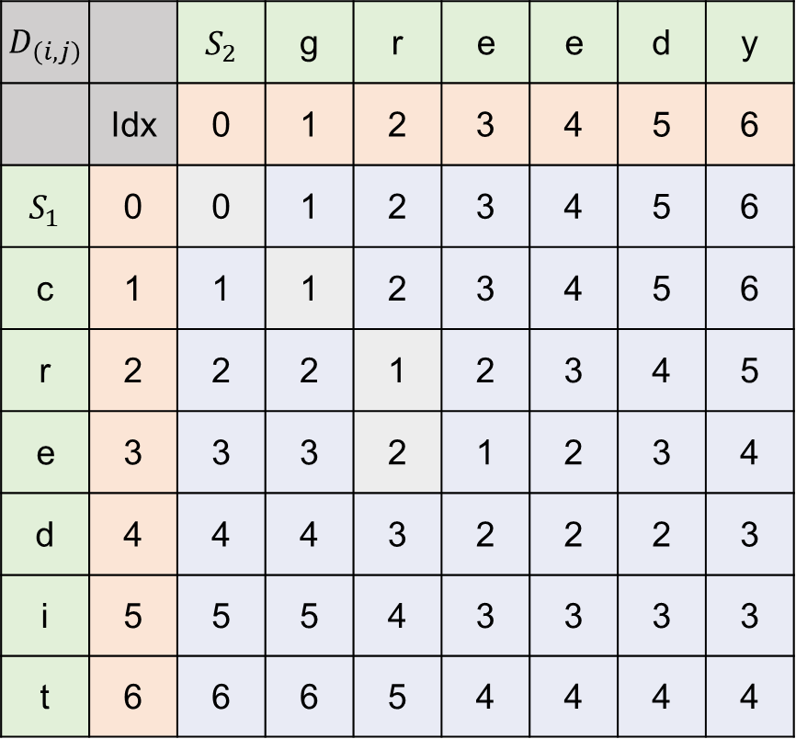
Dynamic Programming Approach : Tabular Computation
$D_{\left(i,j\right)}$ |  | $S_{2}$ | g | r | e | e | d | y
 | Idx | 0 | 1 | 2 | 3 | 4 | 5 | 6
$S_{1}$ | 0 | 0 | 1 | 2 | 3 | 4 | 5 | 6
c | 1 | 1 | 1 | 2 | 3 | 4 | 5 | 6
r | 2 | 2 | 2 | 1 | 2 | 3 | 4 | 5
e | 3 | 3 | 3 | 2 | 1 | 2 | 3 | 4
d | 4 | 4 | 4 | 3 | 2 | 2 | 2 | 3
i | 5 | 5 | 5 | 4 | 3 | 3 | 3 | 3
t | 6 | 6 | 6 | 5 | 4 | 4 | 4 | 4
▶ Base condition
▶ Table is filled
$$D_{\left(i, 0\right)}=i$$
$$D_{\left(0, j\right)}= \text{j}$$
$S_{1}$ : ‘credit’
$S_{2}$ : ‘greedy’

Slide 45


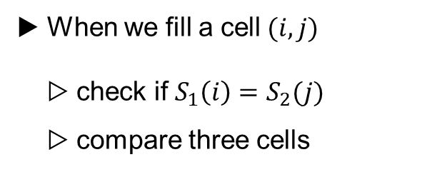
Dynamic Programming Approach : Tabular Computation
$D_{\left(i,j\right)}$ |  | $S_{2}$ | g | r | e | e | d | y
 | Idx | 0 | 1 | 2 | 3 | 4 | 5 | 6
$S_{1}$ | 0 | 0 | 1 | 2 | 3 | 4 | 5 | 6
c | 1 | 1 | 1 | 2 | 3 | 4 | 5 | 6
r | 2 | 2 | 2 | 1 | 2 | 3 | 4 | 5
e | 3 | 3 | 3 | 2 | 1 | 2 | 3 | 4
d | 4 | 4 | 4 | 3 | 2 | 2 | 2 | 3
i | 5 | 5 | 5 | 4 | 3 | 3 | 3 | 3
t | 6 | 6 | 6 | 5 | 4 | 4 | 4 | 4
▶ When we fill a cell$(i,j)$
▷ check if $S_{1}\left(i\right)=S_{2}(j)$
▷ compare three cells
▶ Base condition
$$D_{\left(i, 0\right)}=i$$
$$D_{\left(0, j\right)}= \text{j}$$
constant number of operation!
$S_{1}$ : ‘credit’
$S_{2}$ : ‘greedy’
▶ We had $n∗m$ cells to fill,
so the time analysis should be
$$O(nm)$$

Slide 46
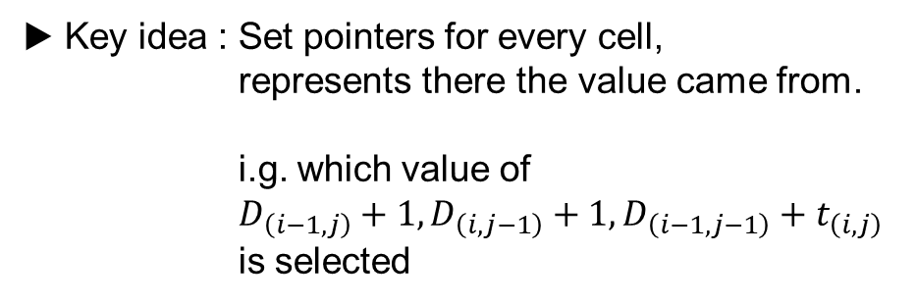
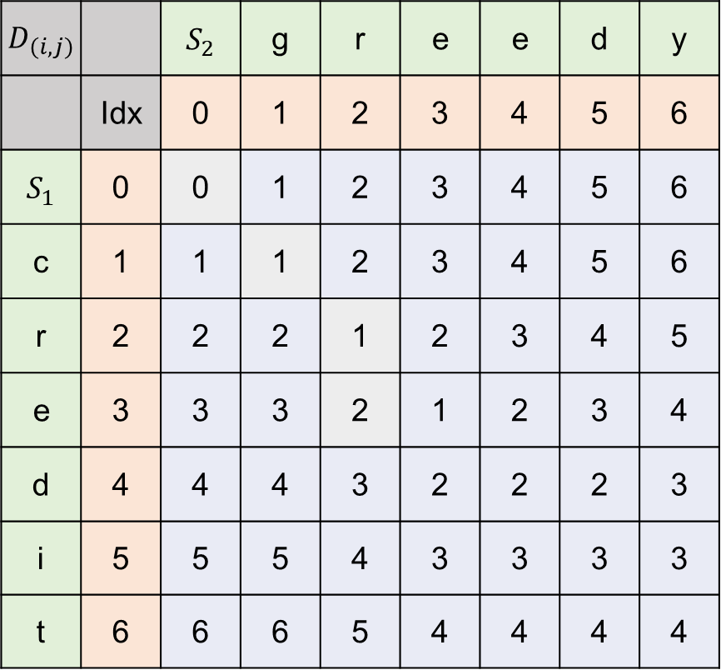
Dynamic Programming Approach : Traceback
$D_{\left(i,j\right)}$ |  | $S_{2}$ | g | r | e | e | d | y
 | Idx | 0 | 1 | 2 | 3 | 4 | 5 | 6
$S_{1}$ | 0 | 0 | 1 | 2 | 3 | 4 | 5 | 6
c | 1 | 1 | 1 | 2 | 3 | 4 | 5 | 6
r | 2 | 2 | 2 | 1 | 2 | 3 | 4 | 5
e | 3 | 3 | 3 | 2 | 1 | 2 | 3 | 4
d | 4 | 4 | 4 | 3 | 2 | 2 | 2 | 3
i | 5 | 5 | 5 | 4 | 3 | 3 | 3 | 3
t | 6 | 6 | 6 | 5 | 4 | 4 | 4 | 4
▶ Key idea : Set pointers for every cell,
represents there the value came from.
i.g. which value of
$D_{\left(i−1,j\right)}+1, D_{\left(i,j−1\right)}+1,D_{\left(i−1,j−1\right)}+t_{\left(i,j\right)}$
is selected

Slide 47
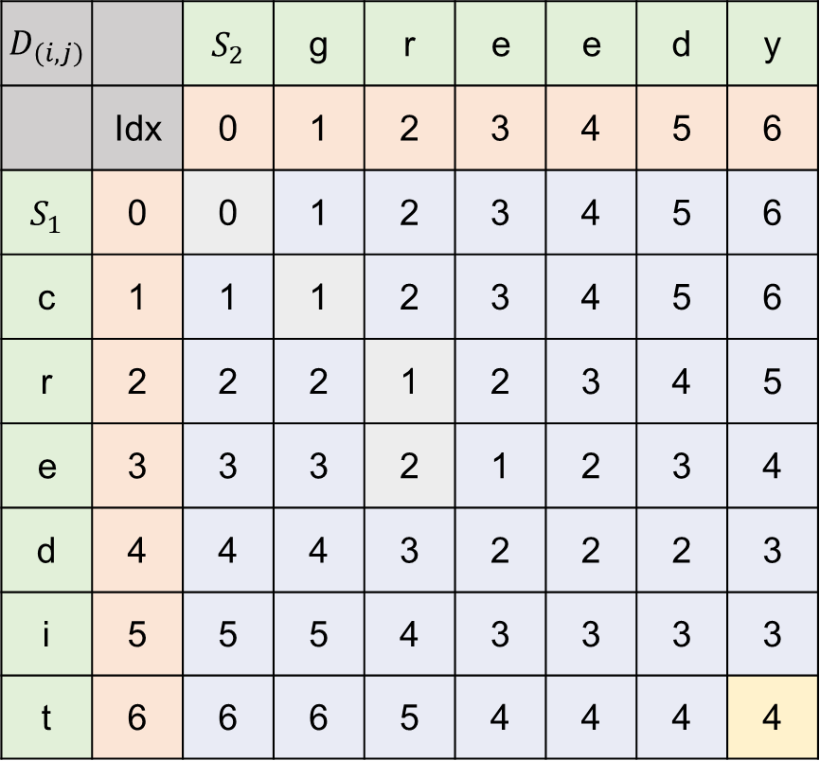
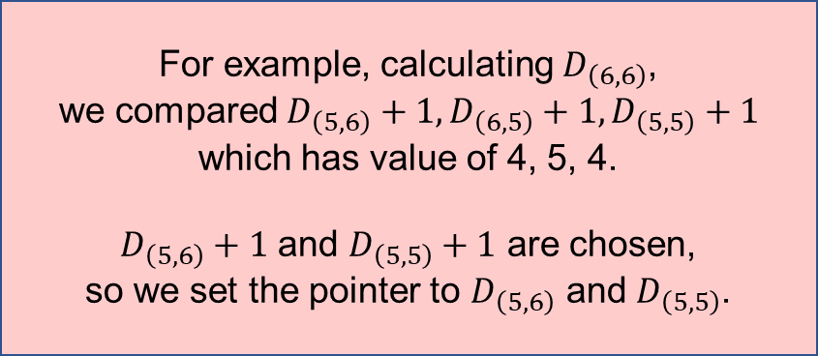
Dynamic Programming Approach : Traceback
$D_{\left(i,j\right)}$ |  | $S_{2}$ | g | r | e | e | d | y
 | Idx | 0 | 1 | 2 | 3 | 4 | 5 | 6
$S_{1}$ | 0 | 0 | 1 | 2 | 3 | 4 | 5 | 6
c | 1 | 1 | 1 | 2 | 3 | 4 | 5 | 6
r | 2 | 2 | 2 | 1 | 2 | 3 | 4 | 5
e | 3 | 3 | 3 | 2 | 1 | 2 | 3 | 4
d | 4 | 4 | 4 | 3 | 2 | 2 | 2 | 3
i | 5 | 5 | 5 | 4 | 3 | 3 | 3 | 3
t | 6 | 6 | 6 | 5 | 4 | 4 | 4 | 4
▶ Key idea : Set pointers for every cell,
represents there the value came from.
i.g. which value of
$D_{\left(i−1,j\right)}+1, D_{\left(i,j−1\right)}+1,D_{\left(i−1,j−1\right)}+t_{\left(i,j\right)}$
is selected
For example, calculating $D_{\left(6,6\right)}$,
we compared $D_{\left(5,6\right)}+1,D_{\left(6,5\right)}+1,D_{\left(5,5\right)}+1$
which has value of 4, 5, 4.
$D_{\left(5,6\right)}+1$ and $D_{\left(5,5\right)}+1$ are chosen,
so we set the pointer to $D_{\left(5,6\right)}$ and $D_{\left(5,5\right)}$.

Slide 48
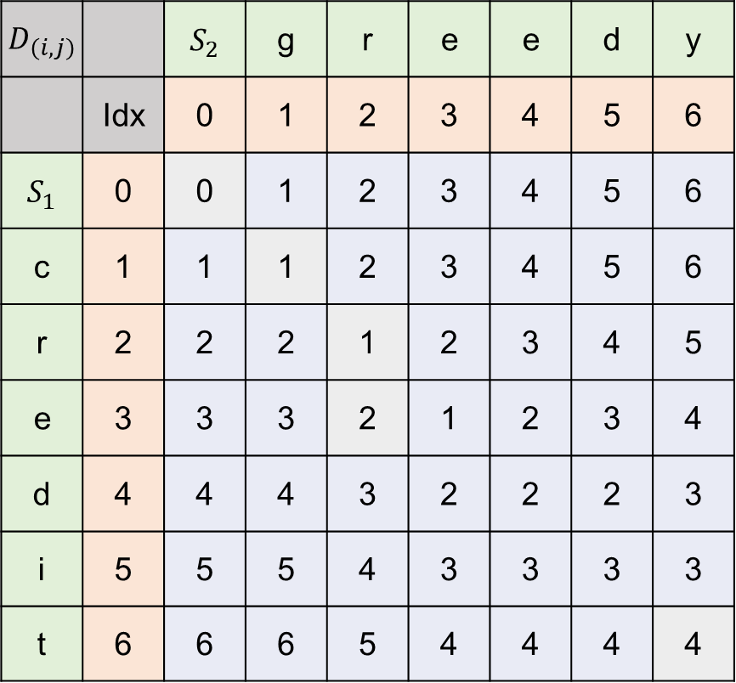
Dynamic Programming Approach : Traceback
$D_{\left(i,j\right)}$ |  | $S_{2}$ | g | r | e | e | d | y
 | Idx | 0 | 1 | 2 | 3 | 4 | 5 | 6
$S_{1}$ | 0 | 0 | 1 | 2 | 3 | 4 | 5 | 6
c | 1 | 1 | 1 | 2 | 3 | 4 | 5 | 6
r | 2 | 2 | 2 | 1 | 2 | 3 | 4 | 5
e | 3 | 3 | 3 | 2 | 1 | 2 | 3 | 4
d | 4 | 4 | 4 | 3 | 2 | 2 | 2 | 3
i | 5 | 5 | 5 | 4 | 3 | 3 | 3 | 3
t | 6 | 6 | 6 | 5 | 4 | 4 | 4 | 4
▶ Likewise, we fill the pointer
▶ With these pointers, we can find optimal alignments
: deletion
: insertion
: match or replace

Slide 49
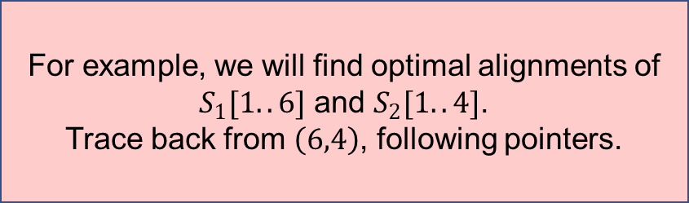
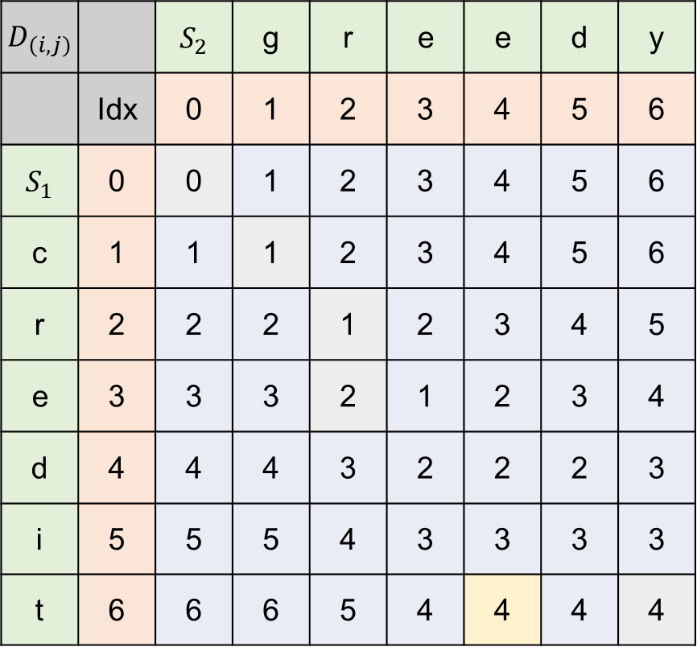
Dynamic Programming Approach : Traceback
$D_{\left(i,j\right)}$ |  | $S_{2}$ | g | r | e | e | d | y
 | Idx | 0 | 1 | 2 | 3 | 4 | 5 | 6
$S_{1}$ | 0 | 0 | 1 | 2 | 3 | 4 | 5 | 6
c | 1 | 1 | 1 | 2 | 3 | 4 | 5 | 6
r | 2 | 2 | 2 | 1 | 2 | 3 | 4 | 5
e | 3 | 3 | 3 | 2 | 1 | 2 | 3 | 4
d | 4 | 4 | 4 | 3 | 2 | 2 | 2 | 3
i | 5 | 5 | 5 | 4 | 3 | 3 | 3 | 3
t | 6 | 6 | 6 | 5 | 4 | 4 | 4 | 4
For example, we will find optimal alignments of
$S_{1}[1..6]$ and $S_{2}[1..4]$.
Trace back from $\left(6,4\right)$, following pointers.

Slide 50
Dynamic Programming Approach : Traceback
$D_{\left(i,j\right)}$ |  | $S_{2}$ | g | r | e | e | d | y
 | Idx | 0 | 1 | 2 | 3 | 4 | 5 | 6
$S_{1}$ | 0 | 0 | 1 | 2 | 3 | 4 | 5 | 6
c | 1 | 1 | 1 | 2 | 3 | 4 | 5 | 6
r | 2 | 2 | 2 | 1 | 2 | 3 | 4 | 5
e | 3 | 3 | 3 | 2 | 1 | 2 | 3 | 4
d | 4 | 4 | 4 | 3 | 2 | 2 | 2 | 3
i | 5 | 5 | 5 | 4 | 3 | 3 | 3 | 3
t | 6 | 6 | 6 | 5 | 4 | 4 | 4 | 4
For example, we will find optimal alignments of
$S_{1}[1..6]$ and $S_{2}[1..4]$.
Trace back from $\left(6,4\right)$, following pointers.
▶ The optimal alignments are
g | r | e | e | _ | _
c | r | e | d | i | t
and we can also find
optimal edit transcripts
since :
g | r | e | _ | e | _
c | r | e | d | i | t
: D
: I
: M or R
g | r | e | _ | _ | e
c | r | e | d | i | t

Slide 51

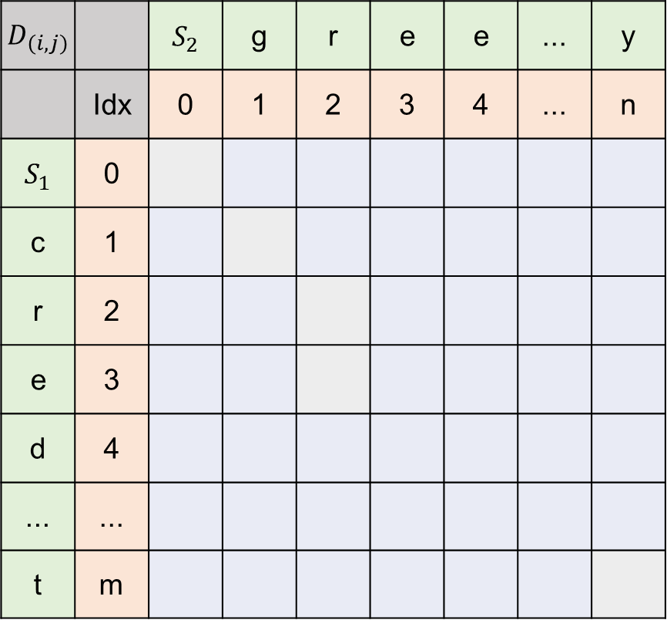
Dynamic Programming Approach : Traceback
$D_{\left(i,j\right)}$ |  | $S_{2}$ | g | r | e | e | ... | y
 | Idx | 0 | 1 | 2 | 3 | 4 | ... | n
$S_{1}$ | 0
c | 1
r | 2
e | 3
d | 4
... | ...
t | m
▶ The worst case in terms of time complexity is
move along the edges of the table,
that will have m+n number of tracking required
So, the optimal edit transcript can be found in
$$O(m+n)$$

Slide 52
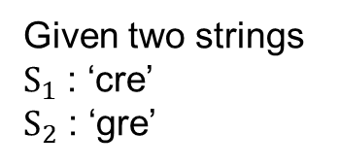
Edit Graphs
Given two strings
$S_{1}$ : ‘cre’
$S_{2}$ : ‘gre’
1 2 3
 |  | g | r | e
 | 0 | 1 | 2 | 3
c | 1 | 1 | 2 | 3
r | 2 | 2 | 1 | 2
e | 3 | 3 | 2 | 1
 |  | g | r | e
 | 〮 | 〮 | 〮 | 〮
c | 〮 | 〮 | 〮 | 〮
r | 〮 | 〮 | 〮 | 〮
e | 〮 | 〮 | 〮 | 〮
1
2
3
Dynamic programming table
Edit graph

Slide 53

Edit Graphs
1 2 3
 |  | g | r | e
 | 〮 | 〮 | 〮 | 〮
c | 〮 | 〮 | 〮 | 〮
r | 〮 | 〮 | 〮 | 〮
e | 〮 | 〮 | 〮 | 〮
Definition
Given two strings $S_{1}$ and $S_{2}$ of lengths $n, m$
a weighted graph has ($n+1)∗(m+1)$ nodes
each labeled with a distinct pair ($i, j$)
their edge weights depend on the
specific string problem
1
2
3
Edit graph

Slide 54

Edit Graphs
▶ So, we can translate finding optimal transcript
to shortest path problem in edit graph.
1 2 3
 |  | g | r | e
 | 〮 | 〮 | 〮 | 〮
c | 〮 | 〮 | 〮 | 〮
r | 〮 | 〮 | 〮 | 〮
e | 〮 | 〮 | 〮 | 〮
Theorem 11.4.1
An edit transcript for $S_{1}, S_{2}$ has the
minimum number of edit operations
if and only if corresponds to a shortest path
from (0,0) to (n,m) in the edit graph.
1
2
3
Edit graph

Slide 55

Weighted Edit Distance
▶ Set weights for each edit operations
$S_{1}$ : ‘variable’
$S_{2}$ : ‘aristotle’
v | a | r | i | _ | a | b | _ | l | e
_ | a | r | i | s | t | o | t | l | e

Slide 56

Weighted Edit Distance
▶ Set weights for each edit operations
$S_{1}$ : ‘variable’
$S_{2}$ : ‘aristotle’
v | a | r | i | _ | a | b | _ | l | e
_ | a | r | i | s | t | o | t | l | e
If we set mismatch weights r, match weights e, space weights d,
this alignment will have $2r+5e+3d$ as a weight

Slide 57



Weighted Edit Distance
$$D_{\left(i, 0\right)}=i∗d$$
$$D_{\left(0, j\right)}=j∗d$$
▶ Base condition
※ r for mismatch, e for match, d for space
$$D_{\left(i, j\right)}=min⁡[D_{\left(i, j−1\right)}+d,D_{\left(i−1, j\right)}+d,D_{\left(i,−1 j−1\right)}+t_{\left(i, j\right)}$$
▶ General recurrence
※ if $S_{1}\left(i\right)=S_{2}(i)$, $t_{\left(i, j\right)}=e$, otherwise r

Slide 58

Weighted Edit Distance
$$D_{\left(i, 0\right)}=i∗d$$
$$D_{\left(0, j\right)}=j∗d$$
▶ Base condition
If the last characters in an alignment match, $D_{\left(i, j\right)}=D_{\left(i,−1 j−1\right)}+e$
if mismatch, $D_{\left(i, j\right)}=D_{\left(i,−1 j−1\right)}+r$
$D_{\left(i, j−1\right)}+d,D_{\left(i−1, j\right)}+d$ corresponds for insertion and deletion, opposite space.
※ r for mismatch, e for match, d for space
$$D_{\left(i, j\right)}=min⁡[D_{\left(i, j−1\right)}+d,D_{\left(i−1, j\right)}+d,D_{\left(i,−1 j−1\right)}+t_{\left(i, j\right)}$$
▶ General recurrence
※ if $S_{1}\left(i\right)=S_{2}(i)$, $t_{\left(i, j\right)}=e$, otherwise r

Slide 59
Weighted Edit Distance : Alphabet Weight Edit Distance
▶ Alphabet weight edit distance is to put weight on
not the type of the edit operation, but focus on which character is inserted, deleted, or replaced.

Slide 60



String similarity
▶ To measure relevance of two strings
Definition
Let $∑$ be the alphabet used for strings $S_{1}$ and $S_{2}$,
and let $∑$’ be $∑$ + ‘_’ ( _ denotes space )
Then, for any two characters x, y in $∑$’,
$s\left(x,y\right)$ denotes the value obtained by
aligning character x against character y
$S_{1}$ | a | x
$S_{2}$ | b | y
$∑$ = {a, b, x, y}
$∑$’ = {a, b, x, y, _}

Slide 61



String similarity
$S_{1}$ | a | x
$S_{2}$ | b | y
▶ Given pairwise scoring matrix,
 | a | b | x | y | _
a | $$w_{(a,a)}$$ | $$w_{(a,b)}$$ | $$w_{(a,x)}$$ | $$w_{(a,y)}$$ | $$w_{(a,_)}$$
b |  | $$w_{(b,b)}$$ | $$w_{(b,x)}$$ | $$w_{(b,y)}$$ | $$w_{(b,_)}$$
x |  |  | $$w_{(x,x)}$$ | $$w_{(x,y)}$$ | $$w_{(x,_)}$$
y |  |  |  | $$w_{(y,y)}$$ | $$w_{(y,_)}$$
_ |  |  |  |  | $$w_{(_,_)}$$
$∑$ = {a, b, x, y}
$∑$’ = {a, b, x, y, _}
▶ This alignment will have a value of $w_{(a,b)}+w_{(x,y)}$
Usually, positive value for match, negative value for mismatch and space.

Slide 62



String similarity
Definition
$S_{1}$ : ‘aabbxxyy’
$S_{2}$ : ‘abbxyyy’
For a given alignment A of $S_{1}$ and $S_{2}$,
Let ${S′}_{1}$ and ${S′}_{2}$ denote the strings including spaces
and let $l$ denote the length of ${S′}_{1}$ and ${S′}_{2}$ in A,
the value of alignment A is defined as
$$\sum_{i=1}^{l}{s({S′}_{1}\left(i\right),{S′}_{2}\left(i\right))}$$
${S′}_{1}$ : ‘aabbxxyy’
${S′}_{2}$ : ‘a_bbxyyy’

Slide 63
String similarity
Definition
$S_{1}$ : ‘aabbxxyy’
$S_{2}$ : ‘abbxyyy’
For a given alignment A of $S_{1}$ and $S_{2}$,
Let ${S′}_{1}$ and ${S′}_{2}$ denote the strings including spaces
and let $l$ denote the length of ${S′}_{1}$ and ${S′}_{2}$ in A,
the value of alignment A is defined as
$$\sum_{i=1}^{l}{s({S′}_{1}\left(i\right),{S′}_{2}\left(i\right))}$$
${S′}_{1}$ : ‘aabbxxyy’
${S′}_{2}$ : ‘a_bbxyyy’
▶ Then the alignment in this page will have a value of $w_{(a,a)}+w_{(a,_)}+{2∗(w}_{(b,b)}+w_{(y,y)})+w_{(x,x)}+w_{(x,y)}$

Slide 64

String similarity
Definition
Given a pairwise scoring matrix over $∑$’,
the similarity of two strings $S_{1}, S_{2}$is
the value of the alignment A of $S_{1}$ and $S_{2}$,
that maximizes total alignment value.
※ It’s called optimal alignment value of $S_{1}$ and $S_{2}$

Slide 65



String similarity
$$V_{\left(0, j\right)}=\sum_{k=1}^{j}{s(_,S_{2}\left(k\right))}$$
$$V_{\left(i, 0\right)}=\sum_{k=1}^{i}{s(S_{1}\left(k\right),_)}$$
▶ Base condition
‘_’
$$V_{\left(0, j\right)}=\sum_{k=1}^{j}{s(_,S_{2}\left(k\right))}$$
$$V_{\left(i, 0\right)}=\sum_{k=1}^{i}{s(S_{1}\left(k\right),_)}$$
$S_{1}$ | ... | ... | $$S_{1}\left(i\right)$$ | ... | $$S_{1}\left(j\right)$$
$S_{2}$ | ... | ... | $$S_{2}\left(i\right)$$ | ... | $$S_{2}\left(j\right)$$
‘_’

Slide 66





String similarity
$$V(i,j)=max⁡[$$
$$V\left(i−1, j−1\right)+s\left(S_{1}\left(i\right),S_{2}\left(j\right)\right),$$
$V\left(i−1, j\right)+s\left(S_{1}\left(i\right), _\right)$,
$V\left(i, j−1\right)+s\left(_, S_{2}\left(j\right)\right)$]
▶ General Recurrence
▶ If $S_{1}\left(i\right)$ opposite $S_{2}\left(j\right)$, it means $i−1, j−1$was in previous step.
by definition, $V\left(i−1, j−1\right)$ is the maximum value by scoring matrix,
so we can add $s\left(S_{1}\left(i\right),S_{2}\left(j\right)\right)$ to $V\left(i−1, j−1\right)$.
$$V\left(i−1, j−1\right)$$
$S_{1}$ | ... | ... | ... | $$S_{1}\left(i−1\right)$$ | $$S_{1}\left(i\right)$$
$S_{2}$ | ... | $$S_{2}\left(j−1\right)$$ | ... | ... | $$S_{2}\left(j\right)$$
$$s\left(S_{1}\left(i\right),S_{2}\left(j\right)\right)$$

Slide 67




String similarity
$$V(i,j)=max⁡[$$
$$V\left(i−1, j−1\right)+s\left(S_{1}\left(i\right),S_{2}\left(j\right)\right),$$
$V\left(i−1, j\right)+s\left(S_{1}\left(i\right), _\right)$,
$V\left(i, j−1\right)+s\left(_, S_{2}\left(j\right)\right)$]
▶ General Recurrence
▶ If $S_{1}\left(i\right)$ opposite space, it means $i−1, j$was in previous step.
by definition, $V\left(i−1, j\right)$ is the maximum value by scoring matrix,
so we can add $s\left(S_{1}\left(i\right), _\right)$ to $V\left(i−1, j\right)$.
$$V\left(i−1, j\right)$$
$S_{1}$ | ... | ... | $$…$$ | ... | $$S_{1}\left(i\right)$$
$S_{2}$ | ... | $$…$$ | $$…$$ | $$S_{2}\left(j\right)$$ | _
$$s\left(S_{1}\left(i\right), _\right)$$

Slide 68




String similarity
$$V(i,j)=max⁡[$$
$$V\left(i−1, j−1\right)+s\left(S_{1}\left(i\right),S_{2}\left(j\right)\right),$$
$V\left(i−1, j\right)+s\left(S_{1}\left(i\right), _\right)$,
$V\left(i, j−1\right)+s\left(_, S_{2}\left(j\right)\right)$]
▶ General Recurrence
▶ If $S_{2}\left(j\right)$ opposite space, it means $i, j−1$was in previous step.
by definition, $V\left(i, j−1\right)$ is the maximum value by scoring matrix,
so we can add $s\left(_,S_{2}\left(j\right)\right)$ to $V\left(i, j−1\right)$.
$$V\left(i, j−1\right)$$
$S_{1}$ | ... | ... | $$…$$ | $$S_{1}\left(i\right)$$ | _
$S_{2}$ | ... | $$…$$ | $$…$$ | ... | $$S_{2}\left(j\right)$$
$$s\left(_,S_{2}\left(j\right)\right)$$

Slide 69


String similarity : Longest subsequence problem
Definition
In a string S, a subsequence is defined as
a subset of the characters of S
arranged in their original relative order.
▶ Given string S for its length n,
for some $k≤n$ and indices $i_{1},i_{2},i_{3} …i_{k}$ ($i_{1}<i_{2}<i_{3}<…<i_{k}$)
subsequence specified by this list of indices is
$$S\left(i_{1}\right)S\left(i_{2}\right)S\left(i_{3}\right)…S\left(i_{k}\right)$$

Slide 70
String similarity : Longest subsequence problem
Definition
In a string S, a subsequence is defined as
a subset of the characters of S
arranged in their original relative order.
S : ‘algorithm’
‘agtm’, ‘aorim’, ‘arm’ are subsequences
▶ Given string S for its length n,
for some $k≤n$ and indices $i_{1},i_{2},i_{3} …i_{k}$ ($i_{1}<i_{2}<i_{3}<…<i_{k}$)
subsequence specified by this list of indices is
$$S\left(i_{1}\right)S\left(i_{2}\right)S\left(i_{3}\right)…S\left(i_{k}\right)$$

Slide 71
String similarity : Longest subsequence problem
Definition
Given two strings, a common subsequence is a subsequence that appears in both of them.
The longest common subsequence problem is to find a longest common subsequence for two strings.

Slide 72
String similarity : Longest subsequence problem
Theorem 11.6.1
With a scoring scheme ( corresponds to what we called pairwise scoring matrix before ),
match for one score, mismatch or space for zero score
will lead to alignment that has a longest common subsequence
▶ This kind of scoring will make an alignment that has maximum number of matches,
regardless of the number of mismatch or space
This kind of property directly means longest common subsequence

Slide 73

String similarity : Longest subsequence problem
$D_{\left(i,j\right)}$ |  | $S_{2}$ | g | r | e | e | d | y
 | Idx | 0 | 1 | 2 | 3 | 4 | 5 | 6
$S_{1}$ | 0 | 0 | 0 | 0 | 0 | 0 | 0 | 0
c | 1 | 0
r | 2 | 0
e | 3 | 0
d | 4 | 0
i | 5 | 0
t | 6 | 0
▶ Time analysis for longest subsequence problem
In dynamic approach in longest subsequence problem,
We fill in the table,
which means the number of subsequence

Slide 74


String similarity : Longest subsequence problem
$D_{\left(i,j\right)}$ |  | $S_{2}$ | g | r | e | e | d | y
 | Idx | 0 | 1 | 2 | 3 | 4 | 5 | 6
$S_{1}$ | 0 | 0 | 0 | 0 | 0 | 0 | 0 | 0
c | 1 | 0 | 0 | 0 | 0 | 0 | 0 | 0
r | 2 | 0 | 0 | 1 | 1 | 1 | 1 | 1
e | 3 | 0 | 0 | 1 | 2 | 2 | 2 | 2
d | 4 | 0 | 0 | 1 | 2 | 2
i | 5 | 0
t | 6 | 0
▶ Time analysis for longest subsequence problem
In dynamic approach in longest subsequence problem,
We fill in the table,
which means the number of subsequence
Example of filling the table
if not match,
choose the maximum value around the cell $(i,j)$
for $S_{1}\left(4\right)=$ ‘d’, and $S_{2}\left(5\right)=$ ‘d’ encountered

Slide 75


String similarity : Longest subsequence problem
$D_{\left(i,j\right)}$ |  | $S_{2}$ | g | r | e | e | d | y
 | Idx | 0 | 1 | 2 | 3 | 4 | 5 | 6
$S_{1}$ | 0 | 0 | 0 | 0 | 0 | 0 | 0 | 0
c | 1 | 0 | 0 | 0 | 0 | 0 | 0 | 0
r | 2 | 0 | 0 | 1 | 1 | 1 | 1 | 1
e | 3 | 0 | 0 | 1 | 2 | 2 | 2 | 2
d | 4 | 0 | 0 | 1 | 2 | 2 | 3
i | 5 | 0
t | 6 | 0
▶ Time analysis for longest subsequence problem
In dynamic approach in longest subsequence problem,
We fill in the table,
which means the number of subsequence
Example of filling the table, i=4 j=5
for $S_{1}\left(i\right)=$ ‘d’, and $S_{2}\left(j\right)=$ ‘d’ encountered
$$V\left(i,j\right)=V\left(i−1,j−1\right)+1$$

Slide 76


String similarity : Longest subsequence problem
$D_{\left(i,j\right)}$ |  | $S_{2}$ | g | r | e | e | d | y
 | Idx | 0 | 1 | 2 | 3 | 4 | 5 | 6
$S_{1}$ | 0 | 0 | 0 | 0 | 0 | 0 | 0 | 0
c | 1 | 0 | 0 | 0 | 0 | 0 | 0 | 0
r | 2 | 0 | 0 | 1 | 1 | 1 | 1 | 1
e | 3 | 0 | 0 | 1 | 2 | 2 | 2 | 2
d | 4 | 0 | 0 | 1 | 2 | 2 | 3 | 3
i | 5 | 0 | 0 | 1 | 2 | 2 | 3 | 3
t | 6 | 0 | 0 | 1 | 2 | 2 | 3 | 3
▶ Time analysis for longest subsequence problem
In dynamic approach in longest subsequence problem,
We fill in the table,
which means the number of subsequence
Filling the table, we have m*n cells
with a constant number of
comparisons and arithmetic operations,
Time complexity obtained is
$$O(nm)$$

Slide 77

String similarity : Alignment Graphs for Similarity
▶ Alignment graph is same as what we did in edit graph,
where the weights of each nodes are
up to the specific pair of characters
( or character against space )
1 2 3
 |  | g | r | e
 | 〮 | 〮 | 〮 | 〮
c | 〮 | 〮 | 〮 | 〮
r | 〮 | 〮 | 〮 | 〮
e | 〮 | 〮 | 〮 | 〮
1
Our goal is to find path to (n,m) with maximum score,
there are $3∗\left(n−1\right)∗\left(m−1\right)+(n+m)$ nodes
$3nm−2n−2m+3$ nodes, which is $O(nm)$
2
3

Slide 78
End-space Free Variant
▶ To set a weight of every spaces at the end, or the beginning to zero
_ | _ | c | a | c | _ | d | b | d | b
l | t | c | a | b | b | d | b | a | _
weight = 0

Slide 79
End-space Free Variant
▶ Usually, mismatch or space corresponds to contribution of negative value,
but end-space free alignment is free of having space at the edge of a string.
_ | _ | _ | a | c | _ | d | b | d | b
l | t | c | a | b | b | d | b | a | a
weight = 0
※ Note that, usually, positive value for match,
negative value for mismatch and space.
▶ As a result, this kind of alignment encourages with one string suffix to other,

Slide 80
End-space Free Variant
▶ Usually, mismatch or space corresponds to contribution of negative value,
but end-space free alignment is free of having space at the edge of a string.
b | a | a | a | c | _ | _ | _ | _ | _
l | t | c | a | b | b | d | b | a | a
weight = 0
※ Note that, usually, positive value for match,
negative value for mismatch and space.
▶ As a result, this kind of alignment encourages with one string suffix to other,
or prefix to other,

Slide 81
End-space Free Variant
▶ Usually, mismatch or space corresponds to contribution of negative value,
but end-space free alignment is free of having space at the edge of a string.
_ | _ | _ | a | c | _ | _ | _ | _ | _
l | t | c | a | b | b | d | b | a | a
weight = 0
※ Note that, usually, positive value for match,
negative value for mismatch and space.
▶ As a result, this kind of alignment encourages with one string suffix to other,
or prefix to other,
or interior to other.

Slide 82


End-space Free Variant
▶ Computing similarity for free end-space alignments
$$V_{\left(0, j\right)}=0$$
$$V_{\left(i, 0\right)}=0$$
▶ Base condition
$$V(i,j)=max⁡[$$
$$V\left(i−1, j−1\right)+s\left(S_{1}\left(i\right),S_{2}\left(j\right)\right),$$
$V\left(i−1, j\right)+s\left(S_{1}\left(i\right), _\right)$,
$V\left(i, j−1\right)+s\left(_, S_{2}\left(j\right)\right)$]
▶ General Recurrence
Same method to computing the value of optimal alignment,
differs in base condition to make free of the spaces at the beginning or end.

Slide 83

Approximate occurrences of P in T
Definition
Given a parameter $δ$,
a substring T’ of T is said to be an approximate occurrence of P
if and only if the optimal alignment of P to T’ has value at least $δ$.

Slide 84
Approximate occurrences of P in T
Definition
Given a parameter $δ$,
a substring T’ of T is said to be an approximate occurrence of P
if and only if the optimal alignment of P to T’ has value at least $δ$.
T = ‘algorithmisveryfunny’
T’ | m | i | s | v | e | r | y | f | u | n
P | m | i | s | s | _ | _ | y | o | u | _
T’ is a substring of T
P = ‘missyou’

Slide 85

Approximate occurrences of P in T
Definition
Given a parameter $δ$,
a substring T’ of T is said to be an approximate occurrence of P
if and only if the optimal alignment of P to T’ has value at least $δ$.
T = ‘algorithmisveryfunny’
T’ | m | i | s | v | e | r | y | f | u | n
P | m | i | s | s | _ | _ | y | o | u | _
T’ is a substring of T
P = ‘missyou’
in this condition,
if $V({T^{′}}_{end}, P_{end})$ $≥$ $δ$,
T’ is an approximate occurrence of P

Slide 86

Approximate occurrences of P in T
Theorem 11.6.2
There is an approximate occurrence of P in T,
ending at position j of T if and only if $V(n, j)$ $≥$ $δ.$
Moreover, $T[k..j]$ is an approximate occurrence of P in T,
if and only if $V\left(n, j\right)$ $≥$ $δ.$
and there is a path of backpointers from cell ($n, j)$ to ($0, k)$.

Slide 87


Approximate occurrences of P in T
Theorem 11.6.2
There is an approximate occurrence of P in T,
ending at position j of T if and only if $V(n, j)$ $≥$ $δ.$
Moreover, $T[k..j]$ is an approximate occurrence of P in T,
if and only if $V\left(n, j\right)$ $≥$ $δ.$
and there is a path of backpointers from cell ($n, j)$ to ($0, k)$.
T = ‘algorithmisveryfunny’, P = ‘missyou’
T’ | a | l | g | o | ... | r | y | f | u | n
P | _ | _ | _ | _ | ... | _ | y | o | u | _
$j=18$
if $V(j, P_{end})$ $≥$ $δ$,
T’ is an approximate occurrence of P
and there is an opproximate occurrence of P in T

Slide 88


Approximate occurrences of P in T
Theorem 11.6.2
There is an approximate occurrence of P in T,
ending at position j of T if and only if $V(n, j)$ $≥$ $δ.$
Moreover, $T[k..j]$ is an approximate occurrence of P in T,
if and only if $V\left(n, j\right)$ $≥$ $δ.$
and there is a path of backpointers from cell ($n, j)$ to ($0, k)$.
T = ‘algorithmisveryfunny’, P = ‘missyou’
T’ | m | i | s | v | e | r | y | f | u | n
P | m | i | s | s | _ | _ | y | o | u | _
$k=9, j=18$
if $V(n,j)$ $≥$ $δ$,
$T[k..j]$ is an approximate occurrence of P
▶ We have discussed it in definition

Slide 89
Approximate occurrences of P in T
Theorem 11.6.2
There is an approximate occurrence of P in T,
ending at position j of T if and only if $V(n, j)$ $≥$ $δ.$
Moreover, $T[k..j]$ is an approximate occurrence of P in T,
if and only if $V\left(n, j\right)$ $≥$ $δ.$
and there is a path of backpointers from cell ($n, j)$ to ($0, k)$.
following literally, we can trace back through the part of table, made with T and P
With two strings T’ and P,
We can make table we discussed in Dynamic Programming Approach
T’ | m | i | s | v | e | r | y | f | u | n
P | m | i | s | s | _ | _ | y | o | u | _

Slide 90




Approximate occurrences of P in T
▶ Backpointers?
Draw the table, measuring string similarity
$D_{\left(i,j\right)}$ |  | P | m | ... | ... | ... | ... | u
 | Idx | i | 1 | ... | ... | ... | ... | 7
T | j
a | 1
... | ...
m | 9 |  | $$W_{9,1}$$ | $$W_{9,2}$$ | $$W_{9,3}$$ | ... | ... | $$W_{9,7}$$
... | ... |  | ... | ... | ... | ... | ... | ...
n | 18 |  | $$W_{18,1}$$ | ... | ... | ... | ... | $$W_{18,7}$$
... | ...
T = ‘algorithmisveryfunny’,
T’ = ‘misveryfun’
P = ‘missyou’
$k=9, j=18$
▶ This table will be filled in $O(nm)$ time,
we have discussed it.
However, finding out every Approximate
occurrence of P in T might have
more time complexity.
$$…$$

Slide 91

Approximate occurrences of P in T
▶ Backpointers?
Draw the table, measuring string similarity
$D_{\left(i,j\right)}$ |  | P | m | ... | ... | ... | ... | u
 | Idx | i | 1 | ... | ... | ... | ... | 7
T | j
a | 1
... | ...
m | 9 |  | $$W_{9,1}$$ | $$W_{9,2}$$ | $$W_{9,3}$$ | ... | ... | $$W_{9,7}$$
... | ... |  | ... | ... | ... | ... | ... | ...
n | 18 |  | $$W_{18,1}$$ | ... | ... | ... | ... | $$W_{18,7}$$
... | ...
T = ‘algorithmisveryfunny’,
T’ = ‘misveryfun’
P = ‘missyou’
$k=9, j=18$
if path from (n, j) to (0, k) found out,
return T’ and move j.
▶ As a compromise of time complexity,
for every position j,
find the shortest approximate occurrence of P
that ends with position j in T.
$$…$$

Slide 92
Local Alignment
▶ We discussed about some global alignment problems.
Now, let’s move on to Local Alignment.

Slide 93


Local Alignment
▶ Given two strings, there might be some regions having high similarity.
$S_{1}$ = ‘security’
$S_{2}$ = ‘chickencurry’
$S_{1}$ | _ | _ | s | e | c | u | r | i | t | y
$S_{2}$ | c | h | ... | ... | c | u | r | r | _ | y

Slide 94

Local Alignment
▶ Given two strings, there might be some regions having high similarity.
$S_{1}$ = ‘security’
$S_{2}$ = ‘chickencurry’
$S_{1}$ | _ | _ | s | e | c | u | r | i | t | y
$S_{2}$ | c | h | ... | ... | c | u | r | r | _ | y
finding out pair of regions
that contains high similarity
▶ This is called local alignment problem

Slide 95





Local Alignment
Definition
Given two strings $S_{1}$ and $S_{2}$,
find substrings $α∈S_{1}, β∈S_{2}$
whose similarity is maximum over all pairs of substrings from $S_{1}$ and $S_{2}$
$$v^{∗}=V(α,β)$$
$S_{1}$ = ‘security’
$S_{2}$ = ‘chickencurry’
$α$ = ‘cur’
$β$ = ‘cur’
$$v^{∗}=V(α_{3}, β_{3})$$
$S_{1}$ | _ | _ | s | e | c | u | r | i | t | y
$S_{2}$ | c | h | ... | ... | c | u | r | r | _ | y

Slide 96



Local Alignment
▶ According to scoring scheme, $α, β$ will be defined differently.
so, local alignment problem is to find $α, β$ that corresponds to the special objective we intend.
$S_{1}$ = ‘security’
$S_{2}$ = ‘chickencurry’
$S_{1}$ | _ | s | e | _ | c | u | r | i | t | y
$S_{2}$ | c | ... | e | n | c | u | r | r | _ | y
We can extract different $α, β$,
according to different scoring scheme.

Slide 97

Local Alignment
▶ Given n, m that corresponds to the length of $S_{1}$ and $S_{2}$,
there are $_{n}C_{2}$ numbers of $α$ candidates
there are $_{m}C_{2}$ numbers of $β$ candidates
so, there are $\frac{n(n−1)}{2}$ $α$ candidates, $\frac{m(m−1)}{2}$ $β$ candidates
so, there are $θ(n^{2}m^{2})$ pairs of substrings

Slide 98


Local Alignment
▶ There are $θ(n^{2}m^{2})$ pairs of substrings
▶ For p, q each corresponds to the length of two substrings from $S_{1}, S_{2}$,
computing similarity of p and q takes $O(pq)$ time ( we have seen before )
So, computing similarity for every pair of substrings is
$$O(n^{3}m^{3})$$

Slide 99
Local Alignment
▶ There are $θ(n^{2}m^{2})$ pairs of substrings
▶ For p, q each corresponds to the length of two substrings from $S_{1}, S_{2}$,
computing similarity of p and q takes $O(pq)$ time ( we have seen before )
So, computing similarity for every pair of substrings is
$$O(n^{3}m^{3})$$
Too much time complexity . . .

Slide 100

Local Alignment
▶ Algorithms that solves local alignment problem in a less time than $O(n^{3}m^{3})$
Definition
Given a pair of indices $i≤n$ and $j≤m$.
the local suffix problem is to find a (possibly empty) suffix $α,β$ of $S_{1}\left[1..i\right], S_{2}[i..j]$
that $V\left(α, β\right)$ is the maximum over all pairs of suffixes of $S_{1}\left[1..i\right], S_{2}[i..j]$
$$v=V(α, β)$$
▶ We will assume that for given $S_{1}=^{′′},S_{2}=^{′′}.$ (both are empty string)
$V\left(S_{1},S_{2}\right)=0$

Slide 101





Local Alignment
Definition
Given a pair of indices $i≤n$ and $j≤m$.
the local suffix problem is to find a (possibly empty) suffix $α,β$ of $S_{1}\left[1..i\right], S_{2}[1..j]$
that $V\left(α, β\right)$ is the maximum over all pairs of suffixes of $S_{1}\left[1..i\right], S_{2}[i..j]$
$$v=V(α, β)$$
$S_{1}$ = ‘channel’
$S_{2}$ = ‘marching’
$i$ = 2
$j$ = 5
$S_{1}[1..i]$, $S_{2}[1..j]$
are the prefixes of $S_{1}$ and $S_{2}$
$S_{1}$ | _ | _ | _ | c | h | a | n | n | e | l
$S_{2}$ | m | a | r | c | h | i | n | g | _ | _

Slide 102


Local Alignment
Definition
Given a pair of indices $i≤n$ and $j≤m$.
the local suffix problem is to find a (possibly empty) suffix $α,β$ of $S_{1}\left[1..i\right], S_{2}[1..j]$
that $V\left(α, β\right)$ is the maximum over all pairs of suffixes of $S_{1}\left[1..i\right], S_{2}[i..j]$
$$v=V(α, β)$$
$S_{1}$ = ‘channel’
$S_{2}$ = ‘marching’
$i$ = 2
$j$ = 5
$S_{1}[1..i]$, $S_{2}[1..j]$
are the prefixes of $S_{1}$ and $S_{2}$
$S_{1}$ | _ | _ | _ | c | h | a | n | n | e | l
$S_{2}$ | m | a | r | c | h | i | n | g | _ | _
$$α=S_{1}\left[1..i\right]$$
$$β=S_{2}[4..j]$$
are the suffixes of
$S_{1}[1..i]$ and $S_{2}[1..j]$
▶ Local suffix problem is to find $α, β$ within all pairs of substring of $S_{1}, S_{2}$
for every index $i$ and $j$

Slide 103



Local Alignment
Definition
Given a pair of indices $i≤n$ and $j≤m$.
the local suffix problem is to find a (possibly empty) suffix $α,β$ of $S_{1}\left[1..i\right], S_{2}[1..j]$
that $V\left(α, β\right)$ is the maximum over all pairs of suffixes of $S_{1}\left[1..i\right], S_{2}[i..j]$
$$v=V(α, β)$$
$S_{1}$ = ‘channel’
$S_{2}$ = ‘marching’
$i$ = 1
$j$ = 2
$S_{1}[1..i]$, $S_{2}[1..j]$
are the prefixes of $S_{1}$ and $S_{2}$
$S_{1}$ | _ | _ | _ | c | h | a | n | n | e | l
$S_{2}$ | m | a | r | c | h | i | n | g | _ | _
$α=$ empty string
$β=$ empty string
$$v=V\left(α, β\right)≥0$$
▶ $α$ and $β$ could be an empty string, and we set its value 0
so, $v=V\left(α,β\right)≥0$

Slide 104



Local Alignment
Theorem 11.7.1
$$v^{∗}=\max\left[v\left(i,j\right):i≤n, j≤m\right].$$
$v^{∗}$ was the value for two substrings from $S_{1}, S_{2}$ respectively,
that had maximum value over all other pair of substrings
$v\left(i,j\right)$ was the value for two suffixes from $S_{1\left[1..i\right]}, S_{2\left[1..j\right]}$ respectively,
that had maximum value over all other pair of suffixes
▶ $v^{∗}≥max⁡[v\left(i,j\right):i≤n, j≤m]$
because solutions derived from local suffix problem can be derived from local alignment problem.

Slide 105





Local Alignment
Theorem 11.7.1
$$v^{∗}=\max\left[v\left(i,j\right):i≤n, j≤m\right].$$
$S_{1}$ = ‘gilgamesh’
$S_{2}$ = ‘progamer’
$α$ = ‘game’
$β$ = ‘game’
$S_{1}$ | g | i | l | g | a | m | e | s | h
$S_{2}$ | p | r | o | g | a | m | e | r
$v^{∗}$ is the value between
‘game’ from $S_{1}$ and ‘game’ from $S_{2}$
In a perspective of local alignment problem,
we derived $α$ and $β$ for optimal local alignment

Slide 106




Local Alignment
Theorem 11.7.1
$$v^{∗}=\max\left[v\left(i,j\right):i≤n, j≤m\right].$$
$S_{1}$ = ‘gilgamesh’
$S_{2}$ = ‘progamer’
$$i=7$$
$$j=7$$
$S_{1}$ | g | i | l | g | a | m | e | s | h
$S_{2}$ | p | r | o | g | a | m | e | r
$v(7, 7)$ is the value between
‘game’ from $S_{1}$ and ‘game’ from $S_{2}$
and it is same as $v^{∗}$
In a perspective of local suffix problem,
we found some suffix of $S_{1}\left[1..7\right],S_{2}[1..7]$

Slide 107


Local Alignment
Theorem 11.7.1
$$v^{∗}=\max\left[v\left(i,j\right):i≤n, j≤m\right].$$
$S_{1}$ = ‘gilgamesh’
$S_{2}$ = ‘progamer’
$$i=7$$
$$j=7$$
$S_{1}$ | g | i | l | g | a | m | e | s | h
$S_{2}$ | p | r | o | g | a | m | e | r
So, it means that
for $α, β$ that represents the optimal local alignment,
they can be derived from the local suffix problem
when we set $i,j$ to the end position of $α, β$.

Slide 108


Local Alignment
Theorem 11.7.2
if $i^{′},j′$ is an index pair, maximizing $v(i,j)$ over all $i, j$ pairs,
$$v^{∗}=v(i′,j′)$$
$v^{∗}$ was the value for two substrings from $S_{1}, S_{2}$ respectively,
that had maximum value over all other pair of substrings
$v\left(i,j\right)$ was the value for two suffixes from $S_{1\left[1..i\right]}, S_{2\left[1..j\right]}$ respectively,
that had maximum value over all other pair of suffixes

Slide 109



Local Alignment
▶ Then, how to solve the local suffix alignment problem ?
First, we assume $v\left(i, 0\right)=0$, $v\left(0, j\right)=0$
※ This is because our chosen suffix is possibly empty
Theorem 11.7.3
For $i>0, j>0$, the recurrence relation for $v(i,j)$ is
$$v\left(i,j\right)=max⁡[0, v\left(i−1,j−1\right)+s\left(S_{1}\left(i\right),S_{2}\left(j\right)\right),$$
$$v\left(i−1,j\right)+s\left(S_{1}\left(i\right),_\right), v\left(i,j−1\right)+s(_,S_{2}\left(j\right))]$$
Add the similarity value with previous step
if the result of adding value for this step is negative,
we will choose 0 for $v(i,j)$

Slide 110
Local Alignment
▶ Then, how to solve the local suffix alignment problem ?
First, we assume $v\left(i, 0\right)=0$, $v\left(0, j\right)=0$
※ This is because our chosen suffix is possibly empty
Theorem 11.7.3
For $i>0, j>0$, the recurrence relation for $v(i,j)$ is
$$v\left(i,j\right)=max⁡[0, v\left(i−1,j−1\right)+s\left(S_{1}\left(i\right),S_{2}\left(j\right)\right),$$
$$v\left(i−1,j\right)+s\left(S_{1}\left(i\right),_\right), v\left(i,j−1\right)+s(_,S_{2}\left(j\right))]$$
▶ When we choose empty string for suffixes, value will be 0

Slide 111



Local Alignment
▶ Then, how to solve the local suffix alignment problem ?
First, we assume $v\left(i, 0\right)=0$, $v\left(0, j\right)=0$
※ This is because our chosen suffix is possibly empty
Theorem 11.7.3
For $i>0, j>0$, the recurrence relation for $v(i,j)$ is
$$v\left(i,j\right)=max⁡[0, v\left(i−1,j−1\right)+s\left(S_{1}\left(i\right),S_{2}\left(j\right)\right),$$
$$v\left(i−1,j\right)+s\left(S_{1}\left(i\right),_\right), v\left(i,j−1\right)+s(_,S_{2}\left(j\right))]$$
▶ if $S_{1}(i)$ opposite $S_{2}(j)$
$$v\left(i−1, j−1\right)$$
$S_{1}$ | ... | ... | ... | $$S_{1}\left(i−1\right)$$ | $$S_{1}\left(i\right)$$
$S_{2}$ | ... | $$S_{2}\left(j−1\right)$$ | ... | ... | $$S_{2}\left(j\right)$$
$$s\left(S_{1}\left(i\right),S_{2}\left(j\right)\right)$$

Slide 112



Local Alignment
▶ Then, how to solve the local suffix alignment problem ?
First, we assume $v\left(i, 0\right)=0$, $v\left(0, j\right)=0$
※ This is because our chosen suffix is possibly empty
Theorem 11.7.3
For $i>0, j>0$, the recurrence relation for $v(i,j)$ is
$$v\left(i,j\right)=max⁡[0, v\left(i−1,j−1\right)+s\left(S_{1}\left(i\right),S_{2}\left(j\right)\right),$$
$$v\left(i−1,j\right)+s\left(S_{1}\left(i\right),_\right), v\left(i,j−1\right)+s(_,S_{2}\left(j\right))]$$
▶ if $S_{1}(i)$ opposite space
$$v\left(i−1, j\right)$$
$S_{1}$ | ... | ... | $$…$$ | ... | $$S_{1}\left(i\right)$$
$S_{2}$ | ... | $$…$$ | $$…$$ | $$S_{2}\left(j\right)$$ | _
$$s\left(S_{1}\left(i\right), _\right)$$

Slide 113



Local Alignment
▶ Then, how to solve the local suffix alignment problem ?
First, we assume $v\left(i, 0\right)=0$, $v\left(0, j\right)=0$
※ This is because our chosen suffix is possibly empty
Theorem 11.7.3
For $i>0, j>0$, the recurrence relation for $v(i,j)$ is
$$v\left(i,j\right)=max⁡[0, v\left(i−1,j−1\right)+s\left(S_{1}\left(i\right),S_{2}\left(j\right)\right),$$
$$v\left(i−1,j\right)+s\left(S_{1}\left(i\right),_\right), v\left(i,j−1\right)+s(_,S_{2}\left(j\right))]$$
▶ if $S_{2}(j)$ opposite space
$$V\left(i, j−1\right)$$
$S_{1}$ | ... | ... | $$…$$ | $$S_{1}\left(i\right)$$ | _
$S_{2}$ | ... | $$…$$ | $$…$$ | ... | $$S_{2}\left(j\right)$$
$$s\left(_,S_{2}\left(j\right)\right)$$

Slide 114

Local Alignment
▶ Then, how to solve the local suffix alignment problem ?
First, we assume $v\left(i, 0\right)=0$, $v\left(0, j\right)=0$
※ This is because our chosen suffix is possibly empty
Theorem 11.7.3
For $i>0, j>0$, the recurrence relation for $v(i,j)$ is
$$v\left(i,j\right)=max⁡[0, v\left(i−1,j−1\right)+s\left(S_{1}\left(i\right),S_{2}\left(j\right)\right),$$
$$v\left(i−1,j\right)+s\left(S_{1}\left(i\right),_\right), v\left(i,j−1\right)+s(_,S_{2}\left(j\right))]$$
We can make table of $(i,j)$, which contains $v(i,j)$
and we can find the maximum value in table,
that will be $v^{∗}$, and $i^{′}, j′$ is also found.

Slide 115



Local Alignment
Theorem 11.7.3
For $i>0, j>0$, the recurrence relation for $v(i,j)$ is
$$v\left(i,j\right)=max⁡[0, v\left(i−1,j−1\right)+s\left(S_{1}\left(i\right),S_{2}\left(j\right)\right),$$
$$v\left(i−1,j\right)+s\left(S_{1}\left(i\right),_\right), v\left(i,j−1\right)+s(_,S_{2}\left(j\right))]$$
$S_{1}$: ‘tree’
$S_{2}$: ‘bee’
<scoring scheme>
match : 3
mismatch : -2
space : -1
$v(i,j)$ | $S_{2}$ | b | e | e
$S_{1}$ | 0 | 0 | 0 | 0
t | 0
r | 0
e | 0
e | 0

Slide 116


Local Alignment
Theorem 11.7.3
For $i>0, j>0$, the recurrence relation for $v(i,j)$ is
$$v\left(i,j\right)=max⁡[0, v\left(i−1,j−1\right)+s\left(S_{1}\left(i\right),S_{2}\left(j\right)\right),$$
$$v\left(i−1,j\right)+s\left(S_{1}\left(i\right),_\right), v\left(i,j−1\right)+s(_,S_{2}\left(j\right))]$$
$S_{1}$: ‘tree’
$S_{2}$: ‘bee’
<scoring scheme>
match : 3
mismatch : -2
space : -1
$v(i,j)$ | $S_{2}$ | b | e | e
$S_{1}$ | 0 | 0 | 0 | 0
t | 0 | 0
r | 0
e | 0
e | 0
‘b’ and ‘t’ mismatch
$$s\left(S_{1}\left(1\right),S_{2}\left(1\right)\right)=−3$$
0 is maximum
for these four candidates

Slide 117


Local Alignment
Theorem 11.7.3
For $i>0, j>0$, the recurrence relation for $v(i,j)$ is
$$v\left(i,j\right)=max⁡[0, v\left(i−1,j−1\right)+s\left(S_{1}\left(i\right),S_{2}\left(j\right)\right),$$
$$v\left(i−1,j\right)+s\left(S_{1}\left(i\right),_\right), v\left(i,j−1\right)+s(_,S_{2}\left(j\right))]$$
$S_{1}$: ‘tree’
$S_{2}$: ‘bee’
<scoring scheme>
match : 3
mismatch : -2
space : -1
$v(i,j)$ | $S_{2}$ | b | e | e
$S_{1}$ | 0 | 0 | 0 | 0
t | 0 | 0 | 0 | 0
r | 0 | 0 | 0 | 0
e | 0 | 0 | 3
e | 0
‘tre’ and ‘e’ in ‘be’, ‘e’ match
$v(3,2)$ is maximum value of
0,
$v\left(2,1\right)+3=3$,
$v\left(2,2\right)−1=−1$,
$$v\left(3,1\right)−1=−1$$

Slide 118


Local Alignment
Theorem 11.7.3
For $i>0, j>0$, the recurrence relation for $v(i,j)$ is
$$v\left(i,j\right)=max⁡[0, v\left(i−1,j−1\right)+s\left(S_{1}\left(i\right),S_{2}\left(j\right)\right),$$
$$v\left(i−1,j\right)+s\left(S_{1}\left(i\right),_\right), v\left(i,j−1\right)+s(_,S_{2}\left(j\right))]$$
$S_{1}$: ‘tree’
$S_{2}$: ‘bee’
<scoring scheme>
match : 3
mismatch : -2
space : -1
$v(i,j)$ | $S_{2}$ | b | e | e
$S_{1}$ | 0 | 0 | 0 | 0
t | 0 | 0 | 0 | 0
r | 0 | 0 | 0 | 0
e | 0 | 0 | 3 | 3
e | 0
‘tre’ and ‘e’ in ‘bee’, ‘e’ match
$v(3,3)$ is maximum value of
0,
$v\left(2,2\right)+3=3$,
$v\left(2,3\right)−1=−1$,
$$v\left(3,2\right)−1=2$$

Slide 119


Local Alignment
Theorem 11.7.3
For $i>0, j>0$, the recurrence relation for $v(i,j)$ is
$$v\left(i,j\right)=max⁡[0, v\left(i−1,j−1\right)+s\left(S_{1}\left(i\right),S_{2}\left(j\right)\right),$$
$$v\left(i−1,j\right)+s\left(S_{1}\left(i\right),_\right), v\left(i,j−1\right)+s(_,S_{2}\left(j\right))]$$
$S_{1}$: ‘tree’
$S_{2}$: ‘bee’
<scoring scheme>
match : 3
mismatch : -2
space : -1
$v(i,j)$ | $S_{2}$ | b | e | e
$S_{1}$ | 0 | 0 | 0 | 0
t | 0 | 0 | 0 | 0
r | 0 | 0 | 0 | 0
e | 0 | 0 | 3 | 3
e | 0 | 0 | 3 | 6
‘tree’ and ‘e’ in ‘bee’, ‘e’ match
$v(4,3)$ is maximum value of
0,
$v\left(3,2\right)+3=6$,
$v\left(3,3\right)−1=2$,
$$v\left(4,2\right)−1=2$$

Slide 120




Local Alignment
Theorem 11.7.3
For $i>0, j>0$, the recurrence relation for $v(i,j)$ is
$$v\left(i,j\right)=max⁡[0, v\left(i−1,j−1\right)+s\left(S_{1}\left(i\right),S_{2}\left(j\right)\right),$$
$$v\left(i−1,j\right)+s\left(S_{1}\left(i\right),_\right), v\left(i,j−1\right)+s(_,S_{2}\left(j\right))]$$
$S_{1}$: ‘tree’
$S_{2}$: ‘bee’
<scoring scheme>
match : 3
mismatch : -2
space : -1
$v(i,j)$ | $S_{2}$ | b | e | e
$S_{1}$ | 0 | 0 | 0 | 0
t | 0 | 0 | 0 | 0
r | 0 | 0 | 0 | 0
e | 0 | 0 | 3 | 3
e | 0 | 0 | 3 | 6
6 is the maximum value in this table,
find $i^{′}=4,j^{′}=3$ with traceback
$α=$‘ee’
$β=$ ‘ee’
$$v^{∗}=6$$
$S_{1}$ | t | r | e | e
$S_{2}$ | _ | b | e | e
▶ This is the
optimal local alignment of $S_{1}, S_{2}$

Slide 121

Local Alignment
Theorem 11.7.3
For $i>0, j>0$, the recurrence relation for $v(i,j)$ is
$$v\left(i,j\right)=max⁡[0, v\left(i−1,j−1\right)+s\left(S_{1}\left(i\right),S_{2}\left(j\right)\right),$$
$$v\left(i−1,j\right)+s\left(S_{1}\left(i\right),_\right), v\left(i,j−1\right)+s(_,S_{2}\left(j\right))]$$
$S_{1}$: ‘tree’
$S_{2}$: ‘bee’
<scoring scheme>
match : 3
mismatch : -2
space : -1
$v(i,j)$ | $S_{2}$ | b | e | e
$S_{1}$ | 0 | 0 | 0 | 0
t | 0 | 0 | 0 | 0
r | 0 | 0 | 0 | 0
e | 0 | 0 | 3 | 3
e | 0 | 0 | 3 | 6
6 is the maximum value in this table,
find $i^{′}=4,j^{′}=3$ with traceback
$α=$‘ee’
$β=$ ‘ee’
$$v^{∗}=6$$
This is the same method we used in global alignment
which can be solved in $O(nm)$
$S_{1}$ | t | r | e | e
$S_{2}$ | _ | b | e | e
▶ This is the
optimal local alignment of $S_{1}, S_{2}$

Slide 122
Local Alignment
▶ So, with various scoring schemes,
we can make some optimal local alignments, that represents some features we intended.

Slide 123
Gaps
▶ Until now, we measured the value of match, mismatch, or space
( whether they are alphabet weighted or not )
▶ Gap is an important feature, that helps to find out some meaningful alignments

Slide 124

Gaps
Definition
A gap is any maximal, consecutive run of spaces
in a single string of a given alignment.
$S_{1}$ : interview
_ | _ | _ | i | n | _ | t | _ | _ | _ | e | r | v | _ | i | e | _ | _ | w | _
These are gaps!
▶ This alignment has 5 gaps, and 11 spaces

Slide 125



Gaps
▶ Computing the similarity value including Gaps
Given two strings $S_{1}$ and $S_{2}$,
$S_{1}^{′}$ and $S_{2}^{′}$ for the alignment of $S_{1}$ and $S_{2}$ each
$$s\left(x,_\right)=s\left(_, y\right)=0$$
$W_{g}$ for the value of a gap
The similarity value that containing $k$ gaps is
$$\sum_{i=1}^{l}{s\left(S_{1}^{′}\left(i\right),S_{2}^{′}\left(j\right)\right)−kW_{g}}$$

Slide 126



Gaps
▶ Computing the similarity value including Gaps
$S_{1}$ : ‘ring’
$S_{2}$ : ‘round’
Given two strings $S_{1}$ and $S_{2}$,
$S_{1}^{′}$ and $S_{2}^{′}$ for the alignment of $S_{1}$ and $S_{2}$ each
$S_{1}^{′}$ | r | i | _ | n | _ | g
$S_{2}^{′}$ | r | o | u | n | d | _
$$s\left(x,_\right)=s\left(_, y\right)=0$$
$W_{g}$ for the value of a gap
The similarity value that containing $k$ gaps is
$$\sum_{i=1}^{l}{s\left(S_{1}^{′}\left(i\right),S_{2}^{′}\left(j\right)\right)−kW_{g}}$$
$$V=s\left(S_{1}^{′}\left(1\right),S_{2}^{′}\left(1\right)\right)+s\left(S_{1}^{′}\left(2\right),S_{2}^{′}\left(2\right)\right)$$
$$+s\left(S_{1}^{′}\left(4\right),S_{2}^{′}\left(4\right)\right)−3∗W_{g}$$

Slide 127
Gaps
▶ Computing the similarity value including Gaps
$S_{1}$ : ‘ring’
$S_{2}$ : ‘round’
Given two strings $S_{1}$ and $S_{2}$,
$S_{1}^{′}$ and $S_{2}^{′}$ for the alignment of $S_{1}$ and $S_{2}$ each
$S_{1}^{′}$ | r | i | _ | n | _ | g
$S_{2}^{′}$ | r | o | u | n | d | _
$$s\left(x,_\right)=s\left(_, y\right)=0$$
$W_{g}$ for the value of a gap
The similarity value that containing $k$ gaps is
$$\sum_{i=1}^{l}{s\left(S_{1}^{′}\left(i\right),S_{2}^{′}\left(j\right)\right)−kW_{g}}$$
$$V=s\left(S_{1}^{′}\left(1\right),S_{2}^{′}\left(1\right)\right)+s\left(S_{1}^{′}\left(2\right),S_{2}^{′}\left(2\right)\right)$$
$$+s\left(S_{1}^{′}\left(4\right),S_{2}^{′}\left(4\right)\right)−3∗W_{g}$$
This is called Constant gap weights !

Slide 128
Gaps
▶ Constant gap weights
▶ Affine gap weights
▶ Convex gap weights
▶ Arbitrary gap weights

Slide 129






Gaps
▶ Constant gap weights what we have seen in previous example, more formally
$$s\left(x,_\right)=s\left(_, y\right)=0$$
$S_{1}^{′}$ | r | i | _ | n | _ | g
$S_{2}^{′}$ | r | o | u | n | d | _
$W_{g}$ for the value of a gap
$W_{m}$ for the value of match
$W_{ms}$ for the value of mismatch
$$V=2∗W_{m}−W_{ms}−3∗W_{g}$$
$g$ for the number of gaps
$m$ for the number of matches
$ms$ for the number of mismatches
Operator-weighted problem is to
find an alignment that maximizes
$$m∗W_{m}−ms∗W_{ms}−g∗W_{g}$$
▶ Every gaps have constant value!

Slide 130





Gaps
▶ Affine gap weights : Gap weight are different, according to its length
q=3
q=1
$W_{g}$ for the value of a gap
$W_{s}$ for the value of a space
$W_{m}$ for the value of match
$W_{ms}$ for the value of mismatch
$S_{1}^{′}$ | s | y | s | t | e | _ | m
$S_{2}^{′}$ | _ | _ | _ | t | e | a | m
$$V=3∗W_{m}−2∗W_{g}−4∗W_{s}$$
For any gaps, weight is measured as
$$W_{g}+qW_{s}$$
This kind of problem is represented as
$$m∗W_{m}−ms∗W_{ms}−g∗W_{g}−s∗W_{s}$$
※ q is the number of spaces gap contains

Slide 131



Gaps
▶ Convex gap weights : Gap weight are different, according to its length, but in not affine function
q=3
q=1
$W_{g}$ for the value of a gap
$W_{m}$ for the value of match
$W_{ms}$ for the value of mismatch
$S_{1}^{′}$ | s | y | s | t | e | _ | m
$S_{2}^{′}$ | _ | _ | _ | t | e | a | m
$$V=3∗W_{m}−2∗W_{g}−\ln{3}−\ln{1}$$
For example,
gap weight can be measured as
$$W_{g}+ln⁡q$$
※ q is the number of spaces gap contains

Slide 132
Gaps
▶ Arbitrary gap weights : Gap weight are different, according to some recurrence relation,
that seeks every combination of alignments in dynamic programming table.

Slide 133









Gaps
▶ Arbitrary gap weights : Gap weight are different, according to some recurrence relation,
that seeks every combination of alignments in dynamic programming table.
▶ case E :
▶ case F :
▶ case G :
$i$ for length of $S_{1}$
$j$ for length of $S_{2}$
gap in the end of $S_{1}$
gap length = $(j−i)$
$S_{1}$
$S_{2}$
$S_{1}$
$S_{2}$
gap in the end of $S_{2}$
gap length = $(i−j)$
$S_{1}$
$S_{2}$
no gaps in the end
▶ Similar method to what we have discussed before
recurrence relation is the maximum value of these cases

Slide 134


Gaps
▶ Arbitrary gap weights : Gap weight are different, according to some recurrence relation,
that seeks every combination of alignments in dynamic programming table.
▶ case E :
▶ case F :
▶ case G :
$i$ for length of $S_{1}$
$j$ for length of $S_{2}$
gap in the end of $S_{1}$
gap length = $(j−i)$
for case E,
$E(i,j)$ as the maximum value
of any alignment
$F\left(i,j\right), G(i,g)$ for
case F, G respectively.
$S_{1}$
$S_{2}$
$S_{1}$
$S_{2}$
gap in the end of $S_{2}$
gap length = $(i−j)$
$$V\left(i,j\right)=$$
$$max⁡[E\left(i,j\right), F\left(i,j\right),G\left(i,j\right)]$$
$S_{1}$
$S_{2}$
no gaps in the end
▶ Similar method to what we have discussed before
recurrence relation is the maximum value of these cases

Slide 135






Gaps
$$E\left(i,j\right)=\max_{0≤k≤j−1}⁡(V\left(i,k\right)−w(j−k))$$
for case E,
$E(i,j)$ as the maximum value
of any alignment
$F\left(i,j\right), G(i,g)$ for
case F, G respectively.
$$F\left(i,j\right)=\max_{0≤k≤i−1}⁡(V\left(k,j\right)−w(i−k))$$
$$V\left(i,j\right)=$$
$$max⁡[E\left(i,j\right), F\left(i,j\right),G\left(i,j\right)]$$
$$G\left(i,j\right)=V\left(i−1,j−1\right)+s(S_{1}\left(i\right),S_{2}\left(j\right))$$

Slide 136

Gaps
$$V\left(i,0\right)=−w\left(i\right)$$
$$V\left(0,j\right)=−w\left(j\right)$$
$$E\left(i,0\right)=−w\left(i\right)$$
$$F\left(0,j\right)=−w\left(j\right)$$
▶ Base condition
$$E\left(i,j\right)=\max_{0≤k≤j−1}⁡(V\left(i,k\right)−w(j−k))$$
for case E,
$E(i,j)$ as the maximum value
of any alignment
$F\left(i,j\right), G(i,g)$ for
case F, G respectively.
$$F\left(i,j\right)=\max_{0≤k≤i−1}⁡(V\left(k,j\right)−w(i−k))$$
$$V\left(i,j\right)=$$
$$max⁡[E\left(i,j\right), F\left(i,j\right),G\left(i,j\right)]$$
$$G\left(i,j\right)=V\left(i−1,j−1\right)+s(S_{1}\left(i\right),S_{2}\left(j\right))$$
▶ Let’s see the example!

Slide 137


Gaps
$$V\left(i,0\right)=−w\left(i\right)$$
$$V\left(0,j\right)=−w\left(j\right)$$
$$E\left(i,0\right)=−w\left(i\right)$$
$$F\left(0,j\right)=−w\left(j\right)$$
 |  | c | a | b | c | b | a
 | 0 | -6 | 12 | -18 | 24 | -30 | 36
c | -6
a | 12
c | -18
b | 24
b | -30
▶ Base condition
$$Σ^{′}=\{a,b,c,_\}$$
Scoring Scheme
 | a | b | c | _
a | 2 | -3 | -2 | 0
b |  | 4 | -4 | 0
c |  |  | 3 | 0
_ |  |  |  | 0
※ $w\left(i\right)=6i∗{\left(−1\right)}^{i}$

Slide 138


Gaps
$$E\left(i,j\right)=\max_{0≤k≤j−1}⁡(V\left(i,k\right)−w(j−k))$$
$$F\left(i,j\right)=\max_{0≤k≤i−1}⁡(V\left(k,j\right)−w(i−k))$$
$$G\left(i,j\right)=V\left(i−1,j−1\right)+s\left(S_{1}\left(i\right),S_{2}\left(j\right)\right)$$
$$V\left(i,j\right)=max⁡(E\left(i,j\right),F\left(i,j\right),G\left(i,j\right))$$
 |  | c | a | b | c | b | a
 | 0 | -6 | 12 | -18 | 24 | -30 | 36
c | -6 | 3
a | 12
c | -18
b | 24
b | -30
Scoring Scheme
 | a | b | c | _
a | 2 | -3 | -2 | 0
b |  | 4 | -4 | 0
c |  |  | 3 | 0
_ |  |  |  | 0
$G\left(1,2\right)=V\left(0,1\right)+s(S_{1}\left(1\right),S_{2}\left(2\right))$
= $−6−2=8$
※ $w\left(i\right)=6i∗{\left(−1\right)}^{i}$

Slide 139



Gaps
$$E\left(i,j\right)=\max_{0≤k≤j−1}⁡(V\left(i,k\right)−w(j−k))$$
$$F\left(i,j\right)=\max_{0≤k≤i−1}⁡(V\left(k,j\right)−w(i−k))$$
$$G\left(1,2\right)=8$$
$$V\left(i,j\right)=max⁡(E\left(i,j\right),F\left(i,j\right),G\left(i,j\right))$$
 |  | c | a | b | c | b | a
 | 0 | -6 | 12 | -18 | 24 | -30 | 36
c | -6 | 3
a | 12
c | -18
b | 24
b | -30
$$E\left(1,2\right)=max⁡[$$
$$V\left(1,0\right)−w\left(2−0\right),$$
$$V\left(1,1\right)−w(2−1)]$$
$$V\left(1,0\right)−w\left(2−0\right)$$
$$=−6−12=−18$$
$$V\left(1,1\right)−w\left(2−1\right)$$
$$=3−\left(−6\right)=9$$
※ $w\left(i\right)=6i∗{\left(−1\right)}^{i}$

Slide 140

Gaps
$$E\left(i,j\right)=\max_{0≤k≤j−1}⁡(V\left(i,k\right)−w(j−k))$$
$$F\left(i,j\right)=\max_{0≤k≤i−1}⁡(V\left(k,j\right)−w(i−k))$$
$$G\left(1,2\right)=8$$
$$V\left(i,j\right)=max⁡(E\left(i,j\right),F\left(i,j\right),G\left(i,j\right))$$
 |  | c | a | b | c | b | a
 | 0 | -6 | 12 | -18 | 24 | -30 | 36
c | -6 | 3
a | 12
c | -18
b | 24
b | -30
$$E\left(1,2\right)=max⁡[$$
$$V\left(1,0\right)−w\left(2−0\right),$$
$$V\left(1,1\right)−w(2−1)]$$
$$V\left(1,0\right)−w\left(2−0\right)$$
$$=−6−12=−18$$
$$V\left(1,1\right)−w\left(2−1\right)$$
$$=3−\left(−6\right)=9$$
$$E\left(1,2\right)=9$$
※ $w\left(i\right)=6i∗{\left(−1\right)}^{i}$

Slide 141



Gaps
$$E\left(1,2\right)=9$$
$$F\left(i,j\right)=\max_{0≤k≤i−1}⁡(V\left(k,j\right)−w(i−k))$$
$$G\left(1,2\right)=8$$
$$V\left(i,j\right)=max⁡(E\left(i,j\right),F\left(i,j\right),G\left(i,j\right))$$
 |  | c | a | b | c | b | a
 | 0 | -6 | 12 | -18 | 24 | -30 | 36
c | -6 | 3
a | 12
c | -18
b | 24
b | -30
$$F\left(1,2\right)=V\left(0,2\right)−w\left(1−0\right)$$
$$V\left(0,2\right)−w\left(1−0\right)$$
$$=12−\left(−6\right)=18$$
※ $w\left(i\right)=6i∗{\left(−1\right)}^{i}$

Slide 142

Gaps
$$E\left(1,2\right)=9$$
$$F\left(i,j\right)=\max_{0≤k≤i−1}⁡(V\left(k,j\right)−w(i−k))$$
$$G\left(1,2\right)=8$$
$$V\left(i,j\right)=max⁡(E\left(i,j\right),F\left(i,j\right),G\left(i,j\right))$$
 |  | c | a | b | c | b | a
 | 0 | -6 | 12 | -18 | 24 | -30 | 36
c | -6 | 3
a | 12
c | -18
b | 24
b | -30
$$F\left(1,2\right)=V\left(0,2\right)−w\left(1−0\right)$$
$$V\left(0,2\right)−w\left(1−0\right)$$
$$=12−\left(−6\right)=18$$
$$F\left(1,2\right)=18$$
※ $w\left(i\right)=6i∗{\left(−1\right)}^{i}$

Slide 143


Gaps
$$E\left(1,2\right)=9$$
$$F\left(1,2\right)=18$$
$$G\left(1,2\right)=8$$
$$V\left(i,j\right)=max⁡(E\left(i,j\right),F\left(i,j\right),G\left(i,j\right))$$
 |  | c | a | b | c | b | a
 | 0 | -6 | 12 | -18 | 24 | -30 | 36
c | -6 | 3 | 18
a | 12
c | -18
b | 24
b | -30
Scoring Scheme
 | a | b | c | _
a | 2 | -3 | -2 | 0
b |  | 4 | -4 | 0
c |  |  | 3 | 0
_ |  |  |  | 0
$$V\left(1,2\right)=F\left(1,2\right)=18$$
※ $w\left(i\right)=6i∗{\left(−1\right)}^{i}$

Slide 144


Gaps
$$E\left(i,j\right)=\max_{0≤k≤j−1}⁡(V\left(i,k\right)−w(j−k))$$
$$F\left(i,j\right)=\max_{0≤k≤i−1}⁡(V\left(k,j\right)−w(i−k))$$
$$G\left(i,j\right)=V\left(i−1,j−1\right)+s\left(S_{1}\left(i\right),S_{2}\left(j\right)\right)$$
$$V\left(i,j\right)=max⁡(E\left(i,j\right),F\left(i,j\right),G\left(i,j\right))$$
 |  | c | a | b | c | b | a
 | 0 | -6 | 12 | -18 | 24 | -30 | 36
c | -6 | 3 | 18 | 24 | 30 | 36 | 42
a | 12 | 18
c | -18
b | 24
b | -30
Scoring Scheme
 | a | b | c | _
a | 2 | -3 | -2 | 0
b |  | 4 | -4 | 0
c |  |  | 3 | 0
_ |  |  |  | 0
$S_{1}$ | ... | $$S_{1}(2)$$
$S_{2}$ | ... | $$S_{2}(2)$$
$$G\left(2,2\right)=V\left(1,1\right)+s\left(S_{1}\left(2\right),S_{2}\left(2\right)\right)$$
$$=3+2=5$$
※ $w\left(i\right)=6i∗{\left(−1\right)}^{i}$

Slide 145



Gaps
$$E\left(i,j\right)=\max_{0≤k≤j−1}⁡(V\left(i,k\right)−w(j−k))$$
$$F\left(i,j\right)=\max_{0≤k≤i−1}⁡(V\left(k,j\right)−w(i−k))$$
$$G\left(2,2\right)=5$$
$$V\left(i,j\right)=max⁡(E\left(i,j\right),F\left(i,j\right),G\left(i,j\right))$$
 |  | c | a | b | c | b | a
 | 0 | -6 | 12 | -18 | 24 | -30 | 36
c | -6 | 3 | 18 | 24 | 30 | 36 | 42
a | 12 | 18
c | -18
b | 24
b | -30
$$E\left(2,2\right)=max⁡[$$
$$V\left(2,0\right)−w\left(2−0\right),$$
$$V\left(2,1\right)−w(2−1)]$$
$$V\left(2,0\right)−w\left(2−0\right)$$
$$=12−12=0$$
$$V\left(2,1\right)−w\left(2−1\right)$$
$$=18−\left(−6\right)=24$$
※ $w\left(i\right)=6i∗{\left(−1\right)}^{i}$

Slide 146


Gaps
$$E\left(i,j\right)=\max_{0≤k≤j−1}⁡(V\left(i,k\right)−w(j−k))$$
$$F\left(i,j\right)=\max_{0≤k≤i−1}⁡(V\left(k,j\right)−w(i−k))$$
$$G\left(2,2\right)=5$$
$$V\left(i,j\right)=max⁡(E\left(i,j\right),F\left(i,j\right),G\left(i,j\right))$$
 |  | c | a | b | c | b | a
 | 0 | -6 | 12 | -18 | 24 | -30 | 36
c | -6 | 3 | 18 | 24 | 30 | 36 | 42
a | 12 | 18
c | -18
b | 24
b | -30
$$E\left(2,2\right)=max⁡[$$
$$V\left(2,0\right)−w\left(2−0\right),$$
$$V\left(2,1\right)−w(2−1)]$$
$S_{1}$ | ... | $S_{1}(2)$ | ... | $$_$$
$S_{2}$ | ... | ... | ... | $$S_{2}(2)$$
$$V\left(2,0\right)−w\left(2−0\right)$$
$$=12−12=0$$
$$V\left(2,1\right)−w\left(2−1\right)$$
$$=18−\left(−6\right)=24$$
$$E\left(2,2\right)=24$$
※ $w\left(i\right)=6i∗{\left(−1\right)}^{i}$

Slide 147



Gaps
$$E\left(2,2\right)=24$$
$$F\left(i,j\right)=\max_{0≤k≤i−1}⁡(V\left(k,j\right)−w(i−k))$$
$$G\left(2,2\right)=5$$
$$V\left(i,j\right)=max⁡(E\left(i,j\right),F\left(i,j\right),G\left(i,j\right))$$
 |  | c | a | b | c | b | a
 | 0 | -6 | 12 | -18 | 24 | -30 | 36
c | -6 | 3 | 18 | 24 | 30 | 36 | 42
a | 12 | 18
c | -18
b | 24
b | -30
$$F\left(2,2\right)=max⁡[$$
$$V\left(0,2\right)−w\left(2−0\right),$$
$$V\left(1,2\right)−w(2−1)]$$
$$V\left(0,2\right)−w\left(2−0\right)$$
$$=12−12=0$$
$$V\left(1,2\right)−w\left(2−1\right)$$
$$=18−\left(−6\right)=24$$
※ $w\left(i\right)=6i∗{\left(−1\right)}^{i}$

Slide 148


Gaps
$$E\left(2,2\right)=24$$
$$F\left(i,j\right)=\max_{0≤k≤i−1}⁡(V\left(k,j\right)−w(i−k))$$
$$G\left(2,2\right)=5$$
$$V\left(i,j\right)=max⁡(E\left(i,j\right),F\left(i,j\right),G\left(i,j\right))$$
 |  | c | a | b | c | b | a
 | 0 | -6 | 12 | -18 | 24 | -30 | 36
c | -6 | 3 | 18 | 24 | 30 | 36 | 42
a | 12 | 18
c | -18
b | 24
b | -30
$$F\left(2,2\right)=max⁡[$$
$$V\left(0,2\right)−w\left(2−0\right),$$
$$V\left(1,2\right)−w(2−1)]$$
$S_{1}$ | ... | ... | ... | $S_{1}(2)$
$S_{2}$ | ... | $S_{2}(2)$ | ... | $_$
$$V\left(0,2\right)−w\left(2−0\right)$$
$$=12−12=0$$
$$V\left(1,2\right)−w\left(2−1\right)$$
$$=18−\left(−6\right)=24$$
$$F\left(2,2\right)=24$$
※ $w\left(i\right)=6i∗{\left(−1\right)}^{i}$

Slide 149


Gaps
$$E\left(2,2\right)=24$$
$$F\left(2,2\right)=24$$
$$G\left(2,2\right)=5$$
$$V\left(i,j\right)=max⁡(E\left(i,j\right),F\left(i,j\right),G\left(i,j\right))$$
 |  | c | a | b | c | b | a
 | 0 | -6 | 12 | -18 | 24 | -30 | 36
c | -6 | 3 | 18 | 24 | 30 | 36 | 42
a | 12 | 18 | 24
c | -18
b | 24
b | -30
▶ Then, fill the table in a same method !
$$V\left(2,2\right)=24$$
※ $w\left(i\right)=6i∗{\left(−1\right)}^{i}$

Slide 150

Gaps
Theorem 11.8.1
Assuming that $\left|S_{1}\right|=n , \left|S_{2}\right|=m,$
the recurrences can be evaluated in $O(nm^{2}+n^{2}m)$ time.

Slide 151


Gaps
Theorem 11.8.1
Assuming that $\left|S_{1}\right|=n , \left|S_{2}\right|=m,$
the recurrences can be evaluated in $O(nm^{2}+n^{2}m)$ time.
▶ Arbitrary gap weights : there are $\left(n+1\right)∗\left(m+1\right)$ cells in a table.
Filling the cell $(i,j)$,
To evaluate $G\left(i,j\right)$,
we have to examine one cell, $(i−1,j−1)$
for every cell in table, time for computing $G(i,j)$ is
$$O(nm)$$
$$G\left(i,j\right)=V\left(i−1,j−1\right)+s(S_{1}\left(i\right),S_{2}\left(j\right))$$

Slide 152


Gaps
Theorem 11.8.1
Assuming that $\left|S_{1}\right|=n , \left|S_{2}\right|=m,$
the recurrences can be evaluated in $O(nm^{2}+n^{2}m)$ time.
▶ Arbitrary gap weights : there are $\left(n+1\right)∗\left(m+1\right)$ cells in a table.
Filling the cell $(i,j)$,
To evaluate $E\left(i,j\right)$,
we have to examine $\sum_{k=0}^{m}{1}$ cells for every row.
for every column in table, time for computing $E(i,j)$ is
$$n∗\sum_{k=0}^{m}{1}=\frac{nm\left(m+1\right)}{2}=O(nm^{2})$$
$E\left(i,j\right)=\max_{0≤k≤j−1}⁡(V\left(i,k\right)−w(j−k))$

Slide 153


Gaps
Theorem 11.8.1
Assuming that $\left|S_{1}\right|=n , \left|S_{2}\right|=m,$
the recurrences can be evaluated in $O(nm^{2}+n^{2}m)$ time.
▶ Arbitrary gap weights : there are $\left(n+1\right)∗\left(m+1\right)$ cells in a table.
Filling the cell $(i,j)$,
To evaluate $F\left(i,j\right)$,
we have to examine $\sum_{k=0}^{n}{1}$ cells for every column.
for every row in table, time for computing $F(i,j)$ is
$$m∗\sum_{k=0}^{n}{1}=\frac{mn\left(n+1\right)}{2}=O(n^{2}m)$$
$F\left(i,j\right)=\max_{0≤k≤i−1}⁡(V\left(k,j\right)−w(i−k))$

Slide 154

Gaps
Theorem 11.8.1
Assuming that $\left|S_{1}\right|=n , \left|S_{2}\right|=m,$
the recurrences can be evaluated in $O(nm^{2}+n^{2}m)$ time.
▶ Arbitrary gap weights : there are $\left(n+1\right)∗\left(m+1\right)$ cells in a table.
Filling the cell $(i,j)$,
$O(nm)$ for computing $G(i,j)$
$O(nm^{2})$ for computing $E(i,j)$
$O(n^{2}m)$ for computing $F(i,j)$
so, time complexity for computing these three values is
$$O(nm^{2}+n^{2}m)$$

Slide 155
Gaps
▶ Return to affine gap weights : Gap weight are different, according to its length
from now on, we will define affine gap weights through the recurrence relation.

Slide 156



Gaps
▶ Return to affine gap weights : Gap weight are different, according to its length
from now on, we will define affine gap weights through the recurrence relation.
q=3
q=1
For any gaps, weight is measured as
$$W_{g}+qW_{s}$$
$S_{1}^{′}$ | s | y | s | t | e | _ | m
$S_{2}^{′}$ | _ | _ | _ | t | e | a | m
※ q is the number of spaces gap contains
$$V=3∗W_{m}−2∗W_{g}−4∗W_{s}$$

Slide 157

Gaps
▶ Return to affine gap weights : Gap weight are different, according to its length
from now on, we will define affine gap weights through the recurrence relation.
▶ Base condition
$$V\left(i,0\right)=−W_{g}−iW_{s}$$
$$V\left(0,j\right)=−W_{g}−jW_{s}$$
$$E\left(i,0\right)=−W_{g}−iW_{s}$$
$$F\left(0,j\right)=−W_{g}−jW_{s}$$

Slide 158





Gaps
▶ Return to affine gap weights : Gap weight are different, according to its length
from now on, we will define affine gap weights through the recurrence relation.
▶ Recurrence relation
$$V\left(i,j\right)=max⁡[E\left(i,j\right),F\left(i,j\right),G\left(i,j\right)]$$
$$E\left(i,j\right)=\max\left[E\left(i,j−1\right),V\left(i,j−1\right)−W_{g}\right]−Ws$$
$$F\left(i,j\right)=\max\left[F\left(i−1,j\right),V\left(i−1,j\right)−W_{g}\right]−Ws$$
$$G\left(i,j\right)=V\left(i−1,j−1\right)+W_{t}$$
※ $W_{t}=W_{m} if S_{1}\left(i\right)=S_{2}(j)$
$W_{t}=W_{ms} if S_{1}\left(i\right)≠S_{2}(j)$

Slide 159





Gaps
$$E\left(i,j\right)=\max\left[E\left(i,j−1\right),V\left(i,j−1\right)−W_{g}\right]−Ws$$
 |  | c | a | b | c | b | a
 | 0 | -4 | -5 | -6 | -7 | -8 | -9
c | -4
a | -5
c | -6
b | -7
b | -8
$$F\left(i,j\right)=\max\left[F\left(i−1,j\right),V\left(i−1,j\right)−W_{g}\right]−Ws$$
$$G\left(i,j\right)=V\left(i−1,j−1\right)+W_{t}$$
$$V\left(i,0\right)=−W_{g}−iW_{s}$$
$$V\left(0,j\right)=−W_{g}−jW_{s}$$
$$E\left(i,0\right)=−W_{g}−iW_{s}$$
$$F\left(0,j\right)=−W_{g}−jW_{s}$$
※ $W_{g}=3$
$W_{s}=1$

Slide 160

Gaps
$$E\left(i,j\right)=\max\left[E\left(i,j−1\right),V\left(i,j−1\right)−W_{g}\right]−Ws$$
 |  | c | a | b | c | b | a
 | 0 | -4 | -5 | -6 | -7 | -8 | -9
c | -4
a | -5
c | -6
b | -7
b | -8
$$F\left(i,j\right)=\max\left[F\left(i−1,j\right),V\left(i−1,j\right)−W_{g}\right]−Ws$$
 |  | c | a | b | c | b | a
 | 0 | -4 | -5 | -6 | -7 | -8 | -9
c | -4
a | -5
c | -6
b | -7
b | -8
 |  | c | a | b | c | b | a
 | 0 | -4 | -5 | -6 | -7 | -8 | -9
c | -4
a | -5
c | -6
b | -7
b | -8
$$G\left(i,j\right)=V\left(i−1,j−1\right)+W_{t}$$
▶ We have to compare previous $E$ and $F$,
calculating $E(i,j)$ and $F(i,j)$.
▶ So, we will have additional table for $E, F$
※ $W_{g}=3$
$W_{s}=1$

Slide 161
Gaps
$$E\left(i,j\right)=\max\left[E\left(i,j−1\right),V\left(i,j−1\right)−W_{g}\right]−Ws$$
 |  | c | a | b | c | b | a
 | 0 | -4 | -5 | -6 | -7 | -8 | -9
c | -4
a | -5
c | -6
b | -7
b | -8
$$F\left(i,j\right)=\max\left[F\left(i−1,j\right),V\left(i−1,j\right)−W_{g}\right]−Ws$$
 |  | c | a | b | c | b | a
 | 0 | -4 | -5 | -6 | -7 | -8 | -9
c | -4
a | -5
c | -6
b | -7
b | -8
 |  | c | a | b | c | b | a
 | 0 | -4 | -5 | -6 | -7 | -8 | -9
c | -4 | ... | ... | ... | ... | ... | ...
a | -5 | ... | ... | ... | ... | ... | ...
c | -6 | ... | ... | ... | ... | ... | ...
b | -7 | ... | ... | ... | ... | ... | ...
b | -8 | ... | ... | ... | ... | ... | ...
$$G\left(i,j\right)=V\left(i−1,j−1\right)+W_{t}$$
▶ Using the same method, fill the table !
※ $W_{g}=3$
$W_{s}=1$

Slide 162

Gaps
$$E\left(i,j\right)=\max\left[E\left(i,j−1\right),V\left(i,j−1\right)−W_{g}\right]−Ws$$
 |  | c | a | b | c | b | a
 | 0 | -4 | -5 | -6 | -7 | -8 | -9
c | -4
a | -5
c | -6
b | -7
b | -8
$$F\left(i,j\right)=\max\left[F\left(i−1,j\right),V\left(i−1,j\right)−W_{g}\right]−Ws$$
 |  | c | a | b | c | b | a
 | 0 | -4 | -5 | -6 | -7 | -8 | -9
c | -4
a | -5
c | -6
b | -7
b | -8
 |  | c | a | b | c | b | a
 | 0 | -4 | -5 | -6 | -7 | -8 | -9
c | -4 | ... | ... | ... | ... | ... | ...
a | -5 | ... | ... | ... | ... | ... | ...
c | -6 | ... | ... | ... | ... | ... | ...
b | -7 | ... | ... | ... | ... | ... | ...
b | -8 | ... | ... | ... | ... | ... | ...
$$G\left(i,j\right)=V\left(i−1,j−1\right)+W_{t}$$
▶ We have $(n+1)(m+1)$ cells for each table,
filling up the table
we have to calculate $E\left(i,j\right),F\left(i,j\right),G(i,j)$,
that takes constant time.
※ $W_{g}=3$
$W_{s}=1$

Slide 163

Gaps
$$E\left(i,j\right)=\max\left[E\left(i,j−1\right),V\left(i,j−1\right)−W_{g}\right]−Ws$$
 |  | c | a | b | c | b | a
 | 0 | -4 | -5 | -6 | -7 | -8 | -9
c | -4
a | -5
c | -6
b | -7
b | -8
$$F\left(i,j\right)=\max\left[F\left(i−1,j\right),V\left(i−1,j\right)−W_{g}\right]−Ws$$
 |  | c | a | b | c | b | a
 | 0 | -4 | -5 | -6 | -7 | -8 | -9
c | -4
a | -5
c | -6
b | -7
b | -8
 |  | c | a | b | c | b | a
 | 0 | -4 | -5 | -6 | -7 | -8 | -9
c | -4 | ... | ... | ... | ... | ... | ...
a | -5 | ... | ... | ... | ... | ... | ...
c | -6 | ... | ... | ... | ... | ... | ...
b | -7 | ... | ... | ... | ... | ... | ...
b | -8 | ... | ... | ... | ... | ... | ...
$$G\left(i,j\right)=V\left(i−1,j−1\right)+W_{t}$$
▶ We have $(n+1)(m+1)$ cells for each table,
filling up the table
we have to calculate $E\left(i,j\right),F\left(i,j\right),G(i,j)$,
that takes constant time.
Theorem 11.8.1
The optimal alignment with affine gap weights
can be computed in $O(nm)$ time, the same time
as for optimal alignment without a gap term.
※ $W_{g}=3$
$W_{s}=1$

