Slide 1
5.25 졸업프로젝트 발표
Transformer
컴퓨터소프트웨어학부 심승현

Slide 2
Contents
https://www.tensorflow.org/text/tutorials/transformer
Tensorflow.org, transformer tutorial
translating Portuguese to English using transformer model

Slide 3
Overview
▶ Translate Portuguese to English using transformer model
▶ We will see implementation of transformer model,
and how to train through this model.

Slide 4
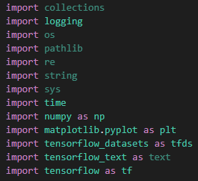
Practice environment
▶ collections : implements specialized container datatypes like UserList, Counter
▶ logging : implements event logging system
▶ os : provides way of using OS dependent functionality
▶ pathlib : instantiates a concrete path for the platform the code is running on
▶ re : provides regular expression
▶ string : provides methods to deal with string
▶ sys : provides access to some variables and functions that interact with the interpreter
▶ time : provides functions associated with time
▶ numpy : provides data structures and methods to calculate numeric data
▶ matplotlib.pyplot : provides graph drawing with provided functions
▶ tensorflow_datasets : Datasets provided by tensorflow,
▶ tensorflow_text : provides methods related to text data
▶ tensorflow : used for ML and deep neural network, calculate tensor with its data flow graph
Libraries

Slide 5

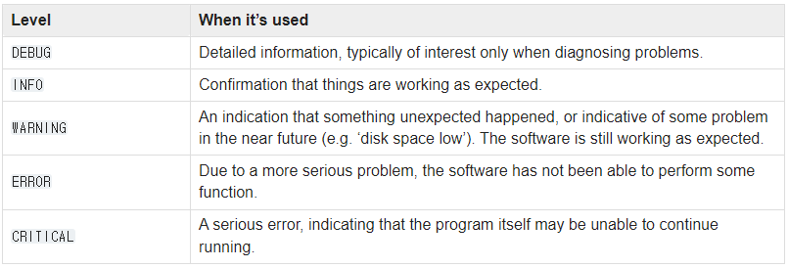
Practice environment
▶ getLogger gets ‘tensorflow’ logger, its level is set to “ ERROR “
“ ERROR “ is importance level of events. Default is “ WARNING “

Slide 6
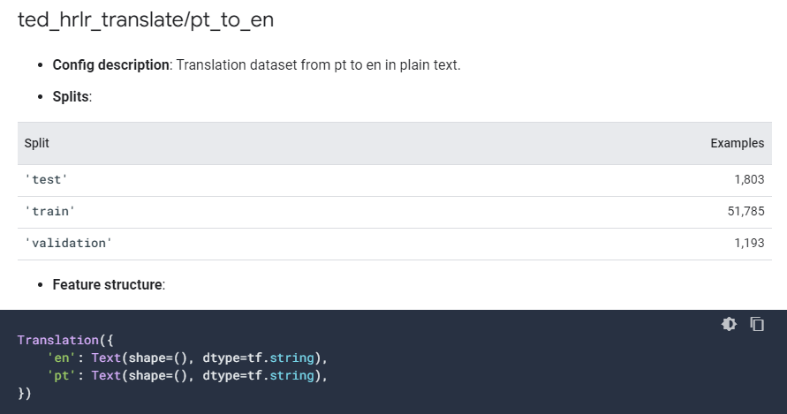
Practice environment
▶ tfds.load gets dataset that is uploaded on ‘tensorflow.org/datasets’
we can find this dataset on https://www.tensorflow.org/datasets/catalog/ted_hrlr_translate?hl=ko

Slide 7
Practice environment
▶ tfds.load returns a tuple form data

Slide 8
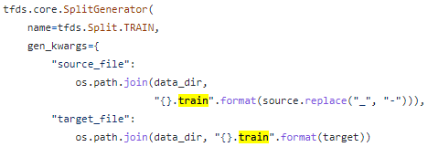
Practice environment
▶ code from ‘ted_hrlr_translate’

Slide 9

Practice environment
▶ code from ‘ted_hrlr_translate’

Slide 10
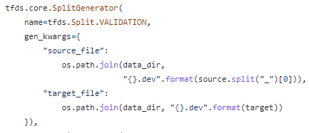
Practice environment
▶ code from ‘ted_hrlr_translate’

Slide 11
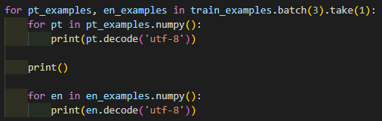
Practice environment
▶ take batch size ( in this code, 3 ) of data from loaded dataset
if we set take(2), next batch will take next 3 data from loaded dataset

Slide 12
Practice environment
▶ numpy() transforms pt_examples to numpy array

Slide 13
Practice environment
▶ print pt with ‘utf-8’ encoding

Slide 14
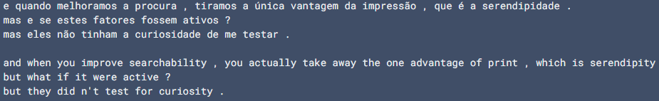
Practice environment
▶ print pt with ‘utf-8’ encoding

Slide 15
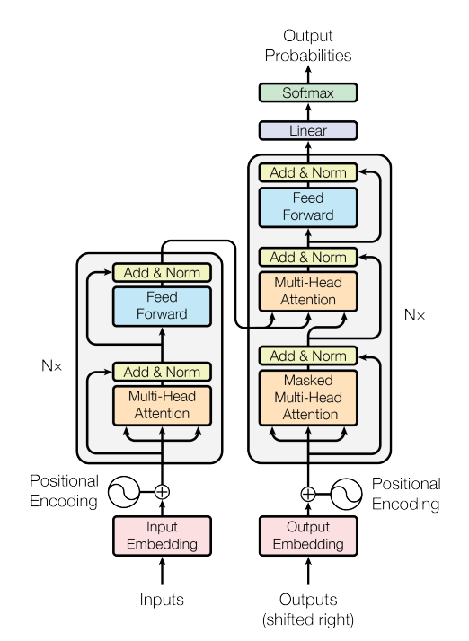
Components of transformer
▶ Input/output embedding
▶ Positional encoding
▶ Scaled dot-product attention
▶ Multi-head attention
▶ Masked Multi-Head Attention
▶ Add & Norm
▶ Feed forward network
Decoder
Encoder
Transformer model architecture

Slide 16
Input of Transformer
▶ We want to translate Portuguese to English
▶ We have sentence for input/output
▶ However, the first layer of transformer takes matrix as input
So we have to transform sentence to matrix
Portuguese sentence for input,
English sentence for output.

Slide 17
Transforming input data
We are here!

Slide 18
Transforming input data
▶ We have to transform string data to matrix with numeric data
Nice
to
meet
you
1.76 2.22 ... 6.66
7.65 1.31 ... 5.36
9.34 0.68 ... 3.78
4.97 2.19 ... 8.12
this will be embedding matrix
※ matrix values are arbitrary
d

Slide 19
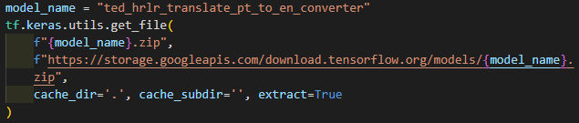
Transforming input data
▶ Set model name

Slide 20
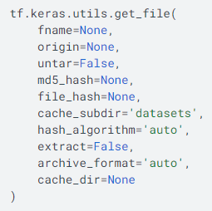
Transforming input data
▶ Return path to downloaded file

Slide 21
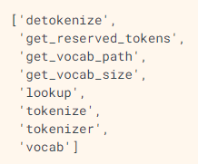
Transforming input data
tf.save_model.load() Loads SavedModel from export_dir

Slide 22

Transforming input data
en_examples
tokenize()
encoded
sos
eos

Slide 23
Transforming input data
en_examples
tokenize()
encoded
sos
eos

Slide 24

Transforming input data
encoded
detokenize()
round_trip

Slide 25
Transforming input data
encoded
detokenize()
list -> numpy array
utf-8 encoding

