Slide 1
Transformer Practice
컴퓨터소프트웨어학부 심승현

Slide 2
Contents
https://www.tensorflow.org/text/tutorials/transformer
Tensorflow.org, transformer tutorial
translating Portuguese to English using transformer model

Slide 3
Review
▶ We want to translate Portuguese to English
▶ We have sentence for input/output
▶ However, the first layer of transformer takes matrix as input
So we have to transform sentence to matrix
▶ We used class ‘tokenizer’ to transform word to token ID
Portuguese sentence for input,
English sentence for output.

Slide 4
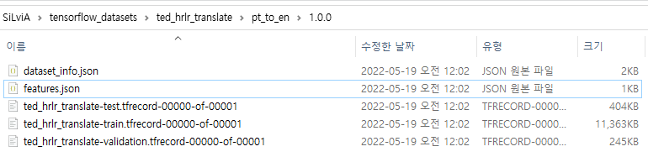
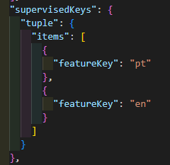
Compliments
▶ Dataset consists of .json files and ,tfrecord-00000-of-00001 files
Dataset is formed as tuple form

Slide 5
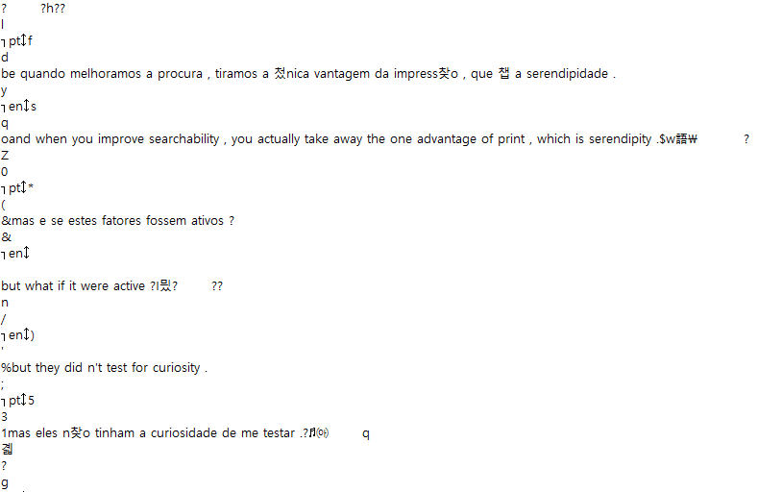
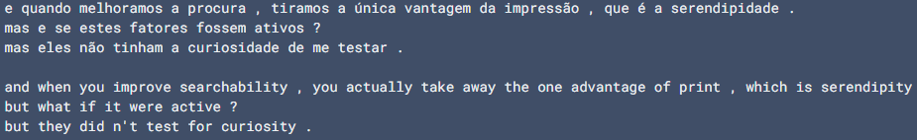
Compliments
< start of train data file

Slide 6
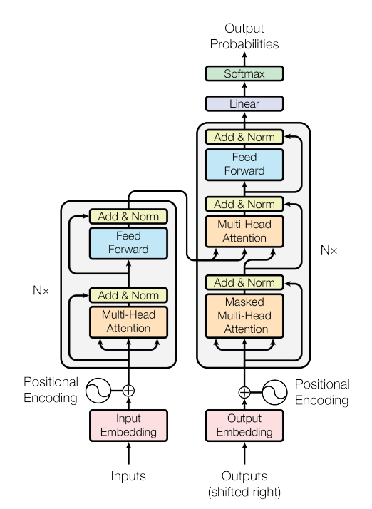
Transforming input data
We are here!

Slide 7
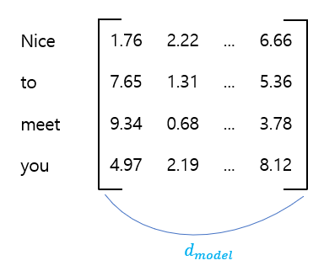
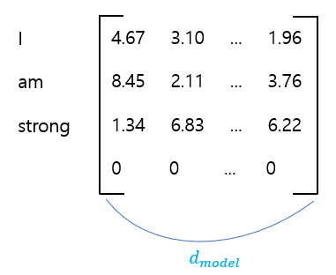
Padding
▶ ‘tokenize’ method transforms string to Padding batch of Token ID
▶ Set maximum number of words in one string, to form embedding matrix,
Padding helps each different size of string to be transformed to embedding matrix
Pad Token
※ matrix values are arbitrary

Slide 8
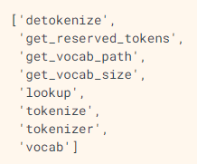

Transforming input data
▶ ‘lookup’ method transforms token ID array to token text
=
tokenize as substring
sos
=
eos

Slide 9
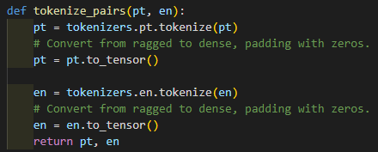
Transforming input data
▶ Batch is part of the entire dataset, we slice dataset into batch, and train each batch.
If every batch in dataset completed training, it is called 1 epoch
string
numpy array
to tensor
token ID ( tensor )

Slide 10
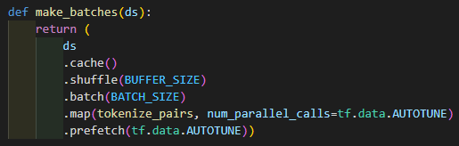
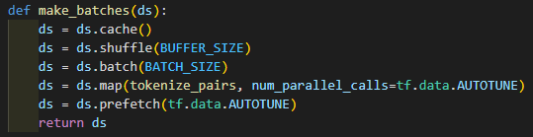
Transforming input data
▶ Batch is part of the entire dataset, we slice dataset into batch, and train each batch.
If every batch in dataset completed training, it is called 1 epoch
syntax
▶ Same meaning with this function

Slide 11
Transforming input data
▶ Batch is part of the entire dataset, we slice dataset into batch, and train each batch.
If every batch in dataset completed training, it is called 1 epoch
syntax
▶ ds.cache() automatically caches dataset

Slide 12

Transforming input data
▶ Batch is part of the entire dataset, we slice dataset into batch, and train each batch.
If every batch in dataset completed training, it is called 1 epoch
syntax
▶ ds.shuffle(BUFFER_SIZE) will shuffle data to prevent training from bias
▶ In this case, first batch will take order randomly from first 20,000 datas

Slide 13
Transforming input data
▶ Batch is part of the entire dataset, we slice dataset into batch, and train each batch.
If every batch in dataset completed training, it is called 1 epoch
syntax
▶ ds.batch(BATCH_SIZE) transforms part of dataset to batches

Slide 14
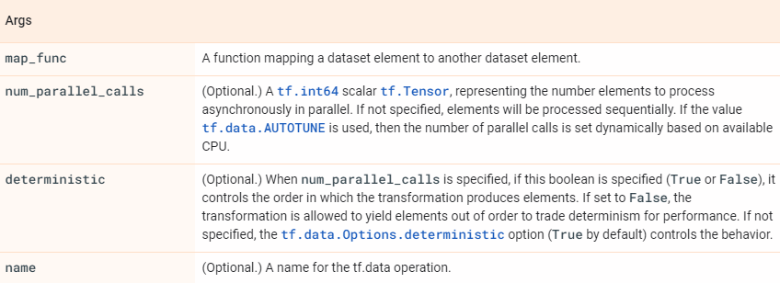
Transforming input data
▶ Batch is part of the entire dataset, we slice dataset into batch, and train each batch.
If every batch in dataset completed training, it is called 1 epoch

Slide 15
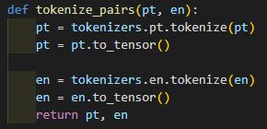
Transforming input data
▶ Batch is part of the entire dataset, we slice dataset into batch, and train each batch.
If every batch in dataset completed training, it is called 1 epoch
※ tokenize_pairs gets tuple of string,
and returns tuple of token ID

Slide 16

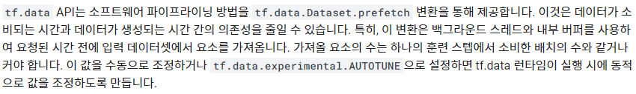
Transforming input data
▶ Batch is part of the entire dataset, we slice dataset into batch, and train each batch.
If every batch in dataset completed training, it is called 1 epoch
※ tokenize_pairs gets tuple of string,
and returns tuple of token ID

Slide 17

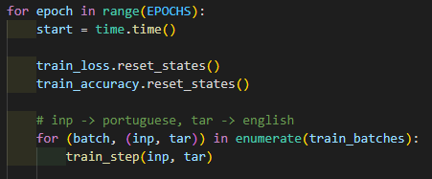
Transforming input data
▶ We use train_batches on the line below
▶ We can assume train_batches has entire batches, not just one batch

Slide 18
Embedding
We are here!

Slide 19
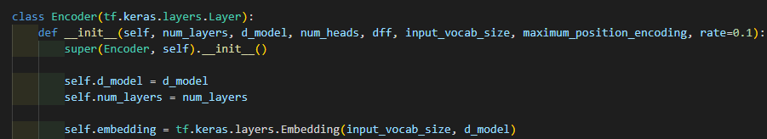
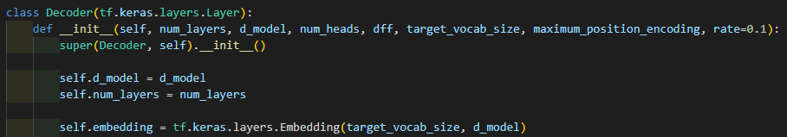
Embedding
▶ Embedding is already implemented in tensorflow.
We can call embedding with Embedding method
▶ Input and output embedding are both calling Embedding method

Slide 20
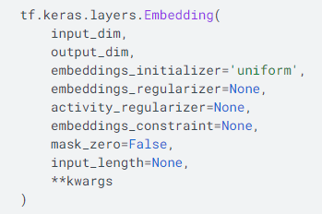
Embedding
▶
▶ Tokenizer tokenize string to token ID, which is integer
▶ We can use max value of token ID as input_dim
▶ In other words, we use number of vocabulary as input_dim

Slide 21

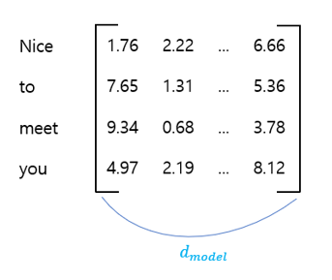
Embedding
▶
This is output_dim

Slide 22

Embedding
▶
Lots of initializers like ‘zeros’, ‘uniform’ ...

Slide 23

Embedding
▶
▶ Regularize

Slide 24
Embedding
▶

Slide 25
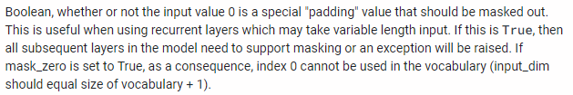
Embedding
▶

Slide 26

Embedding
▶

