Slide 1
Transformer Practice
컴퓨터소프트웨어학부 심승현

Slide 2
Contents
https://www.tensorflow.org/text/tutorials/transformer
Tensorflow.org, transformer tutorial
translating Portuguese to English using transformer model

Slide 3

Review
▶ String Token ID
tokenize as substring
=
sos
=
eos

Slide 4
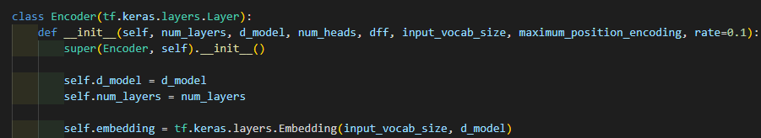
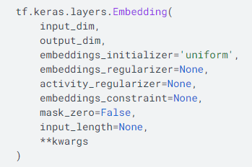
Review
▶ Token ID Embedding Matrix
Implemented in tensorflow

Slide 5
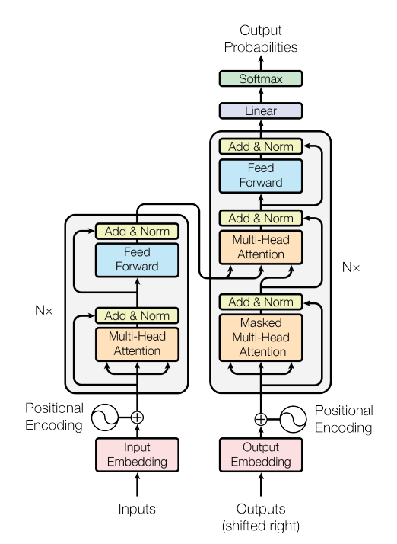
Positional Encoding
We are here!

Slide 6

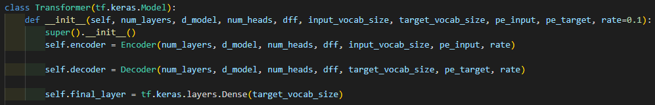
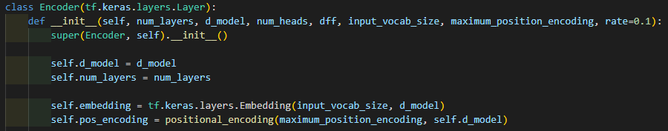
Positional Encoding

Slide 7
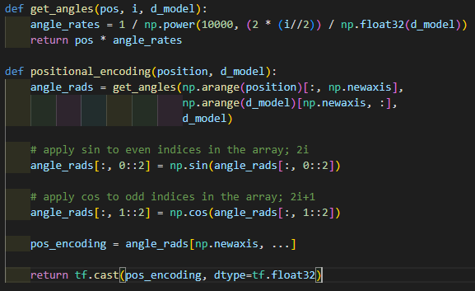
Positional Encoding

Slide 8
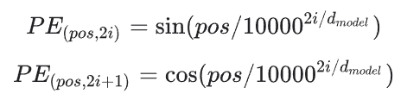
Positional Encoding
Calculating Positional Encoding

Slide 9
Positional Encoding
np.array([ [0], [1], [2], ... [9999] ])
np.array([[ 0, 1, 2, ... 511 ]])

Slide 10


Positional Encoding
▶ pos = np.array([ [0], [1], [2], ... [9999] ])
▶ i = np.array([[ 0, 1, 2, ... 511 ]])
▶ d_model = 512

Slide 11
Positional Encoding

Slide 12
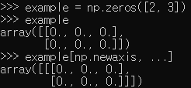
Positional Encoding
▶ add dimension to angle_rads
▶ pos_encoding.shape = (1, 10000, 512)

Slide 13
Positional Encoding
▶ add dimension to angle_rads
▶ pos_encoding.shape = (1, 10000, 512)

Slide 14
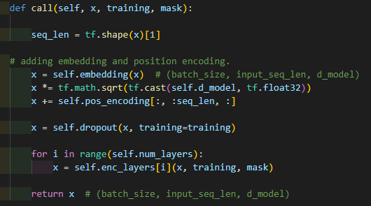
Positional Encoding
Inside of Transformer
Inside of Encoder
tf.shape
▶ returns 1 dimension tensor
that represents the shape of input

Slide 15
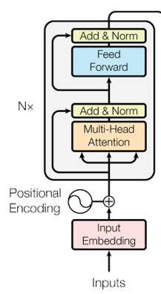
Positional Encoding
Inside of Encoder

Slide 16
Positional Encoding
Inside of Encoder
positional_encoding returns (1, 10000, 512) vector.
pos_encoding[:, :seq_len, :].shape = (1, seq_len, 512)

Slide 17
Encoder Layer and Decoder Layer
Decoder Layer
Encoder Layer

Slide 18
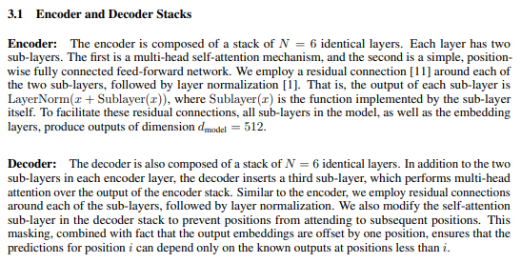
Encoder Layer and Decoder Layer
※ Attention is all you need (NIPS 2017)

Slide 19
Encoder Layer and Decoder Layer
?
?
Encoder Layer
Decoder Layer
※ Attention is all you need (NIPS 2017)

Slide 20
Encoder Layer and Decoder Layer
Encoder Layer
Decoder Layer
Encoder Layer
Decoder Layer
Encoder Layer
Decoder Layer
Encoder Layer
Decoder Layer
Encoder Layer
Decoder Layer
Encoder Layer
Decoder Layer

Slide 21
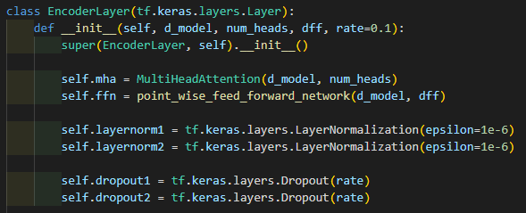
Encoder Layer
Encoder Layer consists of...
▶ Multi head attention
▶ Feed forward network
▶ Add & normalization
▶ Dropout

Slide 22
Multi Head Attention
We are Here!

Slide 23
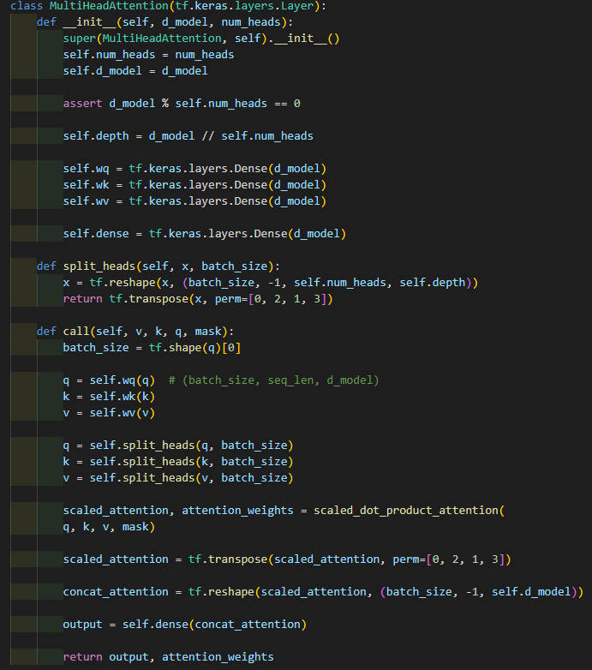
Multi Head Attention
▶ Naively, multi head attention is to split heads,
then calls scaled dot product attention
then concatenate results.

Slide 24
Multi Head Attention
▶ Naively, multi head attention is to split heads,
then calls scaled dot product attention
then concatenate results.
So, let’s talk about scaled dot product attention first.

Slide 25
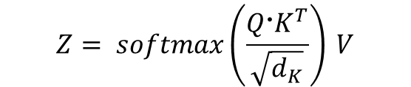
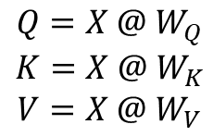
Scaled dot product attention
▶ What we know about scaled dot product attention is,
Use Query, Key, Value to produce the relativeness of the word ( column of Embedding matrix)
$${Q=X @ W}_{Q}$$
$$K=X @ W_{K}$$
$$V=X @ W_{V}$$
$$Z= softmax\left(\frac{Q〮K^{T}}{\sqrt{d_{K}}}\right) V$$
※ Z is attention matrix

Slide 26
Scaled dot product attention
▶ What we know about scaled dot product attention is,
Use Query, Key, Value to produce the relativeness of the word ( column of Embedding matrix)
$${Q=X @ W}_{Q}$$
$$K=X @ W_{K}$$
$$V=X @ W_{V}$$
So, let’s see the code!
$$Z= softmax\left(\frac{Q〮K^{T}}{\sqrt{d_{K}}}\right) V$$
※ Z is attention matrix

Slide 27
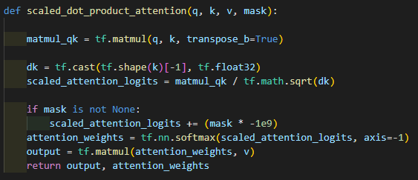

Scaled dot product attention
given q,k,v?
$Q〮K^{T}$

Slide 28
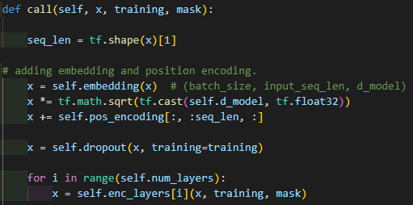


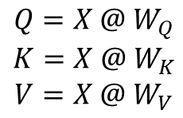
Scaled dot product attention
What we know about Q, K, V is..
$${Q=X @ W}_{Q}$$
$$K=X @ W_{K}$$
$$V=X @ W_{V}$$

Slide 29
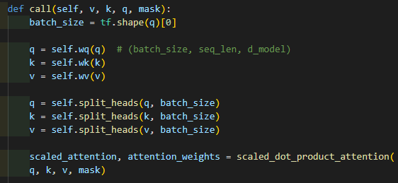

Scaled dot product attention
What we know about Q, K, V is..
$${Q=X @ W}_{Q}$$
$$K=X @ W_{K}$$
$$V=X @ W_{V}$$
is this weight?
How does it produced?

Slide 30
Scaled dot product attention
tf.shape(k) is (batch size, seq_len, d_model)
tf.shape(k)[-1] = d_model

Slide 31
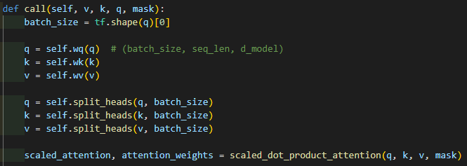

Scaled dot product attention
tf.shape(k) is (batch size, seq_len, d_model)
tf.shape(k)[-1] = d_model
v.shape = (batch_size, seq_len, 512)
x.shape = (batch_size, seq_len, 512)

Slide 32
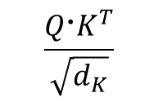

Scaled dot product attention
$$\frac{Q〮K^{T}}{\sqrt{d_{K}}}$$
$$softmax\left(\frac{Q〮K^{T}}{\sqrt{d_{K}}}\right) V$$

Slide 33
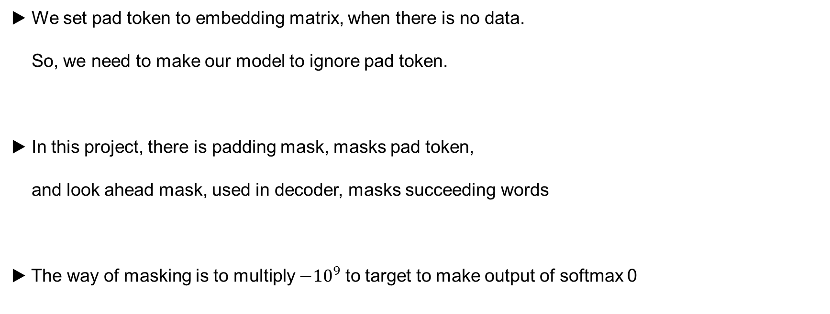
Masking
▶ We set pad token to embedding matrix, when there is no data.
So, we need to make our model to ignore pad token.
▶ In this project, there is padding mask, masks pad token,
and look ahead mask, used in decoder, masks succeeding words
▶ The way of masking is to multiply $−{10}^{9}$ to target to make output of softmax 0

Slide 34
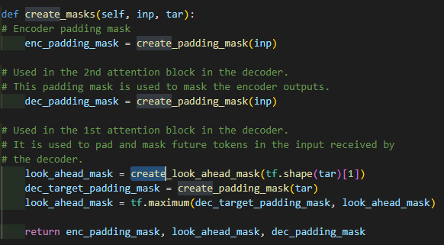
Masking

Slide 35
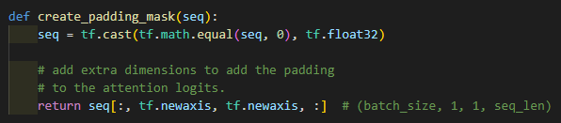
Masking
token ID
pad Token is 0

Slide 36
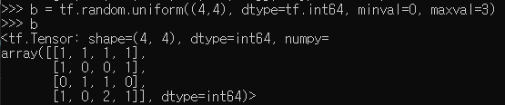


Masking
token ID
pad Token is 0
▶ 1 is pad Token

Slide 37
Masking
token ID
pad Token is 0
return vector dimension

Slide 38
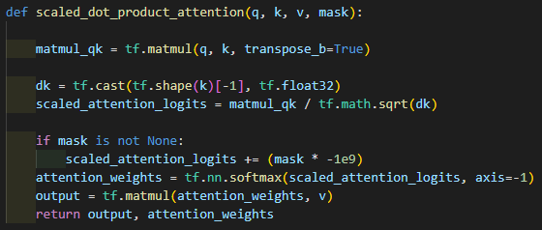
Masking
we can pass None like
it means masking is activated,
then mask is not None is True.

Slide 39
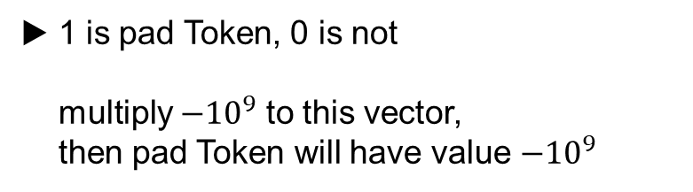
Masking
▶ 1 is pad Token, 0 is not
multiply $−{10}^{9}$ to this vector,
then pad Token will have value $−{10}^{9}$

Slide 40
Masking
▶ Look ahead mask takes role of
masking succeeding words in decoder
▶ tf.shape(tar) = (batch_size, seq_len)
tf.shape(tar)[1] = seq_len

Slide 41

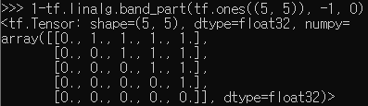
Masking
▶ 1 is mask, 0 is not

Slide 42
Masking
▶ 1 is mask, 0 is not

Slide 43
Masking
▶ Look ahead mask takes role of
masking succeeding words in decoder
▶ 1 is mask, 0 is not
▶ look ahead mask includes padding mask

Slide 44
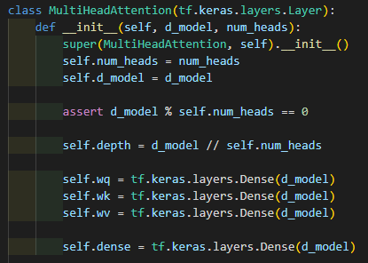

Multi Head Attention
▶ class MultiHeadAttention inherits tf.keras.layers.Layer
Layer is a callable object, takes one or more tensors as input,
and one or more tensors as output.

Slide 45
Multi Head Attention

Slide 46
Multi Head Attention

Slide 47
Multi Head Attention
▶ if d_model % self.num_heads != 0,
AssertionError happens

Slide 48
Multi Head Attention
▶ We have to split vectors,
Define the dimension of splited vector

Slide 49


Multi Head Attention
▶ We have to split vectors,
Define the dimension of splited vector

Slide 50
Multi Head Attention
▶ We have to split vectors,
Define the dimension of splited vector
v.shape = (batch_size, seq_len, 512)
▶ tf.shape(x) = (batch_size, tf.shape(x)[1],
self.num_heads, self.depth))

Slide 51
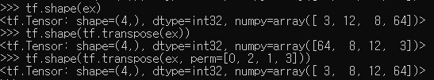
Multi Head Attention
▶ tf.shape(x) = (batch_size, tf.shape(x)[1],
self.num_heads, self.depth)
batch_size = 3
seq_len = 12
num_heads = 8
d_model = 512

Slide 52
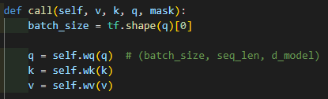
Multi Head Attention

Slide 53

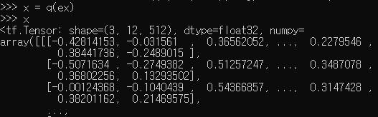
Multi Head Attention

Slide 54
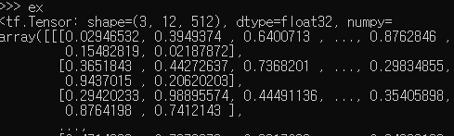
Multi Head Attention
vs

Slide 55
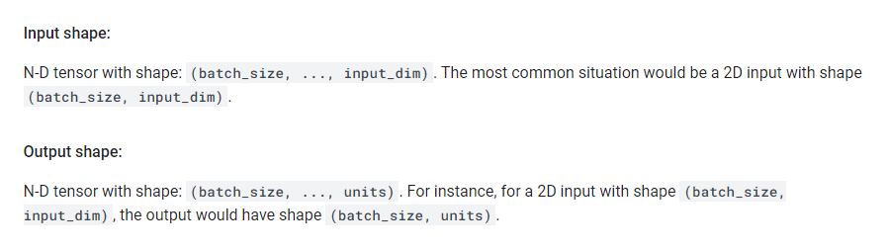
Multi Head Attention
ex
q(ex)

Slide 56


Multi Head Attention
basically, None
▶ So, self.wq, self.wk, self.wv have
their own weight matrix and bias

Slide 57
Multi Head Attention
▶ self.wq is a dense layer, that has its own weight matrix
▶ In call function, we give q as an input for self.wq layer
then derives new q.

Slide 58
Multi Head Attention

Slide 59

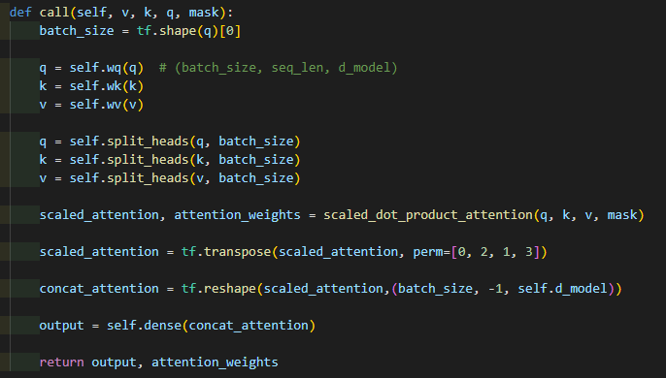
Multi Head Attention
▶ We already saw split_heads() above, lets go to call()

Slide 60
Multi Head Attention
tf.shape(q) = (batch_size, seq_len, d_model)

Slide 61
Multi Head Attention
▶ self.wq is a dense layer,
that has its own weight matrix
▶ take q as an input of self.wq layer
then derives new q.
▶ same operation with k, v also.

Slide 62
Multi Head Attention
▶ tf.shape(q) = (batch_size, seq_len, d_model)
▶ tf.shape(self.split_heads(q, batch_size)) = (batch_size, self.num_heads, seq_len, self.depth))
▶ same operation with k, v also

Slide 63
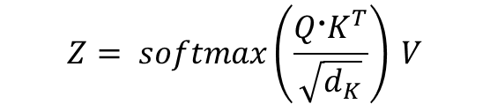
Multi Head Attention
$$Z= softmax\left(\frac{Q〮K^{T}}{\sqrt{d_{K}}}\right) V$$
output
attention_weights

Slide 64
Multi Head Attention
$$Z= softmax\left(\frac{Q〮K^{T}}{\sqrt{d_{K}}}\right) V$$
output
attention_weights
▶ shape of q, k, v = (batch_size, self.num_heads, seq_len, self.depth)
▶ tf.shape(matmul_qk) = (batch_size, self.num_heads, seq_len, seq_len)
▶ tf.shape(attention_weights) = (batch_size, self.num_heads, seq_len, seq_len)
▶ tf.shape(output) = (batch_size, self.num_heads, seq_len, self.depth)

Slide 65
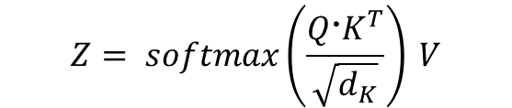
Multi Head Attention
▶ tf.shape(scaled_attention) =
(batch_size, self.num_heads, seq_len, self.depth)
▶ tf.shape(attention_weights) =
(batch_size, self.num_heads, seq_len, seq_len)
$$Z= softmax\left(\frac{Q〮K^{T}}{\sqrt{d_{K}}}\right) V$$
scaled_attention
attention_weights

Slide 66
Multi Head Attention
▶ tf.shape(scaled_attention) =
(batch_size, self.num_heads, seq_len, self.depth)
(batch_size, seq_len, self.num_heads, self.depth)
transpose
perm=[0,2,1,3]

Slide 67
Multi Head Attention
▶ tf.shape(scaled_attention) =
(batch_size, self.num_heads, seq_len, self.depth)
(batch_size, seq_len, self.num_heads, self.depth)
(batch_size, seq_len, seld.d_model)
= tf.shape(concat_attention)
transpose
perm=[0,2,1,3]
tf.reshape
(batch_size, -1, self.d_model)

Slide 68
Multi Head Attention
concat_attention
self.dense
output

Slide 69

Multi Head Attention
concat_attention
self.dense
output
▶ Output vector of multi head attention layer
▶ attention_weights =
$$softmax\left(\frac{Q〮K^{T}}{\sqrt{d_{K}}}\right)$$

Slide 70
Pointwise Feed Forward Network
We are Here!

Slide 71
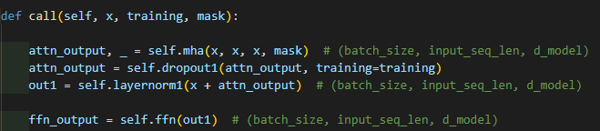
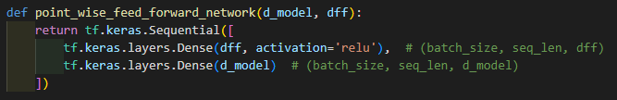
Pointwise Feed Forward Network
▶ Similar to what we did with dense layer,
We create feed forward network layer self.ffn
then give out1 as an input for self.ffn, then ffn_output is output of self.ffn

Slide 72
Pointwise Feed Forward Network
Dense1
ReLU
▶ Similar to what we did with dense layer,
We create feed forward network layer self.ffn
then give out1 as an input for self.ffn, then ffn_output is output of self.ffn
Dense2
▶ Feed forward network consists of two Dense layers when activation function ReLU

Slide 73
Pointwise Feed Forward Network
tf.shape(out1) =
(batch_size, seq_len, d_model)
Dense1
ReLU
tf.shape(Dense1(out1)) =
(batch_size, seq_len, dff)
▶ Similar to what we did with dense layer,
We create feed forward network layer self.ffn
then give out1 as an input for self.ffn, then ffn_output is output of self.ffn
Dense2
tf.shape(ffn_output) =
(batch_size, seq_len, d_model)
▶ Feed forward network consists of two Dense layers when activation function ReLU

Slide 74
Add & Normalization
We are Here!

Slide 75
Add & Normalization
▶ Add & Normalization connects input and output of sublayers
to achieve Layer normalization and Residual connection.
Layer normalization : prevents model from one sublayer’s return value is too big,
and effects training result to a great extent.
Residual connection : prevents model from forgetting information that the previous sublayer provides

Slide 76
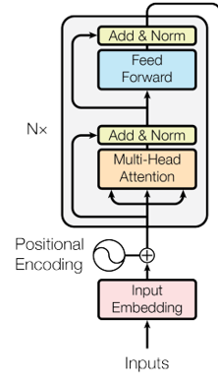
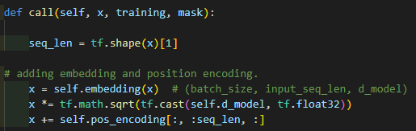
Add & Normalization
Normalization
▶ Normalize embedding matrix with a square root of d_model

Slide 77
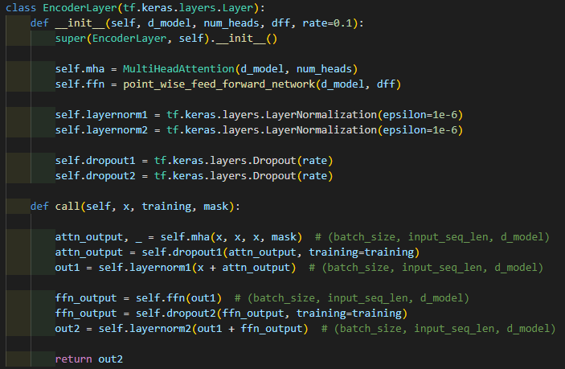


Add & Normalization
+
+

Slide 78
Add & Normalization

