Slide 1
Transformer Practice
컴퓨터소프트웨어학부 심승현

Slide 2
Contents
https://www.tensorflow.org/text/tutorials/transformer
Tensorflow.org, transformer tutorial
translating Portuguese to English using transformer model

Slide 3
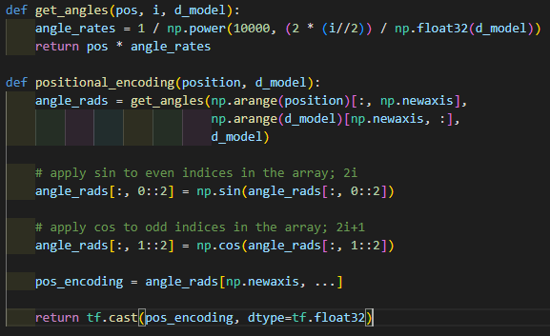
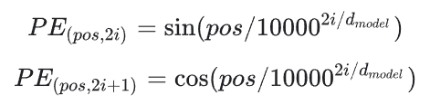
Review : Positional Encoding
input parameters are both int type

Slide 4
Review : Positional Encoding

Slide 5
Review : Positional Encoding
dimension of return matrix is
(1, 10000, 512)

Slide 6
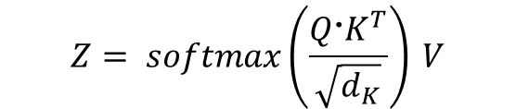

Review : Multi Head Attention
▶ First, get Query, Key, Value matrix from input matrix X
$${Q=X @ W}_{Q}$$
$$K=X @ W_{K}$$
$$V=X @ W_{V}$$
▶ Then, derive attention matrix Z through the formula behind
$$Z= softmax\left(\frac{Q〮K^{T}}{\sqrt{d_{K}}}\right) V$$
※ Z is attention matrix, $d_{K}$ is dimension of matrix K.

Slide 7
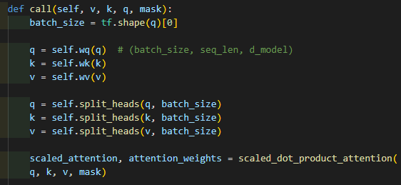
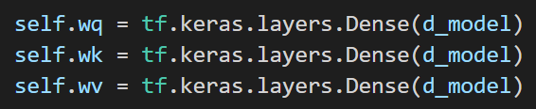
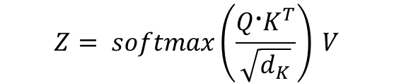

Review : Multi Head Attention
▶ First, get Query, Key, Value matrix
from input matrix X
$${Q=X @ W}_{Q}$$
$$K=X @ W_{K}$$
$$V=X @ W_{V}$$
q.shape
(batch_size, seq_len, d_model)
v, k, q passes different dense layers,
which have different weight matrix and bias.
In this step, Q, K, V are defined.
▶ Then, derive attention matrix
through the formula behind
$$Z= softmax\left(\frac{Q〮K^{T}}{\sqrt{d_{K}}}\right) V$$
※ Z is attention matrix, $d_{K}$ is dimension of matrix K.

Slide 8
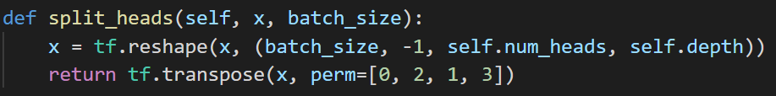
Review : Multi Head Attention
▶ First, get Query, Key, Value matrix
from input matrix X
$${Q=X @ W}_{Q}$$
$$K=X @ W_{K}$$
$$V=X @ W_{V}$$
perm of transpose
tf.transpose(x, perm=[0, 2, 1, 3]) moves
x[a][b][c][d] to x[a][c][b][d]
▶ Then, derive attention matrix
through the formula behind
$$Z= softmax\left(\frac{Q〮K^{T}}{\sqrt{d_{K}}}\right) V$$
q.shape
(batch_size, seq_len, d_model)
->
(batch_size, self.num_heads, seq_len, self.depth)
※ Z is attention matrix, $d_{K}$ is dimension of matrix K.

Slide 9
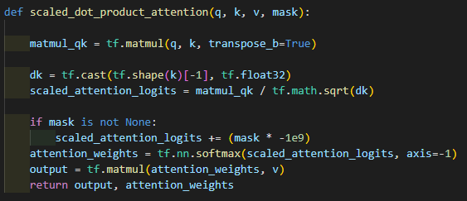
Review : Multi Head Attention
▶ First, get Query, Key, Value matrix
from input matrix X
$${Q=X @ W}_{Q}$$
$$K=X @ W_{K}$$
$$V=X @ W_{V}$$
▶ Then, derive attention matrix
through the formula behind
$$Z= softmax\left(\frac{Q〮K^{T}}{\sqrt{d_{K}}}\right) V$$
matmul_qk.shape
(batch_size, self.num_heads, seq_len, seq_len)
※ Z is attention matrix, $d_{K}$ is dimension of matrix K.

Slide 10
Review : Multi Head Attention
▶ First, get Query, Key, Value matrix
from input matrix X
$${Q=X @ W}_{Q}$$
$$K=X @ W_{K}$$
$$V=X @ W_{V}$$
▶ Then, derive attention matrix
through the formula behind
$$Z= softmax\left(\frac{Q〮K^{T}}{\sqrt{d_{K}}}\right) V$$
dk is a tf.float32 number
※ Z is attention matrix, $d_{K}$ is dimension of matrix K.

Slide 11
Review : Multi Head Attention
▶ First, get Query, Key, Value matrix
from input matrix X
$${Q=X @ W}_{Q}$$
$$K=X @ W_{K}$$
$$V=X @ W_{V}$$
▶ Then, derive attention matrix
through the formula behind
$$Z= softmax\left(\frac{Q〮K^{T}}{\sqrt{d_{K}}}\right) V$$
scaled_attention_logits.shape
(batch_size, self.num_heads, seq_len, seq_len)
※ Z is attention matrix, $d_{K}$ is dimension of matrix K.

Slide 12
Review : Multi Head Attention
▶ First, get Query, Key, Value matrix
from input matrix X
$${Q=X @ W}_{Q}$$
$$K=X @ W_{K}$$
$$V=X @ W_{V}$$
▶ Then, derive attention matrix
through the formula behind
$$Z= softmax\left(\frac{Q〮K^{T}}{\sqrt{d_{K}}}\right) V$$
attention_weights.shape
(batch_size, self.num_heads, seq_len, seq_len)
※ Z is attention matrix, $d_{K}$ is dimension of matrix K.

Slide 13
Review : Multi Head Attention
▶ First, get Query, Key, Value matrix
from input matrix X
$${Q=X @ W}_{Q}$$
$$K=X @ W_{K}$$
$$V=X @ W_{V}$$
▶ Then, derive attention matrix
through the formula behind
$$Z= softmax\left(\frac{Q〮K^{T}}{\sqrt{d_{K}}}\right) V$$
output.shape
(batch_size, self.num_heads, seq_len, self.depth)
※ Z is attention matrix, $d_{K}$ is dimension of matrix K.

Slide 14
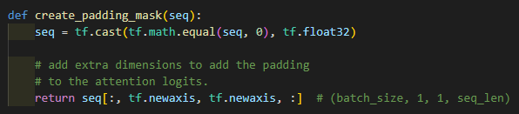
Review : Multi Head Attention
▶ First, get Query, Key, Value matrix
from input matrix X
$${Q=X @ W}_{Q}$$
$$K=X @ W_{K}$$
$$V=X @ W_{V}$$
▶ Then, derive attention matrix
through the formula behind
$$Z= softmax\left(\frac{Q〮K^{T}}{\sqrt{d_{K}}}\right) V$$
▶ Padding mask matrix consists of 1 and 0
1 means mask
※ Z is attention matrix, $d_{K}$ is dimension of matrix K.
seq is token ID matrix, and its size is
(batch_size, seq_len)

Slide 15
Review : Multi Head Attention
▶ First, get Query, Key, Value matrix
from input matrix X
$${Q=X @ W}_{Q}$$
$$K=X @ W_{K}$$
$$V=X @ W_{V}$$
▶ Then, derive attention matrix
through the formula behind
$$Z= softmax\left(\frac{Q〮K^{T}}{\sqrt{d_{K}}}\right) V$$
▶ Padding mask matrix consists of 1 and 0
1 means mask
※ Z is attention matrix, $d_{K}$ is dimension of matrix K.
seq is now mask matrix

Slide 16
Review : Multi Head Attention
▶ First, get Query, Key, Value matrix
from input matrix X
$${Q=X @ W}_{Q}$$
$$K=X @ W_{K}$$
$$V=X @ W_{V}$$
▶ Then, derive attention matrix
through the formula behind
$$Z= softmax\left(\frac{Q〮K^{T}}{\sqrt{d_{K}}}\right) V$$
▶ Padding mask matrix consists of 1 and 0
1 means mask
※ Z is attention matrix, $d_{K}$ is dimension of matrix K.
seq.shape
(batch_size, 1, 1, seq_len)

Slide 17
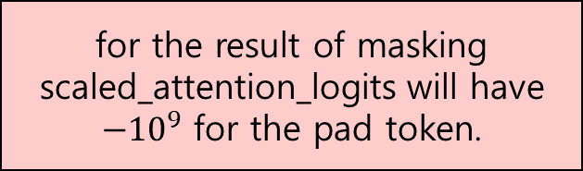
Review : Multi Head Attention
▶ First, get Query, Key, Value matrix
from input matrix X
$${Q=X @ W}_{Q}$$
$$K=X @ W_{K}$$
$$V=X @ W_{V}$$
▶ Then, derive attention matrix
through the formula behind
for the result of masking
scaled_attention_logits will have
$−{10}^{9}$ for the pad token.
$$Z= softmax\left(\frac{Q〮K^{T}}{\sqrt{d_{K}}}\right) V$$
▶ Padding mask matrix consists of 1 and 0
1 means mask
※ Z is attention matrix, $d_{K}$ is dimension of matrix K.
seq.shape
(batch_size, 1, 1, seq_len)

Slide 18
Review : Multi Head Attention
▶ First, get Query, Key, Value matrix
from input matrix X
$${Q=X @ W}_{Q}$$
$$K=X @ W_{K}$$
$$V=X @ W_{V}$$
▶ Then, derive attention matrix
through the formula behind
$$Z= softmax\left(\frac{Q〮K^{T}}{\sqrt{d_{K}}}\right) V$$
attention_weights.shape
(batch_size, self.num_heads, seq_len, seq_len)
※ Z is attention matrix, $d_{K}$ is dimension of matrix K.
output.shape
(batch_size, self.num_heads, seq_len, self.depth)

Slide 19
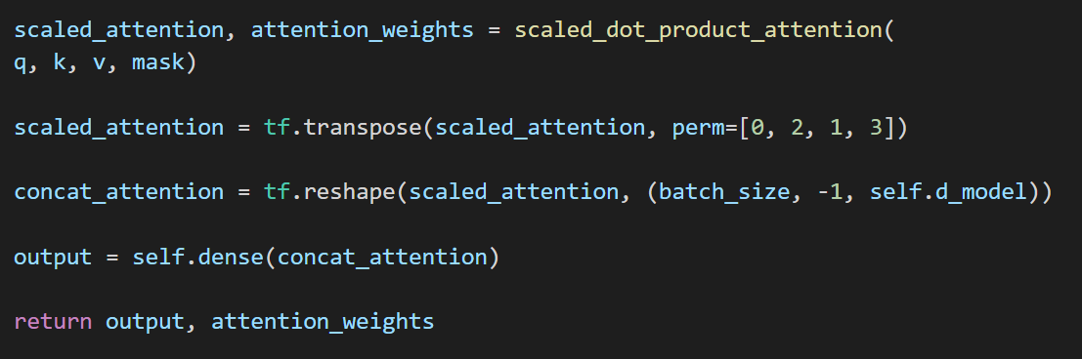
Review : Multi Head Attention
▶ Concatenate heads
attention_weights.shape
(batch_size, self.num_heads, seq_len, seq_len)
scaled_attention.shape
(batch_size, self.num_heads, seq_len, self.depth)

Slide 20
Review : Multi Head Attention
▶ Concatenate heads
scaled_attention.shape
(batch_size, self.num_heads, seq_len, self.depth)
transpose
scaled_attention.shape
(batch_size, seq_len, self.num_heads, self.depth)

Slide 21
Review : Multi Head Attention
▶ Concatenate heads
scaled_attention.shape
(batch_size, self.num_heads, seq_len, self.depth)
transpose
scaled_attention.shape
(batch_size, seq_len, self.num_heads, self.depth)
reshape
concat_attention.shape
(batch_size, seq_len, self.d_model)

Slide 22
Review : Multi Head Attention
▶ Concatenate heads
scaled_attention.shape
(batch_size, self.num_heads, seq_len, self.depth)
transpose
scaled_attention.shape
(batch_size, seq_len, self.num_heads, self.depth)
reshape
output.shape
(batch_size, seq_len, self.d_model)
concat_attention.shape
(batch_size, seq_len, self.d_model)

Slide 23
Review : Multi Head Attention
scaled_attention.shape
(batch_size, self.num_heads, seq_len, self.depth)
transpose
scaled_attention.shape
(batch_size, seq_len, self.num_heads, self.depth)
reshape
output.shape
(batch_size, seq_len, self.d_model)
concat_attention.shape
(batch_size, seq_len, self.d_model)
attention_weights.shape
(batch_size, self.num_heads, seq_len, seq_len)

Slide 24
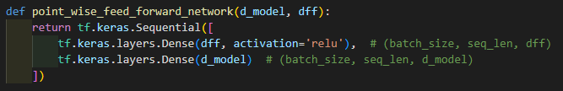
Review : Pointwise Feed Forward Network
Dense Layer 1
ReLU
Dense Layer 2

Slide 25

Review : Pointwise Feed Forward Network
out1
(batch_size, seq_len, d_model)
Dense Layer 1
ReLU
(batch_size, seq_len, dff)
...
Dense Layer 2
ffn_output
(batch_size, seq_len, d_model)

Slide 26
Review : Add & Norm
▶ Add & Normalization connects input and output of sublayers
to achieve Layer normalization and Residual connection.
Layer normalization : prevents model from one sublayer’s return value is too big,
and effects training result to a great extent.
Residual connection : prevents model from forgetting information
that the previous sublayer provides

Slide 27

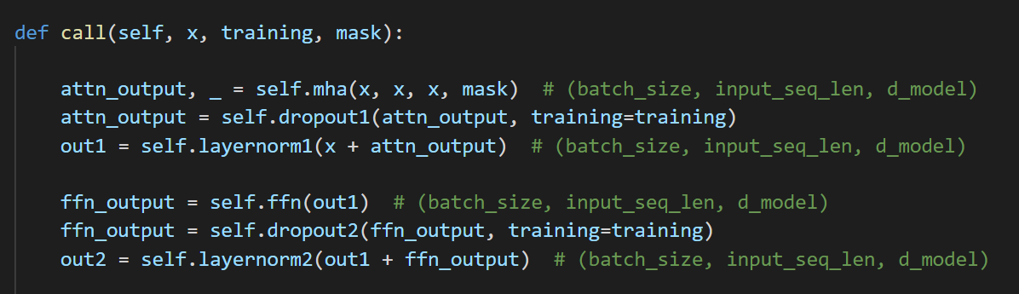
Review : Add & Norm
▶ Add & Normalization connects input and output of sublayers
to achieve Layer normalization and Residual connection.
Layer normalization : prevents model from one sublayer’s return value is too big,
and effects training result to a great extent.
Residual connection : prevents model from forgetting information
that the previous sublayer provides
out1
self.layernorm1
attn_output
self.dropout1
attn_output
self.mha
x

Slide 28
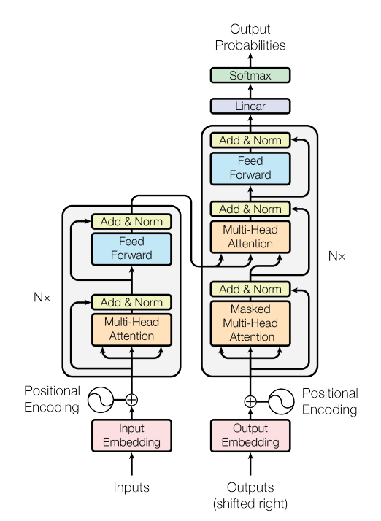
Masked Multi Head Attention
We are Here!

Slide 29
Masked Multi Head Attention
▶ Masked Multi Head Attention is to perform multi head attention with look ahead mask
As we said on ‘Masking’, Look ahead mask includes padding mask!

Slide 30

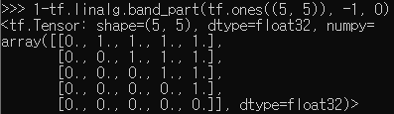
Masked Multi Head Attention
▶ Masked Multi Head Attention is to perform multi head attention with look ahead mask
As we said on ‘Masking’, Look ahead mask includes padding mask!
※ Example of look ahead mask when size=5
※ 1 means mask
padding mask is not included here

Slide 31


Masked Multi Head Attention
▶ Masked Multi Head Attention is to perform multi head attention with look ahead mask
As we said on ‘Masking’, Look ahead mask includes padding mask!
sequence length
※ Example of look ahead mask when size=5
※ 1 means mask
padding mask is not included here
※ Arbitrary padding mask

Slide 32

Masked Multi Head Attention
▶ Masked Multi Head Attention is to perform multi head attention with look ahead mask
As we said on ‘Masking’, Look ahead mask includes padding mask!
the mask matrix
passed tf.maximum will be
sequence length
※ Example of look ahead mask when size=5
※ 1 means mask
padding mask is not included here
※ Arbitrary padding mask

Slide 33

Masked Multi Head Attention
▶ The call function of class MultiHeadAttention returns
▶ multi-head attention in Encoder
▶ multi-head attention in Decoder

Slide 34

Masked Multi Head Attention
▶ The call function of class MultiHeadAttention returns
Attention matrix
▶ multi-head attention in Encoder
▶ multi-head attention in Decoder

Slide 35
Masked Multi Head Attention
▶ The call function of class MultiHeadAttention returns
Attention matrix
▶ multi-head attention in Encoder
In encoder, we only use attention matrix.
dummy variable ‘_’ is to not store the
attention_weights in a variable.
▶ multi-head attention in Decoder

Slide 36
Masked Multi Head Attention
▶ The call function of class MultiHeadAttention returns
Attention matrix
▶ multi-head attention in Encoder
In encoder, we only use attention matrix.
dummy variable ‘_’ is to not store the
attention_weights in a variable.
▶ multi-head attention in Decoder
masked multi head attention is to perform multi head attention with
look ahead mask
In decoder, we do not ignore attention_weights,
and these two attention_weights are
the return variable of Decoder Layer

Slide 37
Masked Multi Head Attention
▶ The call function of class MultiHeadAttention returns
Attention matrix
▶ multi-head attention in Encoder
In encoder, we only use attention matrix.
dummy variable ‘_’ is to not store the
attention_weights in a variable.
▶ multi-head attention in Decoder
masked multi head attention is to perform multi head attention with
look ahead mask
Second MHA in decoder gets
output matrix of encoder as V, K
and output of previous masked MHA as Q

Slide 38
Encoder and Decoder Layers
▶ We have seen the components of Encoder and Decoder Layers so far.
There were Multi Head Attention layer for encoder and decoder both,
Pointwise Feed Forward Network for encoder and decoder both,
Add & Normalization for encoder and decoder both,
and Masked Multi Head Attention for decoder.

Slide 39
Encoder and Decoder Layers
▶ We have seen the components of Encoder and Decoder Layers so far.
There were Multi Head Attention layer for encoder and decoder both,
Pointwise Feed Forward Network for encoder and decoder both,
Add & Normalization for encoder and decoder both,
and Masked Multi Head Attention for decoder.
▶ In Transformer, there are encoder/decoder layer stacks,
and the sum of each layers are called Encoder and Decoder
Encoder
Decoder
Encoder Layer
Decoder Layer
Encoder Layer
Decoder Layer

Slide 40
Encoder and Decoder Layers
▶ Now let’s see how the layers we studied so far are connected in encoder/decoder layers !
Encoder Layer
Decoder Layer
norm
norm
ffn
ffn
norm
norm
mha
mha
norm
mmha

Slide 41
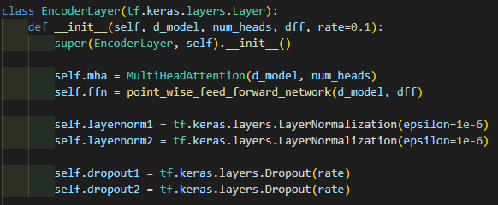
Encoder and Decoder Layers
▶ Now let’s see how the layers we studied so far are connected in encoder/decoder layers !
Encoder Layer
Decoder Layer
norm
norm
ffn
ffn
norm
norm
mha
mha
▶ This is the init function for EncoderLayer.
mha for multi head attention,
ffn for feed forward network,
layernorm for Add&Norm we have seen so far.
let’s talk about dropout first.
norm
mmha

Slide 42
Encoder and Decoder Layers
▶ Dropout is to ‘drop out’ the neurons, setting the output of corresponding neurons to 0
We can set dropout rate,
which decides the probability of dropping for every neurons in hidden layer

Slide 43

Encoder and Decoder Layers
▶ for example, let’s think about example matrix like this.

Slide 44
Encoder and Decoder Layers
▶ for example, let’s think about example matrix like this.
▶ Create dropout layer, dropout rate is 0.5

Slide 45

Encoder and Decoder Layers
▶ for example, let’s think about example matrix like this.
▶ Create dropout layer, dropout rate is 0.5
when we call dropout, we call it with a few parameters.
example is an input matrix(tensor) here
▶ call dropout

Slide 46
Encoder and Decoder Layers
▶ for example, let’s think about example matrix like this.
▶ Create dropout layer, dropout rate is 0.5
when we call dropout, we call it with a few parameters.
training is a Boolean type parameter,
if True, we apply dropout for input layer (example)
if False, this layer will do nothing.
when training=False, it is usually called inference mode
▶ call dropout

Slide 47
Encoder and Decoder Layers
▶ for example, let’s think about example matrix like this.
▶ Create dropout layer, dropout rate is 0.5
Dropout rate was 0.5
we can see 9 zeros, which is not a 50%
Rate is just a probability !
▶ call dropout

Slide 48
Encoder and Decoder Layers
▶ Dropout is to ‘drop out’ the neurons, setting the output of corresponding neurons to 0
We can set dropout rate,
which decides the probability of dropping for every neurons in hidden layer
▶ attn_output is a input matrix
training will be given, like this !

Slide 49
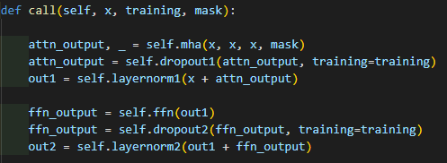
Encoder and Decoder Layers
Encoder Layer
Decoder Layer
norm
norm
ffn
ffn
norm
norm
mha
mha
▶ This is the call function for EncoderLayer.
When we call EncoderLayer object with parameter (x, training, mask),
This code will run.
norm
mmha

Slide 50
Encoder and Decoder Layers
Encoder Layer
Decoder Layer
norm
norm
ffn
ffn
norm
norm
mha
mha
▶ x is a matrix that passed positional encoding layer
norm
x.shape
(batch_size, seq_len, d_model)
mmha

Slide 51
Encoder and Decoder Layers
Encoder Layer
Decoder Layer
norm
norm
ffn
ffn
norm
norm
mha
mha
▶ training is a Boolean type parameter, used in dropout
▷ if True, we apply dropout for input layer (attn_output / ffn_output)
▷ if False, this layer will do nothing.
norm
mmha

Slide 52
Encoder and Decoder Layers
Encoder Layer
Decoder Layer
norm
norm
ffn
ffn
norm
norm
mha
mha
▶ mask is a mask matrix, encoder layer uses padding mask !
norm
mask.shape
(batch_size, 1, 1, seq_len)
mmha
▷ x was 3-dimension matrix, but this is 4-dimension
It’s because we use this in multi head attention, after spliting heads

Slide 53
Encoder and Decoder Layers
Encoder Layer
Decoder Layer
norm
norm
ffn
ffn
norm
norm
mha
mha
▶ Multi-Head attention
use x to make query, key, value matrix
mha returns attention matrix, which has its shape of
norm
mmha
attn_output.shape
(batch_size, seq_len, d_model)

Slide 54
Encoder and Decoder Layers
Encoder Layer
Decoder Layer
norm
norm
ffn
ffn
norm
norm
mha
mha
▶ Apply dropout for attn_output,
shape does not change
norm
attn_output.shape
(batch_size, seq_len, d_model)
mmha

Slide 55
Encoder and Decoder Layers
Encoder Layer
Decoder Layer
norm
norm
ffn
ffn
norm
norm
mha
mha
▶ Apply layer normalization
self.layernorm does not change its shape, so out1.shape is
norm
mmha
attn_output.shape == x.shape
(batch_size, seq_len, d_model)
out1.shape
(batch_size, seq_len, d_model)

Slide 56
Encoder and Decoder Layers
Encoder Layer
Decoder Layer
norm
norm
ffn
ffn
norm
norm
mha
mha
▶ Apply feed forward network.
out1.shape was (batch_size, seq_len, d_model)
During ffn layer, shape of input matrix will be transformed like this
norm
mmha
(batch_size, seq_len, d_model)
(batch_size, seq_len, dff)
(batch_size, seq_len, d_model)

Slide 57
Encoder and Decoder Layers
Encoder Layer
Decoder Layer
norm
norm
ffn
ffn
norm
norm
mha
mha
▶ Dropout and layer normalization in a same method
norm
out1.shape
(batch_size, seq_len, d_model)
mmha
out2.shape
(batch_size, seq_len, d_model)
ffn_output.shape
(batch_size, seq_len, d_model)

Slide 58
Encoder and Decoder Layers
Encoder Layer
Decoder Layer
norm
norm
ffn
ffn
norm
norm
mha
mha
▶ Dropout and layer normalization in a same method
norm
out2.shape
(batch_size, seq_len, d_model)
mmha

Slide 59
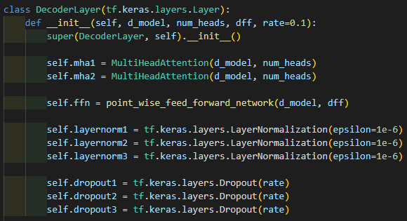
Encoder and Decoder Layers
Encoder Layer
Decoder Layer
norm
norm
ffn
ffn
norm
norm
mha
mha
norm
▶ This is the init function for DecoderLayer.
Almost same components with EncoderLayer,
differs with the number of layers,
since decoder layer has 3 sub layers
mmha

Slide 60
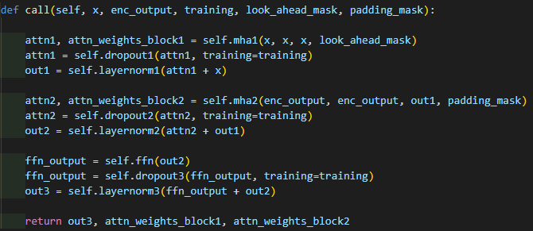
Encoder and Decoder Layers
Encoder Layer
Decoder Layer
norm
norm
ffn
ffn
norm
norm
mha
mha
▶ This is the call function of decoder layer
norm
mmha

Slide 61
Encoder and Decoder Layers
Encoder Layer
Decoder Layer
norm
norm
ffn
ffn
norm
norm
mha
mha
▶ x is a matrix that passed positional encoding layer
and it’s about the target sequence
norm
mmha
x.shape
(batch_size, seq_len, d_model)
sequence length of target sequence

Slide 62
Encoder and Decoder Layers
Encoder Layer
Decoder Layer
norm
norm
ffn
ffn
norm
norm
mha
mha
▶ enc_output is the return value of encoder layer
and it’s about the input sequence
norm
mmha
enc_output.shape
(batch_size, seq_len, d_model)
This will be used in second multi head attention layer, to make key and value matrix
sequence length of input sequence

Slide 63
Encoder and Decoder Layers
Encoder Layer
Decoder Layer
norm
norm
ffn
ffn
norm
norm
mha
mha
▶ Boolean type parameter for dropout
▷ if True, we apply dropout for input layer (attn1 / attn2 / ffn_output)
▷ if False, this layer will do nothing.
norm
mmha

Slide 64
Encoder and Decoder Layers
Encoder Layer
Decoder Layer
norm
norm
ffn
ffn
norm
norm
mha
mha
▶ Look ahead mask and padding mask for decoder
and it’s about the target sequence.
norm
mmha
look_ahead_mask.shape == padding_mask.shape
(batch_size, 1, 1, tar_seq_len)
※ From this slide, we’ll separate
tar_seq_len for target sequence,
inp_seq_len for input sequence

Slide 65
Encoder and Decoder Layers
Encoder Layer
Decoder Layer
norm
norm
ffn
ffn
norm
norm
mha
mha
▶ Masked multi head attention,
multi head attention with look ahead mask.
what is different from encoder layer is
that we store attention_weights in variable attn_weights_block1
norm
mmha

Slide 66
Encoder and Decoder Layers
Encoder Layer
Decoder Layer
norm
norm
ffn
ffn
norm
norm
mha
mha
x.shape
(batch_size, tar_seq_len, d_model)
attn1.shape
(batch_size, tar_seq_len, d_model)
norm
mmha
look_ahead_mask.shape
(batch_size, 1, 1, tar_seq_len)
attn_weights_block1.shape
(batch_size, self.num_heads, tar_seq_len, tar_seq_len)

Slide 67
Encoder and Decoder Layers
Encoder Layer
Decoder Layer
norm
norm
ffn
ffn
norm
norm
mha
mha
▶ Dropout and layer normalization
same method to what we did in encoder layer
norm
mmha
attn1.shape == x.shape
(batch_size, tar_seq_len, d_model)
out1.shape
(batch_size, tar_seq_len, d_model)

Slide 68
Encoder and Decoder Layers
Encoder Layer
Decoder Layer
norm
norm
ffn
ffn
norm
norm
mha
mha
▶ Multi head attention that uses enc_output
to create value and key matrix
norm
mmha
out1.shape
(batch_size, tar_seq_len, d_model)
enc_output.shape
(batch_size, tar_seq_len, d_model)

Slide 69
Encoder and Decoder Layers
Encoder Layer
Decoder Layer
norm
norm
ffn
ffn
norm
norm
mha
mha
▶ padding_mask is a padding mask,
that is created with target sequence
norm
mmha
padding_mask.shape
(batch_size, 1, 1, tar_seq_len)

Slide 70
Encoder and Decoder Layers
Encoder Layer
Decoder Layer
norm
norm
ffn
ffn
norm
norm
mha
mha
attn2.shape
(batch_size, tar_seq_len, d_model)
norm
mmha
attn_weights_block2.shape
(batch_size, self.num_heads, tar_seq_len, tar_seq_len)

Slide 71
Encoder and Decoder Layers
Encoder Layer
Decoder Layer
norm
norm
ffn
ffn
norm
norm
mha
mha
▶ Dropout and layer normalization
norm
attn2.shape == x.shape
(batch_size, tar_seq_len, d_model)
out1.shape
(batch_size, tar_seq_len, d_model)
mmha
out2.shape
(batch_size, tar_seq_len, d_model)

Slide 72
Encoder and Decoder Layers
Encoder Layer
Decoder Layer
norm
norm
ffn
ffn
norm
norm
mha
mha
▶ Pointwise feed forward network.
out2.shape was (batch_size, tar_seq_len, d_model)
During ffn layer, shape of input matrix will be transformed like this
norm
mmha
(batch_size, tar_seq_len, d_model)
(batch_size, tar_seq_len, dff)
(batch_size, tar_seq_len, d_model)

Slide 73
Encoder and Decoder Layers
Encoder Layer
Decoder Layer
norm
norm
ffn
ffn
norm
norm
mha
mha
▶ Dropout and layer normalization
ffn_output.shape
(batch_size, tar_seq_len, d_model)
norm
mmha
out3.shape
(batch_size, tar_seq_len, d_model)
out2.shape
(batch_size, tar_seq_len, d_model)

Slide 74
Encoder and Decoder Layers
Encoder Layer
Decoder Layer
norm
norm
ffn
ffn
norm
norm
mha
mha
▶ Return three matrices
attn_weights_block1.shape
(batch_size, self.num_heads, tar_seq_len, tar_seq_len)
norm
mmha
out3.shape
(batch_size, tar_seq_len, d_model)
attn_weights_block1.shape
(batch_size, self.num_heads, tar_seq_len, tar_seq_len)

Slide 75
Encoder and Decoder Layers
enc_output matrix shape
(batch_num, inp_seq_len, d_model)
Encoder Layer
Decoder Layer
output matrix shape
(batch_num, tar_seq_len, d_model)
norm
norm
ffn
ffn
attn_weights_block.shape
(batch_size, self.num_heads, tar_seq_len, tar_seq_len)
norm
norm
mha
mha
input matrix shape
(batch_num, inp_seq_len, d_model)
norm
mmha
+ padding mask
input matrix shape
(batch_num, tar_seq_len, d_model)
+ padding mask and
look ahead mask

Slide 76
Encoder and Decoder
▶ So, we have seen encoder/decoder layers
and we know that encoder and decoder consists of N stacks of their layers
Encoder
Decoder
Encoder Layer
Decoder Layer
N = 2
Encoder Layer
Decoder Layer

Slide 77
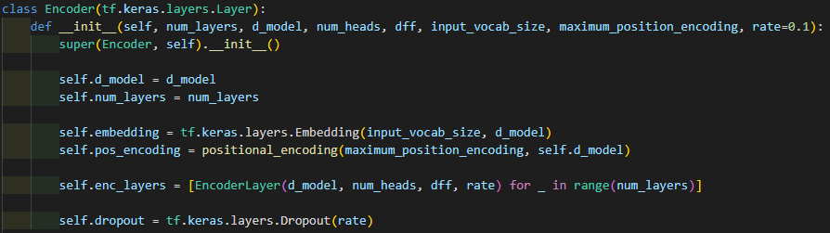
The number of words
for input language
Encoder and Decoder
▶ this is init function for class Encoder
embedding for embedding layer to create embedding matrix
pos_encoding for positional encoding
dropout for dropout layer

Slide 78
Encoder and Decoder
▶ As we said, Encoder consists of N layers ( in this example, num_layers )
enc_layers is an array, that has num_layers of EncoderLayer as element

Slide 79
Encoder and Decoder
syntax
_ is a dummy variable.
num_layers is used here only,
so through this,
we don’t store this value in some variable
▶ As we said, Encoder consists of N layers ( in this example, num_layers )
enc_layers is an array, that has num_layers of EncoderLayer as element
same as
for(i=0; i<num_layers; i++){
enc_layers[i] = EncoderLayer(d_model, num_heads, dff, rate)}
in c

Slide 80
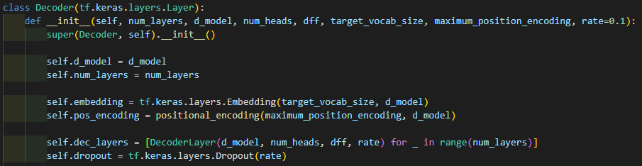
Encoder and Decoder
The number of words
for target language
▶ this is init function for class Decoder
embedding for embedding layer to create embedding matrix
pos_encoding for positional encoding
dec_layers is an array containing decoder layers
dropout for dropout layer

Slide 81
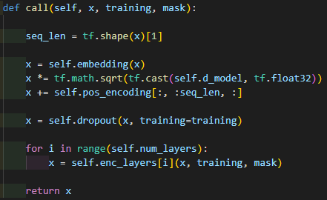
Encoder and Decoder
▶ This is call function for encoder
▶ x is a token ID sequence
its shape is
▶ training is boolean type parameter for dropout
▶ mask is a padding mask matrix, and its shape is
x.shape
(batch_size, inp_seq_len)
mask.shape
(batch_size, inp_seq_len, d_model)
Encoder
Decoder
Encoder Layer
Decoder Layer
Encoder Layer
Decoder Layer

Slide 82
Encoder and Decoder
▶ tf.shape(x)[1] is inp_seq_len since
so inp_seq_len will be stored in variable seq_len
x.shape
(batch_size, inp_seq_len)
Encoder
Decoder
Encoder Layer
Decoder Layer
Encoder Layer
Decoder Layer

Slide 83
Encoder and Decoder
▶ transform input sequence to embedding matrix
then the dimension of x will be transformed to
x.shape
(batch_size, inp_seq_len)
x.shape
(batch_size, inp_seq_len, d_model)
Encoder
Decoder
Encoder Layer
Decoder Layer
Encoder Layer
Decoder Layer
add embedding
to input sequence

Slide 84
Encoder and Decoder
▶ Normalization
Encoder
Decoder
Encoder Layer
Decoder Layer
Encoder Layer
Decoder Layer
add embedding
to input sequence

Slide 85
Encoder and Decoder
▶ Add pos_coding to x
pos_encoding.shape
(1, pe_input, d_model)
[:, :seq_len, :]
pos_encoding[:, :seq_len, :].shape
(1, inp_seq_len, d_model)
In positional encoding,
we got pe_input and d_model
given by transformer as input parameter
and (1, pe_input, d_model) shape matrix as output.
Encoder
Decoder
Encoder Layer
Decoder Layer
Encoder Layer
Decoder Layer
add pos_encoding
to input sequence
add embedding
to input sequence

Slide 86
Encoder and Decoder
▶ Add pos_coding to x
pos_encoding.shape
(1, pe_input, d_model)
[:, :seq_len, :]
pos_encoding[:, :seq_len, :].shape
(1, inp_seq_len, d_model)
In positional encoding,
we got pe_input and d_model
given by transformer as input parameter
and (1, pe_input, d_model) shape matrix as output.
x.shape
(batch_size, inp_seq_len, d_model)
▶ Adds pos_encoding[:, :seq_len, :] to x
Encoder
Decoder
Encoder Layer
Decoder Layer
Encoder Layer
Decoder Layer
add pos_encoding
to input sequence
add embedding
to input sequence

Slide 87
Encoder and Decoder
▶ Add pos_coding to x
pos_encoding.shape
(1, pe_input, d_model)
[:, :seq_len, :]
pos_encoding[:, :seq_len, :].shape
(1, inp_seq_len, d_model)
In positional encoding,
we got pe_input and d_model
given by transformer as input parameter
and (1, pe_input, d_model) shape matrix as output.
x.shape
(batch_size, inp_seq_len, d_model)
▶ Adds pos_encoding[:, :seq_len, :] to x
so, pos_encoding will be added to
every batch of sequence to the same value
it’s because pos_encoding is to express the position of the word in the sequences,
regardless of the value of each sequence
Encoder
Decoder
Encoder Layer
Decoder Layer
Encoder Layer
Decoder Layer
add pos_encoding
to input sequence
add embedding
to input sequence

Slide 88
Encoder and Decoder
▶ Dropout
when training=True, dropout will be activated
otherwise, dropout will do nothing.
Encoder
Decoder
Encoder Layer
Decoder Layer
Encoder Layer
Decoder Layer
add pos_encoding
to input sequence
add embedding
to input sequence

Slide 89
Encoder and Decoder
▶ enc_layers consists of encoding layers
we did not use dummy variable _ here,
because it is used here!
Encoder
Decoder
Encoder Layer
Decoder Layer
Encoder Layer
Decoder Layer
add pos_encoding
to input sequence
add embedding
to input sequence

Slide 90
Encoder and Decoder
▶ enc_layers consists of encoding layers
▶ x is used to handle the
previous output of encoder layer.
and finally, x will have the output of
the last encoder layer
x.shape
(batch_size, inp_seq_len, d_model)
Encoder
Decoder
Encoder Layer
Decoder Layer
Encoder Layer
Decoder Layer
add pos_encoding
to input sequence
add embedding
to input sequence

Slide 91
Encoder and Decoder
▶ Return matrix x is the output of encoder
x.shape
(batch_size, inp_seq_len, d_model)
Encoder
Decoder
Encoder Layer
Decoder Layer
Encoder Layer
Decoder Layer
add pos_encoding
to input sequence
add embedding
to input sequence

Slide 92
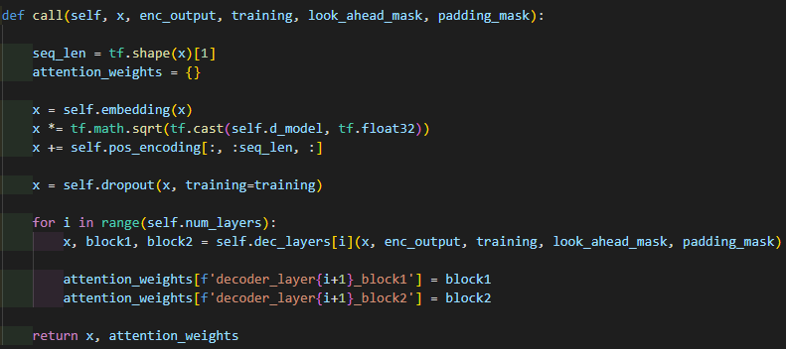
Encoder and Decoder
▶ x is a token ID sequence
for target sequence
x.shape
(batch_size, tar_seq_len)
▶ enc_output is a matrix
returned from encoder
enc_output.shape
(batch_size, inp_seq_len, d_model)
▶ training is Boolean type
parameter decides
activating dropout
▶ look_ahead_mask
padding_mask are
mask matrices
Encoder
Decoder
Encoder Layer
Decoder Layer
Encoder Layer
Decoder Layer
mask.shape
(batch_size, tar_seq_len, d_model)
add pos_encoding
to input sequence
add embedding
to input sequence

Slide 93
Encoder and Decoder
▶ x is a token ID sequence
for target sequence
x.shape
(batch_size, tar_seq_len)
▶ tf.shape(x)[1] is tar_seq_len
Encoder
Decoder
Encoder Layer
Decoder Layer
Encoder Layer
Decoder Layer
add pos_encoding
to input sequence
add embedding
to input sequence

Slide 94
Encoder and Decoder
▶ attention_weights is
an empty dictionary
Encoder
Decoder
Encoder Layer
Decoder Layer
Encoder Layer
Decoder Layer
add pos_encoding
to input sequence
add embedding
to input sequence

Slide 95
Encoder and Decoder
▶ transform token ID sequence
to embedding matrix
▶ Regularization
▶ Add pos_encoding to x
▶ According to training,
if training is true, we will
apply dropout to x
These steps are identical with
what we did in Encoder!
pos_encoding[:, :seq_len, :].shape
(1, tar_seq_len, d_model)
x.shape
(batch_size, tar_seq_len, d_model)
Encoder
Decoder
Encoder Layer
Decoder Layer
Encoder Layer
Decoder Layer
add pos_encoding
to input sequence
add pos_encoding
to input sequence
add embedding
to input sequence
add embedding
to input sequence

Slide 96
Encoder and Decoder
▶ dec_layers is an array,
containing decoder layers
Decoder layer returns
a matrix that passed all of the layers,
and two attention weight matrices
that used for each multi head attentions.
block1 and block2 will have attention weights
used in masked mha and mha each.
Encoder
Decoder
Encoder Layer
Decoder Layer
Encoder Layer
Decoder Layer
add pos_encoding
to input sequence
add embedding
to input sequence

Slide 97
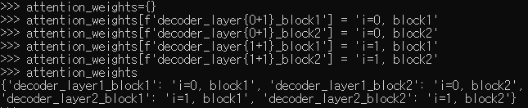
Encoder and Decoder
▶ dec_layers is an array,
containing decoder layers
Decoder layer returns
a matrix that passed all of the layers,
and two attention weight matrices
that used for each multi head attentions.
for each decoder layer,
attention weights will be stored
in attention_wewights dictionary.
Encoder
Decoder
Encoder Layer
Decoder Layer
Encoder Layer
Decoder Layer
add pos_encoding
to input sequence
add embedding
to input sequence

Slide 98
Encoder and Decoder
▶ Decoder returns matrix x
and attention_weights
x.shape
(batch_size, tar_seq_len, d_model)
attention_weights is a dictionary
Encoder
Decoder
Encoder Layer
Decoder Layer
Encoder Layer
Decoder Layer
add pos_encoding
to input sequence
add embedding
to input sequence

Slide 99
Encoder and Decoder
output dictionary
containing every attention_weights
output matrix shape
(batch_num, tar_seq_len, d_model)
Encoder
Decoder
Encoder Layer
Decoder Layer
Encoder Layer
Decoder Layer
input matrix shape
(batch_num, inp_seq_len)
input matrix shape
(batch_num, tar_seq_len)
+ padding mask
+ padding mask
look ahead mask

Slide 100
Transformer
▶ Now we can discuss about the Transformer model
▶ Transformer is subclass of Model tf.keras.Model,
tf.keras.Model groups layers ( we have defined so far )
so the layer group can be used to train and inference
we instantiate Model by subclassing it
when we subclass kf.keras.Model,
we should define layers in __init__()
we should implement the forward pass int call()

Slide 101
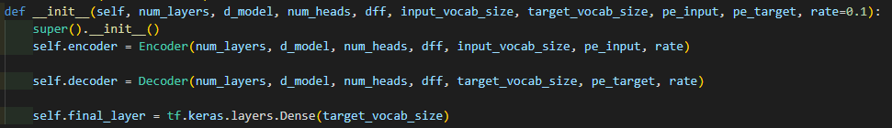
Transformer
These are hyperparameters we can define!
▶ num_layers
▷ number of encoder/decoder layers
▶ d_model
▷ dimension of transformer
▶ num_heads
▷ in mha, we split heads by this parameter
▶ dff
▷ dimension that will be used inside of ffn

Slide 102
Transformer
These are hyperparameters we can define!
▶ input_vocab_size / target_vocab_size
▷ the number of entire words for input/target language
▶ pe_input / pe_target
▷ used in positional encoding, effects the dimension of the positional encoding
▶ rate
▷ dropout rate

Slide 103
Transformer
▶ __init__() function of tf.keras.Model

Slide 104
Transformer
▶ Encoder and Decoder we discussed so far

Slide 105
Transformer
▶ final_layer is a dense layer
its activation function is default None

Slide 106
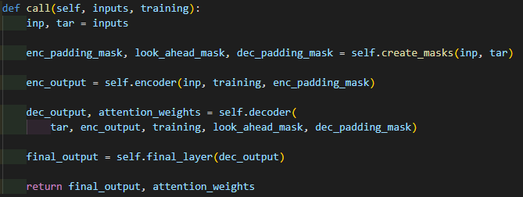
Transformer
▶ call function of transformer
▷ inputs : tuple of English, Portuguese Token ID matrix
▷ training : Boolean type parameter, decides activation of dropout
inputs is a tuple

Slide 107
Transformer
▶ inputs is a tuple
consists of input token ID matrix and target token ID matrix
inp.shape
(batch_size, inp_seq_len)
tar.shape
(batch_size, tar_seq_len)

Slide 108
Transformer
At the first of this practice, we discussed about input data
Dataset => (examples, metadata)
examples => (train data, validation data)
train data => (English token ID matrix, Portuguese token ID matrix)
▶ inputs is a tuple
consists of input token ID matrix and target token ID matrix
inp.shape
(batch_size, inp_seq_len)
tar.shape
(batch_size, tar_seq_len)

Slide 109
Transformer
▶ create mask matrices, we have seen create_masks in Masking section.
enc_padding_mask.shape
(batch_size, 1, 1, inp_seq_len)
look_ahead_mask.shape
(batch_size, 1, 1, tar_seq_len)
dec_padding_mask.shape
(batch_size, 1, 1, tar_seq_len)

Slide 110
Transformer
▶ Encoder, Decoder, and Final dense layer
enc_output.shape
(batch_size, inp_seq_len, d_model)
dec_output.shape
(batch_size, tar_seq_len, d_model)
final_output.shape
(batch_size, tar_seq_len, d_model)
attention_weights is a
dictionary

Slide 111
Transformer
▶ Return final output, and attention weights
final_output.shape
(batch_size, tar_seq_len, d_model)
attention_weights is a
dictionary

