Slide 1
Transformer Practice
컴퓨터소프트웨어학부 심승현

Slide 2
Contents
https://www.tensorflow.org/text/tutorials/transformer
Tensorflow.org, transformer tutorial
translating Portuguese to English using transformer model

Slide 3
Review : Transformer structure
Transformer
output matrix
(batch_size, seq_len, target_vocab_size)
Final layer
Encoder
Decoder
Encoder Layer
Decoder Layer
Encoder Layer
Decoder Layer
+embedding
+positional encoding
+embedding
+positional encoding
input sequence
target sequence

Slide 4
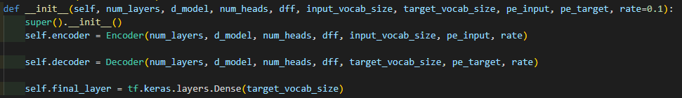
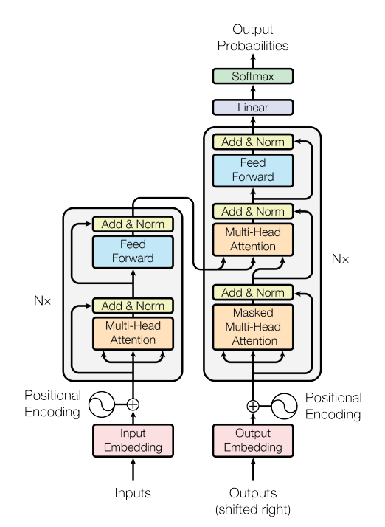
Transformer
num_layers
pe_input
input_vocab_size

Slide 5
Transformer
dff
num_layers
num_heads
pe_input
input_vocab_size

Slide 6
Transformer
target_vocab_size
num_layers
pe_target
target_vocab_size

Slide 7
Transformer
target_vocab_size
dff
num_heads
num_layers
num_heads
pe_target
target_vocab_size

Slide 8
Transformer
▶ final_layer is a dense layer

Slide 9
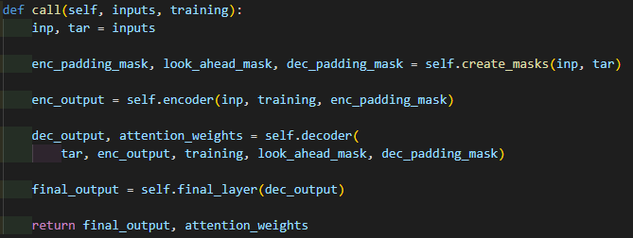
Transformer

Slide 10

Transformer
inputs
([[1, 3, 4, 2, 0]], [[1, 3, 5, 4, 2]])
tokenize

Slide 11
Transformer
▶ training is a Boolean type parameter
True : Apply dropout ( train mode )
False : No dropout ( inference mode )

Slide 12
Transformer
▶ Actions are
▷ Create mask
▷ call encoder and decoder
▷ pass the final layer, and return the result

Slide 13

Transformer
▶ Example transformer model
▶ d_model : decides the dimension of matrix
used in transformer
▶ rate : dropout rate
dff
num_layers
num_heads
pe_input
input_vocab_size

Slide 14
Transformer
▶ Example transformer model
▶ d_model : decides the dimension of matrix
used in transformer
▶ rate : dropout rate
target_vocab_size
dff
num_heads
num_layers
num_heads
pe_target
target_vocab_size

Slide 15
Transformer
output probability matrix
▶ Let’s train the model through this sentence
▷ Transform this string to token ID
that transformer takes as input
Final Layer
Encoder Layer
Decoder Layer
Encoder Layer
Decoder Layer
Input token ID sequence
Target token ID sequence

Slide 16
Transformer
output probability matrix
▶ Let’s train the model through this sentence
▷ Transform this string to token ID
that transformer takes as input
Final Layer
Encoder Layer
Decoder Layer
Encoder Layer
Decoder Layer
([[1, 3, 4, 2, 0]], [[1, 3, 5, 4, 2]])
‘1’ : sos
‘2’ : eos
‘0’ : pad token
Input token ID sequence
Target token ID sequence
tokenize
batch size = 1

Slide 17
Transformer
transformer encoder input
transformer decoder input
[[1, 3, 4, 2, 0]]
[[1, 3, 5, 4]]
([[1, 3, 4, 2, 0]], [[1, 3, 5, 4, 2]])
[[3, 5, 4, 2]]
This is the expected output
of transformer
‘1’ : sos
‘2’ : eos
‘0’ : pad token
tokenize

Slide 18
Transformer
[[3, 5, 4, 2]]
output probability matrix
Final Layer
[[1, 3, 4, 2, 0]]
[[1, 3, 5, 4]]
Encoder Layer
Decoder Layer
([[1, 3, 4, 2, 0]], [[1, 3, 5, 4, 2]])
Encoder Layer
Decoder Layer
‘1’ : sos
‘2’ : eos
‘0’ : pad token
tokenize
[[1, 3, 4, 2, 0]]
[[1, 3, 5, 4]]

Slide 19
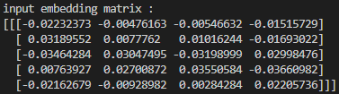
Transformer
▶ Add embedding and positional encoding
output probability matrix
Final Layer
Encoder Layer
Decoder Layer
input embedding matrix
(1, 5, 4)
Encoder Layer
Decoder Layer
input
sequence
length = 5
[[1, 3, 4, 2, 0]]
[[1, 3, 5, 4]]
batch size = 1
d_model = 4

Slide 20
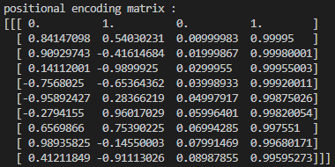
Transformer
▶ Add embedding and positional encoding
output probability matrix
Final Layer
positional encoding matrix
(1, 10, 4)
Encoder Layer
Decoder Layer
Encoder Layer
Decoder Layer
pe_input = 10
[[1, 3, 4, 2, 0]]
[[1, 3, 5, 4]]
batch size = 1
d_model = 4

Slide 21
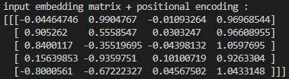
Transformer
▶ Add embedding and positional encoding
output probability matrix
Final Layer
Encoder Layer
Decoder Layer
Add embedding and positional encoding
(1, 5, 4)
Encoder Layer
Decoder Layer
input
sequence
length = 5
[[1, 3, 4, 2, 0]]
[[1, 3, 5, 4]]
batch size = 1
d_model = 4

Slide 22

Transformer
▶ Add embedding and positional encoding
output probability matrix
▶ Same step with target input
Final Layer
Encoder Layer
Decoder Layer
Add embedding and positional encoding
(1, 4, 4)
Encoder Layer
Decoder Layer
target
sequence
length = 4
[[1, 3, 4, 2, 0]]
[[1, 3, 5, 4]]
batch size = 1
d_model = 4

Slide 23
Transformer
▶ This (1, 5, 4) shape matrix is
input of Encoder
output probability matrix
input
sequence
length = 5
Final Layer
batch size = 1
d_model = 4
Encoder Layer
Decoder Layer
Encoder Layer
Decoder Layer
input matrix
input matrix
[[1, 3, 4, 2, 0]]
[[1, 3, 5, 4]]

Slide 24
Transformer
▶ Encoder consists of Encoder Layers
Encoder Layer consists of two sublayers
output probability matrix
Final Layer
ffn
Encoder Layer
Decoder Layer
mha
Encoder Layer
Encoder Layer
Decoder Layer
input matrix
input matrix
[[1, 3, 4, 2, 0]]
[[1, 3, 5, 4]]

Slide 25
Transformer
Encoder input matrix
(1, 5, 4)
Encoder
Layer
ffn
mha
input matrix
[[1, 3, 4, 2, 0]]
input
sequence
length = 5
batch size = 1
d_model = 4

Slide 26
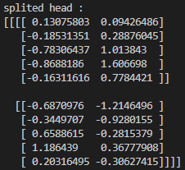
Transformer
d_model // num_heads
Multi head attention matrix (inside)
(1, 2, 5, 2)
Encoder
Layer
input
sequence
length = 5
ffn
mha
batch size = 1
num_heads = 2
input matrix
[[1, 3, 4, 2, 0]]
input
sequence
length = 5
batch size = 1
d_model = 4

Slide 27
Transformer
d_model // num_heads
Multi head attention matrix (inside)
(1, 2, 5, 2)
Encoder
Layer
input
sequence
length = 5
ffn
mha
batch size = 1
num_heads = 2
input matrix
[[1, 3, 4, 2, 0]]

Slide 28
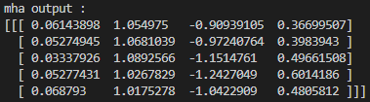
Transformer
d_model // num_heads
Multi head attention matrix (inside)
(1, 2, 5, 2)
Encoder
Layer
input
sequence
length = 5
ffn
Multi head attention output matrix
(1, 5, 4)
mha
batch size = 1
num_heads = 2
input matrix
[[1, 3, 4, 2, 0]]
input
sequence
length = 5
batch size = 1
d_model = 4

Slide 29
Transformer
Encoder
Layer
ffn
mha
input matrix
[[1, 3, 4, 2, 0]]
input
sequence
length = 5
batch size = 1
d_model = 4

Slide 30
Transformer
Encoder
Layer
ffn
mha
input matrix
[[1, 3, 4, 2, 0]]
pad token
input
sequence
length = 5
batch size = 1
d_model = 4

Slide 31
Transformer
Multi head attention matrix (inside)
(1, 2, 5, 2)
Encoder
Layer
ffn
Padding mask
(1, 1, 1, 5)
mha
[[[[0, 0, 0, 0, 1]]]]
input matrix
[[1, 3, 4, 2, 0]]
Encoder input matrix
(1, 5, 4)
pad token
input
sequence
length = 5
batch size = 1
d_model = 4

Slide 32
Transformer
Multi head attention matrix (inside)
(1, 2, 5, 2)
Encoder
Layer
ffn
Padding mask
(1, 1, 1, 5)
Multi head attention matrix (inside)
(1, 2, 5, 5)
mha
[[[[0, 0, 0, 0, 1]]]]
input matrix
Padding mask
(1, 1, 1, 5)
[[1, 3, 4, 2, 0]]
Encoder input matrix
(1, 5, 4)
pad token
input
sequence
length = 5
batch size = 1
d_model = 4

Slide 33
Transformer
Multi head attention output matrix
(1, 5, 4)
Encoder
Layer
ffn
mha
input matrix
[[1, 3, 4, 2, 0]]
input
sequence
length = 5
batch size = 1
d_model = 4

Slide 34
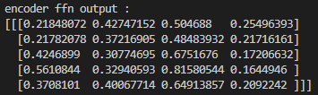
Transformer
Multi head attention output matrix
(1, 5, 4)
Encoder
Layer
Feed forward network
output matrix
(1, 5, 4)
ffn
mha
input matrix
[[1, 3, 4, 2, 0]]
input
sequence
length = 5
batch size = 1
d_model = 4

Slide 35
Transformer
Feed forward network hidden matrix
(1, 5, 8)
Encoder
Layer
dff = 8
ffn
[[
... | ... | ... | ... | ... | ... | ... | ...
... | ... | ... | ... | ... | ... | ... | ...
... | ... | ... | ... | ... | ... | ... | ...
... | ... | ... | ... | ... | ... | ... | ...
... | ... | ... | ... | ... | ... | ... | ...
mha
input
sequence
length = 5
input matrix
[[1, 3, 4, 2, 0]]
]]
input
sequence
length = 5
batch size = 1
d_model = 4

Slide 36
Transformer
Feed forward network
output matrix
(1, 5, 4)
d_model = 4
Encoder
Layer
input
sequence
length = 5
ffn
batch size = 1
mha
input matrix
[[1, 3, 4, 2, 0]]

Slide 37
Transformer
▶ this is the output matrix of a single encoder layer
d_model = 4
Encoder
Layer
ffn
input
sequence
length = 5
mha
batch size = 1
input matrix
[[1, 3, 4, 2, 0]]

Slide 38
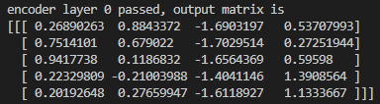
Transformer
▶ this is the output matrix of a single encoder layer
Encoder Layer
d_model = 4
Normalize!
Encoder Layer
input
sequence
length = 5
input matrix
batch size = 1
[[1, 3, 4, 2, 0]]

Slide 39
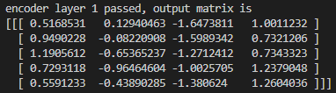
Transformer
▶ Same method to other encoder layers,
and the final encoder layer’s output is the output of Encoder!
Encoder Layer
d_model = 4
Normalize!
Encoder Layer
input
sequence
length = 5
input matrix
batch size = 1
[[1, 3, 4, 2, 0]]

Slide 40
Transformer
▶ Same method to other encoder layers,
and the final encoder layer’s output is the output of Encoder!
Encoder Layer
d_model = 4
Normalize!
Encoder Layer
input
sequence
length = 5
input matrix
batch size = 1
[[1, 3, 4, 2, 0]]

Slide 41
Transformer
▶ Same method to other encoder layers,
and the final encoder layer’s output is the output of Encoder!
Encoder Layer
d_model = 4
Normalize!
Encoder Layer
input
sequence
length = 5
input matrix
batch size = 1
[[1, 3, 4, 2, 0]]

Slide 42
Transformer
▶ Let’s move on to Decoder !
output probability matrix
Final Layer
Encoder Layer
Decoder Layer
Encoder Layer
Decoder Layer
[[1, 3, 4, 2, 0]]
[[1, 3, 5, 4]]

Slide 43

Transformer
▶ Let’s move on to Decoder !
Decoder consists of 3 sub layers
output probability matrix
Final Layer
Decoder
Layer
Encoder Layer
Decoder Layer
ffn
Layer1 output
= Encoder output
Encoder Layer
Decoder Layer
mha
mha
[[1, 3, 4, 2, 0]]
[[1, 3, 5, 4]]

Slide 44
Transformer
▶ First multi head attention
multi head attention with look ahead mask
Decoder
Layer
ffn
Layer1 output
= Encoder output
mha
mha
[[1, 3, 5, 4]]

Slide 45

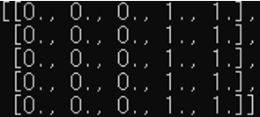
Transformer
▶ First multi head attention
multi head attention with look ahead mask
< Look Ahead Mask >
Decoder
Layer
ffn
Layer1 output
= Encoder output
Look Ahead Mask
when size = 5
Arbitrary padding mask
mha
mha
[[1, 3, 5, 4]]

Slide 46
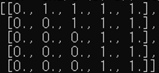
Transformer
▶ First multi head attention
multi head attention with look ahead mask
< Look Ahead Mask >
Decoder
Layer
ffn
Layer1 output
= Encoder output
Look Ahead Mask
when size = 5
Arbitrary padding mask
mha
mha
Result look ahead mask
[[1, 3, 5, 4]]

Slide 47

Transformer
▶ First multi head attention
multi head attention with look ahead mask
< Look Ahead Mask >
Decoder
Layer
ffn
Layer1 output
= Encoder output
Look Ahead Mask
when size = 5
Arbitrary padding mask
mha
mha
Result look ahead mask
In this example,
look ahead mask is
[[1, 3, 5, 4]]
(1, 1, 4, 4)

Slide 48

Transformer
▶ Other parts of multi head attention are the same!
Decoder multi head attention 1 output
(1, 4, 4)
d_model = 4
Decoder
Layer
ffn
target
sequence
length = 4
Layer1 output
= Encoder output
mha
batch size = 1
mha
[[1, 3, 5, 4]]

Slide 49
Transformer
▶ Second multi head attention
Decoder
Layer
ffn
Layer1 output
= Encoder output
mha
mha
[[1, 3, 5, 4]]

Slide 50
Transformer
▶ Second multi head attention
use Encoder output and previous step’s output both.
Encoder output
(1, 5, 4)
Decoder
Layer
ffn
Layer1 output
= Encoder output
Decoder multi head attention 1 output
(1, 4, 4)
mha
mha
[[1, 3, 5, 4]]

Slide 51
Transformer
▶ Second multi head attention
use Encoder output and previous step’s output both.
Encoder output
(1, 5, 4)
K, V
Decoder
Layer
Q
ffn
Layer1 output
= Encoder output
Decoder multi head attention 1 output
(1, 4, 4)
mha
mha
[[1, 3, 5, 4]]

Slide 52
Transformer
Encoder output
(1, 5, 4)
Decoder multi head attention 1 output
(1, 4, 4)
K, V
(1, 2, 5, 2)
Q
(1, 2, 4, 2)

Slide 53
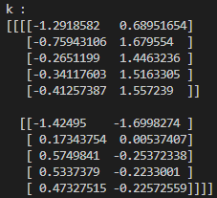
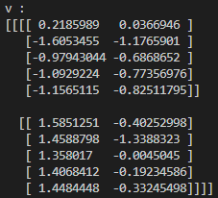
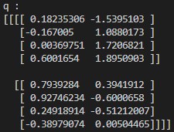
Transformer
Encoder output
(1, 5, 4)
Decoder multi head attention 1 output
(1, 4, 4)
Input
sequence
length = 5
Target
sequence
length = 4
K, V
(1, 2, 5, 2)
Q
(1, 2, 4, 2)

Slide 54
Transformer
K, V
(1, 2, 5, 2)
Q
(1, 2, 4, 2)

Slide 55
Transformer
d_model // num_heads = 2
d_model // num_heads = 2
Input
sequence
length = 5
Target
sequence
length = 4
Batch size = 1
num_heads=2
Batch size = 1
num_heads=2
K, V
(1, 2, 5, 2)
Q
(1, 2, 4, 2)

Slide 56
Transformer
K, V
(1, 2, 5, 2)
Q
(1, 2, 4, 2)

Slide 57
Transformer
K, V
(1, 2, 5, 2)
matmul_qk
(1, 2, 4, 5)
Q
(1, 2, 4, 2)

Slide 58
Transformer
K, V
(1, 2, 5, 2)
matmul_qk
(1, 2, 4, 5)
Q
(1, 2, 4, 2)
Padding mask
(1, 1, 1, 5)
Attention_weights
(1, 2, 4, 5)

Slide 59
Transformer
K, V
(1, 2, 5, 2)
matmul_qk
(1, 2, 4, 5)
Q
(1, 2, 4, 2)
Padding mask
(1, 1, 1, 5)
Attention_weights
(1, 2, 4, 5)

Slide 60
Transformer
K, V
(1, 2, 5, 2)
matmul_qk
(1, 2, 4, 5)
Q
(1, 2, 4, 2)
Padding mask
(1, 1, 1, 5)
Attention_weights
(1, 2, 4, 5)
output
(1, 2, 4, 2)

Slide 61
Transformer
output
(1, 2, 4, 2)
Concatenate
Decoder
Layer
ffn
Layer1 output
= Encoder output
mha
mha
[[1, 3, 5, 4]]

Slide 62

Transformer
output
(1, 2, 4, 2)
Concatenate
Decoder
Layer
ffn
multi head attention 2 output
(1, 4, 4)
Layer1 output
= Encoder output
mha
Target
sequence
length = 4
mha
d_model = 4
[[1, 3, 5, 4]]

Slide 63
Transformer
Decoder
Layer
ffn
multi head attention 2 output
(1, 4, 4)
Layer1 output
= Encoder output
mha
Target
sequence
length = 4
mha
d_model = 4
[[1, 3, 5, 4]]

Slide 64
Transformer
▶ Same method to Encoder’s !
Decoder
Layer
ffn
mha
mha
[[1, 3, 5, 4]]

Slide 65

Transformer
▶ Same method to Encoder’s !
feed forward network output
(1, 4, 4)
ffn
multi head attention 2 output
(1, 4, 4)
Target
sequence
length = 4
d_model = 4

Slide 66
Transformer
▶ This is an output of a single decoder layer
feed forward network output
(1, 4, 4)

Slide 67

Transformer
▶ This is an output of a single decoder layer
Decoder layer 0 output
(1, 4, 4)

Slide 68

Transformer
▶ Same method for other decoder layers
Decoder layer 0 output
(1, 4, 4)
Decoder output
(1, 4, 4)
Target
sequence
length = 4
batch size = 1
d_model = 4

Slide 69
Transformer
▶ Then, call the final layer with the output of Decoder
output probability matrix
Final Layer
Encoder Layer
Decoder Layer
Encoder Layer
Decoder Layer
[[1, 3, 4, 2, 0]]
[[1, 3, 5, 4]]

Slide 70
Transformer
▶ Then, call the final layer with the output of Decoder
output probability matrix
Final Layer
Encoder Layer
Decoder Layer
Encoder Layer
Decoder Layer
[[1, 3, 4, 2, 0]]
[[1, 3, 5, 4]]

Slide 71
Transformer
output probability matrix
▶ The output of decoder is
Target
sequence
length = 4
Decoder output
(1, 4, 4)
Final Layer
Decoder Layer
batch size = 1
Decoder Layer
d_model = 4
[[1, 3, 5, 4]]

Slide 72
Transformer
output probability matrix
▶ The output of decoder is
Target
sequence
length = 4
Decoder output
(1, 4, 4)
Final Layer
Decoder Layer
batch size = 1
Decoder Layer
d_model = 4
[[1, 3, 5, 4]]

Slide 73

Transformer
output probability matrix
▶ The output of decoder is
Target
sequence
length = 4
Decoder output
(1, 4, 4)
Final Layer
Decoder Layer
batch size = 1
Decoder Layer
d_model = 4
Target
sequence
length = 4
Final output
(1, 4, 7)
[[1, 3, 5, 4]]
batch size = 1
target_vocab_size = 7

Slide 74
Transformer
output probability matrix
▶ The output of Final layer is
Final Layer
Target
sequence
length = 4
Final output
(1, 4, 7)
Decoder Layer
Decoder Layer
batch size = 1
target_vocab_size = 7
[[1, 3, 5, 4]]

Slide 75
Transformer
▶ The output of Final layer is
output probability matrix
Target
sequence
length = 4
Final output
(1, 4, 7)
Final Layer
Decoder Layer
batch size = 1
target_vocab_size = 7
Decoder Layer
[[1, 3, 5, 4]]

Slide 76
Transformer
▶ This is the output matrix of transformer !
output probability matrix
Target
sequence
length = 4
Final output
(1, 4, 7)
Final Layer
Decoder Layer
batch size = 1
target_vocab_size = 7
Decoder Layer
[[1, 3, 5, 4]]

Slide 77
Transformer
▶ Let’s discuss what this matrix means
Final output
(1, 4, 7)
output probability matrix
Final Layer
Decoder
[[1, 3, 5, 4]]

Slide 78
Transformer
▶ Let’s discuss what this matrix means
Final output
(1, 4, 7)
output probability matrix
for each target sequence position,
4, 3, 3, 3 is the index of the maximum value
Final Layer
Decoder
[[1, 3, 5, 4]]

Slide 79
Transformer
▶ Let’s discuss what this matrix means
prediction :
[[4, 3, 3, 3]]
Final output
(1, 4, 7)
output probability matrix
for each target sequence position,
4, 3, 3, 3 is the index of the maximum value
Final Layer
Decoder
[[1, 3, 5, 4]]

Slide 80
truth :
[[3, 5, 4, 2]]
Transformer
▶ Let’s discuss what this matrix means
prediction :
[[4, 3, 3, 3]]
Final output
(1, 4, 7)
output probability matrix
for each target sequence position,
4, 3, 3, 3 is the index of the maximum value
Final Layer
Decoder
[[1, 3, 5, 4]]

Slide 81
truth :
[[3, 5, 4, 2]]
Transformer
Loss
▶ Let’s discuss what this matrix means
prediction :
[[4, 3, 3, 3]]
Final output
(1, 4, 7)
output probability matrix
for each target sequence position,
4, 3, 3, 3 is the index of the maximum value
Final Layer
Decoder
[[1, 3, 5, 4]]

Slide 82
truth :
[[3, 5, 4, 2]]
Transformer
Loss
▶ So, we can train the model
with the steps we have discussed.
prediction :
[[4, 3, 3, 3]]
output probability matrix
Final Layer
Decoder
[[1, 3, 5, 4]]

Slide 83
Train Step Using Transformer
▶ Transformer processes one batch of sequences
We can train the whole batch, repeatedly calling Transformer

Slide 84
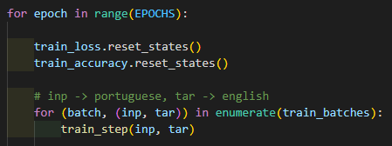
Train Step Using Transformer

Slide 85

Train Step Using Transformer
epoch = every batches in train data is trained once
▶ EPOCHS : How many times
will the entire dataset be trained?

Slide 86



Train Step Using Transformer
train_loss and train_accuracy
will store the mean value of input matrix.

Slide 87
Train Step Using Transformer
?

Slide 88

Train Step Using Transformer
train_examples
(pt, en)
(pt, en)
(pt, en)
...

Slide 89
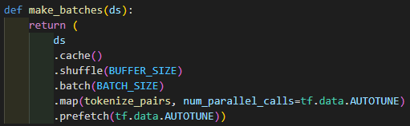
Train Step Using Transformer
train_examples
(pt, en)
(pt, en)
(pt, en)
...
train_batches is a tuple
(batch_num, (inp, tar))
inp, tar is a matrix
shape
(batch_size, seq_len)

Slide 90
Train Step Using Transformer
train_examples
(pt, en)
(pt, en)
(pt, en)
...
train_batches is a tuple
(batch_num, (inp, tar))
inp, tar is a matrix
shape
(batch_size, seq_len)

Slide 91
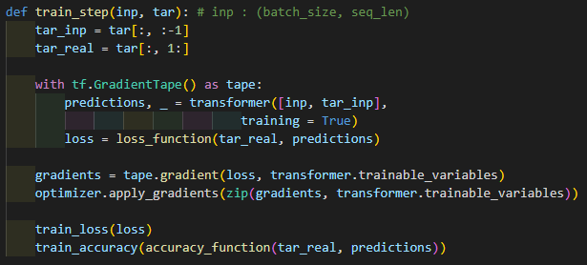
Train Step Using Transformer
inp, tar is a matrix
shape
(batch_size, seq_len)
tar = [sos,2,3,eos,0]
tar_inp = [sos,2,3,eos]
tar_real = [2,3,eos,0]

Slide 92
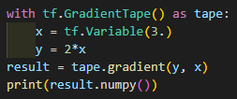
Train Step Using Transformer
▶ Record every operations in tape
prints 2

Slide 93
Train Step Using Transformer
▶ Used here !
gradients will have derivative of loss
prints 2

Slide 94
Train Step Using Transformer
▶ Call transformer, and get the result as predictions
predictions is a logit matrix for one batch

Slide 95
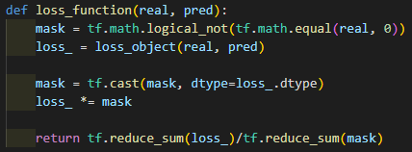
Train Step Using Transformer
▶ Calculate loss

Slide 96
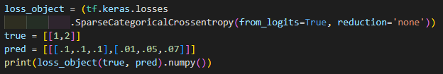
Train Step Using Transformer

Slide 97
Train Step Using Transformer
▶ no loss for pad token

Slide 98
Train Step Using Transformer
▶ tf.reduce_sum returns the sum of every elements for input

Slide 99
Train Step Using Transformer
▶ trainable_variables is an array,
consists of dense layers’ weights, and some other trainable values or matrices

Slide 100
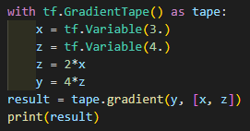
Train Step Using Transformer
▶ trainable_variables is an array,
consists of dense layers’ weights, and some other trainable values or matrices
▶ gradients is array of gradients,
for each element of trainable_variables

Slide 101
Train Step Using Transformer
▶ Apply gradients to variables
▶ apply_gradients function gets (gradients, variable) tuple as input

Slide 102
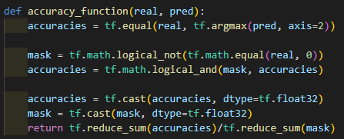
Train Step Using Transformer
loss is float32 variable

Slide 103
Train Step Using Transformer
tf.argmax returns index number
of which has the maximum value in input matrix
so, accuracies is a Boolean matrix
True for correct
False for incorrect
loss is float32 variable

Slide 104
Train Step Using Transformer
loss is float32 variable
tf.reduce_sum(accuracies) : number of correct
tf.reduce_sum(mask) : number of words

Slide 105
Train Step Using Transformer
▶ In summary, train_step calls transformer, and calculate loss, and apply loss to trainable variables
Through this code, we train the model !

Slide 106
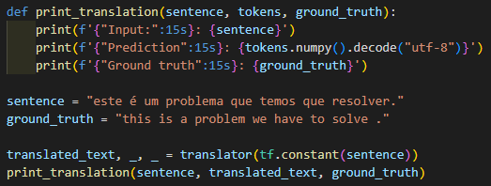
Translator Using Transformer
▶ Through the trained model, we will build translator, converts Portuguese to English

Slide 107

Translator Using Transformer
▶ Through the trained model, we will build translator, converts Portuguese to English
▶ Building Translator class

Slide 108
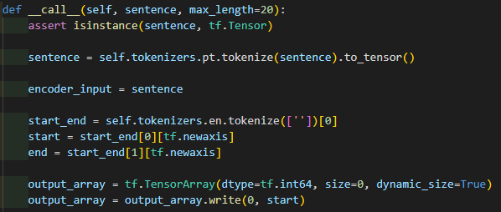

Translator Using Transformer
▶ Sentence is a string tensor
▶ max_length is max number of words for translator

Slide 109
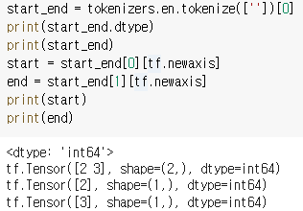
Translator Using Transformer
▶ start_end contains (‘sos token ID’, ‘eos token ID’)
start will have sos token ID,
end will have eos token ID

Slide 110

Translator Using Transformer

Slide 111
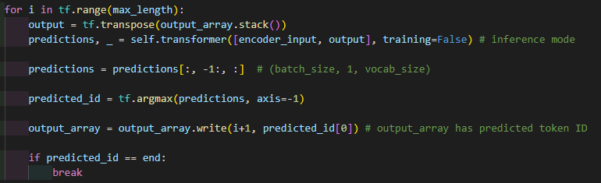
Translator Using Transformer
▶ output is (1,1) matrix at first, only contains start token ID
stack() stacks like
[[2],
[3],
[4]]
[[2, 3, 4]]
transpose

Slide 112
Translator Using Transformer
▶ we call transformer for each words
predictions is the last word of transformer output,
argmax returns index of the element, that has max value

Slide 113
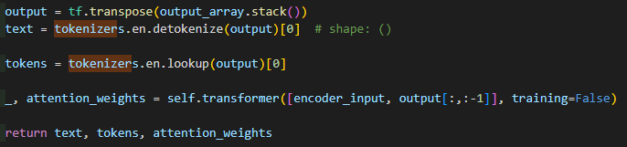
Translator Using Transformer
▶ After for loop, output_array has complete prediction token ID array
text contains prediction string array
output = [2, 4, 5, 6, 3]
text = [‘I’, ‘love’, ‘you’]
tokens = [‘start’, ‘I’, love’, ‘you’, ‘end’]
transpose

Slide 114

Translator Using Transformer

Slide 115



Translator Using Transformer

