Slide 1
Transformer Practice
컴퓨터소프트웨어학부 심승현

Slide 2
Contents
https://www.tensorflow.org/text/tutorials/transformer
Tensorflow.org, transformer tutorial
translating Portuguese to English using transformer model

Slide 3
Review : Transformer structure
output matrix
(batch_size, seq_len, target_vocab_size)
softmax
Encoder
Decoder
Encoder Layer
Decoder Layer
Encoder Layer
Decoder Layer
Input Language Sequence
Target Language Sequence

Slide 4
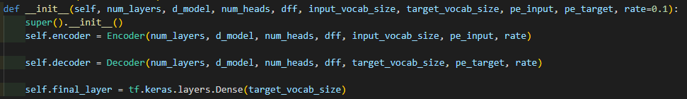
Transformer
▶ Encoder and Decoder we discussed so far

Slide 5
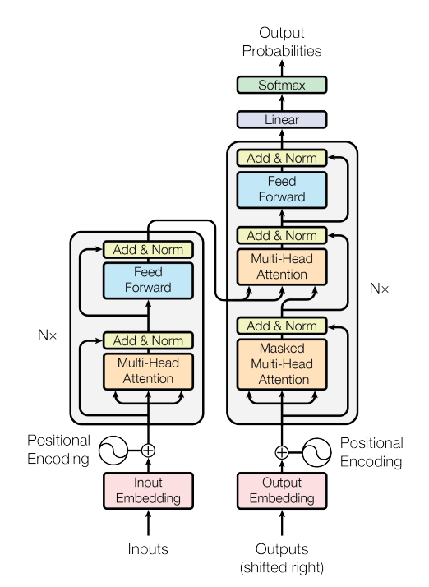
Transformer
▶ final_layer is a dense layer

Slide 6
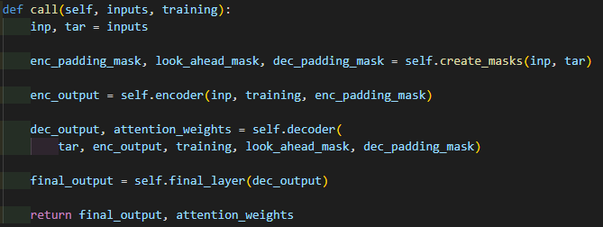
Transformer
▶ create masks
▶ pass encoder and decoder
▶ pass final_layer

Slide 7


Transformer
output probability matrix
softmax
Encoder Layer
Decoder Layer
Encoder Layer
Decoder Layer
Input token ID sequence
Target token ID sequence

Slide 8
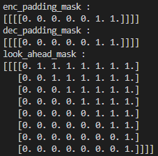
Transformer
output probability matrix
softmax
Encoder Layer
Decoder Layer
Encoder Layer
Decoder Layer
batch_size = 1
inp_seq_len = 7
tar_seq_len = 8
d_model = 6
Input token ID sequence
Target token ID sequence

Slide 9
Transformer
output probability matrix
softmax
Encoder Layer
Decoder Layer
Encoder Layer
Decoder Layer
Look ahead mask
includes padding mask
batch_size = 1
inp_seq_len = 7
d_model = 6
Input token ID sequence
Target token ID sequence

Slide 10


Transformer
output probability matrix
softmax
Encoder Layer
Decoder Layer
Encoder Layer
Decoder Layer
Input token ID sequence
Target token ID sequence
batch_size = 1
inp_seq_len = 7
batch_size = 1
tar_seq_len = 8

Slide 11
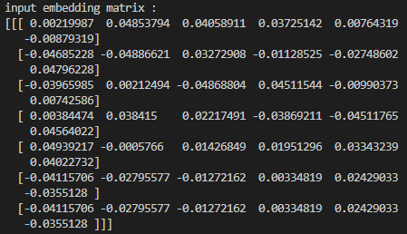
Transformer
output probability matrix
softmax
Encoder Layer
Decoder Layer
Encoder Layer
Decoder Layer
add embedding
to input sequence
Input token ID sequence
Target token ID sequence
batch_size = 1
inp_seq_len = 7
d_model = 6

Slide 12
Transformer
output probability matrix
softmax
Encoder Layer
Decoder Layer
Encoder Layer
Decoder Layer
add embedding
to input sequence
Input token ID sequence
Target token ID sequence
batch_size = 1
inp_seq_len = 7
d_model = 6

Slide 13
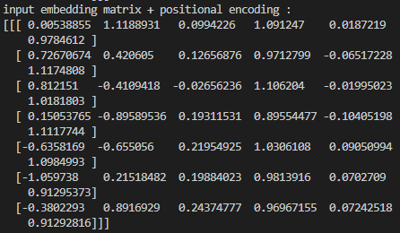
Transformer
output probability matrix
softmax
Encoder Layer
Decoder Layer
Encoder Layer
Decoder Layer
add pos_encoding
to input sequence
Input token ID sequence
Target token ID sequence
batch_size = 1
inp_seq_len = 7
d_model = 6

Slide 14
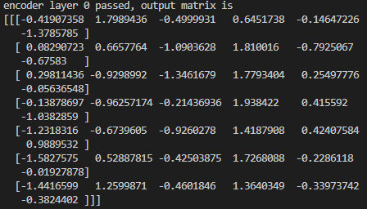
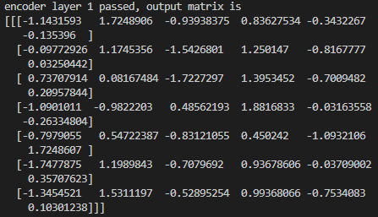
Transformer
output probability matrix
softmax
Encoder Layer
Decoder Layer
batch_size = 1
inp_seq_len = 7
d_model = 6
Encoder Layer
Decoder Layer
Input token ID sequence
Target token ID sequence
Encoder output matrix

Slide 15
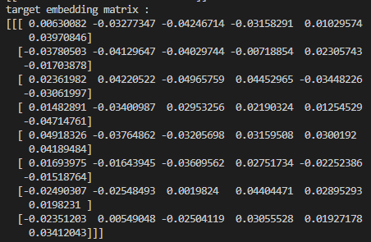
Transformer
output probability matrix
softmax
Encoder Layer
Decoder Layer
Encoder Layer
Decoder Layer
add embedding
to target sequence
Input token ID sequence
Target token ID sequence
batch_size = 1
tar_seq_len = 8
d_model = 6

Slide 16
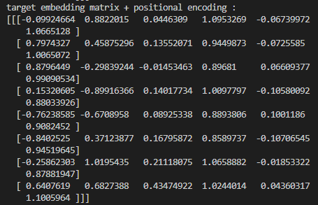
Transformer
output probability matrix
softmax
Encoder Layer
Decoder Layer
Encoder Layer
Decoder Layer
add pos_encoding
to target sequence
Input token ID sequence
Target token ID sequence
batch_size = 1
tar_seq_len = 8
d_model = 6

Slide 17
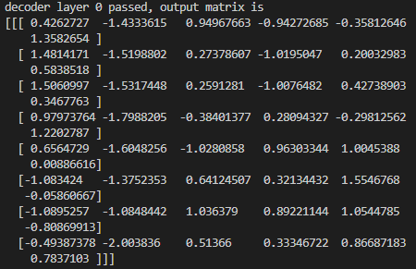
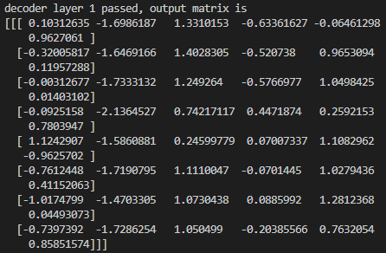
Transformer
output probability matrix
batch_size = 1
tar_seq_len = 8
d_model = 6
softmax
Encoder Layer
Decoder Layer
Encoder Layer
Decoder Layer
Input token ID sequence
Target token ID sequence
Decoder output matrix

Slide 18
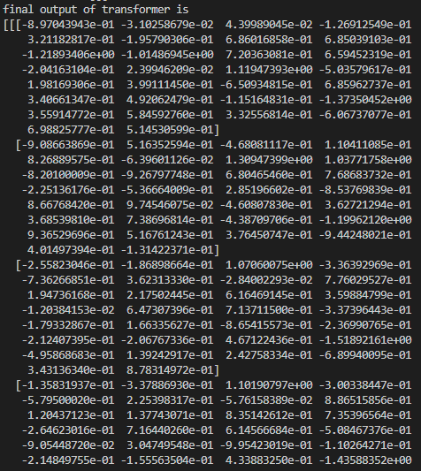
Transformer
Output logits tensor
(batch_size, seq_len, vocab_size)
output probability matrix
softmax
In this project,
final Denser layer has no activation function
this is called logits tensor !
Encoder Layer
Decoder Layer
Encoder Layer
Decoder Layer
Input token ID sequence
Target token ID sequence

Slide 19
Transformer
Output logits tensor
output probability matrix
softmax
Encoder Layer
Decoder Layer
Encoder Layer
Decoder Layer
Input token ID sequence
Target token ID sequence
tokenize
(Input sentence, target sentence)

Slide 20
Train Step Using Transformer
▶ Transformer processes one batch of sequences
We can train the whole dataset, repeatedly calling Transformer

Slide 21
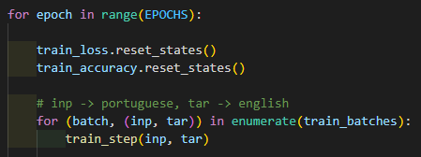
Train Step Using Transformer

Slide 22

Train Step Using Transformer
epoch = every batches in train data is trained once
▶ EPOCHS : How many times
will the entire dataset be trained?

Slide 23



Train Step Using Transformer
train_loss and train_accuracy
will store the mean value of input matrix.

Slide 24
Train Step Using Transformer
?

Slide 25

Train Step Using Transformer
train_examples
(pt, en)
(pt, en)
(pt, en)
...

Slide 26
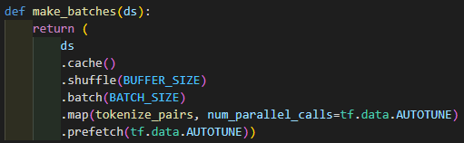
Train Step Using Transformer
train_examples
(pt, en)
(pt, en)
(pt, en)
...
train_batches is a tuple
(batch_num, (inp, tar))
inp, tar is a matrix
shape
(batch_size, seq_len)

Slide 27
Train Step Using Transformer
train_examples
(pt, en)
(pt, en)
(pt, en)
...
train_batches is a tuple
(batch_num, (inp, tar))
inp, tar is a matrix
shape
(batch_size, seq_len)

Slide 28
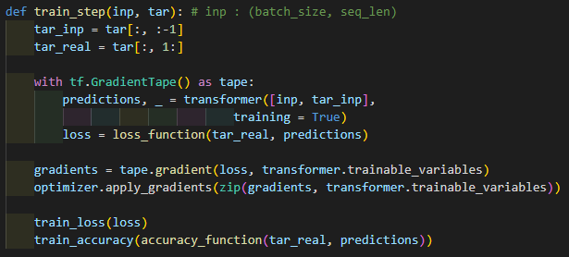
Train Step Using Transformer
inp, tar is a matrix
shape
(batch_size, seq_len)
tar = [sos,2,3,eos,0]
tar_inp = [sos,2,3,eos]
tar_real = [2,3,eos,0]

Slide 29
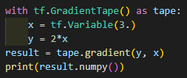
Train Step Using Transformer
▶ Record every operations in tape
prints 2

Slide 30
Train Step Using Transformer
▶ Used here !
gradients will have derivative of loss
prints 2

Slide 31
Train Step Using Transformer
▶ Call transformer, and get the result as predictions
predictions is a logit matrix for one batch

Slide 32
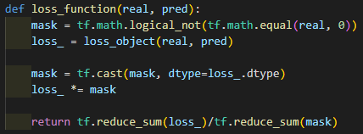
Train Step Using Transformer
▶ Calculate loss

Slide 33
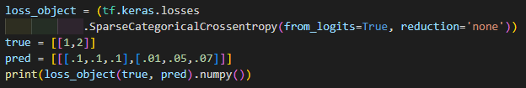
Train Step Using Transformer

Slide 34
Train Step Using Transformer
▶ no loss for pad token

Slide 35
Train Step Using Transformer
▶ tf.reduce_sum returns the sum of every elements for input

Slide 36
Train Step Using Transformer
▶ trainable_variables is an array,
consists of dense layers’ weights, and some other trainable values or matrices

Slide 37
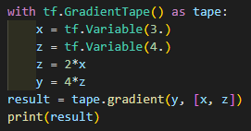
Train Step Using Transformer
▶ trainable_variables is an array,
consists of dense layers’ weights, and some other trainable values or matrices
▶ gradients is array of gradients,
for each element of trainable_variables

Slide 38
Train Step Using Transformer
▶ Apply gradients to variables
▶ apply_gradients function gets (gradients, variable) tuple as input

Slide 39
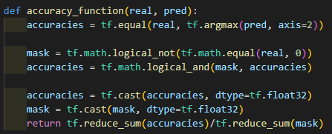
Train Step Using Transformer
loss is float32 variable

Slide 40
Train Step Using Transformer
tf.argmax returns index number
of which has the maximum value in input matrix
so, accuracies is a Boolean matrix
True for correct
False for incorrect
loss is float32 variable

Slide 41
Train Step Using Transformer
loss is float32 variable
tf.reduce_sum(accuracies) : number of correct
tf.reduce_sum(mask) : number of words

Slide 42
Train Step Using Transformer
▶ In summary, train_step calls transformer, and calculate loss, and apply loss to trainable variables
Through this code, we train the model !

Slide 43
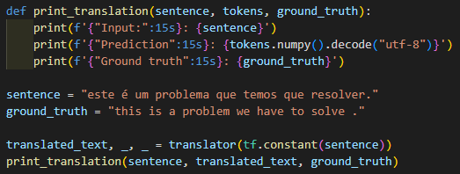
Translator Using Transformer
▶ Through the trained model, we will build translator, converts Portuguese to English

Slide 44

Translator Using Transformer
▶ Through the trained model, we will build translator, converts Portuguese to English
▶ Building Translator class

Slide 45
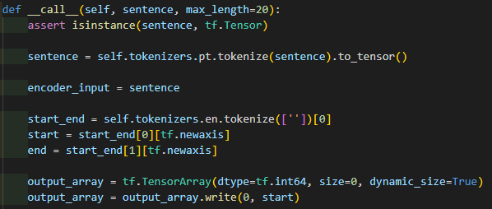

Translator Using Transformer
▶ Sentence is a string tensor
▶ max_length is max number of words for translator

Slide 46
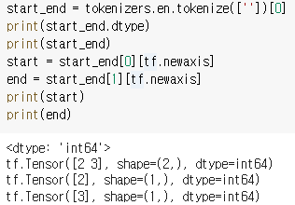
Translator Using Transformer
▶ start_end contains (‘sos token ID’, ‘eos token ID’)
start will have sos token ID,
end will have eos token ID

Slide 47

Translator Using Transformer

Slide 48
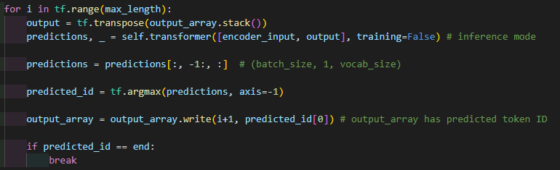
Translator Using Transformer
▶ output is (1,1) matrix at first, only contains start token ID
stack() stacks like
[[2],
[3],
[4]]
[[2, 3, 4]]
transpose

Slide 49
Translator Using Transformer
▶ we call transformer for each words
predictions is the last word of transformer output,
argmax returns index of the element, that has max value

Slide 50
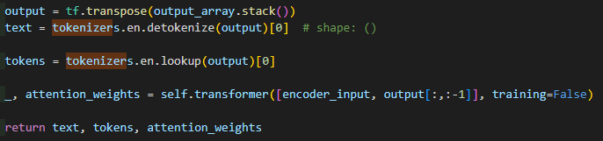
Translator Using Transformer
▶ After for loop, output_array has complete prediction token ID array
text contains prediction string array
output = [2, 4, 5, 6, 3]
text = [‘I’, ‘love’, ‘you’]
tokens = [‘start’, ‘I’, love’, ‘you’, ‘end’]
transpose

Slide 51

Translator Using Transformer

Slide 52



Translator Using Transformer

