Slide 1
4.14 meeting LSTM 컴퓨터소프트웨어학부 심승현
RNN과의 비교를 중심으로

Slide 2
Contents
RNN review
LSTM

Slide 3
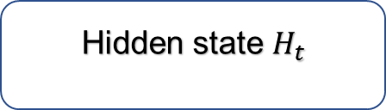

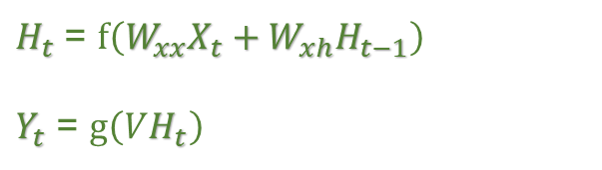


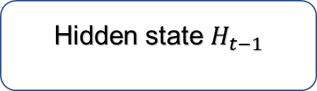


RNN, recurrent neural network
$H_{t}$ = $f\left(W_{xx}X_{t}+{W_{xh}H}_{t−1}\right)$
$Y_{t}$ = $g\left(VH_{t}\right)$
Output $Y_{t}$
Activation Function
g(x)
*$W_{xy}$
Hidden state $H_{t−1}$
Activation function
f(x)
Hidden state $H_{t}$
*$W_{xh}$
Matrix operation
Using parameter
*$W_{xx}$
Input $X_{t}$
3

Slide 4
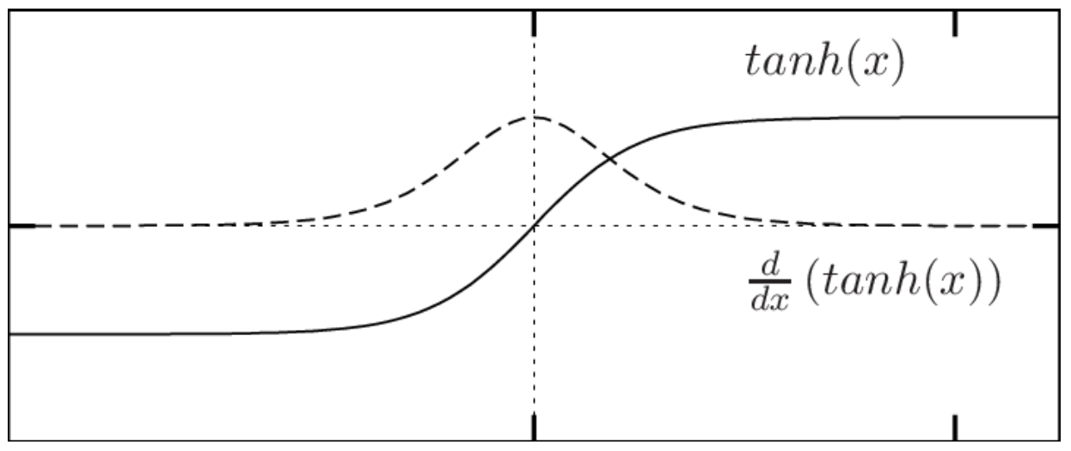
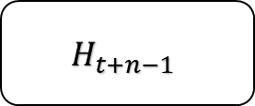
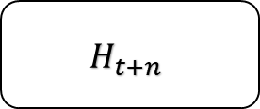
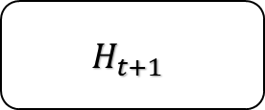

RNN, recurrent neural network
〮 Sequence 가 길어질 경우, Back propagation 을 할 때
Vanishing Gradient Problem 이 나타날 수 있다
Output
$$H_{t}$$
$$H_{t+1}$$
…
$$H_{t+n−1}$$
$$H_{t+n}$$
tanh
…
tanh
Input

Slide 5








LSTM, Long Short-Term Memory
LSTM is “ RNN + Memory cell “
Output $Y_{t}$
Output $Y_{t}$
$$C_{t−1}$$
Cell state $C_{t}$
$$H_{t−1}$$
$$H_{t−1}$$
Hidden state $H_{t}$
Hidden state $H_{t}$
Input $X_{t}$
Input $X_{t}$
< RNN >
< LSTM >

Slide 6









LSTM, Long Short-Term Memory
$$C_{t−1}$$
tanh
$$H_{t}$$
tanh
$$H_{t+1}$$
$$σ$$
$$σ$$
tanh
$$σ$$
$$H_{t−1}$$
$$X_{t}$$
$$X_{t}$$
< RNN >
< LSTM >

