Slide 1
Algorithms on Strings, Trees, and Sequences
Part III
Chapter 11.
Core String Edits, Alignments, and Dynamic Programming
컴퓨터소프트웨어학부 심승현

Slide 2
Contents
▶ Approximate Occurrence of P in T

Slide 3
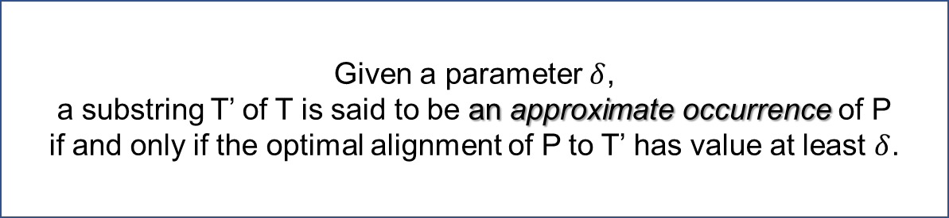
Approximate occurrences of P in T
Definition
Given a parameter $δ$,
a substring T’ of T is said to be an approximate occurrence of P
if and only if the optimal alignment of P to T’ has value at least $δ$.

Slide 4
Approximate occurrences of P in T
Definition
Given a parameter $δ$,
a substring T’ of T is said to be an approximate occurrence of P
if and only if the optimal alignment of P to T’ has value at least $δ$.
T = ‘algorithmisveryfunny’, P = ‘missyou’

Slide 5
Approximate occurrences of P in T
Definition
Given a parameter $δ$,
a substring T’ of T is said to be an approximate occurrence of P
if and only if the optimal alignment of P to T’ has value at least $δ$.
T = ‘algorithmisveryfunny’, P = ‘missyou’
T’ | m | i | s | v | e | r | y | f | u | n
P | m | i | s | s | _ | _ | y | o | u | _
T’ is a substring of T

Slide 6
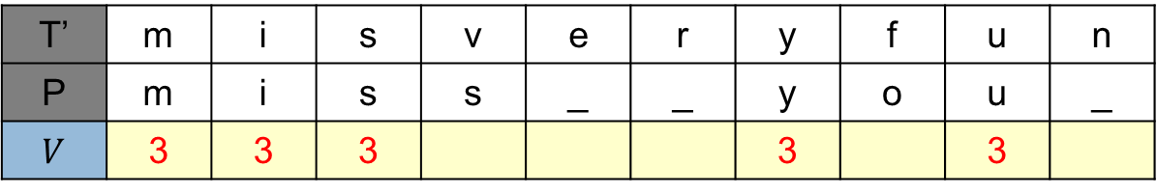
Approximate occurrences of P in T
Definition
Given a parameter $δ$,
a substring T’ of T is said to be an approximate occurrence of P
if and only if the optimal alignment of P to T’ has value at least $δ$.
T = ‘algorithmisveryfunny’, P = ‘missyou’
T’ | m | i | s | v | e | r | y | f | u | n
P | m | i | s | s | _ | _ | y | o | u | _
$V$ | 3 | 3 | 3 |  |  |  | 3 |  | 3
T’ is a substring of T

Slide 7
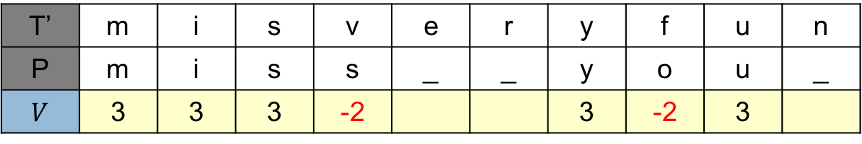
Approximate occurrences of P in T
Definition
Given a parameter $δ$,
a substring T’ of T is said to be an approximate occurrence of P
if and only if the optimal alignment of P to T’ has value at least $δ$.
T = ‘algorithmisveryfunny’, P = ‘missyou’
T’ | m | i | s | v | e | r | y | f | u | n
P | m | i | s | s | _ | _ | y | o | u | _
$V$ | 3 | 3 | 3 | -2 |  |  | 3 | -2 | 3
T’ is a substring of T

Slide 8
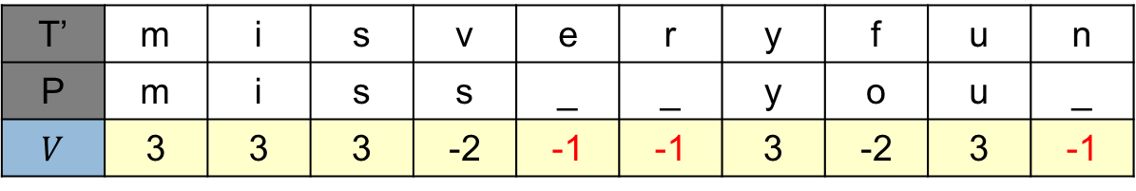
Approximate occurrences of P in T
Definition
Given a parameter $δ$,
a substring T’ of T is said to be an approximate occurrence of P
if and only if the optimal alignment of P to T’ has value at least $δ$.
T = ‘algorithmisveryfunny’, P = ‘missyou’
T’ | m | i | s | v | e | r | y | f | u | n
P | m | i | s | s | _ | _ | y | o | u | _
$V$ | 3 | 3 | 3 | -2 | -1 | -1 | 3 | -2 | 3 | -1
T’ is a substring of T

Slide 9
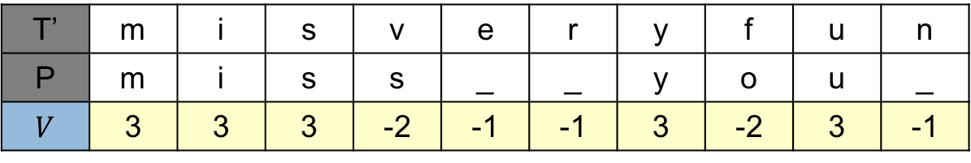


Approximate occurrences of P in T
Definition
Given a parameter $δ$,
a substring T’ of T is said to be an approximate occurrence of P
if and only if the optimal alignment of P to T’ has value at least $δ$.
T = ‘algorithmisveryfunny’, P = ‘missyou’
T’ | m | i | s | v | e | r | y | f | u | n
P | m | i | s | s | _ | _ | y | o | u | _
$V$ | 3 | 3 | 3 | -2 | -1 | -1 | 3 | -2 | 3 | -1
T’ is a substring of T
$$V\left(T_{j}^{′}, P_{n}\right)=8$$
※ $\left|T′\right|=j, \left|P\right|=n$

Slide 10
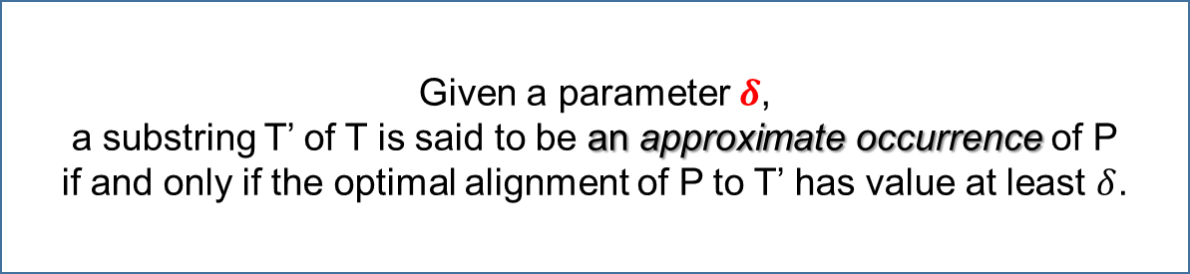

Approximate occurrences of P in T
Definition
Given a parameter $δ$,
a substring T’ of T is said to be an approximate occurrence of P
if and only if the optimal alignment of P to T’ has value at least $δ$.
T = ‘algorithmisveryfunny’, P = ‘missyou’
T’ | m | i | s | v | e | r | y | f | u | n
P | m | i | s | s | _ | _ | y | o | u | _
$V$ | 3 | 3 | 3 | -2 | -1 | -1 | 3 | -2 | 3 | -1
T’ is a substring of T
$$V\left(T_{j}^{′}, P_{n}\right)=8$$
$δ=7$
※ $\left|T′\right|=j, \left|P\right|=n$

Slide 11

Approximate occurrences of P in T
Definition
Given a parameter $δ$,
a substring T’ of T is said to be an approximate occurrence of P
if and only if the optimal alignment of P to T’ has value at least $δ$.
T = ‘algorithmisveryfunny’, P = ‘missyou’
T’ | m | i | s | v | e | r | y | f | u | n
P | m | i | s | s | _ | _ | y | o | u | _
$V$ | 3 | 3 | 3 | -2 | -1 | -1 | 3 | -2 | 3 | -1
T’ is a substring of T
$$V\left(T_{j}^{′}, P_{n}\right)=8$$
$$≥$$
$δ=7$
※ $\left|T′\right|=j, \left|P\right|=n$

Slide 12
Approximate occurrences of P in T
Definition
Given a parameter $δ$,
a substring T’ of T is said to be an approximate occurrence of P
if and only if the optimal alignment of P to T’ has value at least $δ$.
T = ‘algorithmisveryfunny’, P = ‘missyou’
T’ | m | i | s | v | e | r | y | f | u | n
P | m | i | s | s | _ | _ | y | o | u | _
$V$ | 3 | 3 | 3 | -2 | -1 | -1 | 3 | -2 | 3 | -1
T’ is a substring of T
T’ is an approximate occurrence of P
$$V\left(T_{j}^{′}, P_{n}\right)=8$$
$$≥$$
$δ=7$
※ $\left|T′\right|=j, \left|P\right|=n$

Slide 13
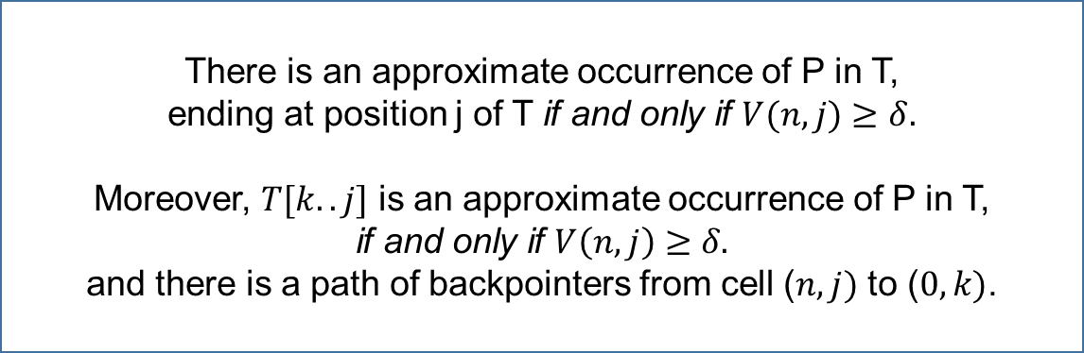
Approximate occurrences of P in T
Theorem 11.6.2
There is an approximate occurrence of P in T,
ending at position j of T if and only if $V(n, j)$ $≥$ $δ.$
Moreover, $T[k..j]$ is an approximate occurrence of P in T,
if and only if $V\left(n, j\right)$ $≥$ $δ.$
and there is a path of backpointers from cell ($n, j)$ to ($0, k)$.
T = ‘algorithmisveryfunny’, P = ‘missyou’

Slide 14
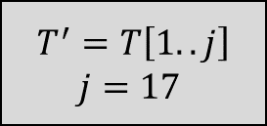
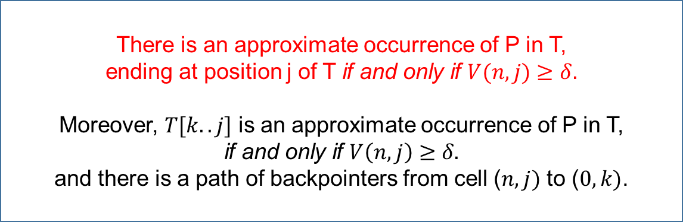
Approximate occurrences of P in T
Theorem 11.6.2
There is an approximate occurrence of P in T,
ending at position j of T if and only if $V(n, j)$ $≥$ $δ.$
Moreover, $T[k..j]$ is an approximate occurrence of P in T,
if and only if $V\left(n, j\right)$ $≥$ $δ.$
and there is a path of backpointers from cell ($n, j)$ to ($0, k)$.
$$T^{′}=T\left[1..j\right]$$
$j=17$
T = ‘algorithmisveryfunny’, P = ‘missyou’
T’ | a | l | g | o | ... | r | y | f | u
P | _ | _ | _ | _ | ... | _ | y | o | u

Slide 15
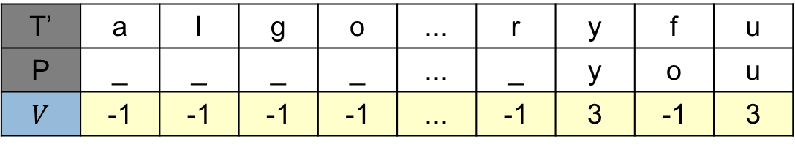
Approximate occurrences of P in T
Theorem 11.6.2
There is an approximate occurrence of P in T,
ending at position j of T if and only if $V(n, j)$ $≥$ $δ.$
Moreover, $T[k..j]$ is an approximate occurrence of P in T,
if and only if $V\left(n, j\right)$ $≥$ $δ.$
and there is a path of backpointers from cell ($n, j)$ to ($0, k)$.
$$T^{′}=T\left[1..j\right]$$
$j=17$
T = ‘algorithmisveryfunny’, P = ‘missyou’
T’ | a | l | g | o | ... | r | y | f | u
P | _ | _ | _ | _ | ... | _ | y | o | u
$V$ | -1 | -1 | -1 | -1 | ... | -1 | 3 | -1 | 3

Slide 16


Approximate occurrences of P in T
Theorem 11.6.2
There is an approximate occurrence of P in T,
ending at position j of T if and only if $V(n, j)$ $≥$ $δ.$
Moreover, $T[k..j]$ is an approximate occurrence of P in T,
if and only if $V\left(n, j\right)$ $≥$ $δ.$
and there is a path of backpointers from cell ($n, j)$ to ($0, k)$.
$$T^{′}=T\left[1..j\right]$$
$j=17$
T = ‘algorithmisveryfunny’, P = ‘missyou’
T’ | a | l | g | o | ... | r | y | f | u
P | _ | _ | _ | _ | ... | _ | y | o | u
$V$ | -1 | -1 | -1 | -1 | ... | -1 | 3 | -1 | 3
$$V\left(T_{j}^{′}, P_{n}\right)=5$$
※ $\left|T′\right|=j, \left|P\right|=n$

Slide 17


Approximate occurrences of P in T
Theorem 11.6.2
There is an approximate occurrence of P in T,
ending at position j of T if and only if $V(n, j)$ $≥$ $δ.$
Moreover, $T[k..j]$ is an approximate occurrence of P in T,
if and only if $V\left(n, j\right)$ $≥$ $δ.$
and there is a path of backpointers from cell ($n, j)$ to ($0, k)$.
$$T^{′}=T\left[1..j\right]$$
$j=17$
T = ‘algorithmisveryfunny’, P = ‘missyou’
T’ | a | l | g | o | ... | r | y | f | u
P | _ | _ | _ | _ | ... | _ | y | o | u
$V$ | -1 | -1 | -1 | -1 | ... | -1 | 3 | -1 | 3
$$V\left(T_{j}^{′}, P_{n}\right)=5$$
$$≥$$
$δ=5$
※ $\left|T′\right|=j, \left|P\right|=n$

Slide 18
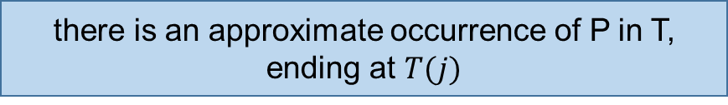
Approximate occurrences of P in T
Theorem 11.6.2
There is an approximate occurrence of P in T,
ending at position j of T if and only if $V(n, j)$ $≥$ $δ.$
Moreover, $T[k..j]$ is an approximate occurrence of P in T,
if and only if $V\left(n, j\right)$ $≥$ $δ.$
and there is a path of backpointers from cell ($n, j)$ to ($0, k)$.
$$T^{′}=T\left[1..j\right]$$
$j=17$
T = ‘algorithmisveryfunny’, P = ‘missyou’
T’ | a | l | g | o | ... | r | y | f | u
P | _ | _ | _ | _ | ... | _ | y | o | u
$V$ | -1 | -1 | -1 | -1 | ... | -1 | 3 | -1 | 3
there is an approximate occurrence of P in T,
ending at $T(j)$
$$V\left(T_{j}^{′}, P_{n}\right)=5$$
$$≥$$
$δ=5$
※ $\left|T′\right|=j, \left|P\right|=n$

Slide 19
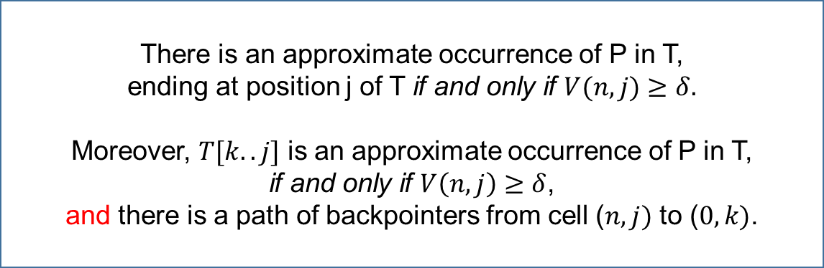
Approximate occurrences of P in T
Theorem 11.6.2
There is an approximate occurrence of P in T,
ending at position j of T if and only if $V(n, j)$ $≥$ $δ.$
Moreover, $T[k..j]$ is an approximate occurrence of P in T,
if and only if $V\left(n, j\right)$ $≥$ $δ$,
and there is a path of backpointers from cell ($n, j)$ to ($0, k)$.
T = ‘algorithmisveryfunny’, P = ‘missyou’

Slide 20
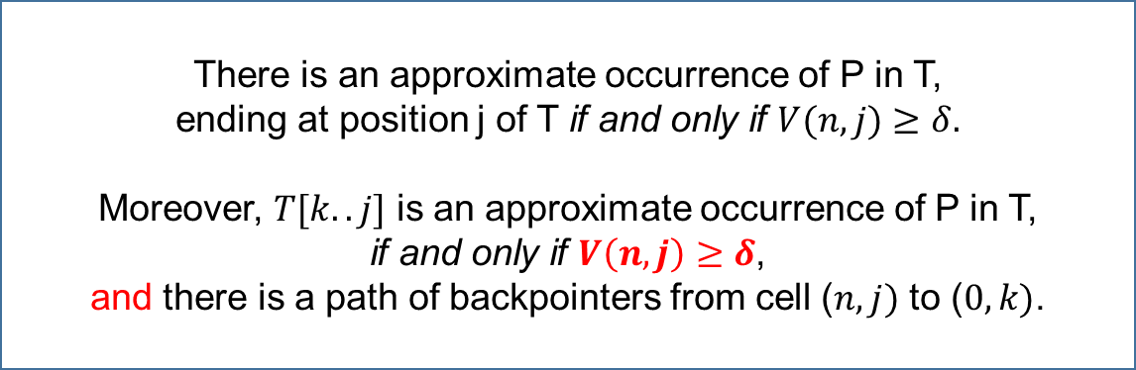
Approximate occurrences of P in T
Theorem 11.6.2
There is an approximate occurrence of P in T,
ending at position j of T if and only if $V(n, j)$ $≥$ $δ.$
Moreover, $T[k..j]$ is an approximate occurrence of P in T,
if and only if $V\left(n, j\right)$ $≥$ $δ$,
and there is a path of backpointers from cell ($n, j)$ to ($0, k)$.
T = ‘algorithmisveryfunny’, P = ‘missyou’

Slide 21
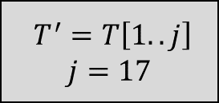
Approximate occurrences of P in T
Theorem 11.6.2
There is an approximate occurrence of P in T,
ending at position j of T if and only if $V(n, j)$ $≥$ $δ.$
Moreover, $T[k..j]$ is an approximate occurrence of P in T,
if and only if $V\left(n, j\right)$ $≥$ $δ$,
and there is a path of backpointers from cell ($n, j)$ to ($0, k)$.
$$T^{′}=T\left[1..j\right]$$
$j=17$
T = ‘algorithmisveryfunny’, P = ‘missyou’

Slide 22


Approximate occurrences of P in T
Theorem 11.6.2
There is an approximate occurrence of P in T,
ending at position j of T if and only if $V(n, j)$ $≥$ $δ.$
Moreover, $T[k..j]$ is an approximate occurrence of P in T,
if and only if $V\left(n, j\right)$ $≥$ $δ$,
and there is a path of backpointers from cell ($n, j)$ to ($0, k)$.
$$T^{′}=T\left[1..j\right]$$
$j=17$
T = ‘algorithmisveryfunny’, P = ‘missyou’
T = ‘algorithmisveryfunny’, P = ‘missyou’
T’ | a | l | g | o | ... | r | y | f | u
P | _ | _ | _ | _ | ... | _ | y | o | u
$V$ | -1 | -1 | -1 | -1 | ... | -1 | 3 | -1 | 3
$$V\left(T_{j}^{′}, P_{n}\right)=5$$
$$≥$$
$δ=5$

Slide 23
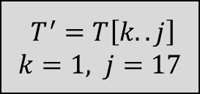

Approximate occurrences of P in T
Theorem 11.6.2
There is an approximate occurrence of P in T,
ending at position j of T if and only if $V(n, j)$ $≥$ $δ.$
Moreover, $T[k..j]$ is an approximate occurrence of P in T,
if and only if $V\left(n, j\right)$ $≥$ $δ$,
and there is a path of backpointers from cell ($n, j)$ to ($0, k)$.
$$T^{′}=T\left[k..j\right]$$
$k=1, j=17$
T = ‘algorithmisveryfunny’, P = ‘missyou’
$T[1..17]$ satisfies the first condition

Slide 24
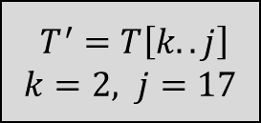

Approximate occurrences of P in T
Theorem 11.6.2
There is an approximate occurrence of P in T,
ending at position j of T if and only if $V(n, j)$ $≥$ $δ.$
Moreover, $T[k..j]$ is an approximate occurrence of P in T,
if and only if $V\left(n, j\right)$ $≥$ $δ$,
and there is a path of backpointers from cell ($n, j)$ to ($0, k)$.
$$T^{′}=T\left[k..j\right]$$
$k=2, j=17$
T = ‘algorithmisveryfunny’, P = ‘missyou’
$T[2..17]$ satisfies the first condition

Slide 25


Approximate occurrences of P in T
Theorem 11.6.2
There is an approximate occurrence of P in T,
ending at position j of T if and only if $V(n, j)$ $≥$ $δ.$
Moreover, $T[k..j]$ is an approximate occurrence of P in T,
if and only if $V\left(n, j\right)$ $≥$ $δ$,
and there is a path of backpointers from cell ($n, j)$ to ($0, k)$.
$$T^{′}=T\left[k..j\right]$$
$k=3, j=17$
T = ‘algorithmisveryfunny’, P = ‘missyou’
$T[3..17]$ satisfies the first condition

Slide 26
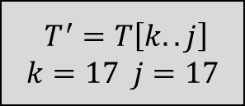

Approximate occurrences of P in T
Theorem 11.6.2
There is an approximate occurrence of P in T,
ending at position j of T if and only if $V(n, j)$ $≥$ $δ.$
Moreover, $T[k..j]$ is an approximate occurrence of P in T,
if and only if $V\left(n, j\right)$ $≥$ $δ$,
and there is a path of backpointers from cell ($n, j)$ to ($0, k)$.
$$T^{′}=T\left[k..j\right]$$
$$k=17 j=17$$
T = ‘algorithmisveryfunny’, P = ‘missyou’
$T[17]$ satisfies the first condition

Slide 27
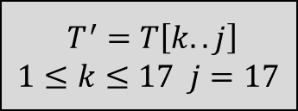
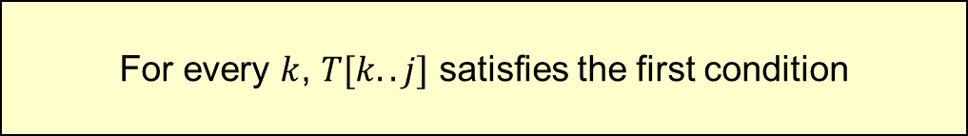
Approximate occurrences of P in T
Theorem 11.6.2
There is an approximate occurrence of P in T,
ending at position j of T if and only if $V(n, j)$ $≥$ $δ.$
Moreover, $T[k..j]$ is an approximate occurrence of P in T,
if and only if $V\left(n, j\right)$ $≥$ $δ$,
and there is a path of backpointers from cell ($n, j)$ to ($0, k)$.
$$T^{′}=T\left[k..j\right]$$
$1≤k≤17 j=17$
T = ‘algorithmisveryfunny’, P = ‘missyou’
$T[17]$ satisfies the first condition
For every $k$, $T[k..j]$ satisfies the first condition

Slide 28
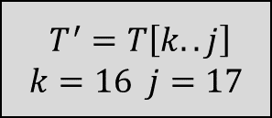
Approximate occurrences of P in T
Theorem 11.6.2
There is an approximate occurrence of P in T,
ending at position j of T if and only if $V(n, j)$ $≥$ $δ.$
Moreover, $T[k..j]$ is an approximate occurrence of P in T,
if and only if $V\left(n, j\right)$ $≥$ $δ$,
and there is a path of backpointers from cell ($n, j)$ to ($0, k)$.
$$T^{′}=T\left[k..j\right]$$
$k=16 j=17$
T = ‘algorithmisveryfunny’, P = ‘missyou’
$T[17]$ satisfies the first condition
For every $k$, $T[k..j]$ satisfies the first condition
In other words, the entire suffix of $T[1..j]$ are candidate of approximate occurrence of P

Slide 29
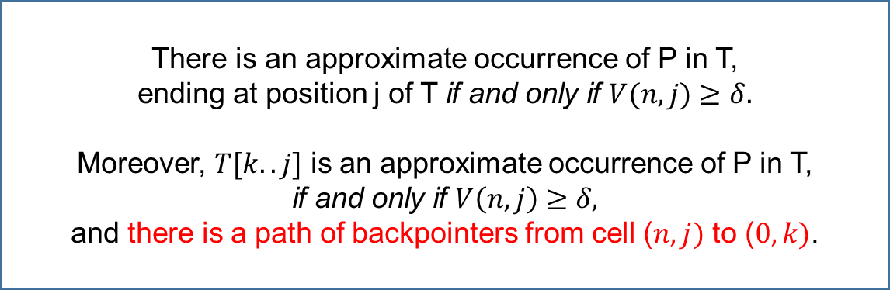
Approximate occurrences of P in T
Theorem 11.6.2
There is an approximate occurrence of P in T,
ending at position j of T if and only if $V(n, j)$ $≥$ $δ.$
Moreover, $T[k..j]$ is an approximate occurrence of P in T,
if and only if $V\left(n, j\right)$ $≥$ $δ,$
and there is a path of backpointers from cell ($n, j)$ to ($0, k)$.

Slide 30
Approximate occurrences of P in T
Theorem 11.6.2
There is an approximate occurrence of P in T,
ending at position j of T if and only if $V(n, j)$ $≥$ $δ.$
Moreover, $T[k..j]$ is an approximate occurrence of P in T,
if and only if $V\left(n, j\right)$ $≥$ $δ,$
and there is a path of backpointers from cell ($n, j)$ to ($0, k)$.
We can build a table, about similarity

Slide 31
Approximate occurrences of P in T
Theorem 11.6.2
There is an approximate occurrence of P in T,
ending at position j of T if and only if $V(n, j)$ $≥$ $δ.$
Moreover, $T[k..j]$ is an approximate occurrence of P in T,
if and only if $V\left(n, j\right)$ $≥$ $δ,$
and there is a path of backpointers from cell ($n, j)$ to ($0, k)$.
T = ‘algorithmisveryfunny’, P = ‘missyou’

Slide 32
Approximate occurrences of P in T
Theorem 11.6.2
There is an approximate occurrence of P in T,
ending at position j of T if and only if $V(n, j)$ $≥$ $δ.$
Moreover, $T[k..j]$ is an approximate occurrence of P in T,
if and only if $V\left(n, j\right)$ $≥$ $δ,$
and there is a path of backpointers from cell ($n, j)$ to ($0, k)$.
T = ‘algorithmisveryfunny’, P = ‘missyou’
With two strings T and P,
We can make table about string similarity

Slide 33
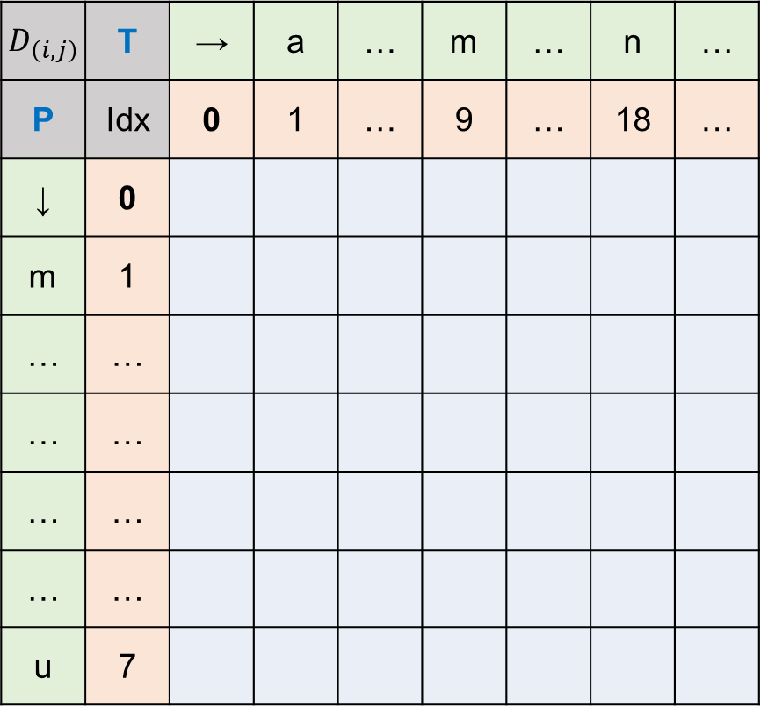
Approximate occurrences of P in T
▶ Draw the table, measuring string similarity
$D_{\left(i,j\right)}$ | T | → | a | … | m | … | n | …
P | Idx | 0 | 1 | … | 9 | … | 18 | …
↓ | 0
m | 1
… | …
… | …
… | …
… | …
u | 7
T = ‘algorithmisveryfunny’,
P = ‘missyou’

Slide 34
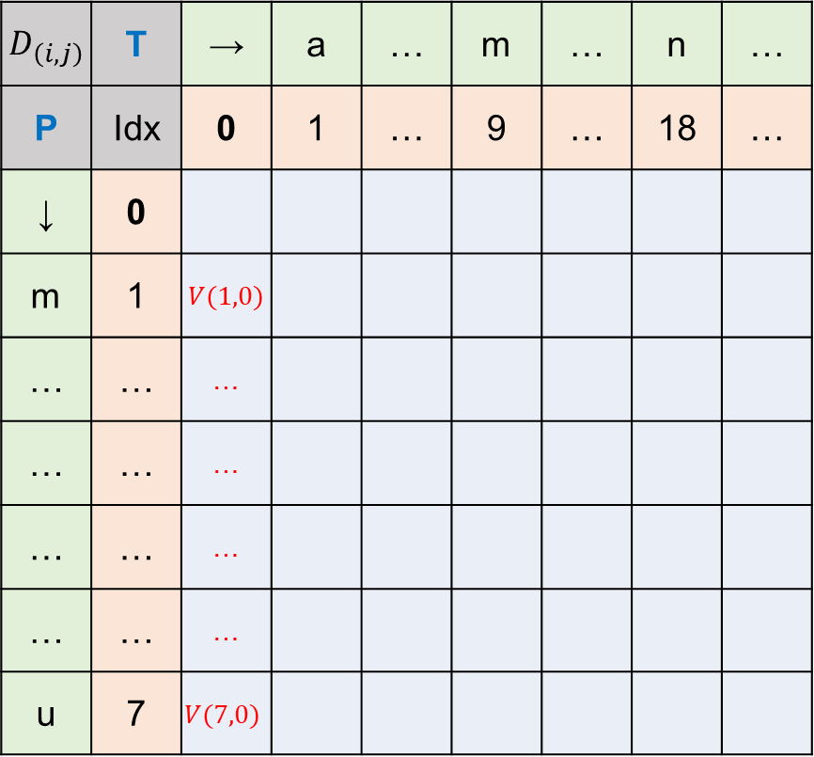
Approximate occurrences of P in T
▶ Draw the table, measuring string similarity
$D_{\left(i,j\right)}$ | T | → | a | … | m | … | n | …
P | Idx | 0 | 1 | … | 9 | … | 18 | …
↓ | 0
m | 1 | $V(1,0)$
… | … | …
… | … | …
… | … | …
… | … | …
u | 7 | $$V(7,0)$$
T = ‘algorithmisveryfunny’,
P = ‘missyou’
▶ Base condition
Base condition of string similarity

Slide 35
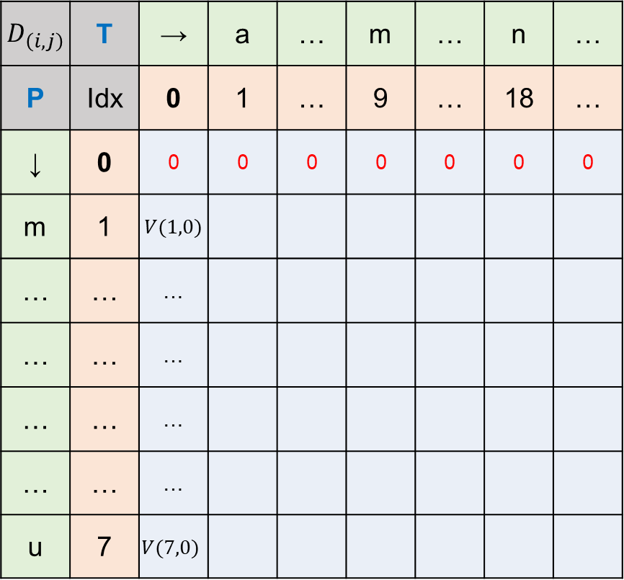

Approximate occurrences of P in T
▶ Draw the table, measuring string similarity
$D_{\left(i,j\right)}$ | T | → | a | … | m | … | n | …
P | Idx | 0 | 1 | … | 9 | … | 18 | …
↓ | 0 | 0 | 0 | 0 | 0 | 0 | 0 | 0
m | 1 | $V(1,0)$
… | … | …
… | … | …
… | … | …
… | … | …
u | 7 | $$V(7,0)$$
T = ‘algorithmisveryfunny’,
P = ‘missyou’
▶ Base condition
$$V\left(0,j\right)=0$$

Slide 36
Approximate occurrences of P in T
▶ Draw the table, measuring string similarity
$D_{\left(i,j\right)}$ | T | → | a | … | m | … | n | …
P | Idx | 0 | 1 | … | 9 | … | 18 | …
↓ | 0 | 0 | 0 | 0 | 0 | 0 | 0 | 0
m | 1 | $V(1,0)$
… | … | …
… | … | …
… | … | …
… | … | …
u | 7 | $$V(7,0)$$
T = ‘algorithmisveryfunny’,
P = ‘missyou’
▶ Base condition
$$V\left(0,j\right)=0$$
In an alignment,
This gives free value to the left end of P

Slide 37
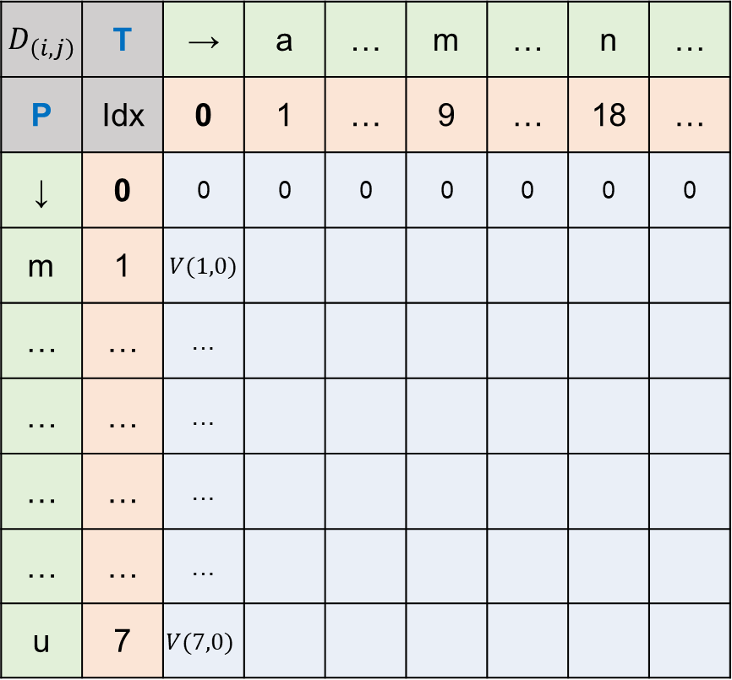
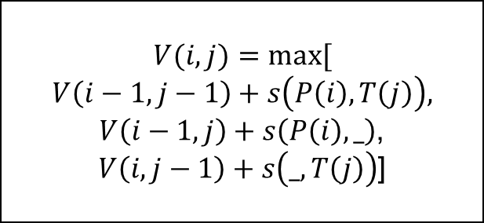
Approximate occurrences of P in T
▶ Draw the table, measuring string similarity
$D_{\left(i,j\right)}$ | T | → | a | … | m | … | n | …
P | Idx | 0 | 1 | … | 9 | … | 18 | …
↓ | 0 | 0 | 0 | 0 | 0 | 0 | 0 | 0
m | 1 | $V(1,0)$
… | … | …
… | … | …
… | … | …
… | … | …
u | 7 | $$V(7,0)$$
T = ‘algorithmisveryfunny’,
P = ‘missyou’
▶ Use recurrence relation for string similarity
$$V(i,j)=max⁡[$$
$$V\left(i−1, j−1\right)+s\left(P\left(i\right),T\left(j\right)\right),$$
$V\left(i−1, j\right)+s\left(P\left(i\right), _\right)$,
$V\left(i, j−1\right)+s\left(_, T\left(j\right)\right)$]

Slide 38
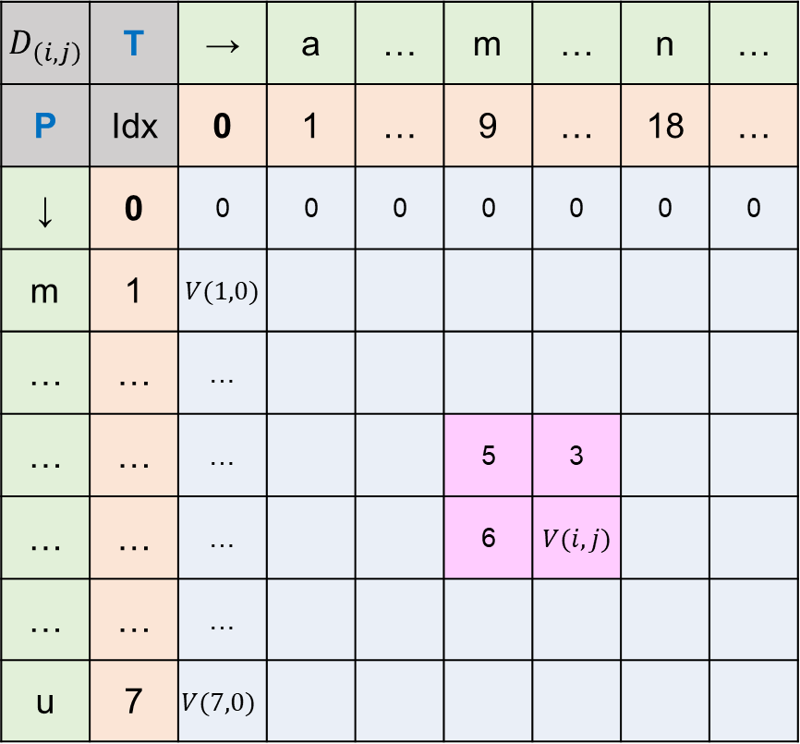
Approximate occurrences of P in T
▶ Draw the table, measuring string similarity
$D_{\left(i,j\right)}$ | T | → | a | … | m | … | n | …
P | Idx | 0 | 1 | … | 9 | … | 18 | …
↓ | 0 | 0 | 0 | 0 | 0 | 0 | 0 | 0
m | 1 | $V(1,0)$
… | … | …
… | … | … |  |  | 5 | 3
… | … | … |  |  | 6 | $V(i,j)$
… | … | …
u | 7 | $$V(7,0)$$
T = ‘algorithmisveryfunny’,
P = ‘missyou’
▶ Use recurrence relation for string similarity
$$V(i,j)=max⁡[$$
$$V\left(i−1, j−1\right)+s\left(P\left(i\right),T\left(j\right)\right),$$
$V\left(i−1, j\right)+s\left(P\left(i\right), _\right)$,
$V\left(i, j−1\right)+s\left(_, T\left(j\right)\right)$]

Slide 39



Approximate occurrences of P in T
▶ Draw the table, measuring string similarity
$D_{\left(i,j\right)}$ | T | → | a | … | m | … | n | …
P | Idx | 0 | 1 | … | 9 | … | 18 | …
↓ | 0 | 0 | 0 | 0 | 0 | 0 | 0 | 0
m | 1 | $V(1,0)$
… | … | …
… | … | … |  |  | 5 | 3
… | … | … |  |  | 6 | $V(i,j)$
… | … | …
u | 7 | $$V(7,0)$$
T = ‘algorithmisveryfunny’,
P = ‘missyou’
▶ Use recurrence relation for string similarity
$$s\left(T\left(i\right), P\left(j\right)\right)=3$$
$$s\left(T\left(i\right), _\right)=−1$$
$$V(i,j)=max⁡[$$
$$V\left(i−1, j−1\right)+s\left(P\left(i\right),T\left(j\right)\right),$$
$V\left(i−1, j\right)+s\left(P\left(i\right), _\right)$,
$V\left(i, j−1\right)+s\left(_, T\left(j\right)\right)$]
$$s\left(_ , P\left(j\right)\right)=−2$$

Slide 40

Approximate occurrences of P in T
▶ Draw the table, measuring string similarity
$D_{\left(i,j\right)}$ | T | → | a | … | m | … | n | …
P | Idx | 0 | 1 | … | 9 | … | 18 | …
↓ | 0 | 0 | 0 | 0 | 0 | 0 | 0 | 0
m | 1 | $V(1,0)$
… | … | …
… | … | … |  |  | 5 | 3
… | … | … |  |  | 6 | $V(i,j)$
… | … | …
u | 7 | $$V(7,0)$$
T = ‘algorithmisveryfunny’,
P = ‘missyou’
▶ Use recurrence relation for string similarity
$$s\left(T\left(i\right), P\left(j\right)\right)=3$$
$$s\left(T\left(i\right), _\right)=−1$$
$$V(i,j)=max⁡[$$
$$V\left(i−1, j−1\right)+s\left(P\left(i\right),T\left(j\right)\right),$$
$V\left(i−1, j\right)+s\left(P\left(i\right), _\right)$,
$V\left(i, j−1\right)+s\left(_, T\left(j\right)\right)$]
$$s\left(_ , P\left(j\right)\right)=−2$$
$$max⁡[5+3, 3−1, 6−2]$$

Slide 41

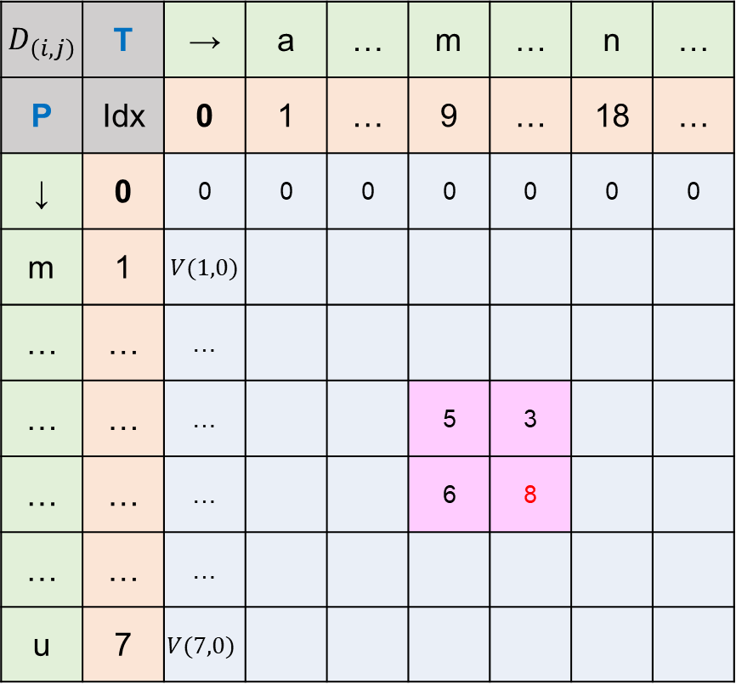
Approximate occurrences of P in T
▶ Draw the table, measuring string similarity
$D_{\left(i,j\right)}$ | T | → | a | … | m | … | n | …
P | Idx | 0 | 1 | … | 9 | … | 18 | …
↓ | 0 | 0 | 0 | 0 | 0 | 0 | 0 | 0
m | 1 | $V(1,0)$
… | … | …
… | … | … |  |  | 5 | 3
… | … | … |  |  | 6 | 8
… | … | …
u | 7 | $$V(7,0)$$
T = ‘algorithmisveryfunny’,
P = ‘missyou’
▶ Use recurrence relation for string similarity
$$s\left(T\left(i\right), P\left(j\right)\right)=3$$
$$s\left(T\left(i\right), _\right)=−1$$
$$V(i,j)=max⁡[$$
$$V\left(i−1, j−1\right)+s\left(P\left(i\right),T\left(j\right)\right),$$
$V\left(i−1, j\right)+s\left(P\left(i\right), _\right)$,
$V\left(i, j−1\right)+s\left(_, T\left(j\right)\right)$]
$$s\left(_ , P\left(j\right)\right)=−2$$
$$max⁡[5+3, 3−1, 6−2]$$

Slide 42
Approximate occurrences of P in T
▶ Draw the table, measuring string similarity
$D_{\left(i,j\right)}$ | T | → | a | … | m | … | n | …
P | Idx | 0 | 1 | … | 9 | … | 18 | …
↓ | 0 | 0 | 0 | 0 | 0 | 0 | 0 | 0
m | 1 | $V(1,0)$
… | … | …
… | … | … |  |  | 5 | 3
… | … | … |  |  | 6 | 8
… | … | …
u | 7 | $$V(7,0)$$
T = ‘algorithmisveryfunny’,
P = ‘missyou’
▶ Use recurrence relation for string similarity
$$s\left(T\left(i\right), P\left(j\right)\right)=3$$
$$s\left(T\left(i\right), _\right)=−1$$
$$V(i,j)=max⁡[$$
$$V\left(i−1, j−1\right)+s\left(P\left(i\right),T\left(j\right)\right),$$
$V\left(i−1, j\right)+s\left(P\left(i\right), _\right)$,
$V\left(i, j−1\right)+s\left(_, T\left(j\right)\right)$]
$$s\left(_ , P\left(j\right)\right)=−2$$
$$max⁡[5+3, 3−1, 6−2]$$

Slide 43
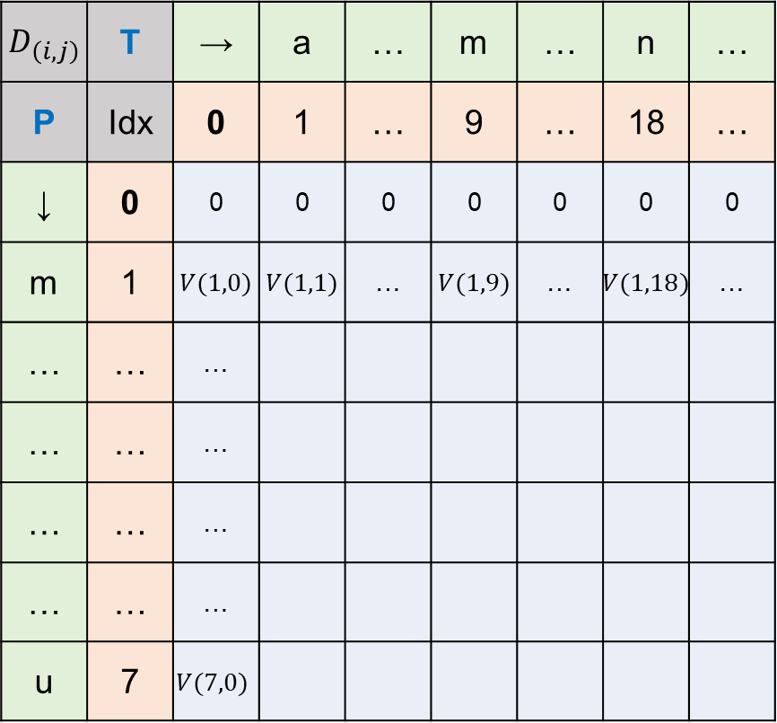
Approximate occurrences of P in T
▶ Draw the table, measuring string similarity
$D_{\left(i,j\right)}$ | T | → | a | … | m | … | n | …
P | Idx | 0 | 1 | … | 9 | … | 18 | …
↓ | 0 | 0 | 0 | 0 | 0 | 0 | 0 | 0
m | 1 | $V(1,0)$ | $V(1,1)$ | … | $V(1,9)$ | … | $V(1,18)$ | …
… | … | …
… | … | …
… | … | …
… | … | …
u | 7 | $$V(7,0)$$
T = ‘algorithmisveryfunny’,
P = ‘missyou’
▶ Use recurrence relation for string similarity
$$V(i,j)=max⁡[$$
$$V\left(i−1, j−1\right)+s\left(P\left(i\right),T\left(j\right)\right),$$
$V\left(i−1, j\right)+s\left(P\left(i\right), _\right)$,
$V\left(i, j−1\right)+s\left(_, T\left(j\right)\right)$]

Slide 44
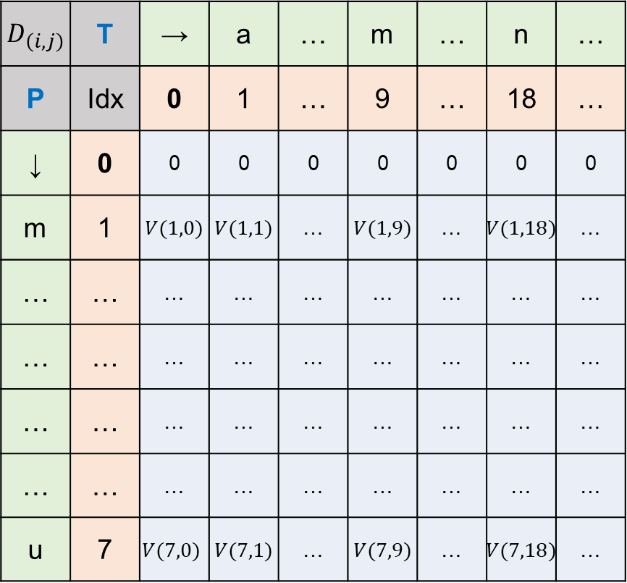
Approximate occurrences of P in T
▶ Draw the table, measuring string similarity
$D_{\left(i,j\right)}$ | T | → | a | … | m | … | n | …
P | Idx | 0 | 1 | … | 9 | … | 18 | …
↓ | 0 | 0 | 0 | 0 | 0 | 0 | 0 | 0
m | 1 | $V(1,0)$ | $V(1,1)$ | … | $V(1,9)$ | … | $V(1,18)$ | …
… | … | … | … | … | … | … | … | …
… | … | … | … | … | … | … | … | …
… | … | … | … | … | … | … | … | …
… | … | … | … | … | … | … | … | …
u | 7 | $$V(7,0)$$ | $V(7,1)$ | … | $V(7,9)$ | … | $V(7,18)$ | …
T = ‘algorithmisveryfunny’,
P = ‘missyou’
▶ Use recurrence relation for string similarity
$$V(i,j)=max⁡[$$
$$V\left(i−1, j−1\right)+s\left(P\left(i\right),T\left(j\right)\right),$$
$V\left(i−1, j\right)+s\left(P\left(i\right), _\right)$,
$V\left(i, j−1\right)+s\left(_, T\left(j\right)\right)$]

Slide 45
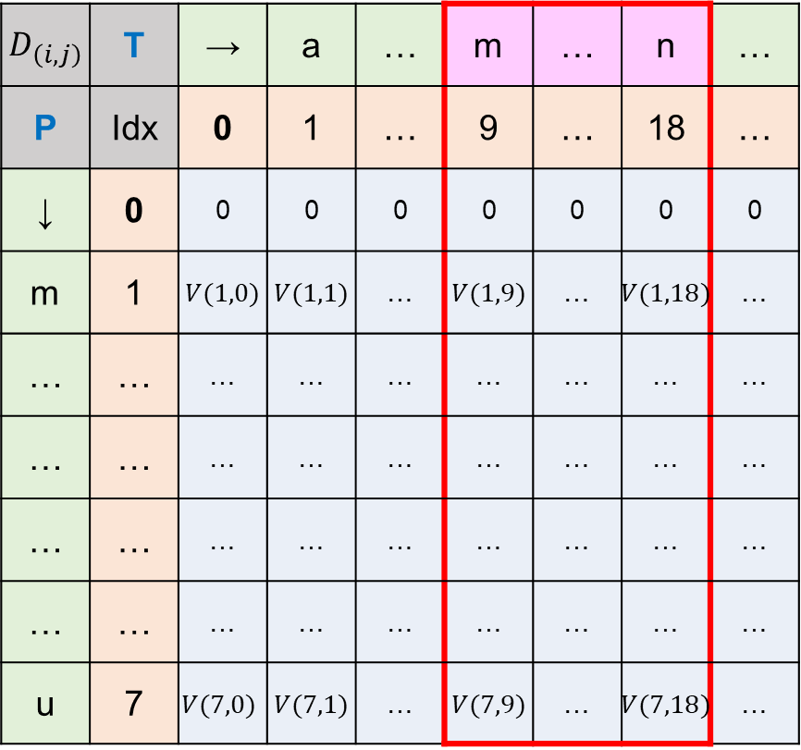


Approximate occurrences of P in T
$$T^{′}=T[k..j]$$
▶ Draw the table, measuring string similarity
$D_{\left(i,j\right)}$ | T | → | a | … | m | … | n | …
P | Idx | 0 | 1 | … | 9 | … | 18 | …
↓ | 0 | 0 | 0 | 0 | 0 | 0 | 0 | 0
m | 1 | $V(1,0)$ | $V(1,1)$ | … | $V(1,9)$ | … | $V(1,18)$ | …
… | … | … | … | … | … | … | … | …
… | … | … | … | … | … | … | … | …
… | … | … | … | … | … | … | … | …
… | … | … | … | … | … | … | … | …
u | 7 | $$V(7,0)$$ | $V(7,1)$ | … | $V(7,9)$ | … | $V(7,18)$ | …
T = ‘algorithmisveryfunny’,
T’ = ‘misveryfun’
P = ‘missyou’
$k=9, j=18$

Slide 46
Approximate occurrences of P in T
$$T^{′}=T[k..j]$$
▶ Draw the table, measuring string similarity
$D_{\left(i,j\right)}$ | T | → | a | … | m | … | n | …
P | Idx | 0 | 1 | … | 9 | … | 18 | …
↓ | 0 | 0 | 0 | 0 | 0 | 0 | 0 | 0
m | 1 | $V(1,0)$ | $V(1,1)$ | … | $V(1,9)$ | … | $V(1,18)$ | …
… | … | … | … | … | … | … | … | …
… | … | … | … | … | … | … | … | …
… | … | … | … | … | … | … | … | …
… | … | … | … | … | … | … | … | …
u | 7 | $$V(7,0)$$ | $V(7,1)$ | … | $V(7,9)$ | … | $V(7,18)$ | …
T = ‘algorithmisveryfunny’,
T’ = ‘misveryfun’
P = ‘missyou’
$k=9, j=18$
…

Slide 47
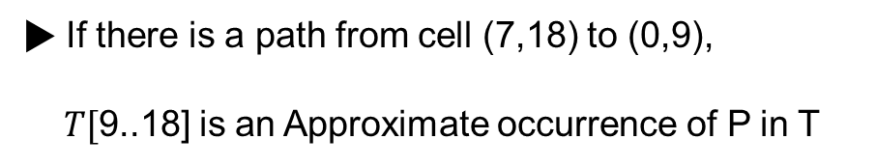
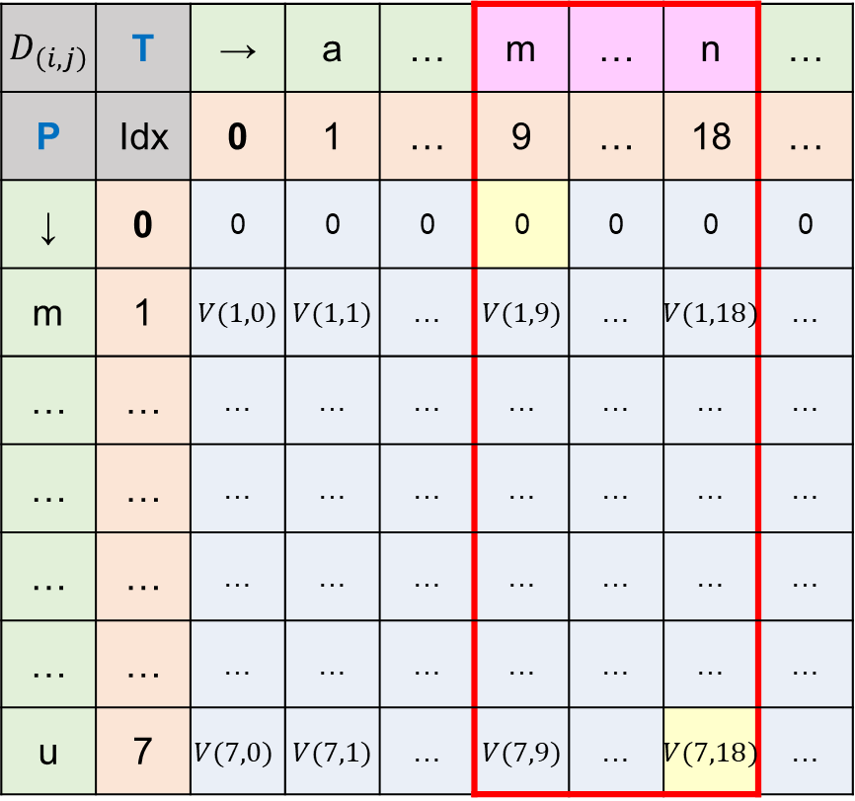
Approximate occurrences of P in T
$$T^{′}=T[k..j]$$
▶ Draw the table, measuring string similarity
$D_{\left(i,j\right)}$ | T | → | a | … | m | … | n | …
P | Idx | 0 | 1 | … | 9 | … | 18 | …
↓ | 0 | 0 | 0 | 0 | 0 | 0 | 0 | 0
m | 1 | $V(1,0)$ | $V(1,1)$ | … | $V(1,9)$ | … | $V(1,18)$ | …
… | … | … | … | … | … | … | … | …
… | … | … | … | … | … | … | … | …
… | … | … | … | … | … | … | … | …
… | … | … | … | … | … | … | … | …
u | 7 | $$V(7,0)$$ | $V(7,1)$ | … | $V(7,9)$ | … | $V(7,18)$ | …
T = ‘algorithmisveryfunny’,
T’ = ‘misveryfun’
P = ‘missyou’
$k=9, j=18$
▶ If there is a path from cell (7,18) to (0,9),
$T[$9..18] is an Approximate occurrence of P in T
…

Slide 48
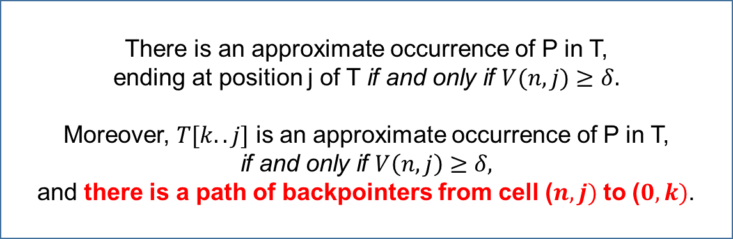

Approximate occurrences of P in T
$$T^{′}=T[k..j]$$
▶ Draw the table, measuring string similarity
$D_{\left(i,j\right)}$ | T | → | a | … | m | … | n | …
P | Idx | 0 | 1 | … | 9 | … | 18 | …
↓ | 0 | 0 | 0 | 0 | 0 | 0 | 0 | 0
m | 1 | $V(1,0)$ | $V(1,1)$ | … | $V(1,9)$ | … | $V(1,18)$ | …
… | … | … | … | … | … | … | … | …
… | … | … | … | … | … | … | … | …
… | … | … | … | … | … | … | … | …
… | … | … | … | … | … | … | … | …
u | 7 | $$V(7,0)$$ | $V(7,1)$ | … | $V(7,9)$ | … | $V(7,18)$ | …
T = ‘algorithmisveryfunny’,
T’ = ‘misveryfun’
P = ‘missyou’
for every $k,j(k≤j)$
Theorem 11.6.2
There is an approximate occurrence of P in T,
ending at position j of T if and only if $V(n, j)$ $≥$ $δ.$
Moreover, $T[k..j]$ is an approximate occurrence of P in T,
if and only if $V\left(n, j\right)$ $≥$ $δ,$
and there is a path of backpointers from cell ($n, j)$ to ($0, k)$.
…

Slide 49
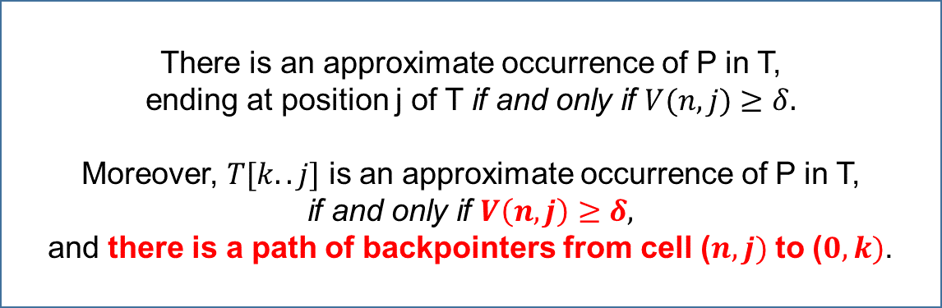
Approximate occurrences of P in T
$$T^{′}=T[k..j]$$
▶ Draw the table, measuring string similarity
$D_{\left(i,j\right)}$ | T | → | a | … | m | … | n | …
P | Idx | 0 | 1 | … | 9 | … | 18 | …
↓ | 0 | 0 | 0 | 0 | 0 | 0 | 0 | 0
m | 1 | $V(1,0)$ | $V(1,1)$ | … | $V(1,9)$ | … | $V(1,18)$ | …
… | … | … | … | … | … | … | … | …
… | … | … | … | … | … | … | … | …
… | … | … | … | … | … | … | … | …
… | … | … | … | … | … | … | … | …
u | 7 | $$V(7,0)$$ | $V(7,1)$ | … | $V(7,9)$ | … | $V(7,18)$ | …
T = ‘algorithmisveryfunny’,
T’ = ‘misveryfun’
P = ‘missyou’
for every $k,j(k≤j)$
Theorem 11.6.2
There is an approximate occurrence of P in T,
ending at position j of T if and only if $V(n, j)$ $≥$ $δ.$
Moreover, $T[k..j]$ is an approximate occurrence of P in T,
if and only if $V\left(n, j\right)$ $≥$ $δ,$
and there is a path of backpointers from cell ($n, j)$ to ($0, k)$.
…

Slide 50

Approximate occurrences of P in T
▶ Draw the table, measuring string similarity
$D_{\left(i,j\right)}$ | T | → | a | … | m | … | n | …
P | Idx | 0 | 1 | … | 9 | … | 18 | …
↓ | 0 | 0 | 0 | 0 | 0 | 0 | 0 | 0
m | 1 | $V(1,0)$ | $V(1,1)$ | … | $V(1,9)$ | … | $V(1,18)$ | …
… | … | … | … | … | … | … | … | …
… | … | … | … | … | … | … | … | …
… | … | … | … | … | … | … | … | …
… | … | … | … | … | … | … | … | …
u | 7 | $$V(7,0)$$ | $V(7,1)$ | … | $V(7,9)$ | … | $V(7,18)$ | …
T = ‘algorithmisveryfunny’,
P = ‘missyou’
▶ This table will be filled in $O(nm)$ time

Slide 51
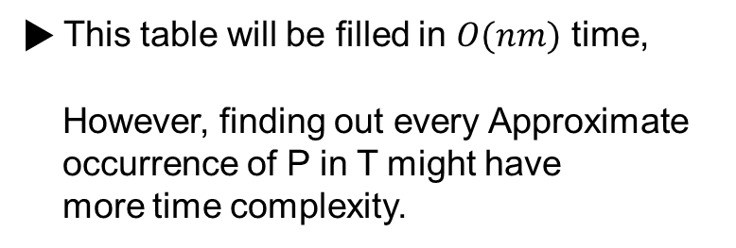
Approximate occurrences of P in T
▶ Draw the table, measuring string similarity
$D_{\left(i,j\right)}$ | T | → | a | … | m | … | n | …
P | Idx | 0 | 1 | … | 9 | … | 18 | …
↓ | 0 | 0 | 0 | 0 | 0 | 0 | 0 | 0
m | 1 | $V(1,0)$ | $V(1,1)$ | … | $V(1,9)$ | … | $V(1,18)$ | …
… | … | … | … | … | … | … | … | …
… | … | … | … | … | … | … | … | …
… | … | … | … | … | … | … | … | …
… | … | … | … | … | … | … | … | …
u | 7 | $$V(7,0)$$ | $V(7,1)$ | … | $V(7,9)$ | … | $V(7,18)$ | …
T = ‘algorithmisveryfunny’,
P = ‘missyou’
▶ This table will be filled in $O(nm)$ time,
However, finding out every Approximate
occurrence of P in T might have
more time complexity.

Slide 52
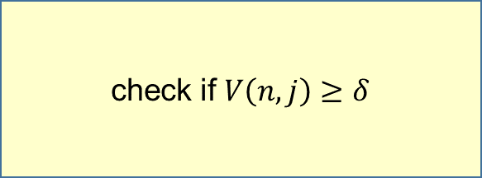
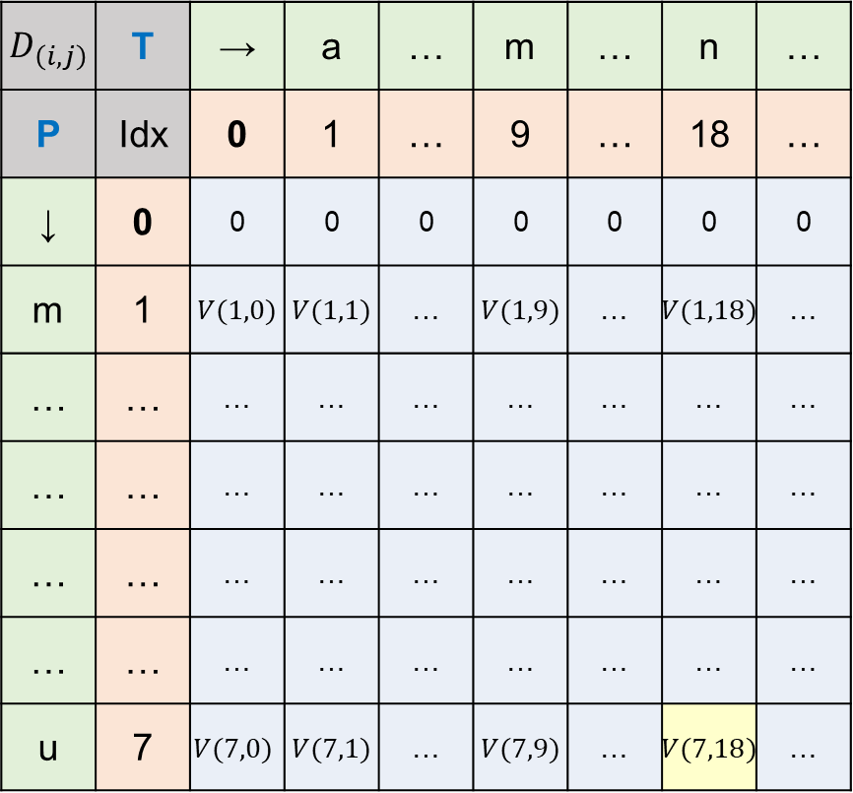
Approximate occurrences of P in T
▶ Draw the table, measuring string similarity
$D_{\left(i,j\right)}$ | T | → | a | … | m | … | n | …
P | Idx | 0 | 1 | … | 9 | … | 18 | …
↓ | 0 | 0 | 0 | 0 | 0 | 0 | 0 | 0
m | 1 | $V(1,0)$ | $V(1,1)$ | … | $V(1,9)$ | … | $V(1,18)$ | …
… | … | … | … | … | … | … | … | …
… | … | … | … | … | … | … | … | …
… | … | … | … | … | … | … | … | …
… | … | … | … | … | … | … | … | …
u | 7 | $$V(7,0)$$ | $V(7,1)$ | … | $V(7,9)$ | … | $V(7,18)$ | …
T = ‘algorithmisveryfunny’,
P = ‘missyou’
▶ This table will be filled in $O(nm)$ time,
However, finding out every Approximate
occurrence of P in T might have
more time complexity.
check if $V\left(n,j\right)≥δ$

Slide 53
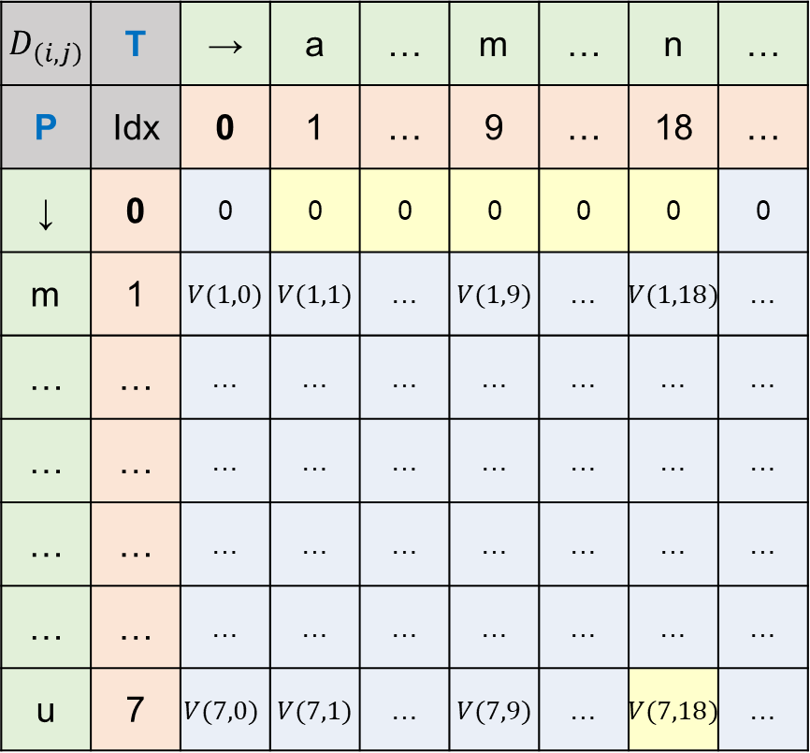
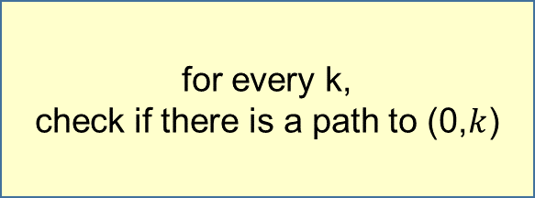

Approximate occurrences of P in T
▶ Draw the table, measuring string similarity
$D_{\left(i,j\right)}$ | T | → | a | … | m | … | n | …
P | Idx | 0 | 1 | … | 9 | … | 18 | …
↓ | 0 | 0 | 0 | 0 | 0 | 0 | 0 | 0
m | 1 | $V(1,0)$ | $V(1,1)$ | … | $V(1,9)$ | … | $V(1,18)$ | …
… | … | … | … | … | … | … | … | …
… | … | … | … | … | … | … | … | …
… | … | … | … | … | … | … | … | …
… | … | … | … | … | … | … | … | …
u | 7 | $$V(7,0)$$ | $V(7,1)$ | … | $V(7,9)$ | … | $V(7,18)$ | …
T = ‘algorithmisveryfunny’,
P = ‘missyou’
▶ This table will be filled in $O(nm)$ time,
However, finding out every Approximate
occurrence of P in T might have
more time complexity.
path exists?
for every k,
check if there is a path to (0,$k$)
※ $0<k≤j$

Slide 54
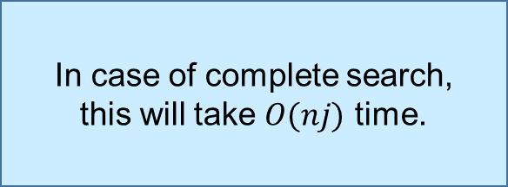
Approximate occurrences of P in T
▶ Draw the table, measuring string similarity
$D_{\left(i,j\right)}$ | T | → | a | … | m | … | n | …
P | Idx | 0 | 1 | … | 9 | … | 18 | …
↓ | 0 | 0 | 0 | 0 | 0 | 0 | 0 | 0
m | 1 | $V(1,0)$ | $V(1,1)$ | … | $V(1,9)$ | … | $V(1,18)$ | …
… | … | … | … | … | … | … | … | …
… | … | … | … | … | … | … | … | …
… | … | … | … | … | … | … | … | …
… | … | … | … | … | … | … | … | …
u | 7 | $$V(7,0)$$ | $V(7,1)$ | … | $V(7,9)$ | … | $V(7,18)$ | …
T = ‘algorithmisveryfunny’,
P = ‘missyou’
In case of complete search,
this will take $O(nj)$ time.
▶ This table will be filled in $O(nm)$ time,
However, finding out every Approximate
occurrence of P in T might have
more time complexity.
path exists?
for every k,
check if there is a path to (0,$k$)
※ $0<k≤j$

Slide 55

Approximate occurrences of P in T
▶ Draw the table, measuring string similarity
$D_{\left(i,j\right)}$ | T | → | a | … | m | … | n | …
P | Idx | 0 | 1 | … | 9 | … | 18 | …
↓ | 0 | 0 | 0 | 0 | 0 | 0 | 0 | 0
m | 1 | $V(1,0)$ | $V(1,1)$ | … | $V(1,9)$ | … | $V(1,18)$ | …
… | … | … | … | … | … | … | … | …
… | … | … | … | … | … | … | … | …
… | … | … | … | … | … | … | … | …
… | … | … | … | … | … | … | … | …
u | 7 | $$V(7,0)$$ | $V(7,1)$ | … | $V(7,9)$ | … | $V(7,18)$ | …
T = ‘algorithmisveryfunny’,
P = ‘missyou’
In case of complete search,
this will take $O(nj)$ time.
▶ This table will be filled in $O(nm)$ time,
However, finding out every Approximate
occurrence of P in T might have
more time complexity.
$$\sum_{j=1}^{m}{nj}=O(nm^{2})$$
path exists?
for every k,
check if there is a path to (0,$k$)
※ $0<k≤j$

Slide 56
Approximate occurrences of P in T
▶ Draw the table, measuring string similarity
$D_{\left(i,j\right)}$ | T | → | a | … | m | … | n | …
P | Idx | 0 | 1 | … | 9 | … | 18 | …
↓ | 0 | 0 | 0 | 0 | 0 | 0 | 0 | 0
m | 1 | $V(1,0)$ | $V(1,1)$ | … | $V(1,9)$ | … | $V(1,18)$ | …
… | … | … | … | … | … | … | … | …
… | … | … | … | … | … | … | … | …
… | … | … | … | … | … | … | … | …
… | … | … | … | … | … | … | … | …
u | 7 | $$V(7,0)$$ | $V(7,1)$ | … | $V(7,9)$ | … | $V(7,18)$ | …
T = ‘algorithmisveryfunny’,
P = ‘missyou’
In case of complete search,
this will take $O(nj)$ time.
▶ This table will be filled in $O(nm)$ time,
However, finding out every Approximate
occurrence of P in T might have
more time complexity.
$$\sum_{j=1}^{m}{nj}=O(nm^{2})$$
path exists?
Too expensive
for every k,
check if there is a path to (0,$k$)
※ $0<k≤j$

Slide 57
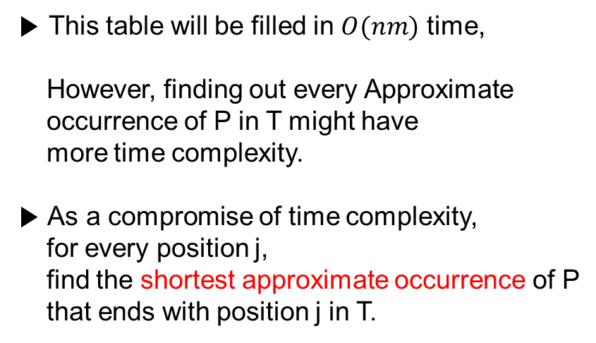
Approximate occurrences of P in T
▶ Draw the table, measuring string similarity
$D_{\left(i,j\right)}$ | T | → | a | … | m | … | n | …
P | Idx | 0 | 1 | … | 9 | … | 18 | …
↓ | 0 | 0 | 0 | 0 | 0 | 0 | 0 | 0
m | 1 | $V(1,0)$ | $V(1,1)$ | … | $V(1,9)$ | … | $V(1,18)$ | …
… | … | … | … | … | … | … | … | …
… | … | … | … | … | … | … | … | …
… | … | … | … | … | … | … | … | …
… | … | … | … | … | … | … | … | …
u | 7 | $$V(7,0)$$ | $V(7,1)$ | … | $V(7,9)$ | … | $V(7,18)$ | …
T = ‘algorithmisveryfunny’,
P = ‘missyou’
▶ This table will be filled in $O(nm)$ time,
However, finding out every Approximate
occurrence of P in T might have
more time complexity.
▶ As a compromise of time complexity,
for every position j,
find the shortest approximate occurrence of P
that ends with position j in T.

Slide 58
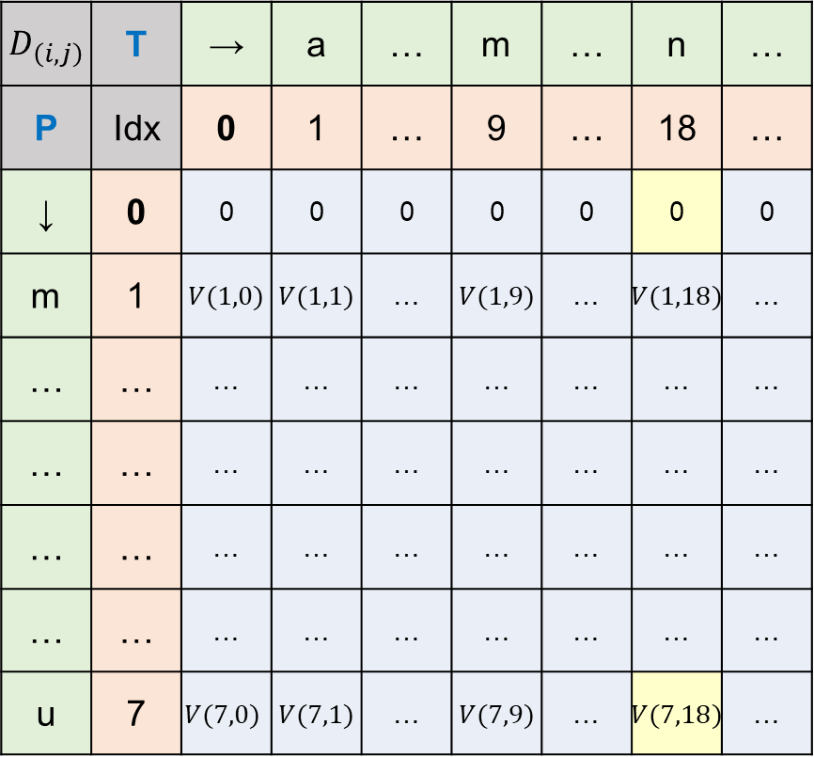
Approximate occurrences of P in T
▶ Draw the table, measuring string similarity
$D_{\left(i,j\right)}$ | T | → | a | … | m | … | n | …
P | Idx | 0 | 1 | … | 9 | … | 18 | …
↓ | 0 | 0 | 0 | 0 | 0 | 0 | 0 | 0
m | 1 | $V(1,0)$ | $V(1,1)$ | … | $V(1,9)$ | … | $V(1,18)$ | …
… | … | … | … | … | … | … | … | …
… | … | … | … | … | … | … | … | …
… | … | … | … | … | … | … | … | …
… | … | … | … | … | … | … | … | …
u | 7 | $$V(7,0)$$ | $V(7,1)$ | … | $V(7,9)$ | … | $V(7,18)$ | …
T = ‘algorithmisveryfunny’,
P = ‘missyou’
▶ This table will be filled in $O(nm)$ time,
However, finding out every Approximate
occurrence of P in T might have
more time complexity.
▶ As a compromise of time complexity,
for every position j,
find the shortest approximate occurrence of P
that ends with position j in T.
path exists?

Slide 59
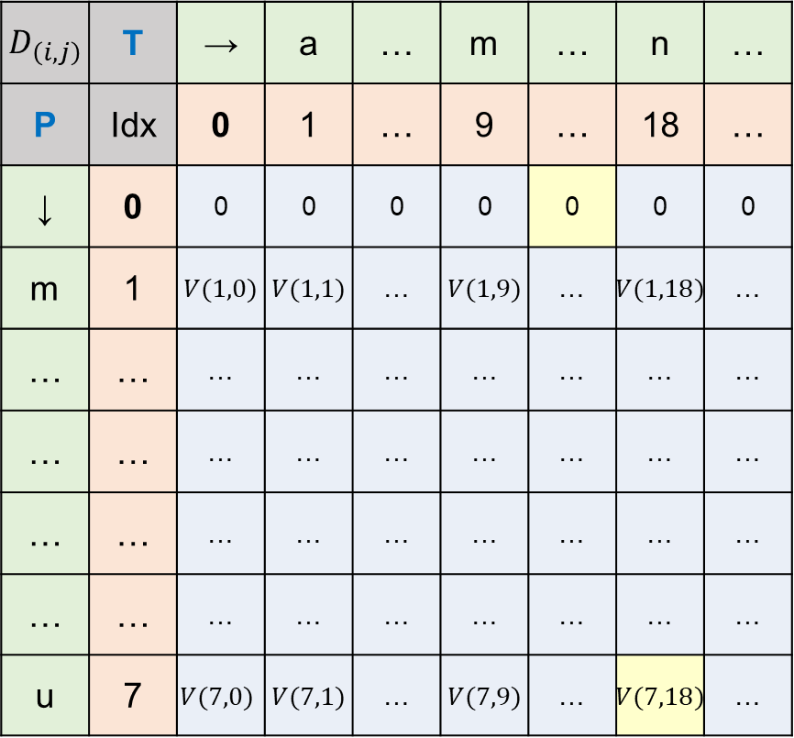
Approximate occurrences of P in T
▶ Draw the table, measuring string similarity
$D_{\left(i,j\right)}$ | T | → | a | … | m | … | n | …
P | Idx | 0 | 1 | … | 9 | … | 18 | …
↓ | 0 | 0 | 0 | 0 | 0 | 0 | 0 | 0
m | 1 | $V(1,0)$ | $V(1,1)$ | … | $V(1,9)$ | … | $V(1,18)$ | …
… | … | … | … | … | … | … | … | …
… | … | … | … | … | … | … | … | …
… | … | … | … | … | … | … | … | …
… | … | … | … | … | … | … | … | …
u | 7 | $$V(7,0)$$ | $V(7,1)$ | … | $V(7,9)$ | … | $V(7,18)$ | …
T = ‘algorithmisveryfunny’,
P = ‘missyou’
▶ This table will be filled in $O(nm)$ time,
However, finding out every Approximate
occurrence of P in T might have
more time complexity.
▶ As a compromise of time complexity,
for every position j,
find the shortest approximate occurrence of P
that ends with position j in T.
path exists?

Slide 60
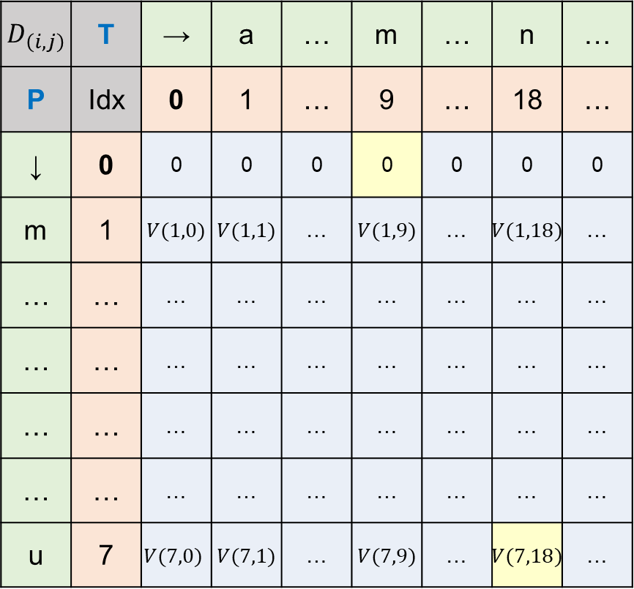
Approximate occurrences of P in T
▶ Draw the table, measuring string similarity
$D_{\left(i,j\right)}$ | T | → | a | … | m | … | n | …
P | Idx | 0 | 1 | … | 9 | … | 18 | …
↓ | 0 | 0 | 0 | 0 | 0 | 0 | 0 | 0
m | 1 | $V(1,0)$ | $V(1,1)$ | … | $V(1,9)$ | … | $V(1,18)$ | …
… | … | … | … | … | … | … | … | …
… | … | … | … | … | … | … | … | …
… | … | … | … | … | … | … | … | …
… | … | … | … | … | … | … | … | …
u | 7 | $$V(7,0)$$ | $V(7,1)$ | … | $V(7,9)$ | … | $V(7,18)$ | …
T = ‘algorithmisveryfunny’,
P = ‘missyou’
▶ This table will be filled in $O(nm)$ time,
However, finding out every Approximate
occurrence of P in T might have
more time complexity.
▶ As a compromise of time complexity,
for every position j,
find the shortest approximate occurrence of P
that ends with position j in T.
path exists?

Slide 61


Approximate occurrences of P in T
▶ Draw the table, measuring string similarity
$D_{\left(i,j\right)}$ | T | → | a | … | m | … | n | …
P | Idx | 0 | 1 | … | 9 | … | 18 | …
↓ | 0 | 0 | 0 | 0 | 0 | 0 | 0 | 0
m | 1 | $V(1,0)$ | $V(1,1)$ | … | $V(1,9)$ | … | $V(1,18)$ | …
… | … | … | … | … | … | … | … | …
… | … | … | … | … | … | … | … | …
… | … | … | … | … | … | … | … | …
… | … | … | … | … | … | … | … | …
u | 7 | $$V(7,0)$$ | $V(7,1)$ | … | $V(7,9)$ | … | $V(7,18)$ | …
T = ‘algorithmisveryfunny’,
P = ‘missyou’
▶ This table will be filled in $O(nm)$ time,
However, finding out every Approximate
occurrence of P in T might have
more time complexity.
▶ As a compromise of time complexity,
for every position j,
find the shortest approximate occurrence of P
that ends with position j in T.
…
Priority :
$$>$$
$$>$$

Slide 62
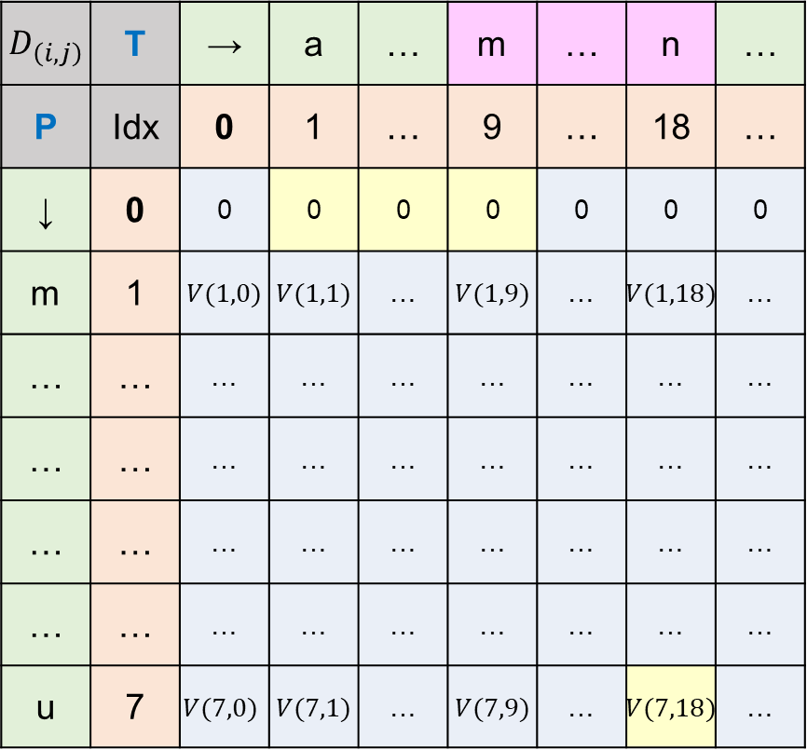
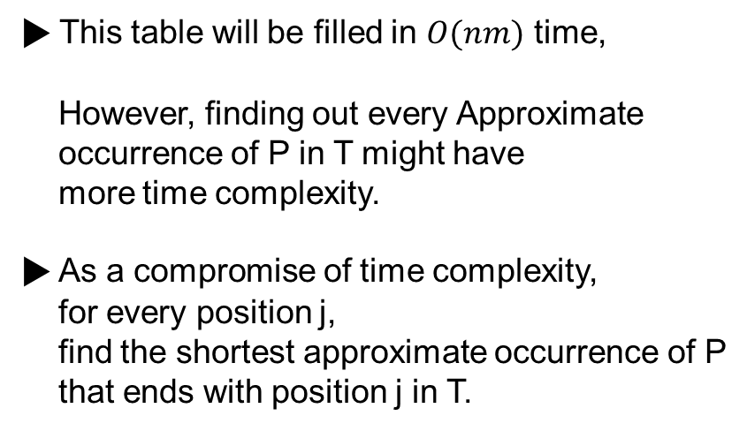
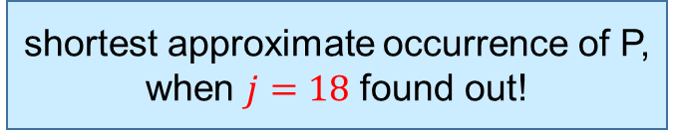
Approximate occurrences of P in T
▶ Draw the table, measuring string similarity
$D_{\left(i,j\right)}$ | T | → | a | … | m | … | n | …
P | Idx | 0 | 1 | … | 9 | … | 18 | …
↓ | 0 | 0 | 0 | 0 | 0 | 0 | 0 | 0
m | 1 | $V(1,0)$ | $V(1,1)$ | … | $V(1,9)$ | … | $V(1,18)$ | …
… | … | … | … | … | … | … | … | …
… | … | … | … | … | … | … | … | …
… | … | … | … | … | … | … | … | …
… | … | … | … | … | … | … | … | …
u | 7 | $$V(7,0)$$ | $V(7,1)$ | … | $V(7,9)$ | … | $V(7,18)$ | …
T = ‘algorithmisveryfunny’,
P = ‘missyou’
shortest approximate occurrence of P,
when $j=18$ found out!
▶ This table will be filled in $O(nm)$ time,
However, finding out every Approximate
occurrence of P in T might have
more time complexity.
▶ As a compromise of time complexity,
for every position j,
find the shortest approximate occurrence of P
that ends with position j in T.
…
Priority :
$$>$$
$$>$$

Slide 63
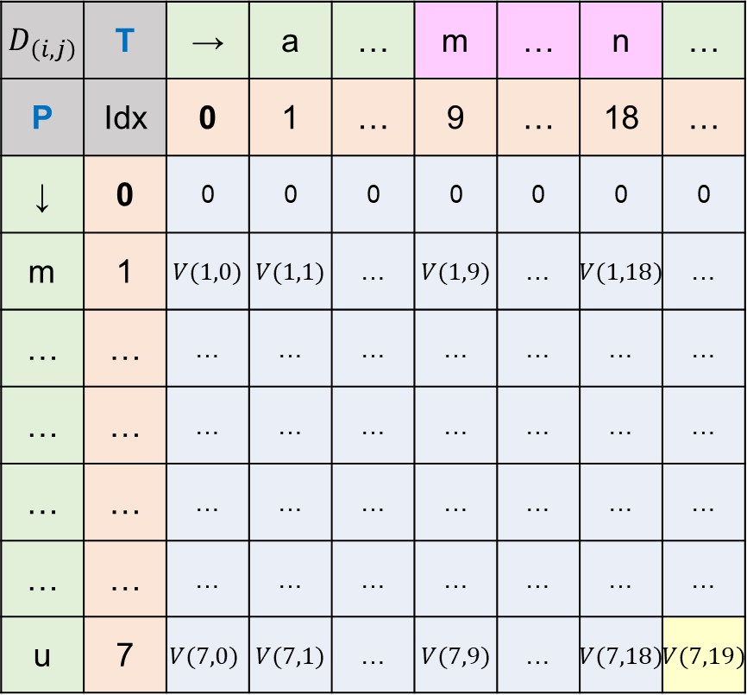

Approximate occurrences of P in T
▶ Draw the table, measuring string similarity
$D_{\left(i,j\right)}$ | T | → | a | … | m | … | n | …
P | Idx | 0 | 1 | … | 9 | … | 18 | …
↓ | 0 | 0 | 0 | 0 | 0 | 0 | 0 | 0
m | 1 | $V(1,0)$ | $V(1,1)$ | … | $V(1,9)$ | … | $V(1,18)$ | …
… | … | … | … | … | … | … | … | …
… | … | … | … | … | … | … | … | …
… | … | … | … | … | … | … | … | …
… | … | … | … | … | … | … | … | …
u | 7 | $$V(7,0)$$ | $V(7,1)$ | … | $V(7,9)$ | … | $V(7,18)$ | $V(7,19)$
T = ‘algorithmisveryfunny’,
P = ‘missyou’
▶ This table will be filled in $O(nm)$ time,
However, finding out every Approximate
occurrence of P in T might have
more time complexity.
▶ As a compromise of time complexity,
for every position j,
find the shortest approximate occurrence of P
that ends with position j in T.
then move $j$,
if $V≥δ$, find shortest path
through traceback

Slide 64
Approximate occurrences of P in T
▶ Draw the table, measuring string similarity
$D_{\left(i,j\right)}$ | T | → | a | … | m | … | n | …
P | Idx | 0 | 1 | … | 9 | … | 18 | …
↓ | 0 | 0 | 0 | 0 | 0 | 0 | 0 | 0
m | 1 | $V(1,0)$ | $V(1,1)$ | … | $V(1,9)$ | … | $V(1,18)$ | …
… | … | … | … | … | … | … | … | …
… | … | … | … | … | … | … | … | …
… | … | … | … | … | … | … | … | …
… | … | … | … | … | … | … | … | …
u | 7 | $$V(7,0)$$ | $V(7,1)$ | … | $V(7,9)$ | … | $V(7,18)$ | $V(7,19)$
T = ‘algorithmisveryfunny’,
P = ‘missyou’
▶ This table will be filled in $O(nm)$ time,
However, finding out every Approximate
occurrence of P in T might have
more time complexity.
▶ As a compromise of time complexity,
for every position j,
find the shortest approximate occurrence of P
that ends with position j in T.
path exists?
then move $j$,
if $V≥δ$, find shortest path
through traceback

Slide 65
Next week
▶ Local Alignments
▶ Gaps

Slide 66
Thank you

Slide 67
Local Alignment

Slide 68


Local Alignment
▶ Given two strings, there might be some regions having high similarity.
$S_{1}$ = ‘security’
$S_{2}$ = ‘chickencurry’
$S_{1}$ | _ | _ | s | e | c | u | r | i | t | y
$S_{2}$ | c | h | ... | ... | c | u | r | r | _ | y

Slide 69

Local Alignment
▶ Given two strings, there might be some regions having high similarity.
$S_{1}$ = ‘security’
$S_{2}$ = ‘chickencurry’
$S_{1}$ | _ | _ | s | e | c | u | r | i | t | y
$S_{2}$ | c | h | ... | ... | c | u | r | r | _ | y

Slide 70
Local Alignment
▶ Given two strings, there might be some regions having high similarity.
$S_{1}$ = ‘security’
$S_{2}$ = ‘chickencurry’
$S_{1}$ | _ | _ | s | e | c | u | r | i | t | y
$S_{2}$ | c | h | ... | ... | c | u | r | r | _ | y
finding out pair of regions
that contains high similarity
▶ This is called local alignment problem

Slide 71





Local Alignment
Definition
Given two strings $S_{1}$ and $S_{2}$,
find substrings $α∈S_{1}, β∈S_{2}$
whose similarity is maximum over all pairs of substrings from $S_{1}$ and $S_{2}$
$$v^{∗}=V(α,β)$$
$S_{1}$ = ‘security’
$S_{2}$ = ‘chickencurry’
$α$ = ‘cur’
$β$ = ‘cur’
$$v^{∗}=V(α_{3}, β_{3})$$
$S_{1}$ | _ | _ | s | e | c | u | r | i | t | y
$S_{2}$ | c | h | ... | ... | c | u | r | r | _ | y

Slide 72



Local Alignment
▶ According to scoring scheme, $α, β$ will be defined differently.
so, local alignment problem is to find $α, β$ that corresponds to the special objective we intend.
$S_{1}$ = ‘security’
$S_{2}$ = ‘chickencurry’
$S_{1}$ | _ | s | e | _ | c | u | r | i | t | y
$S_{2}$ | c | ... | e | n | c | u | r | r | _ | y
We can extract different $α, β$,
according to different scoring scheme.

Slide 73

Local Alignment
▶ Given n, m that corresponds to the length of $S_{1}$ and $S_{2}$,
there are $_{n}C_{2}$ numbers of $α$ candidates
there are $_{m}C_{2}$ numbers of $β$ candidates
so, there are $\frac{n(n−1)}{2}$ $α$ candidates, $\frac{m(m−1)}{2}$ $β$ candidates
so, there are $θ(n^{2}m^{2})$ pairs of substrings

Slide 74
Local Alignment
▶ There are $θ(n^{2}m^{2})$ pairs of substrings

Slide 75

Local Alignment
▶ There are $θ(n^{2}m^{2})$ pairs of substrings
▶ computating similarity every pair of substrings takes $O(nm)$ time
$D_{\left(i,j\right)}$ | T | → | a | … |  | … | n | …
P | Idx | 0 | 1 | … |  | … | 18 | …
↓ | 0 | … | … | … | ... | … | … | …
m | 1 | … | … | … | ... | … | … | …
… | … | … | … | … | ... | … | … | …
… | … | … | … | … | ... | … | … | …
… | … | … | … | … | ... | … | … | …
… | … | … | … | … | ... | … | … | …
u | 7 | … | … | … | ... | … | … | …
\Because we don’t know,
if there is a path

Slide 76

Local Alignment
▶ There are $θ(n^{2}m^{2})$ pairs of substrings
▶ computating similarity every pair of substrings takes $O(nm)$ time
So, computing similarity for every pair of substrings is
$$O(n^{3}m^{3})$$

Slide 77
Local Alignment
▶ There are $θ(n^{2}m^{2})$ pairs of substrings
▶ computating similarity every pair of substrings takes $O(nm)$ time
So, computing similarity for every pair of substrings is
$$O(n^{3}m^{3})$$
Too much time complexity . . .

Slide 78
Local Alignment
▶ Algorithms that solves local alignment problem in a less time than $O(n^{3}m^{3})$

Slide 79

Local Alignment
▶ Algorithms that solves local alignment problem in a less time than $O(n^{3}m^{3})$
Definition
Given a pair of indices $i≤n$ and $j≤m$.
the local suffix problem is to find a (possibly empty) suffix $α,β$ of $S_{1}\left[1..i\right], S_{2}[i..j]$
that $V\left(α, β\right)$ is the maximum over all pairs of suffixes of $S_{1}\left[1..i\right], S_{2}[i..j]$
$$v=V(α, β)$$
▶ We will assume that for given $S_{1}=^{′′},S_{2}=^{′′}.$ (both are empty string)
$V\left(S_{1},S_{2}\right)=0$

Slide 80



Local Alignment
Definition
Given a pair of indices $i≤n$ and $j≤m$.
the local suffix problem is to find a (possibly empty) suffix $α,β$ of $S_{1}\left[1..i\right], S_{2}[1..j]$
that $V\left(α, β\right)$ is the maximum over all pairs of suffixes of $S_{1}\left[1..i\right], S_{2}[i..j]$
$$v=V(α, β)$$
$S_{1}$ = ‘channel’
$S_{2}$ = ‘marching’
$S_{1}$ | _ | _ | _ | c | h | a | n | n | e | l
$S_{2}$ | m | a | r | c | h | i | n | g | _ | _

Slide 81

Local Alignment
Definition
Given a pair of indices $i≤n$ and $j≤m$.
the local suffix problem is to find a (possibly empty) suffix $α,β$ of $S_{1}\left[1..i\right], S_{2}[1..j]$
that $V\left(α, β\right)$ is the maximum over all pairs of suffixes of $S_{1}\left[1..i\right], S_{2}[i..j]$
$$v=V(α, β)$$
$S_{1}$ = ‘channel’
$S_{2}$ = ‘marching’
$i$ = 2
$j$ = 5
$S_{1}$ | _ | _ | _ | c | h | a | n | n | e | l
$S_{2}$ | m | a | r | c | h | i | n | g | _ | _

Slide 82



Local Alignment
Definition
Given a pair of indices $i≤n$ and $j≤m$.
the local suffix problem is to find a (possibly empty) suffix $α,β$ of $S_{1}\left[1..i\right], S_{2}[1..j]$
that $V\left(α, β\right)$ is the maximum over all pairs of suffixes of $S_{1}\left[1..i\right], S_{2}[i..j]$
$$v=V(α, β)$$
$S_{1}$ = ‘channel’
$S_{2}$ = ‘marching’
$i$ = 2
$j$ = 5
$S_{1}[1..i]$, $S_{2}[1..j]$
are the prefixes of $S_{1}$ and $S_{2}$
$S_{1}$ | _ | _ | _ | c | h | a | n | n | e | l
$S_{2}$ | m | a | r | c | h | i | n | g | _ | _

Slide 83




Local Alignment
Definition
Given a pair of indices $i≤n$ and $j≤m$.
the local suffix problem is to find a (possibly empty) suffix $α,β$ of $S_{1}\left[1..i\right], S_{2}[1..j]$
that $V\left(α, β\right)$ is the maximum over all pairs of suffixes of $S_{1}\left[1..i\right], S_{2}[i..j]$
$$v=V(α, β)$$
$S_{1}$ = ‘channel’
$S_{2}$ = ‘marching’
$i$ = 2
$j$ = 5
$S_{1}[1..i]$, $S_{2}[1..j]$
are the prefixes of $S_{1}$ and $S_{2}$
$$α=S_{1}\left[1..i\right]$$
$S_{1}$ | _ | _ | _ | c | h | a | n | n | e | l
$S_{2}$ | m | a | r | c | h | i | n | g | _ | _
$$β=S_{2}\left[4..j\right]$$

Slide 84

Local Alignment
Definition
Given a pair of indices $i≤n$ and $j≤m$.
the local suffix problem is to find a (possibly empty) suffix $α,β$ of $S_{1}\left[1..i\right], S_{2}[1..j]$
that $V\left(α, β\right)$ is the maximum over all pairs of suffixes of $S_{1}\left[1..i\right], S_{2}[i..j]$
$$v=V(α, β)$$
$S_{1}$ = ‘channel’
$S_{2}$ = ‘marching’
$i$ = 2
$j$ = 5
$S_{1}[1..i]$, $S_{2}[1..j]$
are the prefixes of $S_{1}$ and $S_{2}$
$$α=S_{1}\left[1..i\right]$$
$S_{1}$ | _ | _ | _ | c | h | a | n | n | e | l
$S_{2}$ | m | a | r | c | h | i | n | g | _ | _
$α, β$ are the suffixes of
$S_{1}[1..i]$ and $S_{2}[1..j]$
$$β=S_{2}\left[4..j\right]$$

Slide 85
Local Alignment
Definition
Given a pair of indices $i≤n$ and $j≤m$.
the local suffix problem is to find a (possibly empty) suffix $α,β$ of $S_{1}\left[1..i\right], S_{2}[1..j]$
that $V\left(α, β\right)$ is the maximum over all pairs of suffixes of $S_{1}\left[1..i\right], S_{2}[i..j]$
$$v=V(α, β)$$
$S_{1}$ = ‘channel’
$S_{2}$ = ‘marching’
$i$ = 2
$j$ = 5
$S_{1}[1..i]$, $S_{2}[1..j]$
are the prefixes of $S_{1}$ and $S_{2}$
$$α=S_{1}\left[1..i\right]$$
$S_{1}$ | _ | _ | _ | c | h | a | n | n | e | l
$S_{2}$ | m | a | r | c | h | i | n | g | _ | _
$α, β$ are the suffixes of
$S_{1}[1..i]$ and $S_{2}[1..j]$
$$β=S_{2}\left[4..j\right]$$
▶ Local suffix problem is to find $α, β$ within all pairs of substring of $S_{1}, S_{2}$
for every index $i$ and $j$

Slide 86


Local Alignment
Definition
Given a pair of indices $i≤n$ and $j≤m$.
the local suffix problem is to find a (possibly empty) suffix $α,β$ of $S_{1}\left[1..i\right], S_{2}[1..j]$
that $V\left(α, β\right)$ is the maximum over all pairs of suffixes of $S_{1}\left[1..i\right], S_{2}[i..j]$
$$v=V(α, β)$$
$S_{1}$ = ‘channel’
$S_{2}$ = ‘marching’
$i$ = 1
$j$ = 2
$S_{1}[1..i]$, $S_{2}[1..j]$
are the prefixes of $S_{1}$ and $S_{2}$
$S_{1}$ | _ | _ | _ | c | h | a | n | n | e | l
$S_{2}$ | m | a | r | c | h | i | n | g | _ | _
No matching ?

Slide 87

Local Alignment
Definition
Given a pair of indices $i≤n$ and $j≤m$.
the local suffix problem is to find a possibly empty suffix $α,β$ of $S_{1}\left[1..i\right], S_{2}[1..j]$
that $V\left(α, β\right)$ is the maximum over all pairs of suffixes of $S_{1}\left[1..i\right], S_{2}[i..j]$
$$v=V(α, β)$$
$S_{1}$ = ‘channel’
$S_{2}$ = ‘marching’
$i$ = 1
$j$ = 2
$S_{1}[1..i]$, $S_{2}[1..j]$
are the prefixes of $S_{1}$ and $S_{2}$
$S_{1}$ | _ | _ | _ | c | h | a | n | n | e | l
$S_{2}$ | m | a | r | c | h | i | n | g | _ | _
No matching ?

Slide 88


Local Alignment
Definition
Given a pair of indices $i≤n$ and $j≤m$.
the local suffix problem is to find a possibly empty suffix $α,β$ of $S_{1}\left[1..i\right], S_{2}[1..j]$
that $V\left(α, β\right)$ is the maximum over all pairs of suffixes of $S_{1}\left[1..i\right], S_{2}[i..j]$
$$v=V(α, β)$$
$S_{1}$ = ‘channel’
$S_{2}$ = ‘marching’
$i$ = 1
$j$ = 2
$S_{1}[1..i]$, $S_{2}[1..j]$
are the prefixes of $S_{1}$ and $S_{2}$
$α=$ empty string
$S_{1}$ | _ | _ | _ | c | h | a | n | n | e | l
$S_{2}$ | m | a | r | c | h | i | n | g | _ | _
No matching ?
$β=$ empty string

Slide 89

Local Alignment
Definition
Given a pair of indices $i≤n$ and $j≤m$.
the local suffix problem is to find a possibly empty suffix $α,β$ of $S_{1}\left[1..i\right], S_{2}[1..j]$
that $V\left(α, β\right)$ is the maximum over all pairs of suffixes of $S_{1}\left[1..i\right], S_{2}[i..j]$
$$v=V(α, β)$$
$S_{1}$ = ‘channel’
$S_{2}$ = ‘marching’
$i$ = 1
$j$ = 2
$S_{1}[1..i]$, $S_{2}[1..j]$
are the prefixes of $S_{1}$ and $S_{2}$
$α=$ empty string
$S_{1}$ | _ | _ | _ | c | h | a | n | n | e | l
$S_{2}$ | m | a | r | c | h | i | n | g | _ | _
No matching ?
$β=$ empty string
$V\left(α,β\right)=0$

Slide 90

Local Alignment
Definition
Given a pair of indices $i≤n$ and $j≤m$.
the local suffix problem is to find a (possibly empty) suffix $α,β$ of $S_{1}\left[1..i\right], S_{2}[1..j]$
that $V\left(α, β\right)$ is the maximum over all pairs of suffixes of $S_{1}\left[1..i\right], S_{2}[i..j]$
$$v=V\left(α, β\right)$$
$S_{1}$ = ‘channel’
$S_{2}$ = ‘marching’
$S_{1}$ | _ | _ | _ | c | h | a | n | n | e | l
$S_{2}$ | m | a | r | c | h | i | n | g | _ | _

Slide 91

Local Alignment
Definition
Given a pair of indices $i≤n$ and $j≤m$.
the local suffix problem is to find a (possibly empty) suffix $α,β$ of $S_{1}\left[1..i\right], S_{2}[1..j]$
that $V\left(α, β\right)$ is the maximum over all pairs of suffixes of $S_{1}\left[1..i\right], S_{2}[i..j]$
$$v=V\left(α, β\right)$$
$$V\left(α, β\right)≥0$$
$S_{1}$ = ‘channel’
$S_{2}$ = ‘marching’
$S_{1}$ | _ | _ | _ | c | h | a | n | n | e | l
$S_{2}$ | m | a | r | c | h | i | n | g | _ | _

Slide 92

Local Alignment
Theorem 11.7.1
$$v^{∗}=\max\left[v\left(i,j\right):i≤n, j≤m\right].$$

Slide 93
Local Alignment
Theorem 11.7.1
$$v^{∗}=\max\left[v\left(i,j\right):i≤n, j≤m\right].$$
Solution of local alignment problem can be found from
solution of local suffix problem

Slide 94

Local Alignment
Theorem 11.7.1
$$v^{∗}=\max\left[v\left(i,j\right):i≤n, j≤m\right].$$
Solution of local alignment problem can be found from
solution of local suffix problem
▶ $v^{∗}≥max⁡[v\left(i,j\right):i≤n, j≤m]$
For some pair of substring $S_{1}[x..i]$ and $S_{2}[y..j]$,
This is included in local suffix problem

Slide 95


Local Alignment
Theorem 11.7.1
$$v^{∗}=\max\left[v\left(i,j\right):i≤n, j≤m\right].$$
$S_{1}$ = ‘gilgamesh’
$S_{2}$ = ‘progamer’
$S_{1}$ | g | i | l | g | a | m | e | s | h
$S_{2}$ | p | r | o | g | a | m | e | r

Slide 96



Local Alignment
Theorem 11.7.1
$$v^{∗}=\max\left[v\left(i,j\right):i≤n, j≤m\right].$$
$S_{1}$ = ‘gilgamesh’
$S_{2}$ = ‘progamer’
$α$ = ‘game’
$β$ = ‘game’
$S_{1}$ | g | i | l | g | a | m | e | s | h
$S_{2}$ | p | r | o | g | a | m | e | r
$v^{∗}$ is the value between
‘game’ from $S_{1}$ and ‘game’ from $S_{2}$

Slide 97




Local Alignment
Theorem 11.7.1
$$v^{∗}=\max\left[v\left(i,j\right):i≤n, j≤m\right].$$
$S_{1}$ = ‘gilgamesh’
$S_{2}$ = ‘progamer’
$$i=7$$
$$j=7$$
$S_{1}$ | g | i | l | g | a | m | e | s | h
$S_{2}$ | p | r | o | g | a | m | e | r
$$v\left(7,7\right)=v^{∗}$$
In a perspective of local suffix problem,
we found some suffix of $S_{1}\left[1..7\right],S_{2}[1..7]$

Slide 98

Local Alignment
Theorem 11.7.2
if $i^{′},j′$ is an index pair, maximizing $v(i,j)$ over all $i, j$ pairs,
$$v^{∗}=v(i′,j′)$$
Solution in local alignment problem is
maximum value of solution in local suffix problem

Slide 99



Local Alignment
▶ Then, how to solve the local suffix alignment problem ?
First, we assume $v\left(i, 0\right)=0$, $v\left(0, j\right)=0$
※ This is because our chosen suffix is possibly empty
Theorem 11.7.3
For $i>0, j>0$, the recurrence relation for $v(i,j)$ is
$$v\left(i,j\right)=max⁡[0, v\left(i−1,j−1\right)+s\left(S_{1}\left(i\right),S_{2}\left(j\right)\right),$$
$$v\left(i−1,j\right)+s\left(S_{1}\left(i\right),_\right), v\left(i,j−1\right)+s(_,S_{2}\left(j\right))]$$
Add the similarity value with previous step
if the result of adding value for this step is negative,
we will choose 0 for $v(i,j)$

Slide 100
Local Alignment
▶ Then, how to solve the local suffix alignment problem ?
First, we assume $v\left(i, 0\right)=0$, $v\left(0, j\right)=0$
※ This is because our chosen suffix is possibly empty
Theorem 11.7.3
For $i>0, j>0$, the recurrence relation for $v(i,j)$ is
$$v\left(i,j\right)=max⁡[0, v\left(i−1,j−1\right)+s\left(S_{1}\left(i\right),S_{2}\left(j\right)\right),$$
$$v\left(i−1,j\right)+s\left(S_{1}\left(i\right),_\right), v\left(i,j−1\right)+s(_,S_{2}\left(j\right))]$$
▶ When we choose empty string for suffixes, value will be 0

Slide 101



Local Alignment
▶ Then, how to solve the local suffix alignment problem ?
First, we assume $v\left(i, 0\right)=0$, $v\left(0, j\right)=0$
※ This is because our chosen suffix is possibly empty
Theorem 11.7.3
For $i>0, j>0$, the recurrence relation for $v(i,j)$ is
$$v\left(i,j\right)=max⁡[0, v\left(i−1,j−1\right)+s\left(S_{1}\left(i\right),S_{2}\left(j\right)\right),$$
$$v\left(i−1,j\right)+s\left(S_{1}\left(i\right),_\right), v\left(i,j−1\right)+s(_,S_{2}\left(j\right))]$$
▶ if $S_{1}(i)$ opposite $S_{2}(j)$
$$v\left(i−1, j−1\right)$$
$S_{1}$ | ... | ... | ... | $$S_{1}\left(i−1\right)$$ | $$S_{1}\left(i\right)$$
$S_{2}$ | ... | $$S_{2}\left(j−1\right)$$ | ... | ... | $$S_{2}\left(j\right)$$
$$s\left(S_{1}\left(i\right),S_{2}\left(j\right)\right)$$

Slide 102



Local Alignment
▶ Then, how to solve the local suffix alignment problem ?
First, we assume $v\left(i, 0\right)=0$, $v\left(0, j\right)=0$
※ This is because our chosen suffix is possibly empty
Theorem 11.7.3
For $i>0, j>0$, the recurrence relation for $v(i,j)$ is
$$v\left(i,j\right)=max⁡[0, v\left(i−1,j−1\right)+s\left(S_{1}\left(i\right),S_{2}\left(j\right)\right),$$
$$v\left(i−1,j\right)+s\left(S_{1}\left(i\right),_\right), v\left(i,j−1\right)+s(_,S_{2}\left(j\right))]$$
▶ if $S_{1}(i)$ opposite space
$$v\left(i−1, j\right)$$
$S_{1}$ | ... | ... | $$…$$ | ... | $$S_{1}\left(i\right)$$
$S_{2}$ | ... | $$…$$ | $$…$$ | $$S_{2}\left(j\right)$$ | _
$$s\left(S_{1}\left(i\right), _\right)$$

Slide 103



Local Alignment
▶ Then, how to solve the local suffix alignment problem ?
First, we assume $v\left(i, 0\right)=0$, $v\left(0, j\right)=0$
※ This is because our chosen suffix is possibly empty
Theorem 11.7.3
For $i>0, j>0$, the recurrence relation for $v(i,j)$ is
$$v\left(i,j\right)=max⁡[0, v\left(i−1,j−1\right)+s\left(S_{1}\left(i\right),S_{2}\left(j\right)\right),$$
$$v\left(i−1,j\right)+s\left(S_{1}\left(i\right),_\right), v\left(i,j−1\right)+s(_,S_{2}\left(j\right))]$$
▶ if $S_{2}(j)$ opposite space
$$V\left(i, j−1\right)$$
$S_{1}$ | ... | ... | $$…$$ | $$S_{1}\left(i\right)$$ | _
$S_{2}$ | ... | $$…$$ | $$…$$ | ... | $$S_{2}\left(j\right)$$
$$s\left(_,S_{2}\left(j\right)\right)$$

Slide 104

Local Alignment
▶ Then, how to solve the local suffix alignment problem ?
First, we assume $v\left(i, 0\right)=0$, $v\left(0, j\right)=0$
※ This is because our chosen suffix is possibly empty
Theorem 11.7.3
For $i>0, j>0$, the recurrence relation for $v(i,j)$ is
$$v\left(i,j\right)=max⁡[0, v\left(i−1,j−1\right)+s\left(S_{1}\left(i\right),S_{2}\left(j\right)\right),$$
$$v\left(i−1,j\right)+s\left(S_{1}\left(i\right),_\right), v\left(i,j−1\right)+s(_,S_{2}\left(j\right))]$$
We can make table of $(i,j)$, which contains $v(i,j)$
and we can find the maximum value in table,
that will be $v^{∗}$, and $i^{′}, j′$ is also found.

Slide 105



Local Alignment
Theorem 11.7.3
For $i>0, j>0$, the recurrence relation for $v(i,j)$ is
$$v\left(i,j\right)=max⁡[0, v\left(i−1,j−1\right)+s\left(S_{1}\left(i\right),S_{2}\left(j\right)\right),$$
$$v\left(i−1,j\right)+s\left(S_{1}\left(i\right),_\right), v\left(i,j−1\right)+s(_,S_{2}\left(j\right))]$$
$S_{1}$: ‘tree’
$S_{2}$: ‘bee’
<scoring scheme>
match : 3
mismatch : -2
space : -1
$v(i,j)$ | $S_{2}$ | b | e | e
$S_{1}$ | 0 | 0 | 0 | 0
t | 0
r | 0
e | 0
e | 0

Slide 106


Local Alignment
Theorem 11.7.3
For $i>0, j>0$, the recurrence relation for $v(i,j)$ is
$$v\left(i,j\right)=max⁡[0, v\left(i−1,j−1\right)+s\left(S_{1}\left(i\right),S_{2}\left(j\right)\right),$$
$$v\left(i−1,j\right)+s\left(S_{1}\left(i\right),_\right), v\left(i,j−1\right)+s(_,S_{2}\left(j\right))]$$
$S_{1}$: ‘tree’
$S_{2}$: ‘bee’
<scoring scheme>
match : 3
mismatch : -2
space : -1
$v(i,j)$ | $S_{2}$ | b | e | e
$S_{1}$ | 0 | 0 | 0 | 0
t | 0 | 0
r | 0
e | 0
e | 0
‘b’ and ‘t’ mismatch
$$s\left(S_{1}\left(1\right),S_{2}\left(1\right)\right)=−3$$
0 is maximum
for these four candidates

Slide 107


Local Alignment
Theorem 11.7.3
For $i>0, j>0$, the recurrence relation for $v(i,j)$ is
$$v\left(i,j\right)=max⁡[0, v\left(i−1,j−1\right)+s\left(S_{1}\left(i\right),S_{2}\left(j\right)\right),$$
$$v\left(i−1,j\right)+s\left(S_{1}\left(i\right),_\right), v\left(i,j−1\right)+s(_,S_{2}\left(j\right))]$$
$S_{1}$: ‘tree’
$S_{2}$: ‘bee’
<scoring scheme>
match : 3
mismatch : -2
space : -1
$v(i,j)$ | $S_{2}$ | b | e | e
$S_{1}$ | 0 | 0 | 0 | 0
t | 0 | 0 | 0 | 0
r | 0 | 0 | 0 | 0
e | 0 | 0 | 3
e | 0
‘tre’ and ‘e’ in ‘be’, ‘e’ match
$v(3,2)$ is maximum value of
0,
$v\left(2,1\right)+3=3$,
$v\left(2,2\right)−1=−1$,
$$v\left(3,1\right)−1=−1$$

Slide 108


Local Alignment
Theorem 11.7.3
For $i>0, j>0$, the recurrence relation for $v(i,j)$ is
$$v\left(i,j\right)=max⁡[0, v\left(i−1,j−1\right)+s\left(S_{1}\left(i\right),S_{2}\left(j\right)\right),$$
$$v\left(i−1,j\right)+s\left(S_{1}\left(i\right),_\right), v\left(i,j−1\right)+s(_,S_{2}\left(j\right))]$$
$S_{1}$: ‘tree’
$S_{2}$: ‘bee’
<scoring scheme>
match : 3
mismatch : -2
space : -1
$v(i,j)$ | $S_{2}$ | b | e | e
$S_{1}$ | 0 | 0 | 0 | 0
t | 0 | 0 | 0 | 0
r | 0 | 0 | 0 | 0
e | 0 | 0 | 3 | 3
e | 0
‘tre’ and ‘e’ in ‘bee’, ‘e’ match
$v(3,3)$ is maximum value of
0,
$v\left(2,2\right)+3=3$,
$v\left(2,3\right)−1=−1$,
$$v\left(3,2\right)−1=2$$

Slide 109


Local Alignment
Theorem 11.7.3
For $i>0, j>0$, the recurrence relation for $v(i,j)$ is
$$v\left(i,j\right)=max⁡[0, v\left(i−1,j−1\right)+s\left(S_{1}\left(i\right),S_{2}\left(j\right)\right),$$
$$v\left(i−1,j\right)+s\left(S_{1}\left(i\right),_\right), v\left(i,j−1\right)+s(_,S_{2}\left(j\right))]$$
$S_{1}$: ‘tree’
$S_{2}$: ‘bee’
<scoring scheme>
match : 3
mismatch : -2
space : -1
$v(i,j)$ | $S_{2}$ | b | e | e
$S_{1}$ | 0 | 0 | 0 | 0
t | 0 | 0 | 0 | 0
r | 0 | 0 | 0 | 0
e | 0 | 0 | 3 | 3
e | 0 | 0 | 3 | 6
‘tree’ and ‘e’ in ‘bee’, ‘e’ match
$v(4,3)$ is maximum value of
0,
$v\left(3,2\right)+3=6$,
$v\left(3,3\right)−1=2$,
$$v\left(4,2\right)−1=2$$

Slide 110




Local Alignment
Theorem 11.7.3
For $i>0, j>0$, the recurrence relation for $v(i,j)$ is
$$v\left(i,j\right)=max⁡[0, v\left(i−1,j−1\right)+s\left(S_{1}\left(i\right),S_{2}\left(j\right)\right),$$
$$v\left(i−1,j\right)+s\left(S_{1}\left(i\right),_\right), v\left(i,j−1\right)+s(_,S_{2}\left(j\right))]$$
$S_{1}$: ‘tree’
$S_{2}$: ‘bee’
<scoring scheme>
match : 3
mismatch : -2
space : -1
$v(i,j)$ | $S_{2}$ | b | e | e
$S_{1}$ | 0 | 0 | 0 | 0
t | 0 | 0 | 0 | 0
r | 0 | 0 | 0 | 0
e | 0 | 0 | 3 | 3
e | 0 | 0 | 3 | 6
6 is the maximum value in this table,
find $i^{′}=4,j^{′}=3$ with traceback
$α=$‘ee’
$β=$ ‘ee’
$$v^{∗}=6$$
$S_{1}$ | t | r | e | e
$S_{2}$ | _ | b | e | e
▶ This is the
optimal local alignment of $S_{1}, S_{2}$

Slide 111

Local Alignment
Theorem 11.7.3
For $i>0, j>0$, the recurrence relation for $v(i,j)$ is
$$v\left(i,j\right)=max⁡[0, v\left(i−1,j−1\right)+s\left(S_{1}\left(i\right),S_{2}\left(j\right)\right),$$
$$v\left(i−1,j\right)+s\left(S_{1}\left(i\right),_\right), v\left(i,j−1\right)+s(_,S_{2}\left(j\right))]$$
$S_{1}$: ‘tree’
$S_{2}$: ‘bee’
<scoring scheme>
match : 3
mismatch : -2
space : -1
$v(i,j)$ | $S_{2}$ | b | e | e
$S_{1}$ | 0 | 0 | 0 | 0
t | 0 | 0 | 0 | 0
r | 0 | 0 | 0 | 0
e | 0 | 0 | 3 | 3
e | 0 | 0 | 3 | 6
6 is the maximum value in this table,
find $i^{′}=4,j^{′}=3$ with traceback
$α=$‘ee’
$β=$ ‘ee’
$$v^{∗}=6$$
This is the same method we used in global alignment
which can be solved in $O(nm)$
$S_{1}$ | t | r | e | e
$S_{2}$ | _ | b | e | e
▶ This is the
optimal local alignment of $S_{1}, S_{2}$

Slide 112
Local Alignment
▶ So, with various scoring schemes,
we can make some optimal local alignments, that represents some features we intended.

Slide 113
Gaps
▶ Until now, we measured the value of match, mismatch, or space
( whether they are alphabet weighted or not )
▶ Gap is an important feature, that helps to find out some meaningful alignments

Slide 114

Gaps
Definition
A gap is any maximal, consecutive run of spaces
in a single string of a given alignment.
$S_{1}$ : interview
_ | _ | _ | i | n | _ | t | _ | _ | _ | e | r | v | _ | i | e | _ | _ | w | _
These are gaps!
▶ This alignment has 5 gaps, and 11 spaces

Slide 115



Gaps
▶ Computing the similarity value including Gaps
Given two strings $S_{1}$ and $S_{2}$,
$S_{1}^{′}$ and $S_{2}^{′}$ for the alignment of $S_{1}$ and $S_{2}$ each
$$s\left(x,_\right)=s\left(_, y\right)=0$$
$W_{g}$ for the value of a gap
The similarity value that containing $k$ gaps is
$$\sum_{i=1}^{l}{s\left(S_{1}^{′}\left(i\right),S_{2}^{′}\left(j\right)\right)−kW_{g}}$$

Slide 116



Gaps
▶ Computing the similarity value including Gaps
$S_{1}$ : ‘ring’
$S_{2}$ : ‘round’
Given two strings $S_{1}$ and $S_{2}$,
$S_{1}^{′}$ and $S_{2}^{′}$ for the alignment of $S_{1}$ and $S_{2}$ each
$S_{1}^{′}$ | r | i | _ | n | _ | g
$S_{2}^{′}$ | r | o | u | n | d | _
$$s\left(x,_\right)=s\left(_, y\right)=0$$
$W_{g}$ for the value of a gap
The similarity value that containing $k$ gaps is
$$\sum_{i=1}^{l}{s\left(S_{1}^{′}\left(i\right),S_{2}^{′}\left(j\right)\right)−kW_{g}}$$
$$V=s\left(S_{1}^{′}\left(1\right),S_{2}^{′}\left(1\right)\right)+s\left(S_{1}^{′}\left(2\right),S_{2}^{′}\left(2\right)\right)$$
$$+s\left(S_{1}^{′}\left(4\right),S_{2}^{′}\left(4\right)\right)−3∗W_{g}$$

Slide 117
Gaps
▶ Computing the similarity value including Gaps
$S_{1}$ : ‘ring’
$S_{2}$ : ‘round’
Given two strings $S_{1}$ and $S_{2}$,
$S_{1}^{′}$ and $S_{2}^{′}$ for the alignment of $S_{1}$ and $S_{2}$ each
$S_{1}^{′}$ | r | i | _ | n | _ | g
$S_{2}^{′}$ | r | o | u | n | d | _
$$s\left(x,_\right)=s\left(_, y\right)=0$$
$W_{g}$ for the value of a gap
The similarity value that containing $k$ gaps is
$$\sum_{i=1}^{l}{s\left(S_{1}^{′}\left(i\right),S_{2}^{′}\left(j\right)\right)−kW_{g}}$$
$$V=s\left(S_{1}^{′}\left(1\right),S_{2}^{′}\left(1\right)\right)+s\left(S_{1}^{′}\left(2\right),S_{2}^{′}\left(2\right)\right)$$
$$+s\left(S_{1}^{′}\left(4\right),S_{2}^{′}\left(4\right)\right)−3∗W_{g}$$
This is called Constant gap weights !

Slide 118
Gaps
▶ Constant gap weights
▶ Affine gap weights
▶ Convex gap weights
▶ Arbitrary gap weights

Slide 119






Gaps
▶ Constant gap weights what we have seen in previous example, more formally
$$s\left(x,_\right)=s\left(_, y\right)=0$$
$S_{1}^{′}$ | r | i | _ | n | _ | g
$S_{2}^{′}$ | r | o | u | n | d | _
$W_{g}$ for the value of a gap
$W_{m}$ for the value of match
$W_{ms}$ for the value of mismatch
$$V=2∗W_{m}−W_{ms}−3∗W_{g}$$
$g$ for the number of gaps
$m$ for the number of matches
$ms$ for the number of mismatches
Operator-weighted problem is to
find an alignment that maximizes
$$m∗W_{m}−ms∗W_{ms}−g∗W_{g}$$
▶ Every gaps have constant value!

Slide 120





Gaps
▶ Affine gap weights : Gap weight are different, according to its length
q=3
q=1
$W_{g}$ for the value of a gap
$W_{s}$ for the value of a space
$W_{m}$ for the value of match
$W_{ms}$ for the value of mismatch
$S_{1}^{′}$ | s | y | s | t | e | _ | m
$S_{2}^{′}$ | _ | _ | _ | t | e | a | m
$$V=3∗W_{m}−2∗W_{g}−4∗W_{s}$$
For any gaps, weight is measured as
$$W_{g}+qW_{s}$$
This kind of problem is represented as
$$m∗W_{m}−ms∗W_{ms}−g∗W_{g}−s∗W_{s}$$
※ q is the number of spaces gap contains

Slide 121



Gaps
▶ Convex gap weights : Gap weight are different, according to its length, but in not affine function
q=3
q=1
$W_{g}$ for the value of a gap
$W_{m}$ for the value of match
$W_{ms}$ for the value of mismatch
$S_{1}^{′}$ | s | y | s | t | e | _ | m
$S_{2}^{′}$ | _ | _ | _ | t | e | a | m
$$V=3∗W_{m}−2∗W_{g}−\ln{3}−\ln{1}$$
For example,
gap weight can be measured as
$$W_{g}+ln⁡q$$
※ q is the number of spaces gap contains

Slide 122
Gaps
▶ Arbitrary gap weights : Gap weight are different, according to some recurrence relation,
that seeks every combination of alignments in dynamic programming table.

Slide 123









Gaps
▶ Arbitrary gap weights : Gap weight are different, according to some recurrence relation,
that seeks every combination of alignments in dynamic programming table.
▶ case E :
▶ case F :
▶ case G :
$i$ for length of $S_{1}$
$j$ for length of $S_{2}$
gap in the end of $S_{1}$
gap length = $(j−i)$
$S_{1}$
$S_{2}$
$S_{1}$
$S_{2}$
gap in the end of $S_{2}$
gap length = $(i−j)$
$S_{1}$
$S_{2}$
no gaps in the end
▶ Similar method to what we have discussed before
recurrence relation is the maximum value of these cases

Slide 124


Gaps
▶ Arbitrary gap weights : Gap weight are different, according to some recurrence relation,
that seeks every combination of alignments in dynamic programming table.
▶ case E :
▶ case F :
▶ case G :
$i$ for length of $S_{1}$
$j$ for length of $S_{2}$
gap in the end of $S_{1}$
gap length = $(j−i)$
for case E,
$E(i,j)$ as the maximum value
of any alignment
$F\left(i,j\right), G(i,g)$ for
case F, G respectively.
$S_{1}$
$S_{2}$
$S_{1}$
$S_{2}$
gap in the end of $S_{2}$
gap length = $(i−j)$
$$V\left(i,j\right)=$$
$$max⁡[E\left(i,j\right), F\left(i,j\right),G\left(i,j\right)]$$
$S_{1}$
$S_{2}$
no gaps in the end
▶ Similar method to what we have discussed before
recurrence relation is the maximum value of these cases

Slide 125






Gaps
$$E\left(i,j\right)=\max_{0≤k≤j−1}⁡(V\left(i,k\right)−w(j−k))$$
for case E,
$E(i,j)$ as the maximum value
of any alignment
$F\left(i,j\right), G(i,g)$ for
case F, G respectively.
$$F\left(i,j\right)=\max_{0≤k≤i−1}⁡(V\left(k,j\right)−w(i−k))$$
$$V\left(i,j\right)=$$
$$max⁡[E\left(i,j\right), F\left(i,j\right),G\left(i,j\right)]$$
$$G\left(i,j\right)=V\left(i−1,j−1\right)+s(S_{1}\left(i\right),S_{2}\left(j\right))$$

Slide 126

Gaps
$$V\left(i,0\right)=−w\left(i\right)$$
$$V\left(0,j\right)=−w\left(j\right)$$
$$E\left(i,0\right)=−w\left(i\right)$$
$$F\left(0,j\right)=−w\left(j\right)$$
▶ Base condition
$$E\left(i,j\right)=\max_{0≤k≤j−1}⁡(V\left(i,k\right)−w(j−k))$$
for case E,
$E(i,j)$ as the maximum value
of any alignment
$F\left(i,j\right), G(i,g)$ for
case F, G respectively.
$$F\left(i,j\right)=\max_{0≤k≤i−1}⁡(V\left(k,j\right)−w(i−k))$$
$$V\left(i,j\right)=$$
$$max⁡[E\left(i,j\right), F\left(i,j\right),G\left(i,j\right)]$$
$$G\left(i,j\right)=V\left(i−1,j−1\right)+s(S_{1}\left(i\right),S_{2}\left(j\right))$$
▶ Let’s see the example!

Slide 127


Gaps
$$V\left(i,0\right)=−w\left(i\right)$$
$$V\left(0,j\right)=−w\left(j\right)$$
$$E\left(i,0\right)=−w\left(i\right)$$
$$F\left(0,j\right)=−w\left(j\right)$$
 |  | c | a | b | c | b | a
 | 0 | -6 | 12 | -18 | 24 | -30 | 36
c | -6
a | 12
c | -18
b | 24
b | -30
▶ Base condition
$$Σ^{′}=\{a,b,c,_\}$$
Scoring Scheme
 | a | b | c | _
a | 2 | -3 | -2 | 0
b |  | 4 | -4 | 0
c |  |  | 3 | 0
_ |  |  |  | 0
※ $w\left(i\right)=6i∗{\left(−1\right)}^{i}$

Slide 128


Gaps
$$E\left(i,j\right)=\max_{0≤k≤j−1}⁡(V\left(i,k\right)−w(j−k))$$
$$F\left(i,j\right)=\max_{0≤k≤i−1}⁡(V\left(k,j\right)−w(i−k))$$
$$G\left(i,j\right)=V\left(i−1,j−1\right)+s\left(S_{1}\left(i\right),S_{2}\left(j\right)\right)$$
$$V\left(i,j\right)=max⁡(E\left(i,j\right),F\left(i,j\right),G\left(i,j\right))$$
 |  | c | a | b | c | b | a
 | 0 | -6 | 12 | -18 | 24 | -30 | 36
c | -6 | 3
a | 12
c | -18
b | 24
b | -30
Scoring Scheme
 | a | b | c | _
a | 2 | -3 | -2 | 0
b |  | 4 | -4 | 0
c |  |  | 3 | 0
_ |  |  |  | 0
$G\left(1,2\right)=V\left(0,1\right)+s(S_{1}\left(1\right),S_{2}\left(2\right))$
= $−6−2=8$
※ $w\left(i\right)=6i∗{\left(−1\right)}^{i}$

Slide 129



Gaps
$$E\left(i,j\right)=\max_{0≤k≤j−1}⁡(V\left(i,k\right)−w(j−k))$$
$$F\left(i,j\right)=\max_{0≤k≤i−1}⁡(V\left(k,j\right)−w(i−k))$$
$$G\left(1,2\right)=8$$
$$V\left(i,j\right)=max⁡(E\left(i,j\right),F\left(i,j\right),G\left(i,j\right))$$
 |  | c | a | b | c | b | a
 | 0 | -6 | 12 | -18 | 24 | -30 | 36
c | -6 | 3
a | 12
c | -18
b | 24
b | -30
$$E\left(1,2\right)=max⁡[$$
$$V\left(1,0\right)−w\left(2−0\right),$$
$$V\left(1,1\right)−w(2−1)]$$
$$V\left(1,0\right)−w\left(2−0\right)$$
$$=−6−12=−18$$
$$V\left(1,1\right)−w\left(2−1\right)$$
$$=3−\left(−6\right)=9$$
※ $w\left(i\right)=6i∗{\left(−1\right)}^{i}$

Slide 130

Gaps
$$E\left(i,j\right)=\max_{0≤k≤j−1}⁡(V\left(i,k\right)−w(j−k))$$
$$F\left(i,j\right)=\max_{0≤k≤i−1}⁡(V\left(k,j\right)−w(i−k))$$
$$G\left(1,2\right)=8$$
$$V\left(i,j\right)=max⁡(E\left(i,j\right),F\left(i,j\right),G\left(i,j\right))$$
 |  | c | a | b | c | b | a
 | 0 | -6 | 12 | -18 | 24 | -30 | 36
c | -6 | 3
a | 12
c | -18
b | 24
b | -30
$$E\left(1,2\right)=max⁡[$$
$$V\left(1,0\right)−w\left(2−0\right),$$
$$V\left(1,1\right)−w(2−1)]$$
$$V\left(1,0\right)−w\left(2−0\right)$$
$$=−6−12=−18$$
$$V\left(1,1\right)−w\left(2−1\right)$$
$$=3−\left(−6\right)=9$$
$$E\left(1,2\right)=9$$
※ $w\left(i\right)=6i∗{\left(−1\right)}^{i}$

Slide 131



Gaps
$$E\left(1,2\right)=9$$
$$F\left(i,j\right)=\max_{0≤k≤i−1}⁡(V\left(k,j\right)−w(i−k))$$
$$G\left(1,2\right)=8$$
$$V\left(i,j\right)=max⁡(E\left(i,j\right),F\left(i,j\right),G\left(i,j\right))$$
 |  | c | a | b | c | b | a
 | 0 | -6 | 12 | -18 | 24 | -30 | 36
c | -6 | 3
a | 12
c | -18
b | 24
b | -30
$$F\left(1,2\right)=V\left(0,2\right)−w\left(1−0\right)$$
$$V\left(0,2\right)−w\left(1−0\right)$$
$$=12−\left(−6\right)=18$$
※ $w\left(i\right)=6i∗{\left(−1\right)}^{i}$

Slide 132

Gaps
$$E\left(1,2\right)=9$$
$$F\left(i,j\right)=\max_{0≤k≤i−1}⁡(V\left(k,j\right)−w(i−k))$$
$$G\left(1,2\right)=8$$
$$V\left(i,j\right)=max⁡(E\left(i,j\right),F\left(i,j\right),G\left(i,j\right))$$
 |  | c | a | b | c | b | a
 | 0 | -6 | 12 | -18 | 24 | -30 | 36
c | -6 | 3
a | 12
c | -18
b | 24
b | -30
$$F\left(1,2\right)=V\left(0,2\right)−w\left(1−0\right)$$
$$V\left(0,2\right)−w\left(1−0\right)$$
$$=12−\left(−6\right)=18$$
$$F\left(1,2\right)=18$$
※ $w\left(i\right)=6i∗{\left(−1\right)}^{i}$

Slide 133


Gaps
$$E\left(1,2\right)=9$$
$$F\left(1,2\right)=18$$
$$G\left(1,2\right)=8$$
$$V\left(i,j\right)=max⁡(E\left(i,j\right),F\left(i,j\right),G\left(i,j\right))$$
 |  | c | a | b | c | b | a
 | 0 | -6 | 12 | -18 | 24 | -30 | 36
c | -6 | 3 | 18
a | 12
c | -18
b | 24
b | -30
Scoring Scheme
 | a | b | c | _
a | 2 | -3 | -2 | 0
b |  | 4 | -4 | 0
c |  |  | 3 | 0
_ |  |  |  | 0
$$V\left(1,2\right)=F\left(1,2\right)=18$$
※ $w\left(i\right)=6i∗{\left(−1\right)}^{i}$

Slide 134


Gaps
$$E\left(i,j\right)=\max_{0≤k≤j−1}⁡(V\left(i,k\right)−w(j−k))$$
$$F\left(i,j\right)=\max_{0≤k≤i−1}⁡(V\left(k,j\right)−w(i−k))$$
$$G\left(i,j\right)=V\left(i−1,j−1\right)+s\left(S_{1}\left(i\right),S_{2}\left(j\right)\right)$$
$$V\left(i,j\right)=max⁡(E\left(i,j\right),F\left(i,j\right),G\left(i,j\right))$$
 |  | c | a | b | c | b | a
 | 0 | -6 | 12 | -18 | 24 | -30 | 36
c | -6 | 3 | 18 | 24 | 30 | 36 | 42
a | 12 | 18
c | -18
b | 24
b | -30
Scoring Scheme
 | a | b | c | _
a | 2 | -3 | -2 | 0
b |  | 4 | -4 | 0
c |  |  | 3 | 0
_ |  |  |  | 0
$S_{1}$ | ... | $$S_{1}(2)$$
$S_{2}$ | ... | $$S_{2}(2)$$
$$G\left(2,2\right)=V\left(1,1\right)+s\left(S_{1}\left(2\right),S_{2}\left(2\right)\right)$$
$$=3+2=5$$
※ $w\left(i\right)=6i∗{\left(−1\right)}^{i}$

Slide 135



Gaps
$$E\left(i,j\right)=\max_{0≤k≤j−1}⁡(V\left(i,k\right)−w(j−k))$$
$$F\left(i,j\right)=\max_{0≤k≤i−1}⁡(V\left(k,j\right)−w(i−k))$$
$$G\left(2,2\right)=5$$
$$V\left(i,j\right)=max⁡(E\left(i,j\right),F\left(i,j\right),G\left(i,j\right))$$
 |  | c | a | b | c | b | a
 | 0 | -6 | 12 | -18 | 24 | -30 | 36
c | -6 | 3 | 18 | 24 | 30 | 36 | 42
a | 12 | 18
c | -18
b | 24
b | -30
$$E\left(2,2\right)=max⁡[$$
$$V\left(2,0\right)−w\left(2−0\right),$$
$$V\left(2,1\right)−w(2−1)]$$
$$V\left(2,0\right)−w\left(2−0\right)$$
$$=12−12=0$$
$$V\left(2,1\right)−w\left(2−1\right)$$
$$=18−\left(−6\right)=24$$
※ $w\left(i\right)=6i∗{\left(−1\right)}^{i}$

Slide 136


Gaps
$$E\left(i,j\right)=\max_{0≤k≤j−1}⁡(V\left(i,k\right)−w(j−k))$$
$$F\left(i,j\right)=\max_{0≤k≤i−1}⁡(V\left(k,j\right)−w(i−k))$$
$$G\left(2,2\right)=5$$
$$V\left(i,j\right)=max⁡(E\left(i,j\right),F\left(i,j\right),G\left(i,j\right))$$
 |  | c | a | b | c | b | a
 | 0 | -6 | 12 | -18 | 24 | -30 | 36
c | -6 | 3 | 18 | 24 | 30 | 36 | 42
a | 12 | 18
c | -18
b | 24
b | -30
$$E\left(2,2\right)=max⁡[$$
$$V\left(2,0\right)−w\left(2−0\right),$$
$$V\left(2,1\right)−w(2−1)]$$
$S_{1}$ | ... | $S_{1}(2)$ | ... | $$_$$
$S_{2}$ | ... | ... | ... | $$S_{2}(2)$$
$$V\left(2,0\right)−w\left(2−0\right)$$
$$=12−12=0$$
$$V\left(2,1\right)−w\left(2−1\right)$$
$$=18−\left(−6\right)=24$$
$$E\left(2,2\right)=24$$
※ $w\left(i\right)=6i∗{\left(−1\right)}^{i}$

Slide 137



Gaps
$$E\left(2,2\right)=24$$
$$F\left(i,j\right)=\max_{0≤k≤i−1}⁡(V\left(k,j\right)−w(i−k))$$
$$G\left(2,2\right)=5$$
$$V\left(i,j\right)=max⁡(E\left(i,j\right),F\left(i,j\right),G\left(i,j\right))$$
 |  | c | a | b | c | b | a
 | 0 | -6 | 12 | -18 | 24 | -30 | 36
c | -6 | 3 | 18 | 24 | 30 | 36 | 42
a | 12 | 18
c | -18
b | 24
b | -30
$$F\left(2,2\right)=max⁡[$$
$$V\left(0,2\right)−w\left(2−0\right),$$
$$V\left(1,2\right)−w(2−1)]$$
$$V\left(0,2\right)−w\left(2−0\right)$$
$$=12−12=0$$
$$V\left(1,2\right)−w\left(2−1\right)$$
$$=18−\left(−6\right)=24$$
※ $w\left(i\right)=6i∗{\left(−1\right)}^{i}$

Slide 138


Gaps
$$E\left(2,2\right)=24$$
$$F\left(i,j\right)=\max_{0≤k≤i−1}⁡(V\left(k,j\right)−w(i−k))$$
$$G\left(2,2\right)=5$$
$$V\left(i,j\right)=max⁡(E\left(i,j\right),F\left(i,j\right),G\left(i,j\right))$$
 |  | c | a | b | c | b | a
 | 0 | -6 | 12 | -18 | 24 | -30 | 36
c | -6 | 3 | 18 | 24 | 30 | 36 | 42
a | 12 | 18
c | -18
b | 24
b | -30
$$F\left(2,2\right)=max⁡[$$
$$V\left(0,2\right)−w\left(2−0\right),$$
$$V\left(1,2\right)−w(2−1)]$$
$S_{1}$ | ... | ... | ... | $S_{1}(2)$
$S_{2}$ | ... | $S_{2}(2)$ | ... | $_$
$$V\left(0,2\right)−w\left(2−0\right)$$
$$=12−12=0$$
$$V\left(1,2\right)−w\left(2−1\right)$$
$$=18−\left(−6\right)=24$$
$$F\left(2,2\right)=24$$
※ $w\left(i\right)=6i∗{\left(−1\right)}^{i}$

Slide 139


Gaps
$$E\left(2,2\right)=24$$
$$F\left(2,2\right)=24$$
$$G\left(2,2\right)=5$$
$$V\left(i,j\right)=max⁡(E\left(i,j\right),F\left(i,j\right),G\left(i,j\right))$$
 |  | c | a | b | c | b | a
 | 0 | -6 | 12 | -18 | 24 | -30 | 36
c | -6 | 3 | 18 | 24 | 30 | 36 | 42
a | 12 | 18 | 24
c | -18
b | 24
b | -30
▶ Then, fill the table in a same method !
$$V\left(2,2\right)=24$$
※ $w\left(i\right)=6i∗{\left(−1\right)}^{i}$

Slide 140

Gaps
Theorem 11.8.1
Assuming that $\left|S_{1}\right|=n , \left|S_{2}\right|=m,$
the recurrences can be evaluated in $O(nm^{2}+n^{2}m)$ time.

Slide 141


Gaps
Theorem 11.8.1
Assuming that $\left|S_{1}\right|=n , \left|S_{2}\right|=m,$
the recurrences can be evaluated in $O(nm^{2}+n^{2}m)$ time.
▶ Arbitrary gap weights : there are $\left(n+1\right)∗\left(m+1\right)$ cells in a table.
Filling the cell $(i,j)$,
To evaluate $G\left(i,j\right)$,
we have to examine one cell, $(i−1,j−1)$
for every cell in table, time for computing $G(i,j)$ is
$$O(nm)$$
$$G\left(i,j\right)=V\left(i−1,j−1\right)+s(S_{1}\left(i\right),S_{2}\left(j\right))$$

Slide 142


Gaps
Theorem 11.8.1
Assuming that $\left|S_{1}\right|=n , \left|S_{2}\right|=m,$
the recurrences can be evaluated in $O(nm^{2}+n^{2}m)$ time.
▶ Arbitrary gap weights : there are $\left(n+1\right)∗\left(m+1\right)$ cells in a table.
Filling the cell $(i,j)$,
To evaluate $E\left(i,j\right)$,
we have to examine $\sum_{k=0}^{m}{1}$ cells for every row.
for every column in table, time for computing $E(i,j)$ is
$$n∗\sum_{k=0}^{m}{1}=\frac{nm\left(m+1\right)}{2}=O(nm^{2})$$
$E\left(i,j\right)=\max_{0≤k≤j−1}⁡(V\left(i,k\right)−w(j−k))$

Slide 143


Gaps
Theorem 11.8.1
Assuming that $\left|S_{1}\right|=n , \left|S_{2}\right|=m,$
the recurrences can be evaluated in $O(nm^{2}+n^{2}m)$ time.
▶ Arbitrary gap weights : there are $\left(n+1\right)∗\left(m+1\right)$ cells in a table.
Filling the cell $(i,j)$,
To evaluate $F\left(i,j\right)$,
we have to examine $\sum_{k=0}^{n}{1}$ cells for every column.
for every row in table, time for computing $F(i,j)$ is
$$m∗\sum_{k=0}^{n}{1}=\frac{mn\left(n+1\right)}{2}=O(n^{2}m)$$
$F\left(i,j\right)=\max_{0≤k≤i−1}⁡(V\left(k,j\right)−w(i−k))$

Slide 144

Gaps
Theorem 11.8.1
Assuming that $\left|S_{1}\right|=n , \left|S_{2}\right|=m,$
the recurrences can be evaluated in $O(nm^{2}+n^{2}m)$ time.
▶ Arbitrary gap weights : there are $\left(n+1\right)∗\left(m+1\right)$ cells in a table.
Filling the cell $(i,j)$,
$O(nm)$ for computing $G(i,j)$
$O(nm^{2})$ for computing $E(i,j)$
$O(n^{2}m)$ for computing $F(i,j)$
so, time complexity for computing these three values is
$$O(nm^{2}+n^{2}m)$$

Slide 145
Gaps
▶ Return to affine gap weights : Gap weight are different, according to its length
from now on, we will define affine gap weights through the recurrence relation.

Slide 146



Gaps
▶ Return to affine gap weights : Gap weight are different, according to its length
from now on, we will define affine gap weights through the recurrence relation.
q=3
q=1
For any gaps, weight is measured as
$$W_{g}+qW_{s}$$
$S_{1}^{′}$ | s | y | s | t | e | _ | m
$S_{2}^{′}$ | _ | _ | _ | t | e | a | m
※ q is the number of spaces gap contains
$$V=3∗W_{m}−2∗W_{g}−4∗W_{s}$$

Slide 147

Gaps
▶ Return to affine gap weights : Gap weight are different, according to its length
from now on, we will define affine gap weights through the recurrence relation.
▶ Base condition
$$V\left(i,0\right)=−W_{g}−iW_{s}$$
$$V\left(0,j\right)=−W_{g}−jW_{s}$$
$$E\left(i,0\right)=−W_{g}−iW_{s}$$
$$F\left(0,j\right)=−W_{g}−jW_{s}$$

Slide 148





Gaps
▶ Return to affine gap weights : Gap weight are different, according to its length
from now on, we will define affine gap weights through the recurrence relation.
▶ Recurrence relation
$$V\left(i,j\right)=max⁡[E\left(i,j\right),F\left(i,j\right),G\left(i,j\right)]$$
$$E\left(i,j\right)=\max\left[E\left(i,j−1\right),V\left(i,j−1\right)−W_{g}\right]−Ws$$
$$F\left(i,j\right)=\max\left[F\left(i−1,j\right),V\left(i−1,j\right)−W_{g}\right]−Ws$$
$$G\left(i,j\right)=V\left(i−1,j−1\right)+W_{t}$$
※ $W_{t}=W_{m} if S_{1}\left(i\right)=S_{2}(j)$
$W_{t}=W_{ms} if S_{1}\left(i\right)≠S_{2}(j)$

Slide 149





Gaps
$$E\left(i,j\right)=\max\left[E\left(i,j−1\right),V\left(i,j−1\right)−W_{g}\right]−Ws$$
 |  | c | a | b | c | b | a
 | 0 | -4 | -5 | -6 | -7 | -8 | -9
c | -4
a | -5
c | -6
b | -7
b | -8
$$F\left(i,j\right)=\max\left[F\left(i−1,j\right),V\left(i−1,j\right)−W_{g}\right]−Ws$$
$$G\left(i,j\right)=V\left(i−1,j−1\right)+W_{t}$$
$$V\left(i,0\right)=−W_{g}−iW_{s}$$
$$V\left(0,j\right)=−W_{g}−jW_{s}$$
$$E\left(i,0\right)=−W_{g}−iW_{s}$$
$$F\left(0,j\right)=−W_{g}−jW_{s}$$
※ $W_{g}=3$
$W_{s}=1$

Slide 150

Gaps
$$E\left(i,j\right)=\max\left[E\left(i,j−1\right),V\left(i,j−1\right)−W_{g}\right]−Ws$$
 |  | c | a | b | c | b | a
 | 0 | -4 | -5 | -6 | -7 | -8 | -9
c | -4
a | -5
c | -6
b | -7
b | -8
$$F\left(i,j\right)=\max\left[F\left(i−1,j\right),V\left(i−1,j\right)−W_{g}\right]−Ws$$
 |  | c | a | b | c | b | a
 | 0 | -4 | -5 | -6 | -7 | -8 | -9
c | -4
a | -5
c | -6
b | -7
b | -8
 |  | c | a | b | c | b | a
 | 0 | -4 | -5 | -6 | -7 | -8 | -9
c | -4
a | -5
c | -6
b | -7
b | -8
$$G\left(i,j\right)=V\left(i−1,j−1\right)+W_{t}$$
▶ We have to compare previous $E$ and $F$,
calculating $E(i,j)$ and $F(i,j)$.
▶ So, we will have additional table for $E, F$
※ $W_{g}=3$
$W_{s}=1$

Slide 151
Gaps
$$E\left(i,j\right)=\max\left[E\left(i,j−1\right),V\left(i,j−1\right)−W_{g}\right]−Ws$$
 |  | c | a | b | c | b | a
 | 0 | -4 | -5 | -6 | -7 | -8 | -9
c | -4
a | -5
c | -6
b | -7
b | -8
$$F\left(i,j\right)=\max\left[F\left(i−1,j\right),V\left(i−1,j\right)−W_{g}\right]−Ws$$
 |  | c | a | b | c | b | a
 | 0 | -4 | -5 | -6 | -7 | -8 | -9
c | -4
a | -5
c | -6
b | -7
b | -8
 |  | c | a | b | c | b | a
 | 0 | -4 | -5 | -6 | -7 | -8 | -9
c | -4 | ... | ... | ... | ... | ... | ...
a | -5 | ... | ... | ... | ... | ... | ...
c | -6 | ... | ... | ... | ... | ... | ...
b | -7 | ... | ... | ... | ... | ... | ...
b | -8 | ... | ... | ... | ... | ... | ...
$$G\left(i,j\right)=V\left(i−1,j−1\right)+W_{t}$$
▶ Using the same method, fill the table !
※ $W_{g}=3$
$W_{s}=1$

Slide 152

Gaps
$$E\left(i,j\right)=\max\left[E\left(i,j−1\right),V\left(i,j−1\right)−W_{g}\right]−Ws$$
 |  | c | a | b | c | b | a
 | 0 | -4 | -5 | -6 | -7 | -8 | -9
c | -4
a | -5
c | -6
b | -7
b | -8
$$F\left(i,j\right)=\max\left[F\left(i−1,j\right),V\left(i−1,j\right)−W_{g}\right]−Ws$$
 |  | c | a | b | c | b | a
 | 0 | -4 | -5 | -6 | -7 | -8 | -9
c | -4
a | -5
c | -6
b | -7
b | -8
 |  | c | a | b | c | b | a
 | 0 | -4 | -5 | -6 | -7 | -8 | -9
c | -4 | ... | ... | ... | ... | ... | ...
a | -5 | ... | ... | ... | ... | ... | ...
c | -6 | ... | ... | ... | ... | ... | ...
b | -7 | ... | ... | ... | ... | ... | ...
b | -8 | ... | ... | ... | ... | ... | ...
$$G\left(i,j\right)=V\left(i−1,j−1\right)+W_{t}$$
▶ We have $(n+1)(m+1)$ cells for each table,
filling up the table
we have to calculate $E\left(i,j\right),F\left(i,j\right),G(i,j)$,
that takes constant time.
※ $W_{g}=3$
$W_{s}=1$

Slide 153

Gaps
$$E\left(i,j\right)=\max\left[E\left(i,j−1\right),V\left(i,j−1\right)−W_{g}\right]−Ws$$
 |  | c | a | b | c | b | a
 | 0 | -4 | -5 | -6 | -7 | -8 | -9
c | -4
a | -5
c | -6
b | -7
b | -8
$$F\left(i,j\right)=\max\left[F\left(i−1,j\right),V\left(i−1,j\right)−W_{g}\right]−Ws$$
 |  | c | a | b | c | b | a
 | 0 | -4 | -5 | -6 | -7 | -8 | -9
c | -4
a | -5
c | -6
b | -7
b | -8
 |  | c | a | b | c | b | a
 | 0 | -4 | -5 | -6 | -7 | -8 | -9
c | -4 | ... | ... | ... | ... | ... | ...
a | -5 | ... | ... | ... | ... | ... | ...
c | -6 | ... | ... | ... | ... | ... | ...
b | -7 | ... | ... | ... | ... | ... | ...
b | -8 | ... | ... | ... | ... | ... | ...
$$G\left(i,j\right)=V\left(i−1,j−1\right)+W_{t}$$
▶ We have $(n+1)(m+1)$ cells for each table,
filling up the table
we have to calculate $E\left(i,j\right),F\left(i,j\right),G(i,j)$,
that takes constant time.
Theorem 11.8.1
The optimal alignment with affine gap weights
can be computed in $O(nm)$ time, the same time
as for optimal alignment without a gap term.
※ $W_{g}=3$
$W_{s}=1$

