Slide 1
Translator Using Transformer
Translating Portuguese to English using Transformer
컴퓨터소프트웨어학부 심승현

Slide 2

Review : A Single Batch Training of Transformer
Encoder Layer $N−1$
…
Encoder Layer 0
Embedding
Positional Encoding
Input token ID sequence
Input string

Slide 3
Review : A Single Batch Training of Transformer
Encoder Layer $N−1$
…
Encoder Layer 0
Embedding
Positional Encoding
Input token ID sequence
‘obrigado .’

Slide 4
Review : A Single Batch Training of Transformer
Encoder Layer $N−1$
…
Encoder Layer 0
Embedding
Positional Encoding
[[1, 3, 4, 2, 0]]
‘obrigado .’

Slide 5
Review : A Single Batch Training of Transformer
Encoder Layer $N−1$
…
Encoder Layer 0
Embedding
Positional Encoding
[[1, 3, 4, 2, 0]]
start
‘obrigado .’

Slide 6
Review : A Single Batch Training of Transformer
Encoder Layer $N−1$
…
Encoder Layer 0
Embedding
Positional Encoding
[[1, 3, 4, 2, 0]]
[[1, 3, 4, 2, 0]]
‘obrigado .’

Slide 7
Review : A Single Batch Training of Transformer
Encoder Layer $N−1$
…
Encoder Layer 0
Embedding
Positional Encoding
[[1, 3, 4, 2, 0]]
end
‘obrigado .’

Slide 8
Review : A Single Batch Training of Transformer
Encoder Layer $N−1$
…
Encoder Layer 0
Embedding
Positional Encoding
[[1, 3, 4, 2, 0]]
pad token
‘obrigado .’

Slide 9
Review : A Single Batch Training of Transformer
Encoder Layer $N−1$
…
Encoder Layer 0
Embedding
Positional Encoding
[[1, 3, 4, 2, 0]]
‘obrigado .’

Slide 10

Review : A Single Batch Training of Transformer
Encoder Layer $N−1$
…
Encoder Layer 0
Input matrix
[[1, 3, 4, 2, 0]]
…
‘obrigado .’
$$d_{model}$$

Slide 11
Review : A Single Batch Training of Transformer
Encoder Layer $N−1$
…
Encoder Layer 0
Input matrix
[[1, 3, 4, 2, 0]]
…
input sequence length
input sequence length
‘obrigado .’
$$d_{model}$$

Slide 12
Review : A Single Batch Training of Transformer
Encoder Layer $N−1$
…
Encoder Layer 0
Multi Head Attention
Input matrix
[[1, 3, 4, 2, 0]]
…
input sequence length
input sequence length
‘obrigado .’
$$d_{model}$$

Slide 13

Review : A Single Batch Training of Transformer
Encoder Layer $N−1$
…
…
Encoder Layer 0
Multi Head Attention
$$d_{model}$$
Input matrix
[[1, 3, 4, 2, 0]]
…
input sequence length
input sequence length
‘obrigado .’
$$d_{model}$$

Slide 14
Review : A Single Batch Training of Transformer
Encoder Layer $N−1$
…
…
Encoder Layer 0
Multi Head Attention
depth
Input matrix
[[1, 3, 4, 2, 0]]
…
input sequence length
input sequence length
‘obrigado .’
$$d_{model}$$

Slide 15
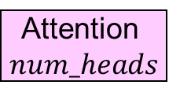
Review : A Single Batch Training of Transformer
Attention
1
Encoder Layer $N−1$
Attention
2
…
Attention$num_heads$
…
Encoder Layer 0
Multi Head Attention
depth
Input matrix
[[1, 3, 4, 2, 0]]
…
input sequence length
input sequence length
‘obrigado .’
$$d_{model}$$

Slide 16
Review : A Single Batch Training of Transformer
Encoder Layer $N−1$
…
…
Encoder Layer 0
Multi Head Attention
depth
Input matrix
[[1, 3, 4, 2, 0]]
…
input sequence length
input sequence length
‘obrigado .’
$$d_{model}$$

Slide 17
Review : A Single Batch Training of Transformer
Encoder Layer $N−1$
…
Concatenate
…
Encoder Layer 0
Multi Head Attention
$$d_{model}$$
Input matrix
[[1, 3, 4, 2, 0]]
…
input sequence length
input sequence length
‘obrigado .’
$$d_{model}$$

Slide 18

Review : A Single Batch Training of Transformer
Encoder Layer $N−1$
…
Encoder Layer 0
Multi Head Attention
Input matrix
…
input sequence length
[[1, 3, 4, 2, 0]]
input sequence length
‘obrigado .’
$$d_{model}$$

Slide 19
Review : A Single Batch Training of Transformer
Encoder Layer $N−1$
…
Pointwise Feed Forward Network
Encoder Layer 0
Multi Head Attention
Input matrix
…
input sequence length
[[1, 3, 4, 2, 0]]
input sequence length
‘obrigado .’
$$d_{model}$$

Slide 20
Review : A Single Batch Training of Transformer
…
Encoder Layer $N−1$
…
dff
Pointwise Feed Forward Network
Encoder Layer 0
Multi Head Attention
Input matrix
…
input sequence length
[[1, 3, 4, 2, 0]]
input sequence length
‘obrigado .’
$$d_{model}$$

Slide 21

Review : A Single Batch Training of Transformer
…
…
Encoder Layer $N−1$
…
dff
$$d_{model}$$
Pointwise Feed Forward Network
Encoder Layer 0
Multi Head Attention
Input matrix
…
input sequence length
[[1, 3, 4, 2, 0]]
input sequence length
‘obrigado .’
$$d_{model}$$

Slide 22
Review : A Single Batch Training of Transformer
input sequence length
…
Encoder Layer $N−1$
…
$$d_{model}$$
Pointwise Feed Forward Network
Encoder Layer 0
Multi Head Attention
Input matrix
[[1, 3, 4, 2, 0]]
input sequence length
‘obrigado .’

Slide 23

Review : A Single Batch Training of Transformer
Encoder Layer $N−1$
…
Encoder Layer 0
output matrix
…
input sequence length
Input matrix
[[1, 3, 4, 2, 0]]
$$d_{model}$$
input sequence length
‘obrigado .’

Slide 24
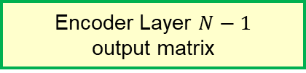
Review : A Single Batch Training of Transformer
Encoder Layer $N−1$
output matrix
…
Encoder Layer 0
output matrix
…
input sequence length
Input matrix
[[1, 3, 4, 2, 0]]
$$d_{model}$$
input sequence length
‘obrigado .’

Slide 25

Review : A Single Batch Training of Transformer
Encoder Layer $N−1$
output matrix
Decoder Layer $N−1$
…
Decoder Layer 0
Embedding
Positional Encoding
Target token ID sequence
Target string

Slide 26
Review : A Single Batch Training of Transformer
Encoder Layer $N−1$
output matrix
Decoder Layer $N−1$
…
Decoder Layer 0
Embedding
Positional Encoding
Target token ID sequence
‘thank you .’

Slide 27
Review : A Single Batch Training of Transformer
Encoder Layer $N−1$
output matrix
Decoder Layer $N−1$
…
Decoder Layer 0
Embedding
Positional Encoding
[[1, 3, 5, 4]]
‘thank you .’

Slide 28
Review : A Single Batch Training of Transformer
Encoder Layer $N−1$
output matrix
Decoder Layer $N−1$
…
Decoder Layer 0
Embedding
Positional Encoding
[[1, 3, 5, 4]]
[[1, 3, 5, 4, 2]]
‘thank you .’
start
end

Slide 29
Review : A Single Batch Training of Transformer
Encoder Layer $N−1$
output matrix
Decoder Layer $N−1$
…
Decoder Layer 0
Embedding
Positional Encoding
[[3, 5, 4, 2]]
[[1, 3, 5, 4]]
Train data
[:, :-1]
[[1, 3, 5, 4, 2]]
‘thank you .’

Slide 30
Review : A Single Batch Training of Transformer
Encoder Layer $N−1$
output matrix
Decoder Layer $N−1$
…
Decoder Layer 0
Truth
Embedding
Positional Encoding
[[3, 5, 4, 2]]
[[1, 3, 5, 4]]
[:, 1:]
[[1, 3, 5, 4, 2]]
‘thank you .’

Slide 31
Review : A Single Batch Training of Transformer
Encoder Layer $N−1$
output matrix
Decoder Layer $N−1$
…
Decoder Layer 0
Embedding
Positional Encoding
[[1, 3, 5, 4]]
‘thank you .’

Slide 32

Review : A Single Batch Training of Transformer
Encoder Layer $N−1$
output matrix
Decoder Layer $N−1$
…
Decoder Layer 0
Input matrix
[[1, 3, 5, 4]]
…
target sequence length
…
target sequence length
‘thank you .’
$$d_{model}$$

Slide 33
Review : A Single Batch Training of Transformer
Encoder Layer $N−1$
output matrix
Decoder Layer $N−1$
…
Decoder Layer 0
Multi Head Attention
Input matrix
[[1, 3, 5, 4]]
…
target sequence length
…
target sequence length
‘thank you .’
$$d_{model}$$

Slide 34
Review : A Single Batch Training of Transformer
Encoder Layer $N−1$
output matrix
Decoder Layer $N−1$
…
Decoder Layer 0
Multi Head Attention
Input matrix
[[1, 3, 5, 4]]
…
target sequence length
…
target sequence length
‘thank you .’
depth

Slide 35
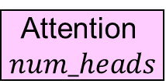
Review : A Single Batch Training of Transformer
Encoder Layer $N−1$
output matrix
Decoder Layer $N−1$
…
Decoder Layer 0
Multi Head Attention
Input matrix
Attention
1
…
[[1, 3, 5, 4]]
…
target sequence length
…
Attention$num_heads$
target sequence length
‘thank you .’
depth

Slide 36
Review : A Single Batch Training of Transformer
Encoder Layer $N−1$
output matrix
Decoder Layer $N−1$
…
target sequence length
Decoder Layer 0
Multi Head Attention
Input matrix
Attention
1
…
look ahead mask
[[1, 3, 5, 4]]
…
target sequence length
…
Attention$num_heads$
target sequence length
‘thank you .’
depth

Slide 37
Review : A Single Batch Training of Transformer
Encoder Layer $N−1$
output matrix
Decoder Layer $N−1$
…
target sequence length
Decoder Layer 0
Multi Head Attention
Input matrix
look ahead mask
[[1, 3, 5, 4]]
…
target sequence length
…
target sequence length
‘thank you .’
depth

Slide 38
Review : A Single Batch Training of Transformer
Encoder Layer $N−1$
output matrix
Decoder Layer $N−1$
…
Decoder Layer 0
Multi Head Attention
Input matrix
Concatenate
[[1, 3, 5, 4]]
…
target sequence length
…
target sequence length
‘thank you .’
$$d_{model}$$

Slide 39
Review : A Single Batch Training of Transformer
Encoder Layer $N−1$
output matrix
Decoder Layer $N−1$
…
Decoder Layer 0
Multi Head Attention
Input matrix
[[1, 3, 5, 4]]
…
target sequence length
…
target sequence length
‘thank you .’
$$d_{model}$$

Slide 40
Review : A Single Batch Training of Transformer
Encoder Layer $N−1$
output matrix
Decoder Layer $N−1$
…
Decoder Layer 0
Multi Head Attention
Multi Head Attention
Input matrix
[[1, 3, 5, 4]]
…
target sequence length
…
target sequence length
‘thank you .’
$$d_{model}$$

Slide 41
Review : A Single Batch Training of Transformer
Encoder Layer $N−1$
output matrix
Decoder Layer $N−1$
…
input sequence length
…
Decoder Layer 0
Multi Head Attention
Multi Head Attention
Input matrix
[[1, 3, 5, 4]]
…
target sequence length
…
target sequence length
‘thank you .’
$$d_{model}$$

Slide 42
Review : A Single Batch Training of Transformer
Encoder Layer $N−1$
output matrix
Decoder Layer $N−1$
…
input sequence length
…
Decoder Layer 0
Multi Head Attention
Multi Head Attention
Input matrix
[[1, 3, 5, 4]]
…
target sequence length
…
target sequence length
‘thank you .’
depth

Slide 43

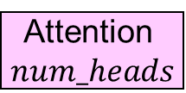
Review : A Single Batch Training of Transformer
Encoder Layer $N−1$
output matrix
Decoder Layer $N−1$
…
Attention
1
input sequence length
…
Decoder Layer 0
…
Multi Head Attention
Multi Head Attention
Attention$num_heads$
Input matrix
Attention
1
[[1, 3, 5, 4]]
…
…
target sequence length
…
Attention$num_heads$
target sequence length
‘thank you .’
depth

Slide 44
Review : A Single Batch Training of Transformer
Encoder Layer $N−1$
output matrix
Decoder Layer $N−1$
…
Decoder Layer 0
Multi Head Attention
Multi Head Attention
Input matrix
[[1, 3, 5, 4]]
…
target sequence length
…
target sequence length
‘thank you .’
depth

Slide 45

Review : A Single Batch Training of Transformer
Encoder Layer $N−1$
output matrix
Decoder Layer $N−1$
…
Decoder Layer 0
Multi Head Attention
Multi Head Attention
Concatenate
Input matrix
target sequence length
…
[[1, 3, 5, 4]]
…
$$d_{model}$$
target sequence length
‘thank you .’

Slide 46
Review : A Single Batch Training of Transformer
Encoder Layer $N−1$
output matrix
Decoder Layer $N−1$
…
Decoder Layer 0
Multi Head Attention
Multi Head Attention
Input matrix
target sequence length
…
[[1, 3, 5, 4]]
…
$$d_{model}$$
target sequence length
‘thank you .’

Slide 47
Review : A Single Batch Training of Transformer
Encoder Layer $N−1$
output matrix
Decoder Layer $N−1$
…
Pointwise Feed Forward Network
Decoder Layer 0
Multi Head Attention
Multi Head Attention
Input matrix
target sequence length
…
[[1, 3, 5, 4]]
…
$$d_{model}$$
target sequence length
‘thank you .’

Slide 48
Review : A Single Batch Training of Transformer
Encoder Layer $N−1$
output matrix
Decoder Layer $N−1$
…
Pointwise Feed Forward Network
Decoder Layer 0
Multi Head Attention
Multi Head Attention
Input matrix
target sequence length
…
[[1, 3, 5, 4]]
…
$$d_{model}$$
target sequence length
‘thank you .’

Slide 49
Review : A Single Batch Training of Transformer
Encoder Layer $N−1$
output matrix
Decoder Layer $N−1$
…
Decoder Layer 0
output matrix
Input matrix
target sequence length
…
[[1, 3, 5, 4]]
…
$$d_{model}$$
target sequence length
‘thank you .’

Slide 50
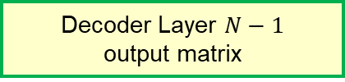

Review : A Single Batch Training of Transformer
Encoder Layer $N−1$
output matrix
Decoder Layer $N−1$
output matrix
…
target sequence length
…
Decoder Layer 0
output matrix
Input matrix
$$d_{model}$$
[[1, 3, 5, 4]]
…
target sequence length
‘thank you .’

Slide 51
Review : A Single Batch Training of Transformer
Decoder Layer $N−1$
output matrix
target sequence length
…
$$d_{model}$$

Slide 52
Review : A Single Batch Training of Transformer
Decoder Layer $N−1$
output matrix
Final Layer
target sequence length
…
$$d_{model}$$

Slide 53
Review : A Single Batch Training of Transformer
Decoder Layer $N−1$
output matrix
Output matrix
target sequence length
…
…
$$d_{model}$$
number of target language vocabulary

Slide 54
Review : A Single Batch Training of Transformer
Decoder Layer $N−1$
output matrix
Output matrix
target sequence length
…
start
thank
…
you
$$d_{model}$$
.
number of target language vocabulary
For each words (column),
the value in this matrix means
probability of prediction on which word will appear next

Slide 55
Review : A Single Batch Training of Transformer
Decoder Layer $N−1$
output matrix
Output matrix
target sequence length
…
start
thank
…
you
Find max value
$$d_{model}$$
.
number of target language vocabulary
For each words (column),
the value in this matrix means
probability of prediction on which word will appear next

Slide 56
Review : A Single Batch Training of Transformer
Decoder Layer $N−1$
output matrix
Output matrix
target sequence length
…
start
3
thank
…
5
you
3
$$d_{model}$$
.
2
number of target language vocabulary
For each words (column),
the value in this matrix means
probability of prediction on which word will appear next

Slide 57
Review : A Single Batch Training of Transformer
Decoder Layer $N−1$
output matrix
Output matrix
token ID of prediction
target sequence length
…
start
3
thank
…
5
you
3
$$d_{model}$$
.
2
number of target language vocabulary
For each words (column),
the value in this matrix means
probability of prediction on which word will appear next

Slide 58
Review : A Single Batch Training of Transformer
Decoder Layer $N−1$
output matrix
Output matrix
truth
prediction
target sequence length
…
start
3
3
thank
5
…
5
you
4
3
$$d_{model}$$
.
2
2
number of target language vocabulary
For each words (column),
the value in this matrix means
probability of prediction on which word will appear next

Slide 59
Review : A Single Batch Training of Transformer
Decoder Layer $N−1$
output matrix
Output matrix
truth
prediction
target sequence length
…
start
3
3
thank
5
…
5
you
4
3
$$d_{model}$$
.
2
Loss
2
number of target language vocabulary
For each words (column),
the value in this matrix means
probability of prediction on which word will appear next

Slide 60
Review : A Single Batch Training of Transformer
Decoder Layer $N−1$
output matrix
Output matrix
truth
prediction
target sequence length
…
start
3
3
thank
5
…
5
you
4
3
$$d_{model}$$
.
2
Loss
2
Back Propagation
number of target language vocabulary
For each words (column),
the value in this matrix means
probability of prediction on which word will appear next

Slide 61
Complements : Why positional encoding ?
▶ Transformer do not use recurrence, convolution, only attention

Slide 62
Complements : Why positional encoding ?
▶ Transformer do not use recurrence, convolution, only attention
▶ The whole sentence will be processed parallely, in a matrix
▷ How about giving some position information in addition ?

Slide 63
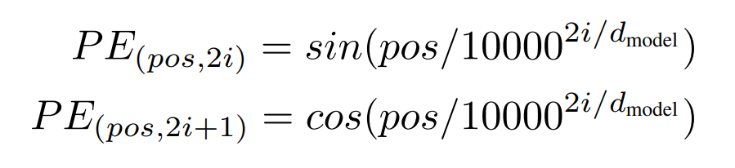
Complements : Why positional encoding ?
▶ Then, why do we get positional encoding as
▶ and add this to embedding matrix?

Slide 64
Complements : Why positional encoding ?
▶ In a empirical method, it is one of the correction of attention

Slide 65
Complements : Why positional encoding ?
▶ In a empirical method, it is one of the correction of attention
I
sometimes allow my
dog
to bark
because
I
found that
it
makes
her
feel free

Slide 66
Complements : Why positional encoding ?
▶ In a empirical method, it is one of the correction of attention
I
sometimes allow my
dog
to bark
because
I
found that
it
makes
her
feel free
it
her

Slide 67
Complements : Why positional encoding ?
▶ In a empirical method, it is one of the correction of attention
I
sometimes allow my
dog
to bark
because
I
found that
it
makes
her
feel free
it
her
Model decides where to attention
and position can be a critical criterion

Slide 68
Complements : Why positional encoding ?
▶ Why do we use this function?

Slide 69

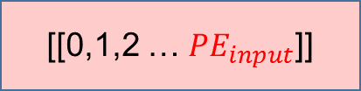
Complements : Why positional encoding ?
▶ Why do we use this function?
[[0],[1],[2] … [$d_{model}]]$
integer
[[0,1,2 … $PE_{input}$]]

Slide 70
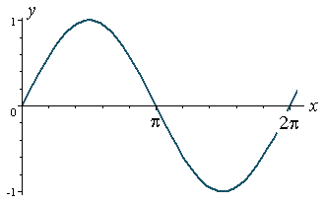
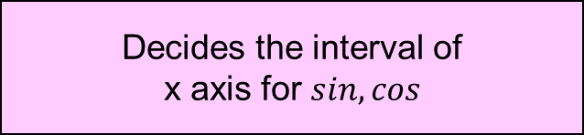
Complements : Why positional encoding ?
Decides the interval of
x axis for $sin, cos$
▶ Why do we use this function?
consists of
consecutive integers

Slide 71
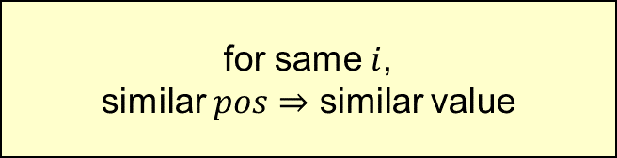

Complements : Why positional encoding ?
Decides the interval of
x axis for $sin, cos$
▶ Why do we use this function?
consists of
consecutive integers
for same $i$,
similar $pos⇒$ similar value
$$x=\frac{pos}{{10000}^{\frac{2i}{d_{model}}}}$$

Slide 72
Complements : Why positional encoding ?
Decides the interval of
x axis for $sin, cos$
▶ Why do we use this function?
consists of
consecutive integers
for same $i$,
similar $pos⇒$ similar value
Similar value for the words in similar position
$$x=\frac{pos}{{10000}^{\frac{2i}{d_{model}}}}$$

Slide 73
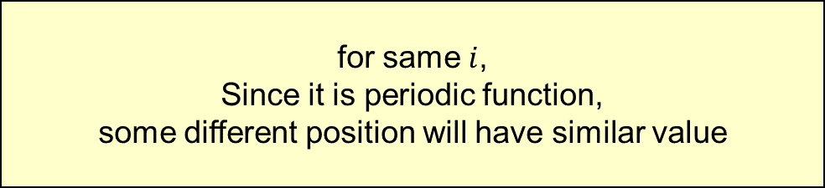
Complements : Why positional encoding ?
Decides the interval of
x axis for $sin, cos$
▶ Why do we use this function?
consists of
consecutive integers
for same $i$,
Since it is periodic function,
some different position will have similar value
$$x=\frac{pos}{{10000}^{\frac{2i}{d_{model}}}}$$

Slide 74
Complements : Why positional encoding ?
Decides the interval of
x axis for $sin, cos$
▶ Why do we use this function?
consists of
consecutive integers
for same $i$,
Since it is periodic function,
some different position will have similar value
Similar value for the words in different position
$$x=\frac{pos}{{10000}^{\frac{2i}{d_{model}}}}$$

Slide 75
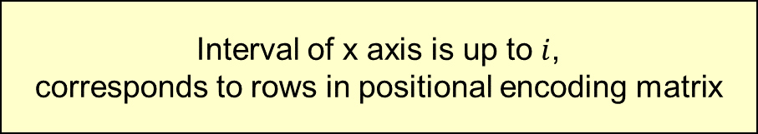
Complements : Why positional encoding ?
Decides the interval of
x axis for $sin, cos$
▶ Why do we use this function?
consists of
consecutive integers
Interval of x axis is up to $i$,
corresponds to rows in positional encoding matrix

Slide 76
Complements : Why positional encoding ?
Decides the interval of
x axis for $sin, cos$
▶ Why do we use this function?
consists of
consecutive integers
Different rows in an positional encoding matrix
will have different representation of position
Interval of x axis is up to $i$,
corresponds to rows in positional encoding matrix

Slide 77


Complements : Why positional encoding ?
$$i$$
$$pos$$
Different rows in an positional encoding matrix
will have different representation of position
Interval of x axis is up to $i$,
corresponds to rows in positional encoding matrix

Slide 78


Complements : Why Multi Head Attention ?
$$d_{model}$$
$$d_{model}$$
$$pos$$
$$pos$$
multi head attention
single head attention

Slide 79


Complements : Why Multi Head Attention ?
$$d_{model}$$
$$d_{model}$$
$$pos$$
$$pos$$
multi head attention
single head attention

Slide 80
Complements : Why Multi Head Attention ?
$$d_{model}$$
$$d_{model}$$
$$pos$$
$$pos$$
multi head attention
single head attention

Slide 81
Complements : Why Multi Head Attention ?
$$d_{model}$$
$$d_{model}$$
$$pos$$
$$pos$$
multi head attention
single head attention

Slide 82
Complements : Why Multi Head Attention ?
$$d_{model}$$
$$d_{model}$$
$$pos$$
$$pos$$
multi head attention
single head attention
Multi head attention conserves different representations

