Slide 1
Algorithms on Strings, Trees, and Sequences
Chapter 11.8
Gaps
컴퓨터소프트웨어학부 심승현

Slide 2
Contents
▶ What is a gap?
▶ Four kinds of gap weight

Slide 3
What is a Gap ?

Slide 4
What is a Gap ?
▶ Until now, we measured the value of match, mismatch, or space
▶ Gap is an important feature, that helps to find out some meaningful alignments

Slide 5

What is a Gap ?
Definition
A gap is any maximal, consecutive run of spaces
in a single string of a given alignment.
$S_{1}$ : interview
_ | _ | _ | i | n | _ | t | _ | _ | _ | e | r | v | _ | i | e | _ | _ | w | _
These are gaps!
▶ This alignment has 6 gaps, and 11 spaces

Slide 6
Four kinds of gap weight

Slide 7
Four kinds of gap weight
▶ Constant gap weight
▶ Affine gap weight
▶ Convex gap weight
▶ Arbitrary gap weight

Slide 8
Four kinds of gap weight
▶ Computing the similarity value including constant gap weights

Slide 9

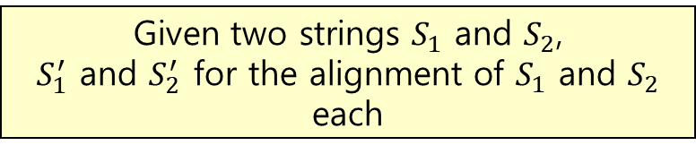
Four kinds of gap weight
▶ Computing the similarity value including constant gap weights
Given two strings $S_{1}$ and $S_{2}$,
$S_{1}^{′}$ and $S_{2}^{′}$ for the alignment of $S_{1}$ and $S_{2}$ each
Free value for space,
$W_{gap}$ for each gaps

Slide 10
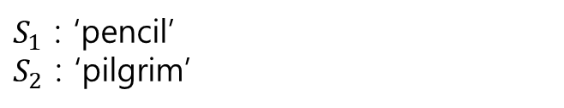
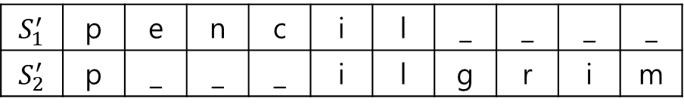
Four kinds of gap weight
▶ Computing the similarity value including constant gap weights
$S_{1}$ : ‘pencil’
$S_{2}$ : ‘pilgrim’
Given two strings $S_{1}$ and $S_{2}$,
$S_{1}^{′}$ and $S_{2}^{′}$ for the alignment of $S_{1}$ and $S_{2}$ each
$S_{1}^{′}$ | p | e | n | c | i | l | _ | _ | _ | _
$S_{2}^{′}$ | p | _ | _ | _ | i | l | g | r | i | m
Free value for space,
$W_{gap}$ for each gaps

Slide 11
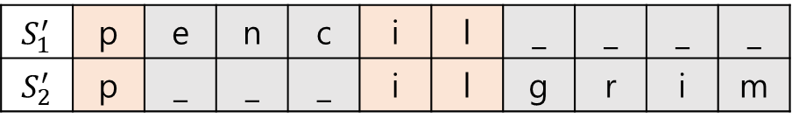
Four kinds of gap weight
▶ Computing the similarity value including constant gap weights
$S_{1}$ : ‘pencil’
$S_{2}$ : ‘pilgrim’
Given two strings $S_{1}$ and $S_{2}$,
$S_{1}^{′}$ and $S_{2}^{′}$ for the alignment of $S_{1}$ and $S_{2}$ each
$S_{1}^{′}$ | p | e | n | c | i | l | _ | _ | _ | _
$S_{2}^{′}$ | p | _ | _ | _ | i | l | g | r | i | m
Free value for space,
$W_{gap}$ for each gaps

Slide 12
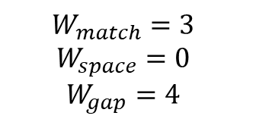
Four kinds of gap weight
▶ Computing the similarity value including constant gap weights
$$W_{match}=3$$
$$W_{space}=0$$
$$W_{gap}=4$$
$S_{1}$ : ‘pencil’
$S_{2}$ : ‘pilgrim’
Given two strings $S_{1}$ and $S_{2}$,
$S_{1}^{′}$ and $S_{2}^{′}$ for the alignment of $S_{1}$ and $S_{2}$ each
$S_{1}^{′}$ | p | e | n | c | i | l | _ | _ | _ | _
$S_{2}^{′}$ | p | _ | _ | _ | i | l | g | r | i | m
Free value for space,
$W_{gap}$ for each gaps

Slide 13
Four kinds of gap weight
▶ Computing the similarity value including constant gap weights
$$W_{match}=3$$
$$W_{space}=0$$
$$W_{gap}=4$$
$S_{1}$ : ‘pencil’
$S_{2}$ : ‘pilgrim’
Given two strings $S_{1}$ and $S_{2}$,
$S_{1}^{′}$ and $S_{2}^{′}$ for the alignment of $S_{1}$ and $S_{2}$ each
$S_{1}^{′}$ | p | e | n | c | i | l | _ | _ | _ | _
$S_{2}^{′}$ | p | _ | _ | _ | i | l | g | r | i | m
Free value for space,
$W_{gap}$ for each gaps
3
3
3

Slide 14
Four kinds of gap weight
▶ Computing the similarity value including constant gap weights
$$W_{match}=3$$
$$W_{space}=0$$
$$W_{gap}=4$$
$S_{1}$ : ‘pencil’
$S_{2}$ : ‘pilgrim’
Given two strings $S_{1}$ and $S_{2}$,
$S_{1}^{′}$ and $S_{2}^{′}$ for the alignment of $S_{1}$ and $S_{2}$ each
$S_{1}^{′}$ | p | e | n | c | i | l | _ | _ | _ | _
$S_{2}^{′}$ | p | _ | _ | _ | i | l | g | r | i | m
Free value for space,
$W_{gap}$ for each gaps
3
0
0
0
3
3
0
0
0
0

Slide 15
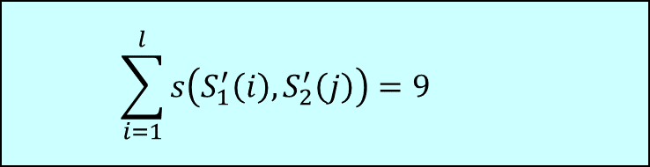
Four kinds of gap weight
▶ Computing the similarity value including constant gap weights
$$W_{match}=3$$
$$W_{space}=0$$
$$W_{gap}=4$$
$S_{1}$ : ‘pencil’
$S_{2}$ : ‘pilgrim’
Given two strings $S_{1}$ and $S_{2}$,
$S_{1}^{′}$ and $S_{2}^{′}$ for the alignment of $S_{1}$ and $S_{2}$ each
$S_{1}^{′}$ | p | e | n | c | i | l | _ | _ | _ | _
$S_{2}^{′}$ | p | _ | _ | _ | i | l | g | r | i | m
Free value for space,
$W_{gap}$ for each gaps
3
0
0
0
3
3
0
0
0
0
$$\sum_{i=1}^{l}{s\left(S_{1}^{′}\left(i\right),S_{2}^{′}\left(j\right)\right)=9}$$

Slide 16

Four kinds of gap weight
▶ Computing the similarity value including constant gap weights
$$W_{match}=3$$
$$W_{space}=0$$
$$W_{gap}=4$$
$S_{1}$ : ‘pencil’
$S_{2}$ : ‘pilgrim’
Given two strings $S_{1}$ and $S_{2}$,
$S_{1}^{′}$ and $S_{2}^{′}$ for the alignment of $S_{1}$ and $S_{2}$ each
There are two gaps
$S_{1}^{′}$ | p | e | n | c | i | l | _ | _ | _ | _
$S_{2}^{′}$ | p | _ | _ | _ | i | l | g | r | i | m
Free value for space,
$W_{gap}$ for each gaps
3
0
0
0
3
3
0
0
0
0
$$\sum_{i=1}^{l}{s\left(S_{1}^{′}\left(i\right),S_{2}^{′}\left(j\right)\right)=9 }$$

Slide 17


Four kinds of gap weight
▶ Computing the similarity value including constant gap weights
$$W_{match}=3$$
$$W_{space}=0$$
$$W_{gap}=4$$
$S_{1}$ : ‘pencil’
$S_{2}$ : ‘pilgrim’
Given two strings $S_{1}$ and $S_{2}$,
$S_{1}^{′}$ and $S_{2}^{′}$ for the alignment of $S_{1}$ and $S_{2}$ each
There are two gaps
$S_{1}^{′}$ | p | e | n | c | i | l | _ | _ | _ | _
$S_{2}^{′}$ | p | _ | _ | _ | i | l | g | r | i | m
Free value for space,
$W_{gap}$ for each gaps
3
0
0
0
3
3
0
0
0
0
$$V\left(S_{1}^{′},S_{2}^{′}\right)=9$$
$$−2W_{gap}$$

Slide 18

Four kinds of gap weight
▶ Computing the similarity value including constant gap weights
$$W_{match}=3$$
$$W_{space}=0$$
$$W_{gap}=4$$
$S_{1}$ : ‘pencil’
$S_{2}$ : ‘pilgrim’
Given two strings $S_{1}$ and $S_{2}$,
$S_{1}^{′}$ and $S_{2}^{′}$ for the alignment of $S_{1}$ and $S_{2}$ each
There are two gaps
$S_{1}^{′}$ | p | e | n | c | i | l | _ | _ | _ | _
$S_{2}^{′}$ | p | _ | _ | _ | i | l | g | r | i | m
Free value for space,
$W_{gap}$ for each gaps
3
0
0
0
3
3
0
0
0
0
$$V\left(S_{1}^{′},S_{2}^{′}\right)=9$$
$$−8=1$$

Slide 19

Four kinds of gap weight
▶ Computing the similarity value including constant gap weights
$$W_{match}=3$$
$$W_{space}=0$$
$$W_{gap}=4$$
$S_{1}$ : ‘pencil’
$S_{2}$ : ‘pilgrim’
Given two strings $S_{1}$ and $S_{2}$,
$S_{1}^{′}$ and $S_{2}^{′}$ for the alignment of $S_{1}$ and $S_{2}$ each
$S_{1}^{′}$ | p | e | n | c | i | l | _ | _ | _ | _
$S_{2}^{′}$ | p | _ | _ | _ | i | l | g | r | i | m
Free value for space,
$W_{gap}$ for each gaps
3
0
0
0
3
3
0
0
0
0
$$V\left(S_{1}^{′},S_{2}^{′}\right)=1$$

Slide 20
Four kinds of gap weight
▶ Computing the similarity value including affine gap weights

Slide 21
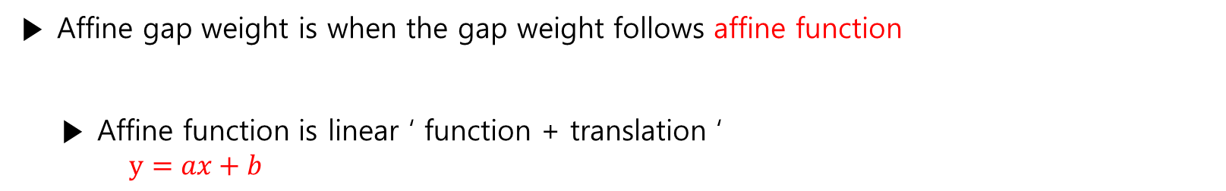
Four kinds of gap weight
▶ Affine gap weight is when the gap weight follows affine function
▶ Affine function is linear ‘ function + translation ‘
$y=ax+b$

Slide 22

Four kinds of gap weight
▶ Computing the similarity value including affine gap weights
$S_{1}$ : ‘pencil’
$S_{2}$ : ‘pilgrim’
Given two strings $S_{1}$ and $S_{2}$,
$S_{1}^{′}$ and $S_{2}^{′}$ for the alignment of $S_{1}$ and $S_{2}$ each
$S_{1}^{′}$ | p | e | n | c | i | l | _ | _ | _ | _
$S_{2}^{′}$ | p | _ | _ | _ | i | l | g | r | i | m
$W_{space}$ value for space,
$W_{gap}$ for each gaps

Slide 23
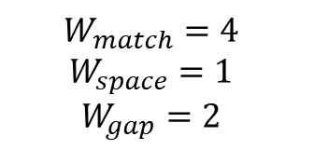
Four kinds of gap weight
▶ Computing the similarity value including affine gap weights
$$W_{match}=4$$
$$W_{space}=1$$
$$W_{gap}=2$$
$S_{1}$ : ‘pencil’
$S_{2}$ : ‘pilgrim’
Given two strings $S_{1}$ and $S_{2}$,
$S_{1}^{′}$ and $S_{2}^{′}$ for the alignment of $S_{1}$ and $S_{2}$ each
$S_{1}^{′}$ | p | e | n | c | i | l | _ | _ | _ | _
$S_{2}^{′}$ | p | _ | _ | _ | i | l | g | r | i | m
$W_{space}$ value for space,
$W_{gap}$ for each gaps

Slide 24
Four kinds of gap weight
▶ Computing the similarity value including affine gap weights
$$W_{match}=4$$
$$W_{space}=1$$
$$W_{gap}=2$$
$S_{1}$ : ‘pencil’
$S_{2}$ : ‘pilgrim’
Given two strings $S_{1}$ and $S_{2}$,
$S_{1}^{′}$ and $S_{2}^{′}$ for the alignment of $S_{1}$ and $S_{2}$ each
$S_{1}^{′}$ | p | e | n | c | i | l | _ | _ | _ | _
$S_{2}^{′}$ | p | _ | _ | _ | i | l | g | r | i | m
$W_{space}$ value for space,
$W_{gap}$ for each gaps
4
1
1
1
4
4
1
1
1
1

Slide 25

Four kinds of gap weight
▶ Computing the similarity value including affine gap weights
$$W_{match}=4$$
$$W_{space}=1$$
$$W_{gap}=2$$
$S_{1}$ : ‘pencil’
$S_{2}$ : ‘pilgrim’
Given two strings $S_{1}$ and $S_{2}$,
$S_{1}^{′}$ and $S_{2}^{′}$ for the alignment of $S_{1}$ and $S_{2}$ each
$S_{1}^{′}$ | p | e | n | c | i | l | _ | _ | _ | _
$S_{2}^{′}$ | p | _ | _ | _ | i | l | g | r | i | m
$W_{space}$ value for space,
$W_{gap}$ for each gaps
4
1
1
1
4
4
1
1
1
1
$$W_{match_{total}}=12$$

Slide 26

Four kinds of gap weight
▶ Computing the similarity value including affine gap weights
$$W_{match}=4$$
$$W_{space}=1$$
$$W_{gap}=2$$
$S_{1}$ : ‘pencil’
$S_{2}$ : ‘pilgrim’
Given two strings $S_{1}$ and $S_{2}$,
$S_{1}^{′}$ and $S_{2}^{′}$ for the alignment of $S_{1}$ and $S_{2}$ each
$S_{1}^{′}$ | p | e | n | c | i | l | _ | _ | _ | _
$S_{2}^{′}$ | p | _ | _ | _ | i | l | g | r | i | m
$W_{space}$ value for space,
$W_{gap}$ for each gaps
4
1
1
1
4
4
1
1
1
1
$$W_{match_{total}}=12$$
$$W_{gap_{1}}=W_{gap}+4W_{space}$$

Slide 27
Four kinds of gap weight
▶ Computing the similarity value including affine gap weights
$$W_{match}=4$$
$$W_{space}=1$$
$$W_{gap}=2$$
$S_{1}$ : ‘pencil’
$S_{2}$ : ‘pilgrim’
Given two strings $S_{1}$ and $S_{2}$,
$S_{1}^{′}$ and $S_{2}^{′}$ for the alignment of $S_{1}$ and $S_{2}$ each
$S_{1}^{′}$ | p | e | n | c | i | l | _ | _ | _ | _
$S_{2}^{′}$ | p | _ | _ | _ | i | l | g | r | i | m
$W_{space}$ value for space,
$W_{gap}$ for each gaps
4
1
1
1
4
4
1
1
1
1
$$W_{match_{total}}=12$$
gap initiation weight
$$W_{gap_{1}}=W_{gap}+4W_{space}$$
gap extension weight

Slide 28
Four kinds of gap weight
▶ Computing the similarity value including affine gap weights
$$W_{match}=4$$
$$W_{space}=1$$
$$W_{gap}=2$$
$S_{1}$ : ‘pencil’
$S_{2}$ : ‘pilgrim’
Given two strings $S_{1}$ and $S_{2}$,
$S_{1}^{′}$ and $S_{2}^{′}$ for the alignment of $S_{1}$ and $S_{2}$ each
$S_{1}^{′}$ | p | e | n | c | i | l | _ | _ | _ | _
$S_{2}^{′}$ | p | _ | _ | _ | i | l | g | r | i | m
$W_{space}$ value for space,
$W_{gap}$ for each gaps
4
1
1
1
4
4
1
1
1
1
$$W_{match_{total}}=12$$
gap initiation weight
$$W_{gap_{1}}=W_{gap}+4W_{space}$$
gap extension weight
constant gap weight :
gap extension weight = 0

Slide 29
Four kinds of gap weight
▶ Computing the similarity value including affine gap weights
$$W_{match}=4$$
$$W_{space}=1$$
$$W_{gap}=2$$
$S_{1}$ : ‘pencil’
$S_{2}$ : ‘pilgrim’
Given two strings $S_{1}$ and $S_{2}$,
$S_{1}^{′}$ and $S_{2}^{′}$ for the alignment of $S_{1}$ and $S_{2}$ each
$S_{1}^{′}$ | p | e | n | c | i | l | _ | _ | _ | _
$S_{2}^{′}$ | p | _ | _ | _ | i | l | g | r | i | m
$W_{space}$ value for space,
$W_{gap}$ for each gaps
4
1
1
1
4
4
1
1
1
1
$$W_{match_{total}}=12$$
$$W_{gap_{1}}=W_{gap}+4W_{space}$$
Affine function

Slide 30
Four kinds of gap weight
▶ Computing the similarity value including affine gap weights
$$W_{match}=4$$
$$W_{space}=1$$
$$W_{gap}=2$$
$S_{1}$ : ‘pencil’
$S_{2}$ : ‘pilgrim’
Given two strings $S_{1}$ and $S_{2}$,
$S_{1}^{′}$ and $S_{2}^{′}$ for the alignment of $S_{1}$ and $S_{2}$ each
$S_{1}^{′}$ | p | e | n | c | i | l | _ | _ | _ | _
$S_{2}^{′}$ | p | _ | _ | _ | i | l | g | r | i | m
$W_{space}$ value for space,
$W_{gap}$ for each gaps
4
1
1
1
4
4
1
1
1
1
$$W_{match_{total}}=12$$
$$W_{gap_{1}}=W_{gap}+4W_{space}$$

Slide 31

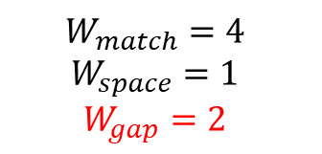
Four kinds of gap weight
▶ Computing the similarity value including affine gap weights
$$W_{match}=4$$
$$W_{space}=1$$
$$W_{gap}=2$$
$S_{1}$ : ‘pencil’
$S_{2}$ : ‘pilgrim’
Given two strings $S_{1}$ and $S_{2}$,
$S_{1}^{′}$ and $S_{2}^{′}$ for the alignment of $S_{1}$ and $S_{2}$ each
$S_{1}^{′}$ | p | e | n | c | i | l | _ | _ | _ | _
$S_{2}^{′}$ | p | _ | _ | _ | i | l | g | r | i | m
$W_{space}$ value for space,
$W_{gap}$ for each gaps
4
1
1
1
4
4
1
1
1
1
$$W_{match_{total}}=12$$
$$W_{gap_{1}}=2+4W_{space}$$

Slide 32

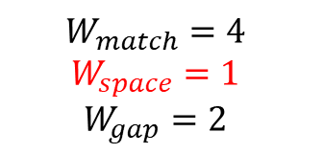
Four kinds of gap weight
▶ Computing the similarity value including affine gap weights
$$W_{match}=4$$
$$W_{space}=1$$
$$W_{gap}=2$$
$S_{1}$ : ‘pencil’
$S_{2}$ : ‘pilgrim’
Given two strings $S_{1}$ and $S_{2}$,
$S_{1}^{′}$ and $S_{2}^{′}$ for the alignment of $S_{1}$ and $S_{2}$ each
$S_{1}^{′}$ | p | e | n | c | i | l | _ | _ | _ | _
$S_{2}^{′}$ | p | _ | _ | _ | i | l | g | r | i | m
$W_{space}$ value for space,
$W_{gap}$ for each gaps
4
1
1
1
4
4
1
1
1
1
$$W_{match_{total}}=12$$
$$W_{gap_{1}}=2+4$$

Slide 33

Four kinds of gap weight
▶ Computing the similarity value including affine gap weights
$$W_{match}=4$$
$$W_{space}=1$$
$$W_{gap}=2$$
$S_{1}$ : ‘pencil’
$S_{2}$ : ‘pilgrim’
Given two strings $S_{1}$ and $S_{2}$,
$S_{1}^{′}$ and $S_{2}^{′}$ for the alignment of $S_{1}$ and $S_{2}$ each
$S_{1}^{′}$ | p | e | n | c | i | l | _ | _ | _ | _
$S_{2}^{′}$ | p | _ | _ | _ | i | l | g | r | i | m
$W_{space}$ value for space,
$W_{gap}$ for each gaps
4
1
1
1
4
4
1
1
1
1
$$W_{match_{total}}=12$$
$$W_{gap_{1}}=6$$

Slide 34

Four kinds of gap weight
▶ Computing the similarity value including affine gap weights
$$W_{match}=4$$
$$W_{space}=1$$
$$W_{gap}=2$$
$S_{1}$ : ‘pencil’
$S_{2}$ : ‘pilgrim’
Given two strings $S_{1}$ and $S_{2}$,
$S_{1}^{′}$ and $S_{2}^{′}$ for the alignment of $S_{1}$ and $S_{2}$ each
$S_{1}^{′}$ | p | e | n | c | i | l | _ | _ | _ | _
$S_{2}^{′}$ | p | _ | _ | _ | i | l | g | r | i | m
$W_{space}$ value for space,
$W_{gap}$ for each gaps
4
1
1
1
4
4
1
1
1
1
$$W_{match_{total}}=12$$
$$W_{gap_{1}}=6$$
$$W_{gap_{2}}=W_{gap}+3W_{space}$$

Slide 35

Four kinds of gap weight
▶ Computing the similarity value including affine gap weights
$$W_{match}=4$$
$$W_{space}=1$$
$$W_{gap}=2$$
$S_{1}$ : ‘pencil’
$S_{2}$ : ‘pilgrim’
Given two strings $S_{1}$ and $S_{2}$,
$S_{1}^{′}$ and $S_{2}^{′}$ for the alignment of $S_{1}$ and $S_{2}$ each
$S_{1}^{′}$ | p | e | n | c | i | l | _ | _ | _ | _
$S_{2}^{′}$ | p | _ | _ | _ | i | l | g | r | i | m
$W_{space}$ value for space,
$W_{gap}$ for each gaps
4
1
1
1
4
4
1
1
1
1
$$W_{match_{total}}=12$$
$$W_{gap_{1}}=6$$
$$W_{gap_{2}}=5$$

Slide 36
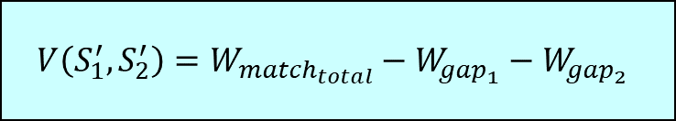
Four kinds of gap weight
▶ Computing the similarity value including affine gap weights
$$W_{match}=4$$
$$W_{space}=1$$
$$W_{gap}=2$$
$S_{1}$ : ‘pencil’
$S_{2}$ : ‘pilgrim’
Given two strings $S_{1}$ and $S_{2}$,
$S_{1}^{′}$ and $S_{2}^{′}$ for the alignment of $S_{1}$ and $S_{2}$ each
$S_{1}^{′}$ | p | e | n | c | i | l | _ | _ | _ | _
$S_{2}^{′}$ | p | _ | _ | _ | i | l | g | r | i | m
$W_{space}$ value for space,
$W_{gap}$ for each gaps
4
1
1
1
4
4
1
1
1
1
$$W_{match_{total}}=12$$
$$W_{gap_{1}}=6$$
$$W_{gap_{2}}=5$$
$$V\left(S_{1}^{′}, S_{2}^{′}\right)=W_{match_{total}}−W_{gap_{1}}−W_{gap_{2}}$$

Slide 37

Four kinds of gap weight
▶ Computing the similarity value including affine gap weights
$$W_{match}=4$$
$$W_{space}=1$$
$$W_{gap}=2$$
$S_{1}$ : ‘pencil’
$S_{2}$ : ‘pilgrim’
Given two strings $S_{1}$ and $S_{2}$,
$S_{1}^{′}$ and $S_{2}^{′}$ for the alignment of $S_{1}$ and $S_{2}$ each
$S_{1}^{′}$ | p | e | n | c | i | l | _ | _ | _ | _
$S_{2}^{′}$ | p | _ | _ | _ | i | l | g | r | i | m
$W_{space}$ value for space,
$W_{gap}$ for each gaps
4
1
1
1
4
4
1
1
1
1
$$W_{match_{total}}=12$$
$$W_{gap_{1}}=6$$
$$W_{gap_{2}}=5$$
$$V\left(S_{1}^{′}, S_{2}^{′}\right)=1$$

Slide 38
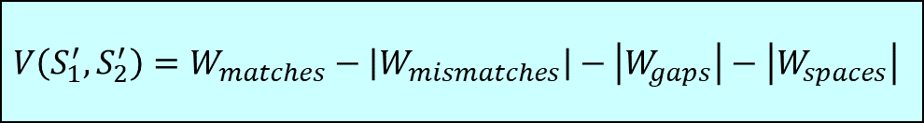
Four kinds of gap weight
▶ Computing the similarity value including affine gap weights
$$V\left(S_{1}^{′}, S_{2}^{′}\right)=W_{matches}−\left|W_{mismatches}\right|−\left|W_{gaps}\right|−\left|W_{spaces}\right|$$

Slide 39
Four kinds of gap weight
▶ Defining affine gap weight with recurrence relation

Slide 40
Four kinds of gap weight
▶ There are only three kinds of alignment

Slide 41
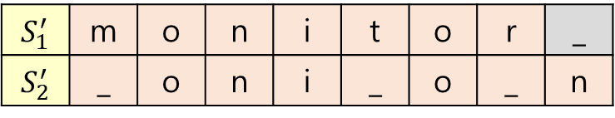

Four kinds of gap weight
▶ There are only three kinds of alignment
$S_{1}=$ ‘monitor’, $S_{2}=$ ‘onion’
$S_{1}^{′}$ | m | o | n | i | t | o | r | _
$S_{2}^{′}$ | _ | o | n | i | _ | o | _ | n
▶ Gap in the end of $S_{1}$

Slide 42
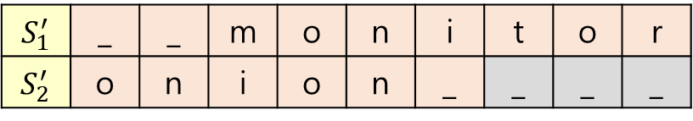
Four kinds of gap weight
▶ There are only three kinds of alignment
$S_{1}=$ ‘monitor’, $S_{2}=$ ‘onion’
$S_{1}^{′}$ | m | o | n | i | t | o | r | _
$S_{2}^{′}$ | _ | o | n | i | _ | o | _ | n
▶ Gap in the end of $S_{1}$
$S_{1}^{′}$ | _ | _ | m | o | n | i | t | o | r
$S_{2}^{′}$ | o | n | i | o | n | _ | _ | _ | _
▶ Gap in the end of $S_{2}$

Slide 43
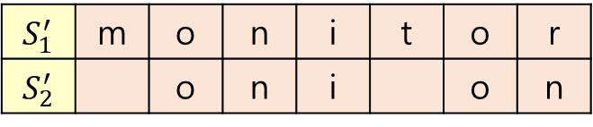
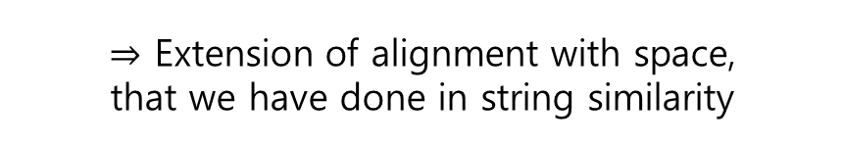
Four kinds of gap weight
▶ There are only three kinds of alignment
$S_{1}=$ ‘monitor’, $S_{2}=$ ‘onion’
$S_{1}^{′}$ | m | o | n | i | t | o | r | _
$S_{2}^{′}$ | _ | o | n | i | _ | o | _ | n
▶ Gap in the end of $S_{1}$
$S_{1}^{′}$ | _ | _ | m | o | n | i | t | o | r
$S_{2}^{′}$ | o | n | i | o | n | _ | _ | _ | _
▶ Gap in the end of $S_{2}$
$S_{1}^{′}$ | m | o | n | i | t | o | r
$S_{2}^{′}$ |  | o | n | i |  | o | n
▶ No gap in the end
$⇒$ Extension of alignment with space,
that we have done in string similarity

Slide 44



Four kinds of gap weight
▶ There are only three kinds of alignment
$S_{1}=$ ‘monitor’, $S_{2}=$ ‘onion’
$S_{1}^{′}$ | m | o | n | i | t | o | r | _
$S_{2}^{′}$ | _ | o | n | i | _ | o | _ | n
$⇒$ Case E
▶ Gap in the end of $S_{1}$
$S_{1}^{′}$ | _ | _ | m | o | n | i | t | o | r
$S_{2}^{′}$ | o | n | i | o | n | _ | _ | _ | _
$⇒$ Case F
▶ Gap in the end of $S_{2}$
$S_{1}^{′}$ | m | o | n | i | t | o | r
$S_{2}^{′}$ |  | o | n | i |  | o | n
$⇒$ Case G
▶ No gap in the end

Slide 45
Four kinds of gap weight
▶ Find max similarity value of case E, F, G
$S_{1}=$ ‘monitor’, $S_{2}=$ ‘onion’
$S_{1}^{′}$ | m | o | n | i | t | o | r | _
$S_{2}^{′}$ | _ | o | n | i | _ | o | _ | n
$⇒$ Case E
▶ Gap in the end of $S_{1}$
$S_{1}^{′}$ | _ | _ | m | o | n | i | t | o | r
$S_{2}^{′}$ | o | n | i | o | n | _ | _ | _ | _
$⇒$ Case F
▶ Gap in the end of $S_{2}$
$S_{1}^{′}$ | m | o | n | i | t | o | r
$S_{2}^{′}$ |  | o | n | i |  | o | n
$⇒$ Case G
▶ No gap in the end

Slide 46
Four kinds of gap weight
▶ Find max similarity value of case E, F, G
$S_{1}=$ ‘monitor’, $S_{2}=$ ‘onion’
$S_{1}^{′}$ | m | o | n | i | t | o | r | _
$S_{2}^{′}$ | _ | o | n | i | _ | o | _ | n
$⇒$ Case E
▶ Gap in the end of $S_{1}$
$S_{1}^{′}$ | _ | _ | m | o | n | i | t | o | r
$S_{2}^{′}$ | o | n | i | o | n | _ | _ | _ | _
$⇒$ Case F
▶ Gap in the end of $S_{2}$
$S_{1}^{′}$ | m | o | n | i | t | o | r
$S_{2}^{′}$ |  | o | n | i |  | o | n
$⇒$ Case G
▶ No gap in the end
Draw Dynamic Table !

Slide 47

Four kinds of gap weight
▶ Find max similarity value of case E, F, G
 |  | t | a | r | s
s
t
a
r
※ $W_{gap}=3, W_{space}=1$

Slide 48
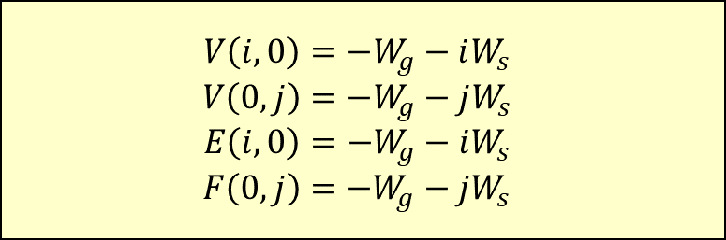
Four kinds of gap weight
▶ Base condition
▶ Find max similarity value of case E, F, G
$$V\left(i,0\right)=−W_{g}−iW_{s}$$
$$V\left(0,j\right)=−W_{g}−jW_{s}$$
$$E\left(i,0\right)=−W_{g}−iW_{s}$$
$$F\left(0,j\right)=−W_{g}−jW_{s}$$
 |  | t | a | r | s
s
t
a
r
※ $W_{gap}=3, W_{space}=1$

Slide 49
Four kinds of gap weight
▶ Base condition
▶ Find max similarity value of case E, F, G
$$V\left(i,0\right)=−W_{g}−iW_{s}$$
$$V\left(0,j\right)=−W_{g}−jW_{s}$$
$$E\left(i,0\right)=−W_{g}−iW_{s}$$
$$F\left(0,j\right)=−W_{g}−jW_{s}$$
V |  | t | a | r | s
s
t
a
r
E |  | t | a | r | s
s
t
a
r
F |  | t | a | r | s
s
t
a
r
※ $W_{gap}=3, W_{space}=1$

Slide 50
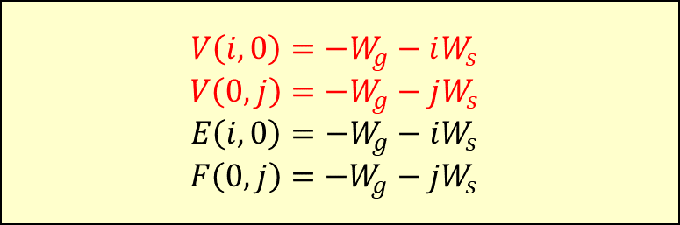
Four kinds of gap weight
▶ Base condition
▶ Find max similarity value of case E, F, G
$$V\left(i,0\right)=−W_{g}−iW_{s}$$
$$V\left(0,j\right)=−W_{g}−jW_{s}$$
$$E\left(i,0\right)=−W_{g}−iW_{s}$$
$$F\left(0,j\right)=−W_{g}−jW_{s}$$
V |  | t | a | r | s
 | -3 | -4 | -5 | -6 | -7
s | -4
t | -5
a | -6
r | -7
E |  | t | a | r | s
s
t
a
r
F |  | t | a | r | s
s
t
a
r
※ $W_{gap}=3, W_{space}=1$

Slide 51
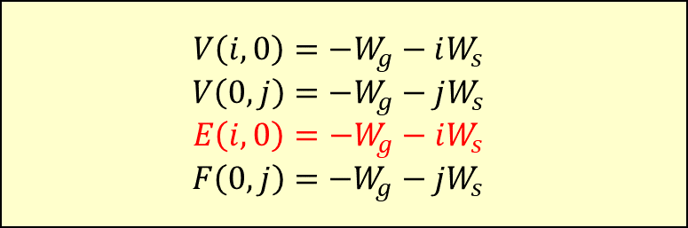
Four kinds of gap weight
▶ Base condition
▶ Find max similarity value of case E, F, G
$$V\left(i,0\right)=−W_{g}−iW_{s}$$
$$V\left(0,j\right)=−W_{g}−jW_{s}$$
$$E\left(i,0\right)=−W_{g}−iW_{s}$$
$$F\left(0,j\right)=−W_{g}−jW_{s}$$
V |  | t | a | r | s
 | -3 | -4 | -5 | -6 | -7
s | -4
t | -5
a | -6
r | -7
E |  | t | a | r | s
 | -3
s | -4
t | -5
a | -6
r | -7
F |  | t | a | r | s
s
t
a
r
※ $W_{gap}=3, W_{space}=1$

Slide 52
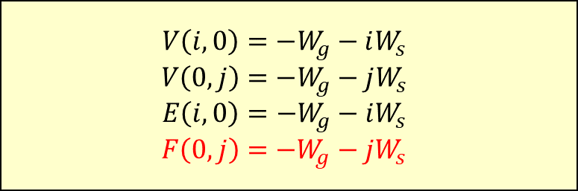
Four kinds of gap weight
▶ Base condition
▶ Find max similarity value of case E, F, G
$$V\left(i,0\right)=−W_{g}−iW_{s}$$
$$V\left(0,j\right)=−W_{g}−jW_{s}$$
$$E\left(i,0\right)=−W_{g}−iW_{s}$$
$$F\left(0,j\right)=−W_{g}−jW_{s}$$
V |  | t | a | r | s
 | -3 | -4 | -5 | -6 | -7
s | -4
t | -5
a | -6
r | -7
E |  | t | a | r | s
 | -3
s | -4
t | -5
a | -6
r | -7
F |  | t | a | r | s
 | -3 | -4 | -5 | -6 | -7
s
t
a
r
※ $W_{gap}=3, W_{space}=1$

Slide 53
Four kinds of gap weight
s | … | _
_ | … | s
_ | … | r
t | … | _
V |  | t | a | r | s
 | -3 | -4 | -5 | -6 | -7
s | -4
t | -5
a | -6
r | -7
E |  | t | a | r | s
 | -3
s | -4
t | -5
a | -6
r | -7
F |  | t | a | r | s
 | -3 | -4 | -5 | -6 | -7
s
t
a
r
※ $W_{gap}=3, W_{space}=1$

Slide 54
Four kinds of gap weight
s | t | … | _
_ | _ | … | s
_ | _ | … | r
t | a | … | _
V |  | t | a | r | s
 | -3 | -4 | -5 | -6 | -7
s | -4
t | -5
a | -6
r | -7
E |  | t | a | r | s
 | -3
s | -4
t | -5
a | -6
r | -7
F |  | t | a | r | s
 | -3 | -4 | -5 | -6 | -7
s
t
a
r
※ $W_{gap}=3, W_{space}=1$

Slide 55
Four kinds of gap weight
s | t | a | … | _
_ | _ | _ | … | s
_ | _ | _ | … | r
t | a | r | … | _
V |  | t | a | r | s
 | -3 | -4 | -5 | -6 | -7
s | -4
t | -5
a | -6
r | -7
E |  | t | a | r | s
 | -3
s | -4
t | -5
a | -6
r | -7
F |  | t | a | r | s
 | -3 | -4 | -5 | -6 | -7
s
t
a
r
※ $W_{gap}=3, W_{space}=1$

Slide 56
Four kinds of gap weight
s | t | a | r | _ | _ | _ | _
_ | _ | _ | _ | t | a | r | s
t | a | r | s | _ | _ | _ | _
_ | _ | _ | _ | s | t | a | r
V |  | t | a | r | s
 | -3 | -4 | -5 | -6 | -7
s | -4
t | -5
a | -6
r | -7
E |  | t | a | r | s
 | -3
s | -4
t | -5
a | -6
r | -7
F |  | t | a | r | s
 | -3 | -4 | -5 | -6 | -7
s
t
a
r
※ $W_{gap}=3, W_{space}=1$

Slide 57
Four kinds of gap weight
V |  | t | a | r | s
 | -3 | -4 | -5 | -6 | -7
s | -4
t | -5
a | -6
r | -7
E |  | t | a | r | s
 | -3
s | -4
t | -5
a | -6
r | -7
F |  | t | a | r | s
 | -3 | -4 | -5 | -6 | -7
s
t
a
r
※ $W_{gap}=3, W_{space}=1$

Slide 58
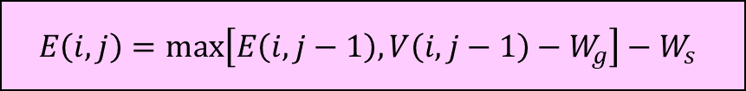

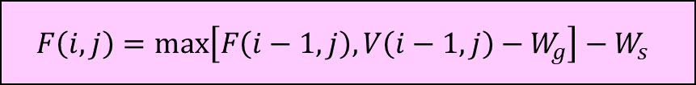
Four kinds of gap weight
▶ General recurrence
$$E\left(i,j\right)=\max\left[E\left(i,j−1\right),V\left(i,j−1\right)−W_{g}\right]−W_{s}$$
$$F\left(i,j\right)=\max\left[F\left(i−1,j\right),V\left(i−1,j\right)−W_{g}\right]−W_{s}$$
$$G\left(i,j\right)=V\left(i−1,j−1\right)+s(S_{1}\left(i\right),S_{2}\left(j\right))$$
V |  | t | a | r | s
 | -3 | -4 | -5 | -6 | -7
s | -4
t | -5
a | -6
r | -7
E |  | t | a | r | s
 | -3
s | -4
t | -5
a | -6
r | -7
F |  | t | a | r | s
 | -3 | -4 | -5 | -6 | -7
s
t
a
r
※ $W_{gap}=3, W_{space}=1$

Slide 59
Four kinds of gap weight
▶ General recurrence
$$E\left(i,j\right)=\max\left[E\left(i,j−1\right),V\left(i,j−1\right)−W_{g}\right]−W_{s}$$
$$F\left(i,j\right)=\max\left[F\left(i−1,j\right),V\left(i−1,j\right)−W_{g}\right]−W_{s}$$
$$G\left(i,j\right)=V\left(i−1,j−1\right)+s(S_{1}\left(i\right),S_{2}\left(j\right))$$
V |  | t | a | r | s
 | -3 | -4 | -5 | -6 | -7
s | -4
t | -5
a | -6
r | -7
E |  | t | a | r | s
 | -3
s | -4
t | -5
a | -6
r | -7
F |  | t | a | r | s
 | -3 | -4 | -5 | -6 | -7
s
t
a
r
※ $W_{gap}=3, W_{space}=1$

