Slide 1
Transformer Practice
컴퓨터소프트웨어학부 심승현

Slide 2
Contents
https://www.tensorflow.org/text/tutorials/transformer
Tensorflow.org, transformer tutorial
translating Portuguese to English using transformer model

Slide 3
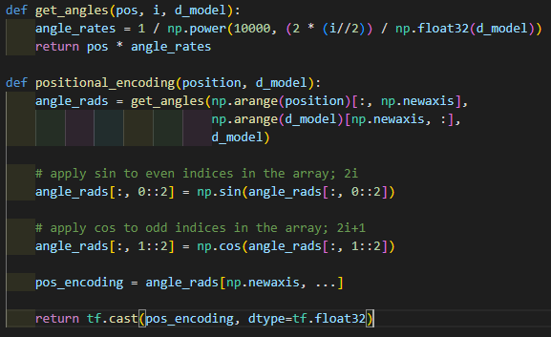
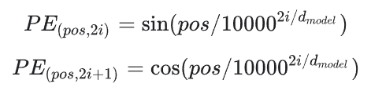
Review : Positional Encoding
input parameters are both int type

Slide 4
Review : Positional Encoding

Slide 5
Review : Positional Encoding
dimension of return matrix is
(1, 10000, 512)

Slide 6
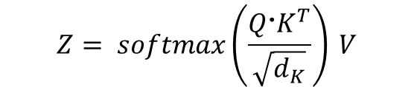

Review : Multi Head Attention
▶ First, get Query, Key, Value matrix from input matrix X
$${Q=X @ W}_{Q}$$
$$K=X @ W_{K}$$
$$V=X @ W_{V}$$
▶ Then, derive attention matrix Z through the formula behind
$$Z= softmax\left(\frac{Q〮K^{T}}{\sqrt{d_{K}}}\right) V$$
※ Z is attention matrix, $d_{K}$ is dimension of matrix K.

Slide 7
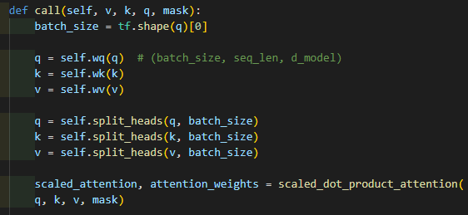
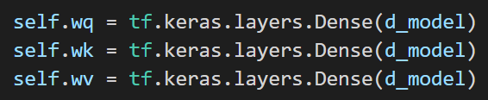
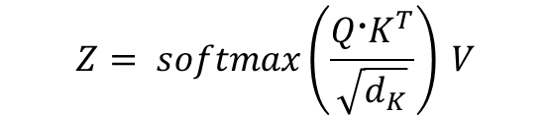

Review : Multi Head Attention
▶ First, get Query, Key, Value matrix
from input matrix X
$${Q=X @ W}_{Q}$$
$$K=X @ W_{K}$$
$$V=X @ W_{V}$$
q.shape
(batch_size, seq_len, d_model)
v, k, q passes different dense layers,
which have different weight matrix and bias.
In this step, Q, K, V are defined.
▶ Then, derive attention matrix
through the formula behind
$$Z= softmax\left(\frac{Q〮K^{T}}{\sqrt{d_{K}}}\right) V$$
※ Z is attention matrix, $d_{K}$ is dimension of matrix K.

Slide 8
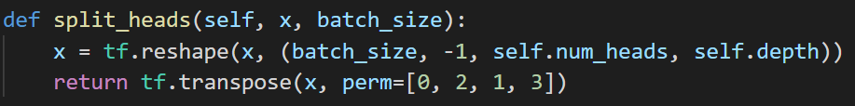
Review : Multi Head Attention
▶ First, get Query, Key, Value matrix
from input matrix X
$${Q=X @ W}_{Q}$$
$$K=X @ W_{K}$$
$$V=X @ W_{V}$$
perm of transpose
tf.transpose(x, perm=[0, 2, 1, 3]) moves
x[a][b][c][d] to x[a][c][b][d]
▶ Then, derive attention matrix
through the formula behind
$$Z= softmax\left(\frac{Q〮K^{T}}{\sqrt{d_{K}}}\right) V$$
q.shape
(batch_size, seq_len, d_model)
->
(batch_size, self.num_heads, seq_len, self.depth)
※ Z is attention matrix, $d_{K}$ is dimension of matrix K.

Slide 9
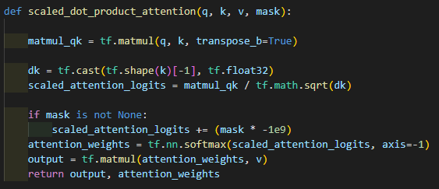
Review : Multi Head Attention
▶ First, get Query, Key, Value matrix
from input matrix X
$${Q=X @ W}_{Q}$$
$$K=X @ W_{K}$$
$$V=X @ W_{V}$$
▶ Then, derive attention matrix
through the formula behind
$$Z= softmax\left(\frac{Q〮K^{T}}{\sqrt{d_{K}}}\right) V$$
matmul_qk.shape
(batch_size, self.num_heads, seq_len, seq_len)
※ Z is attention matrix, $d_{K}$ is dimension of matrix K.

Slide 10
Review : Multi Head Attention
▶ First, get Query, Key, Value matrix
from input matrix X
$${Q=X @ W}_{Q}$$
$$K=X @ W_{K}$$
$$V=X @ W_{V}$$
▶ Then, derive attention matrix
through the formula behind
$$Z= softmax\left(\frac{Q〮K^{T}}{\sqrt{d_{K}}}\right) V$$
dk is a tf.float32 number
※ Z is attention matrix, $d_{K}$ is dimension of matrix K.

Slide 11
Review : Multi Head Attention
▶ First, get Query, Key, Value matrix
from input matrix X
$${Q=X @ W}_{Q}$$
$$K=X @ W_{K}$$
$$V=X @ W_{V}$$
▶ Then, derive attention matrix
through the formula behind
$$Z= softmax\left(\frac{Q〮K^{T}}{\sqrt{d_{K}}}\right) V$$
scaled_attention_logits.shape
(batch_size, self.num_heads, seq_len, seq_len)
※ Z is attention matrix, $d_{K}$ is dimension of matrix K.

Slide 12
Review : Multi Head Attention
▶ First, get Query, Key, Value matrix
from input matrix X
$${Q=X @ W}_{Q}$$
$$K=X @ W_{K}$$
$$V=X @ W_{V}$$
▶ Then, derive attention matrix
through the formula behind
$$Z= softmax\left(\frac{Q〮K^{T}}{\sqrt{d_{K}}}\right) V$$
attention_weights.shape
(batch_size, self.num_heads, seq_len, seq_len)
※ Z is attention matrix, $d_{K}$ is dimension of matrix K.

Slide 13
Review : Multi Head Attention
▶ First, get Query, Key, Value matrix
from input matrix X
$${Q=X @ W}_{Q}$$
$$K=X @ W_{K}$$
$$V=X @ W_{V}$$
▶ Then, derive attention matrix
through the formula behind
$$Z= softmax\left(\frac{Q〮K^{T}}{\sqrt{d_{K}}}\right) V$$
output.shape
(batch_size, self.num_heads, seq_len, self.depth)
※ Z is attention matrix, $d_{K}$ is dimension of matrix K.

Slide 14
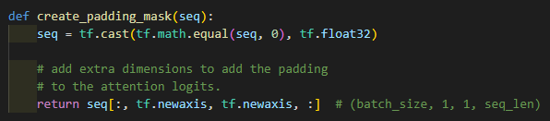
Review : Multi Head Attention
▶ First, get Query, Key, Value matrix
from input matrix X
$${Q=X @ W}_{Q}$$
$$K=X @ W_{K}$$
$$V=X @ W_{V}$$
▶ Then, derive attention matrix
through the formula behind
$$Z= softmax\left(\frac{Q〮K^{T}}{\sqrt{d_{K}}}\right) V$$
▶ Padding mask matrix consists of 1 and 0
1 means mask
※ Z is attention matrix, $d_{K}$ is dimension of matrix K.
seq is token ID matrix, and its size is
(batch_size, seq_len)

Slide 15
Review : Multi Head Attention
▶ First, get Query, Key, Value matrix
from input matrix X
$${Q=X @ W}_{Q}$$
$$K=X @ W_{K}$$
$$V=X @ W_{V}$$
▶ Then, derive attention matrix
through the formula behind
$$Z= softmax\left(\frac{Q〮K^{T}}{\sqrt{d_{K}}}\right) V$$
▶ Padding mask matrix consists of 1 and 0
1 means mask
※ Z is attention matrix, $d_{K}$ is dimension of matrix K.
seq is now mask matrix

Slide 16
Review : Multi Head Attention
▶ First, get Query, Key, Value matrix
from input matrix X
$${Q=X @ W}_{Q}$$
$$K=X @ W_{K}$$
$$V=X @ W_{V}$$
▶ Then, derive attention matrix
through the formula behind
$$Z= softmax\left(\frac{Q〮K^{T}}{\sqrt{d_{K}}}\right) V$$
▶ Padding mask matrix consists of 1 and 0
1 means mask
※ Z is attention matrix, $d_{K}$ is dimension of matrix K.
seq.shape
(batch_size, 1, 1, seq_len)

Slide 17
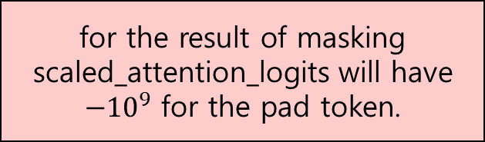
Review : Multi Head Attention
▶ First, get Query, Key, Value matrix
from input matrix X
$${Q=X @ W}_{Q}$$
$$K=X @ W_{K}$$
$$V=X @ W_{V}$$
▶ Then, derive attention matrix
through the formula behind
for the result of masking
scaled_attention_logits will have
$−{10}^{9}$ for the pad token.
$$Z= softmax\left(\frac{Q〮K^{T}}{\sqrt{d_{K}}}\right) V$$
▶ Padding mask matrix consists of 1 and 0
1 means mask
※ Z is attention matrix, $d_{K}$ is dimension of matrix K.
seq.shape
(batch_size, 1, 1, seq_len)

Slide 18
Review : Multi Head Attention
▶ First, get Query, Key, Value matrix
from input matrix X
$${Q=X @ W}_{Q}$$
$$K=X @ W_{K}$$
$$V=X @ W_{V}$$
▶ Then, derive attention matrix
through the formula behind
$$Z= softmax\left(\frac{Q〮K^{T}}{\sqrt{d_{K}}}\right) V$$
attention_weights.shape
(batch_size, self.num_heads, seq_len, seq_len)
※ Z is attention matrix, $d_{K}$ is dimension of matrix K.
output.shape
(batch_size, self.num_heads, seq_len, self.depth)

Slide 19
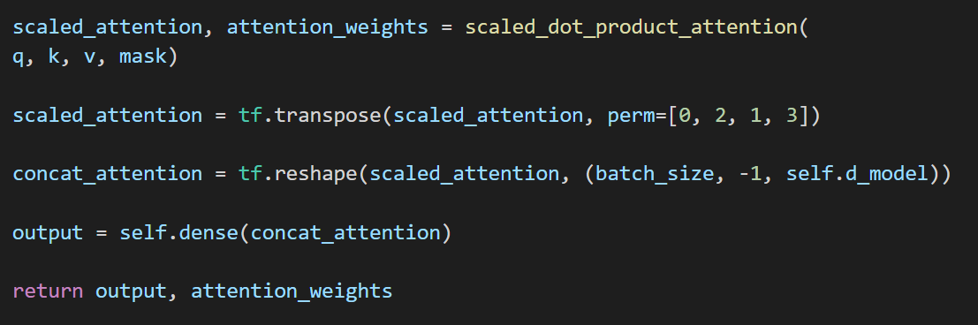
Review : Multi Head Attention
▶ Concatenate heads
attention_weights.shape
(batch_size, self.num_heads, seq_len, seq_len)
scaled_attention.shape
(batch_size, self.num_heads, seq_len, self.depth)

Slide 20
Review : Multi Head Attention
▶ Concatenate heads
scaled_attention.shape
(batch_size, self.num_heads, seq_len, self.depth)
transpose
scaled_attention.shape
(batch_size, seq_len, self.num_heads, self.depth)

Slide 21
Review : Multi Head Attention
▶ Concatenate heads
scaled_attention.shape
(batch_size, self.num_heads, seq_len, self.depth)
transpose
scaled_attention.shape
(batch_size, seq_len, self.num_heads, self.depth)
reshape
concat_attention.shape
(batch_size, seq_len, self.d_model)

Slide 22
Review : Multi Head Attention
▶ Concatenate heads
scaled_attention.shape
(batch_size, self.num_heads, seq_len, self.depth)
transpose
scaled_attention.shape
(batch_size, seq_len, self.num_heads, self.depth)
reshape
output.shape
(batch_size, seq_len, self.d_model)
concat_attention.shape
(batch_size, seq_len, self.d_model)

Slide 23
Review : Multi Head Attention
scaled_attention.shape
(batch_size, self.num_heads, seq_len, self.depth)
transpose
scaled_attention.shape
(batch_size, seq_len, self.num_heads, self.depth)
reshape
output.shape
(batch_size, seq_len, self.d_model)
concat_attention.shape
(batch_size, seq_len, self.d_model)
attention_weights.shape
(batch_size, self.num_heads, seq_len, seq_len)

Slide 24
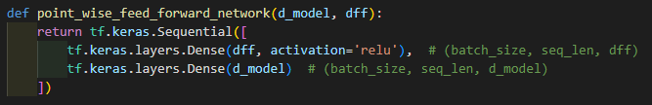
Review : Pointwise Feed Forward Network
Dense Layer 1
ReLU
Dense Layer 2

Slide 25

Review : Pointwise Feed Forward Network
out1
(batch_size, seq_len, d_model)
Dense Layer 1
ReLU
(batch_size, seq_len, dff)
...
Dense Layer 2
ffn_output
(batch_size, seq_len, d_model)

Slide 26
Review : Pointwise Feed Forward Network
out1
(batch_size, seq_len, d_model)
Dense Layer 1
ReLU
(batch_size, seq_len, dff)
...
Dense Layer 2
ffn_output
(batch_size, seq_len, d_model)

Slide 27
Review : Add & Norm
▶ Add & Normalization connects input and output of sublayers
to achieve Layer normalization and Residual connection.
Layer normalization : prevents model from one sublayer’s return value is too big,
and effects training result to a great extent.
Residual connection : prevents model from forgetting information
that the previous sublayer provides

Slide 28

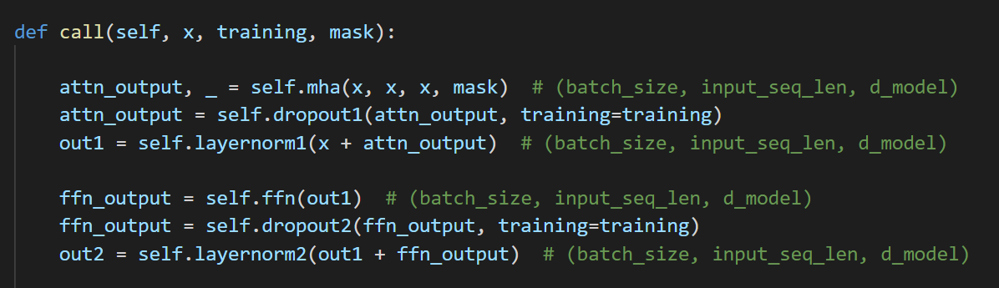
Review : Add & Norm
▶ Add & Normalization connects input and output of sublayers
to achieve Layer normalization and Residual connection.
Layer normalization : prevents model from one sublayer’s return value is too big,
and effects training result to a great extent.
Residual connection : prevents model from forgetting information
that the previous sublayer provides
out1
self.layernorm1
attn_output
self.dropout1
attn_output
self.mha
x

Slide 29
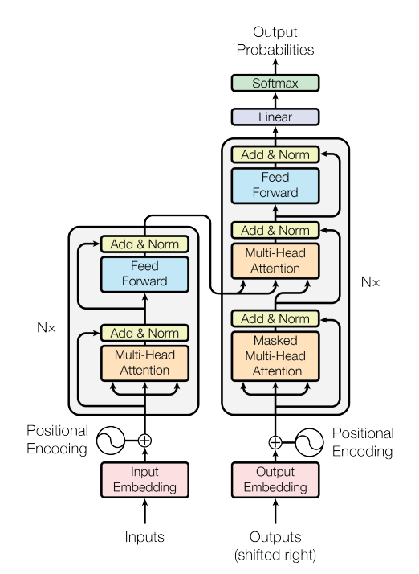
Masked Multi Head Attention
We are Here!

Slide 30

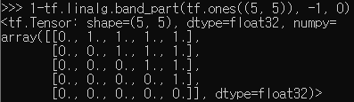
Masked Multi Head Attention
▶ Masked Multi Head Attention is to perform multi head attention with look ahead mask
As we said on ‘Masking’, Look ahead mask includes padding mask!
※ Example of look ahead mask when size=5
※ 1 means mask
padding mask is not included in this example

Slide 31
Masked Multi Head Attention
▶ Masked Multi Head Attention is to perform multi head attention with look ahead mask
As we said on ‘Masking’, Look ahead mask includes padding mask!
※ Example of look ahead mask when size=5
※ 1 means mask
padding mask is not included in this example

