Slide 1
Transformer Practice
컴퓨터소프트웨어학부 심승현

Slide 2
Contents
https://www.tensorflow.org/text/tutorials/transformer
Tensorflow.org, transformer tutorial
translating Portuguese to English using transformer model

Slide 3
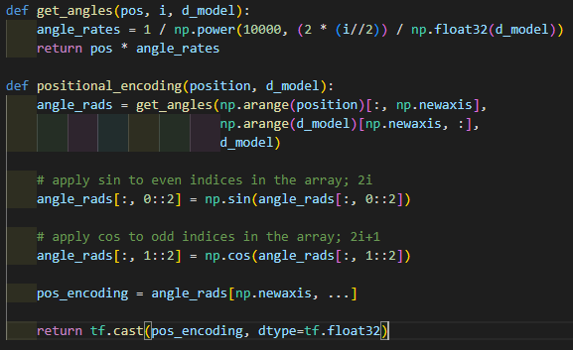
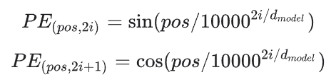
Review : Positional Encoding
input parameters are both int type

Slide 4
Review : Positional Encoding

Slide 5
Review : Positional Encoding
dimension of return matrix is
(1, 10000, 512)

Slide 6
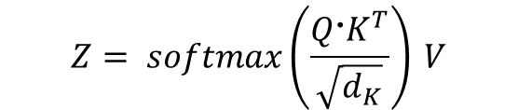

Review : Multi Head Attention
▶ First, get Query, Key, Value matrix from input matrix X
$${Q=X @ W}_{Q}$$
$$K=X @ W_{K}$$
$$V=X @ W_{V}$$
▶ Then, derive attention matrix Z through the formula behind
$$Z= softmax\left(\frac{Q〮K^{T}}{\sqrt{d_{K}}}\right) V$$
※ Z is attention matrix, $d_{K}$ is dimension of matrix K.

Slide 7


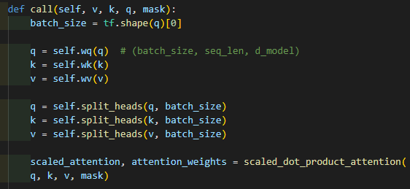
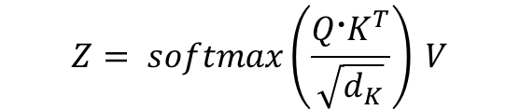

Review : Multi Head Attention
▶ First, get Query, Key, Value matrix
from input matrix X
$${Q=X @ W}_{Q}$$
$$K=X @ W_{K}$$
$$V=X @ W_{V}$$
▶ Then, derive attention matrix
through the formula behind
q.shape
(batch_size, seq_len, d_model)
$$Z= softmax\left(\frac{Q〮K^{T}}{\sqrt{d_{K}}}\right) V$$
※ Z is attention matrix, $d_{K}$ is dimension of matrix K.

Slide 8
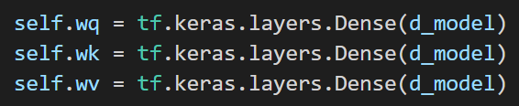
Review : Multi Head Attention
▶ First, get Query, Key, Value matrix
from input matrix X
$${Q=X @ W}_{Q}$$
$$K=X @ W_{K}$$
$$V=X @ W_{V}$$
▶ Then, derive attention matrix
through the formula behind
$$Z= softmax\left(\frac{Q〮K^{T}}{\sqrt{d_{K}}}\right) V$$
v, k, q passes different dense layers,
which have different weight matrix and bias.
In this step, Q, K, V are defined.
※ Z is attention matrix, $d_{K}$ is dimension of matrix K.

Slide 9
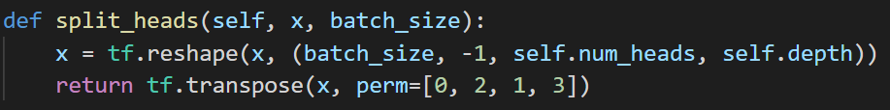
Review : Multi Head Attention
▶ First, get Query, Key, Value matrix
from input matrix X
$${Q=X @ W}_{Q}$$
$$K=X @ W_{K}$$
$$V=X @ W_{V}$$
perm of transpose
tf.transpose(x, perm=[0, 2, 1, 3]) moves
x[a][b][c][d] to x[a][c][b][d]
▶ Then, derive attention matrix
through the formula behind
$$Z= softmax\left(\frac{Q〮K^{T}}{\sqrt{d_{K}}}\right) V$$
q.shape
(batch_size, seq_len, d_model)
->
(batch_size, self.num_heads, seq_len, self.depth)
※ Z is attention matrix, $d_{K}$ is dimension of matrix K.

Slide 10
Review : Multi Head Attention
▶ First, get Query, Key, Value matrix
from input matrix X
$${Q=X @ W}_{Q}$$
$$K=X @ W_{K}$$
$$V=X @ W_{V}$$
▶ Then, derive attention matrix
through the formula behind
$$Z= softmax\left(\frac{Q〮K^{T}}{\sqrt{d_{K}}}\right) V$$
※ Z is attention matrix, $d_{K}$ is dimension of matrix K.
let’s go to scaled dot product attention!

Slide 11
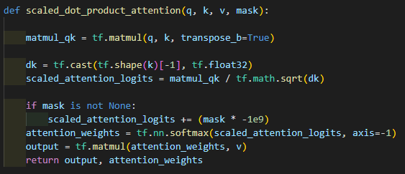
Review : Multi Head Attention
▶ First, get Query, Key, Value matrix
from input matrix X
q.shape
(batch_size, self.num_heads, seq_len, self.depth)
$${Q=X @ W}_{Q}$$
$$K=X @ W_{K}$$
$$V=X @ W_{V}$$
▶ Then, derive attention matrix
through the formula behind
$$Z= softmax\left(\frac{Q〮K^{T}}{\sqrt{d_{K}}}\right) V$$
※ Z is attention matrix, $d_{K}$ is dimension of matrix K.

Slide 12
Review : Multi Head Attention
▶ First, get Query, Key, Value matrix
from input matrix X
q.shape
(batch_size, self.num_heads, seq_len, self.depth)
$${Q=X @ W}_{Q}$$
$$K=X @ W_{K}$$
$$V=X @ W_{V}$$
matmul_qk.shape
(batch_size, self.num_heads, seq_len, seq_len)
▶ Then, derive attention matrix
through the formula behind
matmul_qk
$$Z= softmax\left(\frac{Q〮K^{T}}{\sqrt{d_{K}}}\right) V$$
※ Z is attention matrix, $d_{K}$ is dimension of matrix K.

Slide 13
Review : Multi Head Attention
▶ First, get Query, Key, Value matrix
from input matrix X
q.shape
(batch_size, self.num_heads, seq_len, self.depth)
$${Q=X @ W}_{Q}$$
$$K=X @ W_{K}$$
$$V=X @ W_{V}$$
dk is a tf.float32 number
▶ Then, derive attention matrix
through the formula behind
matmul_qk
$$Z= softmax\left(\frac{Q〮K^{T}}{\sqrt{d_{K}}}\right) V$$
dk
※ Z is attention matrix, $d_{K}$ is dimension of matrix K.

Slide 14
Review : Multi Head Attention
▶ First, get Query, Key, Value matrix
from input matrix X
matmul_qk.shape
(batch_size, self.num_heads, seq_len, seq_len)
$${Q=X @ W}_{Q}$$
$$K=X @ W_{K}$$
$$V=X @ W_{V}$$
scaled_attention_logits.shape
(batch_size, self.num_heads, seq_len, seq_len)
▶ Then, derive attention matrix
through the formula behind
$$Z= softmax\left(\frac{Q〮K^{T}}{\sqrt{d_{K}}}\right) V$$
scaled_attention_logits
※ Z is attention matrix, $d_{K}$ is dimension of matrix K.

Slide 15
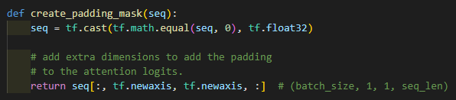
Review : Multi Head Attention
▶ First, get Query, Key, Value matrix
from input matrix X
$${Q=X @ W}_{Q}$$
$$K=X @ W_{K}$$
$$V=X @ W_{V}$$
▶ Then, derive attention matrix
through the formula behind
$$Z= softmax\left(\frac{Q〮K^{T}}{\sqrt{d_{K}}}\right) V$$
▶ Padding mask matrix consists of 1 and 0
1 means mask
scaled_attention_logits
※ Z is attention matrix, $d_{K}$ is dimension of matrix K.
seq is token ID matrix, and its size is
(batch_size, seq_len)

Slide 16
Review : Multi Head Attention
▶ First, get Query, Key, Value matrix
from input matrix X
$${Q=X @ W}_{Q}$$
$$K=X @ W_{K}$$
$$V=X @ W_{V}$$
▶ Then, derive attention matrix
through the formula behind
$$Z= softmax\left(\frac{Q〮K^{T}}{\sqrt{d_{K}}}\right) V$$
▶ Padding mask matrix consists of 1 and 0
1 means mask
scaled_attention_logits
※ Z is attention matrix, $d_{K}$ is dimension of matrix K.
seq is token ID matrix, and its size is
(batch_size, seq_len)
seq is now mask matrix, and its size is
(batch_size, 1, 1, seq_len)

Slide 17
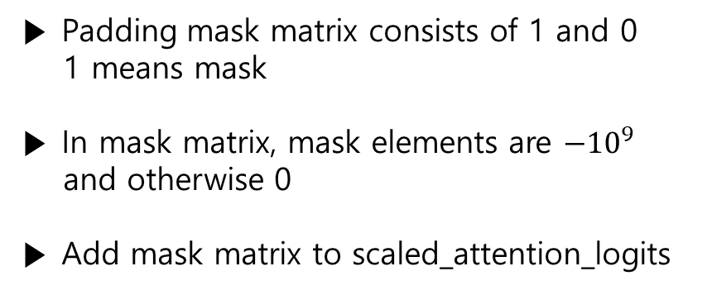
Review : Multi Head Attention
▶ First, get Query, Key, Value matrix
from input matrix X
$${Q=X @ W}_{Q}$$
$$K=X @ W_{K}$$
$$V=X @ W_{V}$$
scaled_attention_logits.shape
(batch_size, self.num_heads, seq_len, seq_len)
▶ Then, derive attention matrix
through the formula behind
mask.shape
(batch_size, 1, 1, seq_len)
$$Z= softmax\left(\frac{Q〮K^{T}}{\sqrt{d_{K}}}\right) V$$
▶ Padding mask matrix consists of 1 and 0
1 means mask
▶ In mask matrix, mask elements are $−{10}^{9}$
and otherwise 0
▶ Add mask matrix to scaled_attention_logits
scaled_attention_logits
※ Z is attention matrix, $d_{K}$ is dimension of matrix K.

Slide 18
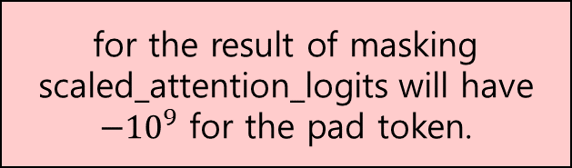
Review : Multi Head Attention
▶ First, get Query, Key, Value matrix
from input matrix X
$${Q=X @ W}_{Q}$$
$$K=X @ W_{K}$$
$$V=X @ W_{V}$$
for the result of masking
scaled_attention_logits will have
$−{10}^{9}$ for the pad token.
▶ Then, derive attention matrix
through the formula behind
$$Z= softmax\left(\frac{Q〮K^{T}}{\sqrt{d_{K}}}\right) V$$
▶ Padding mask matrix consists of 1 and 0
1 means mask
▶ In mask matrix, mask elements are $−{10}^{9}$
and otherwise 0
▶ Add mask matrix to scaled_attention_logits
scaled_attention_logits
※ Z is attention matrix, $d_{K}$ is dimension of matrix K.

Slide 19
Review : Multi Head Attention
▶ First, get Query, Key, Value matrix
from input matrix X
$${Q=X @ W}_{Q}$$
$$K=X @ W_{K}$$
$$V=X @ W_{V}$$
▶ Then, derive attention matrix
through the formula behind
$$Z= softmax\left(\frac{Q〮K^{T}}{\sqrt{d_{K}}}\right) V$$
output
attemtion_weights
※ Z is attention matrix, $d_{K}$ is dimension of matrix K.

