Slide 1
Abstract Structure on
Transformer-based MS/MS spectrum refining model
컴퓨터소프트웨어학부 심승현

Slide 2
Overview

Slide 3
Overview
Output
Transformer
Encoder
input
Decoder
input

Slide 4
Overview
Output
Transformer
Encoder
input
Decoder
input

Slide 5
Overview
Output
Transformer
Encoder
input
Decoder
input
3-dimensional
tf.Tensor
mgfToTensor()
.mgf Data

Slide 6
Overview
Output
Transformer
This is dataset
Encoder
input
Decoder
input
3-dimensional
tf.Tensor
mgfToTensor()
.mgf Data

Slide 7
Overview
Output
Transformer
This is dataset
Encoder
input
Decoder
input
3-dimensional
tf.Tensor
3-dimensional
tf.Tensor
Batch
mgfToTensor()
.mgf Data

Slide 8
Overview
Output
Transformer
Encoder
input
Decoder
input
3-dimensional
tf.Tensor
Shape
(batch, num_peaks, 3)

Slide 9
Overview
Output
Transformer
+ Embedding
Encoder
input
Decoder
input
3-dimensional
tf.Tensor
Shape
(batch, num_peaks, 3)

Slide 10
Overview
▶기존 Transformer model :
Encoder input : (batch, seq_len)
Embedding output : (batch, seq_len, d_model)

Slide 11
Overview
▶기존 Transformer model :
Encoder input : (batch, seq_len)
Embedding output : (batch, seq_len, d_model)
[[how, are, you]
[nice, to, meet, you]]

Slide 12
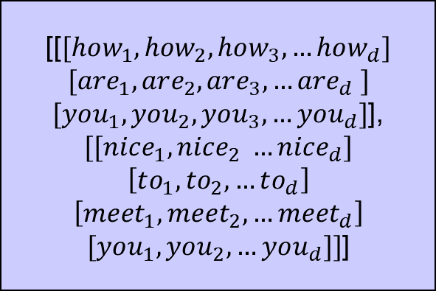
Overview
▶기존 Transformer model :
Encoder input : (batch, seq_len)
Embedding output : (batch, seq_len, d_model)
[[how, are, you]
[nice, to, meet, you]]
[[$[how_{1}, how_{2}, how_{3}, …how_{d}]$
$$[are_{1}, are_{2}, are_{3}, …are_{d} ]$$
$[you_{1}, you_{2}, you_{3}, …you_{d}]$],
$$[[nice_{1}, nice_{2} …nice_{d}]$$
$$\left[to_{1}, to_{2},…to_{d}\right]$$
$$\left[meet_{1},meet_{2}, …meet_{d}\right]$$
$[you_{1},you_{2},…you_{d}]]$]

Slide 13
Overview
▶ Our Transformer model :
Encoder input : (batch, num_peaks, 3)
Embedding output : (batch, num_peaks, d_model)
▶기존 Transformer model :
Encoder input : (batch, seq_len)
Embedding output : (batch, seq_len, d_model)
[[how, are, you]
[nice, to, meet, you]]
[[$[how_{1}, how_{2}, how_{3}, …how_{d}]$
$$[are_{1}, are_{2}, are_{3}, …are_{d} ]$$
$[you_{1}, you_{2}, you_{3}, …you_{d}]$],
$$[[nice_{1}, nice_{2} …nice_{d}]$$
$$\left[to_{1}, to_{2},…to_{d}\right]$$
$$\left[meet_{1},meet_{2}, …meet_{d}\right]$$
$[you_{1},you_{2},…you_{d}]]$]

Slide 14
Overview
▶ Our Transformer model :
Encoder input : (batch, num_peaks, 3)
Embedding output : (batch, num_peaks, d_model)
[[[50, 15, 0.16],
[26, 01, 0.09]],
[[ …]
[ …]]]
▶기존 Transformer model :
Encoder input : (batch, seq_len)
Embedding output : (batch, seq_len, d_model)
[[how, are, you]
[nice, to, meet, you]]
[[$[how_{1}, how_{2}, how_{3}, …how_{d}]$
$$[are_{1}, are_{2}, are_{3}, …are_{d} ]$$
$[you_{1}, you_{2}, you_{3}, …you_{d}]$],
$$[[nice_{1}, nice_{2} …nice_{d}]$$
$$\left[to_{1}, to_{2},…to_{d}\right]$$
$$\left[meet_{1},meet_{2}, …meet_{d}\right]$$
$[you_{1},you_{2},…you_{d}]]$]

Slide 15
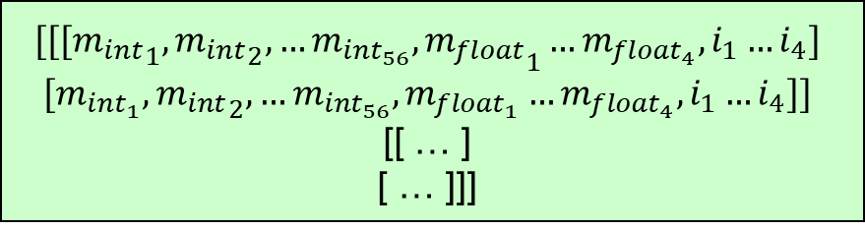
Overview
▶ Our Transformer model :
Encoder input : (batch, num_peaks, 3)
Embedding output : (batch, num_peaks, d_model)
[[[50, 15, 0.16],
[26, 01, 0.09]],
[[ …]
[ …]]]
▶기존 Transformer model :
Encoder input : (batch, seq_len)
Embedding output : (batch, seq_len, d_model)
[[how, are, you]
[nice, to, meet, you]]
[[$[how_{1}, how_{2}, how_{3}, …how_{d}]$
$$[are_{1}, are_{2}, are_{3}, …are_{d} ]$$
$[you_{1}, you_{2}, you_{3}, …you_{d}]$],
$$[[nice_{1}, nice_{2} …nice_{d}]$$
$$\left[to_{1}, to_{2},…to_{d}\right]$$
$$\left[meet_{1},meet_{2}, …meet_{d}\right]$$
$[you_{1},you_{2},…you_{d}]]$]
$$[[[{m_{int}}_{1}, {m_{int}}_{2}, …m_{int_{56}}, {m_{float}}_{1}…m_{float_{4}}, i_{1}…i_{4}]$$
$$[m_{int_{1}}, {m_{int}}_{2}, …m_{int_{56}}, m_{float_{1}}…m_{float_{4}}, i_{1}…i_{4}]]$$
[[ … ]
[ … ]]]

Slide 16
Overview
[[[50, 15, 0.16],
[26, 01, 0.09]],
[[ …]
[ …]]]
How?
$$[[[{m_{int}}_{1}, {m_{int}}_{2}, …m_{int_{56}}, {m_{float}}_{1}…m_{float_{4}}, i_{1}…i_{4}]$$
$$[m_{int_{1}}, {m_{int}}_{2}, …m_{int_{56}}, m_{float_{1}}…m_{float_{4}}, i_{1}…i_{4}]]$$
[[ … ]
[ … ]]]

Slide 17
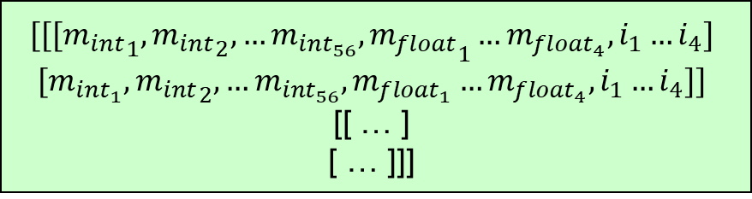
Overview
[[[50, 15, 0.16],
[26, 01, 0.09]],
[[ …]
[ …]]]
How?
$$[[[{m_{int}}_{1}, {m_{int}}_{2}, …m_{int_{56}}, {m_{float}}_{1}…m_{float_{4}}, i_{1}…i_{4}]$$
$$[m_{int_{1}}, {m_{int}}_{2}, …m_{int_{56}}, m_{float_{1}}…m_{float_{4}}, i_{1}…i_{4}]]$$
[[ … ]
[ … ]]]

Slide 18
Overview
[[[50, 15, 0.16],
[26, 01, 0.09]],
[[ …]
[ …]]]
How?
$$[[[{m_{int}}_{1}, {m_{int}}_{2}, …m_{int_{56}}, {m_{float}}_{1}…m_{float_{4}}, i_{1}…i_{4}]$$
$$[m_{int_{1}}, {m_{int}}_{2}, …m_{int_{56}}, m_{float_{1}}…m_{float_{4}}, i_{1}…i_{4}]]$$
[[ … ]
[ … ]]]
▶ Embedding respectively

Slide 19
Overview
[[[50, 15, 0.16],
[26, 01, 0.09]],
[[ …]
[ …]]]
How?
$$[[[{m_{int}}_{1}, {m_{int}}_{2}, …m_{int_{56}}, {m_{float}}_{1}…m_{float_{4}}, i_{1}…i_{4}]$$
$$[m_{int_{1}}, {m_{int}}_{2}, …m_{int_{56}}, m_{float_{1}}…m_{float_{4}}, i_{1}…i_{4}]]$$
[[ … ]
[ … ]]]
▶ Embedding respectively
▶ Concatenate

Slide 20
Overview
Output
Transformer
Encoder
input
Decoder
input
[[[50, 15, 0.16],
[26, 01, 0.09]],
[[ …]
[ …]]]

Slide 21
Overview
Output
Transformer
Encoder
input
Decoder
input

Slide 22
Overview
Output
Transformer
Encoder
input
Decoder
input
Extract Sequence
This is string
.mgf Data

Slide 23
Overview
Output
Transformer
Encoder
input
Decoder
input
Tokenize
This is number
Extract Sequence
This is string
.mgf Data

Slide 24
Overview
Output
Transformer
Encoder
input
Decoder
input
Tokenize
mgfToTensor 클래스에서 tuple을 출력하거나
Sequence 를 얻는 메소드를 따로 정의하여 호출하거나
Extract Sequence
.mgf Data

Slide 25


Overview
Output
Transformer
Encoder
input
Decoder
input
Tokenize
mgfToTensor 클래스에서 tuple을 출력하거나
Sequence 를 얻는 메소드를 따로 정의하여 호출하거나
Extract Sequence
.mgf Data

Slide 26

Overview
Output
Transformer
얻어진 Sequence 에 대하여
$$\left[mass_{int}, mass_{float}, intensity\right]$$
형태를 반환
Encoder
input
Decoder
input
Tokenize
Extract Sequence
.mgf Data

Slide 27


Overview
Output
Example :
SEQ = ‘abcd’
$$[\left[{a_{m}}_{int}, a_{m_{float}}, 50\right]$$
$$\left[ab_{m_{int}}, ab_{m_{float}}, 50\right]$$
$$\left[d_{m_{int}}, d_{m_{float}}, 50\right]$$
$$…$$
$$\left[abcd_{{b_{m}}_{int}}, abc{d_{b_{m}}}_{float}, 50\right]$$
$$[abc{d_{y_{m}}}_{int}, abcd_{y_{m_{float}}}, 50]]$$
Transformer
하나의 sequence 에서
가능한 모든 digestion 에 대하여
$$\left[mass_{int}, mass_{float}\right]$$
형태를 출력
얻어진 Sequence 에 대하여
$$\left[mass_{int}, mass_{float}, intensity\right]$$
형태를 반환
Encoder
input
Decoder
input
Tokenize
Extract Sequence
.mgf Data

Slide 28

Overview
Output
Example :
SEQ = ‘abcd’
$$[\left[{a_{m}}_{int}, a_{m_{float}}, 50\right]$$
$$\left[ab_{m_{int}}, ab_{m_{float}}, 50\right]$$
$$\left[d_{m_{int}}, d_{m_{float}}, 50\right]$$
$$…$$
$$\left[abcd_{{b_{m}}_{int}}, abc{d_{b_{m}}}_{float}, 50\right]$$
$$[abc{d_{y_{m}}}_{int}, abcd_{y_{m_{float}}}, 50]]$$
Transformer
순서 :
$mass$에 관하여 오름차순
하나의 sequence 에서
가능한 모든 digestion 에 대하여
$$\left[mass_{int}, mass_{float}\right]$$
형태를 출력
얻어진 Sequence 에 대하여
$$\left[mass_{int}, mass_{float}, intensity\right]$$
형태를 반환
Encoder
input
Decoder
input
Tokenize
Extract Sequence
.mgf Data

Slide 29
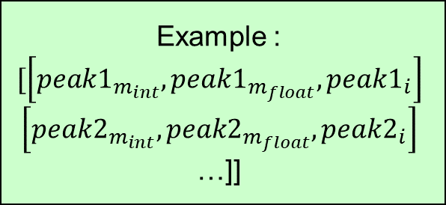
Overview
Output
Example :
$$[\left[peak1_{m_{int}}, peak1_{m_{float}}, peak1_{i}\right]$$
$$\left[peak2_{m_{int}}, peak2_{m_{float}}, peak2_{i}\right]$$
…]]
Transformer
Shape
(num_peak, 3)
Encoder
input
Decoder
input
Shape
(2*length, 3)

Slide 30
Overview
Output
Transformer
Encoder
input
Decoder
input

Slide 31
Overview
Transformer 의 출력은 확률 행렬
최종적으로 하고자 하는 것은
peak 의 True/False 판별
Output
Transformer
Encoder
input
Decoder
input

Slide 32
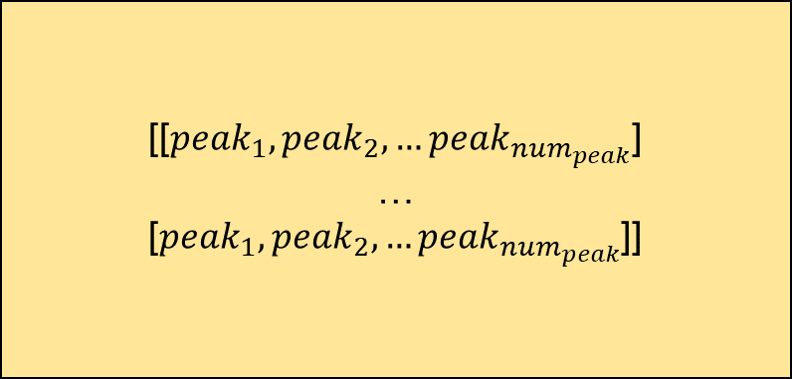
Overview
[[$peak_{1}, peak_{2}, …peak_{num_{peak}}$]
…
[$peak_{1}, peak_{2}, …peak_{num_{peak}}$]]
Output
Transformer
Encoder
input
Decoder
input

Slide 33
Overview
[[$peak_{1}, peak_{2}, …peak_{num_{peak}}$]
…
[$peak_{1}, peak_{2}, …peak_{num_{peak}}$]]
Output
Transformer
Inference mode 에서는,
이걸 어떠한 방식으로 가공하여
노이즈가 제거된 .mgf 파일을 출력해야 함
: 후처리의 목표

