Slide 1
5.6 졸업프로젝트 발표
LSTM
컴퓨터소프트웨어학부 심승현

Slide 2
Contents
Back propagation of RNN/LSTM
LSTM Example

Slide 3
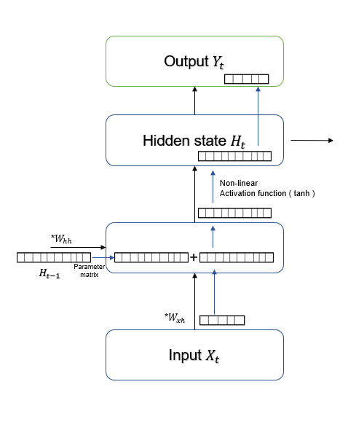













Back propagation of RNN
$$H_{t}$$
$H_{t}$
$$tanh⁡(W_{xh}∗X_{t}+W_{hh}∗H_{t−1}+bias)$$
$$tanh$$
$W_{xh}∗X_{t}+W_{hh}∗H_{t−1}+bias$
+
$bias$
$W_{hh}$
$W_{xh}∗X_{t}+W_{hh}∗H_{t−1}$
X
+
+bias
$W_{hh}∗H_{t−1}$
$H_{t−1}$
$W_{xh}∗X_{t}$
X
$X_{t}$
$W_{xh}$

Slide 4



















Back propagation of RNN
$$H_{t}$$
$$H_{t}$$
$H_{t}$
$H_{t}$
$$\frac{∂L}{∂H_{t}}$$
$$tanh⁡(W_{xh}∗X_{t}+W_{hh}∗H_{t−1}+bias)$$
$$tanh$$
$$tanh$$
$$\frac{∂L}{∂H_{t}}∗tanh′(H_{t})$$
$W_{xh}∗X_{t}+W_{hh}∗H_{t−1}+bias$
+
$bias$
+
$bias$
$$H_{t−1}^{T}∗\frac{∂L}{∂H_{t}}∗tanh′(H_{t})$$
$$\frac{∂L}{∂H_{t}}∗tanh′(H_{t})$$
$W_{hh}$
$W_{xh}∗X_{t}+W_{hh}∗H_{t−1}$
$W_{hh}$
X
+
X
+
$W_{hh}∗H_{t−1}$
$H_{t−1}$
$$\frac{∂L}{∂H_{t}}∗tanh′(H_{t})$$
$$\frac{∂L}{∂H_{t}}∗tanh′(H_{t})$$
$H_{t−1}$
$W_{xh}∗X_{t}$
$$\frac{∂L}{∂H_{t}}∗tanh^{′}\left(H_{t}\right)∗W_{hh}^{T}$$
X
X
$$\frac{∂L}{∂H_{t}}∗tanh^{′}\left(H_{t}\right)∗W_{xh}^{T}$$
$$X_{t}^{T}∗\frac{∂L}{∂H_{t}}∗tanh′(H_{t})$$
$X_{t}$
$W_{xh}$
$X_{t}$
$W_{xh}$

Slide 5
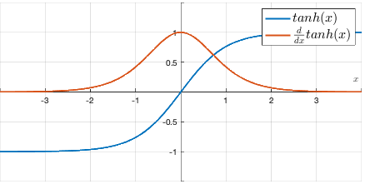






Back propagation of RNN
$$H_{t}$$
$H_{t}$
$$\frac{∂L}{∂H_{t}}$$
$tanh(x)$ = $\frac{e^{x}−e^{−x}}{e^{x}+e^{−x}}$
$$tanh$$
$$f\left(x\right)= e^{x}−e^{−x}$$
$${g\left(x\right)= e}^{x}+e^{−x}$$
$$\frac{∂L}{∂H_{t}}∗tanh′(H_{t})$$
$tanh′(x)$ = $\frac{f^{′}\left(x\right)g\left(x\right)−f\left(x\right)g′(x)}{g^{2}(x)}$
+
$bias$
= $\frac{{(e^{x}+e^{−x})}^{2}−{(e^{x}−e^{−x})}^{2}}{{(e^{x}+e^{−x})}^{2}}$
$$H_{t−1}^{T}∗\frac{∂L}{∂H_{t}}∗tanh′(H_{t})$$
$$\frac{∂L}{∂H_{t}}∗tanh′(H_{t})$$
= $1−{(\frac{e^{x}−e^{−x})}{e^{x}+e^{−x}})}^{2}$
$W_{hh}$
= $1−{tanh(x)}^{2}$
X
+
$H_{t−1}$
$$\frac{∂L}{∂H_{t}}∗tanh′(H_{t})$$
$$\frac{∂L}{∂H_{t}}∗tanh′(H_{t})$$
$$\frac{∂L}{∂H_{t}}∗tanh^{′}\left(H_{t}\right)∗W_{hh}^{T}$$
X
$$\frac{∂L}{∂H_{t}}∗tanh^{′}\left(H_{t}\right)∗W_{xh}^{T}$$
$$X_{t}^{T}∗\frac{∂L}{∂H_{t}}∗tanh′(H_{t})$$
$X_{t}$
$W_{xh}$

Slide 6



Back propagation of RNN
$$H_{t}$$
$H_{t}$
$$\frac{∂L}{∂H_{t}}$$
$$tanh$$
Iterative tanh functions cause vanishing gradient problem
$$\frac{∂L}{∂H_{t}}∗tanh′(H_{t})$$
$$(\frac{∂L}{∂H_{t}}∗tanh^{′}\left(H_{t}\right)∗W_{hh}^{T})∗tanh^{′}\left(H_{t−1}\right)∗W_{hh}^{T}$$
$H_{t−2}$
$H_{t−1}$
+
$bias$
$$H_{t−1}^{T}∗\frac{∂L}{∂H_{t}}∗tanh′(H_{t})$$
$$\frac{∂L}{∂H_{t}}∗tanh′(H_{t})$$
$$\frac{∂L}{∂H_{t}}∗tanh^{′}\left(H_{t}\right)∗W_{hh}^{T}$$
$W_{hh}$
X
+
$$\frac{∂L}{∂H_{t}}∗tanh′(H_{t})$$
$$\frac{∂L}{∂H_{t}}∗tanh′(H_{t})$$
X
$$\frac{∂L}{∂H_{t}}∗tanh^{′}\left(H_{t}\right)∗W_{xh}^{T}$$
$$X_{t}^{T}∗\frac{∂L}{∂H_{t}}∗tanh′(H_{t})$$
$X_{t}$
$W_{xh}$

Slide 7






























Back propagation of LSTM
$C_{t−1}$
X
+
$C_{t}$
$$C_{tmp}$$
X
+
$$σ$$
$$C_{t−1}$$
$$C_{t}$$
$W_{f}$
$$f_{t}$$
$b_{f}$
$$g_{t}$$
tanh
$$σ$$
$$σ$$
$$o_{t}$$
X
+
$$σ$$
$$i_{t}$$
$W_{g}$
X
$$σ$$
$b_{g}$
tanh
$$H_{t−1}$$
tanh
$$H_{t}$$
X
+
$W_{i}$
tanh
$H_{t−1}$
+
$b_{i}$
X
+
$$σ$$
X
$H_{t}$
$W_{o}$
$$X_{t}$$
$X_{t}$
$b_{o}$
Assume that dim($X_{t}$) = dim($H_{t−1}$)

Slide 8




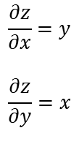

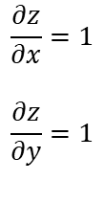

Back propagation of LSTM
Back propagation of ‘+’ node
No node that has value between 0 and 1
x
$\frac{∂L}{∂z}$ $\frac{∂z}{∂x}$
$$\frac{∂z}{∂x}=1$$
$$\frac{∂z}{∂y}=1$$
$C_{t−1}$
X
+
$C_{t}$
+
z
+
y
$$\frac{∂L}{∂z}$$
$\frac{∂L}{∂z}$ $\frac{∂z}{∂y}$
X
+
$$σ$$
$W_{f}$
Passes $\frac{∂L}{∂z}$
$b_{f}$
X
+
$$σ$$
$W_{g}$
X
Back propagation of ‘X’ node
$b_{g}$
tanh
X
+
tanh
$W_{i}$
$H_{t−1}$
+
$b_{i}$
x
$\frac{∂L}{∂z}$ $\frac{∂z}{∂x}$
$$\frac{∂z}{∂x}=y$$
$$\frac{∂z}{∂y}=x$$
X
+
$$σ$$
X
$H_{t}$
X
z
+
$W_{o}$
y
$b_{o}$
$\frac{∂L}{∂z}$ $\frac{∂z}{∂y}$
$$\frac{∂L}{∂z}$$
$X_{t}$
Assume that dim($X_{t}$) = dim($H_{t−1}$)
Passes $\frac{∂L}{∂z}x$, $\frac{∂L}{∂z}y$

Slide 9
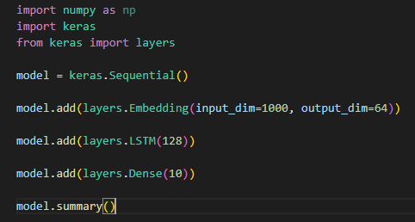
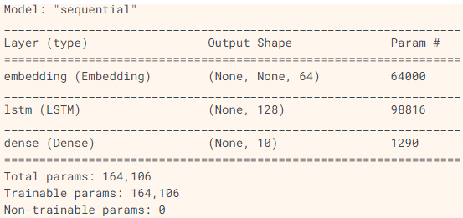
LSTM Example
Using LSTM
units = 128
units is a positive integer,
meaning dimension of output
Lots of parameters ! ( can be omitted )

Slide 10
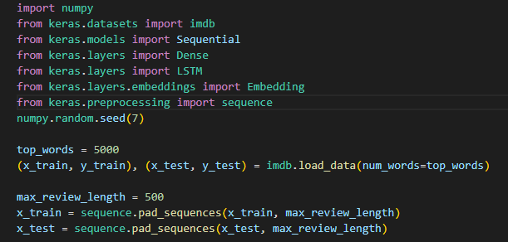
LSTM Example
Simple Sequence Classification
dataset is 5,000 words
And split into train and test sets
set input sequences length same
Value 0 => no information
Train data
Training
Validation data
Test
Test data

Slide 11
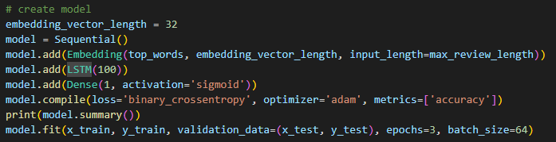
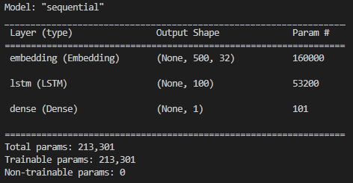
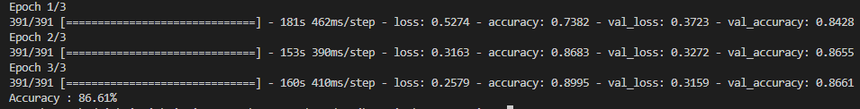
LSTM Example
Simple Sequence Classification

Slide 12
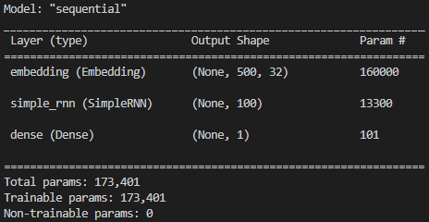
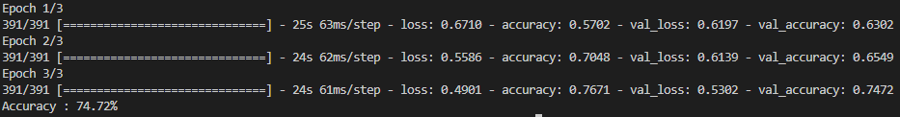
LSTM Example
Compare with SimpleRNN

Slide 13
References
오젤리앙 제롱. (2020). 핸즈온 머신러닝 (2e). 한빛미디어.
Keras API reference. LSTM layer ( https://keras.io/api/layers/recurrent_layers/lstm/ )
Jason Browniee. Jul 2016.
Sequence Classification with LSTM Recurrent Neural Networks in Python with Keras
( https://machinelearningmastery.com/sequence-classification-lstm-recurrent-neural-networks-python-keras/ )
최용석 교수. 딥러닝및응용 강의자료.
Stanford university CS231n lecture. Recurrent Neural Networks. ( https://cs231n.github.io/rnn/ )

