Slide 1
Translator Using Transformer
Translating Portuguese to English using Transformer
컴퓨터소프트웨어학부 심승현

Slide 2

Review : A Single Batch Training of Transformer
Encoder Layer $N−1$
…
Encoder Layer 0
Embedding
Positional Encoding
Input token ID sequence
Input string

Slide 3
Review : A Single Batch Training of Transformer
Encoder Layer $N−1$
…
Encoder Layer 0
Embedding
Positional Encoding
Input token ID sequence
‘obrigado .’

Slide 4
Review : A Single Batch Training of Transformer
Encoder Layer $N−1$
…
Encoder Layer 0
Embedding
Positional Encoding
[[1, 3, 4, 2, 0]]
‘obrigado .’

Slide 5
Review : A Single Batch Training of Transformer
Encoder Layer $N−1$
…
Encoder Layer 0
Embedding
Positional Encoding
[[1, 3, 4, 2, 0]]
start
‘obrigado .’

Slide 6
Review : A Single Batch Training of Transformer
Encoder Layer $N−1$
…
Encoder Layer 0
Embedding
Positional Encoding
[[1, 3, 4, 2, 0]]
[[1, 3, 4, 2, 0]]
‘obrigado .’

Slide 7
Review : A Single Batch Training of Transformer
Encoder Layer $N−1$
…
Encoder Layer 0
Embedding
Positional Encoding
[[1, 3, 4, 2, 0]]
end
‘obrigado .’

Slide 8
Review : A Single Batch Training of Transformer
Encoder Layer $N−1$
…
Encoder Layer 0
Embedding
Positional Encoding
[[1, 3, 4, 2, 0]]
pad token
‘obrigado .’

Slide 9
Review : A Single Batch Training of Transformer
Encoder Layer $N−1$
…
Encoder Layer 0
Embedding
Positional Encoding
[[1, 3, 4, 2, 0]]
‘obrigado .’

Slide 10

Review : A Single Batch Training of Transformer
Encoder Layer $N−1$
…
Encoder Layer 0
Input matrix
[[1, 3, 4, 2, 0]]
…
‘obrigado .’
$$d_{model}$$

Slide 11
Review : A Single Batch Training of Transformer
Encoder Layer $N−1$
…
Encoder Layer 0
Input matrix
[[1, 3, 4, 2, 0]]
…
input sequence length
input sequence length
‘obrigado .’
$$d_{model}$$

Slide 12
Review : A Single Batch Training of Transformer
Encoder Layer $N−1$
…
Encoder Layer 0
Multi Head Attention
Input matrix
[[1, 3, 4, 2, 0]]
…
input sequence length
input sequence length
‘obrigado .’
$$d_{model}$$

Slide 13

Review : A Single Batch Training of Transformer
Encoder Layer $N−1$
…
…
Encoder Layer 0
Multi Head Attention
$$d_{model}$$
Input matrix
[[1, 3, 4, 2, 0]]
…
input sequence length
input sequence length
‘obrigado .’
$$d_{model}$$

Slide 14
Review : A Single Batch Training of Transformer
Encoder Layer $N−1$
…
…
Encoder Layer 0
Multi Head Attention
depth
Input matrix
[[1, 3, 4, 2, 0]]
…
input sequence length
input sequence length
‘obrigado .’
$$d_{model}$$

Slide 15
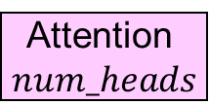
Review : A Single Batch Training of Transformer
Attention
1
Encoder Layer $N−1$
Attention
2
…
Attention$num_heads$
…
Encoder Layer 0
Multi Head Attention
depth
Input matrix
[[1, 3, 4, 2, 0]]
…
input sequence length
input sequence length
‘obrigado .’
$$d_{model}$$

Slide 16
Review : A Single Batch Training of Transformer
Encoder Layer $N−1$
…
…
Encoder Layer 0
Multi Head Attention
depth
Input matrix
[[1, 3, 4, 2, 0]]
…
input sequence length
input sequence length
‘obrigado .’
$$d_{model}$$

Slide 17
Review : A Single Batch Training of Transformer
Encoder Layer $N−1$
…
Concatenate
…
Encoder Layer 0
Multi Head Attention
$$d_{model}$$
Input matrix
[[1, 3, 4, 2, 0]]
…
input sequence length
input sequence length
‘obrigado .’
$$d_{model}$$

Slide 18

Review : A Single Batch Training of Transformer
Encoder Layer $N−1$
…
Encoder Layer 0
Multi Head Attention
Input matrix
…
input sequence length
[[1, 3, 4, 2, 0]]
input sequence length
‘obrigado .’
$$d_{model}$$

Slide 19
Review : A Single Batch Training of Transformer
Encoder Layer $N−1$
…
Pointwise Feed Forward Network
Encoder Layer 0
Multi Head Attention
Input matrix
…
input sequence length
[[1, 3, 4, 2, 0]]
input sequence length
‘obrigado .’
$$d_{model}$$

Slide 20
Review : A Single Batch Training of Transformer
…
Encoder Layer $N−1$
…
dff
Pointwise Feed Forward Network
Encoder Layer 0
Multi Head Attention
Input matrix
…
input sequence length
[[1, 3, 4, 2, 0]]
input sequence length
‘obrigado .’
$$d_{model}$$

Slide 21

Review : A Single Batch Training of Transformer
…
…
Encoder Layer $N−1$
…
dff
$$d_{model}$$
Pointwise Feed Forward Network
Encoder Layer 0
Multi Head Attention
Input matrix
…
input sequence length
[[1, 3, 4, 2, 0]]
input sequence length
‘obrigado .’
$$d_{model}$$

Slide 22
Review : A Single Batch Training of Transformer
input sequence length
…
Encoder Layer $N−1$
…
$$d_{model}$$
Pointwise Feed Forward Network
Encoder Layer 0
Multi Head Attention
Input matrix
[[1, 3, 4, 2, 0]]
input sequence length
‘obrigado .’

Slide 23

Review : A Single Batch Training of Transformer
Encoder Layer $N−1$
…
Encoder Layer 0
output matrix
…
input sequence length
Input matrix
[[1, 3, 4, 2, 0]]
$$d_{model}$$
input sequence length
‘obrigado .’

Slide 24
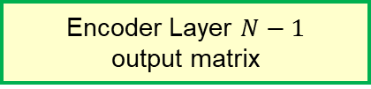
Review : A Single Batch Training of Transformer
Encoder Layer $N−1$
output matrix
…
Encoder Layer 0
output matrix
…
input sequence length
Input matrix
[[1, 3, 4, 2, 0]]
$$d_{model}$$
input sequence length
‘obrigado .’

Slide 25

Review : A Single Batch Training of Transformer
Encoder Layer $N−1$
output matrix
Decoder Layer $N−1$
…
Decoder Layer 0
Embedding
Positional Encoding
Target token ID sequence
Target string

Slide 26
Review : A Single Batch Training of Transformer
Encoder Layer $N−1$
output matrix
Decoder Layer $N−1$
…
Decoder Layer 0
Embedding
Positional Encoding
Target token ID sequence
‘thank you .’

Slide 27
Review : A Single Batch Training of Transformer
Encoder Layer $N−1$
output matrix
Decoder Layer $N−1$
…
Decoder Layer 0
Embedding
Positional Encoding
[[1, 3, 5, 4]]
‘thank you .’

Slide 28
Review : A Single Batch Training of Transformer
Encoder Layer $N−1$
output matrix
Decoder Layer $N−1$
…
Decoder Layer 0
Embedding
Positional Encoding
[[1, 3, 5, 4]]
[[1, 3, 5, 4, 2]]
‘thank you .’
start
end

Slide 29
Review : A Single Batch Training of Transformer
Encoder Layer $N−1$
output matrix
Decoder Layer $N−1$
…
Decoder Layer 0
Embedding
Positional Encoding
[[3, 5, 4, 2]]
[[1, 3, 5, 4]]
Train data
[:, :-1]
[[1, 3, 5, 4, 2]]
‘thank you .’

Slide 30
Review : A Single Batch Training of Transformer
Encoder Layer $N−1$
output matrix
Decoder Layer $N−1$
…
Decoder Layer 0
Truth
Embedding
Positional Encoding
[[3, 5, 4, 2]]
[[1, 3, 5, 4]]
[:, 1:]
[[1, 3, 5, 4, 2]]
‘thank you .’

Slide 31
Review : A Single Batch Training of Transformer
Encoder Layer $N−1$
output matrix
Decoder Layer $N−1$
…
Decoder Layer 0
Embedding
Positional Encoding
[[1, 3, 5, 4]]
‘thank you .’

Slide 32

Review : A Single Batch Training of Transformer
Encoder Layer $N−1$
output matrix
Decoder Layer $N−1$
…
Decoder Layer 0
Input matrix
[[1, 3, 5, 4]]
target sequence length
…
target sequence length
‘thank you .’
$$d_{model}$$

Slide 33
Review : A Single Batch Training of Transformer
Encoder Layer $N−1$
output matrix
Decoder Layer $N−1$
…
Decoder Layer 0
Multi Head Attention
Input matrix
[[1, 3, 5, 4]]
target sequence length
…
target sequence length
‘thank you .’
$$d_{model}$$

Slide 34
Review : A Single Batch Training of Transformer
Encoder Layer $N−1$
output matrix
Decoder Layer $N−1$
…
Decoder Layer 0
Multi Head Attention
Input matrix
[[1, 3, 5, 4]]
target sequence length
…
target sequence length
‘thank you .’
depth

Slide 35
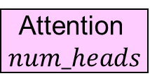
Review : A Single Batch Training of Transformer
Encoder Layer $N−1$
output matrix
Decoder Layer $N−1$
…
Decoder Layer 0
Multi Head Attention
Input matrix
Attention
1
…
[[1, 3, 5, 4]]
target sequence length
…
Attention$num_heads$
target sequence length
‘thank you .’
depth

Slide 36
Review : A Single Batch Training of Transformer
Encoder Layer $N−1$
output matrix
Decoder Layer $N−1$
…
target sequence length
Decoder Layer 0
Multi Head Attention
Input matrix
Attention
1
…
look ahead mask
[[1, 3, 5, 4]]
target sequence length
…
Attention$num_heads$
target sequence length
‘thank you .’
depth

Slide 37
Review : A Single Batch Training of Transformer
Encoder Layer $N−1$
output matrix
Decoder Layer $N−1$
…
target sequence length
Decoder Layer 0
Multi Head Attention
Input matrix
look ahead mask
[[1, 3, 5, 4]]
target sequence length
…
target sequence length
‘thank you .’
depth

Slide 38
Review : A Single Batch Training of Transformer
Encoder Layer $N−1$
output matrix
Decoder Layer $N−1$
…
Decoder Layer 0
Multi Head Attention
Input matrix
Concatenate
[[1, 3, 5, 4]]
target sequence length
…
target sequence length
‘thank you .’
$$d_{model}$$

Slide 39
Review : A Single Batch Training of Transformer
Encoder Layer $N−1$
output matrix
Decoder Layer $N−1$
…
Decoder Layer 0
Multi Head Attention
Input matrix
[[1, 3, 5, 4]]
target sequence length
…
target sequence length
‘thank you .’
$$d_{model}$$

Slide 40
Review : A Single Batch Training of Transformer
Encoder Layer $N−1$
output matrix
Decoder Layer $N−1$
…
Decoder Layer 0
Multi Head Attention
Multi Head Attention
Input matrix
[[1, 3, 5, 4]]
target sequence length
…
target sequence length
‘thank you .’
$$d_{model}$$

Slide 41
Review : A Single Batch Training of Transformer
Encoder Layer $N−1$
output matrix
Decoder Layer $N−1$
…
input sequence length
…
Decoder Layer 0
Multi Head Attention
Multi Head Attention
Input matrix
[[1, 3, 5, 4]]
target sequence length
…
target sequence length
‘thank you .’
$$d_{model}$$

Slide 42
Review : A Single Batch Training of Transformer
Encoder Layer $N−1$
output matrix
Decoder Layer $N−1$
…
input sequence length
…
Decoder Layer 0
Multi Head Attention
Multi Head Attention
Input matrix
[[1, 3, 5, 4]]
target sequence length
…
target sequence length
‘thank you .’
depth

Slide 43

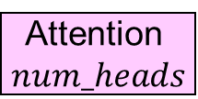
Review : A Single Batch Training of Transformer
Encoder Layer $N−1$
output matrix
Decoder Layer $N−1$
…
Attention
1
input sequence length
…
Decoder Layer 0
…
Multi Head Attention
Multi Head Attention
Attention$num_heads$
Input matrix
Attention
1
[[1, 3, 5, 4]]
target sequence length
…
…
Attention$num_heads$
target sequence length
‘thank you .’
depth

Slide 44
Review : A Single Batch Training of Transformer
Encoder Layer $N−1$
output matrix
Decoder Layer $N−1$
…
Decoder Layer 0
Multi Head Attention
Multi Head Attention
Input matrix
[[1, 3, 5, 4]]
target sequence length
…
target sequence length
‘thank you .’
depth

Slide 45

Review : A Single Batch Training of Transformer
Encoder Layer $N−1$
output matrix
Decoder Layer $N−1$
…
Decoder Layer 0
Multi Head Attention
Multi Head Attention
Concatenate
Input matrix
target sequence length
…
[[1, 3, 5, 4]]
$$d_{model}$$
target sequence length
‘thank you .’

Slide 46
Review : A Single Batch Training of Transformer
Encoder Layer $N−1$
output matrix
Decoder Layer $N−1$
…
Decoder Layer 0
Multi Head Attention
Multi Head Attention
Input matrix
target sequence length
…
[[1, 3, 5, 4]]
$$d_{model}$$
target sequence length
‘thank you .’

Slide 47
Review : A Single Batch Training of Transformer
Encoder Layer $N−1$
output matrix
Decoder Layer $N−1$
…
Pointwise Feed Forward Network
Decoder Layer 0
Multi Head Attention
Multi Head Attention
Input matrix
target sequence length
…
[[1, 3, 5, 4]]
$$d_{model}$$
target sequence length
‘thank you .’

Slide 48
Review : A Single Batch Training of Transformer
Encoder Layer $N−1$
output matrix
Decoder Layer $N−1$
…
Pointwise Feed Forward Network
Decoder Layer 0
Multi Head Attention
Multi Head Attention
Input matrix
target sequence length
…
[[1, 3, 5, 4]]
$$d_{model}$$
target sequence length
‘thank you .’

Slide 49
Review : A Single Batch Training of Transformer
Encoder Layer $N−1$
output matrix
Decoder Layer $N−1$
…
Decoder Layer 0
output matrix
Input matrix
target sequence length
…
[[1, 3, 5, 4]]
$$d_{model}$$
target sequence length
‘thank you .’

Slide 50
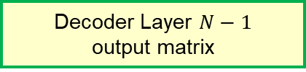

Review : A Single Batch Training of Transformer
Encoder Layer $N−1$
output matrix
Decoder Layer $N−1$
output matrix
…
target sequence length
…
Decoder Layer 0
output matrix
Input matrix
$$d_{model}$$
[[1, 3, 5, 4]]
target sequence length
‘thank you .’

Slide 51
Review : A Single Batch Training of Transformer
Decoder Layer $N−1$
output matrix
target sequence length
…
$$d_{model}$$

Slide 52
Review : A Single Batch Training of Transformer
Decoder Layer $N−1$
output matrix
Final Layer
target sequence length
…
$$d_{model}$$

Slide 53
Review : A Single Batch Training of Transformer
Decoder Layer $N−1$
output matrix
Output matrix
target sequence length
…
…
$$d_{model}$$
number of target language vocabulary

Slide 54
Review : A Single Batch Training of Transformer
Decoder Layer $N−1$
output matrix
Output matrix
target sequence length
…
start
thank
…
you
$$d_{model}$$
.
number of target language vocabulary
For each words (column),
the value in this matrix means
probability of prediction on which word will appear next

Slide 55
Review : A Single Batch Training of Transformer
Decoder Layer $N−1$
output matrix
Output matrix
target sequence length
…
start
thank
…
you
Find max value
$$d_{model}$$
.
number of target language vocabulary
For each words (column),
the value in this matrix means
probability of prediction on which word will appear next

Slide 56
Review : A Single Batch Training of Transformer
Decoder Layer $N−1$
output matrix
Output matrix
target sequence length
…
start
3
thank
…
5
you
3
$$d_{model}$$
.
2
number of target language vocabulary
For each words (column),
the value in this matrix means
probability of prediction on which word will appear next

Slide 57
Review : A Single Batch Training of Transformer
Decoder Layer $N−1$
output matrix
Output matrix
token ID of prediction
target sequence length
…
start
3
thank
…
5
you
3
$$d_{model}$$
.
2
number of target language vocabulary
For each words (column),
the value in this matrix means
probability of prediction on which word will appear next

Slide 58
Review : A Single Batch Training of Transformer
Decoder Layer $N−1$
output matrix
Output matrix
truth
prediction
target sequence length
…
start
3
3
thank
5
…
5
you
4
3
$$d_{model}$$
.
2
2
number of target language vocabulary
For each words (column),
the value in this matrix means
probability of prediction on which word will appear next

Slide 59
Review : A Single Batch Training of Transformer
Decoder Layer $N−1$
output matrix
Output matrix
truth
prediction
target sequence length
…
start
3
3
thank
5
…
5
you
4
3
$$d_{model}$$
.
2
Loss
2
number of target language vocabulary
For each words (column),
the value in this matrix means
probability of prediction on which word will appear next

Slide 60
Review : A Single Batch Training of Transformer
Decoder Layer $N−1$
output matrix
Output matrix
truth
prediction
target sequence length
…
start
3
3
thank
5
…
5
you
4
3
$$d_{model}$$
.
2
Loss
2
Back Propagation
number of target language vocabulary
For each words (column),
the value in this matrix means
probability of prediction on which word will appear next

Slide 61
Complements : Why positional encoding ?
▶ Transformer do not use recurrence, convolution, only attention

Slide 62
Complements : Why positional encoding ?
▶ Transformer do not use recurrence, convolution, only attention
▶ The whole sentence will be processed parallely, in a matrix
▷ How about giving some position information in addition ?

Slide 63
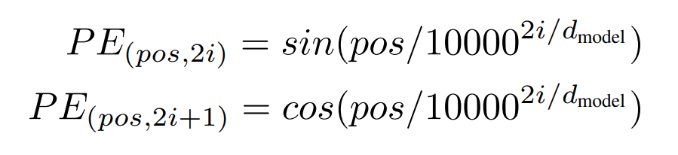
Complements : Why positional encoding ?
▶ Then, why do we get positional encoding as
▶ and add this to embedding matrix?

Slide 64
Complements : Why positional encoding ?
▶ In a empirical method, it is one of the correction of attention

Slide 65
Complements : Why positional encoding ?
▶ In a empirical method, it is one of the correction of attention
I
sometimes allow my
dog
to bark
because
I
found that
it
makes
her
feel free

Slide 66
Complements : Why positional encoding ?
▶ In a empirical method, it is one of the correction of attention
I
sometimes allow my
dog
to bark
because
I
found that
it
makes
her
feel free
it
her

Slide 67
Complements : Why positional encoding ?
▶ In a empirical method, it is one of the correction of attention
I
sometimes allow my
dog
to bark
because
I
found that
it
makes
her
feel free
it
her
Model decides where to attention
and position can be a critical criterion

Slide 68
Complements : Why positional encoding ?
▶ Why do we use this function?

Slide 69

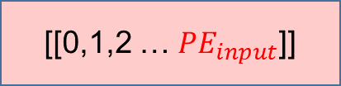
Complements : Why positional encoding ?
▶ Why do we use this function?
[[0],[1],[2] … [$d_{model}]]$
integer
[[0,1,2 … $PE_{input}$]]

Slide 70
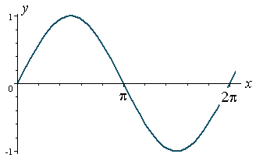
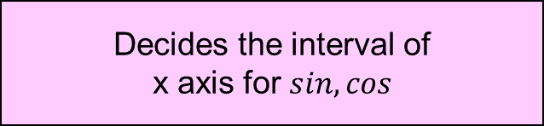
Complements : Why positional encoding ?
Decides the interval of
x axis for $sin, cos$
▶ Why do we use this function?
consists of
consecutive integers

Slide 71
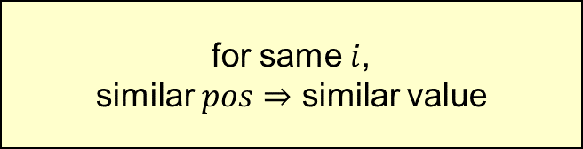

Complements : Why positional encoding ?
Decides the interval of
x axis for $sin, cos$
▶ Why do we use this function?
consists of
consecutive integers
for same $i$,
similar $pos⇒$ similar value
$$x=\frac{pos}{{10000}^{\frac{2i}{d_{model}}}}$$

Slide 72
Complements : Why positional encoding ?
Decides the interval of
x axis for $sin, cos$
▶ Why do we use this function?
consists of
consecutive integers
for same $i$,
similar $pos⇒$ similar value
Similar value for the words in similar position
$$x=\frac{pos}{{10000}^{\frac{2i}{d_{model}}}}$$

Slide 73
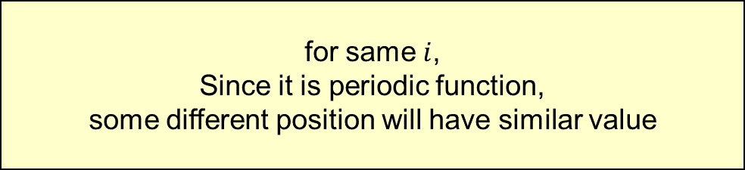
Complements : Why positional encoding ?
Decides the interval of
x axis for $sin, cos$
▶ Why do we use this function?
consists of
consecutive integers
for same $i$,
Since it is periodic function,
some different position will have similar value
$$x=\frac{pos}{{10000}^{\frac{2i}{d_{model}}}}$$

Slide 74
Complements : Why positional encoding ?
Decides the interval of
x axis for $sin, cos$
▶ Why do we use this function?
consists of
consecutive integers
for same $i$,
Since it is periodic function,
some different position will have similar value
Similar value for the words in different position
$$x=\frac{pos}{{10000}^{\frac{2i}{d_{model}}}}$$

Slide 75
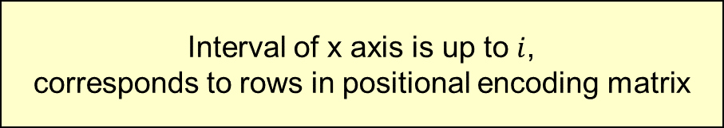
Complements : Why positional encoding ?
Decides the interval of
x axis for $sin, cos$
▶ Why do we use this function?
consists of
consecutive integers
Interval of x axis is up to $i$,
corresponds to rows in positional encoding matrix

Slide 76
Complements : Why positional encoding ?
Decides the interval of
x axis for $sin, cos$
▶ Why do we use this function?
consists of
consecutive integers
Different rows in an positional encoding matrix
will have different representation of position
Interval of x axis is up to $i$,
corresponds to rows in positional encoding matrix

Slide 77


Complements : Why positional encoding ?
$$i$$
$$pos$$
Different rows in an positional encoding matrix
will have different representation of position
Interval of x axis is up to $i$,
corresponds to rows in positional encoding matrix

Slide 78


Complements : Why Multi Head Attention ?
$$d_{model}$$
$$d_{model}$$
$$pos$$
$$pos$$
multi head attention
single head attention

Slide 79


Complements : Why Multi Head Attention ?
$$d_{model}$$
$$d_{model}$$
$$pos$$
$$pos$$
multi head attention
single head attention

Slide 80
Complements : Why Multi Head Attention ?
$$d_{model}$$
$$d_{model}$$
$$pos$$
$$pos$$
multi head attention
single head attention

Slide 81
Complements : Why Multi Head Attention ?
$$d_{model}$$
$$d_{model}$$
$$pos$$
$$pos$$
multi head attention
single head attention

Slide 82
Complements : Why Multi Head Attention ?
$$d_{model}$$
$$d_{model}$$
$$pos$$
$$pos$$
multi head attention
single head attention
Multi head attention conserves different representations

Slide 83
Train Step

Slide 84
Train Step
Dataset

Slide 85
Train Step
Dataset
Batch
Batch
Batch
Batch
Batch
Batch
Batch
Batch
Batch
Batch
Batch
Batch
Batch
Batch
Batch
Batch

Slide 86
Train Step
Dataset
Batch
Train
Batch
Batch
Batch
Batch
Batch
Batch
Batch
Batch
Batch
Batch
Batch
Batch
Batch
Batch
Batch

Slide 87
Train Step
Dataset
Batch
Batch
Train
Batch
Batch
Batch
Batch
Batch
Batch
Batch
Batch
Batch
Batch
Batch
Batch
Batch
Batch

Slide 88
Train Step
Dataset
Batch
Batch
Batch
Train
Batch
Batch
Batch
Batch
Batch
Batch
Batch
Batch
Batch
Batch
Batch
Batch
Batch

Slide 89
Train Step
Dataset
Batch
Batch
Batch
Batch
Batch
Batch
Batch
Batch
Batch
Batch
Batch
Batch
Batch
Batch
Batch
Batch
Train

Slide 90
Train Step
Dataset
Batch
Batch
Batch
Batch
Batch
Batch
Batch
Batch
Batch
Batch
Batch
1 Epoch
Batch
Batch
Batch
Batch
Batch
Train

Slide 91
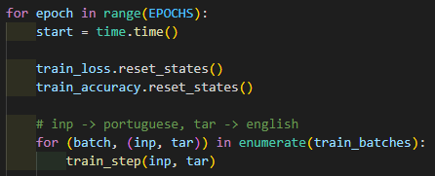
Train Step
Dataset
Batch
Batch
Batch
Batch
Batch
Train code
Batch
Batch
Batch
Batch
Batch
Batch
1 Epoch
Batch
Batch
Batch
Batch
Batch
Train

Slide 92

Train Step

Slide 93
Train Step
( [[obrigado], [este e um problema] ... [pt]],
[[thank you], [this is a problem] ... [en]] )
batch size

Slide 94
Train Step
train for all batches

Slide 95
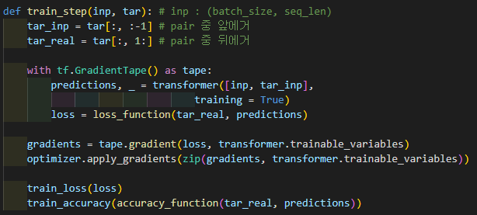
Train Step
train for all batches

Slide 96
Train Step
[[1, 3, 5, 4, 2]]
tar_inp
tar_real
[[1, 3, 5, 4]]
[[3, 5, 4, 2]]
train data
truth

Slide 97
Train Step
▶ GradientTape() is an object
that records every opration in its context

Slide 98
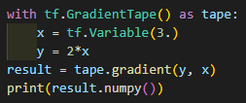

Train Step
▶ GradientTape() is an object
that records every opration in its context
$\frac{dy}{dx}$
prints 2

Slide 99
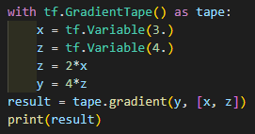
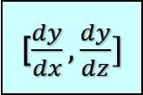
Train Step
▶ GradientTape() is an object
that records every opration in its context
[$\frac{dy}{dx},\frac{dy}{dz}]$
prints [8, 4]

Slide 100
Train Step
▶ use transformer,
predictions output probability matrix

Slide 101
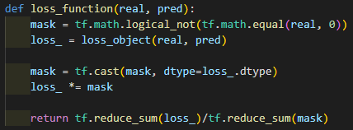
Train Step

Slide 102
Train Step
real : truth
pred : output of transformer

Slide 103
Train Step
real : truth
pred : output of transformer
real
pred
[[3, 1, 3, 2]]
[[0, 0, .1, 0]
[0, .1, 0, 0]
[0, 0, .1, 0]
[0, 0, 0, .1]]

Slide 104
Train Step
real
pred
[[3, 1, 3, 2]]
[[0, 0, .1, 0]
[0, .1, 0, 0]
[0, 0, .1, 0]
[0, 0, 0, .1]]
[[True, True, True, True]]
mask
[[1, 1, 1, 1]]

Slide 105
Train Step
real
[[2, 1, 0, 0]]
[[True, True, False, False]]
mask
[[1, 1, 0, 0]]

Slide 106
Train Step
real
[[2, 1, 0, 0]]
[[True, True, False, False]]
mask
[[1, 1, 0, 0]]
Don’t calculate Loss
for pad token

Slide 107

Train Step
real
pred
[[3, 1, 3, 2]]
[[0, 0, .1, 0]
[0, .1, 0, 0]
[0, 0, .1, 0]
[0, 0, 0, .1]]
for each words,
calculate loss

Slide 108
Train Step
multiply 0 for pad token

Slide 109
Train Step
multiply 0 for pad token
loss_
[[1.42, 1.79, 1.61, 0.98]]
[[1, 1, 0, 0]]
[[1.42, 1.79, 0, 0]]

Slide 110
Train Step
multiply 0 for pad token
loss_
[[1.42, 1.79, 1.61, 0.98]]
[[1, 1, 0, 0]]
[[1.42, 1.79, 0, 0]]
Loss for only existing words

Slide 111
Train Step
reduce_sum(mask) = 1 + 1
mask
[[1, 1, 0, 0]]
reduce_sum(loss_) = 1.42 + 1.79
loss_
[[1.42, 1.79, 0, 0]]

Slide 112
Train Step
number of words
reduce_sum(mask) = 1 + 1
mask
[[1, 1, 0, 0]]
reduce_sum(loss_) = 1.42 + 1.79
loss_
[[1.42, 1.79, 0, 0]]
sum of loss

Slide 113
Train Step

Slide 114
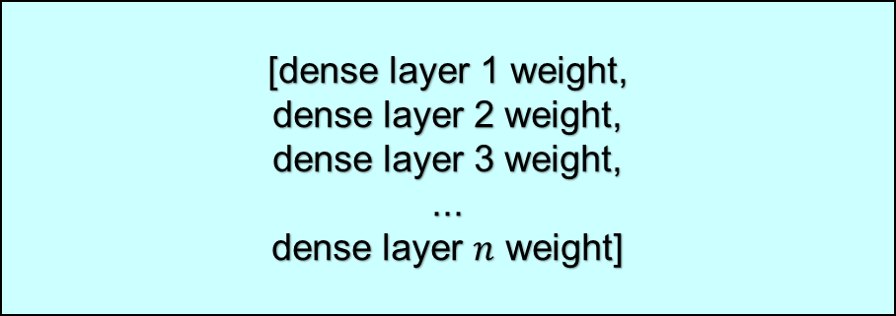
Train Step
trainable_variables :
weight, and bias for dense layers in transformer
[dense layer 1 weight,
dense layer 2 weight,
dense layer 3 weight,
...
dense layer $n$ weight]

Slide 115

Train Step
trainable_variables :
weight, and bias for dense layers in transformer
[dense layer 1 weight,
dense layer 2 weight,
dense layer 3 weight,
...
dense layer $n$ weight]
$$\frac{d\left(loss\right)}{d\left(weight_{1}\right)}$$

Slide 116

Train Step
trainable_variables :
weight, and bias for dense layers in transformer
[dense layer 1 weight,
dense layer 2 weight,
dense layer 3 weight,
...
dense layer $n$ weight]
$$\frac{d\left(loss\right)}{d\left(weight_{2}\right)}$$

Slide 117

Train Step
trainable_variables :
weight, and bias for dense layers in transformer
[dense layer 1 weight,
dense layer 2 weight,
dense layer 3 weight,
...
dense layer $n$ weight]
$$\frac{d\left(loss\right)}{d\left(weight_{3}\right)}$$

Slide 118

Train Step
trainable_variables :
weight, and bias for dense layers in transformer
[dense layer 1 weight,
dense layer 2 weight,
dense layer 3 weight,
...
dense layer $n$ weight]
$$\frac{d\left(loss\right)}{d\left(weight_{n}\right)}$$

Slide 119
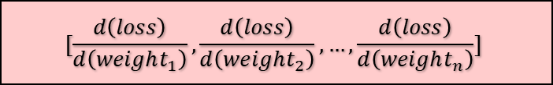
Train Step
trainable_variables :
weight, and bias for dense layers in transformer
[dense layer 1 weight,
dense layer 2 weight,
dense layer 3 weight,
...
dense layer $n$ weight]
gradients
$$[\frac{d\left(loss\right)}{d\left(weight_{1}\right)},\frac{d\left(loss\right)}{d\left(weight_{2}\right)}, …,\frac{d\left(loss\right)}{d\left(weight_{n}\right)}]$$

Slide 120
Train Step
[dense layer 1 weight,
dense layer 2 weight,
dense layer 3 weight,
...
dense layer $n$ weight]
gradients
$$[\frac{d\left(loss\right)}{d\left(weight_{1}\right)},\frac{d\left(loss\right)}{d\left(weight_{2}\right)}, …,\frac{d\left(loss\right)}{d\left(weight_{n}\right)}]$$

Slide 121
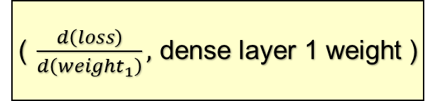
Train Step
( $\frac{d\left(loss\right)}{d\left(weight_{1}\right)},$dense layer 1 weight )
[dense layer 1 weight,
dense layer 2 weight,
dense layer 3 weight,
...
dense layer $n$ weight]
gradients
$$[\frac{d\left(loss\right)}{d\left(weight_{1}\right)},\frac{d\left(loss\right)}{d\left(weight_{2}\right)}, …,\frac{d\left(loss\right)}{d\left(weight_{n}\right)}]$$

Slide 122
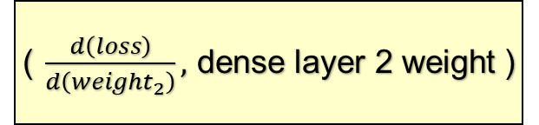
Train Step
( $\frac{d\left(loss\right)}{d\left(weight_{1}\right)},$dense layer 1 weight )
( $\frac{d\left(loss\right)}{d\left(weight_{2}\right)},$dense layer 2 weight )
[dense layer 1 weight,
dense layer 2 weight,
dense layer 3 weight,
...
dense layer $n$ weight]
gradients
$$[\frac{d\left(loss\right)}{d\left(weight_{1}\right)},\frac{d\left(loss\right)}{d\left(weight_{2}\right)}, …,\frac{d\left(loss\right)}{d\left(weight_{n}\right)}]$$

Slide 123
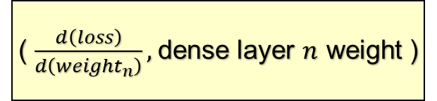
Train Step
( $\frac{d\left(loss\right)}{d\left(weight_{1}\right)},$dense layer 1 weight )
( $\frac{d\left(loss\right)}{d\left(weight_{2}\right)},$dense layer 2 weight )
...
( $\frac{d\left(loss\right)}{d\left(weight_{n}\right)},$dense layer $n$ weight )
[dense layer 1 weight,
dense layer 2 weight,
dense layer 3 weight,
...
dense layer $n$ weight]
gradients
$$[\frac{d\left(loss\right)}{d\left(weight_{1}\right)},\frac{d\left(loss\right)}{d\left(weight_{2}\right)}, …,\frac{d\left(loss\right)}{d\left(weight_{n}\right)}]$$

Slide 124
Train Step
( $\frac{d\left(loss\right)}{d\left(weight_{1}\right)},$dense layer 1 weight )
( $\frac{d\left(loss\right)}{d\left(weight_{2}\right)},$dense layer 2 weight )
...
( $\frac{d\left(loss\right)}{d\left(weight_{n}\right)},$dense layer $n$ weight )
▶ Back Propagation

Slide 125

Train Step
tf.keras.metrics.Mean object
contains the mean value of inputs

Slide 126

Train Step
tf.keras.metrics.Mean object
contains the mean value of inputs
mean value

Slide 127
Train Step
accuracy_function
correct prediction / number of words
tf.keras.metrics.Mean object
contains the mean value of inputs
mean value

Slide 128
Train Step
accuracy_function
correct prediction / number of words
returns the hit ratio of prediction
tf.keras.metrics.Mean object
contains the mean value of inputs
mean value

Slide 129
Train Step
▶ Train step for one batch over,
and train next batch

Slide 130
Train Step
▶ through single batch train, we calculated loss,
and edit weights through back propagation
▶ Same step for whole batch,
Same step for Epochs
▶ Train step for one batch over,
and train next batch

Slide 131
Translator with Trained Transformer

Slide 132
Translator with Trained Transformer
▶ Our goal is to translate input Portuguese sentence, to English sentence.
Like this!
input
obrigado .
output
thank you .

Slide 133
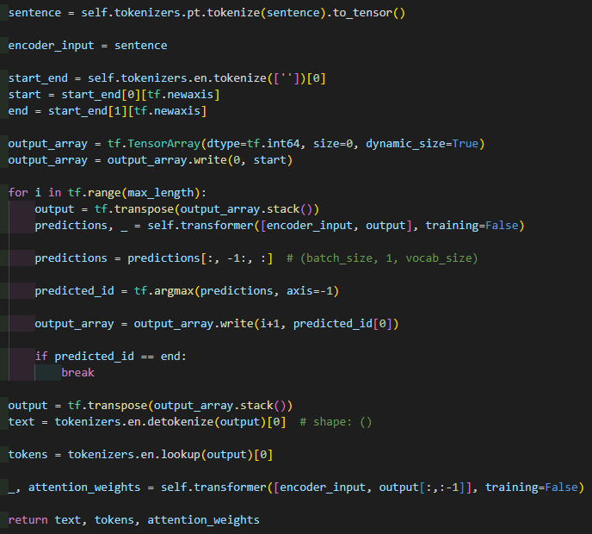
Translator with Trained Transformer
▶ Input is a Portuguese sentence
input
obrigado .

Slide 134
Translator with Trained Transformer
▶ Input is a Portuguese sentence
input
obrigado .
▶ Encoder input is tokenized tensor for input
encoder_input
[1, 2, 3, 4]

Slide 135
Translator with Trained Transformer
empty string

Slide 136
Translator with Trained Transformer
empty string
start_end
[sos, eos]

Slide 137
Translator with Trained Transformer
empty string
start_end
[sos, eos]
[sos]
[eos]
start
end
▶ start : sos token
end : eos token

Slide 138
Translator with Trained Transformer
▶ output_array is empty array
write(0, start)
index
data

Slide 139
Translator with Trained Transformer
▶ output_array is empty array
write(0, start)
index
data
output_array
[[sos]]

Slide 140
Translator with Trained Transformer
output_array
[[sos]]

Slide 141
Translator with Trained Transformer
output_array
[[sos]]
output
[[sos]]
transformer will have the prediction of the next word of output

Slide 142
Translator with Trained Transformer
output_array
[[sos]]
predictions
[[[0, 0, 1, 0, 0]
[0, 1, 0, 0, 0]
...
[0, 0, 0, 1, 0]]]
predictions for the next word

Slide 143
Translator with Trained Transformer
output_array
[[sos]]
predicted_id
[2]
tf.argmax returns the index of max value
x = [0, 1, 3, 2, 0, 1, 0]
tf.argmax(x) = 2

Slide 144
Translator with Trained Transformer
output_array
[[sos]]
tf.argmax returns the index of max value
x = [[0, 1, 3, 2, 0, 1, 0], [4, 0, 0, 0, 0, 0, 0]]
tf.argmax(x) = [1, 0, 0, 0, 0, 0, 0]

Slide 145
Translator with Trained Transformer
output_array
[[sos]]
tf.argmax returns the index of max value
x = [[0, 1, 3, 2, 0, 1, 0], [4, 0, 0, 0, 0, 0, 0]]
tf.argmax(x, axis = -1) = [2, 0]
for every prediction in batch,
get the index max probability value

Slide 146
Translator with Trained Transformer
output_array
[[sos]]
predicted_id
[2]

Slide 147
Translator with Trained Transformer
output_array
[[sos],
[2]]

Slide 148
Translator with Trained Transformer
output_array
[[sos],
[2]]
output
[[sos, 2]]

Slide 149
Translator with Trained Transformer
output_array
[[sos],
[2],
[1]
...]]
output
[[sos, 2, 1, ...]]

Slide 150
Translator with Trained Transformer
output_array
[[sos],
[2],
[1]
...]]
output
[[sos, 2, 1, ...]]

Slide 151
Translator with Trained Transformer
output_array
[[sos, sos],
[2, 3],
[1, 4]
...]]
If batch size = 2
output
[[sos, 2, 1, ...]
[sos, 3, 4, ...]]

Slide 152
Translator with Trained Transformer
detokenize : ‘thank you .’
lookup : [thank, you, .]
output
[[sos, 2, 1, ...]]

Slide 153
Translator with Trained Transformer

Slide 154
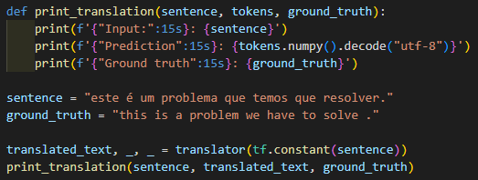

Translator with Trained Transformer

Slide 155
Thank you

