Slide 1

BACHELOR THESIS DEFENSE
Design and Implementation of a Full-Stack
Web-Based Recruitment Platform
for Students and Employers
A centralized platform for the recruitment round trip — from application to decision
Phung Dam Tien Si · 23BI14384
External Supervisor: Eng. Dinh Viet Ha · Internal Supervisor: Prof. Dr. Giang Anh Tuan
Hanoi, 2026
Notes:
Hook (15s): 'Every candidate I know has applied to the same job on three platforms. This thesis builds one place where the whole recruitment round trip — from application to decision — actually lives.' Do not read the title. Move on.

Slide 2
INTRODUCTION — WHY RECRUITMENT
Recruitment is broken at scale
35%
~44 days
≈7 sec
of Vietnamese professionals are job-hunting right now
average time from posting to accepted offer
a recruiter spends screening one resume
Michael Page, 2023
Global recruiter survey, 2023
Ladders eye-tracking, 2018
The friction: candidates recreate profiles and resumes on every platform and check each one separately — employers stitch postings, applications and decisions together by hand.
How I began — self-taught, then a process
Learn SDLC from scratch
Use-case-driven loop
Backend-first, deliberately
→
→
no formal process — studied the fundamentals first
document → implement → write every surprise back
my goal is Backend Engineering
2 / 9
Notes:
Why Recruitment — 1:45–2:00. Story first: I kept watching friends grind the same application across 3–4 websites, and employers drowning in resumes they screen in seconds. Read the three numbers as a sequence: 35% of the workforce is hunting right now; a posting takes ~44 days to fill; a single resume gets ~7 seconds. Good — thank the sources. Then the friction line. How I began (the personal note): I had no formal SDLC background; I taught myself the fundamentals, then locked onto a use-case-driven loop — document a group, implement backend-first, write any surprise back into the docs. Save the career motive for the demo slide.

Slide 3
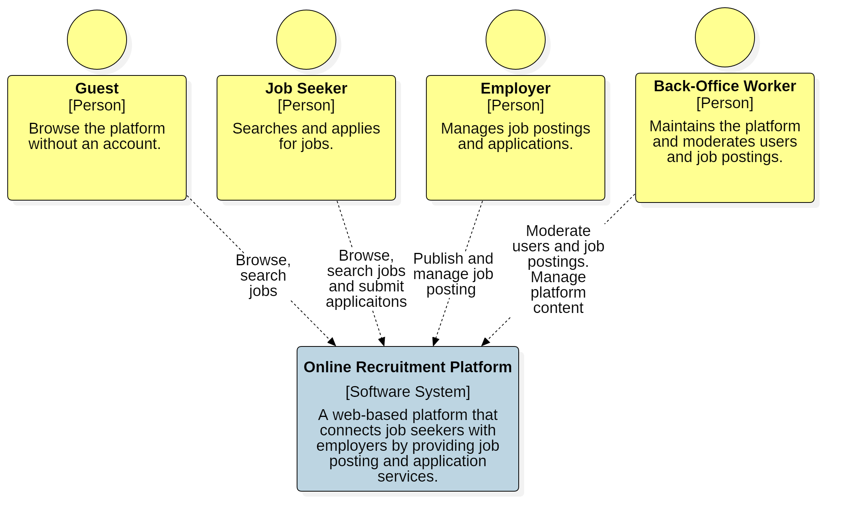
GOAL & SCOPE
One platform for the whole round trip
Job seekers: search jobs, apply with a resume, track and withdraw applications.
Employers: manage a company, publish postings, run them through their lifecycle, review applications to a decision.
Administration: moderation, user management, audit logs.
TWO FLOWS IN DEPTH
Job Application (seeker) + Employer Job Management (employer) — together the recruitment round trip.
System context — three actors around one platform
8 modules built in total; the supporting ones are implemented and summarized, not dissected.
3 / 9
Notes:
Goal & scope — ~1:00. One sentence: the platform is one place for the whole round trip; two of the eight modules — Job Application and Employer Job Management — are examined in depth, and they complete each other: a seeker applies, an employer decides. Everything else (auth, profile, resume, discovery, admin) is built and described briefly. Point at the context diagram: three actors, one system.

Slide 4
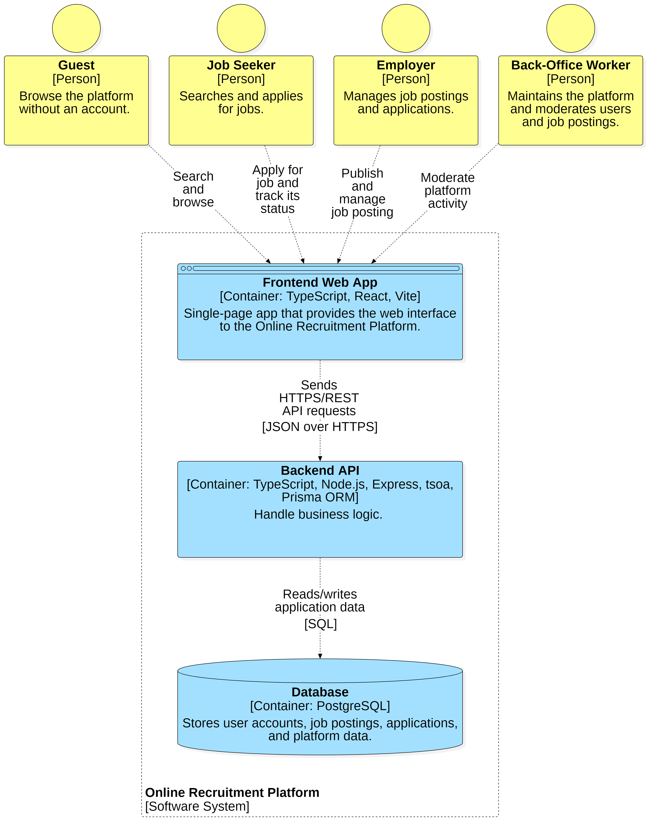
SYSTEM DESIGN — ARCHITECTURE
Contract-first monorepo
pnpm monorepo — two apps, one contract.
Backend (apps/api): Express 5 + TypeScript; tsoa generates the OpenAPI spec and the routes from annotated controllers; Prisma → PostgreSQL.
Frontend (apps/web): React 19 + Vite; a typed API client is regenerated from the same OpenAPI spec; Tailwind + shadcn/ui.
Why this matters: one source of truth for request/response types.
Change a response shape on the server and the client type updates at the next build — the two sides can never drift.
C2 — the two containers
4 / 9
Notes:
Architecture — ~1:30. The one idea to drive home: contract-first. tsoa reads decorators on the controllers and emits both the route table and swagger.json; the web client is generated from that same file. So a change on the server shows up in the client's types at the next build — they cannot drift. Backend owns all rules (controller stays thin, service holds business logic, defense-in-depth role checks). Keep it to three bullets and the container diagram.

Slide 5
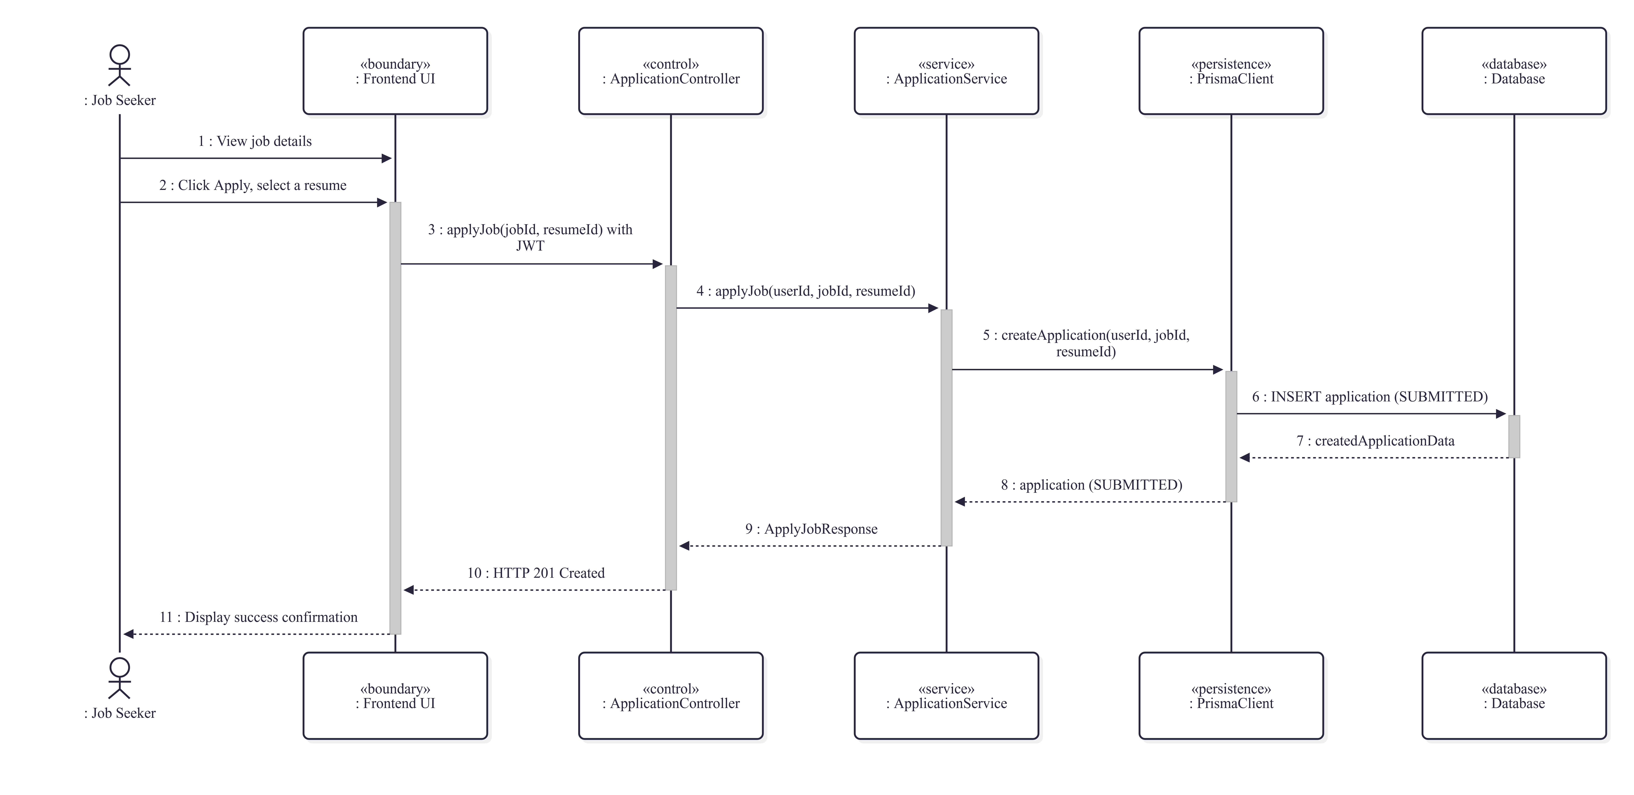
SYSTEM DESIGN — THE ROUND TRIP
Two flows, modeled before code
1 · Job Seeker applies — happy path
2 · Employer reviews → status transitions
5 / 9
Notes:
Design, the round trip — ~1:30. These are the happy-path sequence diagrams, shown exactly as modeled before implementation (the guarded full versions are in the paper). Left: the seeker applies — controller → service → Prisma → 201, application created as SUBMITTED. Right: the employer works through three steps — list, mark UNDER_REVIEW, decide ACCEPTED or REJECTED. Every guard (401/403/404/409) was documented; for the slide we show only the flow you're about to see live.

Slide 6
LIVE DEMO
One application, end to end
1 · Job Seeker
2 · Employer
3 · Both sides
search the right posting → apply with a saved resume → watch it land in My Applications
open the same posting → review the application → mark UNDER_REVIEW → decide ACCEPTED
the status ripples back to the seeker's tracker — same browser, two roles
Runs locally: apps/api on :3000 (Swagger at /docs) · apps/web on :5173 · seeded data — 3 companies, 12 postings, fixed accounts and passwords.
Target: ~2 minutes · scripted and rehearsed · screenshot fallbacks ready
6 / 9
Notes:
LIVE DEMO — 2:00 hard cap. Keep the clock; this slides into Q&A. Beat 1: as the seeded seeker (job-seeker account), search a term, open 'Backend Engineer', Apply with the pre-uploaded resume, show it appear in My Applications as SUBMITTED. Beat 2: switch to the employer account (hr@fptsoftware.demo), open the same posting, find the fresh application, mark UNDER_REVIEW, then ACCEPT — and flip back to the seeker view to show the status now reads ACCEPTED. That 'ripple' is the point of one platform. If time remains (optional 15s closer): try an admin action as the seeker and show the 403. Fallback on any failure: say 'here's what that looks like' and jump to the appendix screenshot slide you will add during rehearsal — do not linger, your buffer is only ~30s.

Slide 7
TESTING & RESULTS
Every business rule is verified
89
0
7
test cases
failures
integration files
across 7 suites
entire suite in ~30 s
one per actor + expiry sweep
Real database, real migrations — the suite derives a dedicated _test DB and applies prisma migrate deploy before every run.
Requirements traceability — each business rule is mapped to its use case and its passing test (the matrix is in the paper).
Honest limits: the React UI is verified manually; load and concurrency are not yet exercised.
7 / 9
Notes:
Testing — ~1:00. Numbers first: 89 cases, 0 failures, ~30 seconds — and it's not mocked, it runs against a derived test database built from the real migrations. The requirements traceability table is the strongest evidence: rule ↔ use case ↔ passing test. Then say the honest sentence yourself before they can: the UI is verified manually, and there is no load testing yet — the paper says so and so do I. That defuses the Q&A.

Slide 8
CONCLUSION
What I built, what I learned
Contribution
What I learned
A centralized platform spanning the recruitment round trip — application to decision — in one contract-first monorepo.
89 passing tests pin the business rules to their use cases; the docs and the code never fell out of step.
The document loop keeps analysis and implementation honest.
Generated contracts eliminate drift between two codebases.
Backend-first builds the core that every UI talks to.
Limitations owned: prototype, not deployed. Next: notifications · deployment & scale · mobile.
8 / 9
Notes:
Conclusion — ~1:00. Contribution in two lines; then the three lessons, deliberately personal (that's the 'what I learned' the committee is told to listen for). Close by owning the limits before they ask: prototype, not deployed; the future list — notifications, deployment and scale, mobile — shows where this goes. Land it and open for questions.

Slide 9
Q&A
Thank you
Questions are welcome.
— or ask me to open the repo: Swagger UI lives at /docs on apps/api —
Notes:
Leave this on screen during Q&A. Expected themes: why 2 modules in depth, the contract-first choice, the state machines, testing limits, and deployment plans — each has a prepared answer.

