Slide 1

BACHELOR THESIS DEFENSE
Design and Implementation of a Full-Stack
Web-Based Recruitment Platform
for Students and Employers
One platform for the recruitment round trip — from application to decision
Phung Dam Tien Si · 23BI14384
External Supervisor: Eng. Dinh Viet Ha · Internal Supervisor: Prof. Dr. Giang Anh Tuan
Hanoi, 2026
Notes:
~0:30. Hand out the printed copies, greet the council, introduce yourself and the thesis in one sentence. Do not read the title aloud word for word.

Slide 2
OUTLINE
Outline
01
Introduction
why recruitment, and how I worked
02
Goal & Scope
four actors, two modules in depth
03
System Design
architecture and the two flows of the round trip
04
Testing
how the backend is verified — and what is not
05
Conclusion
what I built, what I learned, what comes next
06
Live Demo → Q&A
one application, end to end
2 / 12
Notes:
~0:15. One sentence covering all six items. The demo is last on purpose: it is the bridge into Q&A.

Slide 3
INTRODUCTION — WHY RECRUITMENT
A large, active market — still fragmented
52.9 M
35%
44 days
people in Vietnam's labour force
of Vietnamese professionals actively job-hunting
average from a job being posted to an offer being made
National Statistics Office, 2024
Michael Page Vietnam, 2023
AMS & The Josh Bersin Company, 2023
Platforms already operate at this scale — TopCV alone reports 8M+ candidate profiles and 540,000+ employers (TopCV, 2023) — yet hiring remains slow and largely manual.
THE FRICTION I FOCUS ON
Job seekers recreate the same profile and resume on every site, then check each one separately.
Employers stitch postings, applications and decisions together by hand.
3 / 12
Notes:
~1:10. Scale first (labour force, 35% hunting), then: platforms are already big, yet hiring is still slow and manual (44 days, posted → offer made). Then pivot: the part of that friction I address is fragmentation. Do NOT say the platform shortens time-to-hire; these are market figures, not my measurements.

Slide 4
INTRODUCTION — HOW I WORKED
A use-case-driven loop
1 · Document
2 · Implement
3 · Write back
use cases, specifications, class and sequence diagrams for one group
backend first, then the frontend that consumes it
anything unexpected becomes a documented use case
repeat for each group: profile · resume · job application · employer · back office
Started from the fundamentals
Backend-first, on purpose
During my internship I first studied the Software Development Life Cycle, then applied it to this project.
My goal is to learn Backend Engineering skills, so the business rules were built and tested first.
4 / 12
Notes:
~0:40. The loop is why the paper and the code agree: every surprise found during implementation was written back into the analysis. If running long, cut this slide and say it in one sentence on slide 3.

Slide 5
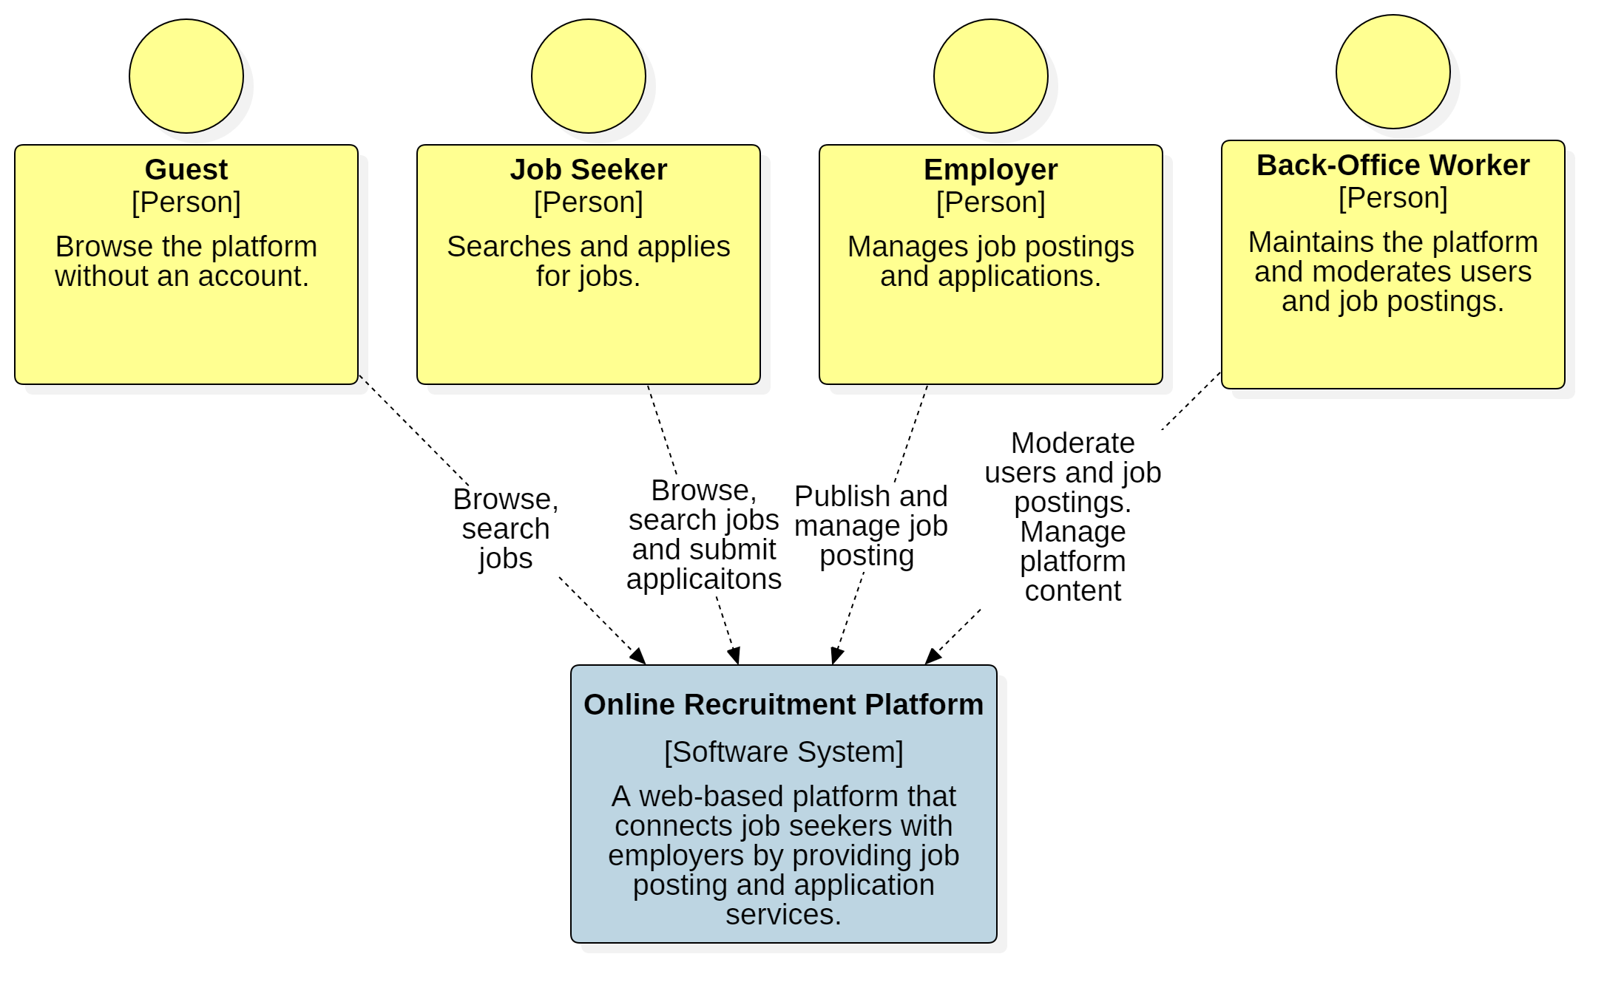
GOAL & SCOPE
One platform for the whole round trip
Guest: a visitor — search jobs, see companies and their jobs, no account needed.
Job Seeker: search, apply with a resume, track and withdraw applications; recommendations ranked on stated preferences.
Employer: company profile, job postings through their lifecycle, review applications to a decision.
Back-Office Worker: moderate postings, manage users, read audit logs.
TWO MODULES IN DEPTH
Job Application (Job Seeker) + Employer Job Management (Employer) — together, the recruitment round trip.
System context — four actors around one platform
7 modules built in total; the other five are implemented and summarized in the paper.
5 / 12
Notes:
~0:45. Four actors; I focus on the two every recruitment platform needs. The Job Seeker applies, the Employer manages postings and decides — those two modules complete each other. Everything else is built and summarized.

Slide 6
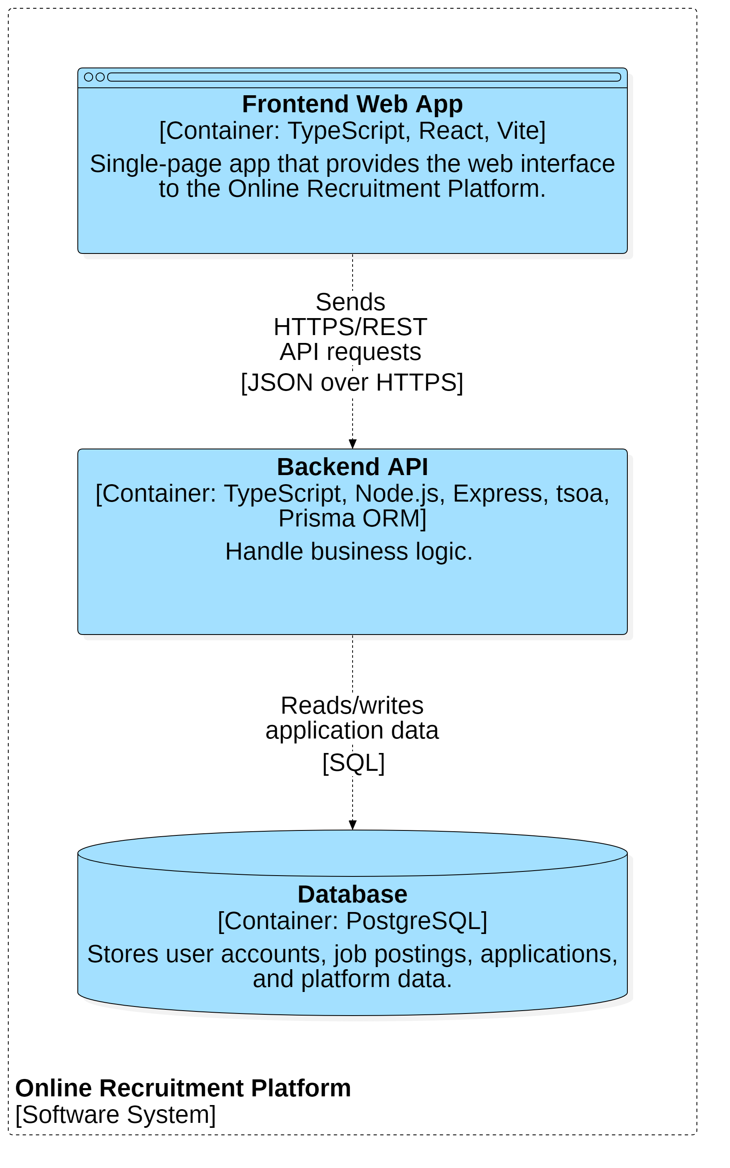
SYSTEM DESIGN — ARCHITECTURE
Three containers, one contract
Frontend Web App — React 19 + Vite single-page app (Tailwind, shadcn/ui).
Backend API — Express 5 + TypeScript; every business rule lives here.
Database — PostgreSQL, accessed through the Prisma ORM.
Contract-first
tsoa generates the OpenAPI spec and the routes from annotated controllers; the frontend's typed API client is generated from the same spec — the two sides cannot drift apart.
Every request takes the same path
Route → Controller → Service → Prisma. Controllers stay thin; services own the rules and re-check the caller's role (defense in depth).
C2 — three containers
6 / 12
Notes:
~1:15. One sentence per container, then the decision that is mine: contract-first. Change a response shape on the server and the client's types change at the next build. Then the request path: controller → service → Prisma; the service re-checks the role even though the route already did.

Slide 7
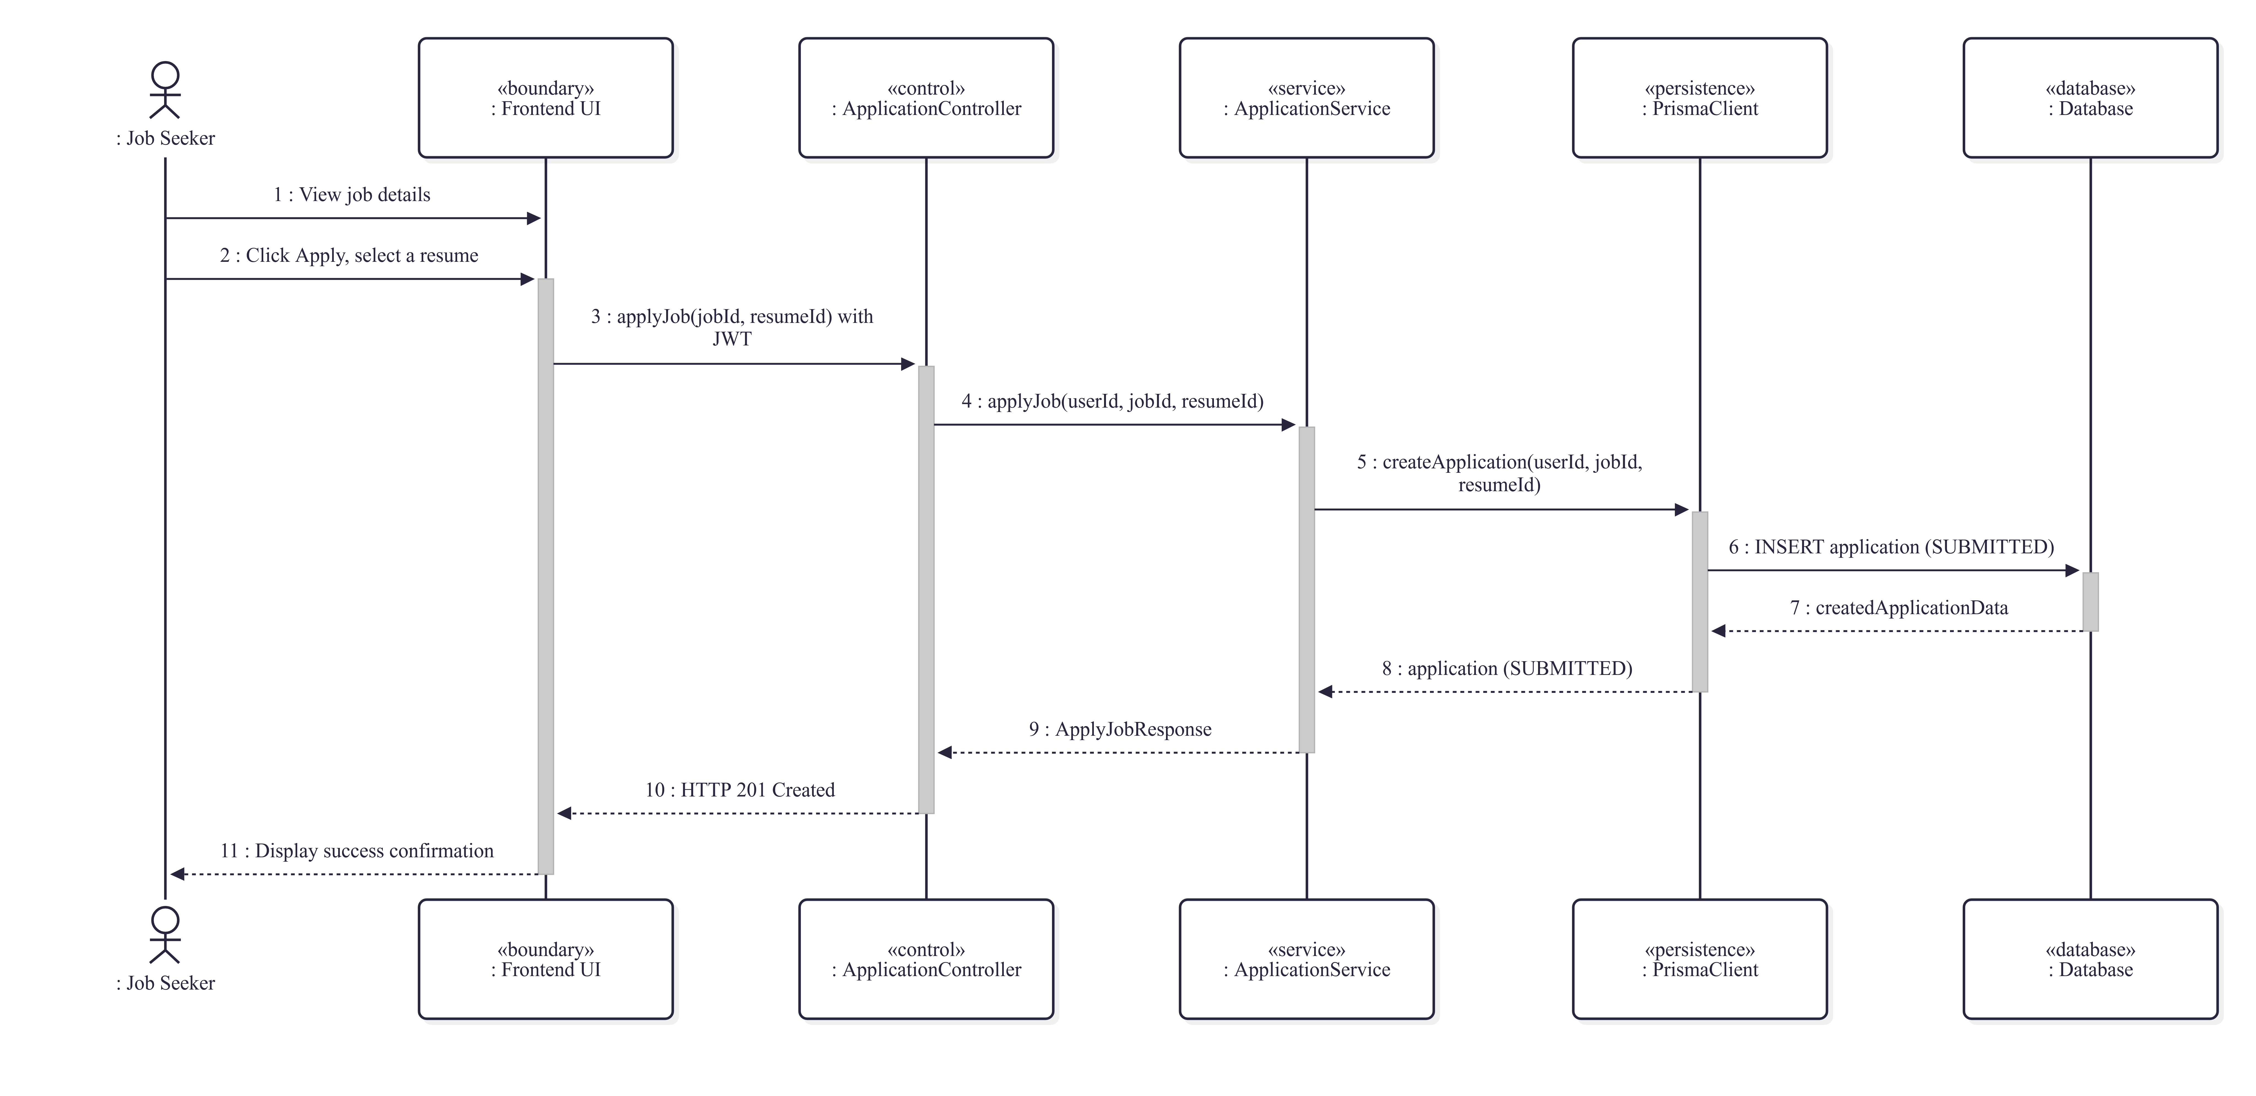
SYSTEM DESIGN — ROUND TRIP ①
The Job Seeker applies for a job
Before creating the application, the service checks:
the posting is ACTIVE (approved)
its deadline has not passed
the resume belongs to this seeker
no earlier application to this posting
Result: 201 Created, stored as SUBMITTED
Sequence diagram — happy path, modeled before implementation
Any failed check is refused with an error; nothing is written.
7 / 12
Notes:
~0:40. Point at the lifelines: controller → service → Prisma, the same path as the previous slide. Name the four checks, then the result: SUBMITTED. Don't walk the arrows one by one — the demo shows this live.

Slide 8
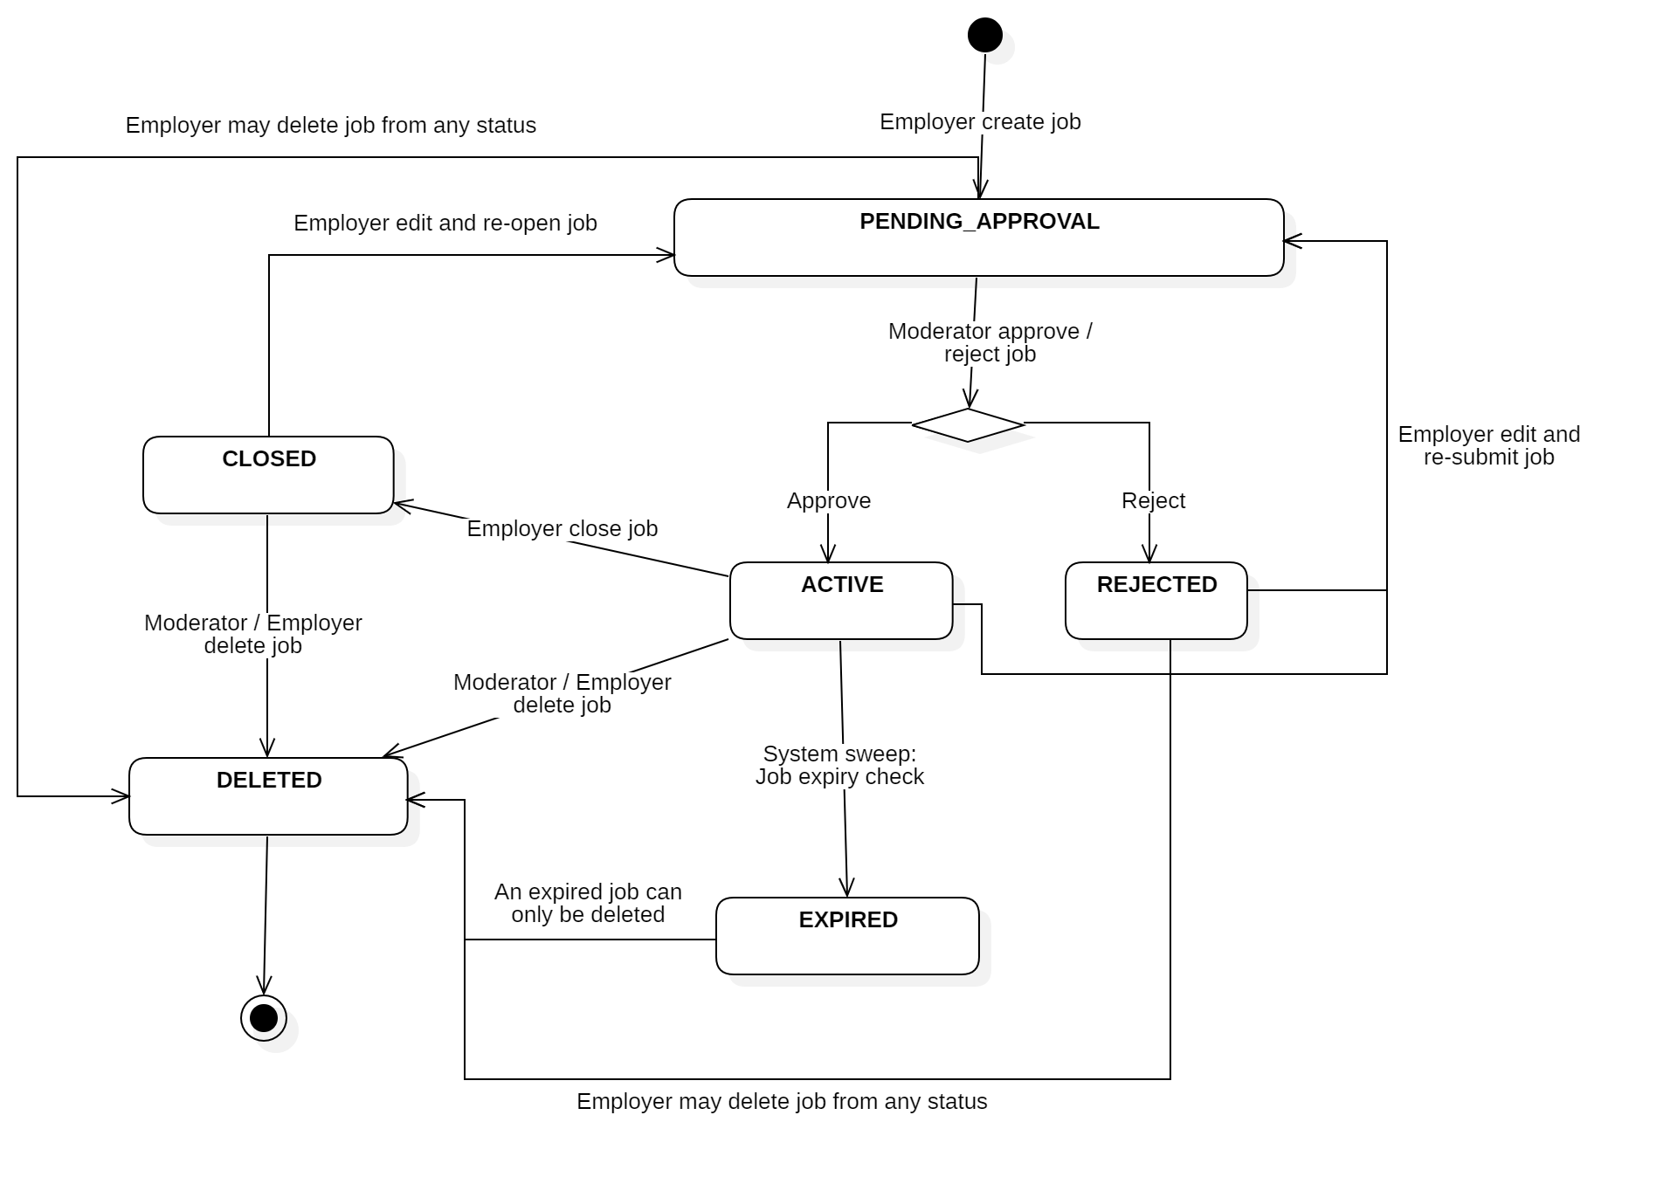
SYSTEM DESIGN — ROUND TRIP ②
The Employer manages postings and decides
Reviewing an application
SUBMITTED
employer opens it
UNDER_REVIEW
employer decides
ACCEPTED
REJECTED
While it is still SUBMITTED, the seeker may WITHDRAW it. Only the posting's owner can move an application, and the service refuses any other transition (409).
Job posting lifecycle — moderated before it goes live
8 / 12
Notes:
~0:50. Left: a posting starts PENDING_APPROVAL, a moderator approves it to ACTIVE; it can be closed, expire through the daily sweep, or be deleted; an edit sends it back to moderation. Right: the employer marks an application UNDER_REVIEW, then ACCEPTED or REJECTED. The service enforces every transition; the UI is never trusted. The full review sequence diagram is in the paper.

Slide 9
TESTING
How the backend is verified
89
74
15
test cases, 0 failures
integration tests
unit tests
the whole suite runs in ~30 s
HTTP request → real PostgreSQL
the recommendation scoring, no database
A separate _test database, built from the real migrations and emptied before every test — no mocks.
Requirements traceability: each tested rule is mapped to its use case and its test (full matrix in the paper).
NOT YET COVERED
The employer's application review, profile management and password reset have no automated tests yet; the React UI is checked by hand; no load or concurrency testing.
9 / 12
Notes:
~0:50. Numbers, then how: real database, real migrations, reset before each test. Then say the gaps yourself before they ask; the paper lists them in the Results section. Be ready to open one test and explain it line by line (see qa-prep.md).

Slide 10
CONCLUSION
What I built, what I learned
Contribution
What I learned
A working platform for the recruitment round trip — application to decision — in one contract-first monorepo.
Explainable job recommendations, ranked on the seeker's stated preferences.
89 passing tests, traced back to the use cases they verify.
Writing surprises back keeps the documents and the code honest.
A generated contract removes drift between two codebases.
Backend-first builds the core that every screen depends on.
Limitations: a prototype run locally — not deployed, not used by real users, not load-tested.
Next: notifications · employer–applicant messaging · deployment & scale · a mobile app.
10 / 12
Notes:
~0:50. Contribution, then the three personal lessons, then the limitations — said before they ask. End with: 'Let me show you the platform.' and move straight to the demo.

Slide 11
LIVE DEMO → Q&A
Live demo: one application, end to end
1 · Job Seeker
2 · Employer
3 · Back to the seeker
dashboard recommendations, each with its reason → open “Backend Engineer” → apply with a saved resume → SUBMITTED
open the same posting → find the new application → mark UNDER_REVIEW → ACCEPT
My Applications now reads ACCEPTED — one platform, one round trip
Runs locally: API on :3000 (Swagger UI at /docs) · web app on :5173 · seeded data — 3 companies, 12 postings.
Questions are welcome during the demo.
11 / 12
Notes:
The demo sits outside the 10-minute talk and bridges into Q&A. Follow demo-script.md. If a council member interrupts with a question, answer it: that is Q&A starting early. If anything breaks, switch to the screenshots and carry on.

Slide 12
Q&A
Thank you
Questions are welcome.
Notes:
Leave on screen during Q&A. Prepared answers: qa-prep.md — especially Testing (card 6) and Recommendations (card 7).

