Slide 1


MIIT Programming Tutor
Hybrid Burmese tutor for programming lessons and MIIT institutional knowledge
30-minute technical presentation
Notes:
~1 min. Introduce yourself and the project name. One sentence: Burmese-speaking students get programming help plus grounded MIIT answers from local notes.

Slide 2
Agenda
~30 minutes
Motivation, goals, and design principles
System architecture and hybrid routing
MIIT knowledge base, embeddings, and retrieval
Prompting, cloud generation, and reliability
Gradio UI, API, TTS, and logging
Limitations, evaluation hooks, and future work
Live demo + Q&A
MIIT Programming Tutor — Hybrid Burmese NLP
Notes:
~1 min. Set expectations: architecture-first, then demo. Invite questions at the end.

Slide 3
Problem & motivation
Why this project exists
Programming education in Myanmar often mixes Burmese explanations with English technical terms.
Students need beginner-friendly Burmese answers without losing correct CS vocabulary.
MIIT-specific questions (faculty, campus, CSE curriculum) must not be hallucinated.
A single generic chatbot either invents institute facts or gives shallow coding help.
MIIT Programming Tutor — Hybrid Burmese NLP
Notes:
~2 min. Tie to your audience (MIIT / NLP class). Emphasize trust for institutional Q&A.

Slide 4
Project objectives
What we built
Answer programming questions in natural spoken Burmese (terms like function, loop stay in English).
Answer MIIT questions only from curated local JSONL notes (RAG-style retrieval).
Refuse out-of-scope topics with a fixed Burmese message—no cloud call.
Ship a usable demo: Gradio UI with chat history, optional speech, and HTTP API.
MIIT Programming Tutor — Hybrid Burmese NLP
Notes:
~1.5 min. Objectives map to measurable behaviors: grounded MIIT, helpful prog, clear refusal.

Slide 5
Hybrid tutor design
Not a single monolithic model
Programming route → cloud LLM only (Gemini 2.0 Flash default, or OpenRouter).
MIIT route → retrieve passages from data/miit, then same LLM with notes-only prompt.
No on-device fine-tuned weights; fast iteration via prompts and local notes.
All surfaces call HybridEngine.answer() in tutor/hybrid.py.
MIIT Programming Tutor — Hybrid Burmese NLP
Notes:
~2 min. Contrast with training a Burmese code LLM (cost, data, GPU). Hybrid = pragmatic NLP project.

Slide 6
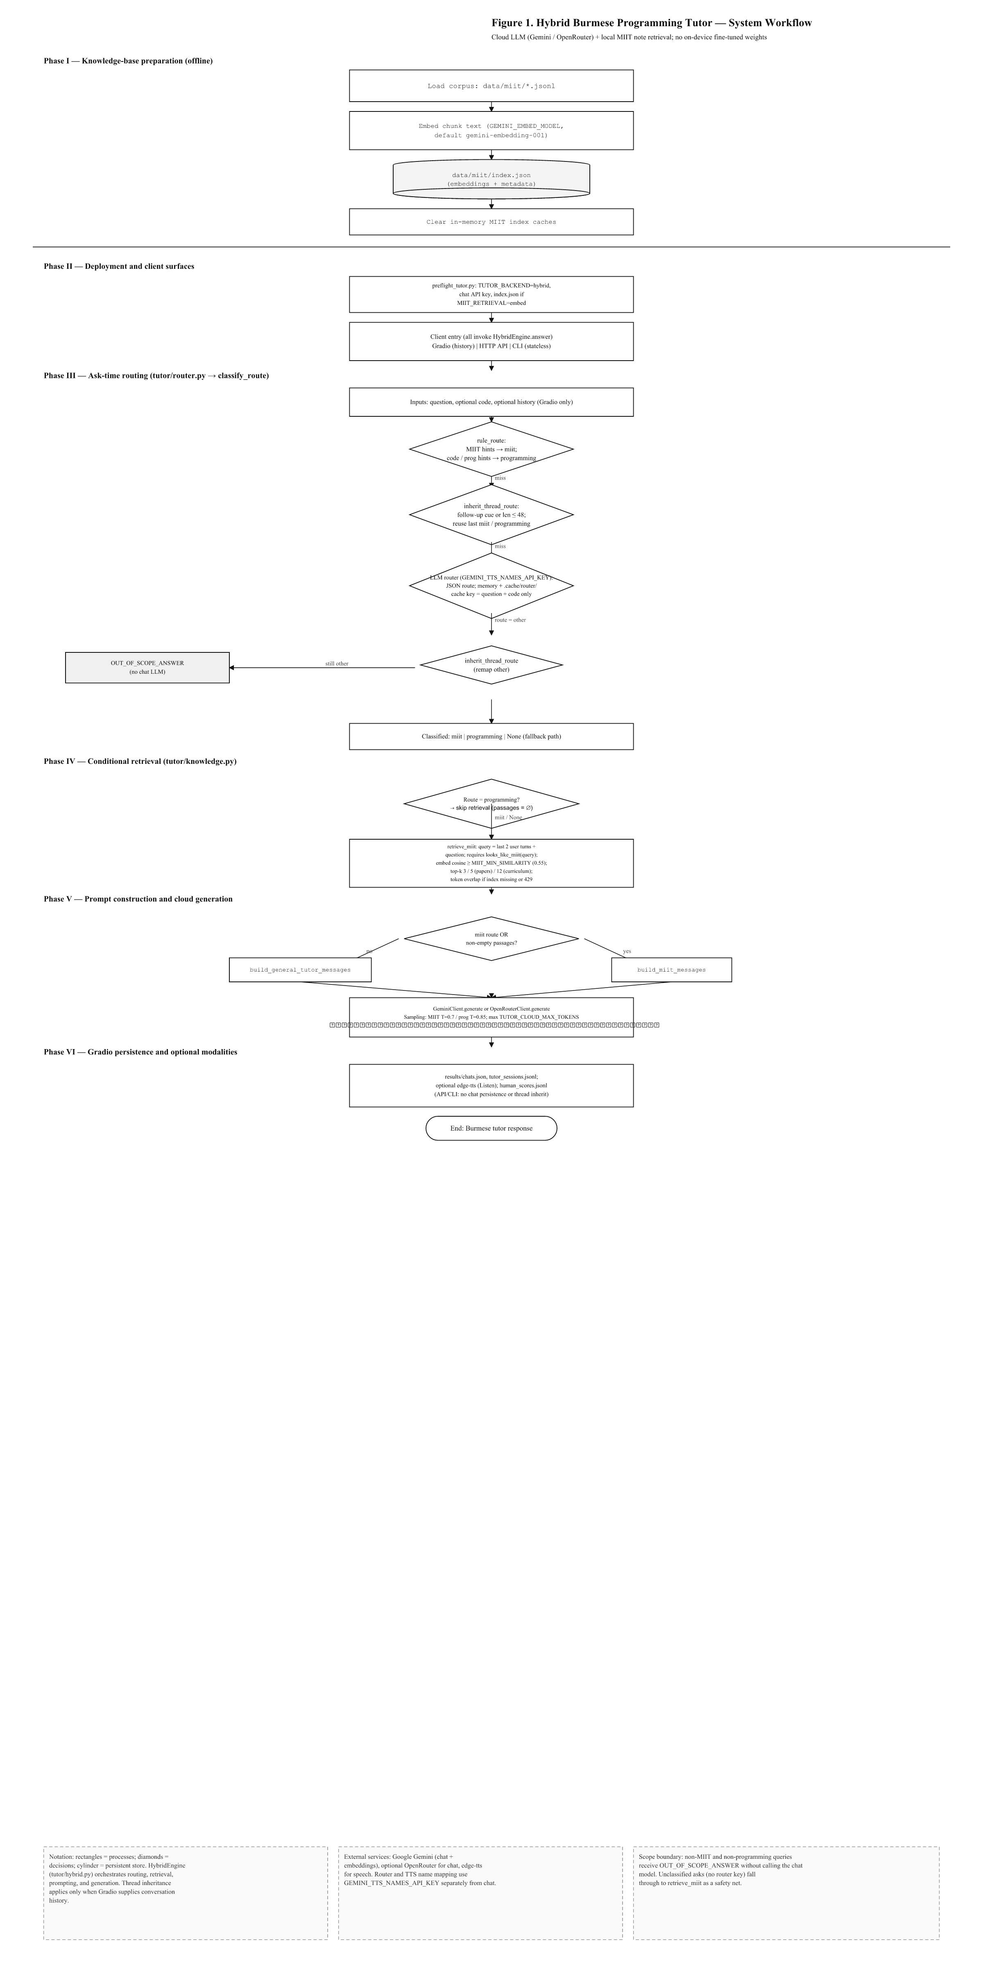
End-to-end workflow
Offline index + online ask pipeline
MIIT Programming Tutor — Hybrid Burmese NLP
Notes:
~2.5 min. Walk phases I–VI top to bottom. Point out routing diamond and OUT_OF_SCOPE branch.

Slide 7
Major components
Repository map
tutor/hybrid.py — orchestration (route → retrieve → prompt → generate).
tutor/router.py — classify_route (rules, thread inherit, optional LLM router).
tutor/knowledge.py — retrieve_miit (embeddings + token fallback).
tutor/prompts.py — programming vs MIIT message builders.
scripts/serve_gradio.py — UI, chats, TTS; tutor/api.py — REST chat.
MIIT Programming Tutor — Hybrid Burmese NLP
Notes:
~1.5 min. For technical examiners: clean separation of concerns.

Slide 8
MIIT knowledge base
Curated JSONL corpora
institute.jsonl — campus, governance, programs.
cynthia_myint.jsonl — faculty profile and publications.
cse_be_hons.jsonl — CSE B.E. (Hons) years, semesters, electives.
Each record: id, text, sources[] (URLs for citation in answers).
Editors update JSONL; make miit-index rebuilds embeddings.
MIIT Programming Tutor — Hybrid Burmese NLP
Notes:
~2 min. Stress human-curated ground truth vs crawling the web.

Slide 9
Index construction
make miit-index
Load all data/miit/*.jsonl chunks.
Embed with gemini-embedding-001 (GEMINI_EMBED_MODEL).
Write data/miit/index.json: embed_model, built_at, chunks with vectors.
At query time: cosine similarity ≥ 0.55; top-k 3 (5 papers, 12 curriculum).
Missing index or 429 → token-overlap fallback with stderr warning.
MIIT Programming Tutor — Hybrid Burmese NLP
Notes:
~2 min. Mention preflight requires index when MIIT_RETRIEVAL=embed.

Slide 10
Client surfaces
Same engine, different context
Gradio (make app) — multi-turn history, sidebar chats, TTS, human scores, theme.
HTTP API (make serve-api) — POST /v1/chat, optional TUTOR_API_KEY, stateless.
CLI (make chat) — single-shot questions, optional pasted code.
Only Gradio passes history → follow-ups like “အဲဒါအပို ရှိသေးလဲ။” stay on MIIT topic.
MIIT Programming Tutor — Hybrid Burmese NLP
Notes:
~1.5 min. Demo will use Gradio; mention API for integration projects.

Slide 11
Ask-time routing
classify_route order
1. rule_route — MIIT hints (miit, cse, faculty names) before programming hints.
2. inherit_thread_route — short or follow-up cues reuse last miit/programming topic.
3. LLM JSON router (GEMINI_TTS_NAMES_API_KEY) with disk cache; key = question + code.
4. Remap “other” via inherit; HybridEngine retries inherit before refusal.
Still other → OUT_OF_SCOPE_ANSWER (no chat LLM). None → retrieve_miit safety net.
MIIT Programming Tutor — Hybrid Burmese NLP
Notes:
~2.5 min. This is the intellectual core—rules cheap, inherit fixes Gradio threads, LLM for edge cases.

Slide 12
Retrieval (MIIT only)
tutor/knowledge.py
Query = last two user questions + current question (context for “အသေးစိတ်”).
Must pass looks_like_miit on the combined query or return empty.
Programming route skips retrieval entirely.
MIIT prompt used even with zero passages—model must say it does not know, not invent codes.
MIIT Programming Tutor — Hybrid Burmese NLP
Notes:
~2 min. Connect to NLP course: dense retrieval + constrained generation.

Slide 13
Prompting & generation
Grounded answers in Burmese
Programming: beginner tutor, short paragraphs, random first-turn style (analogy / example / mistake).
MIIT: inject retrieved text + source URLs; who-questions lead with name/title; curriculum lists all years in notes.
Both: spoken Burmese, သူ/သူမ for people, strip ဆရာ့အဖြေ: from output.
Sampling: prog T=0.85, MIIT T=0.7; max 3072 tokens; retries + GEMINI_API_KEY_FALLBACK on 429 (chat only).
MIIT Programming Tutor — Hybrid Burmese NLP
Notes:
~2 min. Show one example question on next slides verbally during demo.

Slide 14
Gradio experience
scripts/serve_gradio.py
Ask → Generating answer… → metrics line (Myanmar ratio, mix penalty, ends with ။).
Sidebar: New chat, open past title, delete non-active threads; results/chats.json.
Code-like messages auto-fill code argument (def, function, fences, {).
Quota errors show Burmese warning; turn still saved to session log.
Light/Dark theme persisted in localStorage.
MIIT Programming Tutor — Hybrid Burmese NLP
Notes:
~2 min. Transition to live demo if available.

Slide 15
Speech (Listen)
Accessibility
edge-tts: my-MM-NilarNeural / my-MM-ThihaNeural.
prepare_for_speech strips URLs; maps names (e.g. Cynthia Myint → စင်သီယာမြင့်).
Optional Gemini JSON name map via GEMINI_TTS_NAMES_API_KEY.
Audio cached under .cache/tts/; requires outbound internet.
MIIT Programming Tutor — Hybrid Burmese NLP
Notes:
~1.5 min. Nice differentiator for low-literacy or mobile users.

Slide 16
HTTP API
Integration
GET /health — readiness check.
POST /v1/chat — JSON { question, code? }; same HybridEngine, no history.
Optional Authorization when TUTOR_API_KEY is set.
code field up to TUTOR_MAX_CODE_CHARS (16384).
MIIT Programming Tutor — Hybrid Burmese NLP
Notes:
~1 min. Quick curl example in speaker notes if asked.

Slide 17
Logging & evaluation hooks
Demo-quality metrics
results/tutor_sessions.jsonl — per-turn Myanmar-script ratio, English-mix penalty, punctuation.
results/human_scores.jsonl — fluency / correctness / beginner-friendly (1–5).
make smoke-hybrid — 15 live prompts against Gemini (CI / manual check).
pytest suite covers router, retrieval, hybrid paths, API, chats.
MIIT Programming Tutor — Hybrid Burmese NLP
Notes:
~1.5 min. Honest: no large public benchmark yet—hooks for human eval.

Slide 18
Limitations & scope
What we deliberately do not do
No local LLM weights, LoRA, or RAG beyond data/miit.
API/CLI cannot inherit conversation threads.
Router disk cache ignores history—Gradio inherit handles follow-ups.
Cloud dependency (Gemini/OpenRouter, VPN where blocked); TTS needs network.
MIIT answers bounded by note coverage and retrieval quality.
MIIT Programming Tutor — Hybrid Burmese NLP
Notes:
~1.5 min. Shows maturity—know failure modes.

Slide 19
Technology stack
Python 3.12+, uv, Gradio, Litestar API.
Google Gemini (chat + embeddings); optional OpenRouter.
NumPy cosine similarity; edge-tts for speech.
Data: JSONL + index.json; chats in JSON on disk.
MIIT Programming Tutor — Hybrid Burmese NLP
Notes:
~1 min.

Slide 20
Suggested live demo
~5 minutes
1. Programming: “Python loop ကို ရှင်းပြပါ” (short Burmese explanation).
2. MIIT faculty: “စင်သီယာမြင့် ပါမောက္ခ အကြောင်း” (grounded bio).
3. Follow-up: “အဲဒါအပို ရှိသေးလဲ။” (thread inherit on Gradio).
4. Out of scope: weather or news → fixed refusal.
5. Click Listen on one answer; toggle dark mode.
MIIT Programming Tutor — Hybrid Burmese NLP
Notes:
~3–5 min demo block. Have VPN/API keys ready; run make preflight first.

Slide 21
Future work
Expand MIIT JSONL coverage and periodic index refresh automation.
Formal human evaluation study with MIIT students.
API session tokens for lightweight multi-turn clients.
Stronger Myanmar TTS pronunciation for mixed English/code tokens.
MIIT Programming Tutor — Hybrid Burmese NLP
Notes:
~1.5 min.

Slide 22
Questions?
Repository: programming_burmese_tutor | Docs: WORKFLOW.md, LAPTOP_SETUP.md
Notes:
Thank the audience. Offer to show code or architecture figure again.

