Slide 1

Git Checkpoint:
Create a folder called learn_git_again.
Cd (change directory) into the learn_git_again folder.
Create a file called third.txt.
Initialize an empty git repository.
Add third.txt to the staging area.
Commit with the message "adding third.txt".
Check out your commit with git log.
Create another file called fourth.txt.
Add fourth.txt to the staging area.
Commit with the message "adding fourth.txt"
Remove the third.txt file.
Add this change to the staging area.
Commit with the message "removing third.txt".
Check out your commits using git log.
Change your global settings to core.pager=cat - you can read more about that here.
Write the appropriate command to list all the global configurations for git on your machine.
You can type git config --global to find out how to do this.
Siwar Belkhir
20.10.2021

Slide 2
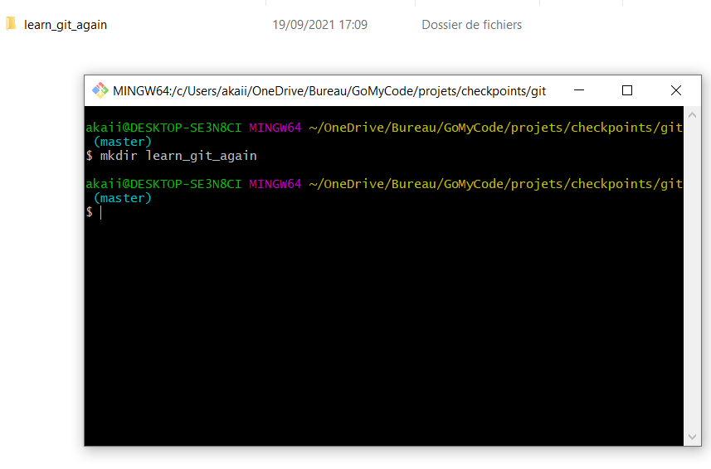
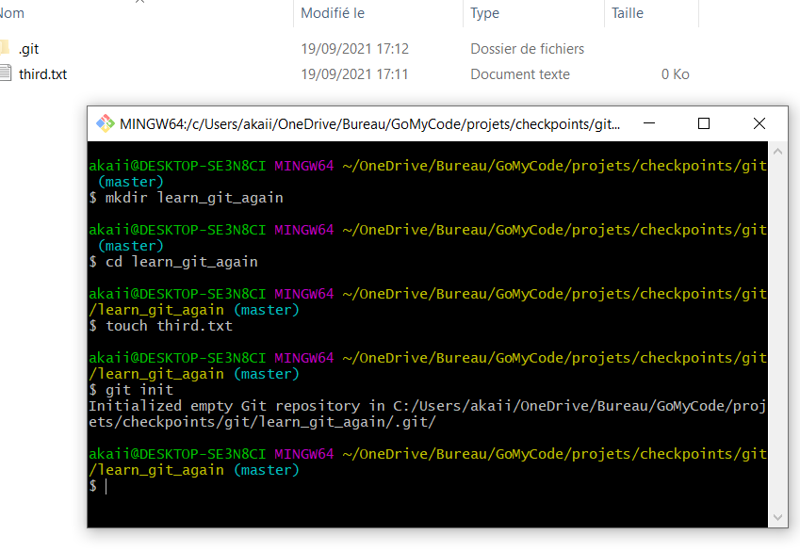
Create a folder called learn_git_again.
Cd (change directory) into the learn_git_again folder.
Create a file called third.txt.
Initialize an empty git repository.

Slide 3
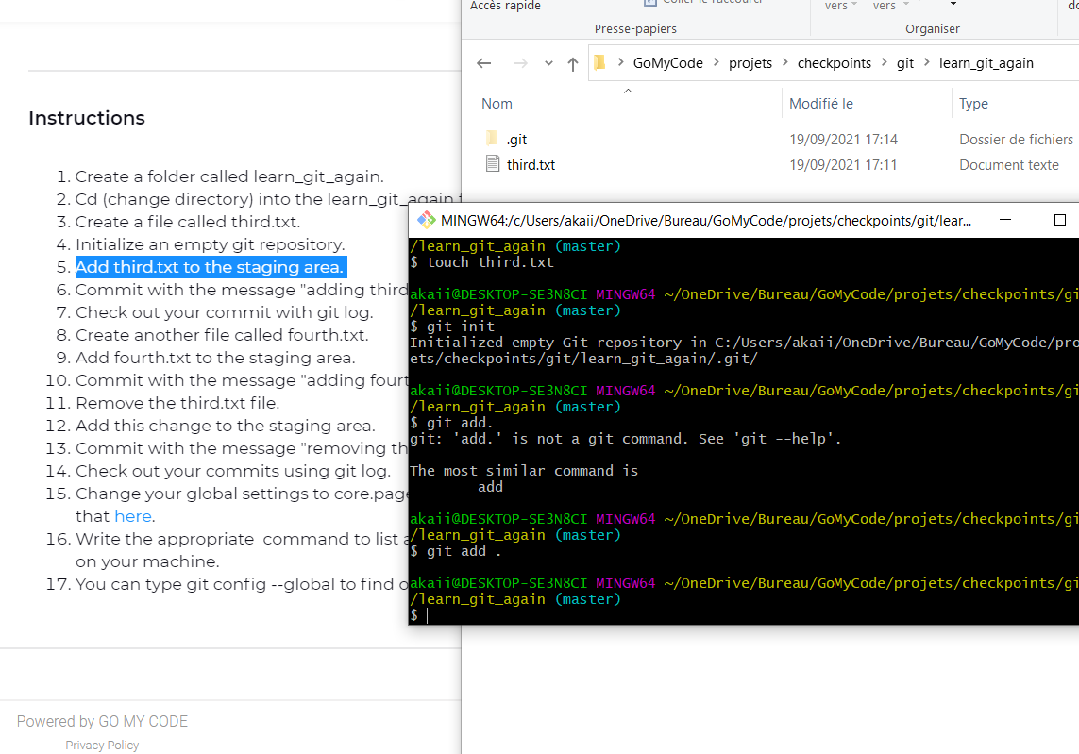

Slide 4
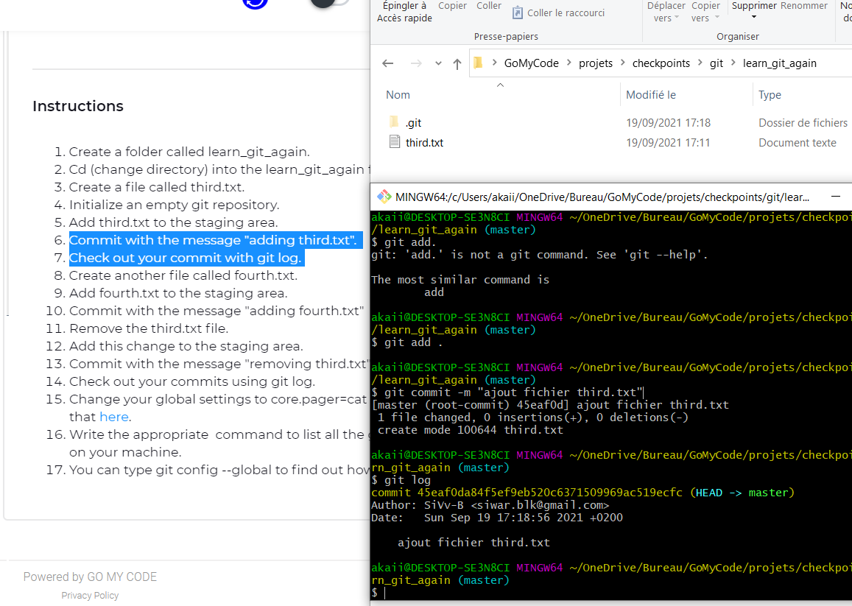

Slide 5
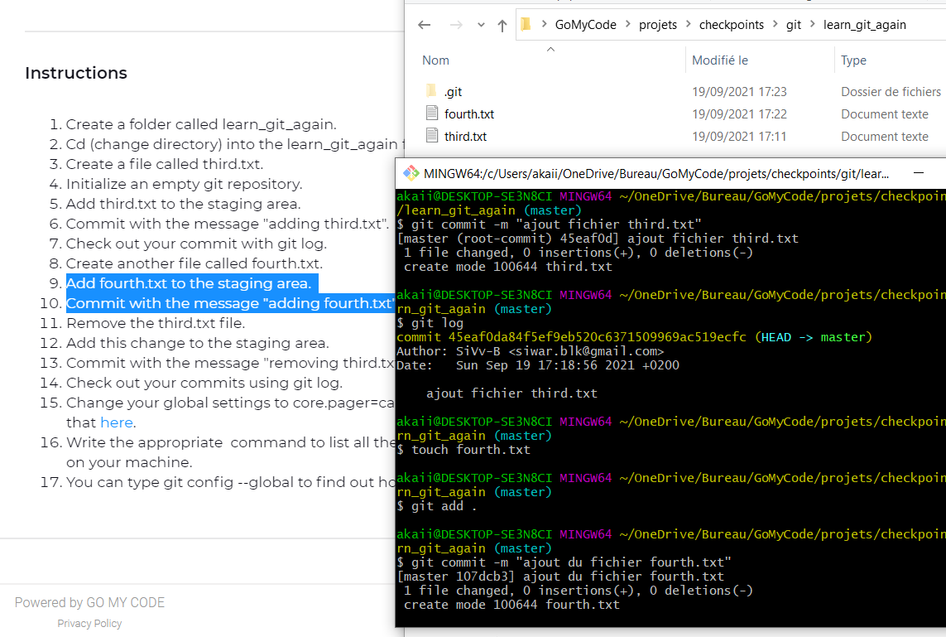

Slide 6
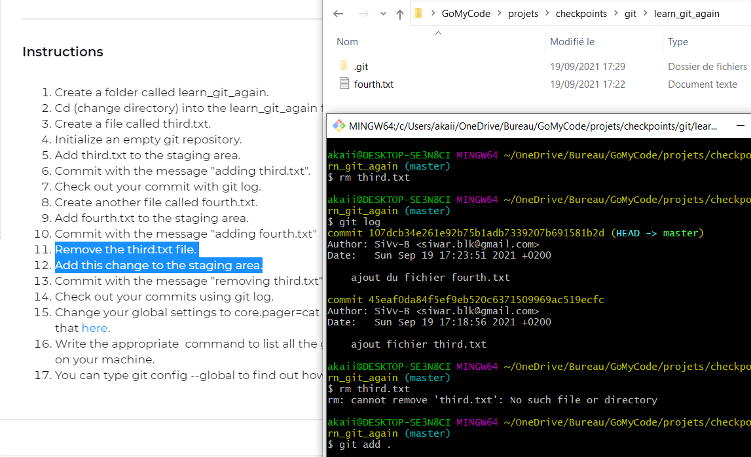

Slide 7
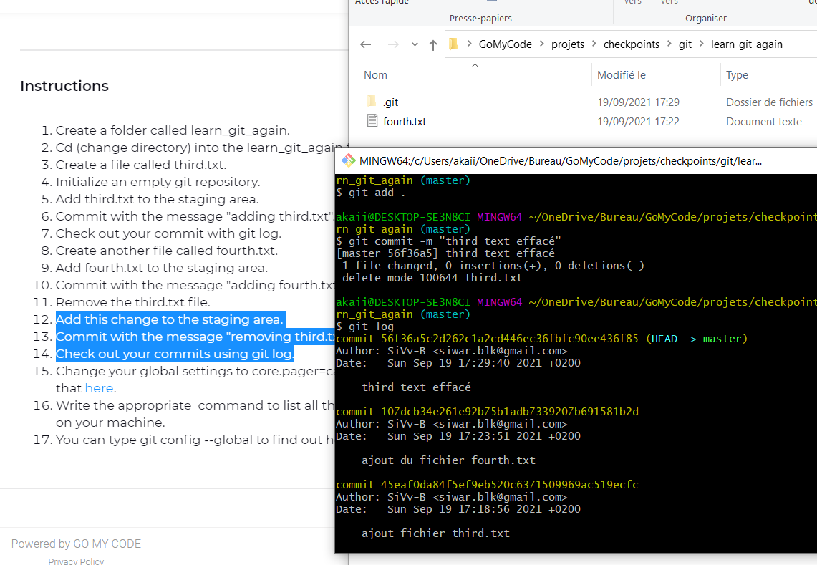

Slide 8
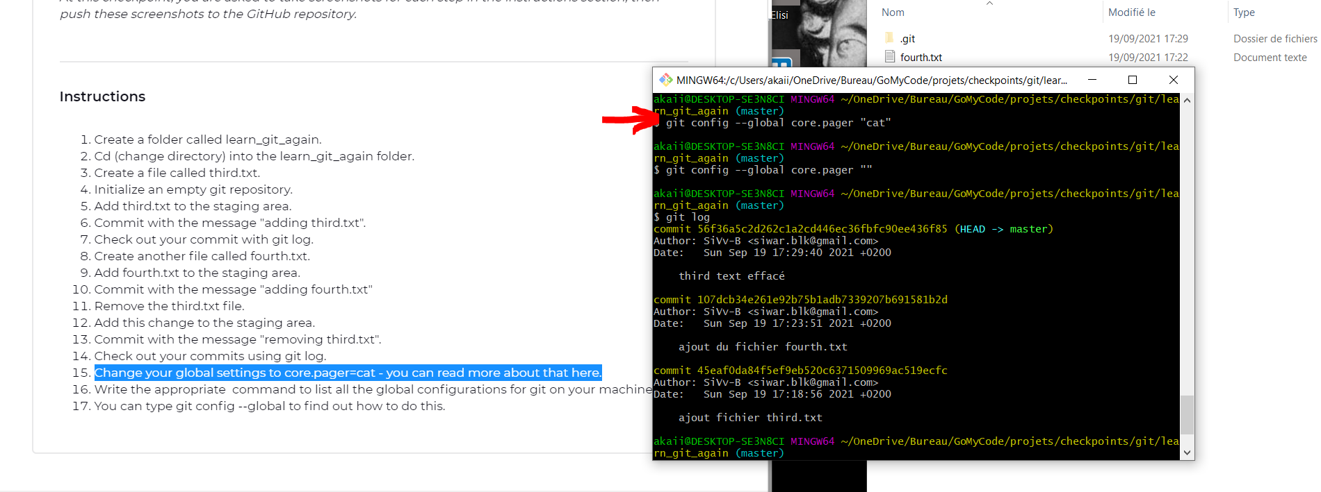

Slide 9
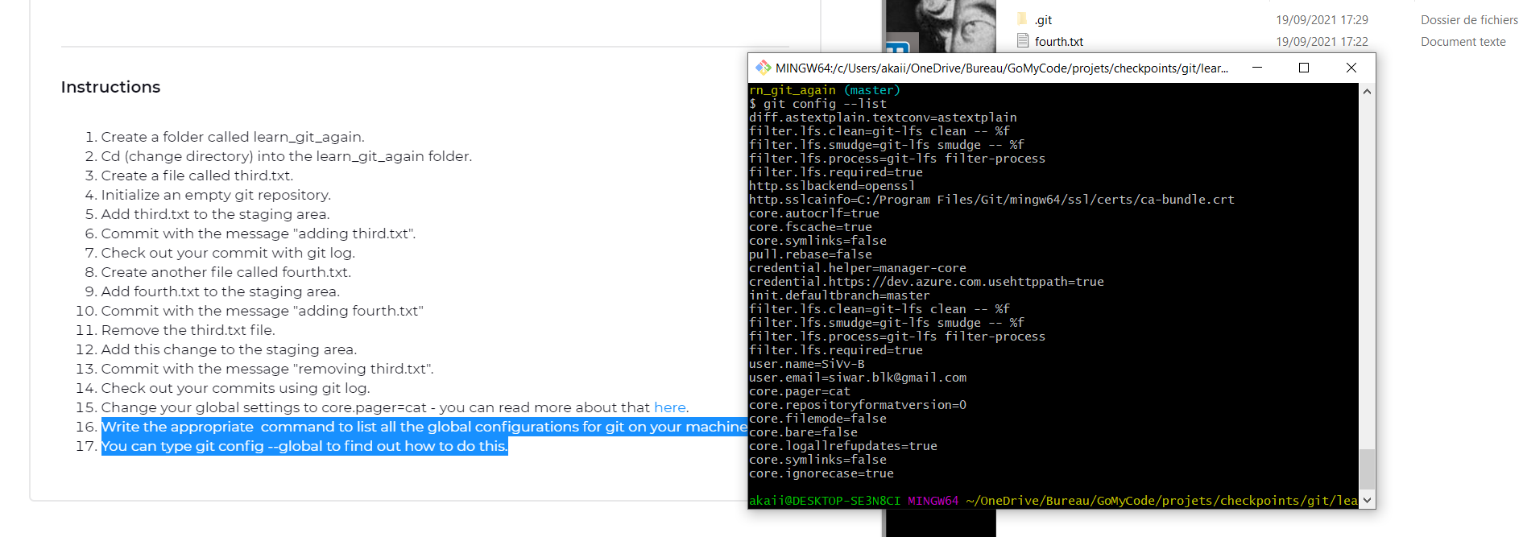

Slide 10
