Slide 1
Spring-Mass System
Sai Keung Wong
NCTU

Slide 2
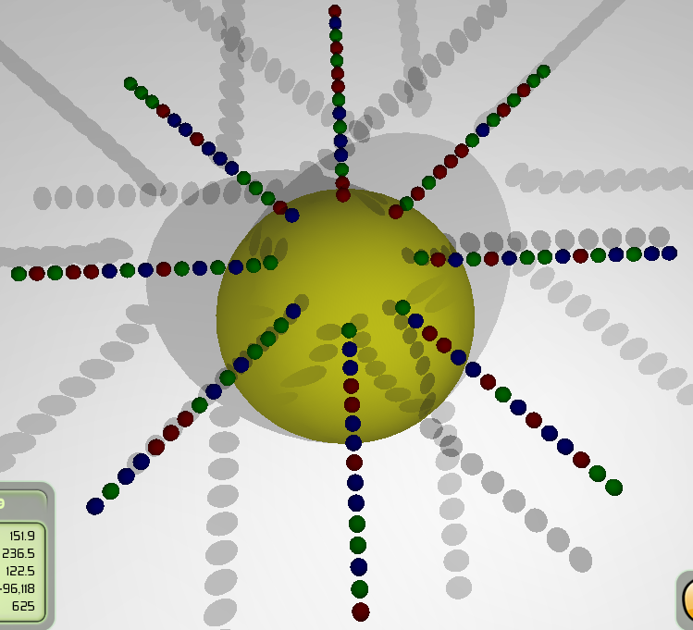
Purpose
You must use the MASS_SPRING_SYSTEM class to implement.
Compute the motion
Detect collisions and perform collision response
Implement a robust collision handling method

Slide 3
System parameters
Time step size : 0.06 second
Spring stiffness : 500

Slide 4
Key usage
‘7’: gravity (0, -9.8, 0)
‘8’ : gravity (0, -30, 0)
‘9’ : gravity (0, 9.8, 0)
‘0’ : gravity (0, 30, 0)
‘P’ : reset velocities of particles
‘J’ : reset position and velocity of particles
‘K’ : disable robust collision handling method; background is red
‘L’ : enable robust collision handling method; background is blue

Slide 5
Model structure
Particles are organized along straight lines above a sphere.
Each adjacent particle pair along a straight line is connected with a spring
A spring also connects two particles that are skipped by a middle particle

Slide 6
Spring force
p0
p1
The rest length of the spring (p₀, p₁)
L0
The unit vector from p₀ to p₁
n(1,0) = (p₁ - p₀)/ || p₁ - p₀ ||
The spring (p₀, p₁) exerts force on p₀
f(0,1)= k (|| p₁ - p₀ || - L0) n(1,0)
k is the spring stiffness
|| p₁ - p₀ || is the current length of the spring

Slide 7
Gravity force
A force exerts on an object due to the weight of the particle i
w_{i} = m_{i} g,
where g is the gravitational vector towards a reference point
m_{i} is the particle mass

Slide 8
Viscous damping force
h_{i} = -k_{d} v_{i}
k_{d} is inside [0, 1)
h_{ij} = -k_{s} (v_{i} - v_{j} ), between connected particles i and j.
k_{d} = 0.025
k_{s} = 0.15

Slide 9
Net force, velocity and position
*Sum up all the forces exerting on each particle i
f_{i} = w_{i} + h_{i}+ …
*Velocity update
v_{i}(t + Δt) = v_{i}(t) + (f_{i} /m_{i}) Δt
*Position update
p_{i}(t+ Δt) = p_{i}(t) + v_{i}(t+Δt) Δt
where Δt is the time step size

Slide 10
Simple Collision Detection and Handling
Use sphere-sphere collision detection
Separate two spheres along the centrals if they collide
Drawback: make the system stiff. Why is that so?

Slide 11
Robust collision handling
Eliminate the velocity component along the contact normal direction.
If the colliding particle is moving away, do nothing.
If the colliding particle moves towards another particle, eliminate its velocity component.
n(i,j) = (p_{i} - p_{j})/ || p_{j} - p_{i} ||
If particle j moves toward i, i.e., (n(i,j) . v_{j} ) >0
v_{j} = v_{j} - (n(i,j) . v_{j} ) n(i,j)
If particle i moves toward j, , i.e., (n(i,j) . v_{j} ) < 0
v_{i} = v_{i} + (n(i,j) . v_{i} ) n(i,j)
p_{j}
p_{i}

Slide 12
Robust collision handling
Eliminate the velocity component earlier before they really collide
Or reduce the velocity component
Collide if || p_{j} - p_{i} || < r_{i} + r_{j} + e, where e is a small value

Slide 13
Algorithm
Compute force exerting on each particle
Compute net force exerting on each particle
Compute velocities of particles
Adjust velocities of particles due to collision
Update positions of particles

Slide 14
Final note
Limit the maximum speed of each particle

Slide 15
TA: Notes for marking
Ask questions and let the students answer
Robust collision handling?
Spring mass systems? etc…
Check all the parameters are correct:
Time step size : 0.06 second
Spring stiffness : 500
h_{i} = -k_{d} v_{i}
h_{ij} = -k_{s} (v_{i} - v_{j} ), between connected particles i andj.
k_{d} = 0.025
k_{s} = 0.12
Gravity

Slide 16
Tasks
Must finish all the tasks, similar to the demo.
Show your student Name and ID on the top bar of the window.
MUST DO or your score is ZERO.
A large sphere at the origin
Spring force, gravity, damping force computation
Viscous damping force
Motion computation for the spring mass system
Sime collision handling method
Robust collision handling method
Change gravitational force directions

Slide 17
Some hints
Create the spring mass system
Create scene nodes and entities for particles: BasicTutorial_00::createSpace()
Set the particle positions: BasicTutorial_00::setObjPositions
Set up the spring mass system: BasicTutorial_00::setMassSpringSystem
Simple collision handling method
BasicTutorial_00::handleCollision()
Simulation loop: frameStarted
Major algorithm
MASS_SPRING_SYSTEM::update
void resolveCollision(
SceneNode *nodeA, SceneNode *nodeB,
float rA, float rB, float wA, float wB)

