Slide 1
Decentralized Identity Overview
Systems Security Lab @ SKKU
Si Won Heo

Slide 2
Background
Today’s web
Information centralized to few enterprises (e.g. Google, Youtube)
Users have to manage different ID-PW pairs for every services
Decentralized web
All the information managed by its owner
Decentralized ID is one of the tool for Decentralized Web

Slide 3
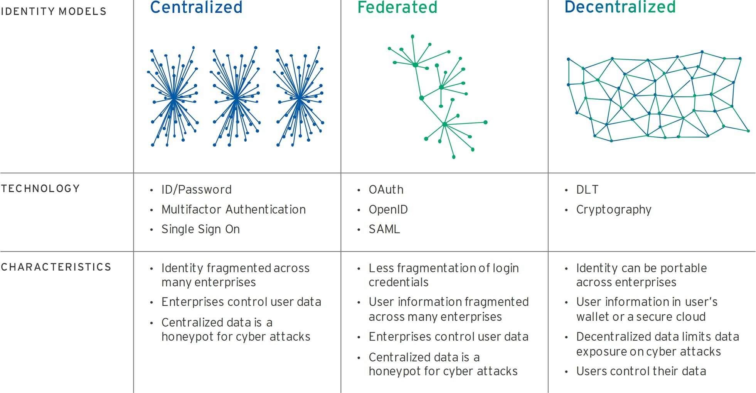
Background
DID is on the third phase of Identity management system

Slide 4
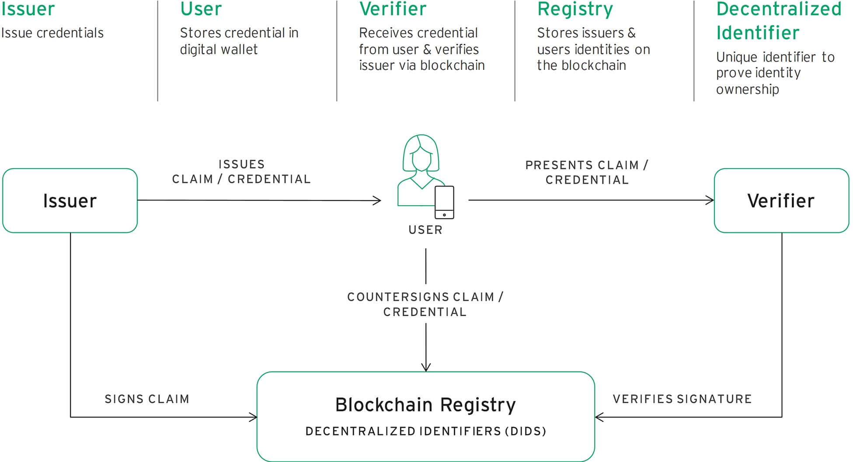
Decentralized Identification : How?
User stores signed credential in Blockchain Registry or DLT
Decentralized Identifier(DID) proves user’s identity ownership

Slide 5
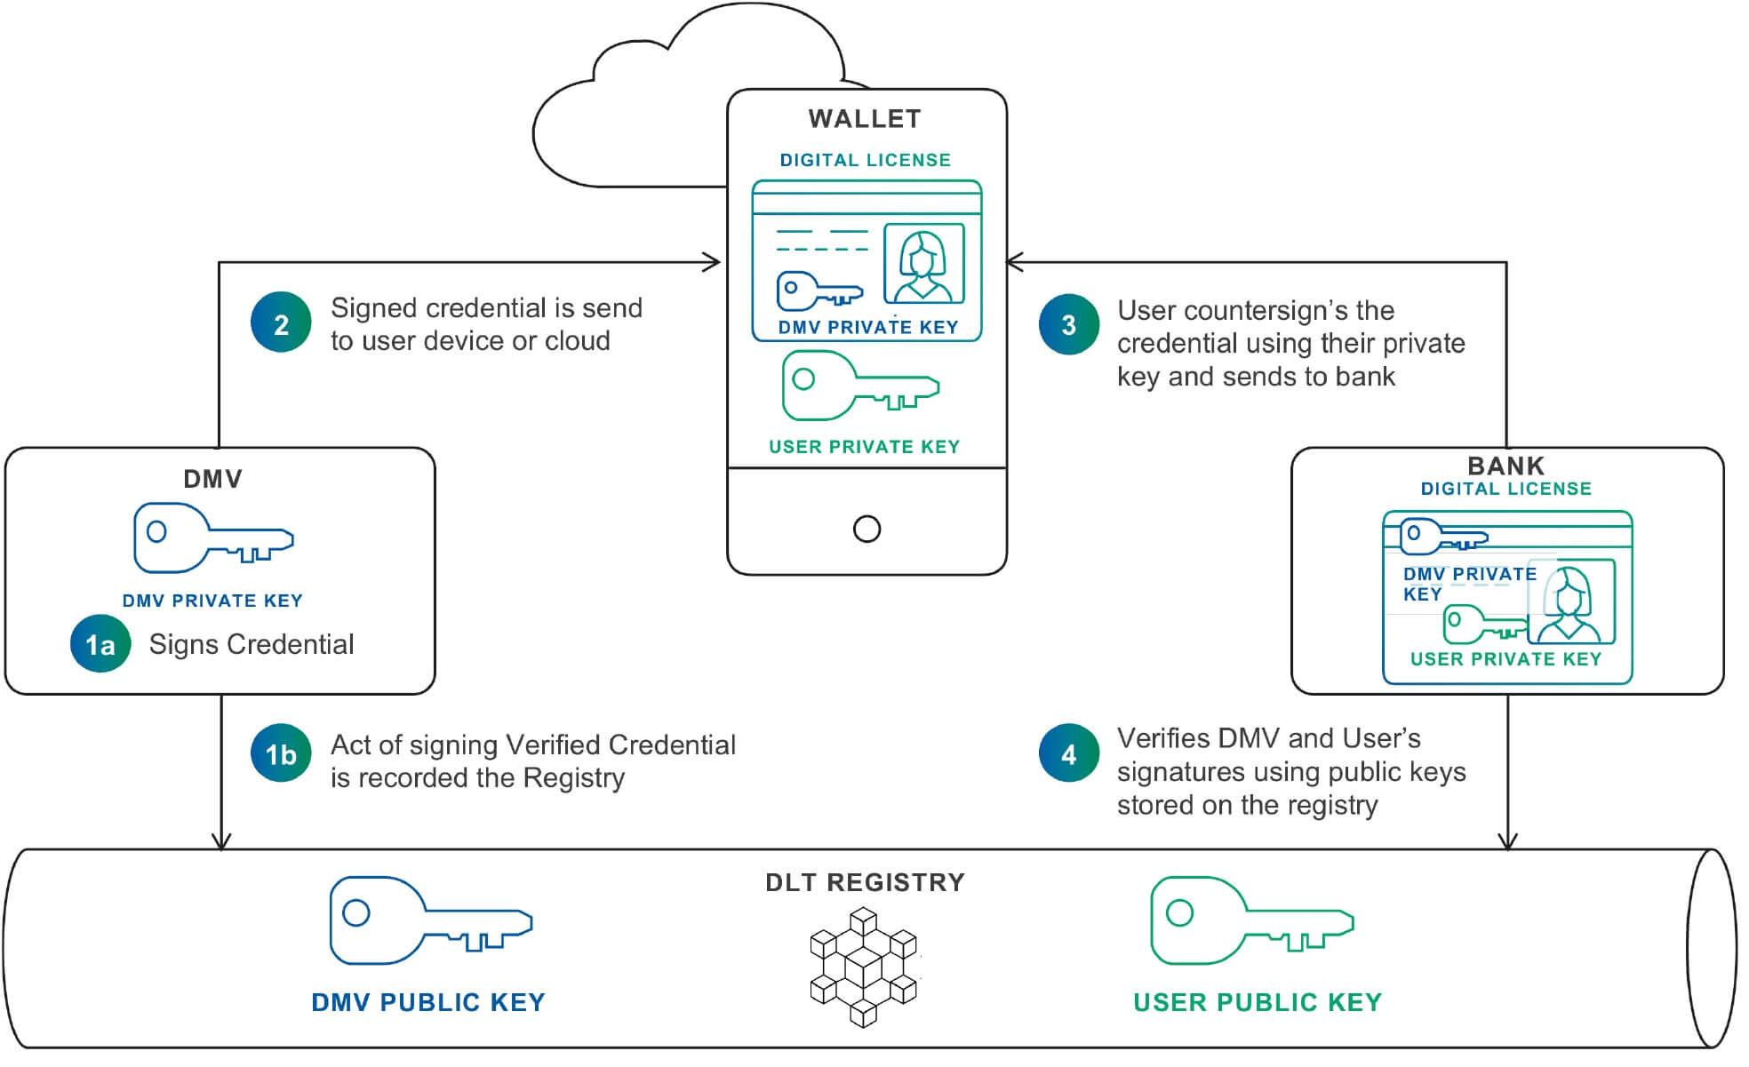
Decentralized Identification : How?
Public-Private Key Cryptography
Private-key Signed Credentials & User’s Public Key stored in DLT
Verified by Public Key of User

Slide 6
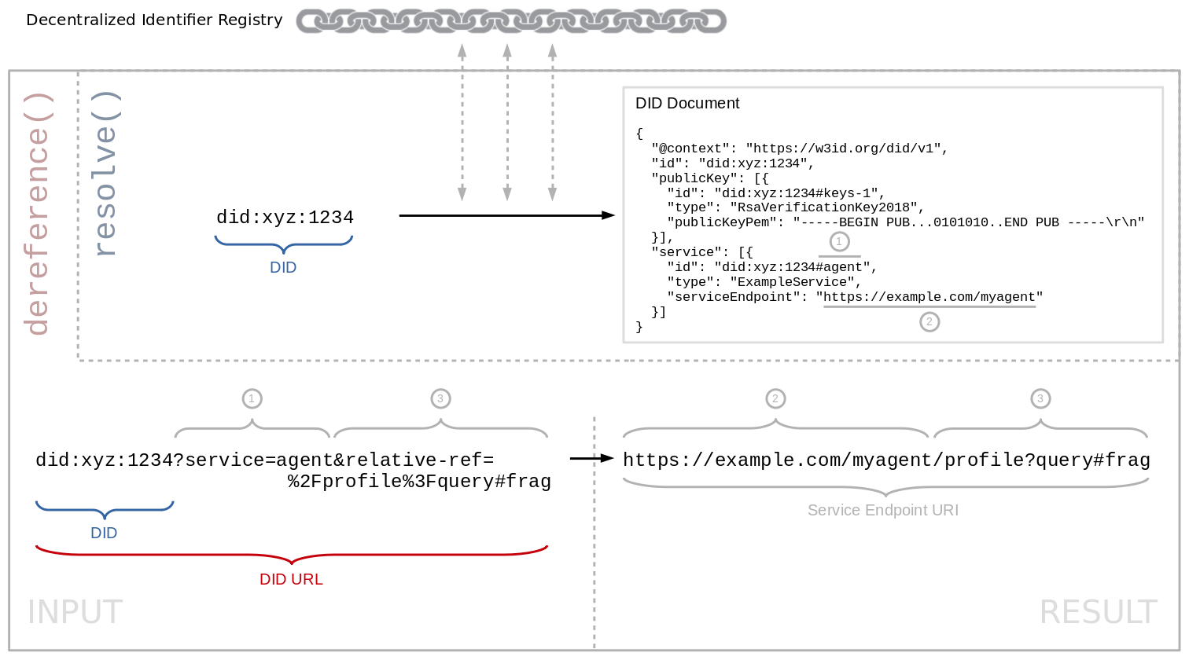
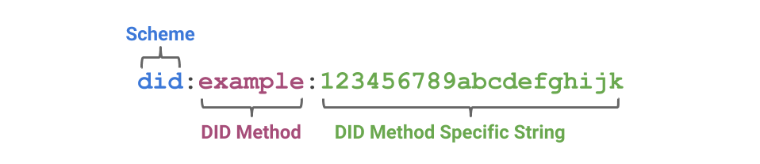
What is DID?
URI form identifier
Method : Platform of DID service
Specific String : Resolved to DID document

Slide 7
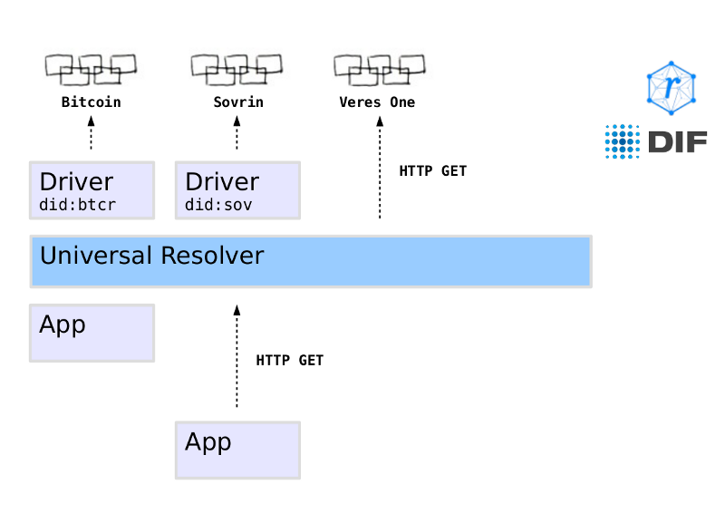
Extensible Driver Network : Universal Resolver
Unified interface resolves any kind of DID
“Driver” of each type comm. with DLT
Drivers’ job may be different each other

Slide 8
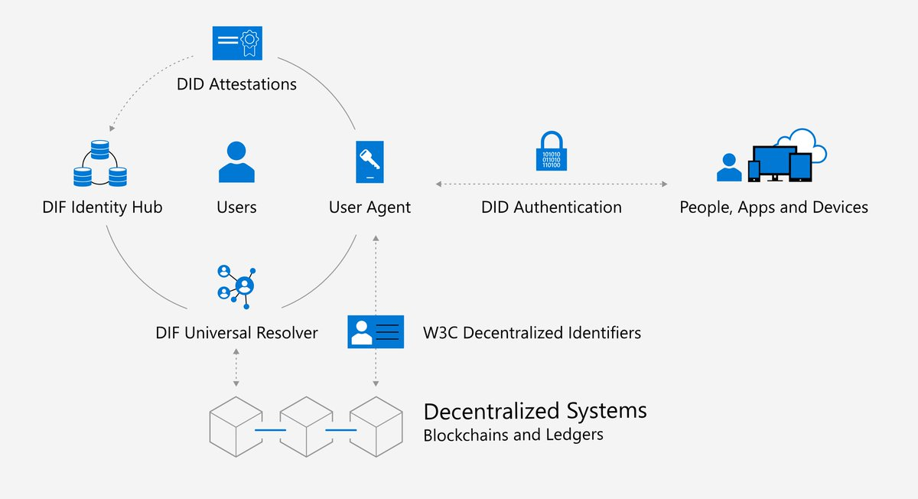
DID Standardization

Slide 9









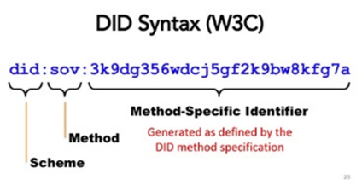
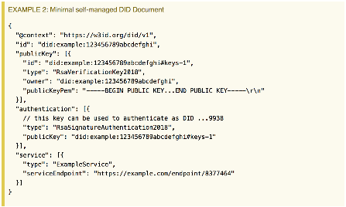




DID Request Life Cycle
Universal Resolver
5. Resolve Given DID Request
Blockchain Networks
6. Request DID Document with resolved request
Blockchain Drivers
7. Return DID Document
4. If Cache Miss, Call Driver
8. Store DID Document
Cache
3. Lookup Cache
9. Return DID Document
3*. If Cache Hit, return DDO
Community Resolver
2. Send DID Request
10. Return DID Document
12. Update DID Subject Status
1. Request Identity
11. Return DID Document
DID Subject
DID Requester

Slide 10




DID Security Analysis
Universal Resolver
4. Third-Party
Device Driver Issue
5. Resolve Given DID Request
Blockchain Networks
6. Request DID Document with resolved request
Blockchain Drivers
7. Return DID Document
4. If Cache Miss, Call Driver
8. Store DID Document
3. Side Channel Information Leak Issue
Cache
3. Lookup Cache
9. Return DID Document
3*. If Cache Hit, return DDO
Community Resolver
2. DID Query Procedure Protection Issue
2. Send DID Request
10. Return DID Document
1. Blockchain Wallet Issue
12. Update DID Subject Status
1. Request Identity
11. Return DID Document
DID Subject
DID Requester

Slide 11

Solution : SEDRA on UR
Universal Resolver
Blockchain Networks
Blockchain Drivers
6. Detour POST Message to SEDRA
5. Send ephID to Blockchain Driver
SEDRA
Driver Message Receiver
EphID Generator
4. Store realID – ephID map to Cache
3. Send DID to generate ephemeral ID
8. Send realID string
Cache
7*. Deliver Cached realID
7. Deliver POST message
SEDRA FE
9. Return DID Document
10. Return DID Document
2. Send DID to SEDRA
12. Update DID Subject Status
1. Request Identity
11. Return Document
DID Subject
DID Requester

