Slide 1
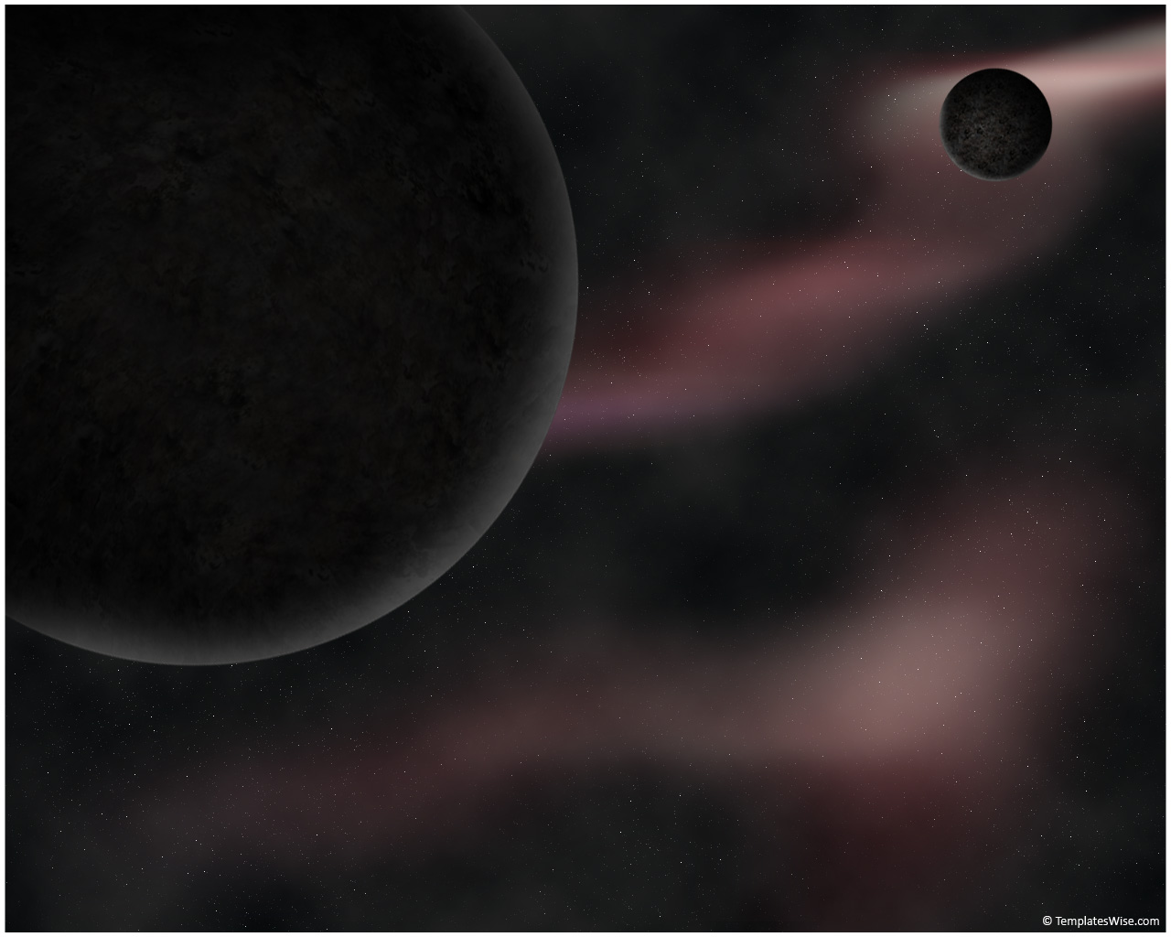
Orbital Motion About Asteroids
Ali Siahkamari

Slide 2
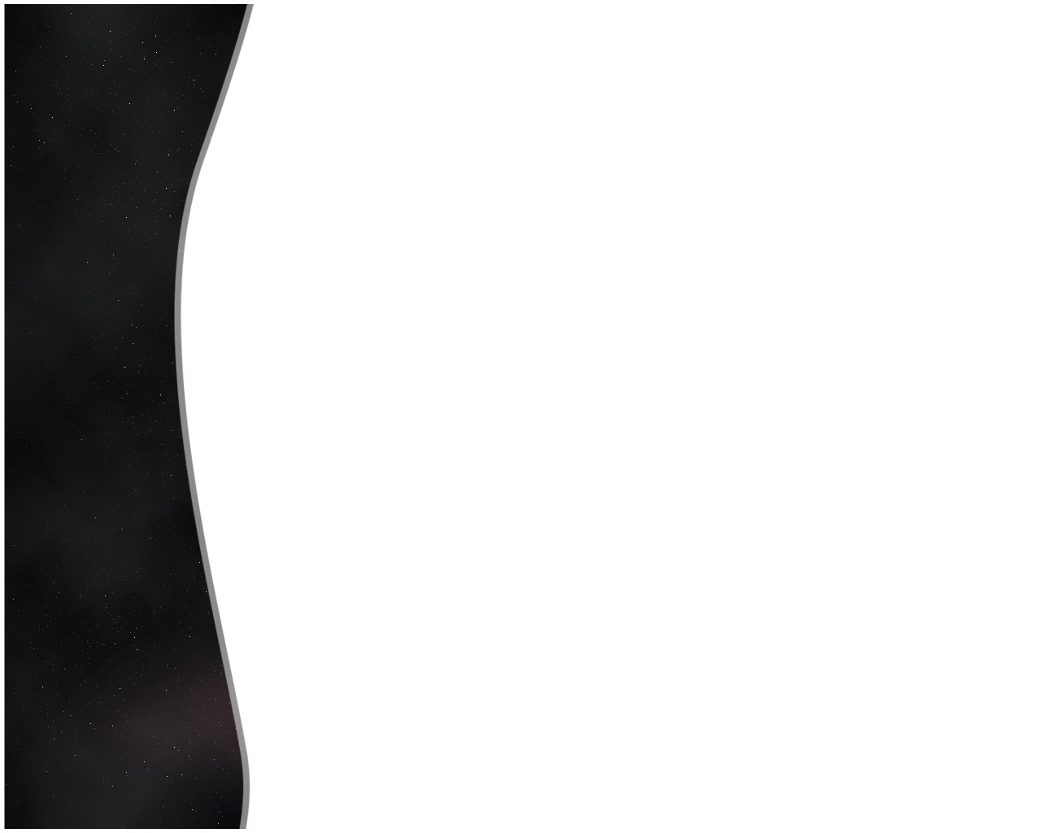
Titre
Introduction
Environment of asteroids.
Potential function.
Equations of motion.
Simulation.
Guass planetry equations.
Averaging results.

Slide 3
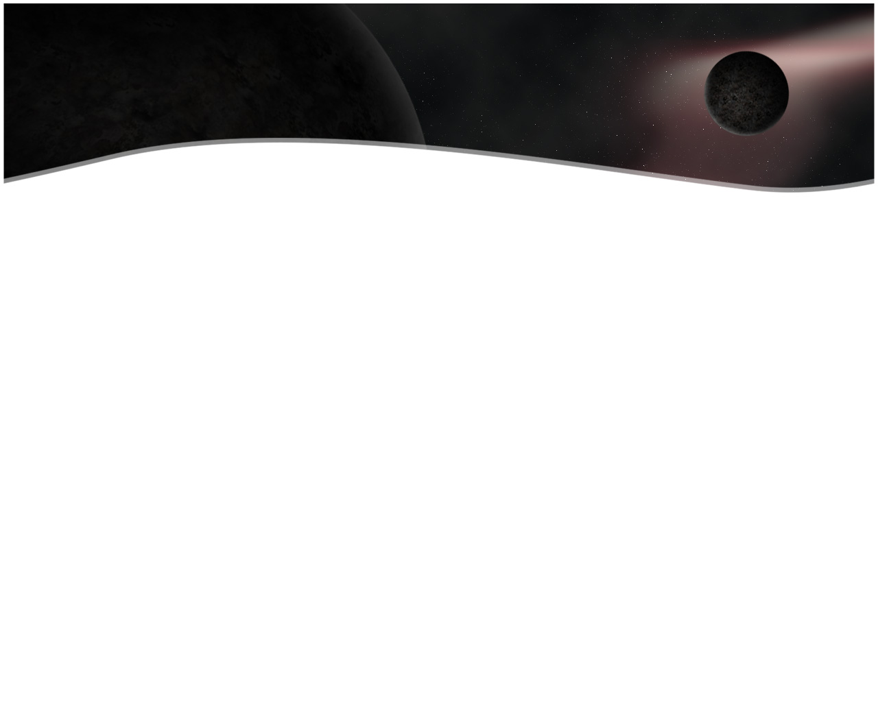
Introduction
In this presentation methods of analysis to quickly and systematically evaluate the dynamical environment close to an asteroid are
presented, concentrating on the effect of the asteroid’s gravity field and rotation state on a spacecraft orbit.
Due to their different state of rotation and irregular shape each of them
has its own characterestic to orbit around. So analytic studies can be
Helpful to capture some of their important characterestics. Such an
analysis is useful and needed for missions to small solar system bodies
such as asteroids and comets.

Slide 4
Environment
There are some assumtion we can make when talking about general asteroids:
Cause they have internal dissipation of energy after some time they finally
start to rotate uniformly about their maximum moment of inertia axis
which we take here az Z axis.
For their small volume and density, effect of perterbation from other planets
can be very important, perturbation like SRP.
When orbiting close to them the most important perturbation is from the
Irregular shaped body and simply we can neglect other perturbation.

Slide 5
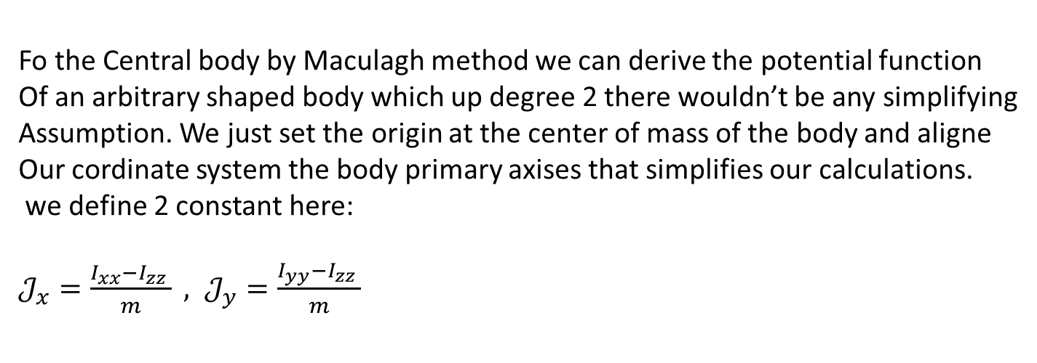
Potential Function
Fo the Central body by Maculagh method we can derive the potential function
Of an arbitrary shaped body which up degree 2 there wouldn’t be any simplifying
Assumption. We just set the origin at the center of mass of the body and aligne
Our cordinate system the body primary axises that simplifies our calculations.
we define 2 constant here:
$𝒥_{x}=\frac{I_{xx}−I_{zz} }{m} , 𝒥_{y}=\frac{I_{yy}−I_{zz} }{m}$

Slide 6
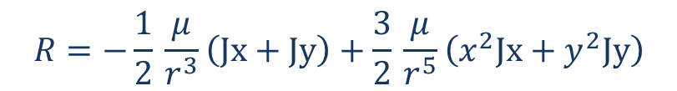
Potential Function
The perturbing potential Function up to degree 2 will be:
$$R=−\frac{1}{2}⁢\frac{μ}{r^{3}}⁢\left(Jx+Jy\right)+\frac{3}{2}⁢\frac{μ}{r^{5}}⁢\left(x^{2}⁢Jx+y^{2}⁢Jy\right)$$
Which is similar to potential function derived by spherical harmonic method
Up to degree and order 2

Slide 7
Equation of motion
We can write the equation om motion in 2 different frames
The inertial frame
The body fixed frame

Slide 8
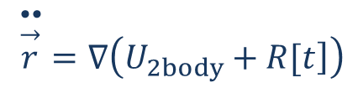
Equation of motion
The inertial frame :
$$\overset{••}{\overset{→}{r}}=∇\left(U_{2⁢body}+\left.R[t\right]\right)$$
The disadvantage of this method is that the potential is a function of time due to
Asteroid rotation.

Slide 9
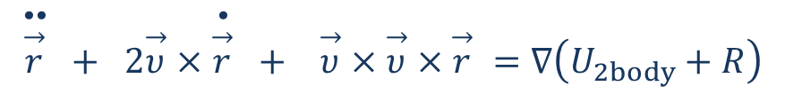
Equation of motion
The body fixed frame :
$$\overset{••}{\overset{→}{r}} + 2⁢\overset{→}{υ}×\overset{•}{\overset{→}{r}} + \overset{→}{υ}×\overset{→}{υ}×\overset{→}{r} =∇\left(U_{2⁢body}+R\right)$$

Slide 10



Simulation
With both these equation of motion and some assumed values
For gravitational parametres of the asteroid as below we simmulate
Some orbits abot the bodies with different rotation rates
$$Jx=1.1012∗{10}^{9};$$
$$Jy=0.35∗{10}^{8};$$
$$m=8.4∗{10}^{16};$$

Slide 11
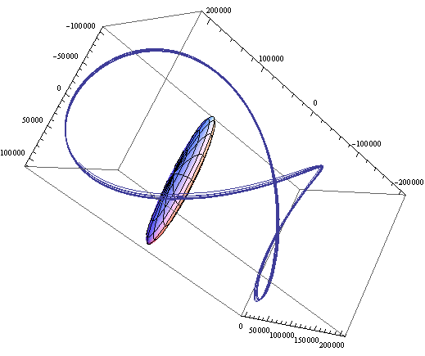
Simulation
Body fixed frame periodic orbit
Rotation peroid in the order
Of the mean motion of the satellite

Slide 12
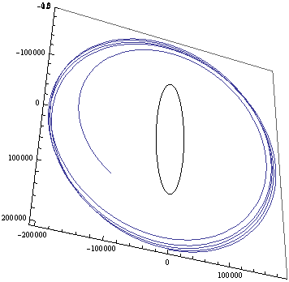
Simulation
Inertial frame impacting orbit
Rotation peroid in the order
Of the mean motion of the satellite

Slide 13
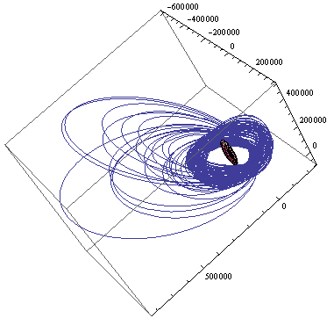
Simulation
Inertial escaping orbit
Rotation peroid in the order
Of the mean motion of the satellite

Slide 14
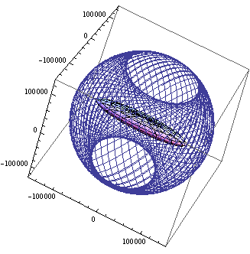
Simulation
Inertial semi peridic orbit
Rotation peroid 2 order of magnitude more
Than the order of the mean motion
of the satellite

Slide 15
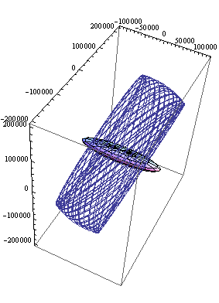
Simulation
Body fixed frame semi peridic orbit
Rotation peroid 1 order of magnitude less than
the order of the mean motion of the satellite

Slide 16
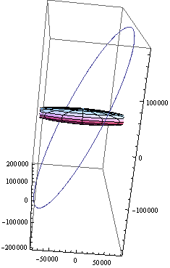
Simulation
Body fixed frame peridic orbit
Rotation peroid 1 order of magnitude less than
the order of the mean motion of the satellite

Slide 17
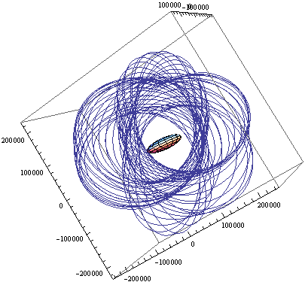
Simulation
Inertial frame orbit
Asteroid with no rotation

Slide 18
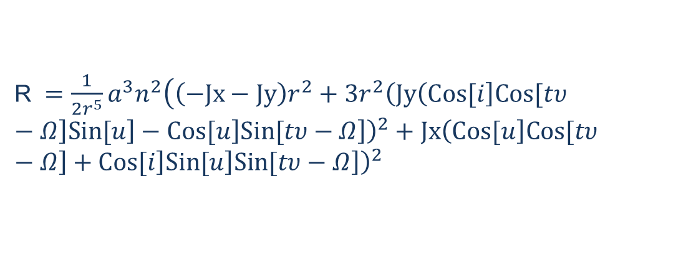
Guass planetry equations
The first to do is to write the potential function
in terms of orbital elements
R $=\frac{1}{2⁢r^{5}}⁢a^{3}⁢n^{2}⁢\left(\left(−Jx−Jy\right)⁢r^{2}+3⁢r^{2}⁢\left(Jy⁢{\left(\left.Cos[i\right]⁢\left.Cos[t⁢υ−Ω\right]⁢\left.Sin[u\right]−\left.Cos[u\right]⁢\left.Sin[t⁢υ−Ω\right]\right)}^{2}+Jx⁢{\left(\left.Cos[u\right]⁢\left.Cos[t⁢υ−Ω\right]+\left.Cos[i\right]⁢\left.Sin[u\right]⁢\left.Sin[t⁢υ−Ω\right]\right)}^{2}\right)\right)$

Slide 19
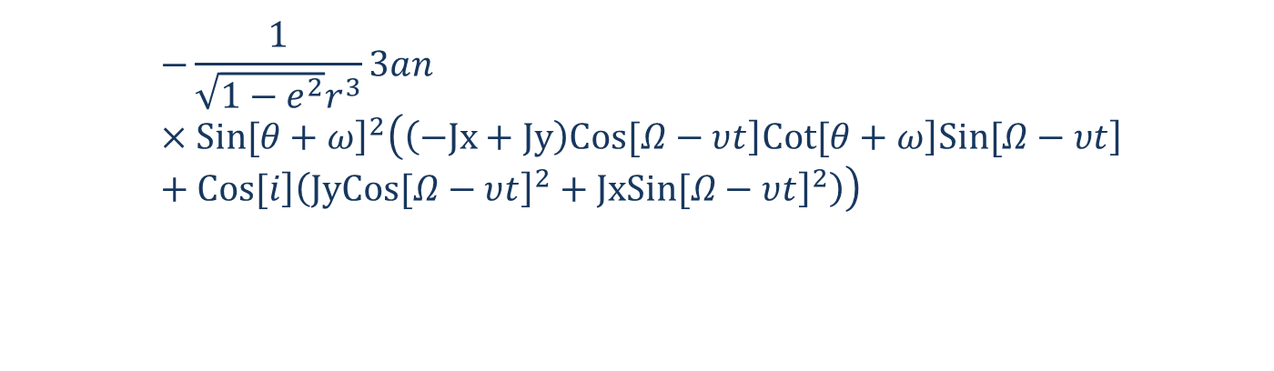
Guass planetry equations
If we write the guass equation for example for Right ascention we get
$$\frac{d}{dt}Ω=$$
$$−\frac{1}{\sqrt{1−e^{2}}⁢r^{3}}⁢3⁢a⁢n⁢{\left.Sin[θ+ω\right]}^{2}\left(\left(−Jx+Jy\right)⁢\left.Cos[Ω−υ⁢t\right]⁢\left.Cot[θ+ω\right]⁢\left.Sin[Ω−υ⁢t\right]+\left.Cos[i\right]⁢\left(Jy⁢{\left.Cos[Ω−υ⁢t\right]}^{2}+Jx⁢{\left.Sin[Ω−υ⁢t\right]}^{2}\right)\right)$$
Here we need to decide what to do if we want to average thse osculating rates
And derive the secular rates. Cause these rates are function of 2 fast variables
True anomaly and time

Slide 20
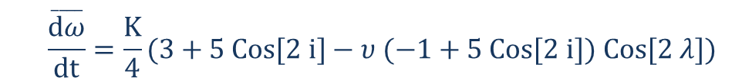
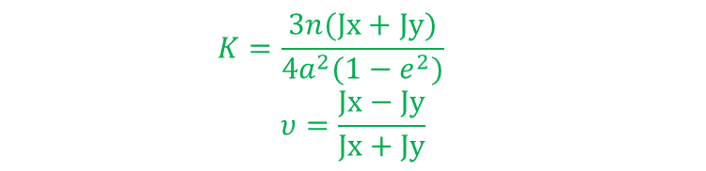
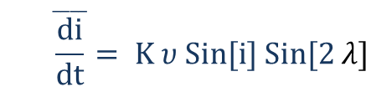
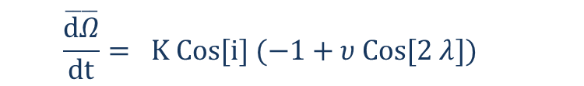
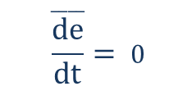
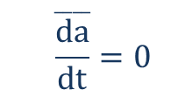
Averaging results
In some refferences the focus has been on the slowly rotating asteroids
So the rotation of the asteroid in one orbit of the satellite has been neglected.
And the averagin results are as folows
Averaging results
$$\overset{____}{\frac{da}{dt}}=0$$
$$\overset{____}{\frac{de}{dt}}= 0$$
$$\overset{____}{\frac{dΩ}{dt}}= K Cos[i] (−1+υ Cos[2 λ])$$
$$\overset{____}{\frac{di}{dt}}= K υ Sin[i] Sin[2 λ]$$
$$\overset{____}{\frac{dω}{dt}}=\frac{K}{4}(3+5 Cos[2 i]−υ (−1+5 Cos[2 i]) Cos[2 λ])$$
$$K=\frac{3n(Jx+Jy)}{4a^{2}(1−e^{2})}$$
$$υ=\frac{Jx−Jy}{Jx+Jy}$$
$$\overset{____}{\frac{dM}{dt}}=n−\frac{K}{4}(1+3Cos\left[2 i\right]+6υCos[2(λ)]{Sin[i]}^{2})$$

Slide 21

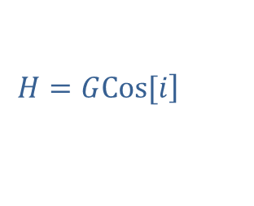

Averaging results
In some refferences the numerical analysis has been used. And the integral has
Been computed for different values in plots
$$C=\frac{−μ}{2⁢a}$$
$$G=\sqrt{μ⁢a⁢\left(1−e^{2}\right)}$$
$$H=G⁢\left.Cos[i\right]$$

Slide 22
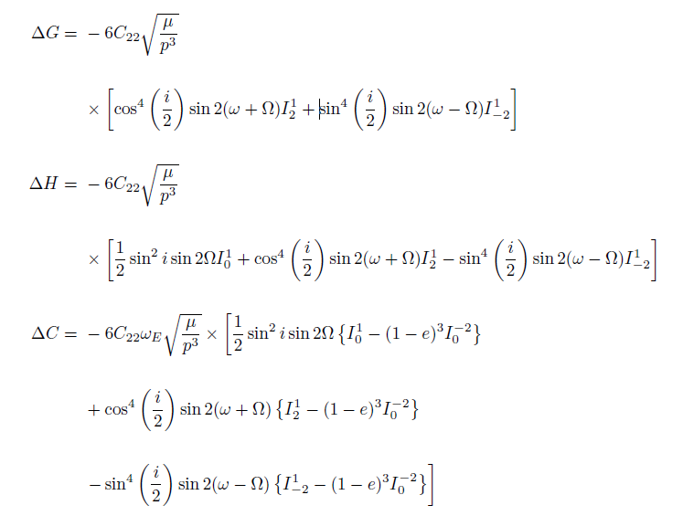
Averaging results

Slide 23
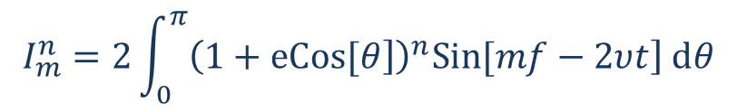
Averaging results
Which I is defined as
$$I_{m}^{n}=2⁢\int_{0}^{π}{{\left(1+\left.eCos[θ\right]\right)}^{n}⁢\left.Sin[m⁢f−2⁢υ⁢t\right]⁢ⅆθ}$$

Slide 24
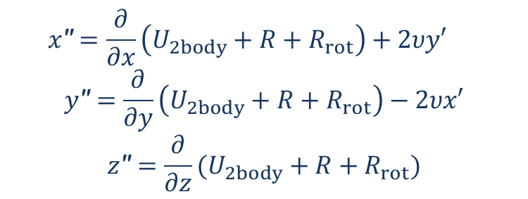
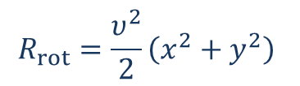
Averaging results
Another approch that we have used is to look at the orbit in the body fixed
Frame. In this way there wouldnt be any time variations in potential functions.
We just need to see the curiolis and centrifugal terms of the
equations of motion as the perturbation
$$x\text{′′}=\frac{∂}{∂x}\left(U_{2body}+R+R_{rot}\right)+2υy′$$
$$y\text{′′}=\frac{∂}{∂y}\left(U_{2body}+R+R_{rot}\right)−2υx′$$
$$z\text{′′}=\frac{∂}{∂z}(U_{2body}+R+R_{rot})$$
$$R_{rot}=\frac{υ^{2}}{2}\left(x^{2}+y^{2}\right)$$

Slide 25
Averaging results
We just need to examine each term of the perturbation and derive the
Secular rates for them and sum them up.
Here they folows

Slide 26
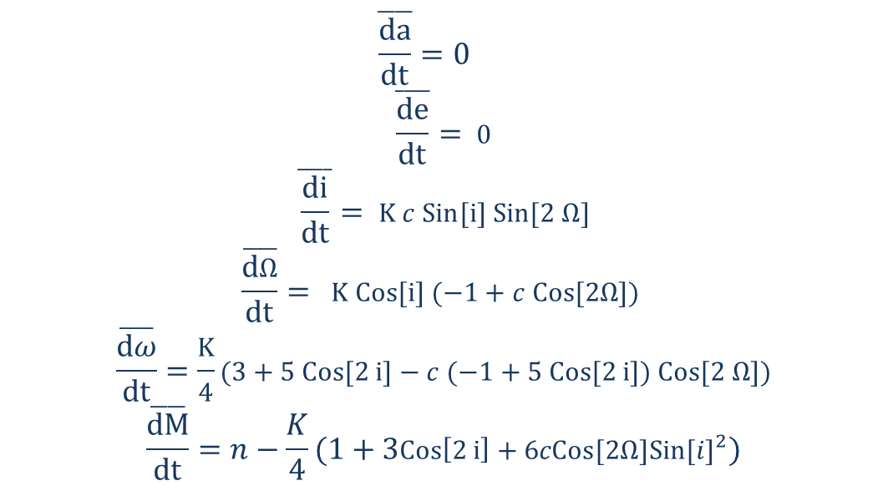
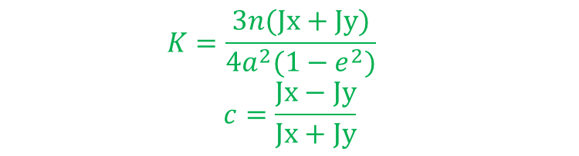
Averaging results
Perturbation from R
$$\overset{____}{\frac{da}{dt}}=0$$
$$\overset{____}{\frac{de}{dt}}= 0$$
$$\overset{____}{\frac{di}{dt}}= K c Sin[i] Sin[2 Ω]$$
$$\overset{____}{\frac{dΩ}{dt}}= K Cos[i] (−1+c Cos[2Ω])$$
$$\overset{____}{\frac{dω}{dt}}=\frac{K}{4}(3+5 Cos[2 i]−c (−1+5 Cos[2 i]) Cos[2 Ω])$$
$$\overset{____}{\frac{dM}{dt}}=n−\frac{K}{4}(1+3Cos\left[2 i\right]+6cCos[2Ω]{Sin[i]}^{2})$$
$$K=\frac{3n(Jx+Jy)}{4a^{2}(1−e^{2})}$$
$$c=\frac{Jx−Jy}{Jx+Jy}$$

Slide 27
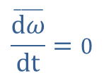
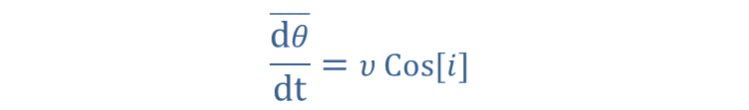
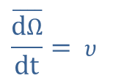
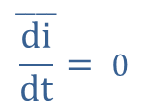
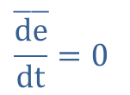
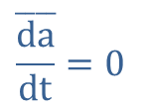
Averaging results
Perturabation from curiolis acceleration
$$\overset{____}{\frac{da}{dt}}=0$$
$$\overset{____}{\frac{de}{dt}}=0$$
$$\overset{____}{\frac{di}{dt}}= 0$$
$$\overset{____}{\frac{dΩ}{dt}}= υ$$
$$\overset{____}{\frac{dθ}{dt}}=υ Cos[i]$$
$$\overset{____}{\frac{dω}{dt}}=0$$

Slide 28
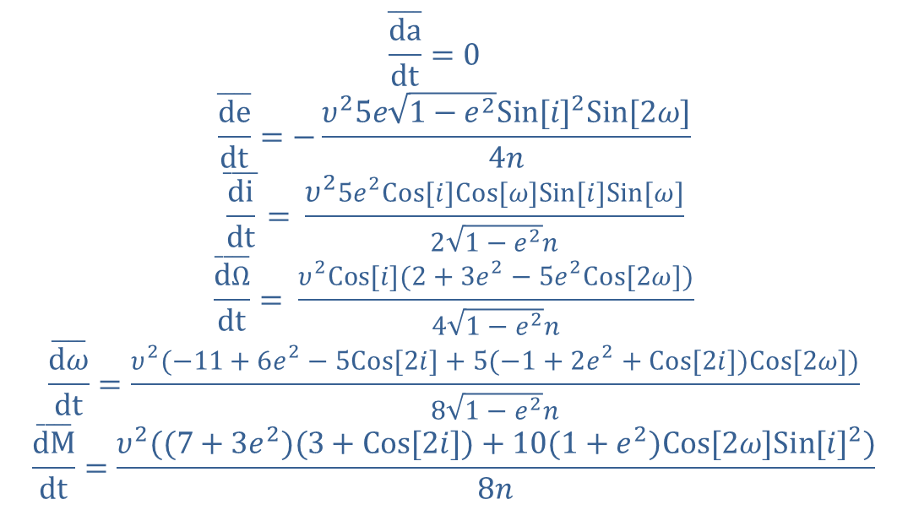
Averaging results
Perturabation from centrifugal acceleration
$$\overset{____}{\frac{da}{dt}}=0$$
$$\overset{____}{\frac{de}{dt}}=−\frac{υ^{2}5e\sqrt{1−e^{2}}{Sin[i]}^{2}Sin[2ω]}{4n}$$
$$\overset{____}{\frac{di}{dt}}= \frac{υ^{2}5e^{2}Cos[i]Cos[ω]Sin[i]Sin[ω]}{2\sqrt{1−e^{2}}n}$$
$$\overset{____}{\frac{dΩ}{dt}}= \frac{υ^{2}Cos[i](2+3e^{2}−5e^{2}Cos[2ω])}{4\sqrt{1−e^{2}}n}$$
$$\overset{____}{\frac{dω}{dt}}=\frac{υ^{2}(−11+6e^{2}−5Cos[2i]+5(−1+2e^{2}+Cos[2i])Cos[2ω])}{8\sqrt{1−e^{2}}n}$$
$$\overset{____}{\frac{dM}{dt}}=\frac{υ^{2}((7+3e^{2})(3+Cos[2i])+10(1+e^{2})Cos[2ω]{Sin[i]}^{2})}{8n}$$

Slide 29
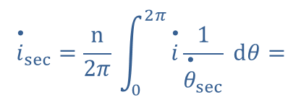
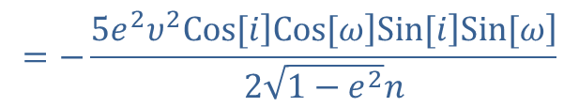
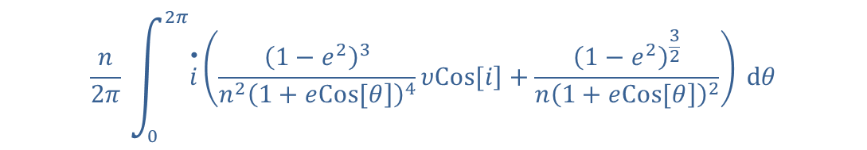
Averaging results
But we know that these perturbation are peridic and their secular rates
Must be zero except for True anomaly and Right ascention of ascending node
So if we examine perturbation from coriolis acceleration by degree 2 we see
That some of these term cancel by perturbation from centrifugal acceleration
We show for inclination here
$$\frac{n}{2⁢π⁢}⁢\int_{0}^{2⁢π}{\overset{•}{i}⁢\left(\frac{⁢{\left(1−e^{2}\right)}^{3}}{{n^{2}\left(1+e⁢\left.Cos[θ\right]\right)}^{4}}⁢υ⁢\left.Cos[i\right]+\frac{⁢{\left(1−e^{2}\right)}^{\frac{3}{2}}}{{n\left(1+e⁢\left.Cos[θ\right]\right)}^{2}}\right)⁢ⅆθ}$$
$${\overset{•}{i}}_{sec}=\frac{n}{2⁢π⁢}⁢\int_{0}^{2⁢π}{\overset{•}{i}⁢\frac{1}{{\overset{•}{θ}}_{sec}}⁢ⅆθ}=$$
$$=−\frac{5⁢e^{2}⁢υ^{2}⁢\left.Cos[i\right]⁢\left.Cos[ω\right]⁢\left.Sin[i\right]⁢\left.Sin[ω\right]}{2⁢\sqrt{1−e^{2}}⁢n}$$

Slide 30
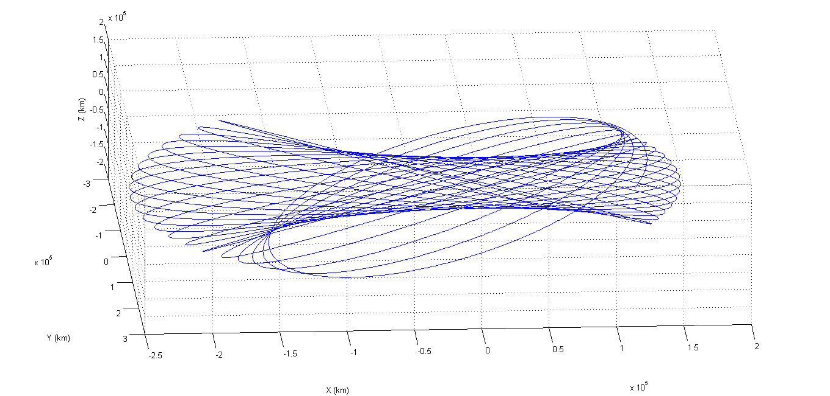
Averaging results
Simmulation of the averaged results and exact results

Slide 31
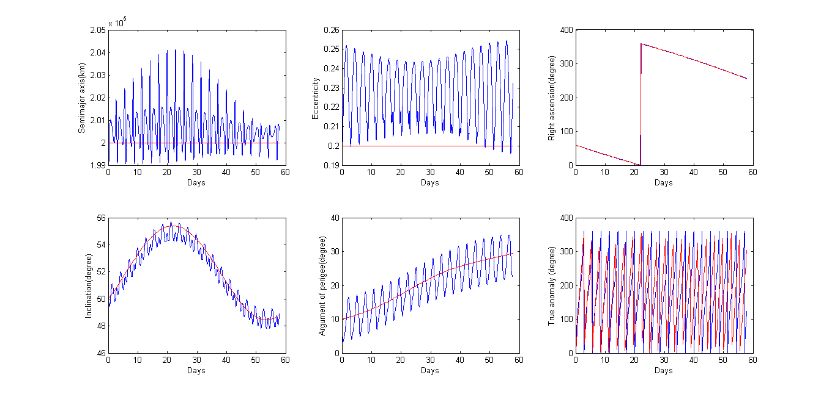
Averaging results
Simmulation of the averaged results and exact results

Slide 32
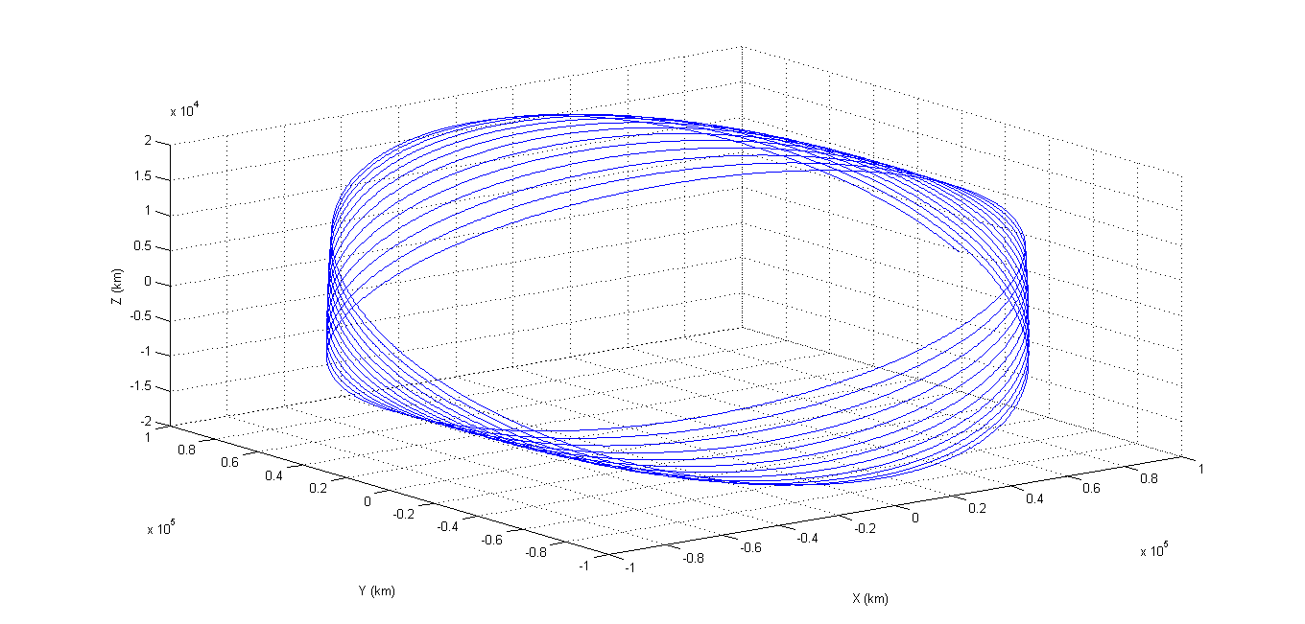
Averaging results

Slide 33
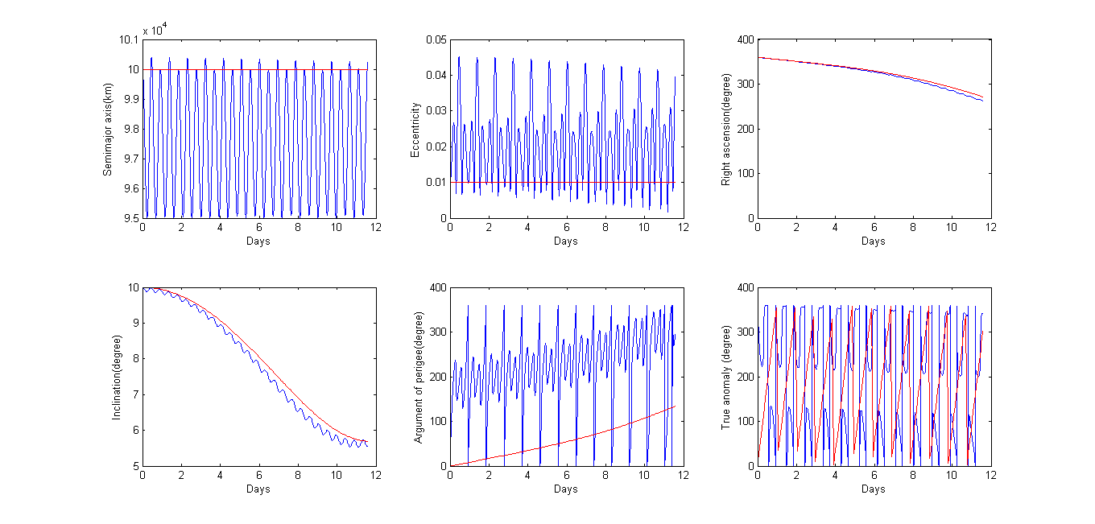
Averaging results

Slide 34
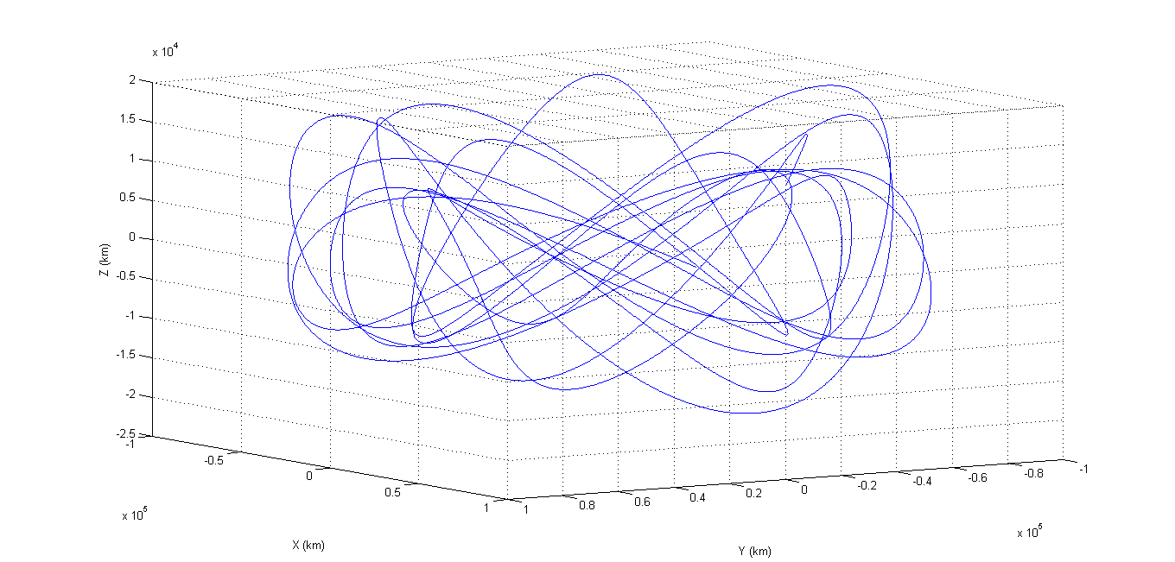
Averaging results

Slide 35
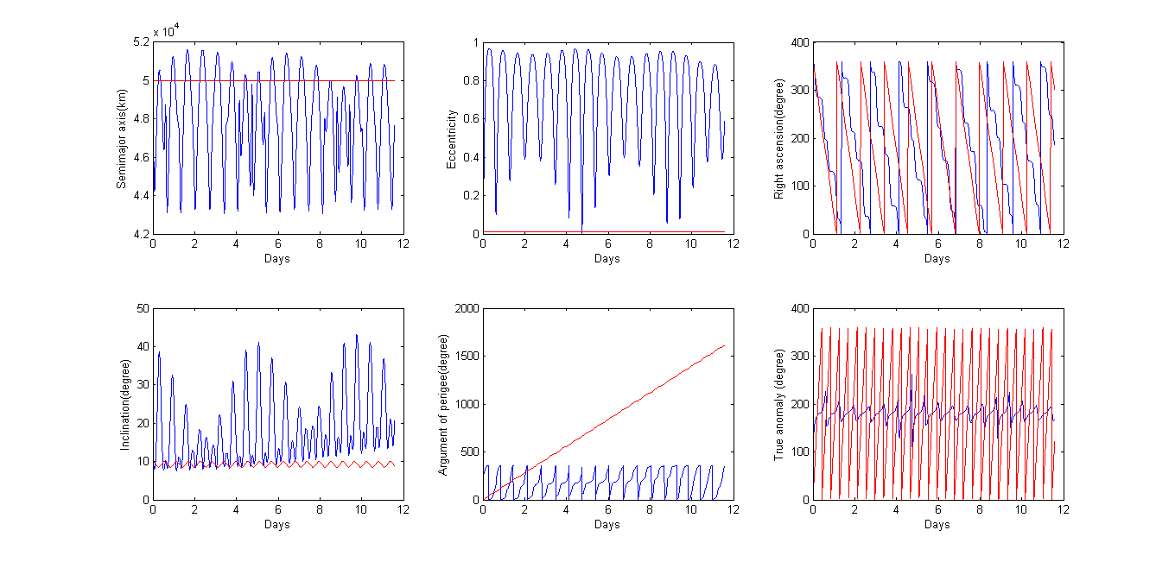
Averaging results

Slide 36
The End
Thank you for your attention ☺

