Slide 1

Efficient Low-Rank Matrix Approximation algorithms: global comparison
Su Yanzhen, Tahir Mahamat Saleh, Coulibaly Zie Siaka

Slide 2
CONTENTS
1 - MOTIVATION
2- IMPLEMENTATION
3- EVALUATION AND RESULTS
4- DISCUSSION AND DEMO

Slide 3

MOTIVATION AND INTRODUCTION
1. SVD : The gold standard for low-rank approximation
2. NMF : Useful for parts-based representation and interpretability (requiring non-negative constraints)
3. CUR : Provides interpretability by selecting actual columns and rows from the data

Slide 4

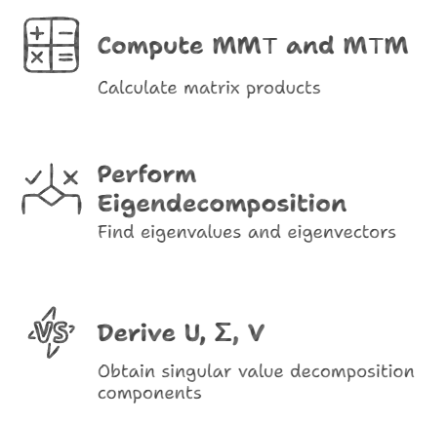
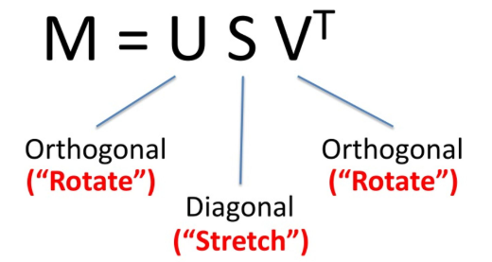
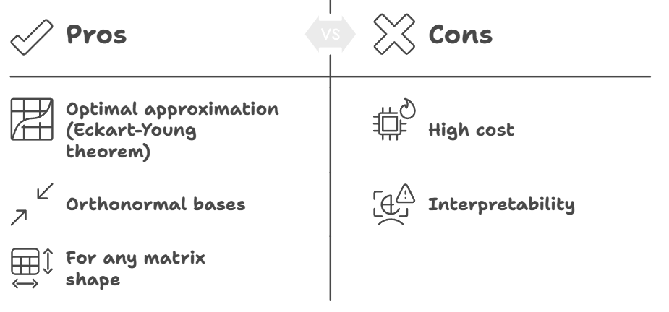
SVD

Slide 5
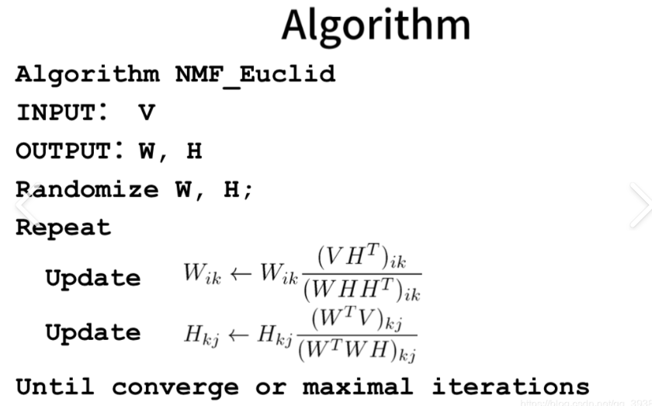
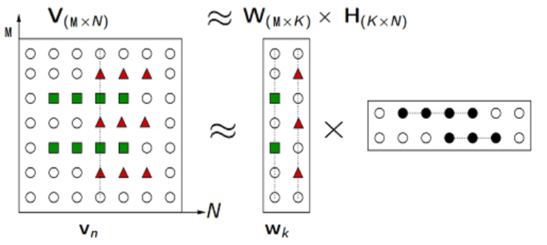
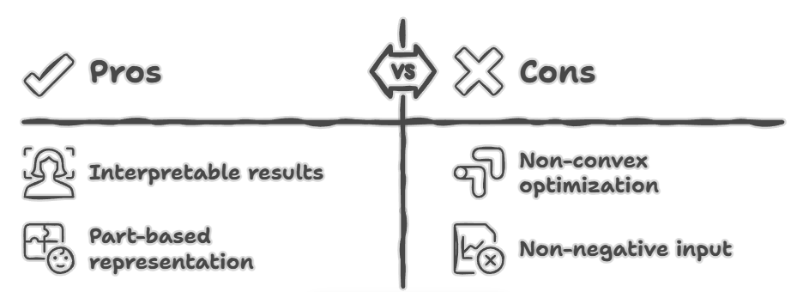
NMF

Slide 6

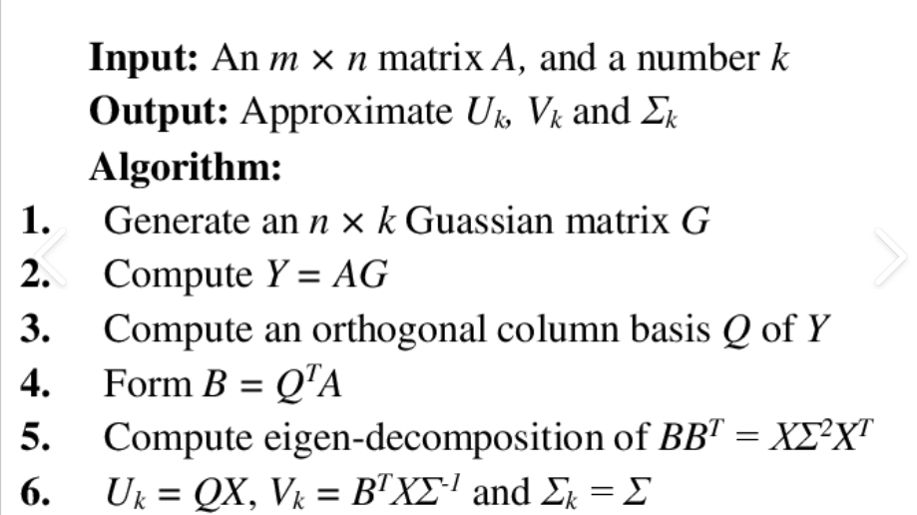
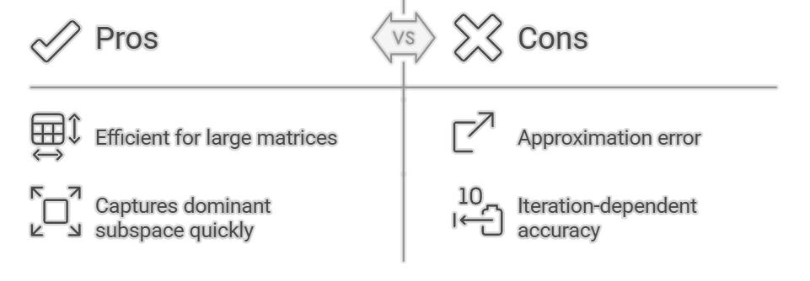
Randomized or Stochastic versions

Slide 7
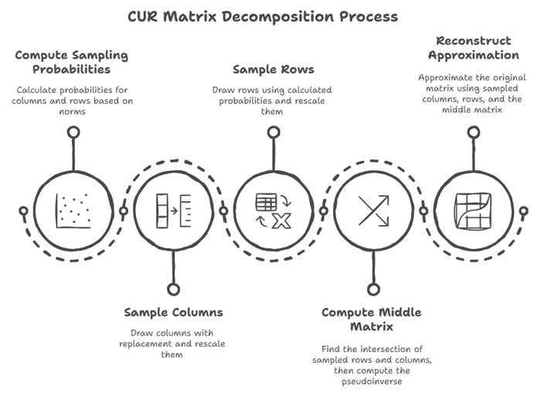
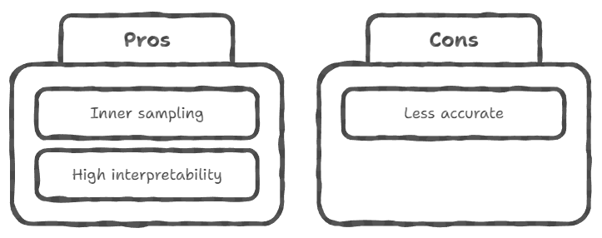
CUR

Slide 8
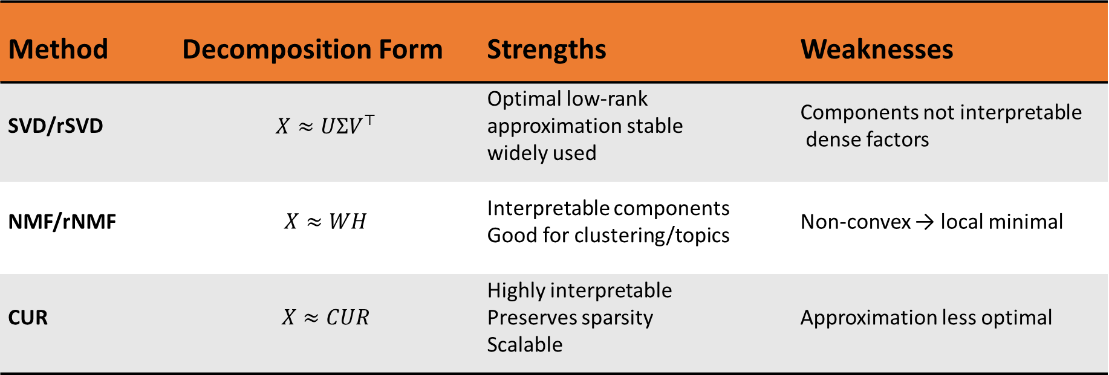
Summary
Method | Decomposition Form | Strengths | Weaknesses
SVD/rSVD | $$X≈UΣV^{⊤}$$ | Optimal low-rank approximation stable widely used | Components not interpretable dense factors
NMF/rNMF | $$X≈WH$$ | Interpretable components Good for clustering/topics | Non-convex → local minimal
CUR | $$X≈CUR$$ | Highly interpretable Preserves sparsity Scalable | Approximation less optimal

Slide 9
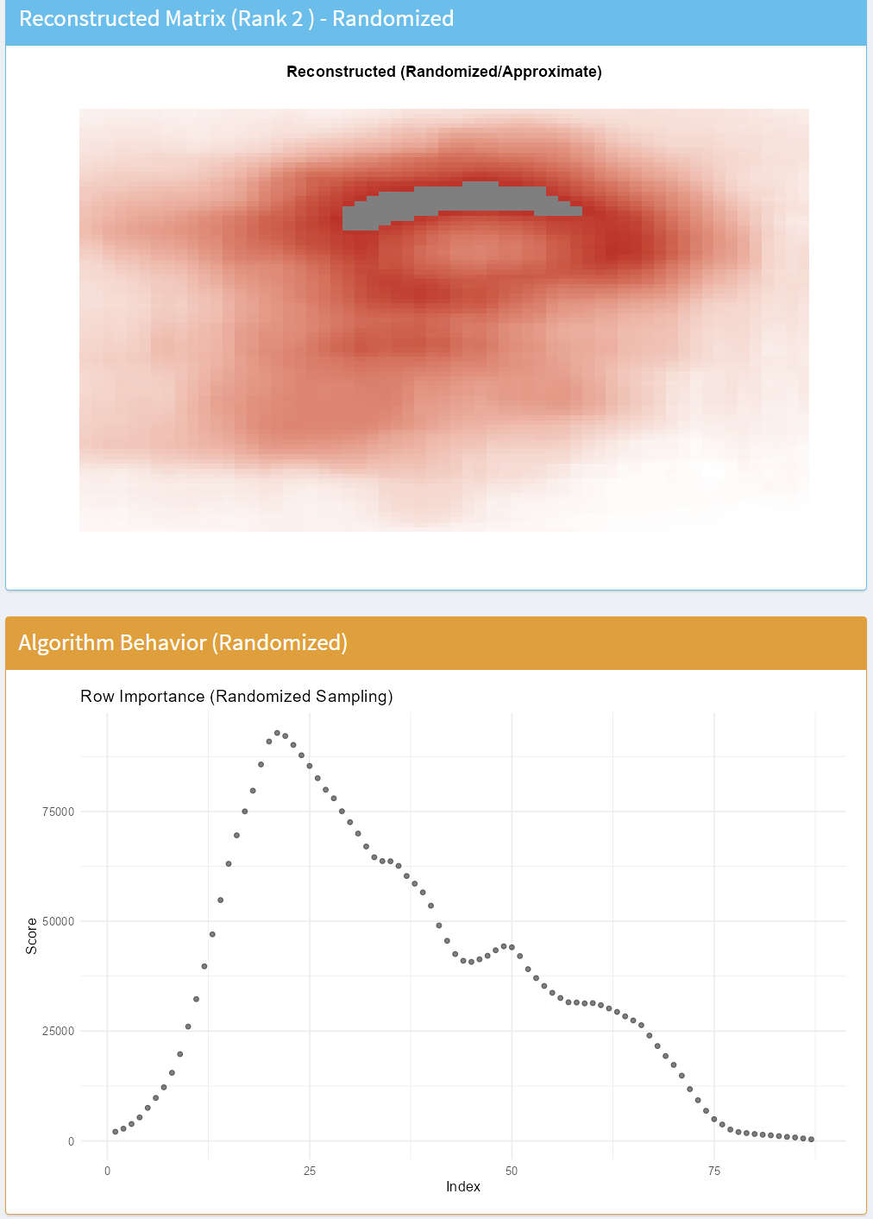
Demo for the Shiny Dashboard and Conclusion

Slide 10
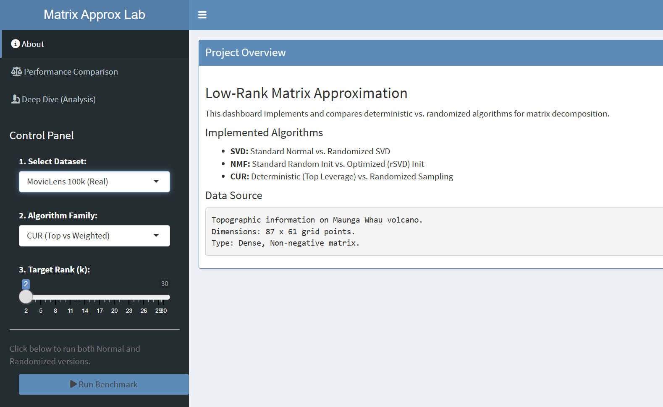
Shiny dashboard
Performance Comparison
Deep Analysis
Choice of Target Rank
Three Matrix Approximation Algorithms
Three Optional Data Sources:
  Two real-word datasets – for illustrating the features of different algos
  One simulated large matrix – for time performance comparison

Slide 11
Data Sources
MovieLens
A subset with top 200 users × 300 movies
Highly Sparse with >70% zeros
Volcano Topography
A 87×61 matrix representing the elevation of a volcano
Dense, Non-negative with high spatial correlation
Synthetic Matrix
2000×2000 with rank = 50 to simulate large scale data
Gauss noise added to simulate real-world measurements

Slide 12
SVD: Deterministic vs Randomized
Deterministic SVD
Mathematically optimal solution with time complexity O(mn^2)
Randomized SVD
Random projection & Dimensionality reduction with O(mnk)
Features on the datasets
Reconstructed Matrix: Matrix completion(dense)
Factor Components: Top columns of left singular matrix U
Algorithm Behavior: Fluctuation pattern of the eigenvector on each row

Slide 13
NMF: Randomly initialized vs Random HALS
Randomly initialized NMF
Multiplicative update on the full matrix with O(T·mnk)
Randomized HALS
Matrix compression & HALS iteration with O(mnk+T(m+n)k^2)
Features on the datasets
Reconstructed Matrix: Local optimal / prediction
Factor Components: Basis matrix W
Algorithm Behavior: Residual distribution X - WH

Slide 14

CUR: Top-k vs Weight Sampling
Top-k CUR
Select top-k row leverage score with O(mn^2)
Weight Sampling CUR
Probability sampling based on row leverage score with O(mn^2)
Features on the datasets
Reconstructed Matrix: Keep the raw data property(sparse)
Factor Components: Actual selected column C – interpretable raw data
Algorithm Behavior: Row leverage scores(importance of each row)

Slide 15
Conclusion
SVD & NMF: randomized version
Compress then factorize
Performs much faster on large scale datasets
CUR: top-k vs weighted sampling
Bottlenecks lie in the leverage score calculation
Might be optimized by focusing on approximate leverage score computation

