Slide 1
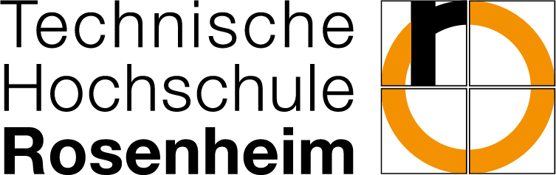
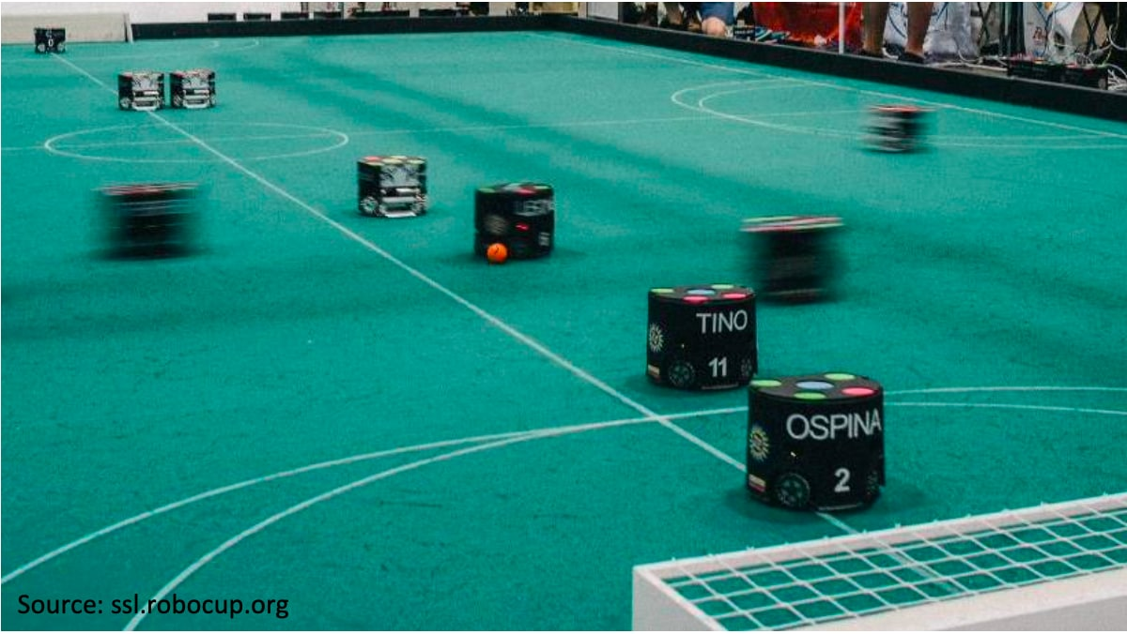
RoboSoccer – Design and development of an image processing system
Project Supervisor : Prof.Dr. Benedikt Dietrich
Master project of the student : Siamak Mirifar
Master Ingenieurwissenschaften, Master Angewandte Forschung und Entwicklung Sommer Semester 2022
Notes:
grüß ihnen, Herzlich willkommen alle zu meinem heutigen Präsentation
Mein heutiger Präsentation wird sich mit der Bildverarbeitung von SSL RoboSoccer befassen.
Weil das gesamte Projekt noch nicht fertig ist, werde ich nur meinen Teil unterstützen, und wir werden zusammen durch den gesamten Prozess führen

Slide 2
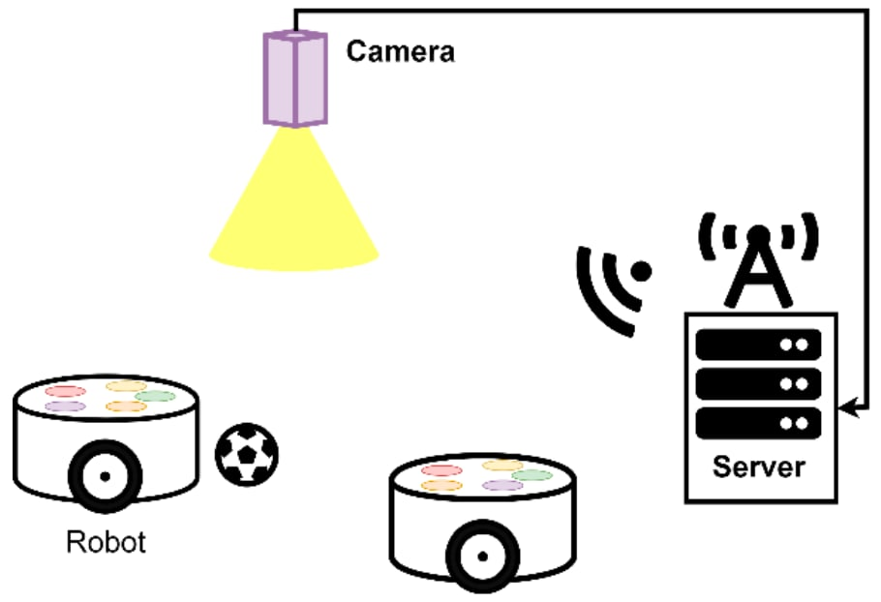
Brief Description
1: Goal My Project
2: The Construction
Master Ingenieurwissenschaften, Master Angewandte Forschung und Entwicklung Sommer Semester 2022
Notes:
My project is limited to a vision system that sends the position of the ball and each robot to each team's software, and with this information, each team running on the server can remotely control the robots on the soccer field.
The setup consists of the robots, a vision system, and a server. The image processing system detects both the robots and the position of the ball on the soccer field.

Slide 3
Challenges of the project
Video recording
Image processing
Robot pattern recognition
Real-time data processing and application performance
Server connection
Graphical user interface (GUI)
Master Ingenieurwissenschaften, Master Angewandte Forschung und Entwicklung Sommer Semester 2022
Notes:
2- The video resolution should be high enough to detect robots and low enough to allow fast image processing.
3- What image processing methods should be used?
4- How to give ID to robots?
5- How can we speed up the process?
6- ....
7- GUI to connect all the functions together (In my presentation I use the term GUI.

Slide 4
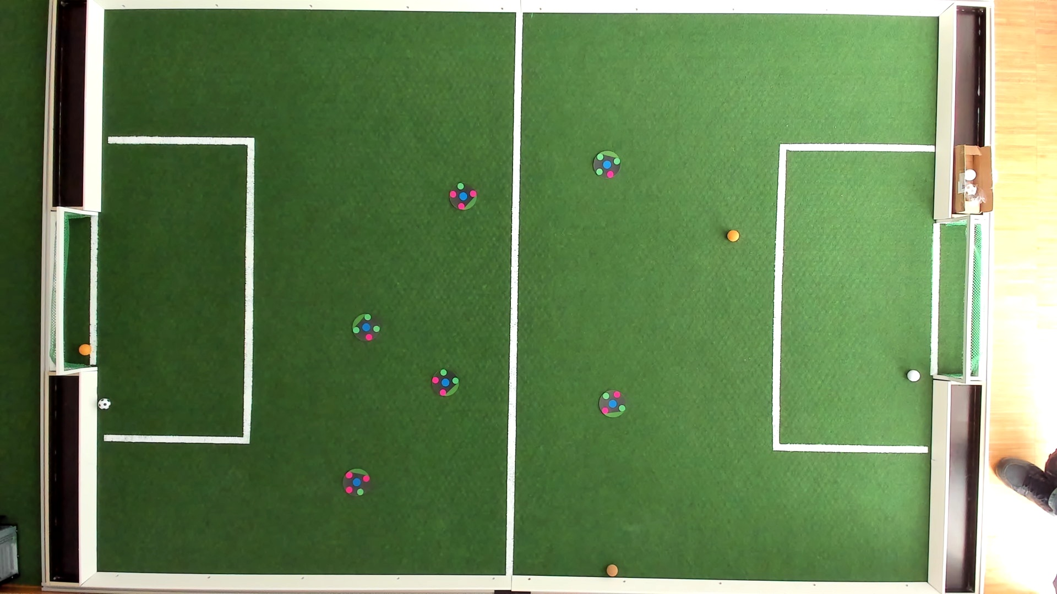
Structure of the soccer field
Structure :
Camera: Logitech Brio 4k
Field size : 277*188 cm
Background color : Dark green
Material: Carpet
Robot radius size : 85 cm
Master Ingenieurwissenschaften, Master Angewandte Forschung und Entwicklung Sommer Semester 2022
Notes:
The sensor is a Logitech Ultra HD (4K). The sensor supports multiple resolutions, including 4K at 30 fps, 1080p at 30 or 60 fps, and 720p (HD) at 30, 60, or 90 fps.
It is important to note that the fps depends on the length of the cable and the quality of the cable. For example, if we use USB 2, we will have lower fps or if we use a very long cable with low quality, the fps will be reduced.
Also it is important to have a dark green background, then it is easier to recognize robots later.

Slide 5

Image Processing
Possibilities of image processing :
OpenCV
Loading image
Video recording
http://opencv.willowgarage.com/wiki/OpenCVLogo
Master Ingenieurwissenschaften, Master Angewandte Forschung und Entwicklung Sommer Semester 2022
Notes:
I have used OpenCv for capturing videos and images.... OpenCV (short for Open Computer Vision) is a free program library of algorithms for image processing and computer vision. OpenCV is written for the programming languages C, C++, Python and Java and is available as free software.
The advantage of OpenCV is that it gives us the ability to upload images and capture video at very high FPS.
It also helps us with image processing to find robots and their position.

Slide 6
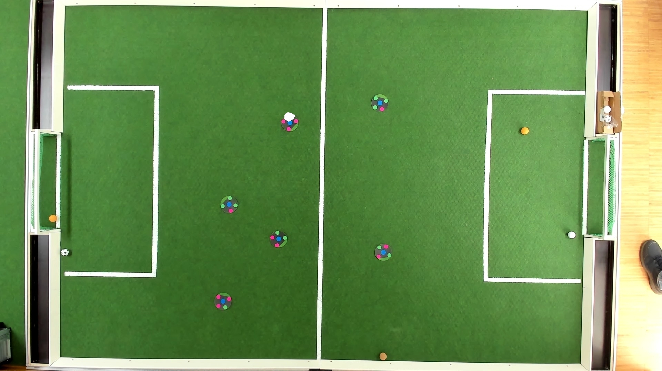
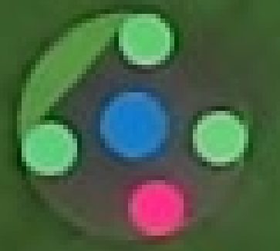
Image Processing
Steps through the process :
Reduce the image size
Blue color detection
Is the area of the blue circle is accepted ?
Saving the pixel position
Master Ingenieurwissenschaften, Master Angewandte Forschung und Entwicklung Sommer Semester 2022
Notes:
1- To speed up the process, we reduce the image resolution from 4k to 1080p.
2- The first and most important step in finding the robot is to look for the blue circle on the field.
3- After finding the blue circle, we check if its size is sufficient. If so, I save the pixel position of the circle.

Slide 7
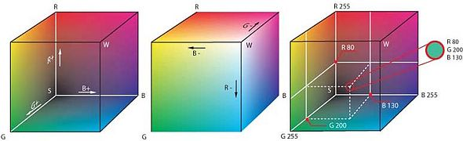
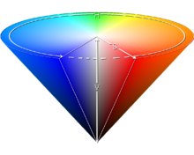
Image Processing
Color space:
The captured images are in RGB color space.
To detect the blue color, we need to use the HSV color space.
https://de.wikipedia.org/wiki/RGB-Farbraum
https://en.wikipedia.org/wiki/HSL_and_HSV
Master Ingenieurwissenschaften, Master Angewandte Forschung und Entwicklung Sommer Semester 2022
Notes:
An RGB color space is an additive color space that replicates color perceptions by additively mixing three primary colors (red, green, and blue). Human color vision is characterized by three cone types.
The HSV color space is the color space of several color models. Here the chromaticity coordinate of a color is defined with the help of the three coordinates:
Color value (English hue): Color angle on the color wheel (0° for red, 120° for green, 240° for blue)
Color saturation: (0% = neutral gray, 50% = little saturated color, 100% = saturated, pure color)
Brightness value (value; also called darkness level): (0% = no brightness, 100% = full brightness)

Slide 8
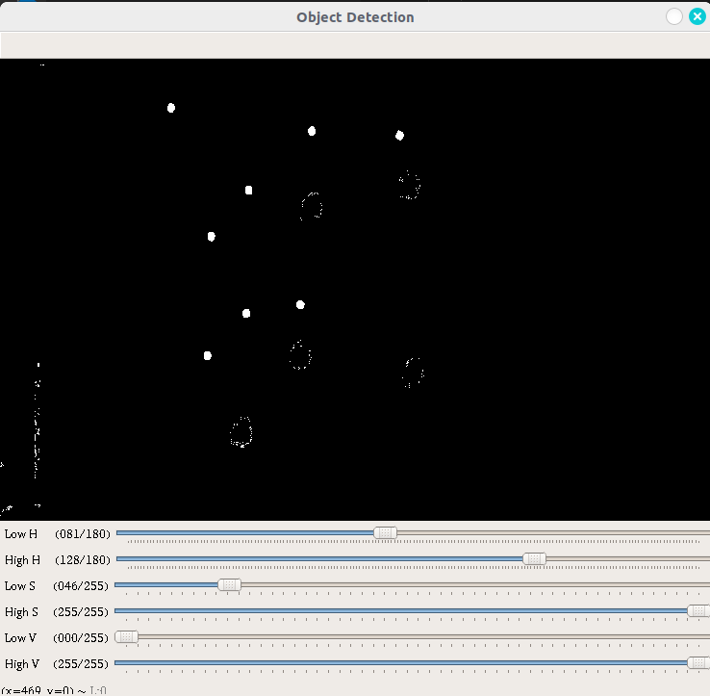
Image Processing
Mask :
In OpenCV, by specifying the lower limits of the color and the upper limits of the color (blue in our case), we can disable all other color spaces.
Master Ingenieurwissenschaften, Master Angewandte Forschung und Entwicklung Sommer Semester 2022
Notes:
Was bedeutet Maske?
In opencv by specifying the lower limits of color and upper limits of color (in our case blue color) we can disable(delete) all other color range.

Slide 9
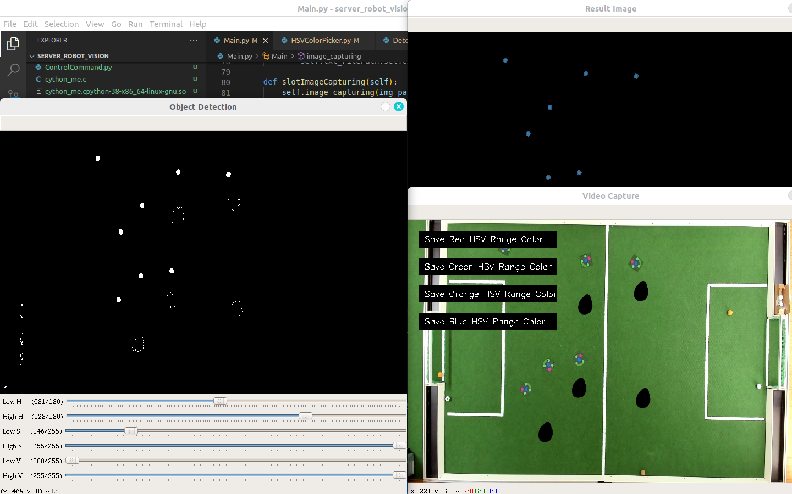
Image Processing
Mask :
Master Ingenieurwissenschaften, Master Angewandte Forschung und Entwicklung Sommer Semester 2022
Notes:
Here we have another view of the same image, which also shows the main image, and we can see the result of masking

Slide 10
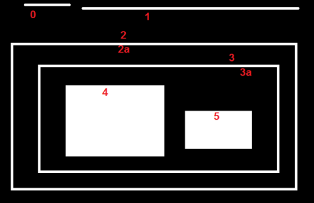
Image Processing
Contours :
Contours can be simply explained as a curve that connects all points constantly (in sequence) that have the same color or intensity (in our case, the color mask is blue).
Areas that are not included
Master Ingenieurwissenschaften, Master Angewandte Forschung und Entwicklung Sommer Semester 2022
Notes:
Contours can be simply explained as a curve that connects all constantly (follow in series) points that have the same color or intensity (in our case the color mask is blue) . The contours are a useful tool for the detection of objects.
!!! As you can see in the picture, the contours can also contain image noise that causes unwanted area.
To avoid this unwanted area, I calculated the needed area (based on pixels) and saved the contours that are in the desired Bereic/area.

Slide 11
Image Processing
Crop image :
Master Ingenieurwissenschaften, Master Angewandte Forschung und Entwicklung Sommer Semester 2022
Notes:
After finding the pixel position of the blue circle, I can crop the image based on the pixel position.
and now we have our robot in the image.

Slide 12
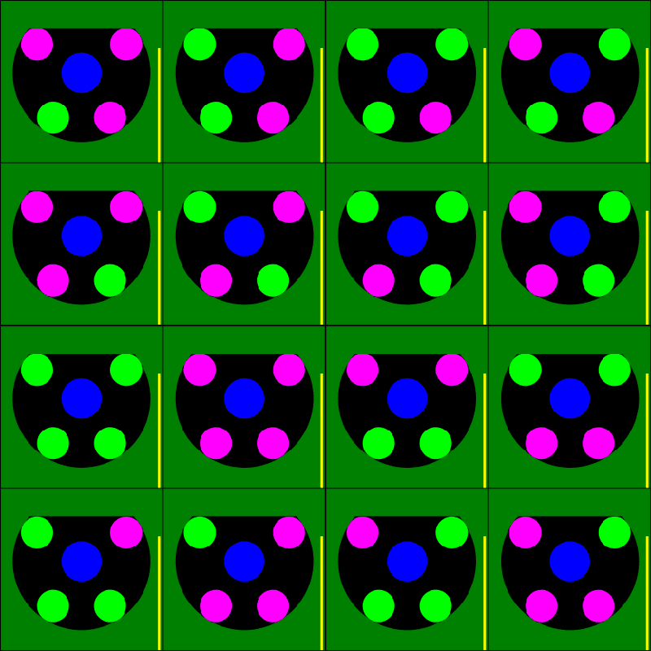
Recognition of robot patterns
Pattern :
1
2
3
4
5
6
7
8
9
10
11
12
13
14
15
16
Master Ingenieurwissenschaften, Master Angewandte Forschung und Entwicklung Sommer Semester 2022
Notes:
Im nächsten Schritt möchte ich den Winkel und die Roboter-ID des Roboters herausfinden.
wie wir sehen können, gibt es 16 Roboter, mit verschiedenen Farbmustern.
Was soll ich tun?
Kreis

Slide 13
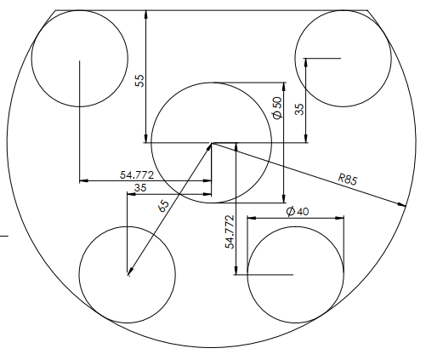
Recognition of robot patterns
Pattern recognition :
2
1
3
4
https://github.com/RoboCup-SSL/ssl-vision/blob/master/patterns/teams/standard/standard2010_template_all_dimensions.pdf
Master Ingenieurwissenschaften, Master Angewandte Forschung und Entwicklung Sommer Semester 2022
Notes:
As you can see, we have pattern which us available from SSLROBOCUP Github that shows how a robot should be seen from above.
to find an ID, first I have to find the angle
1- First I divided the picture into 4 parts

Slide 14
Recognition of robot patterns
TOP_LEFT
0˚
TOP_RIGHTS
2
1
Negative-Angle
Positive-Angle
3
4
DOWN_LEFT
180˚
DOWN_RIGHT
Master Ingenieurwissenschaften, Master Angewandte Forschung und Entwicklung Sommer Semester 2022
Notes:
To calculate the angle, I had to define a reference. Therefore, I consider the right side of the image as a positive angle, and the left side as a negative angle. In this case, the robot is almost -40 from the reference.

Slide 15
Recognition of robot patterns
TOP_LEFT
TOP_RIGHT
2
1
Negative-Angle
Positive-Angle
3
4
DOWN_RIGHT
DOWN_RIGHT
Master Ingenieurwissenschaften, Master Angewandte Forschung und Entwicklung Sommer Semester 2022
Notes:
To find the angle, I first find the shortest line between the centers of all the circles.
In this case both circles are at position 4, bottom right.
then I draw an (imaginary/imagined ) line from the pixel with the smallest x-position value

Slide 16
Recognition of robot patterns
TOP_LEFT
TOP_RIGHT
2
1
Negative-Angle
Positive-Angle
3
4
DOWN_LEFT
DOWN_RIGHT
Master Ingenieurwissenschaften, Master Angewandte Forschung und Entwicklung Sommer Semester 2022
Notes:
Since it is clear, I could calculate the angle with the tangent function

Slide 17
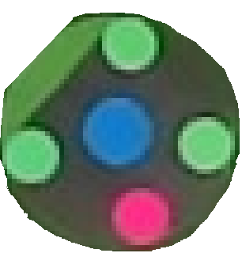
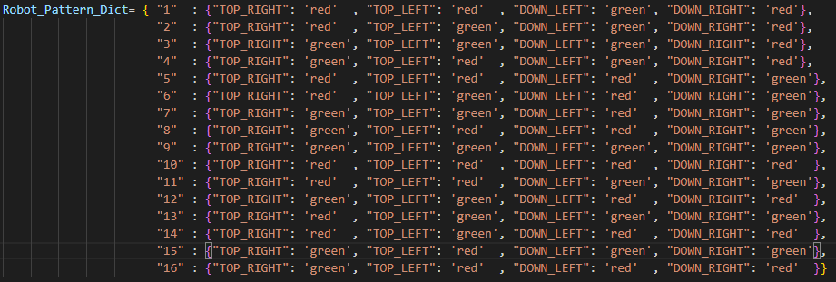
Recognition of robot patterns
finding robot:
Master Ingenieurwissenschaften, Master Angewandte Forschung und Entwicklung Sommer Semester 2022
Notes:
Then I rotated the image by the found degree
In the last step I used contours and masks to find the red and green circles and their pixel positions. And by matching with the predefined list I could find out the robot ID.

Slide 18
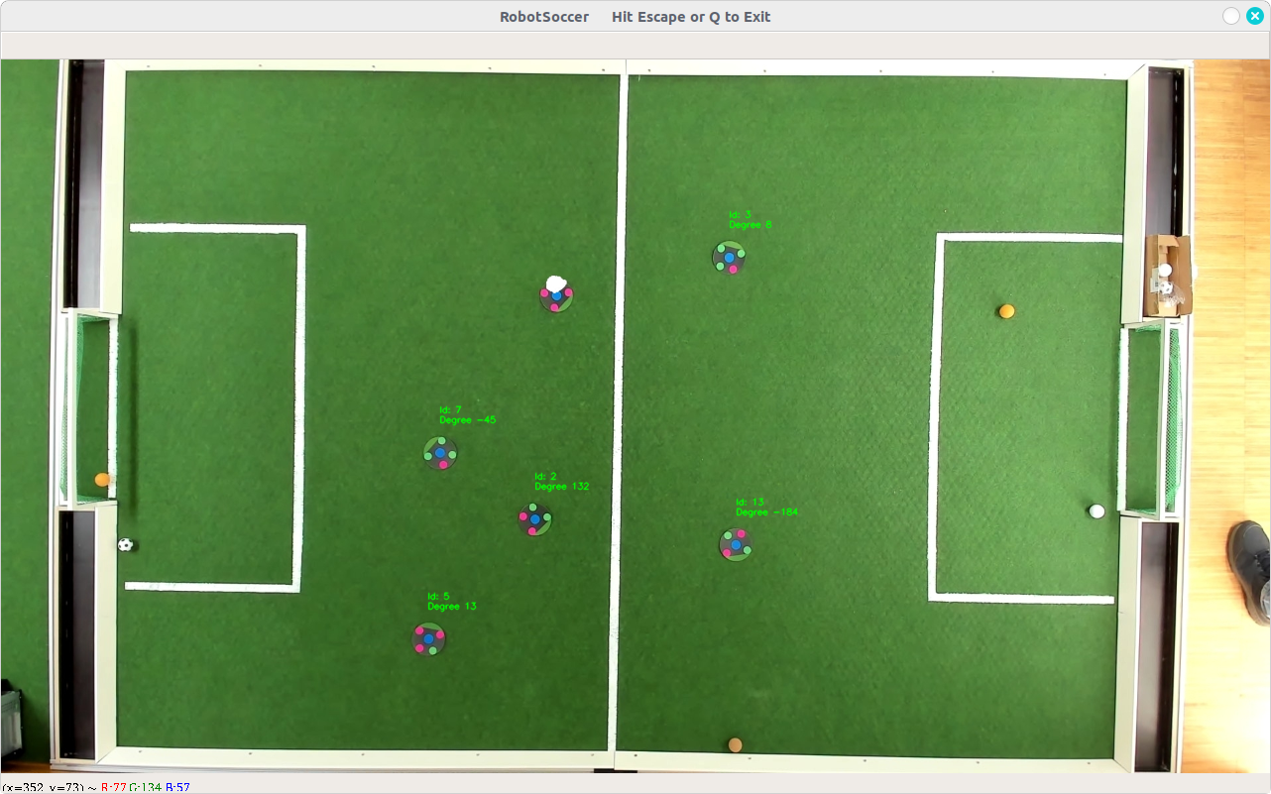
Recognition of robot patterns
The final results for all robots with the same pattern recognition:
Master Ingenieurwissenschaften, Master Angewandte Forschung und Entwicklung Sommer Semester 2022
Notes:
As you can see, all other robots are detected using the same method and the angles of the robots are quite accurate.

Slide 19
Real-time data processing and application performance
Multithreading:
Multiprocessing
Advantage
Disadvantage
Faster for light process
Shared memory
One thread shares the data, the code
Threads take less time to terminate
Communication between threads takes less time than between processes
(This is how the thread works in Python)
GIL
(Global Interpreter Lock), Globale Interpreter-Sperre
Master Ingenieurwissenschaften, Master Angewandte Forschung und Entwicklung Sommer Semester 2022
Notes:
To speed up my application, I thought it would be good to use multithreading or multiprocessing.
1: The first logical option was to use multithreading.
only one thread can execute the Python code at runtime.

Slide 20
Real-time data processing and application performance
Multithreading
Multiprocessing:
Advantage
Disadvantage
There is no GIL (Global Interpreter Lock).
When a process is blocked, the remaining processes can continue execution.
A process can run completely independently like a separate program
Processes are completely independent and do not share memory
Processes require more time for creation
Processes require more time for termination
Communication between processes requires more time (QUEUE)
Master Ingenieurwissenschaften, Master Angewandte Forschung und Entwicklung Sommer Semester 2022
Notes:
The second possibility was to use multiprocessing.
One process writes data to the QUEUE, which takes time, and the other reads from the QUEUE, which takes more time.
but I found another solution !!!

Slide 21



Real-time data processing and application performance
Python :
Cython :
def for_loop(x):
for i in range(0,x):
x += 2
return x
Cdef def for_loop(int x):
cdef int i = 0
for i in range(0,x):
x += 2
return x
https://en.wikipedia.org/wiki/Cython
Master Ingenieurwissenschaften, Master Angewandte Forschung und Entwicklung Sommer Semester 2022
Notes:
Cython is a general-purpose programming language that is largely compatible with Python.
However, its main advantage is the translation into the target language C, which allows both high performance compared to the standard Python interpreter and direct interaction with external code written in C, C++ or Fortran.

Slide 22
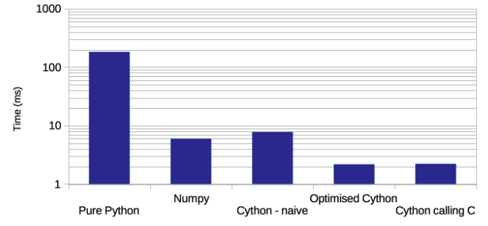
Real-time data processing and application performance
Cython performance:
Standard deviation of 1e6 elements of the list
https://en.wikipedia.org/wiki/Cython
Zeit (ms)
https://notes-on-cython.readthedocs.io/en/latest/std_dev.html
Master Ingenieurwissenschaften, Master Angewandte Forschung und Entwicklung Sommer Semester 2022
Notes:
The diagram shows us that the "standard deviation" of a list of one million items is up to 100 times faster in Cython than in Python.
In my application, however, the difference was only 10-20 times faster because my data size was smaller.

Slide 23

Server connection
Google Protocol Buffer :
syntax = "proto3";
package protoblog;
message SSL_DetectionRobot {
uint32 robot_id = 2;
float x = 3;
float y = 4;
float orientation = 5;
float pixel_x = 6;
float pixel_y = 7;
float height = 8;
}
The Google protocol makes it possible to develop universal code for several programming languages from one and the same file.
Master Ingenieurwissenschaften, Master Angewandte Forschung und Entwicklung Sommer Semester 2022
Notes:
Google protocol provides fast and secure data packets for a server connection.
Google protocol allows to develop a universal code for several programming languages from one and the same file.
This means that by creating a Google protocol, the data is packaged in the format (encoded) and when another language, e.g. C++, connects to the server, the data can be read and decoded. Therefore, the developer on the other side does not have to worry about decoding.

Slide 24
Server connection
Server:
The User Datagram Protocol (UDP) is a minimal, connection network protocol that belongs to the transport layer of the Internet protocol family.
UDP enables applications to send datagrams in IP-based computer networks.
Master Ingenieurwissenschaften, Master Angewandte Forschung und Entwicklung Sommer Semester 2022
Notes:
UDP belongs to the Internet protocol family.
← !!! ( Second line )
The advantage of using UDP is that multiple users can receive the same data simultaneously.

Slide 25
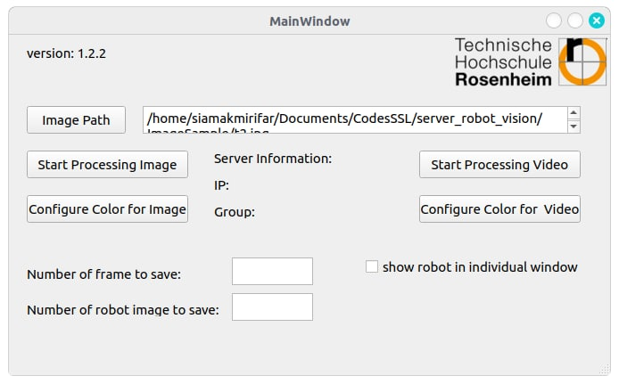
Graphical user interface
User interface :
Master Ingenieurwissenschaften, Master Angewandte Forschung und Entwicklung Sommer Semester 2022
Notes:
For the graphical user interface, I used PyQt, a pioneer library for graphical user interface applications using Python.

Slide 26
END
Thank you for your attention
Master Ingenieurwissenschaften, Master Angewandte Forschung und Entwicklung Sommer Semester 2022

