Slide 1
Functions
CSI 121 – Structured Programming Language

Slide 2
Let’s cook biriyani for new year!!!
Go to market
Buy rice, meat and groceries
Return home
Cook food
and enjoy

Slide 3
But there is one problem!!!
You have just recovered from Chikunguniya, but still suffering from pain.
So you can’t go out.

Slide 4

So let’s ask Moti Bhai!!!

Slide 5
Let’s cook biriyani for new year!!!
Give Moti 1000 taka and tell him to go
Go to market
Buy rice, meat and groceries
Get the food items from Moti
Return home
Cook food
and enjoy
You
Moti Bhai

Slide 6
Function
A set of instructions that, together, does a particular task
We can divide our program to several functions, where each function achieves a single part
A function can communicate with another function by means of parameter(s) and return value

Slide 7
Write a program to find out the factorial of a given integer

Slide 8
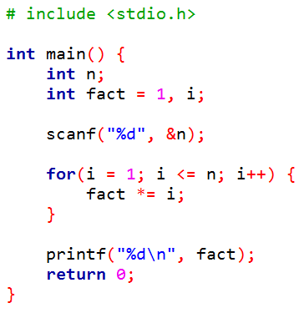
Let’s put this
in a function

Slide 9
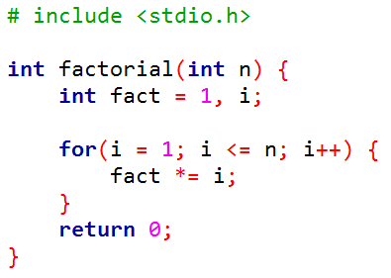
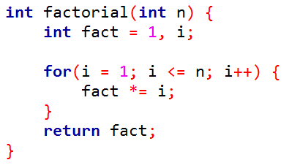
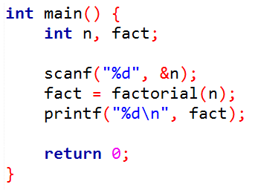
main function tells the callee whose factorial to find out
factorial function conveys the result to caller
main function calls factorial function

Slide 10
So we are just copying the task to another function. Big deal!!!

Slide 11
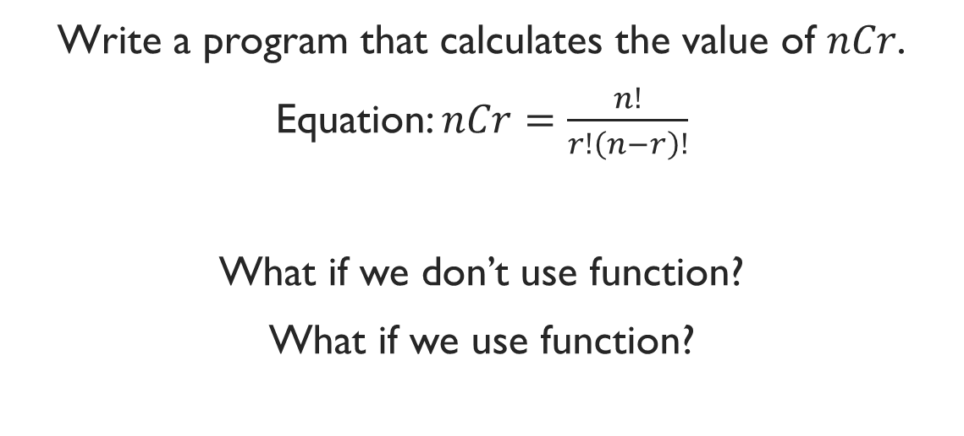
Exercise
Write a program that calculates the value of $nCr$.
Equation: $nCr=\frac{n!}{r!\left(n−r\right)!}$
What if we don’t use function?
What if we use function?

Slide 12
scanf(“%d%d”, &n, &r);
result = factorial(n) / (factorial(r) * factorial(n – r));
printf(“%d\n”, result);
Reusability!!!

Slide 13
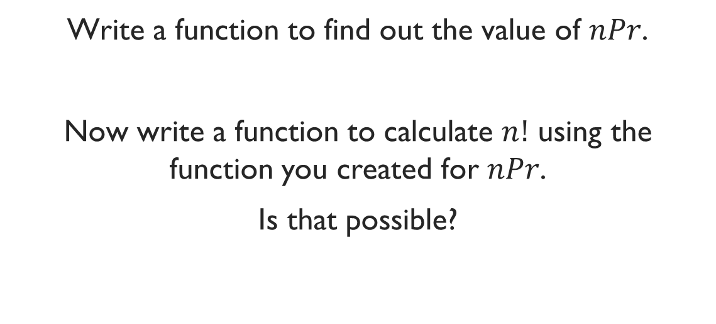
Exercise
Write a function to find out the value of $nPr$.
Now write a function to calculate $n!$ using the function you created for $nPr$.
Is that possible?

Slide 14
Exercise
Write a function to calculate the area of a rectangle.
Now write a function to calculate the area of a circle.

Slide 15
Exercise
Write a function to calculate the distance of two points in the 2D coordinate system.

