Slide 1
Chapter 4 AC to AC Converters
Outline
4.1 AC voltage controllers
4.2 Other AC controllers
4.3 Thyristor cycloconverters
4.4 Matrix converters

Slide 2
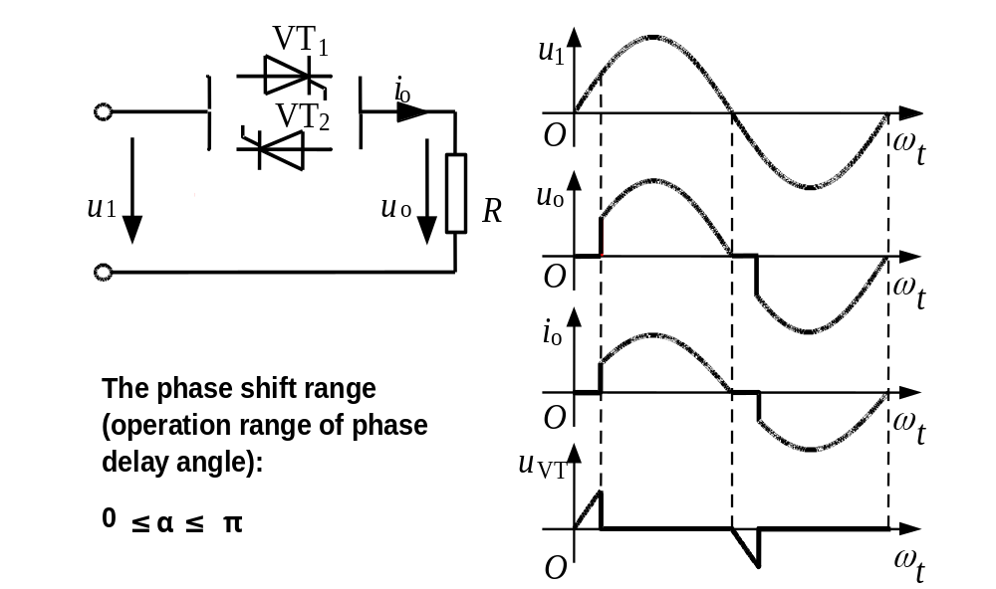
4.1.1 Single-phase AC voltage controller

Slide 3
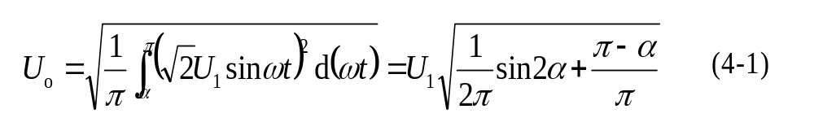

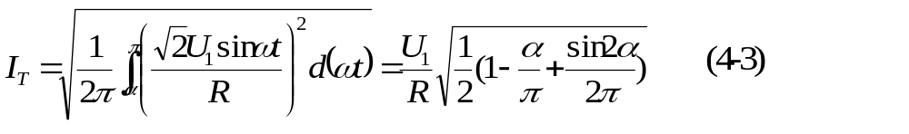
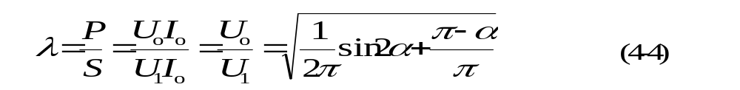
Resistive load, quantitative analysis
RMS value of output voltage
RMS value of output current
RMS value of thyristor current
Power factor of the circuit

Slide 4
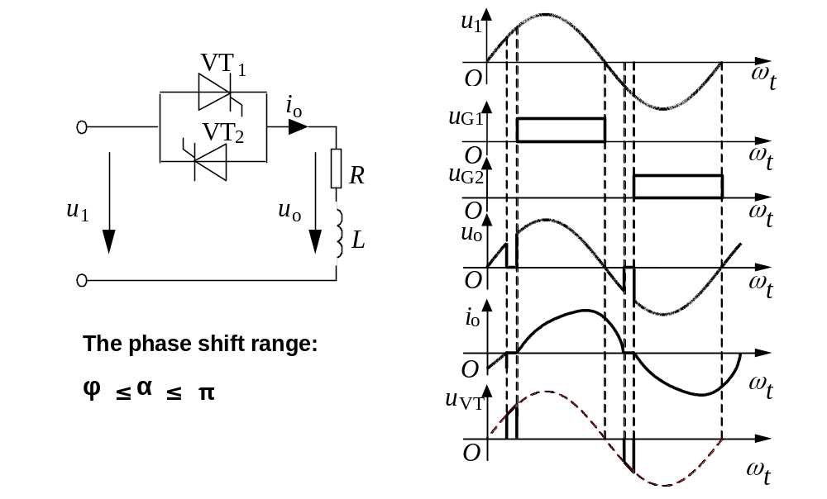
Inductive (Inductor- resistor) load , operation principle

Slide 5
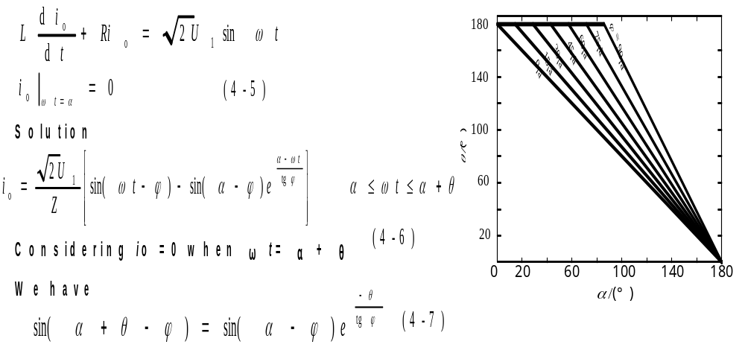
Inductive load, quantitative analysis
Differential equation
The RMS value of output voltage, output current, and thyristor current can then be calculated.

Slide 6
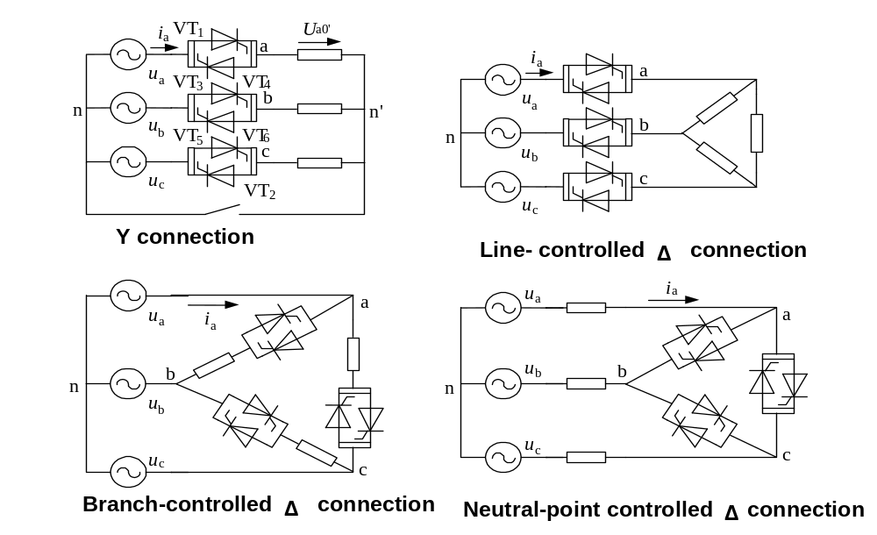
4.1.2 Three-phase AC voltage controller
Classification of three- phase circuits

Slide 7
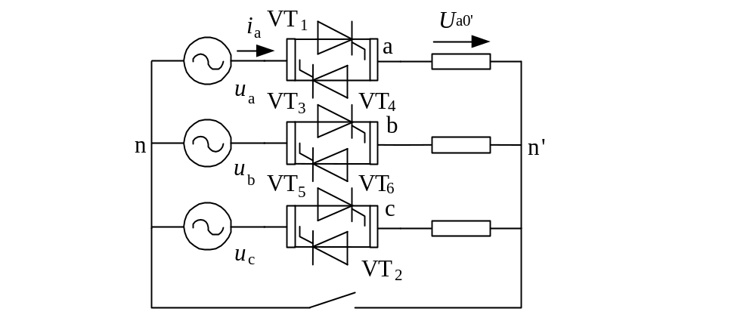
3- phase 3- wire Y connection AC voltage controller
For a time instant, there are 2 possible conduction states:
–Each phase has a thyristor conducting. Load voltages are the same as the source voltages.
–There are only 2 thyristors conducting, each from a phase. The load voltages of the two conducting phases are half of the corresponding line to line voltage, while the load voltage of the other phase is 0.

Slide 8
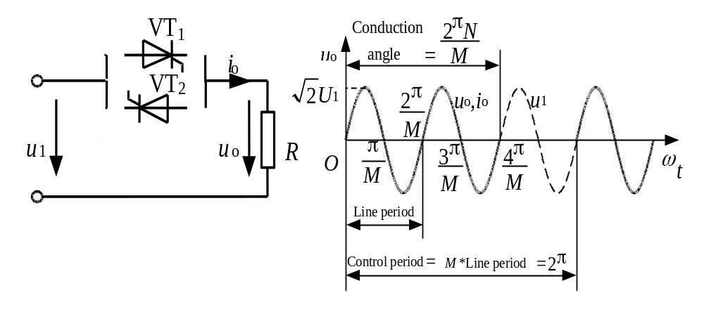
4.2 Other AC controllers
4.2.1 Integral cycle control—AC power controller
Circuit topologies are the same as AC voltage controllers.
Only the control method is different.
Load voltage and current are both sinusoidal when thyristors are conducting.

Slide 9
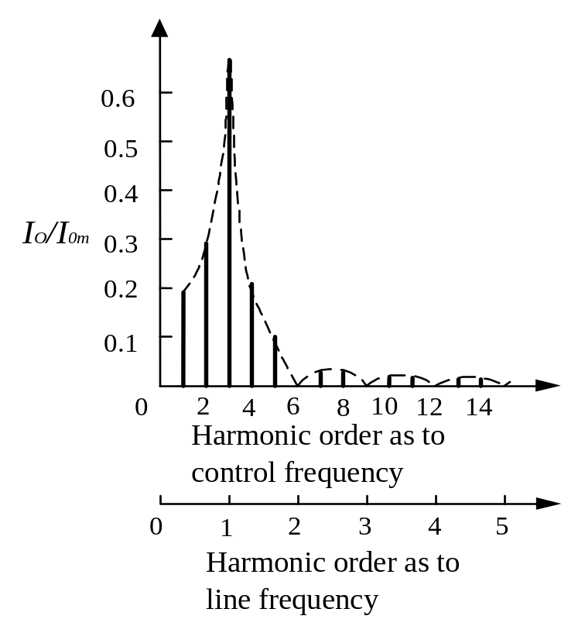
Spectrum of the current inAC power controller
There is NO
harmonics in the
ordinary sense.
There is harmonics
as to the control
frequency. As to the
line frequency, these
components become
fractional harmonics.

Slide 10
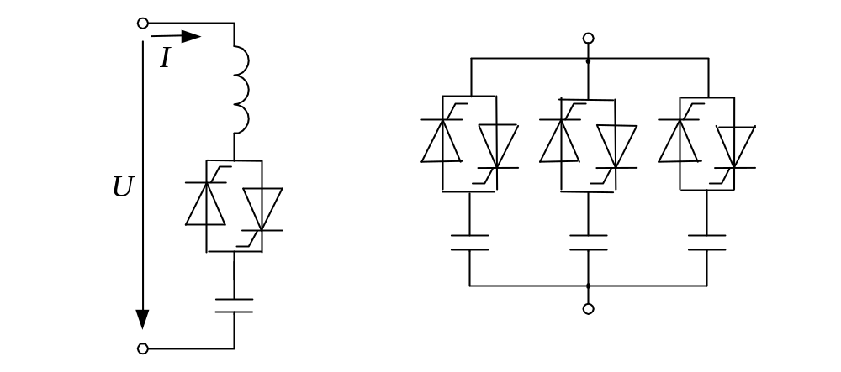
4.2.2 Electronic AC switch
Circuit topologies are the same as AC voltage controllers. But the back- to- back thyristors are just used like a switch to turn the equipment on or off.
Application—Thyristor-switched capacitor (TSC)

Slide 11
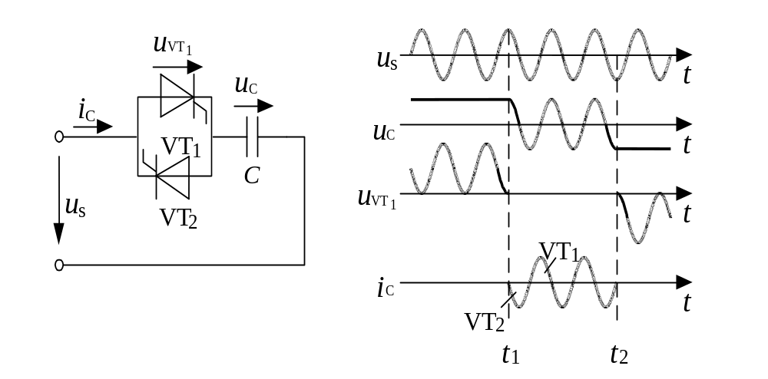
TSC waveforms when the capacitor is switched in/out
The voltage across the thyristor must be nearly zero when switching in the capacitor, and the current of the thyristor must be zero when switching out the capacitor.

Slide 12
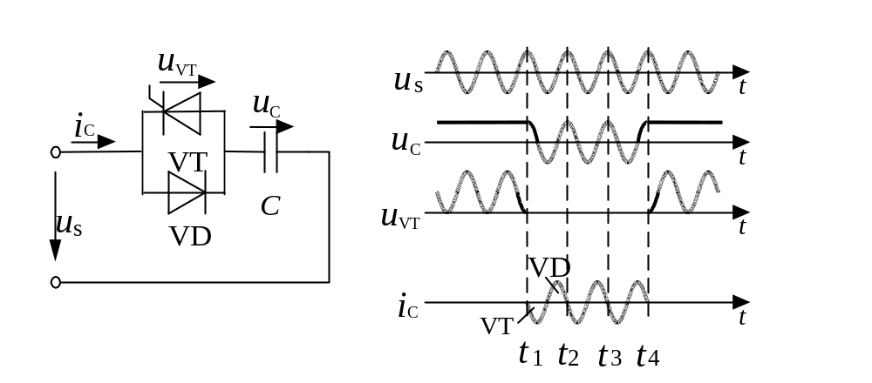
TSC with the electronic switch realized by a thyristor and an anti-parallel diode
The capacitor voltage will be always charged up to the peak of source voltage.
The response to switching- out command could be a little slower (maximum delay is one line-cycle).

Slide 13
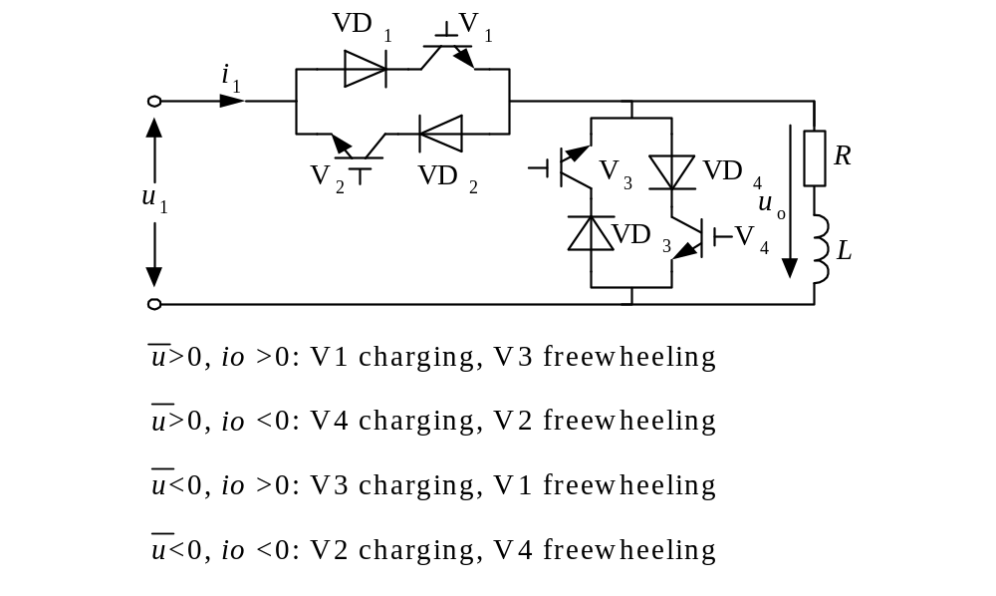
4.2.3 Chopping control—AC chopper
AC chopper
Modes of operation

Slide 14
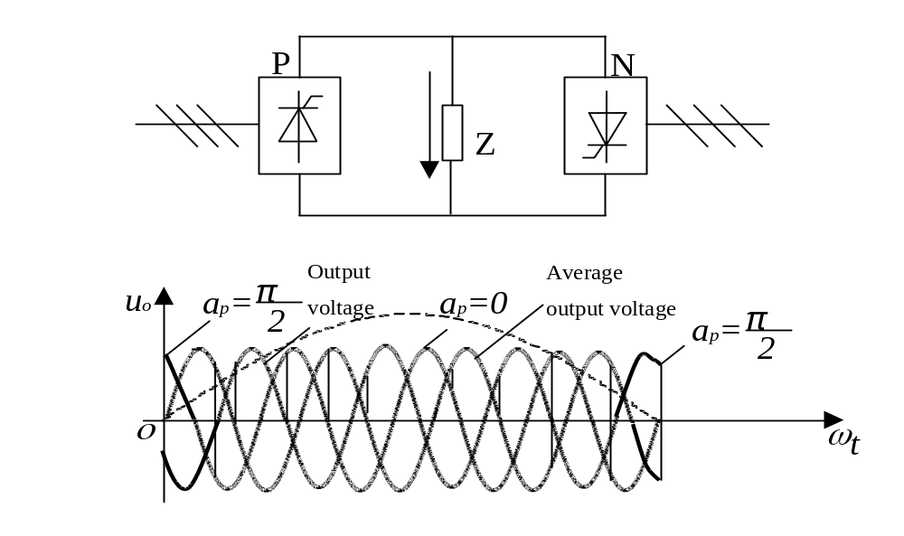
4.3 Thyristor cycloconverters
4.3.1 Single- phase thyristor-cycloconverter
Circuit configuration and operation principle

Slide 15
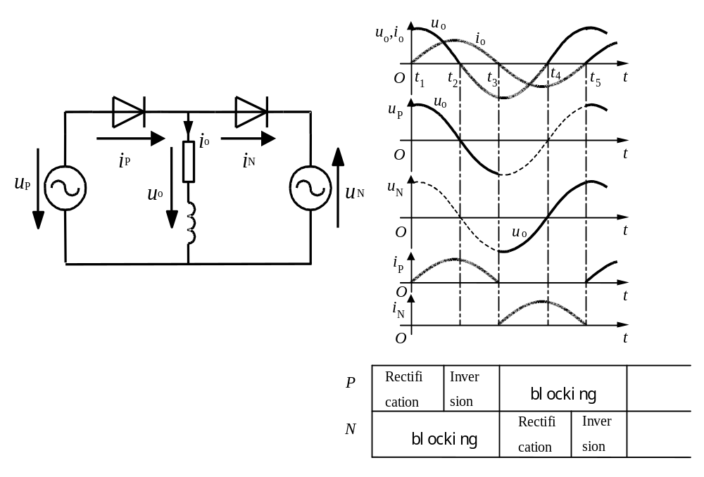
Single- phase thyristor-cycloconverter
Modes of operation

Slide 16
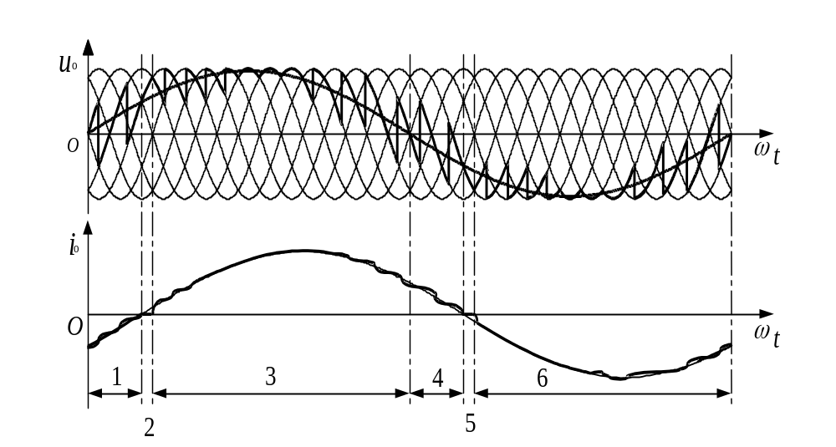
Typical waveforms

Slide 17
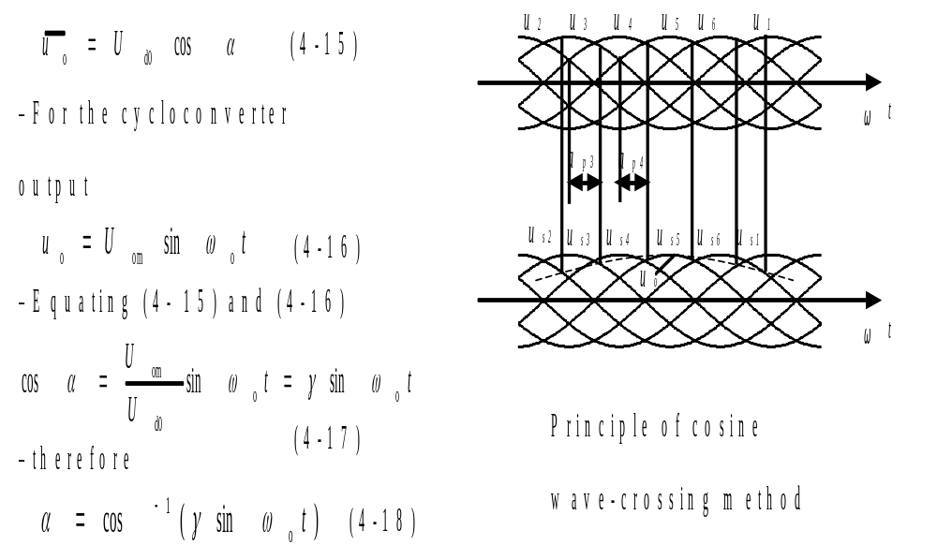
Modulation methods for firing delay angle
Calculation method
– For the rectifier circuit

Slide 18
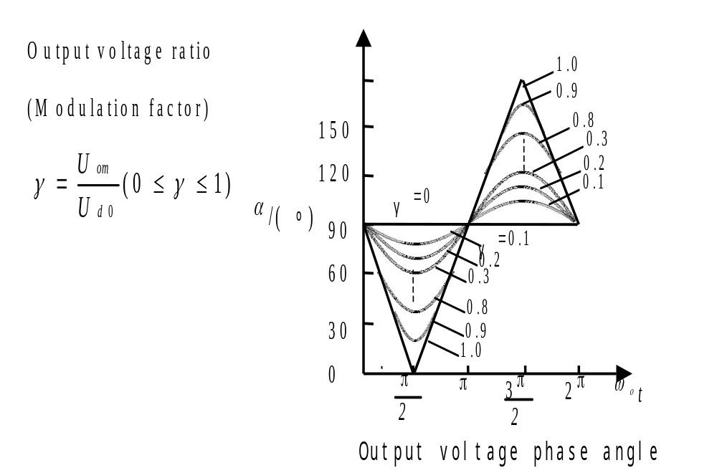

Slide 19
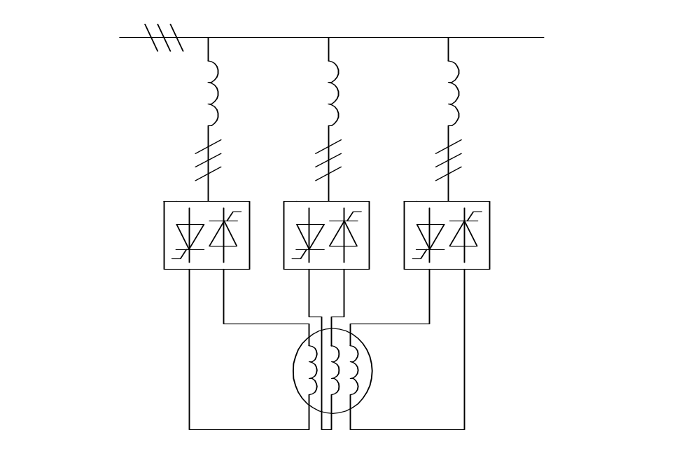
4.3.2 Three- phase thyristor-cyclo converter
The configuration with common input line

Slide 20
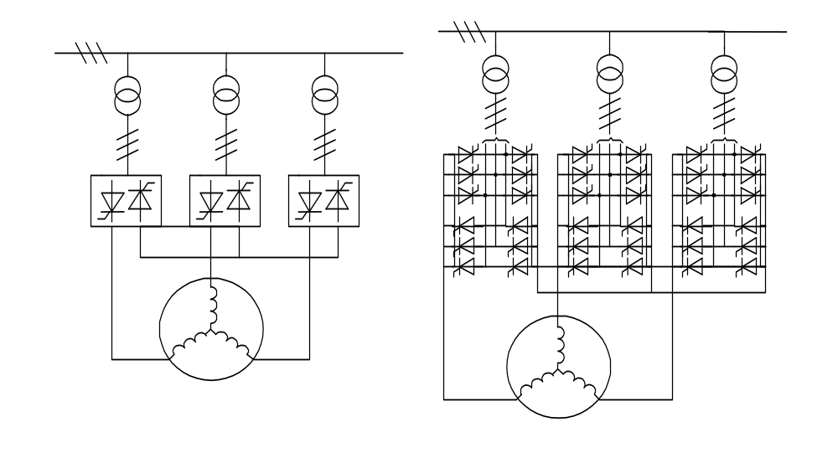
The configuration with star-connected output

Slide 21
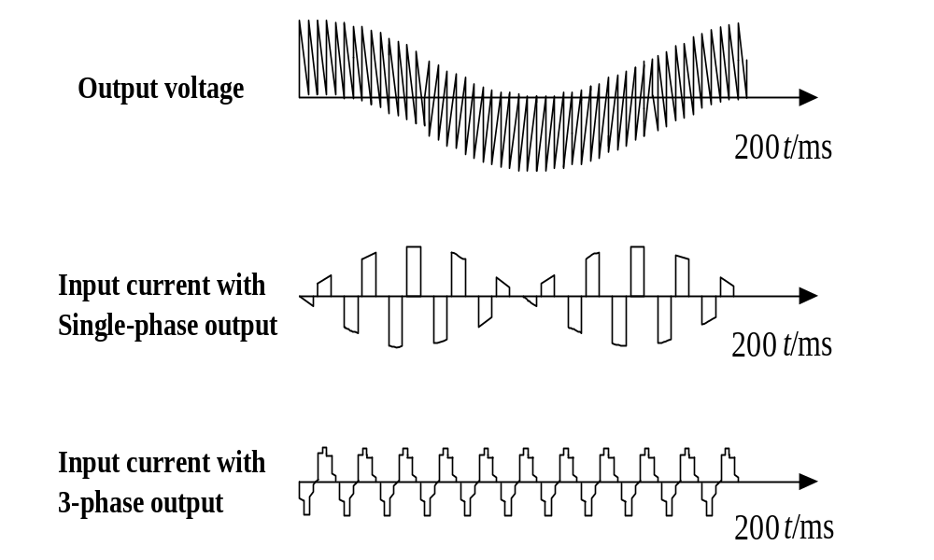
Typical waveforms

Slide 22
Input and output characteristics
The maximum output frequency and the harmonics in the output voltage are the same as in single-phase circuit. Input power factor is a little higher than single-phase circuit. Harmonics in the input current is a little lower thanthe single- phase circuit due to the cancellation of some harmonics among the 3 phases.
To improve the input power factor:
–Use DC bias or 3k order component bias on each of the 3 output phase voltages
Features and applications
Features:
–Direct frequency conversion—high efficiency
–Bidirectional energy flow, easy to realize 4- quadrant operation
–Very complicated—too many power semiconductor devices
–Low output frequency
–Low input power factor and bad input current waveform
Applications:
–High power low speed AC motor drive

Slide 23
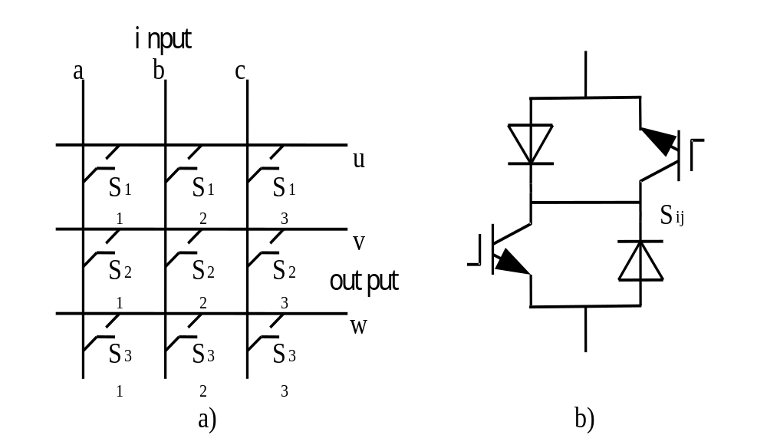
4.4 Matrix converter
Circuit configuration

Slide 24
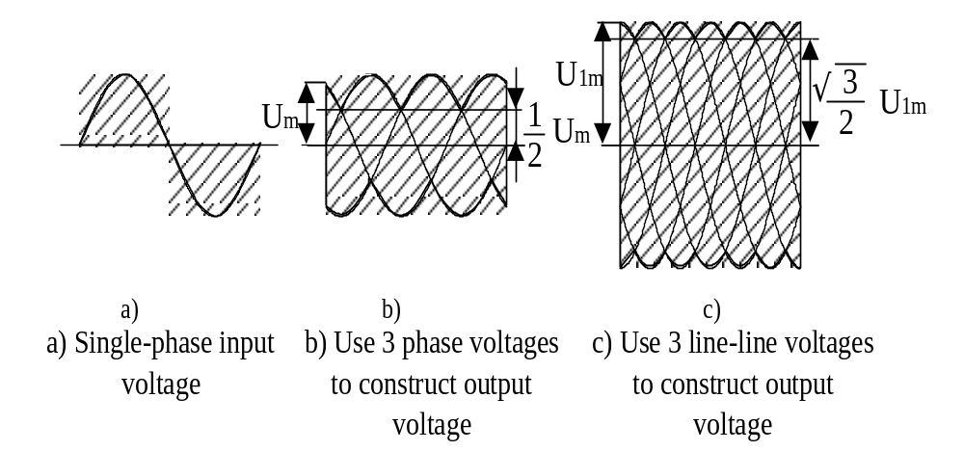
Usable input voltage

Slide 25
Features
Direct frequency conversion—high efficiency can realize good input and output waveforms, low harmonics, and nearly unity displacement factor
Bidirectional energy flow, easy to realize 4- quadrant operation
Output frequency is not limited by input frequency
No need for bulk capacitor (as compared to indirect frequency converter)
Very complicated—too many power semiconductor devices
Output voltage magnitude is a little lower as compared to indirect frequency converter.

