Slide 1
AC-AC converters Matrix converters

Slide 2
Why Ac-ac converters?
To change the frequency of an AC voltage
To adjust the load voltage amplitude
To control the displacement angle
To control bi-directional (or only unidirectional) power flow through the converter

Slide 3
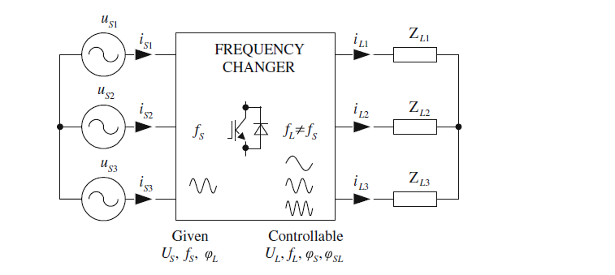
Generic diagram of three-phase PWM AC–AC frequency converter and its functionality

Slide 4
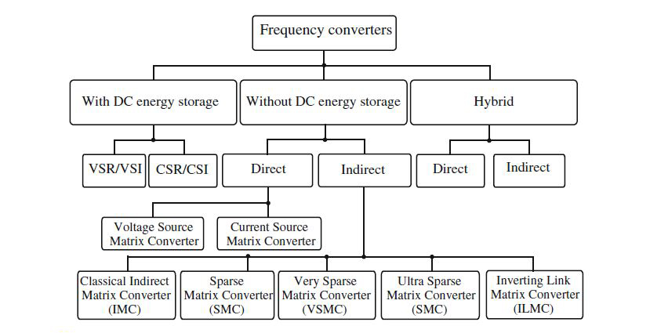
Classification of three-phase AC–AC converter topologies

Slide 5
The DC energy storage elements’ Drawbacks
DC link capacitors are relatively large(about 30 to 50% of the total volume of the converter).
They reduce the speed of response.
Electrolytic capacitor has by far the shortest lifetime of any element, active or passive, used in power electronic converters.
The presence of the capacitor significantly limits the power converter on high temperature applications.

Slide 6
Direct AC–AC Frequency Converters: Matrix Converter
Direct Matrix converters
Voltage Source Matrix Converters (VSMC)
Current Source Matrix Converters (CSMC)

Slide 7
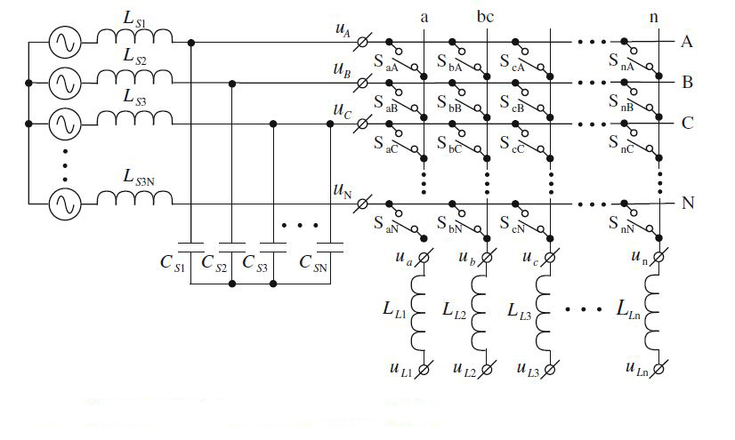
Simplified circuit

Slide 8
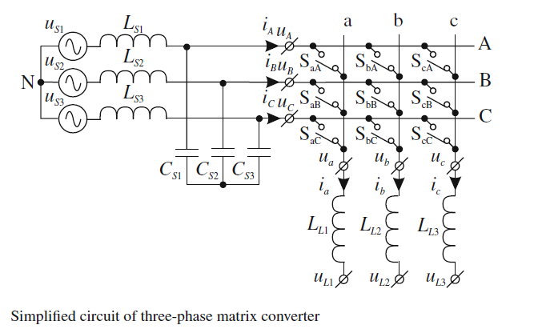
3-phase matrix converters

Slide 9
matrix converters
For good performance, the VSMC should have a source filter.
Their size is inversely proportional to the matrix converter switching frequency.
The major advantage of matrix converters is the absence of the DC link capacitor.
Venturini and Alesina proposed the basic principles of the operation in the early 1980s.

Slide 10

Basic principles of matrix converter
The switching function of a single switch
$S_{jk}=\left\{\begin{aligned}1, switch{ S}_{jk} is turned on \\ 0, switch{ S}_{jk} is turned off\end{aligned}\right.$
j ∈ {a, b, c} the name of the output phase
K ∈ {A,B,C} the name of the input phase.
Taking into account that the input phases must never be short circuited and that the output currents must never be interrupted.

Slide 11
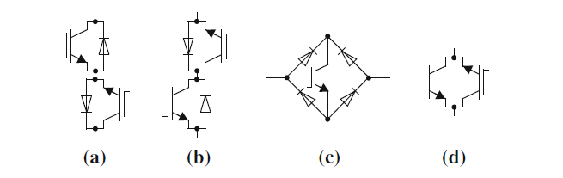
Topologies of bi-directional switches
diode bridge with an IGBT
common emitter anti-paralleled IGBT
common collector anti-paralleled IGBT
anti-paralleled reverse blocking IGBTs (RB-IGBT)

Slide 12
commercially available bi-directional switch cell single switch and the matrix connected nine switcheS

Slide 13
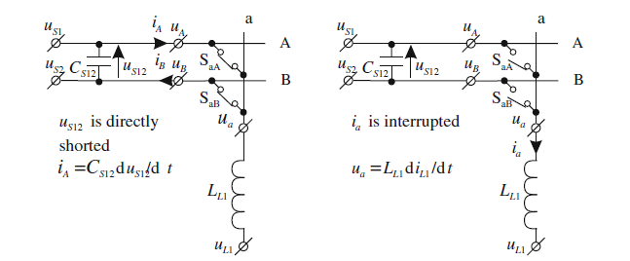
Commutation strategies, LIMITATIONS

Slide 14
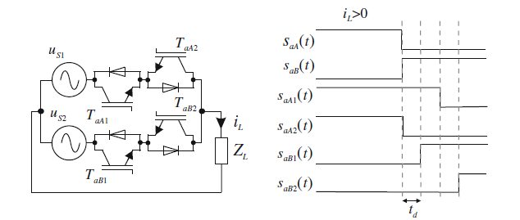
the four-step commutation strategy
The most common solution is the four-Step commutation strategy (or semi-soft current commutation) introduced by Burany in1989.

Slide 15
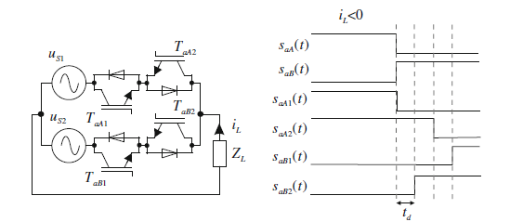
the four-step commutation strategy
It’s based on the direction of current.

Slide 16
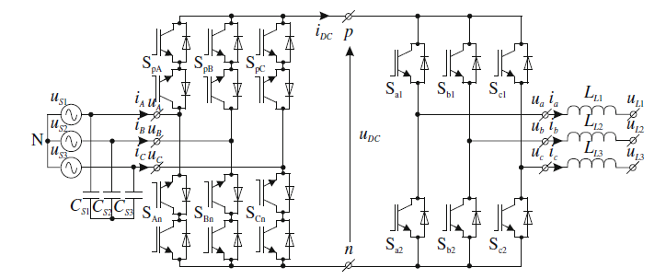
Indirect Matrix Converters

Slide 17
development of power electronic converters
higher efficiency
lower volume and lower cost
lower production costs
Wide range of voltage gain ratio

