Slide 1

WeFeed
A platform to relocate food leftovers from restaurants/hotels to charities.

Slide 2
Sign up as:
Donators with food leftovers
Volunteers who want to help
Charities who need some food

Slide 3
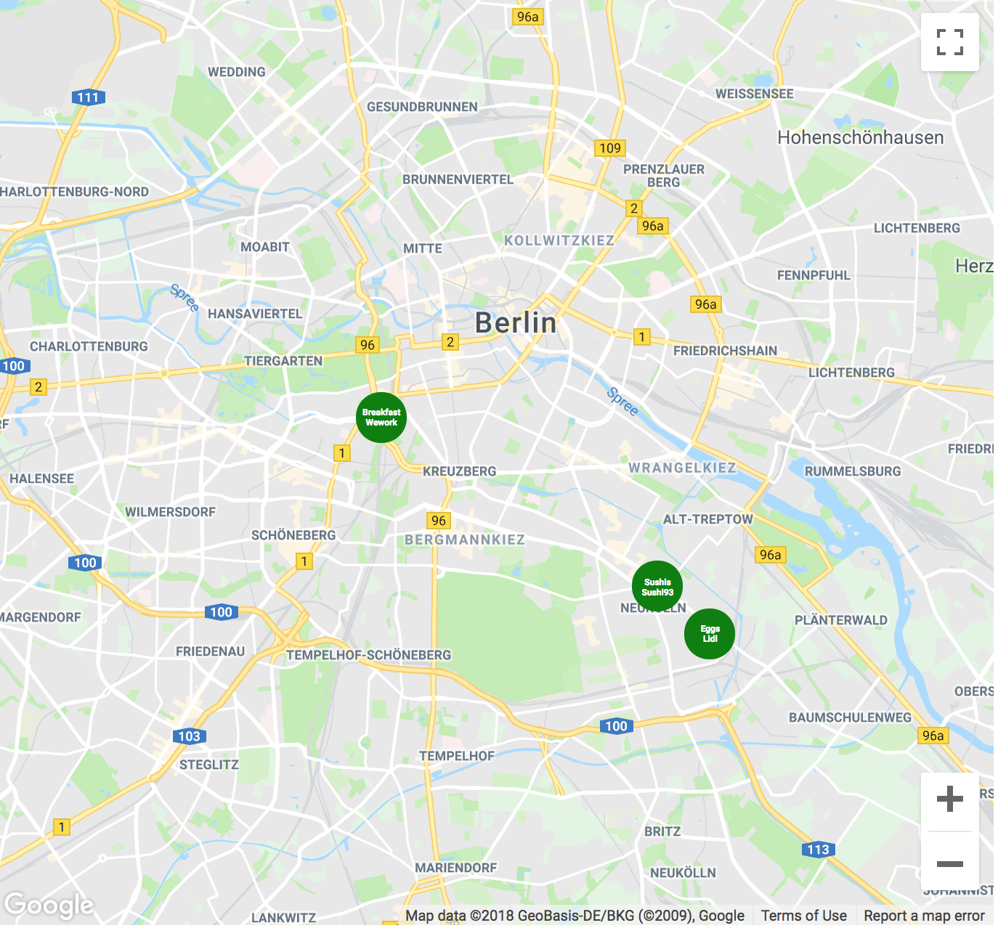
Donations:
Make a donation and add it to our map of donations

Slide 4






Technology

