Slide 1

Introduction to ASP NET WEB API

Slide 2

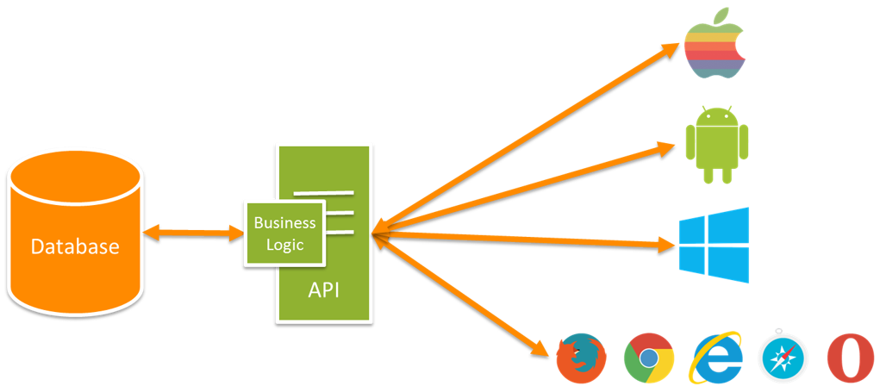

What is asp net web api?
ASP.NET Web API is a framework for building web apis on top of .net framework.
Web API can interact with various applications (web, mobile, desktop).
.NET’s Web API is an easy way to implement a restful web service.

Slide 3
rest
REST (Representational State Transfer) is an architectural pattern which is based on HTTP and uses HTTP requests, responses, verbs and status codes to communicate.
Principles:
Client server
Stateless
Cacheable
Uniform interface
Notes:
What are RESTful Services? REST stands for Representational State Transfer. It was first introduced in 2001. REST is an architectural pattern for creating an API that uses HTTP as a communication method. The REST architectural pattern specifies a set of constraints that a system should adhere to. Now, let’s look at REST Constraints. -Client Server This is the first constraint. Client sends a request and a Server sends a response. This separation of concerns supports the independence and evolution of client-side logic and server-side logic.
-Stateless The communication between client and a server must be stateless. This means we should not be storing anything on the server related to the client. The request from the client should contain all the necessary information for the server to process that request. This, ensures that each request is treated independently by the server.
-Cacheable Some data provided by the server like list of products or list of departments as this data is does not change the fact that often this constraint says how long data is good for so that the client does not have to come back to the server for the same data over and over again. Caching avoids unnecessary processing and significantly increases the performance of the system.
-Uniform Interface Uniform interface determines the interface between client and the server. To understand uniform interface we first need to understand what a resource is and the HTTP verbs like GET, PUT, POST and DELETE. In the context of REST API, resources typically represent data entities like product, employees etc. which are all resource.s The HTTP verb sends a request to API and tells it what to do with that resource. The resource is identified by a specific URI (Uniform Resource Identifier)
For example
/Employees the verb is GET here it is going to get list of employees
/Employees/1 the verb is GET going to fetch employee where id is 1
/Employees if the verb is POST going to create a new employee
/Employee/1 if the verb is PUT going to update that employee details where id is 1
/Employee/1 if the verb is DELETE going to delete that record where id is 1 .

Slide 4
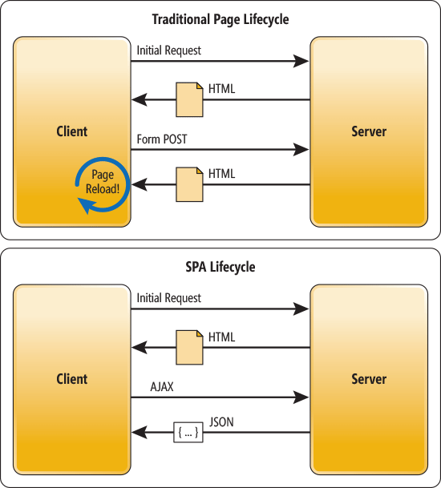
SPA vs MPA
In a traditional web app, every time the app calls the server, the server renders a new HTML page. This triggers a page refresh in the browser.
In SPA, after the first page loads, all interaction with the server happens through ajax calls. These AJAX calls return data—not markup—usually in JSON format. The app uses the JSON data to update the page dynamically, without reloading the page.
Notes:
One benefit of SPAs is obvious: Applications are more fluid and responsive, without the jarring effect of reloading and re-rendering the page. Another benefit might be less obvious and it concerns how you architect a Web app. Sending the app data as JSON creates a separation between the presentation (HTML markup) and application logic (AJAX requests plus JSON responses).
This separation makes it easier to design and evolve each layer. In a well-architected SPA, you can change the HTML markup without touching the code that implements the application logic (at least, that’s the ideal).
In a pure SPA, all UI interaction occurs on the client side, through JavaScript and CSS. After the initial page load, the server acts purely as a service layer. The client just needs to know what HTTP requests to send. It doesn’t care how the server implements things on the back end.
With this architecture, the client and the service are independent. You could replace the entire back end that runs the service, and as long as you don’t change the API, you won’t break the client. The reverse is also true—you can replace the entire client app without changing the service layer. For example, you might write a native mobile client that consumes the service.

Slide 5
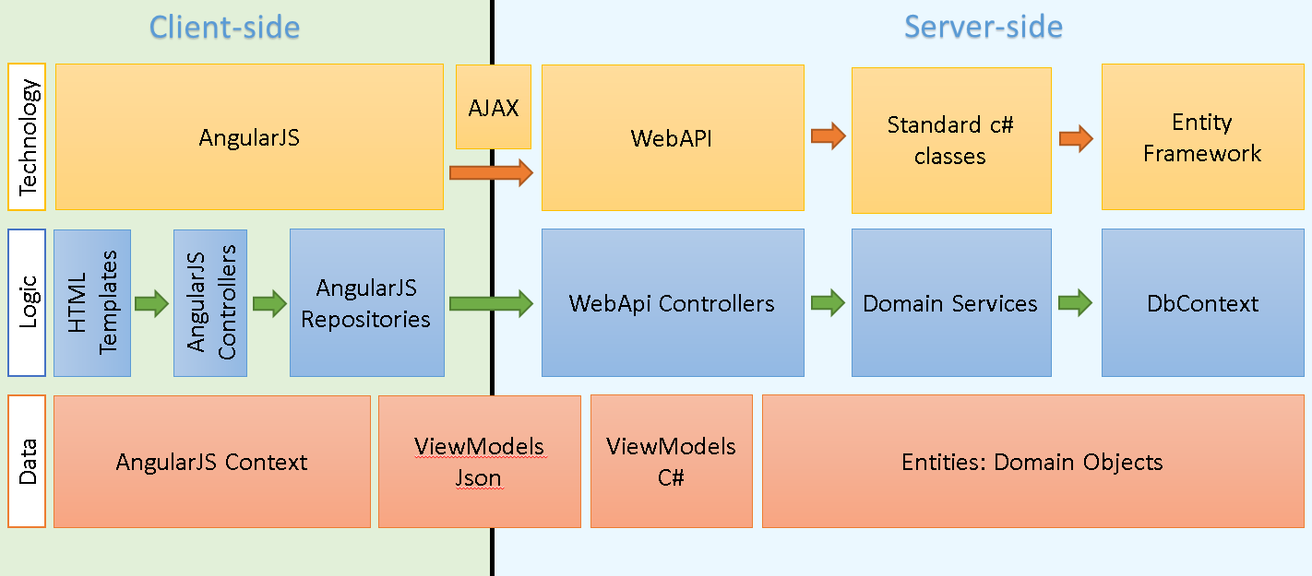
Spa architecture

Slide 6

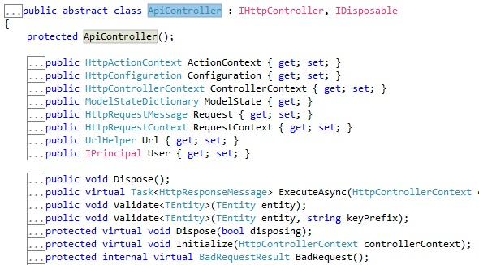
Controllers
All controllers inherit ApiController that inherits the interface IHttpController
Notes:
ActionContext - Получает контекст действия.
Configuration - Получает HttpConfiguration текущего ApiController.
ControllerContext - Получает HttpConfiguration текущего ApiController.
ModelState - Получает состояние модели после привязки модели.
Request - данное свойство хранит объект Http.HttpRequestMessage, предоставляющий информацию о запросе.
RequestContext - представляет объект HttpRequestContext, содержащий информацию о текущем запросе, специфичную для Web API.
Url - Получает экземпляр UrlHelper, используемый при создании URL-адресов для других API.
User - Возвращает текущего участника, связанного с этим запросом.

Slide 7
Difference between Web API and MVC controller
Web API Controller | MVC Controller
Derives from System.Web.Http.ApiController class | Derives from System.Web.Mvc.Controller class.
Method name must start with Http verbs otherwise apply http verbs attribute. | Must apply appropriate Http verbs attribute.
Specialized in returning data. | Specialized in rendering view.
Return data automatically formatted based on Accept-Type header attribute. Default to json or xml. | Returns ActionResult or any derived type.
Requires .NET 4.0 or above | Requires .NET 3.5 or above

Slide 8
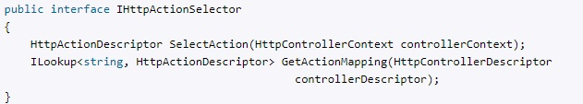

methods
Selection:
After getting request controller delegates responsibility to object which implement the interface IHttpActionSelector for choosing the necessary method (by default it is ApiControllerActionSelector).
Calling:
After getting method the object which implement the interface IHttpActionInvoker calls method of controller (by default it is ApiControllerActionInvoker).
Notes:
Web API предоставляет встроенную реализацию интерфейса - класс ApiControllerActionSelector, который по умолчанию собственно и управляет выбором метода контроллера.
Выбор метода для обработки запроса представляет многоэтапный процесс:
1) Сначала идет обращение к механизму рефлексии для получения у контроллера всех возможных методов.
2) Затем у всех методов-кандидатов просматриваются атрибуты маршрутизации (при их наличии). Если будут найдены методы, в атрибутах которых определены маршруты, соответствующие запросу, то все остальные методы отбрасываются.
3) Далее просматриваются данные маршрута на наличие в них значения для сегмента action (если в маршруте определен такой сегмент). Если такое значение (которое передает имя метода) имеется, выбираются все методы, которые имеют данное имя. Остальные методы отбрасываются.
4) На следующем этапе проверяется, соответствуют ли методы соглашениям о наименовании Web API RESTful. Например, согласно этим условностям метод, обрабатывающий запрос GET, должно называться или начинаться с "Get", например, "GetBooks". Все методы, которые не соответствуют типу запроса (GET, POST, PUT) и не следуют условностям об наименовании, отбрасываются
Если ни один метод не использует соглашения о наименовании, то ApiControllerActionSelector просматривает наличие у методов атрибутов HttpGet, HttpPost, HttpDelete и HttpPut, которые соответствуют типу запроса.
5) На финальном этапе отбрасываются все методы, которые не соответствуют маршруту по числу и типу параметров.
И по идее в конце должен остаться только один метод. Если же не остается ни одного или, наоборот, больше одного, то возникает ошибочная ситуация.

Slide 9
Methods
Return type | How Web API creates the response
void | Return empty 204 (No Content)
HttpResponseMessage | Convert directly to an HTTP response message.
IHttpActionResult | Call ExecuteAsync to create an HttpResponseMessage, then convert to an HTTP response message.
Other type | Write the serialized return value into the response body; return 200 (OK).

Slide 10
routing
Web API supports two types of routing:
Convention-based routing
Attribute routing

Slide 11
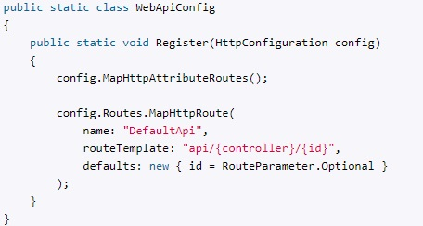
Routing
Convention-based routing
Registration of routes is in a file WebApiConfig.cs:

Slide 12
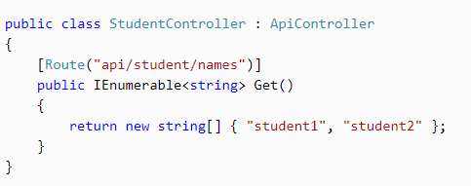
routing
Attribute routing

Slide 13
routing
When the web API framework receives an HTTP request, it tries to match the URI against one of the route templates in the routing table. If no route matches, the client receives a 404 error.
Once a matching route is found, web API selects the controller and the action.

Slide 14
Model binding
Model binding is used for parameters which are not primitive types.
Web API has 5 main model binding:
ArrayModelBinder
CollectionModelBinder
DictionaryModelBinder
MutableObjectModelBinder
TypeConverterModelBinder
Notes:
ArrayModelBinder: используется для привязки к массивам
CollectionModelBinder: устанавливает привязку для строго типизированных коллекций
DictionaryModelBinder: устанавливает привязку для строго типизированных объектов dictionary
MutableObjectModelBinder: связывает объекты
TypeConverterModelBinder: связывает объекты, применяя преобразование типов

Slide 15
pipeline
LINK

