Slide 1




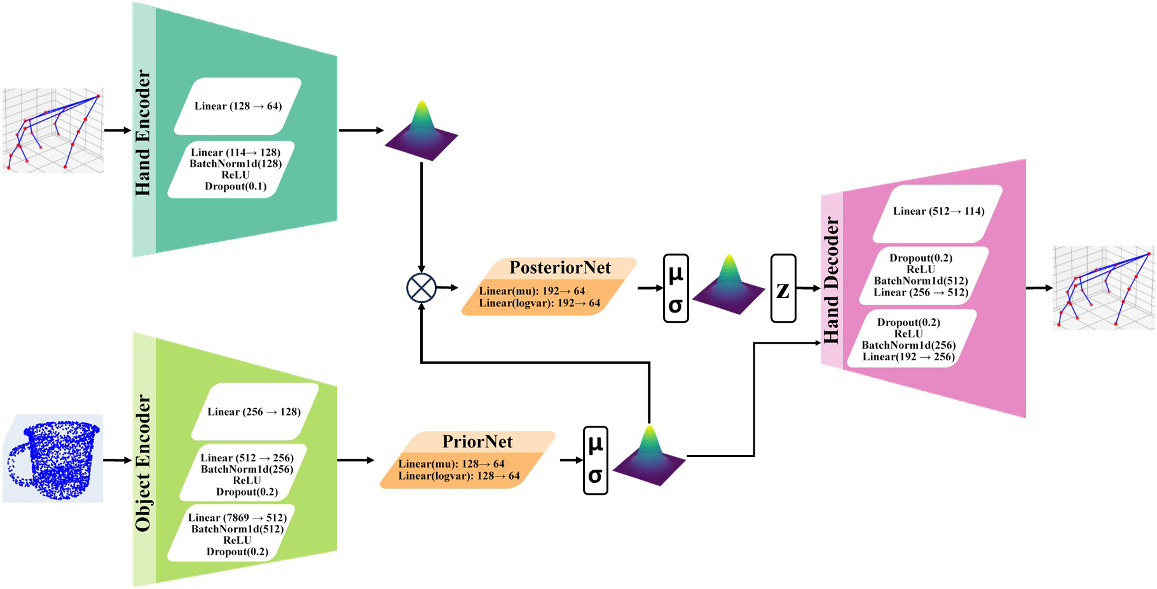
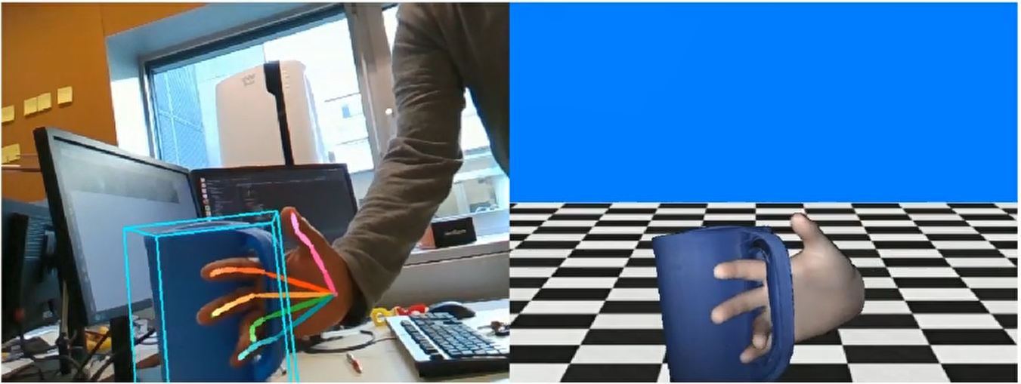
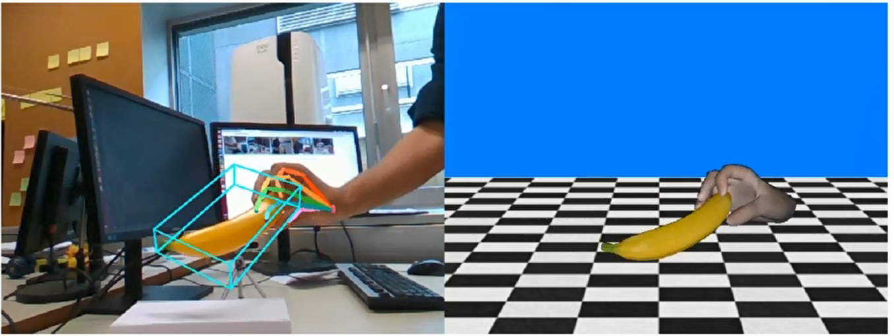
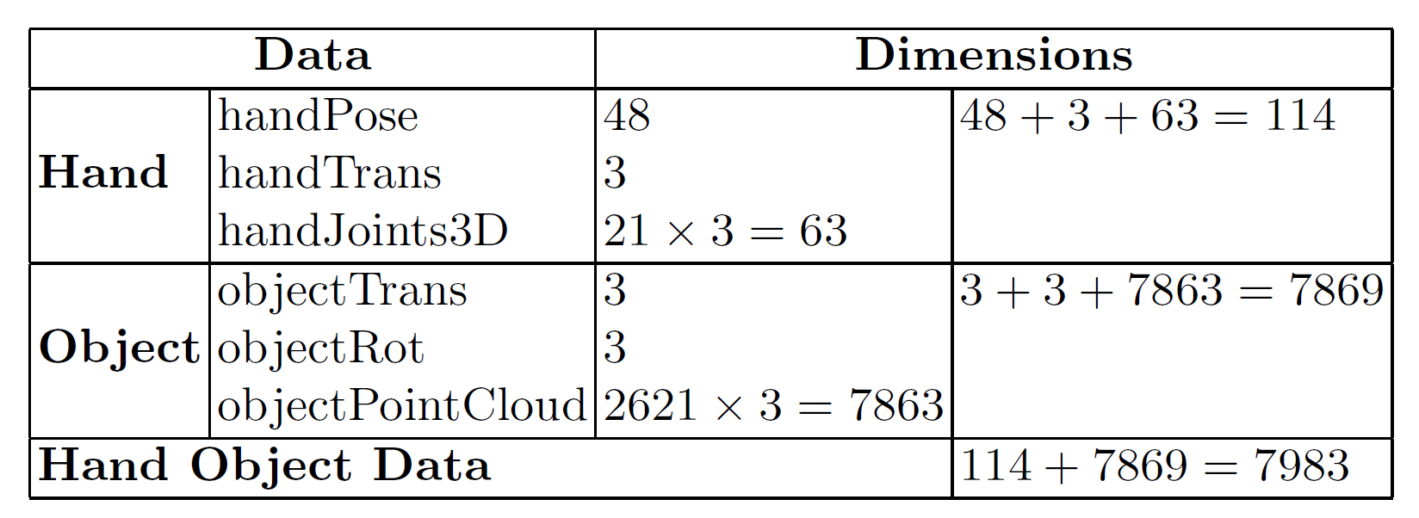
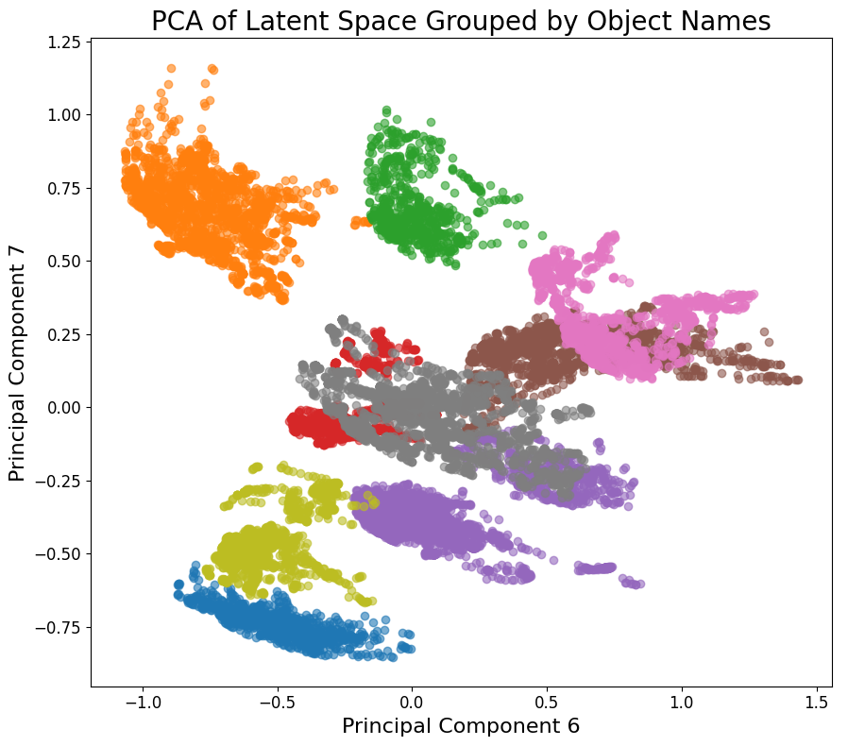
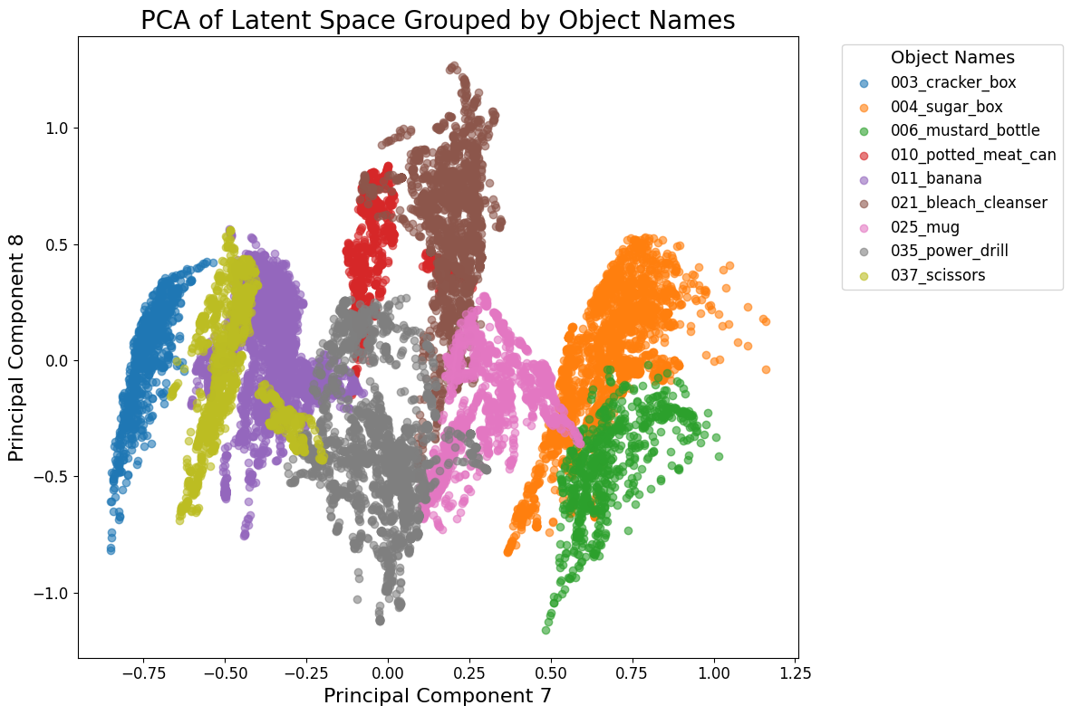
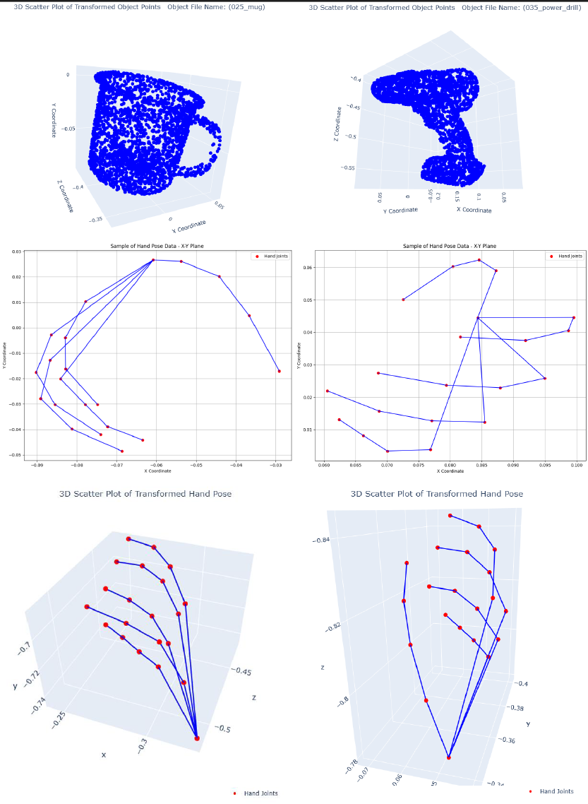

Disentangling Grasp-Object Representations in the Latent Space: Toward Brain-like Affordances for Machines
Siavash Mortaz Hejri¹, Hamed Pourfannan^{1,2}, Ruidong Ma¹, Alejandro
Jimenez Rodriguez¹ and Alessandro Di Nuovo^{1,2}
1. Smart Interactive Technologies Research Lab, SHU
2. Advanced Wellbeing Research Centre, SHU
ABSTRACT
Brain Imaging studies show that when planning grasping action, certain parts of the sensorimotor cortex associate object properties with the type of grasp that would match the object.
Curious to see if such patterns can also emerge in Artificial Neural Networks, a Conditional Variational Autoencoder (CVAE) was trained on the HO-3D_v3 dataset to reconstruct grasping hand poses conditioned on the object.
Principal Component Analysis (PCA) on the latent space of the trained CVAE model revealed abstract hand representations that were distinctly organized by the type of object.
RESEARCH QUESTIONS
Can Artificial Neural Networks develop latent representations that mimic how the human brain links object properties to grasp types?
Would the latent space of a CVAE trained on hand-object interaction data show affordance-relevant organizations like what is observed in the human sensorimotor cortex?
DATASET AND MODEL TRAINING
Dataset
CVAE Architecture
Hampali, S., Sarkar, S. D., & Lepetit, V. (2021). Ho-3d_v3: Improving the accuracy of hand-object annotations of the ho-3d dataset. arXiv preprint arXiv:2107.00887.
LATENT SPACE ANALYSIS
Findings:
  CVAE effectively reconstructed grasping hand poses based on the objects.
  PCA revealed a structured latent space: the first 8 components explained over 97% of the variance.
  Distinct object-specific clusters were observed in the latent space, notably PCs 5-8.
  Clusters reflect functional similarities in grasp types rather than purely visual object features (e.g., scissors and banana overlap due to similar grip).
  These representations could improve robotic control by enabling real-time motor planning in the latent space for complex humanoid hand actions, bypassing the need for pixel and joint-level computations.
ACKNOWLEDGMENTS
This work was funded by Innovate UK (grant number 10089807 for the Horizon Europe project PRIMI Grant agreement n. 101120727).

