Slide 1

Listen, Chat, and Edit on Edge
Final Project Presentation
LCEE
Siavash Shams (ss6928)
Pranav Kumar Kota (pkk2125)
EECS E6692 Deep Learning on the Edge, 2022 Spring

Slide 2
Outline of the Presentation
Description
Sound Editing Module
LLM
Approach
Connecting Jetson Nano to the Cloud
Dataset
Demonstration
What’s happening to the mixture?
Does it always work?
Profiling

Slide 3
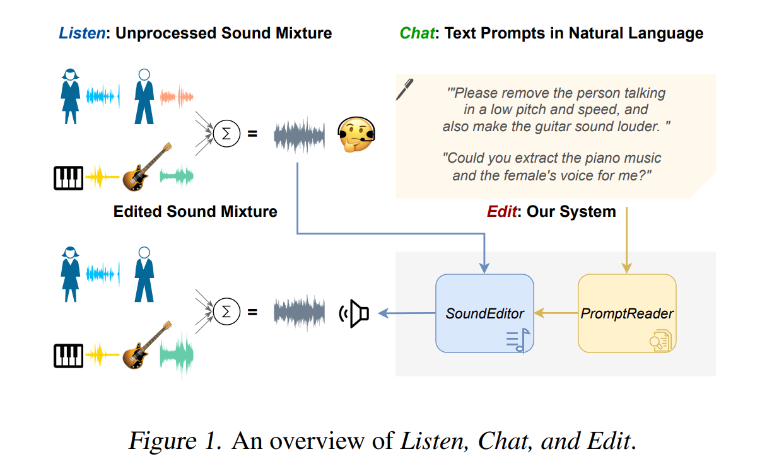
Description
Introduction to LCE: A groundbreaking multimodal sound mixture editor leveraging user-provided text instructions for sound editing.
Problem Addressed: Tackles the "cocktail party problem"
Innovative Approach: Utilizes a user-friendly chat interface for specifying sound editing tasks in natural language

Slide 4
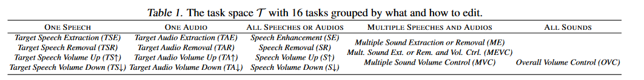
Description
Editing Objective: The aim is to edit the original sound mixture into a new one, where each source may be scaled differently according to user instructions.
Action Space: Defines the set of possible editing actions - removing, keeping, increasing volume, or decreasing volume, with corresponding scaling factors.

Slide 5
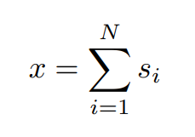
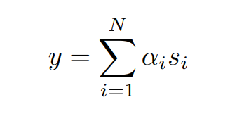
Description
Sound Mixture Editing:
Given a sound mixture x, it can be represented as the linear combination of each of its sources:
Sound descriptors: one or more of gender, pitch, tempo, energy, emotion
The goal of sound mixing is to produce a new sound y mixture

Slide 6

Description
The scaling factors are determined by the user’s desired action
Action space : {removing, keeping, increasing, decreasing}
This accurately describes the sound mixture editing instruction, but inconvenient
Solution:-
Deploy an LLM to interpret

Slide 7
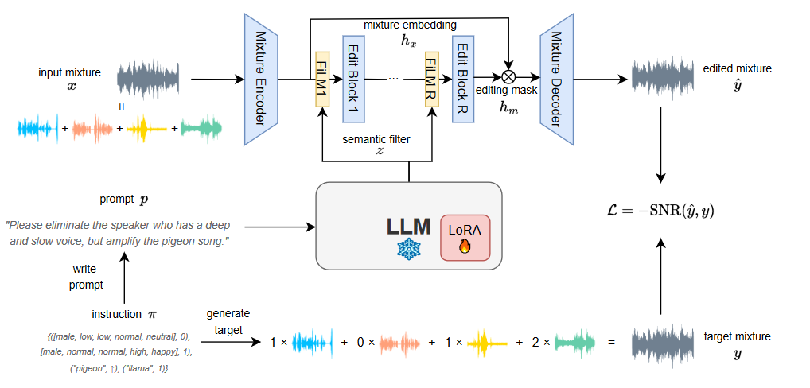
Description
Sound editing module

Slide 8
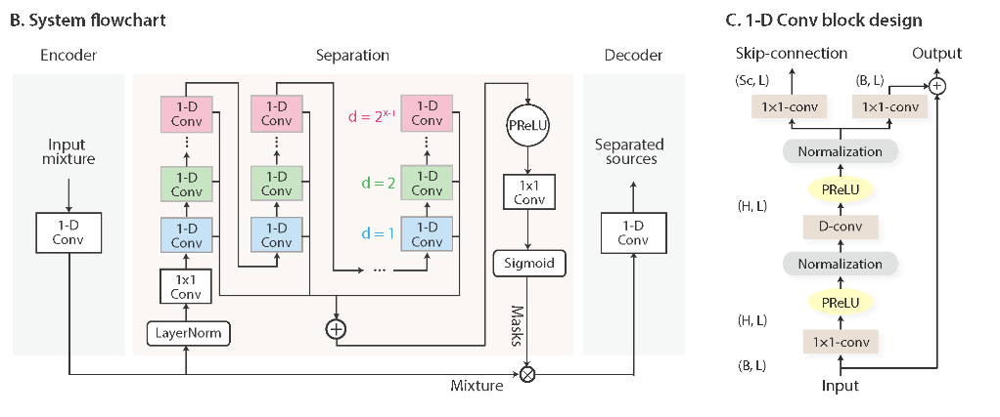
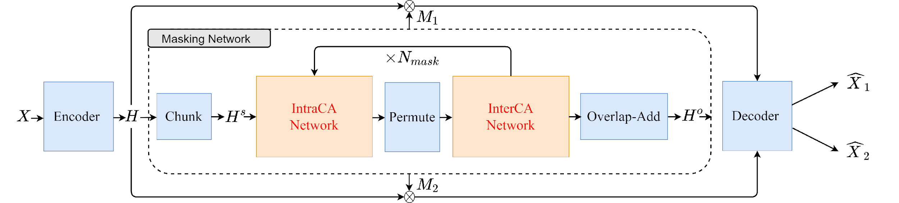
Sound Editing Module
Masknet
Conv-TasNet (ours)
Luo, Yi, and Nima Mesgarani. "Conv-tasnet: Surpassing ideal time–frequency magnitude masking for speech separation."
Sepformer
Luo, Jian, et al. "Tiny-sepformer: A tiny time-domain transformer network for speech separation."

Slide 9
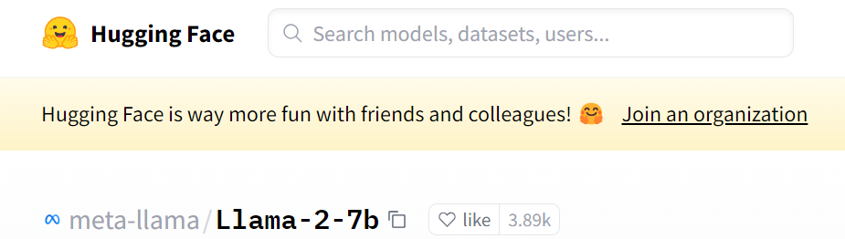

LLM

Slide 10

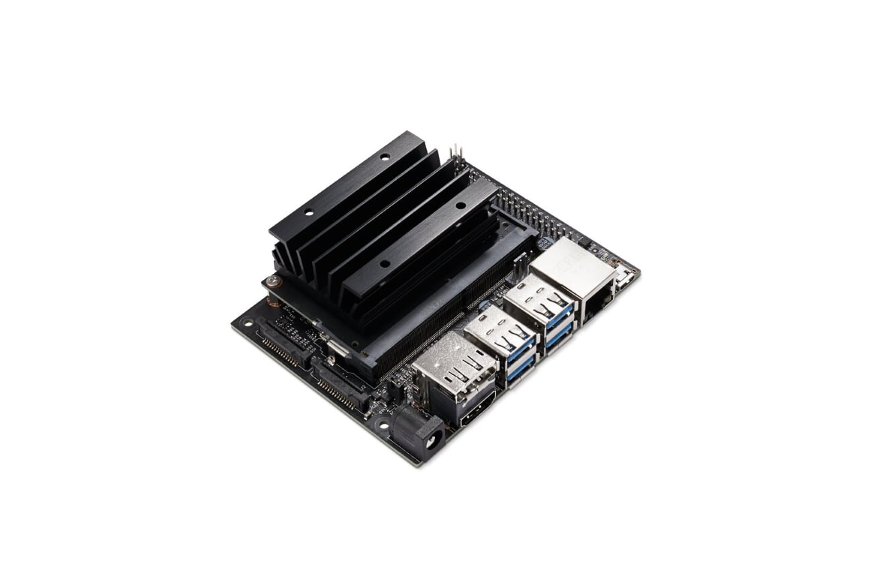

Approach:-
Deploy the Fine-tuned LLM on cloud.
Setup a connection between jetson and the cloud and send the prompt to cloud and get the embeddings.
Use the obtained embeddings as input to the sound editor module to do the sound editing on jetson.
LLM
Prompt: extract the female voice
Separation module

Slide 11
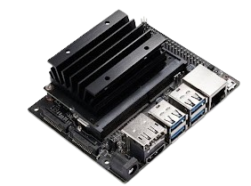
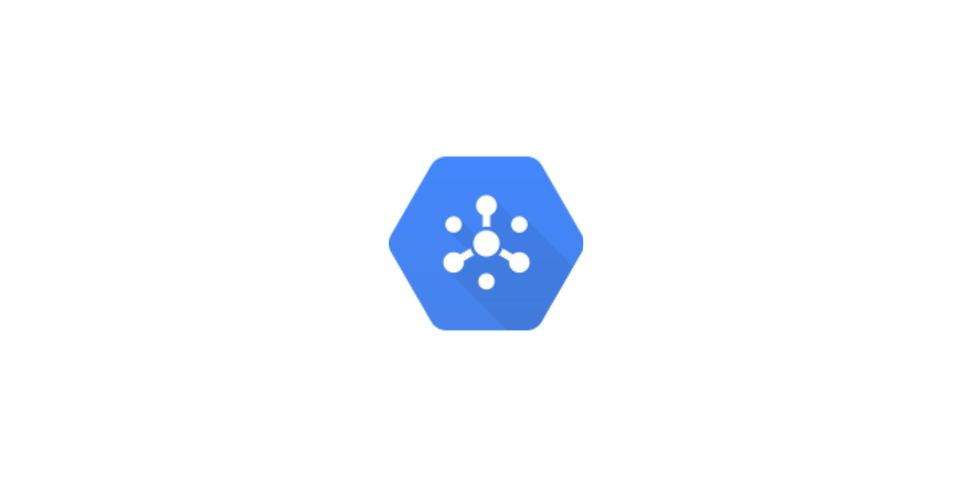
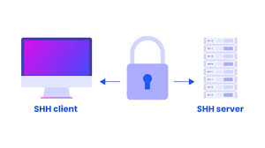
Connecting the Jetson Nano to the Cloud
LLM
Communication
Block
Jetson Nano
Pub/Sub
SSH

Slide 12
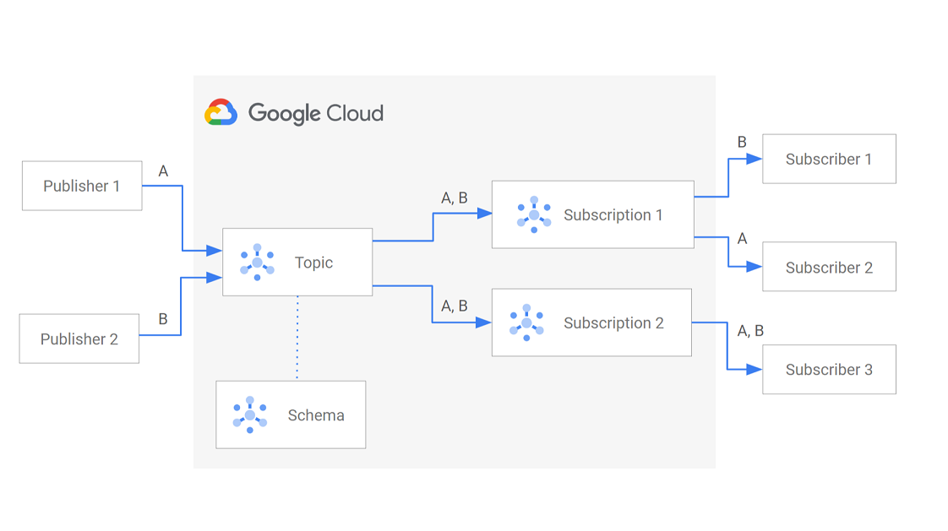
Pub/Sub

Slide 13
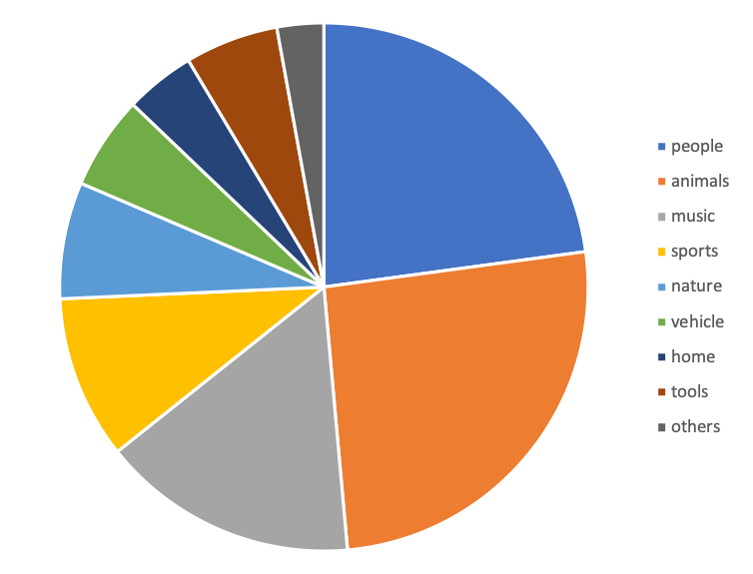
Dataset
Name: VGGSound
Link: https://www.robots.ox.ac.uk/~vgg/data/vggsound/
Size: ~320Gb
Short Description:
Where will data reside?
How will it be used: We will create audio mixtures required for training the model
Did we download? No
Potential Issues: -

Slide 14

A few demonstrations
Input mixture
Input prompt
Output mixture
Remove the female talker and amplify the male talker's voice
Remove all people talking.
Enhance this recording by removing all the noises.
Exclude the speaker with a high-frequency voice and average vitality, conveying a neutral tone.

Slide 15
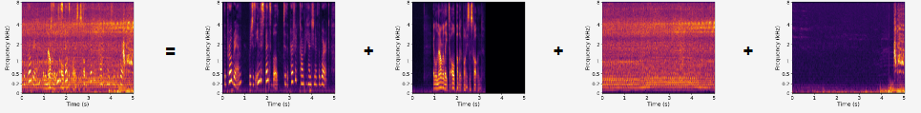
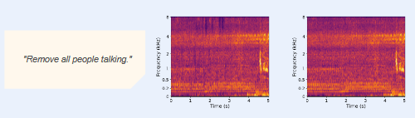
What’s happening to the mixture
Unprocessed Mixture
male speaker
turkey gobbling
female speaker
helicopter
Text Prompt
Edited Mixture
Target Mixture

Slide 16
Does it always work?
Input mixture
Input prompt
Output mixture
ours
Please remove all non-human sounds.
paper results

Slide 17
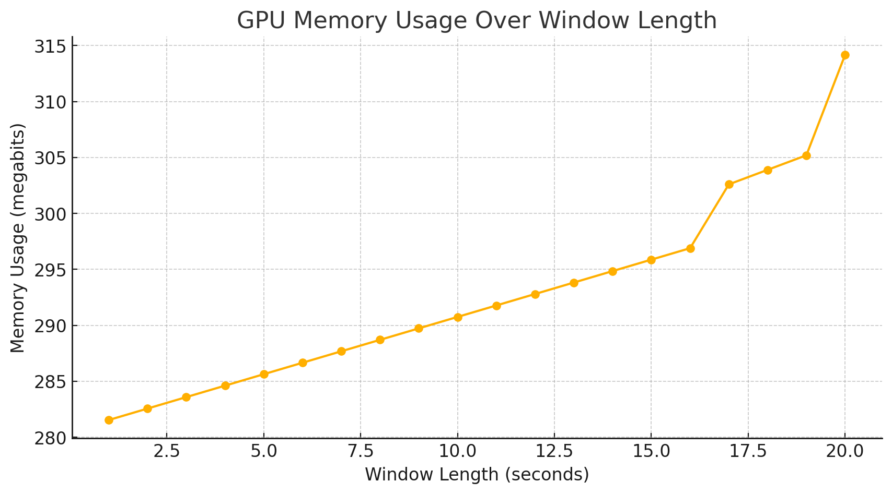
Profiling

Slide 18
Profiling
Module | Submodules | Processing Time (s)
Sound Editing Module | Encoder MaskNet Decoder | 0.042 ± 0.024 4.520 ± 0.551 0.011 ± 0.016
LLM | LLAMA 2 | 3.26 ± 0.149

Slide 19
Key Challenges
The development environment on the Nano - compatible with the sound mixture models
Ensuring model fits on the device
LLM too large to handle; Deployed on cloud
Communication through Pub/Sub service erroneous due to mismatch.

Slide 20
Key References and Links
Papers: https://arxiv.org/pdf/2402.03710.pdf
Github: https://github.com/eecse6692/e6692-2024spring-finalproject-lcee
Paper Demo: https://listenchatedit.github.io

Slide 21
Thanks

