Slide 1

Research Sensitization & Innovative Project Development
Smart Agriculture: A Cognitive Digital Twin for Crop Yield and Failure Detection
Members:-
Faculty Mentors:-
Om Prakash Sahoo : 2401109207
Tejeswar Mishal : 2401109
Soumya Ranjan Sahu : 2401109239
Sambit Sekhar Biswal : 2521109014
Sibananda Dora : 2401109233
Dr. Niranjan Panigrahi
Dr. Sasmita Rani Behera

Slide 2
DOMAIN & DESCRIPTION
DOMAIN
Agricultural Technology (AgriTech)
Artificial Intelligence
Cognitive Digital Twin (CDT)
Core Focus : Building a continuous, data-driven feedback loop for proactive crop failure detection.
PROBLEM DESCRIPTION
Currently, agricultural yield forecasting relies heavily on retrospective government statistics that lack real-time predictive capabilities. When climate-induced anomalies—such as severe droughts, extreme thermal stress, or flooding—occur, traditional regression models fail to accurately classify the probability of a crop failure in time for intervention. Furthermore, uninterpretable deep learning models provide predictions without actionable explanations, reducing trust among stakeholders. There is a critical need for an intelligent system that can continuously ingest environmental telemetry, model biophysical failure triggers, account for weather uncertainty, and provide explainable AI insights. A Cognitive Digital Twin (CDT) solves this by replicating the physical agricultural state digitally, allowing for proactive decision-making and counterfactual "What-If" climate simulations.

Slide 3
LITERATURE REVIEWS
PAPER -1 : Climate Prediction Using RNN LSTM to Estimate Agricultural Products Based on Koppen Classification (Andini & Utomo, 2021)
Brief Description: This study focuses on predicting climate variables to optimize agricultural product estimation and mitigate the risk of crop failure due to incompatible climate conditions.
Dataset Used: A climate time-series dataset structured around the Köppen climate classification system.
Proposed Methodology: The researchers implemented a Recurrent Neural Network (RNN) architecture utilizing Long Short-Term Memory (LSTM) cells (with 48 input neurons), optimized via the Adam optimizer over 200 epochs.
Key Outcomes: The methodology successfully achieved high predictive accuracy, yielding a Mean Absolute Percentage Error (MAPE) of just 3.29% for 1-month-ahead climate forecasting.
Research Gaps: The model's temporal depth is limited to forecasting just one month ahead, rather than projecting a full 12-week agricultural season. Additionally, it omits critical sub-surface environmental features like root zone soil wetness (GWETROOT), which are essential for robust biophysical stress modeling.
PAPER -2 : A Time-Series Hybrid Multi-Model Machine Learning Framework for Staple Crops Yield Prediction (Arya et al., 2026)
Brief Description: This research aims to improve the accuracy of staple crop yield forecasting by addressing the complex, nonlinear dynamics inherent in agricultural data.
Dataset Used: International macro-level agricultural yield datasets and historical time-series production records.
Proposed Methodology: The authors designed a Time-Series Hybrid Multi-Model Machine Learning Framework, combining traditional linear time-series forecasting (ETS) with non-linear deep learning (Artificial Neural Networks and LSTM).
Key Outcomes: The hybrid approach demonstrated superior accuracy for staple crops, specifically achieving an R² of 98.4% for Rice yield predictions.
Research Gaps: The framework operates as an uninterpretable "black box," lacking Model Interpretability to explain why a crop might fail. Furthermore, its reliance on international macro-data makes it poorly suited for district-stratified, localized interventions for smallholder farmers.

Slide 4
PAPER -3 : Precision Agriculture Revolution: Integrating Digital Twins and Advanced Crop Recommendation for Optimal Yield
Brief Description: This paper explores the integration of Cyber-Physical Systems (CPS) to construct an agricultural digital twin capable of advanced, dynamic crop recommendation.
Dataset Used: Operational farm-level data collected via localized Internet of Things (IoT) sensor networks.
Proposed Methodology: The researchers developed a digital twin methodology that digitally mirrors the physical farm environment, enabling the execution of dynamic "What-if" simulations for agricultural planning.
Key Outcomes: The implementation of the digital twin led to highly impactful optimizations, demonstrating a 10-25% increase in crop yield and a 20-30% reduction in water usage.
Research Gaps: The heavy reliance on a sensor-dense "single-farm silo" creates a massive infrastructure cost and data interoperability bottleneck, rendering it financially unviable for smallholders. It also lacks an automated, explainable mechanism for translating complex AI logic to the farmer.
PAPER -4 : Crop Yield Time-Series Data Prediction Based on Multiple Hybrid Machine Learning Models (Yan et al., 2025)
Brief Description: This study focuses on enhancing the accuracy of continuous crop yield predictions by analyzing complex, non-linear relationships in agricultural time-series data.
Dataset Used: Historical agricultural yield metrics combined with localized, real-time pesticide usage records.
Proposed Methodology: The researchers constructed a Weighted Ensemble model that combines the predictive strengths of Random Forest (RF) and XGBoost algorithms.
Key Outcomes: The hybrid ensemble approach significantly outperformed standalone models, successfully reducing the Mean Absolute Error (MAE) from 0.0177 (standalone RF) to 0.0042.
Research Gaps: The model strictly predicts continuous yield volume (t/ha) rather than classifying the binary "Failure Anomalies" required for disaster relief triggering. Additionally, its heavy reliance on real-time pesticide data creates a severe operational bottleneck in developing regions where such data is often delayed or unavailable.

Slide 5
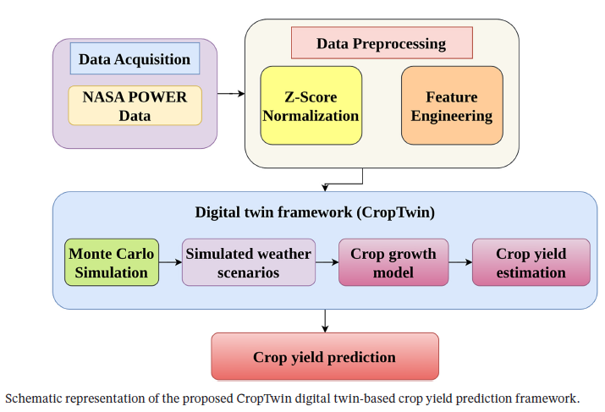
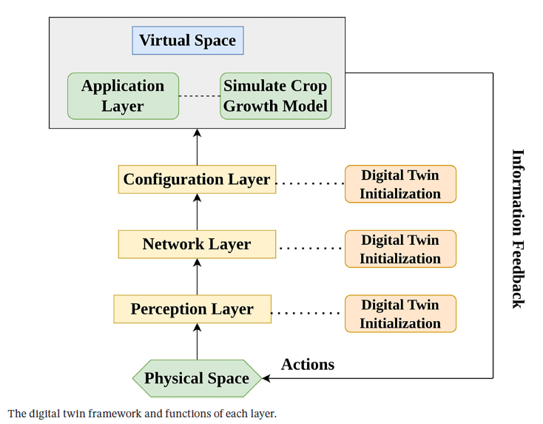
PAPER -5 : Digital Twin-Based Uncertain Weather Condition Monitoring for Enhanced Crop Yield Prediction (Kenneth, 2026)
Brief Description: Kenneth (2026) introduces the "CropTwin" framework, designed to monitor and mathematically model uncertain weather conditions to enhance the prediction of crop yields without relying on local hardware.
Dataset Used: Continuous satellite meteorological telemetry sourced directly from the NASA POWER API.
Proposed Methodology: The framework integrates digital twin technology with Monte Carlo simulations to computationally model weather uncertainty and evaluate counterfactual environmental scenarios.
Key Outcomes: The simulated uncertainty approach proved highly viable, generating a real-time yield prediction of 5.90 t/ha compared to an uncertain weather projection of 5.62 t/ha using only satellite API data.
Research Gaps: The framework exclusively models weather uncertainty while completely ignoring critical biotic stress factors (like pest infestations driven by humidity). It also operates purely as a predictive monitor, lacking a Decision Support System (DSS) to issue actionable intervention advisories back to the physical layer.

Slide 6
Key Limitations in Existing Literature (Research Gaps)
Prediction of Continuous Yield vs. Binary Disaster Risk
Existing hybrid models (e.g., Yan et al., 2025) focus entirely on predicting absolute crop volume (t/ha).
They fail to classify whether a drop in yield constitutes a full-scale agricultural "failure anomaly," which is the actual metric required for immediate disaster intervention.
The Model Interpretability Gap
Advanced deep learning models (e.g., Arya et al., 2026; Andini & Utomo, 2021) achieve high accuracy but operate as uninterpretable black boxes.
They do not map mathematical predictions (like LSTM attention weights) to real-world biophysical triggers (such as severe drought or thermal sterility), reducing stakeholder trust.
High Infrastructure Cost and Scalability Bottlenecks
○ Current Cyber-Physical Systems (CPS) and agricultural Digital Twins often rely heavily on expensive, localized IoT sensor networks.
○ This "single-farm silo" approach poses massive data interoperability challenges and is financially unviable for smallholder farmers in regions like Odisha.
Omission of Actionable Feedback Loops
While systems like Kenneth's (2026) CropTwin successfully model weather uncertainty, they operate purely as passive predictive monitors.
They lack an integrated, intelligent Decision Support System (DSS) that automatically translates complex predictions into actionable agronomic advisories for the end-user.
Incomplete Environmental Stress Profiling
Current models often rely on high-friction, hard-to-acquire data like real-time pesticide usage, while omitting critical sub-surface metrics like Root Zone Soil Wetness (GWETROOT).
This causes predictions to fail when chemical application data is delayed or when complex biotic stress triggers are ignored.

Slide 7
Our Innovative Approach (The Cognitive Digital Twin Framework)
Macro-to-Micro Data Bridging via NASA POWER API
Dual-Track ML Engine for Binary Failure Classification
Model Interpretability Mapped to Biophysical Triggers
To solve the IoT hardware infrastructure bottleneck, our framework completely bypasses the need for expensive local sensors.
Implements a dual-track engine (Tabular ML alongside a PyTorch 3D Tensor LSTM-Attention model).
We ensure high model interpretability by extracting Temporal Attention Weights from our LSTM network.
We utilize a probabilistic Q1​ thresholding logic on the
data to explicitly classify, label and predict
Failure Anomalies" for disaster relief prioritization.
We ingest continuous, district-stratified macro-data directly from the NASA POWER API, computationally transforming satellite weather telemetry into localized field-level risk proxies.
We map these mathematical weights directly to physical agricultural stressors (e.g., automatically flagging "High risk due to week-4 thermal stress").
LangGraph-Powered Expert Advisory Node (DSS)
Interactive "What-If" Climate Simulations
Instead of just displaying a raw risk percentage on a screen, we close the feedback loop by embedding an AI-driven Chatbot directly into the Application Layer.
We elevate the system from a passive "Digital Shadow" to a true Cognitive Digital Twin by enabling dynamic counterfactual testing.
This Orchestrator Agent automatically translates complex tensor outputs into plain-language, actionable interventions and advisories tailored for the farmer.
Our dashboard allows analysts to dynamically manipulate climate variables (temperature, humidity) and run Monte Carlo simulations to observe potential future disaster outcomes.

Slide 8
PROBLEM STATEMENT :
To design and develop a Cognitive Digital Twin that integrates 20 years of historical yield data (APY Data by Govt. of Odisha) with continuous NASA POWER weather telemetry to accurately forecast crop yield, classify failure anomalies using an intelligent prediction engine, and provide explainable Decision Support System (DSS) and can run "what-if" simulations.
OBJECTIVES :
1.Engineer an automated data pipeline : A pipeline that harmonizes two decades of historical crop yield statistics with continuous, satellite-based weather telemetry from the NASA POWER API.
2.Formulate a statistical framework: A framework that accurately defines, quantifies, and labels district-level crop failure anomalies for machine learning tasks.
3.Design and train a dual-purpose predictive engine : capable of forecasting continuous seasonal crop yields while simultaneously classifying the probability of imminent crop failure.
4.Deploy an intelligent Decision Support System (DSS) : A natural language query-response interface for easy interaction with the predictive models
5.Construct an interactive Digital Twin dashboard : A Dashboard that empowers stakeholders to run counterfactual "what-if" climate simulations .

Slide 9
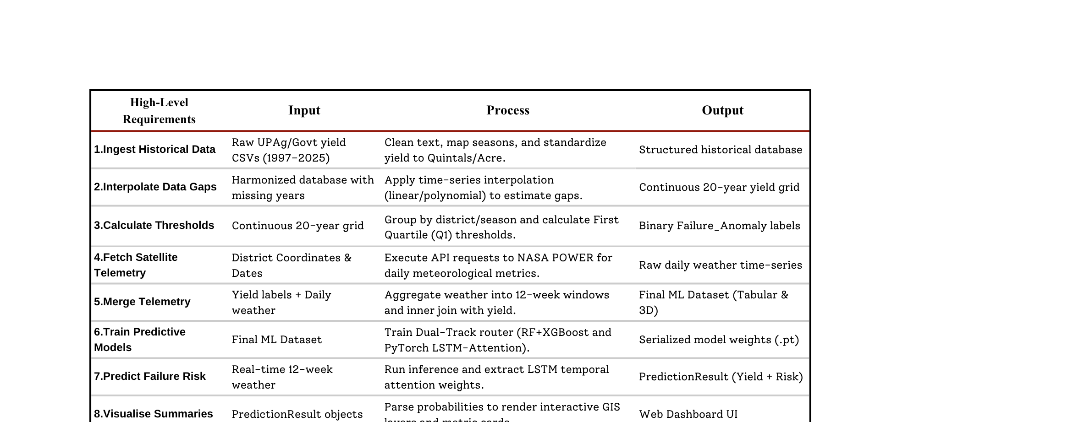
Functional Requirements

Slide 10
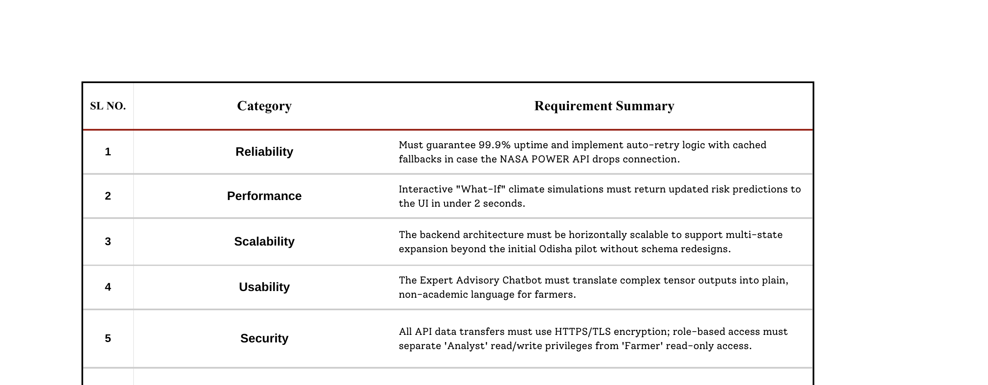
Non-Functional Requirements

Slide 11
















Technology Stack
AGENTIC-AI
FRAMEWORKS
Data Engineering
--LangGraph
--LangChain
Python
Pandas
Numpy
NASA POWER API
Backend & Orchestration
ML-DL Framework
Frontend & Visualization
PyTorch
Scikit-Learn
TensorFlow
--Typescript
Api connection
--Tailwind CSS
Design
--Next-js
UI and Server

Slide 12
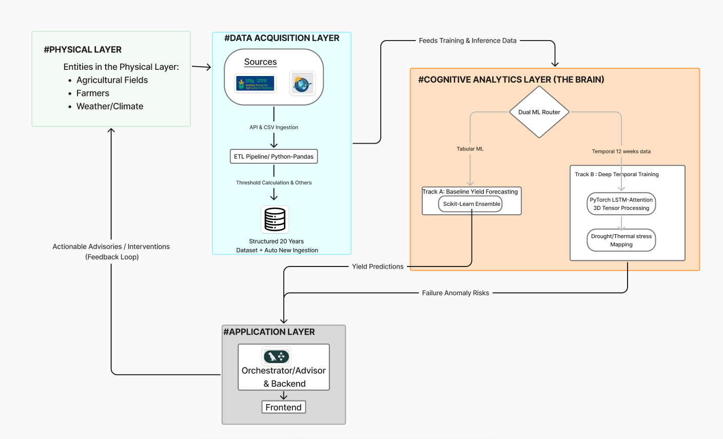
DIGITAL TWIN ARCHITECTURE

Slide 13
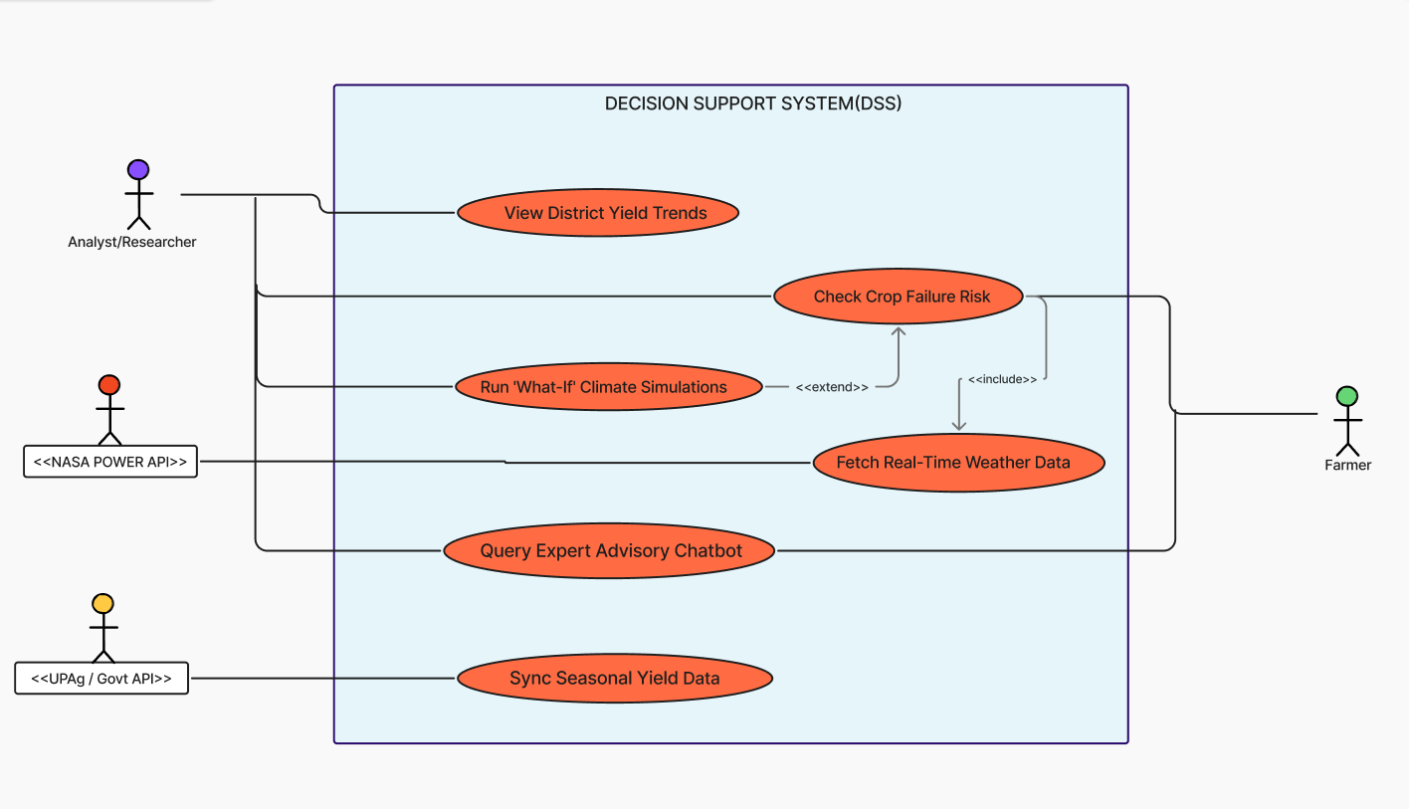
USE-CASE DIAGRAM

Slide 14
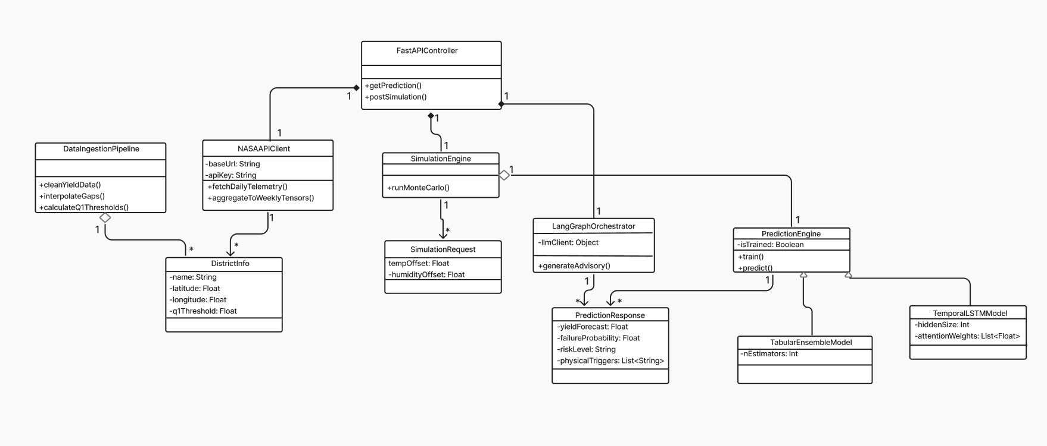
CLASS DIAGRAM

Slide 15
ROADMAP
Phase 1: Data Engineering & System Design (Completed)
Phase 2: Core Model Development & Training
(Current)
Data Harmonization: Cleaned and interpolated 20 years
of historical yield data.
Thresholding: Established Q1​ logic for defining binary "Failure Anomalies".
Architecture Validation: Finalized the Architecture bridging the Physical Layer to the DSS.
Track A Deployment: Train the Scikit-Learn Ensemble methods for baseline tabular yield forecasting.
Track B Deployment: Construct and train the PyTorch LSTM-Attention model using 12-week temporal 3D tensors.
Validation: Test both models against historical disaster years to validate failure classification accuracy.
Phase 3:Model Interpretability & LangGraph Integration (Future)
Phase 4: Frontend GIS Dashboard & Real-World Pilot (Future)
Trigger Mapping: Extract the temporal attention weights from the LSTM and mathematically map them to physical stress triggers.
Chatbot Deployment: Integrate the LangGraph Orchestrator to power the Natural Language Expert Advisory Chatbot.
UI Construction: Build and deploy the React/Vite dashboard featuring interactive Leaflet GIS maps and metric trend cards.
Simulation Engine: Finalize the UI sliders to allow users to manipulate weather variables for "What-If" simulations.
User Testing: Conduct simulated User Acceptance Testing (UAT) utilizing Analyst and Farmer personas.

Slide 16
CONCLUSION
The Cognitive Digital Twin framework successfully bridges the critical gap between passive agricultural yield reporting and proactive, predictive disaster management. By continuously integrating 20 years of historical government baseline data with automated NASA POWER satellite telemetry, the system achieves a robust, dual-track machine learning prediction engine. Crucially, the framework ensures high model interpretability by translating complex deep learning temporal attention weights into transparent biophysical triggers (such as severe drought or thermal stress). Ultimately, this framework transforms complex data into an interactive Decision Support System (DSS) where stakeholders can run counterfactual "what-if" climate simulations—moving agricultural strategy away from reactive crisis response and toward proactive resilience planning.

Slide 17
References
Core Literature
[1] Andini, A., & Utomo, P. (2021). Climate Prediction Using RNN LSTM to Estimate Agricultural Products Based on Koppen
Classification. Journal of Physics: Conference Series.
[2] Arya, S., et al. (2026). A Time-Series Hybrid Multi-Model Machine Learning Framework for Staple Crops Yield Prediction. Expert
Systems with Applications.
[3] Kenneth, O. (2026). Digital Twin‐Based Uncertain Weather Condition Monitoring for Enhanced Crop Yield Prediction. Meteorological
Applications.
[4] Yan, J., et al. (2025). Crop Yield Time-Series Data Prediction Based on Multiple Hybrid Machine Learning Models. Computers and
Electronics in Agriculture.
[5] Sayan Banerjee∗, Aniruddha Mukherjee∗, Suket Kamboj . (2024). Integrating Digital-Twins and Advanced Crop Recommendation
Agricultural Systems.
Methodological & Technical References
[1] NASA POWER. (2026). Prediction of Worldwide Energy Resources (POWER) Agroclimatology Data Access Viewer & API
Documentation. NASA Langley Research Center.
[2] Odisha Department of Agriculture & Farmers' Empowerment (UPAg). Historical District-Wise Crop Production Statistics (1997–2025).
Government of Odisha.

