Slide 1



A Project Report on
Student Performance Prediction System
using
Machine Learning
By
Sibaprasad Jyotish
Roll No.2205260021
Regd. No. 2205260021
Under The Guidance Of
Dr. Swatee Rekha Mohanty
Professor, MCA,
RIMS

Slide 2
Introduction
In this project, we focused on leveraging student data to predict academic performance, benefiting both students and educators. By employing a variety of data mining algorithms including Decision Trees, Random Forests, and Support Vector Machines, we aimed to accurately classify students into performance categories. Such predictions enable mentors to offer tailored support to students at risk of failing, ultimately improving overall educational outcomes. Our primary objective was feature selection, identifying key attributes with a strong predictive relationship to the target variable within a complex, high-dimensional dataset. Through rigorous evaluation, we assessed the efficacy of each algorithm in forecasting student performance, offering valuable insights applicable to prominent educational institutions.

Slide 3
Objectives
Education is very important issue regarding development of a country. The main objective of educational institutions is to provide high quality education to its students. One way to accomplish this is by predicting student's academic performance and thereby taking early steps to improve student's performance and teaching quality.
This system aims to predict student's marks using linear regression. The idea behind this analysis is to predict the marks of students by their studying hours. Through this project we can determine: How many hours need to do the study to get 99% marks. If I will do study x hours per day so how much marks I will get. Through these points the school/College can determine the performance of the student.

Slide 4
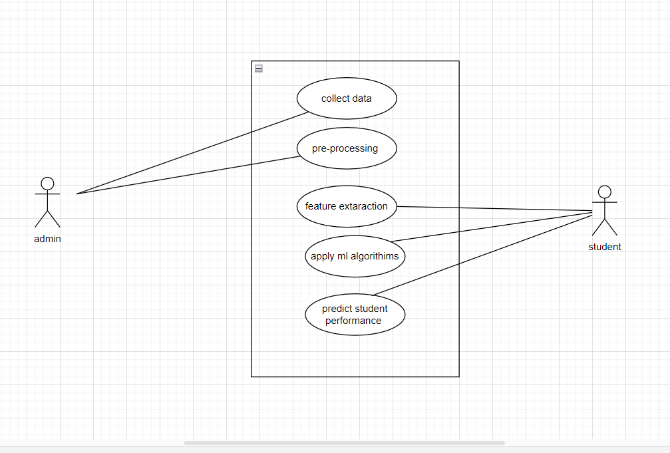
UML DIAGRAM

Slide 5
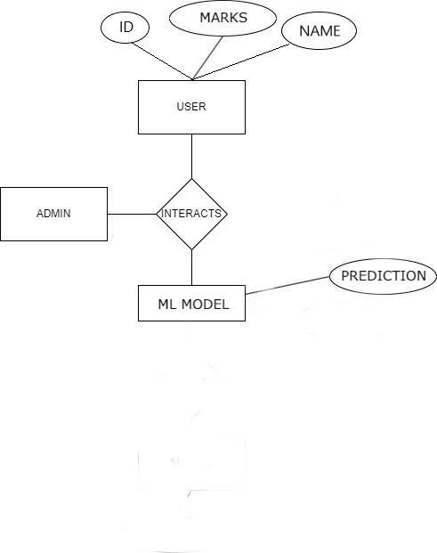
Architecture Diagram

Slide 6
Hardware and Software Specification
Hardware Specifications
HDD-1TB
SSD-256 GB
Processor- i5
Windows-11
Software Specification
Frontend Language - HTML, CSS, JAVASCRIPT
Backend Language - Python 3.10
Framework - Django
CSS Library: Bootstrap
Environment Settings
Python Dependencies:
1. numpy==1.19.2
2. pandas==1.3.1
3. matplotlib==3.3.4
4. scipy==1.5.2
5. seaborn-0.11.2
6. scikit-learn==0.24.2
7.joblib==0.16.0
Deployment Platform: Django ENVIRONMENT SETTINGS
Prerequisite
• Python 3.8 or above
• HTML, CSS, JS
• Microsoft Visual Studio Code
• GitHub
• Windows 10, Windows 11

Slide 7
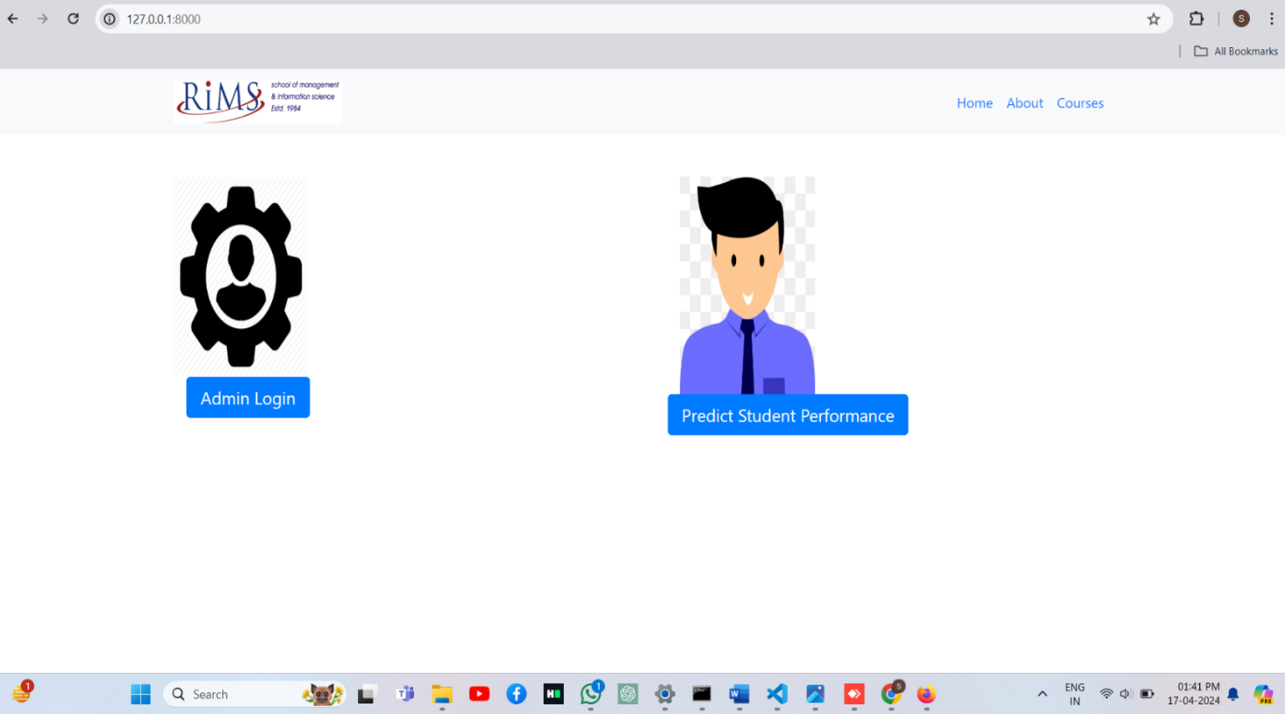
Result

Slide 8
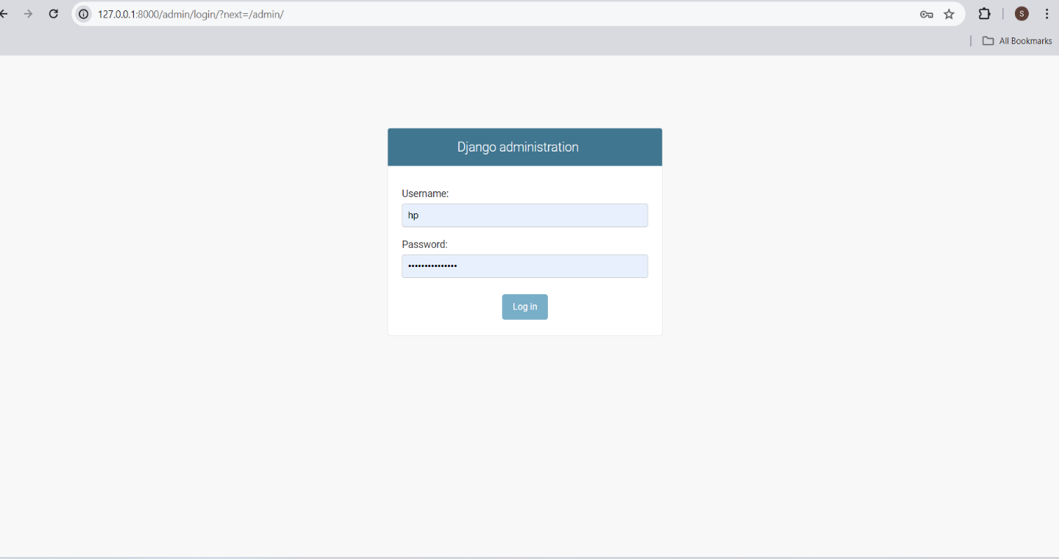
Result
Click into the admin login it provides authentication process so for that the result is.

Slide 9
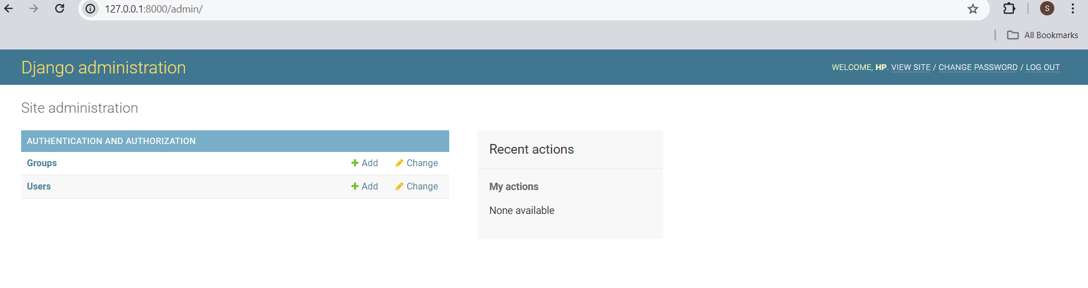
Result
After Admin login the admin logged dashboard

Slide 10
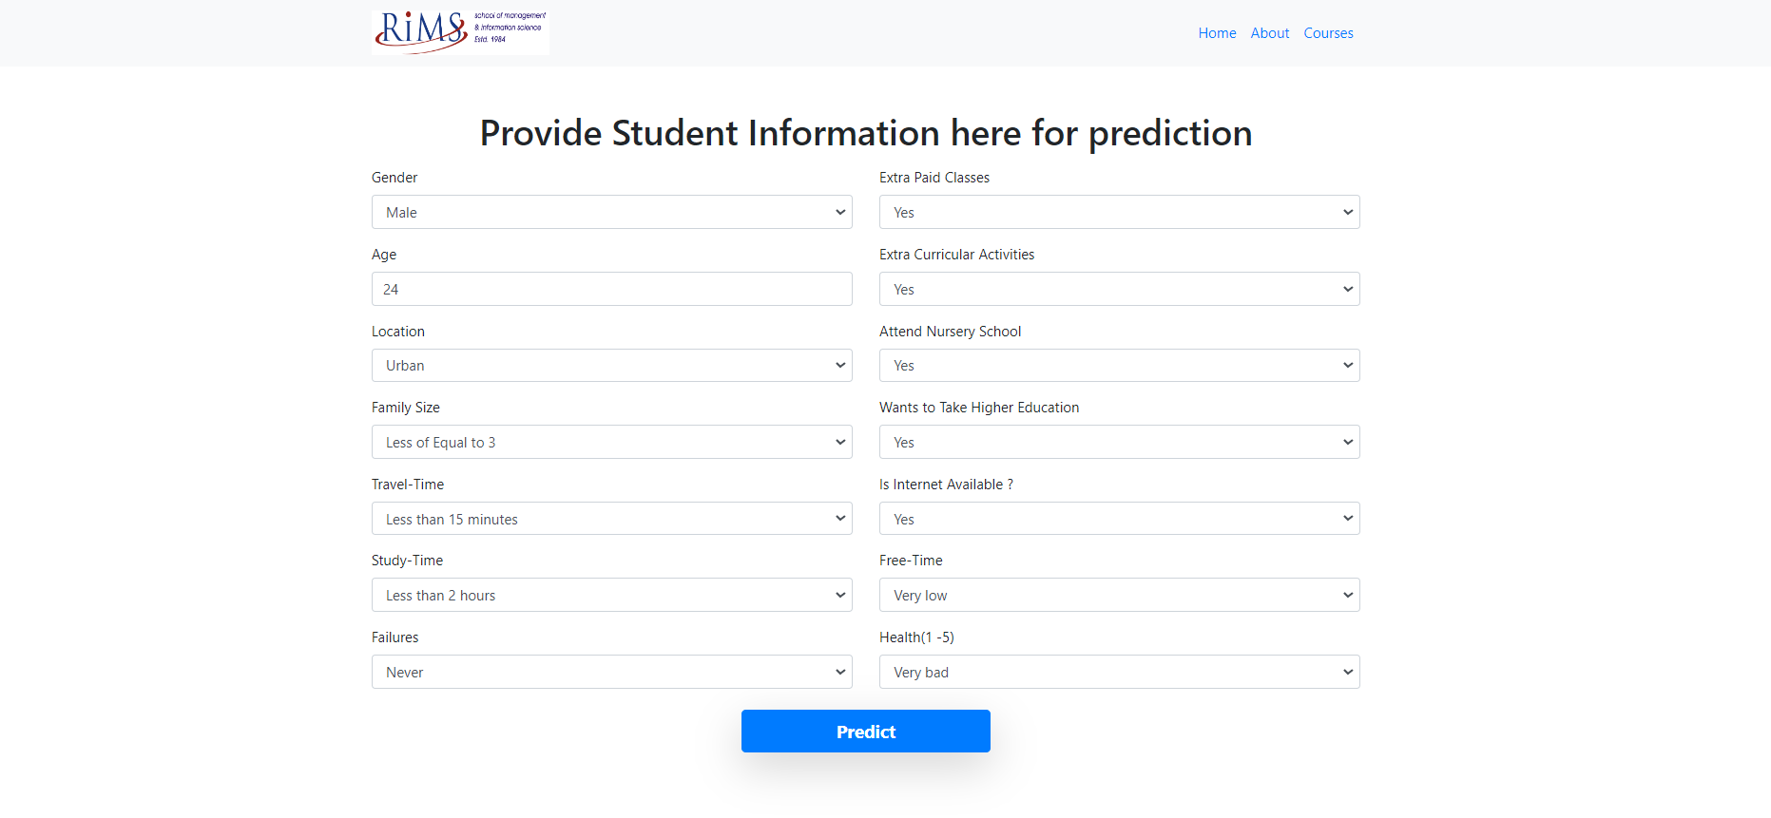
Result
On Student login the Dashboard will be

Slide 11
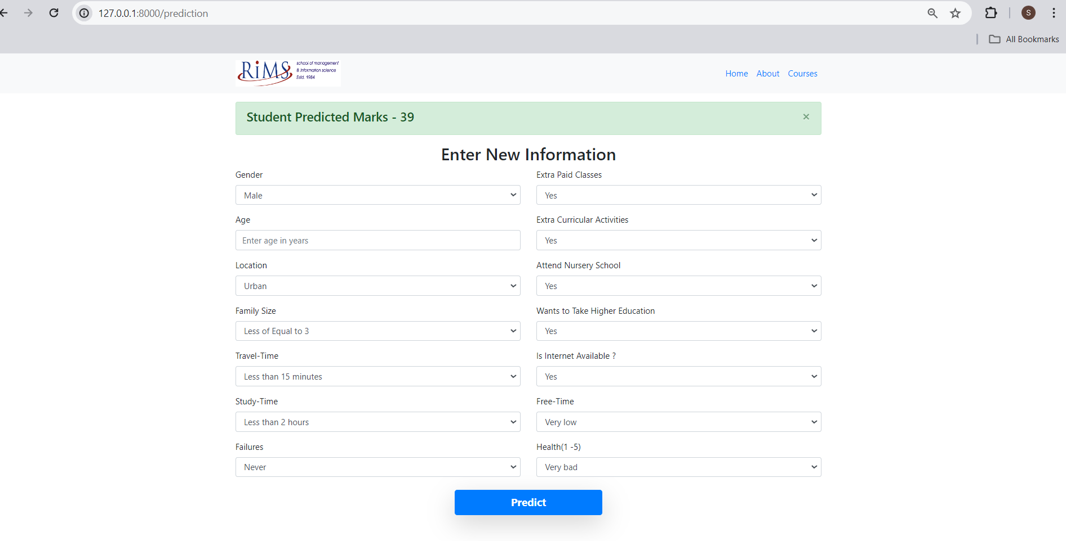
Result
On putting values the screen will look like this.

Slide 12
Conclusion
In this chapter, the research aimed to generate insights into student well-being data, highlighting the impact of gender, age, and various well-being dimensions.
A model was designed using machine learning methods to predict student grades based on this data, with validation against actual performance data. Ethical evaluation using Value Sensitive Design underscored the importance of balancing predictive accuracy with ethical considerations, especially regarding potential impacts on student well-being and educational experiences.
Moving forward, future work could focus on refining the predictive model to enhance its accuracy and reliability while further integrating ethical considerations into the design process.
Additionally, ongoing research should continue to explore the evolving intersection of technology, education, and ethics, ensuring that educational technologies prioritize the well-being and interests of all stakeholders.
Git-https://github.com/Sibaprasadjyotish/Student-Performance-Prediction-Using-Random-forest

Slide 13

Any Queries?

Slide 14


