Slide 1
HR Analytics Behavioral Modeling to Predict Regenege
Name
Sibarpita Chandan Mohapatra

Slide 2
1.
Background of the Project under discussion

Slide 3
Project Background
There is a start-up providing talent acquisition solutions. An HR consultancy service agency advised it customers on talent acquisition practices and also implemented individually tailored solutions using analytics.
The no. of people not joining the company after accepting the offer varies from 15% to 35%. If a company rolls out thousand offers then the impact of renege is significant.
Key Questions:
What are the key drivers that influence the candidate joining/not-joining the company?
What rules can be used to predict the renege?
Devising a predictive algorithm to calculate the possibility of acceptance of an offer and joining the company after offer acceptance stage

Slide 4
2.
Problem Statement - Builiding Hypotheis

Slide 5
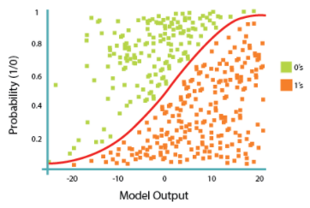

Problem Statements
Formulate a predictive algorithm to calculate the probability of acceptance of an offer and joining the company after acceptance stage.
A binomial logistic regression (often referred to simply as logistic regression), predicts the probability that an observation falls into one of two categories of a dichotomous dependent variable based on one or more independent variables that can be either continuous or categorical.
In our case –
The Dependent Variable is “Status” of the candidate which is categorical – Either the candidate will join or not join
And the Independent Variables are – DOJ Extended, Duration to accept offer, Notice period, Offered band, Percent hike expected in CTC, Percent hike offered in CTC, Percent difference CTC, Joining Bonus, Candidate relocate actual, Gender, Candidate Source, Rex in Yrs, LOB, Location and Age
Equation for Logistic Regression:
$$\frac{e^{θ0+θ1x1+θ2x2+θ3x3+ … +θnxn}}{1+e^{θ0+θ1x1+θ2x2+θ3x3+ … +θnxn}}$$
𝜎(𝜃^{𝑇}𝑋) =
𝑃𝑟𝑜𝑏𝑎𝑏𝑖𝑙𝑖𝑡𝑦 𝑂𝑓 𝐶𝑙𝑎𝑠𝑠 1=𝑃(𝑌=1|𝑋)=𝜎(𝜃^{𝑇}𝑋)

Slide 6
2.
Data Avilable and Assumptions

Slide 7
Data Avilable and Assumptions
Sl. No. | Name of Variable | Variable Description
1 | Candidate reference number | Unique number to identify the candidate
2 | DOJ extended | Binary variable identifying whether candidate asked for date of joining extension (Yes/No)
3 | Duration to accept the offer | Number of days taken by the candidate to accept the offer (continuous variable)
4 | Notice period | Notice period to be served in the parting company before candidate can join this company (continuous variable)
5 | Offered band | Band offered to the candidate based on experience and performance in interview rounds (categorical variable labelled C0/C1/C2/C3/C4/C5/C6)
6 | Percentage hike (CTC) expected | Percentage hike expected by the candidate (continuous variable)
7 | Percentage hike offered (CTC) | Percentage hike offered by the company (continuous variable)
8 | Joining bonus | Binary variable indicating if joining bonus was given or not (Yes/No)
9 | Gender | Gender of the candidate (Male/Female)
10 | Candidate source | Source from which resume of the candidate was obtained (categorical variables with categories: Employee referral/Agency/Direct)
11 | REX (in years) | Relevant years of experience of the candidate for the position offered (continuous variable)
12 | LOB | Line of business for which offer was rolled out (categorical variable)
13 | DOB | Date of birth of the candidate
14 | Joining location | Company location for which offer was rolled out for candidate to join (categorical variable)
15 | Candidate relocation status | Binary variable indicating whether candidate has to relocate from one city to another city for joining (Yes/No)
16 | HR status | Final joining status of candidate (Joined/Not-Joined)
“Blank Values” has been removed for the two columns - Percent hike expected in CTC and Percent hike offered in CTC
“Blank Values” represented as 0 in the following column - Duration

Slide 8
3.
Analysis through “Logistic Regression”

Slide 9
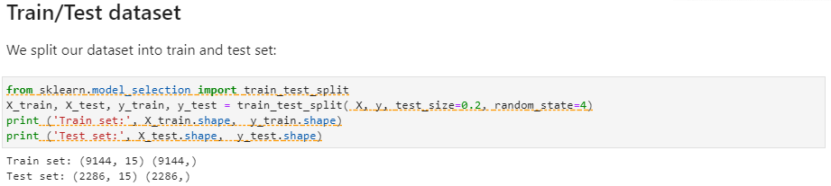
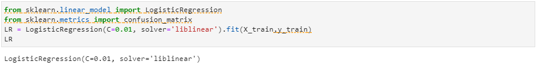
Analysis
Output of Train / Test : Train Set / Test Set (# of Entities, # of Rows)
Modeling
The version of Logistic Regression in Scikit-learn, support regularization. Regularization is a technique used to solve the overfitting problem of machine learning models. C parameter indicates inverse of regularization strength which must be a positive float. Smaller values specify stronger regularization. Now let's fit our model with train set:
Notes:
91
Regularization is applying a penalty to increasing the magnitude of parameter values in order to reduce overfitting. When you train a model such as a logistic regression model, you are choosing parameters that give you the best fit to the data. This means minimizing the error between what the model predicts for your dependent variable given your data compared to what your dependent variable actually is.
The problem comes when you have a lot of parameters (a lot of independent variables) but not too much data. In this case, the model will often tailor the parameter values to idiosyncrasies in your data -- which means it fits your data almost perfectly. However because those idiosyncrasies don't appear in future data you see, your model predicts poorly.
To solve this, as well as minimizing the error as already discussed, you add to what is minimized and also minimize a function that penalizes large values of the parameters. Most often the function is λΣθ_{j}², which is some constant λ times the sum of the squared parameter values θ_{j}². The larger λ is the less likely it is that the parameters will be increased in magnitude simply to adjust for small perturbations in the data. In your case however, rather than specifying λ, you specify C=1/λ.

Slide 10
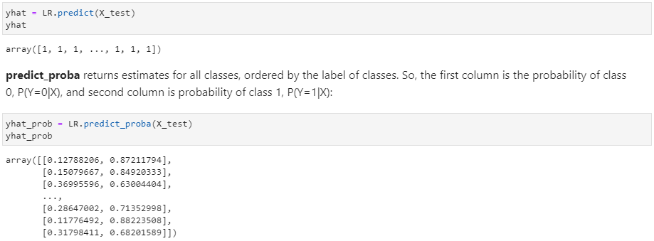
Analysis
Output : Probability of “Not Joining” vs “Joining”

Slide 11
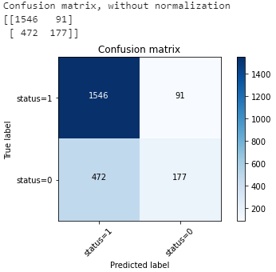
Analysis
Jaccard index
We can define jaccard as the size of the intersection divided by the size of the union of the two label sets. If the entire set of predicted labels for a sample strictly match with the true set of labels, then the subset accuracy is 1.0; if not, 0.0
Confusion matrix
Another way of looking at the accuracy of the classifier is to look at confusion matrix
Out of 2286 candidates, the status of 1637 of them is 1(Joined)
For 1546 candidates, the actual status was 1 (Joined) in test set and classifier also correctly predicted those as 1 (Joined)
However, while the actual label of 91 customers was 1 (Joined), the classifier predicted those as 0 (Not Joined), which is particularly good. We can consider it as the error of the model for first row
There were 649 candidates whose status were 0 (Not Joined)
The classifier correctly predicted 177 of them as 0 (Not Joined), and 472 of them wrongly as 1 (Joined). So, it has not done a good job in predicting the candidates with status as 0 (Not Joined)

Slide 12
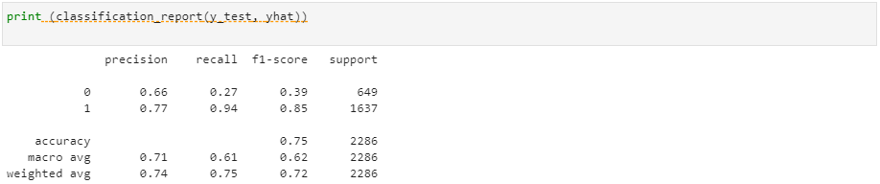
Analysis
Based on the count of each section, we can calculate precision and recall of each label:
Precision is a measure of the accuracy provided that a class label has been predicted. It is defined by precision =TP / (TP + FP)
Recall is the true positive rate. It is defined as Recall =TP / (TP + FN)
F1 score: The F1 score is the harmonic average of the precision and recall, where an F1 score reaches its best value at 1 (perfect precision and recall) and worst at 0.
We can tell the average accuracy for this classifier is the average of the F1-score for both labels, which is 0.72 in our case.

Slide 13
Thanks !!!

