Slide 1



GomesSample_financ
View in Power BI
Last data refresh:
01/04/2023 22:54:15 UTC
Downloaded at:
01/04/2023 22:57:55 UTC

Slide 2
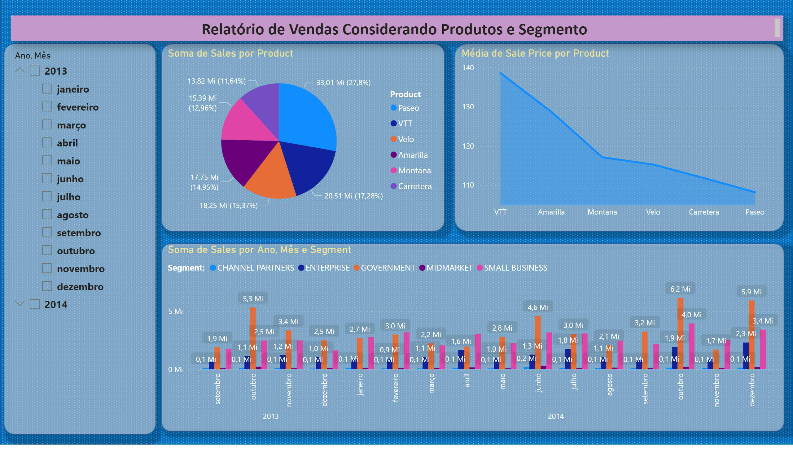
Vendas
Notes:
pieChart
No alt text provided
areaChart
No alt text provided
clusteredColumnChart
No alt text provided
slicer
No alt text provided
textbox
No alt text provided

Slide 3
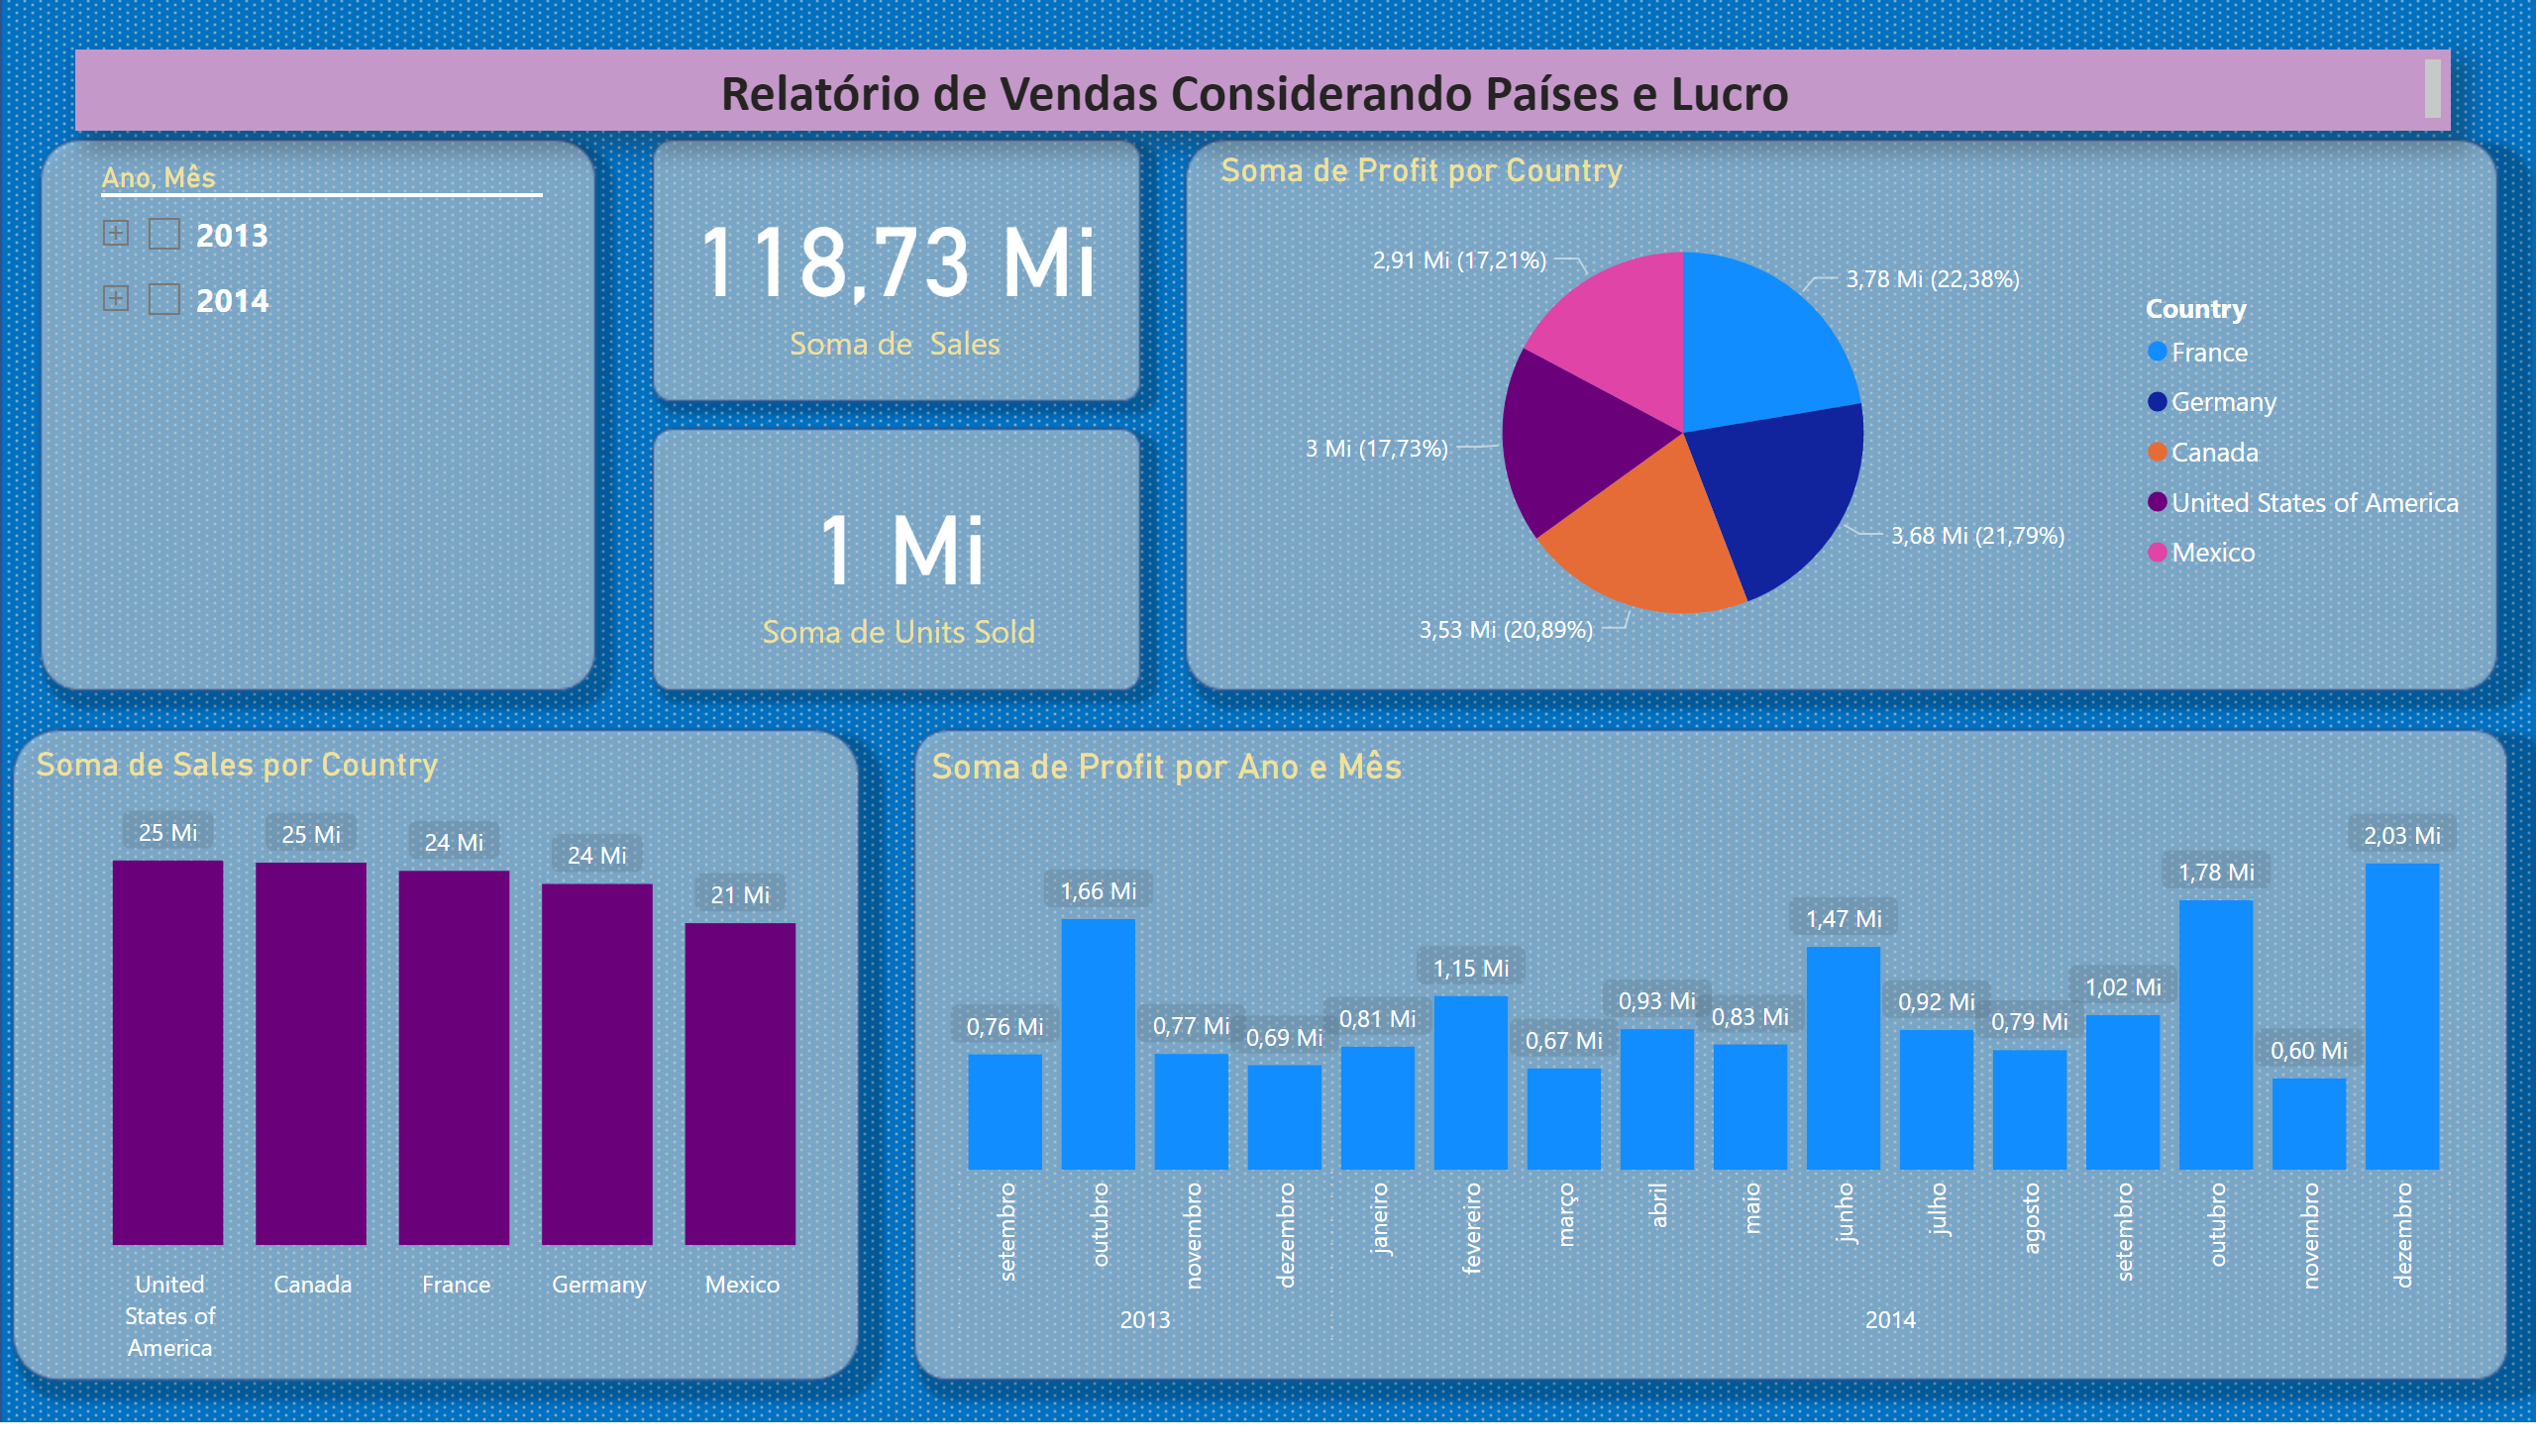
Paises
Notes:
textbox
No alt text provided
card
No alt text provided
card
No alt text provided
pieChart
No alt text provided
clusteredColumnChart
No alt text provided
clusteredColumnChart
No alt text provided
slicer
No alt text provided

Slide 4
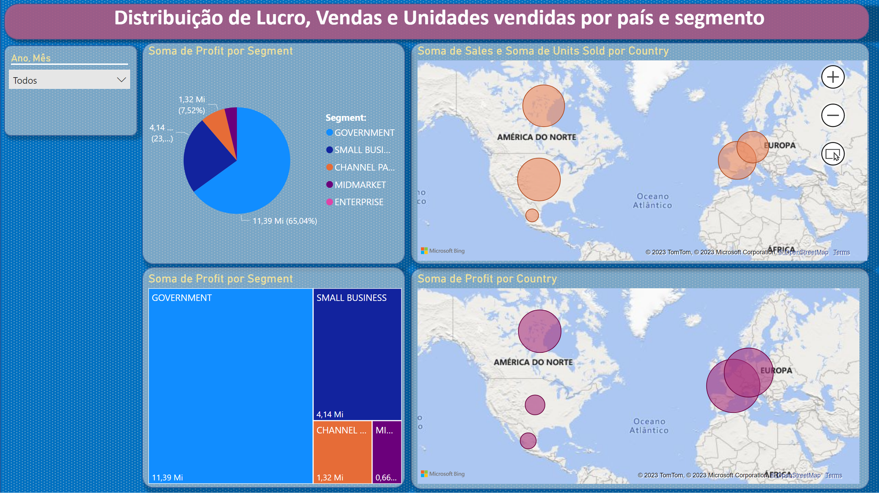
Distribuição
Notes:
pieChart
No alt text provided
map
No alt text provided
map
No alt text provided
textbox
No alt text provided
treemap
No alt text provided
slicer
No alt text provided

