Slide 1

Ecommerce Product Categorization - Hackathon Project
Problem Statement : In the rapidly evolving world of eCommerce, accurate product categorization is crucial for ensuring seamless customer experiences, reducing search friction, and increasing product discoverability. However, the sheer volume of diverse products poses a significant challenge. Current classification systems struggle to handle ambiguities, unconventional naming conventions, and multi-language data. This hackathon aims to address these challenges by inviting participants to create innovative solutions that enhance product categorization efficiency, accuracy, and scalability.
Aim : To develop a text classification model that categorizes products with maximum accuracy based on description of the product.
SC
by Shubham Chhari

Slide 2

Importing and Understanding the dataset
1
Importing dataset
2
Understanding the dataset
Imported the necessary libraries required for the data handling, manipulation and visualization.
Imported the data using the pandas library as a dataframe which is a primary data structure in pandas.
Checked the shape of the dataset which includes identifying the number of features and the row entries in the dataset.
Checked the missing values and the datatypes of the respective features using the different attributes of the pandas dataframe.
Also checked the unique values present in each feature and performed the descripted ananlysis on the numerical features.
Identified the target and the independent variable in the dataset.

Slide 3
Exploratory Data Analysis
Target Label
Independent Feature
As the target variable is ("product_category_tree“), made a bar graph of to identify the different categories and their value counts.
Insights Drawn: It can be seen that Clothing and Jewellery are more dominant categories which indicate that the customers preferred these 2 categories more than other categories. There can be multiple reasons for this like:
- 1. Better collection
- 2. Exotic offers & Discounts
- 3. Faster delivery
- 4. Easy Exchange
As description is a text column and we are going to predict based on the words present in the description feature, the best way to visualize was by using word cloud.
Insights Drawn: It can be seen that words like "Key" and "Features" are appearing in almost every row and it does not give any significant meaning to that particular row entry. As a result it best to remove those words during data preprocessing so the model can focus on the more important words

Slide 4
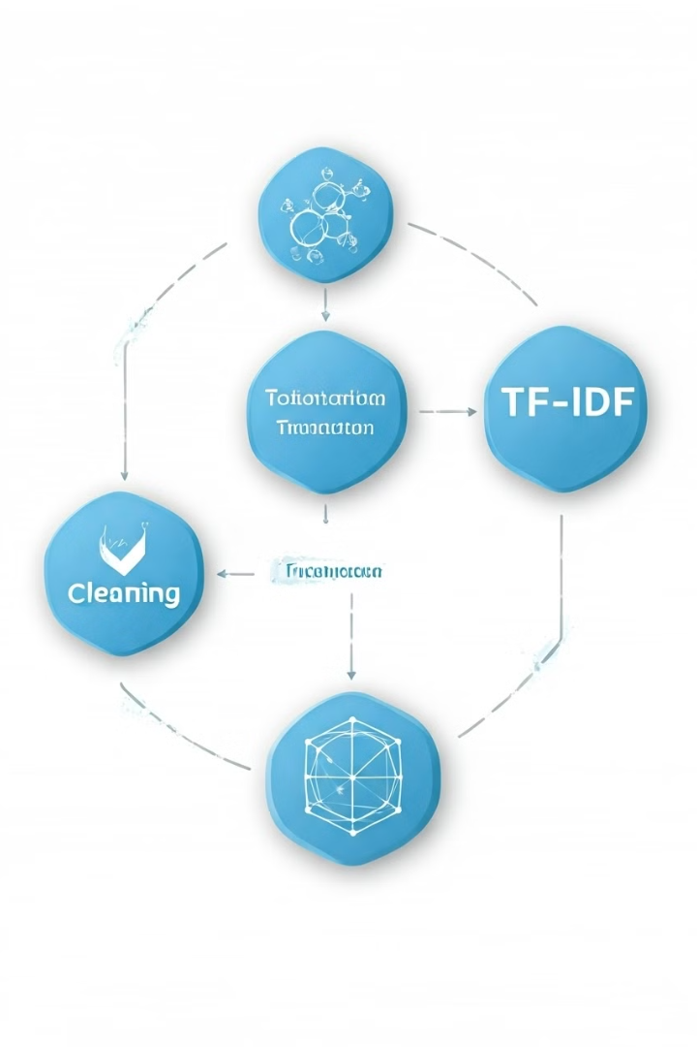
Data Preprocessing
1
NLP Libraries
Imported the required NLP libraries for Text data preprocessing.
Used regex to clean the text column containing special characters, punctuations, etc.
Removed stop-words which are non useful words from the independent variable so the model can focus on only important words.
2
Tokenization and Lemmatization
Tokenized each row in a list of words
Used the Lemmatization to convert the tokenized words to their base form using a grammatical library called WordNet.
3
Count Vectorizer and TF-IDF
Created a sparsity matrix using Bag of words(BOW) which contains the vector form of each row sentence.
Taking it further created a TF-IDF transformer which gives the more weight to how important a word is to a document in a collection or corpus.

Slide 5
Creation of model and Evaluation
Model Identification
Checking the train and test data
We know as it is a classification problem, we can use different classification model from Sckit-Learn library and evaluate them using different metrices.
Checked the shape of the train and test data.
The train data contains 11998 rows and test data contains 3000 rows.
Split the data into train and test
Splitting the data into train and test using train_test_split as we need some part of unseen data to evaluate our model on. Some parameters are:
test_size = 0.2 means 20% of our data is reserved for testing purpose
random state = 42 means that the model initiates the same split at every instance
stratify maintains the same distribution of classes as in the original dataset.

Slide 6

Model Selection, Creation and Evaluation
Multinomial Naïve Bayes model
Pipeline creation
Model Fit and Predict
As per the problem and need different models can be used and imported from the Sckit-Learn library.
As I needed a classification model I opted to use the multinomial Naïve Bayes model which is a multi level probabilistic classification model based on Bayes theorem.
I created a pipeline using the preprocessed custom function, Count Vectorizer and TF-IDF score.
Used the classifier as Multinomial NB.
Fitted the model pipeline on the x-train and y-train.
Then used the fitted pipeline to generate predictions on the test data.
Model Evaluation
Model Performance & Insights
Used the metrices like accuracy, precision, recall and f-1 score to evaluate the model predictions which are present in the classification report of the sklearn library.
The Overall Accuracy of the Multinomial Naive Bayes model was around 90% which was a good start.
But the f-1 score for the category 3 and 10 was very low which means the model was not correctly able to generalize those categories.

Slide 7
Model Selection, Creation and Evaluation
Random Forest Classifier model
Pipeline creation
Model Fit and Predict
After trying the Multinomial NB model I decided to try an ensemble model and I choose Random Forest as it is a combination of multiple Decision trees rather than single Decision tree.
I created a pipeline using the preprocessed custom function, Count Vectorizer and TF-IDF score.
Used the classifier as RandomForest Classifier.
Fitted the model pipeline on the x-train and y-train.
Then used the fitted pipeline to generate predictions on the test data.
Model Evaluation
Model Performance & Insights
Used the metrices like accuracy, precision, recall and f-1 score to evaluate the model predictions which are present in the classification report of the sklearn library.
The Overall Accuracy of the Random Forest Model was 96% which was an improvement since last model only gave me 90% accuracy.
Also I observed that the f-1 score for categories 3 and 10 also improved significantly which means the model was able was able to generalize them correctly.

Slide 8
Model Selection, Creation and Evaluation
Hyperparameters Tuning
Pipeline creation
Model Fit and Predict
The overall accuracy of RandomForest model was around 96%, so I decided to tune the certain hyperparameters using GridSerach Cross validation technique and check if there is an improvement in the performance of the model.
Created the parameters grid containing maximum depth of the tree, minimum sample split and criterion as Gini Index and Entropy.
Fitted the GridSearch model on the Random Forest classifier pipeline with the scoring “accuracy” and cross validation as 5.
Model Evaluation
Model Performance & Insights
Unfortunately I was not able to run the code on my device as the kernel was taking too long and I didn’t find any errors in my code.
So the tuned model could not be tested.
No insights drawn.

Slide 9
Model Selection, Creation and Evaluation
XGBoost model
Pipeline creation
Model Fit and Predict
After failing in the hyperparameter tuning I decided to go for an advanced model and choose XGBoost for that purpose as it a powerful Gradient boosting algorithm.
Imported the xgb class from xgboost
I created a pipeline using the preprocessed custom function, Count Vectorizer and TF-IDF score.
Used the classifier as XGB Classifier.
Fitted the model pipeline on the x-train and y-train.
Then used the fitted pipeline to generate predictions on the test data.
Model Evaluation
Model Performance & Insights
Used the metrices like accuracy, precision, recall and f-1 score to evaluate the model predictions which are present in the classification report of the sklearn library.
I saw that there was no improvement in the model performance as the XGBoost model gave me the accuracy which was given by RandomForest classifier.
So I thought to use a deep learning model rather than go for another Supervised ML model.

Slide 10
Model Selection, Creation and Evaluation
Deep Learning model
Pipeline creation
Model Fit and Predict
After reaching the maximum threshold for accuracy in supervised models I decided to go for a deep learning model and check if there is an improvement in the model performance.
Imported all the libraries required for Deep learning.
I created a pipeline using the preprocessed custom function, Count Vectorizer and TF-IDF score.
Transformed my x-train and y-train in vector form using this pipeline
Used a sequential model which contains a combination of layers. The first layer was dense layer with 200 neurons and the output layer was again a Dense layer with 14 neurons and Softmax activation function. Also included hidden layers like Batch normalization and Dropout to enhance the model performance.
Model Evaluation
Model Performance & Insights
Compiled the model using adam optimizer and metric as accuracy which generated more than 3 lakh trainable parameters.
Fitted the deep learning model on the transformed x-train and y-train with epoch = 10 and batch_size of 32 .
I saw that the accuracy of the deep learning model was around 98% on test data which was an improvement as compared to previous supervised ML models.
So I decided to predict the product categories on the unseen data using this model.

Slide 11



Conclusion and Insights
Conclusion:
I was able to categorize the product category on the unseen data based on their descriptions which was the aim of this Hackathon.
Designed various Supervised ML models as well as implemented a Deep learning model.
Able to achieve a maximum of 98% accuracy on the test data.
Insights:
Potential Business Insights drawn from such model are:
Enhanced Customer Experience:
-Improved search accuracy and better personalized recommendations.
Increased Sales and Revenue:
-Better categorization can lead to higher product Discoverability by the potential buyers and
makes it easier to identify most popular product categories.
Inventory Management:
-Accurate product categorization helps in better inventory organization, making it easier to track
stock levels and manage restocking.
Scalability:
- A robust categorization model can support business growth by efficiently handling an
increasing volume of products without compromising on accuracy.

Slide 12

Thank You

