Slide 1
Coding with React
TechnoLearn

Slide 2
Agenda
What is React ?
Why to use React ?
Initial set-up
Basics of Javascript
JSX & ES6
React Component
Stateful component (Smart Component)
Stateless component (Dumb Component)

Slide 3
What is React ?
React is a declarative, efficient, and flexible JavaScript library pioneered by Facebook Inc. for building user interfaces.
It lets you compose complex UIs from small and isolated pieces of code called “components”.
React works on the principle of Uni-directional data flow

Slide 4
Why React ?
React is based on virtual DOM concept which improves the applications performance.
Can easily be integrated with other frameworks.
Components and Uni-directional data flow make is easier to maintain huge application.
Developing open source community

Slide 5
React Limitations:
It covers only the view layer of application, therefore need to be integrated with for complete MVC architecture.
Mix-up of HTML and Javascript

Slide 6
Initial Set-up
Install Node > 8.0.0
Use Visual Studio or Atom as editor

Slide 7
Basics of Javascript
Syntax
Variables
Function
Looping
Events
Objects
Storage

Slide 8
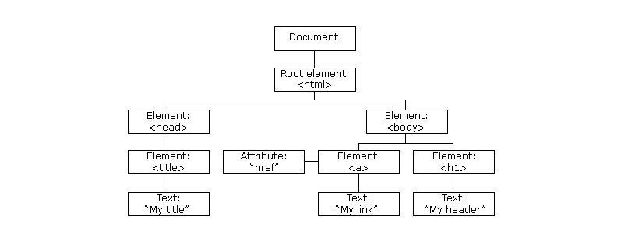
Basics of Javascript (Cont.)
DOM Tree:

Slide 9
JSX & ES6
JSX is a preprocessor step that adds XML syntax to JavaScript.
React with JSX makes React a lot more elegant.
JSX is used for embedding HTML inside Javascript.

Slide 10
JSX & ES6 (Cont…)
class Hello extends React.Component {
render() {
return <div>Hello {this.props.toWhat}</div>;
}
}
ReactDOM.render(
<Hello toWhat="World" />,
document.getElementById('root')
);

Slide 11
JSX & ES6 (Cont…)
ES6 Features:
Let
Const
Class
Constructor
Arrow function
Default Parameters
For…of Loop
Spread Attributes
Static methods
Getter and Setter

Slide 12
JSX & ES6 (Cont…)
Let & Const
let is similar to var but let has scope. let is only accessible in the block level it is defined.
let a = 50; let b = 100; if (true) { let a = 60; var c = 10;
var d = 20; console.log(a/c); // output => 6 console.log(b/c); // output => 10 }
console.log(d); // output => undefined console.log(c); // output => 10 console.log(a); // output => 50

Slide 13
JSX & ES6 (Cont…)
Let & Const
Const is used to assign a constant value to the variable. And that value cannot be changed. Its fixed.
const a = 50; a = 60; // shows error. You cannot change the value of const.const b = "Constant variable"; b = "Assigning new value"; // shows error.
const LANGUAGES = ['Js', 'Ruby', 'Python', 'Go'];
LANGUAGES = "Javascript"; // shows error.
LANGUAGES.push('Java'); // Works fine.
console.log(LANGUAGES); // ['Js', 'Ruby', 'Python', 'Go', 'Java'

Slide 14
JSX & ES6 (Cont…)
Class & Constructor
class Vehicle {
constructor (name, type) {
this.name = name;
this.type = type;
}
getName () {
return this.name;
}
getType () {
return this.type;
}
}
class Car extends Vehicle {
constructor (name) {
super(name, 'car');
}
getName () {
return 'It is a car: ' + super.getName();
}
}
let car = new Car('Tesla');
console.log(car.getName()); // It is a car: Tesla
console.log(car.getType()); // car

Slide 15
JSX & ES6 (Cont…)
Arrow Function:
Conventional:
function funcName(params) {
return params + 2;
}
var funcName1 = function() {
return “Hello…!!!”;
}
funcName1();
Arrow Function:
const funcName = (params) => params + 2
const funcName = param => param + 2;
const funcName = (param1, param2) => param1+ param2;
const funcName = (param1, param2) => {
if (param1 %2 === 0) {
return true;
}
return false;
};

Slide 16
JSX & ES6 (Cont…)
Default Parameters
Default parameters are parameters which are given by default while declaring a function. But it’s value can be changed when calling the function.
let Func = (a, b = {}) => { return b.x; // } Func(20); // 20 + 10 = 30
let NotWorkingFunction = (a = 10, b) => { return a + b; } NotWorkingFunction(20); // NAN. Not gonna work.
var Func = (a, b) => { return a + b; } Func(20); //NaN

Slide 17
JSX & ES6 (Cont…)
For…of
for..of is very similar to for..in with slight modification.
for..of iterates through list of elements (i.e) like Array and returns the elements (not their index) one by one.
let obj = {
x: 1,
y: 2
}; for (let i in obj) { console.log(obj[i]); //1, 2 }
let arr = [2,3,4,1]; for (let value of arr) { console.log(value); // 2, 3 ,4 1 }

Slide 18
JSX & ES6 (Cont…)
Spread attributes
Spread attributes help to spread the expression as the name suggests. In simple words, it converts a list of elements to an array and vice versa.
let SumElements = (...arr) => { console.log(arr); // [10, 20, 40, 60, 90]let sum = 0; for (let element of arr) { sum += element; } console.log(sum); // 220. }SumElements(10, 20, 40, 60, 90); // Note we are not passing array here. Instead we are passing the elements as arguments.
let SumElements = (arr) => { console.log(arr); // [10, 20, 40, 60, 90] let sum = 0; for (let element of arr) { sum += element; } console.log(sum); // 220. }SumElements([10, 20, 40, 60, 90]);
let arr = [10, 20, 60]; Math.max(arr); // Shows error. Doesn't accept an array.
let arr = [10, 20, 60]; Math.max(...arr); // 60
const a = {x: 'India', y:'Spain'};
const f = {y: 'UK', z:'USA'};
const g = {...a, ...f}; {x: 'India', y: 'UK', z:'USA' }
Console.log(g); // {x: "India", y: "UK", z: "USA"}

Slide 19
JSX & ES6 (Cont…)
Getters & Setters
class People {
constructor(name) { this.name = name; } get Name() { return this.name; } set Name(name) { this.name = name; }
get abc() {
return this.name;
} }
let person = new People("Jon Snow"); console.log(person.Name); // Jon Snow person.Name = "Dany"; console.log(person.Name);

Slide 20
React JS Overview
React is a declarative, efficient, and flexible JavaScript library for building small UI components. Developed by Facebook.
Advantage:
Strong foundation and large community behind it
Implements one-way data flow
Uses virtual DOM which is a JavaScript object. This will improve apps performance, since JavaScript virtual DOM is faster than the regular DOM.
improve readability, which helps to maintain larger apps.
Limitation:
Only covers the view layer, hence need to integrate other framework/library to build an end to end application.
Uses inline templating – Mixing up the concerns.

Slide 21
React Component
Components let you split the UI into independent, reusable pieces, and let developer concentrate each component in isolation.
function DemoView(name, age) {
return <h1>Hello, {name} is {age} years old</h1>;
}
How to render:
const obj = {name: ‘Bheem’, age: ‘15’};
const element = < DemoView {… obj}/>;
ReactDOM.render(
element,
document.getElementById('root')
);

Slide 22
React Component
Components let you split the UI into independent, reusable pieces, and let developer concentrate each component in isolation.
Class Components
class DemoComp extends React.Component {
render() {
return <h1>Hello, {this.props.name}</h1>;
}
}
How to render:
const element = < DemoComp name=“Bheem" />;
ReactDOM.render(
element,
document.getElementById('root')
);

Slide 23
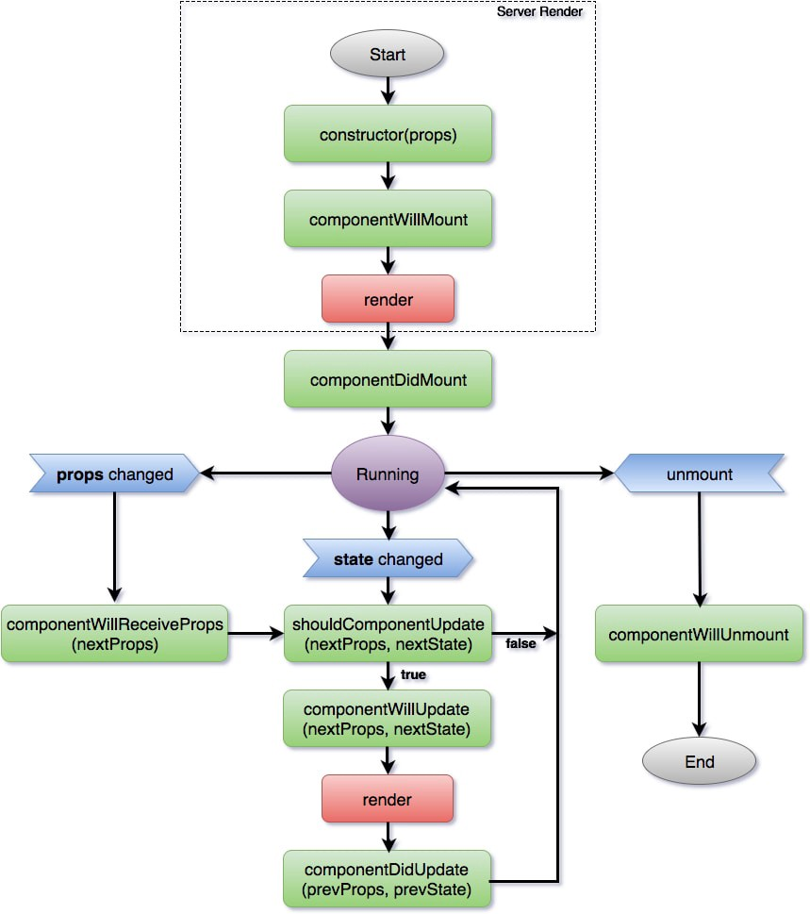
React Lifecycle

Slide 24
React State Overview
State is one of the source data to componet.
Always try to make our state as simple as possible and minimize.
State should be initialized in constructor itself.
setState(): This method is called to set the state and re-render the component.
forceUpdate(): This method is called to explicitly re-render the dom.

Slide 25
React Props Overview
Props are the properties (inputs) provided to a react component while loading.
Props are immutable, cannot be modified.
Parent component’s state can be used as props for its child.
class DemoComp extends React.Component {
render() {
return (
<div>
<p>{this.props.name}</p>
<p> {this.props.age}</p>
<p> {this.props.dept}</p>
</div>
);
}
}
< DemoComp
name=“”
age=“”
dept=“” />;
Here name, age & dept are props of Demo component.

Slide 26
React Props Overview(cont…)
Default Props
class DemoComp extends React.Component {
render() {
return (
<div>
<p>{this.props.name}</p>
<p> {this.props.age}</p>
<p> {this.props.dept}</p>
</div>
);
}
}
DemoComp.defaultProps = {
name : “Anonymous",
age :“30“,
dept: “admin”
}
export default DemoComp;

Slide 27
React Props Overview(cont…)
Props validation
App.propTypes = {
name: PropTypes.string.isRequired,
age: PropTypes.number.isRequired,
dept: PropTypes.string,
evaluateFundValue: PropTypes.func
};
Details: https://reactjs.org/docs/typechecking-with-proptypes.html

Slide 28
Hands-on
Do initial set-up with webpack and bable.
Create a functional component to show Today’s Date and time.
Create a class component with life cycle method to create a react application to display list of employees, their dept, salary, age and address. Also allow to add and remove employee at runtime and change their dept using dropdown.
Create a button to do increment employees salary

Slide 29
Thanks

