Slide 1


HEART DISEASE DETECTION
Sibghatullah MSDS2024-117

Slide 2
INTRODUCTION
Heart disease is one of the leading causes of death worldwide.
Early detection can significantly improve treatment outcomes.
Machine learning models analyze large health data for diagnosis.
This presentation covers heart disease detection challenges and solutions.

Slide 3
PROBLEM STATEMENT
Early detection of heart disease is challenging due to:
How can machine learning help identify patterns and predict heart disease risk?
Complexity of symptoms.
Variability in risk factors (age, cholesterol, blood pressure, etc.).
Need for efficient, non-invasive diagnosis methods.

Slide 4
OBJECTIVES
Develop a predictive model for heart disease diagnosis.
Analyze health parameters (e.g., blood pressure, cholesterol levels).
Improve accuracy and efficiency in detecting high-risk individuals.
Minimize the need for invasive procedures through reliable predictions.

Slide 5
DATASET OVERVIEW
Collected from Kaggle
Key Features are:
Age, gender.
Blood pressure, cholesterol levels.
Resting heart rate, blood sugar levels.
Exercise-induced angina, ST depression, etc.

Slide 6
METHODOLOGY
Data Preprocessing:
Handling missing values.
Normalizing data.
Splitting data into training and testing sets.
Model Selection:
Logistic Regression.
Evaluation Metrics:
Accuracy.
Precision, Recall, F1-Score

Slide 7
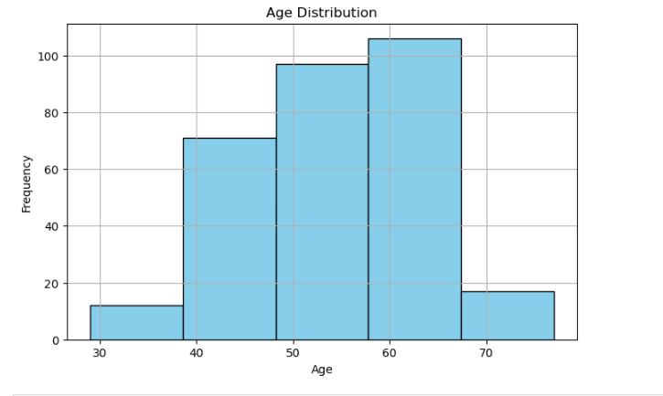
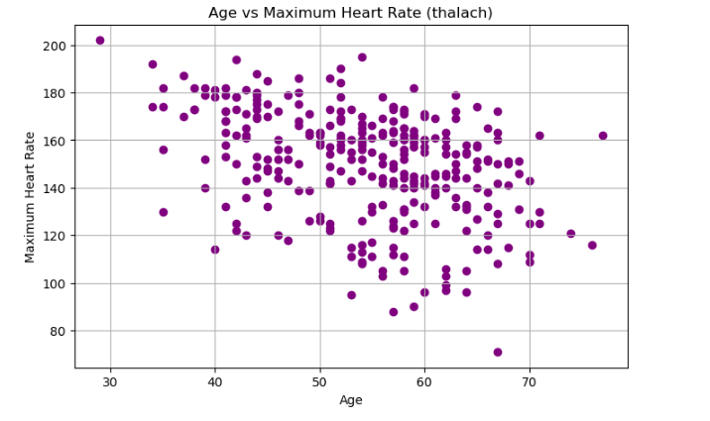
DATA VISUALIZATION

Slide 8
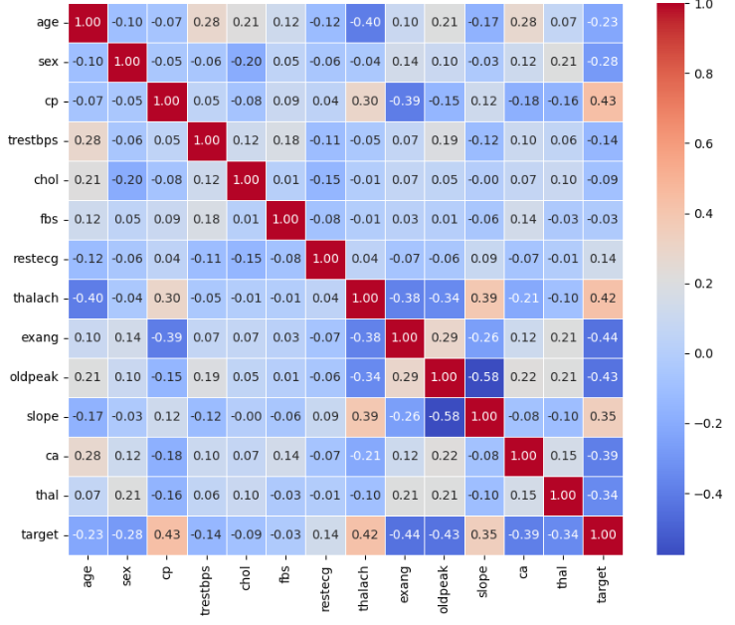
CORRELATION HEATMAP

Slide 9
Results
Accuracy : 85 %
Precision : 95%
Recall : 79 %
F1 score : 84 %

Slide 10
CONCLUSION
Machine learning models like Logistic Regression help detect heart disease early.
Logistic Regression provides simplicity and interpretability for risk prediction.
Future research should improve accuracy and integrate real-time continuous monitoring.

Slide 11
THANK YOU

