Slide 1
Comparing Efficiency of AI algorithm in Connect 4
Contribution:
Sibi Akkash 18BCE1170 – Game
Ashwin S Guptha 18BCE1026– minmax
Madhurima Magesh 18BCE1009– Heuristic and literature
Siddarth S 18BCE1171 – Parallelizing and literature

Slide 2
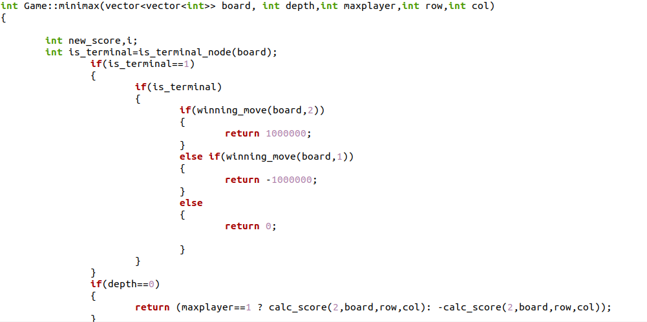
Important code snippet

Slide 3
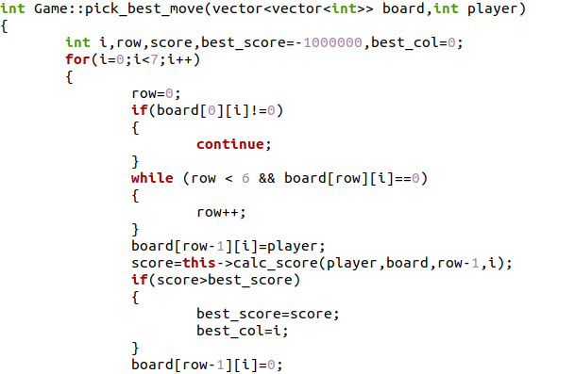

Slide 4
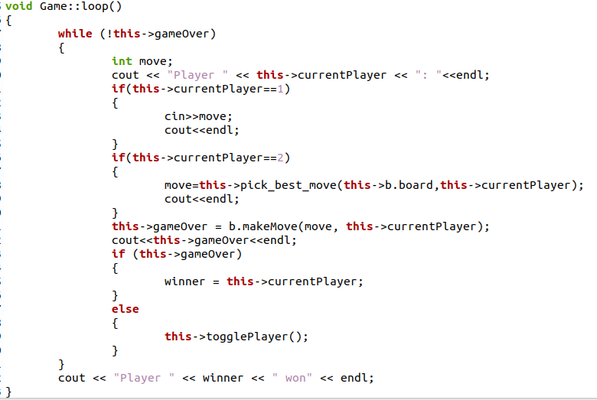

Slide 5
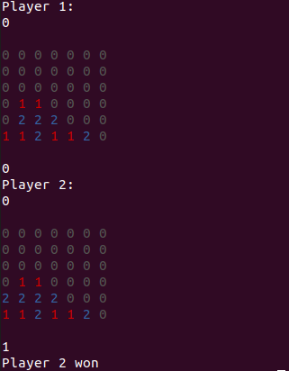
Output

Slide 6
Why Minmax Algorithm needs to be parallelized?
A cost function value (states value of goodness of a position) is computed for each node in the game tree and is associated with the profitability of that game. The player will choose a move that will result in increasing the probability of his/her winning chance.
In our connect 4 game(6x7) we have 7 branches for each node at each depth and the amount of work increases exponentially as a move is examined to a greater depth.
We need to reduce the computation time by restricting our search to the best moves for the player. This leads us to the idea of parallelizing our game tree.

Slide 7
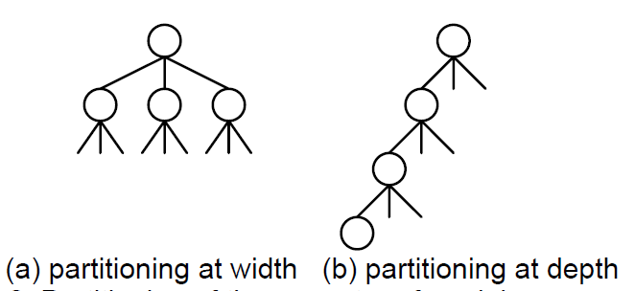
Parallel Computation Model
The easiest way to parallelize the minmax algorithm is to partition the search tree into sub-trees and assign them into multiple processors for searching.
We can partition by a) width or by b) depth

Slide 8
Parallel Computation Model
We can divide the computation workload(evaluating the cost function of each node of the game tree) among parallel processes.
If we apply a) for our game tree: In case of two parallel processors- one will evaluate the positions at 0,2,4,6 and second will evaluate at 1,3,5.
Player
P1 & p2 are two processors.
AI
0
1
2
3
4
5
6
p1
p2
p1
p2
p1
p2
p1

Slide 9
Parallel Computation Model
In Openmp we have functions like MPI_GATHER, MPI_Reduce and MPI_Bcast to manage the processes.
MPI_GATHER – gathers the best function values and the best moves by each of the processors
MPI_Reduce –determines the best function value obtained by all processes.
MPI_Bcast –broadcast the best move to all worker processes sent by the master thread.

Slide 10
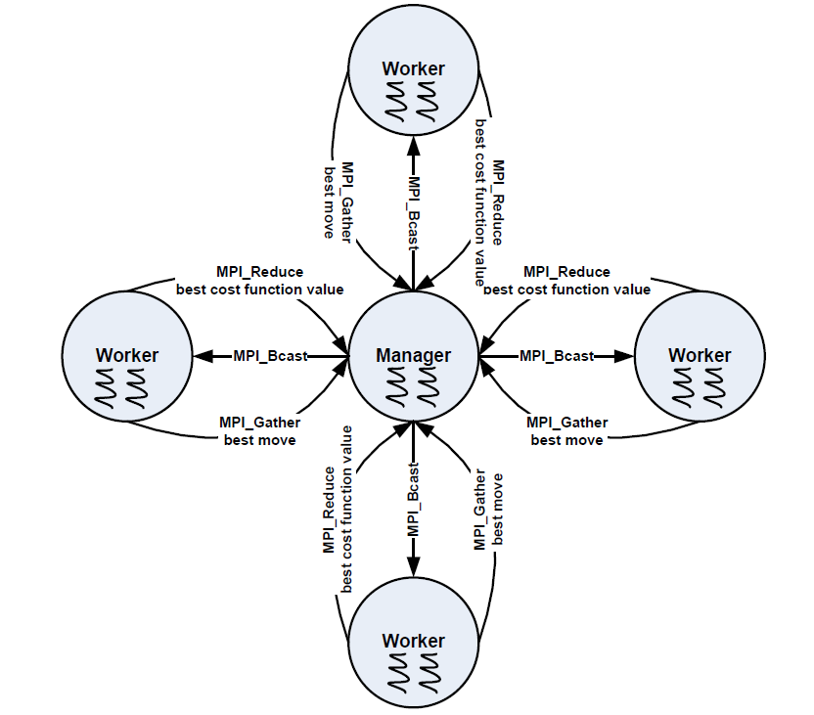

Slide 11
Literature review
Massively Parallel Artificial Intelligence
https://www.ijcai.org/Proceedings/91-1/Papers/087.pdf
Efficiency of Parallel Minimax Algorithm for Game Tree Search
https://www.researchgate.net/publication/220795557_Efficiency_of_parallel_minimax_algorithm_for_game_tree_search
Parallel Minimax Tree Searching on GPU Kamil Rocki and Reiji Suda
http://olab.is.s.u-tokyo.ac.jp/~kamil.rocki/rocki_ppam09.pdf
Parallel Implementation and Optimization of the Minimax Algorithm with Alpha-Beta Cutoffs in the context of the game Othello, Amy S. Biermann, CRPC Summer Research Student, Caltech
http://www.pressibus.org/ataxx/autre/minimax/paper.html
Comparative study of performance of parallel Alpha Beta Pruning for different architectures, by Shubhendra Pal Singhal M. Sridevi
https://arxiv.org/pdf/1908.11660.pdf

Slide 12
● Parallelization of Alpha-beta Pruning Algorithm for Enhancing the Two Player Games Akanksha
Kumari, Shreya Singh, Shailja Dalmia, Geetha V
http://www.iraj.in/journal/journal_file/journal_pdf/12-344-149466366874-81.pdf
● Alpha-Beta Pruning in Mini-Max Algorithm –An Optimized Approach for a Connect-4 Game Rijul
Nasa, Rishabh Didwania, Shubhranil Maji, Vipul Kumar
https://www.irjet.net/archives/V5/i4/IRJET-V5I4366.pdf
● OpenMP Parallelization of Dynamic Programming and Greedy Algorithms Claude, Tadonki
● Alpha-Beta Pruning and Alth¨ofer’s Pathology-FreeNegamax AlgorithmAshraf M. Abdelbar
https://www.researchgate.net/publication/289716392_Alpha-Beta_Pruning_and_Althofer's_Pathology-Free_Negamax_Algorithm
● Enhanced parallel NegaMax tree search algorithm on GPU
https://ieeexplore.ieee.org/document/6972394

Slide 13
● Monte-Carlo Tree Search and Minimax Hybrids, Hendrik Baier and Mark H.M. Winands
https://dke.maastrichtuniversity.nl/m.winands/documents/paper%2049.pdf
● Monte-Carlo Tree Search: A New Framework for Game AI, Guillaume Chaslot, Sander Bakkes, Istvan Szita and Pieter Spronck
https://www.aaai.org/Papers/AIIDE/2008/AIIDE08-036.pdf
● Exploiting Vector and Multicore Parallelism for Recursive, Data- and Task-Parallel Programs
● A Machine Learning and Compiler-based Approach to Automatically Parallelize Serial Programs Using OpenMP
● Comparison of OpenMP and Classical Multi-Threading Parallelization for Regular and Irregular Algorithms

