Slide 1

SOFTWARE TRAINING SERIES
ASP.NET Core Web API
A Hands-On Training Guide for Freshers
Presented by: Software Trainee | Module: Backend Development with .NET

Slide 2









SESSION ROADMAP
Agenda
01
02
03
Web API & REST Fundamentals
Project Setup & Structure
Controllers, Routing & HTTP Verbs
04
05
06
Model Binding & Validation
Dependency Injection & Middleware
Database Access with EF Core
07
08
09
Async Programming Best Practices
Swagger, Error Handling & Security (JWT)
Testing with Postman & Best Practices
Agenda
2

Slide 3


FUNDAMENTALS
What is a Web API?
A Web API (Application Programming Interface) is a set of HTTP endpoints that allows different applications — web, mobile, or desktop — to communicate with a server and exchange data, typically in JSON format.
Client
(Web / Mobile App)
HTTP Request / Response (JSON)
REST Principles Web APIs Follow
Stateless — every request contains all info needed
Resource-based URLs (e.g. /api/products/5)
Uses standard HTTP verbs: GET, POST, PUT, DELETE
Client-Server separation of concerns
ASP.NET Core
Web API Server
Database
Fundamentals
3

Slide 4




FUNDAMENTALS
Why ASP.NET Core Web API?
High Performance
Cross-Platform
Built-in DI
One of the fastest web frameworks — built on a lightweight, optimized runtime (Kestrel).
Runs on Windows, Linux, and macOS. Deploy anywhere: containers, cloud, on-prem.
Dependency Injection is a first-class citizen, making code testable and modular.
Enterprise Ready
Cloud Native
Open Source
Strong support for security, authentication, logging, and configuration.
Great fit for microservices, Docker, and Azure/AWS deployments.
Actively developed by Microsoft & the community on GitHub.
Fundamentals
4

Slide 5


GETTING READY
Tools You'll Need
.NET SDK (8.0 or later)
Download from dotnet.microsoft.com — includes the CLI, runtime, and libraries.
Visual Studio / VS Code
Visual Studio 2022 (Windows) or VS Code with the C# Dev Kit extension.
Postman / REST Client
For sending requests and testing your API endpoints during development.
SQL Server / SQLite
A database engine to practice Entity Framework Core integration.
Getting Ready
5

Slide 6

GETTING STARTED
Create Your First Web API Project
Use the .NET CLI to scaffold a new Web API project in seconds:
What just happened?
// 1. Create a new Web API project
dotnet new webapi -n MyFirstApi
// 2. Move into the project folder
cd MyFirstApi
// 3. Run the application
dotnet run
// App now listens on https://localhost:5001
Scaffolds a ready-to-run API template
Includes an example WeatherForecast controller
Configures Swagger UI automatically
Sets up launch profiles for local dev
Getting Started
6

Slide 7

GETTING STARTED
Project Structure at a Glance
Program.cs
Application entry point — configures services & the HTTP request pipeline.
Controllers/
Contains API controller classes that handle incoming HTTP requests.
Models/
Plain C# classes (POCOs) representing your data / DTOs.
appsettings.json
Configuration file — connection strings, logging levels, custom settings.
Properties/launchSettings.json
Local development server & environment settings.
MyFirstApi.csproj
Project file listing target framework & NuGet package references.
Getting Started
7

Slide 8
CORE CONCEPTS
Controllers & Routing
A Controller is a class that handles HTTP requests
[ApiController] enables automatic model validation
[Route] defines the base URL pattern for the controller
Each action method maps to one endpoint
[controller] token auto-resolves to the class name
[ApiController]
[Route("api/[controller]")]
public class ProductsController : ControllerBase
{
private readonly IProductService _service;
public ProductsController(IProductService svc)
{
_service = svc;
}
[HttpGet]
public IActionResult GetAll()
{
return Ok(_service.GetAll());
}
}
Core Concepts
8

Slide 9
CORE CONCEPTS
HTTP Methods & CRUD Mapping
HTTP Verb | Attribute | CRUD Action | Example Route
GET | [HttpGet] | Read | GET /api/products
GET (by id) | [HttpGet("{id}")] | Read one | GET /api/products/5
POST | [HttpPost] | Create | POST /api/products
PUT | [HttpPut("{id}")] | Update | PUT /api/products/5
DELETE | [HttpDelete("{id}")] | Delete | DELETE /api/products/5
[HttpPost]
public IActionResult Create([FromBody] Product p)
{
if (!ModelState.IsValid) return BadRequest();
_service.Add(p);
return CreatedAtAction(nameof(GetAll), new { id = p.Id }, p);
}
Core Concepts
9

Slide 10
CORE CONCEPTS
Model Binding & Validation
Model binding maps request data (body, query, route) to C# objects
[FromBody], [FromQuery], [FromRoute] control the binding source
Data Annotations declare validation rules on the model
[ApiController] auto-returns 400 on invalid models
public class Product
{
public int Id { get; set; }
[Required, MaxLength(100)]
public string Name { get; set; }
[Range(1, 10000)]
public decimal Price { get; set; }
}
Core Concepts
10

Slide 11
CORE CONCEPTS
Dependency Injection (DI)
DI provides objects (services) to classes that need them
Reduces tight coupling and improves testability
Registered in Program.cs before the app is built
Three lifetimes: Transient, Scoped, Singleton
// Program.cs
var builder = WebApplication.CreateBuilder(args);
builder.Services.AddScoped<IProductService,
ProductService>();
builder.Services.AddControllers();
var app = builder.Build();
app.MapControllers();
app.Run();
Core Concepts
11

Slide 12




CORE CONCEPTS
The Middleware Pipeline
Every request flows through an ordered chain of middleware components. Each one can inspect, modify, short-circuit, or pass the request to the next.
→
→
→
→
→
Exception
Handling
HTTPS
Redirection
Routing
Authentication
Authorization
Controller
Endpoint
app.UseExceptionHandler("/error");
app.UseHttpsRedirection();
app.UseAuthentication();
app.UseAuthorization();
app.MapControllers();
Core Concepts
12

Slide 13
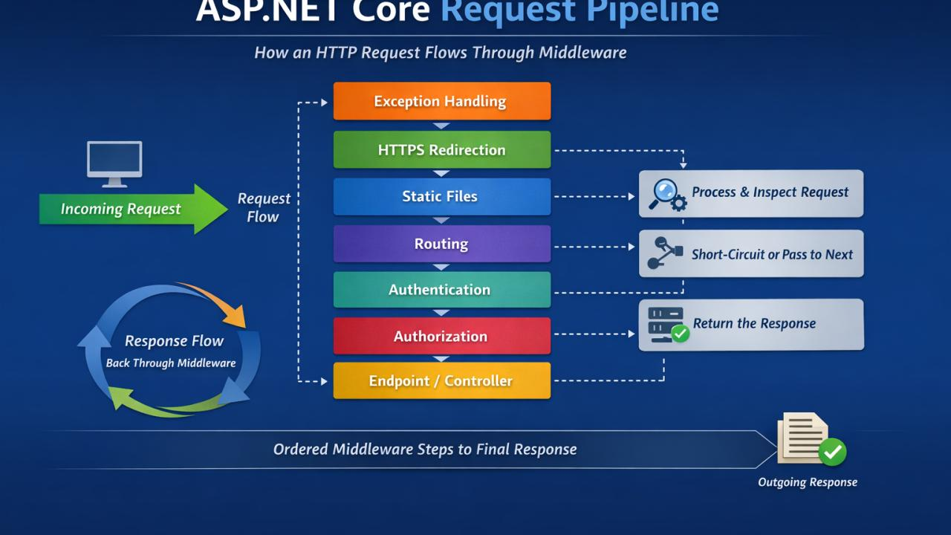
CORE CONCEPTS
The Middleware Pipeline
Every request flows through an ordered chain of middleware components. Each one can inspect, modify, short-circuit, or pass the request to the next.
→
→
→
→
→
Exception
Handling
HTTPS
Redirection
Routing
Authentication
Authorization
Controller
Endpoint
app.UseExceptionHandler("/error");
app.UseHttpsRedirection();
app.UseAuthentication();
app.UseAuthorization();
app.MapControllers();
Core Concepts
12

Slide 14
DATA ACCESS
Connecting to a Database with EF Core
Entity Framework Core is an Object-Relational Mapper (ORM)
DbContext represents a session with the database
DbSet<T> maps a model class to a database table
Migrations keep schema in sync with your models
public class AppDbContext : DbContext
{
public AppDbContext(DbContextOptions o)
: base(o) { }
public DbSet<Product> Products { get; set; }
}
// CLI: apply schema changes
dotnet ef migrations add InitialCreate
dotnet ef database update
Data Access
13

Slide 15
BEST PRACTICES
Async / Await for Scalability
Async frees up threads while waiting on I/O (DB, network)
Always use async all the way — avoid mixing with .Result
Use CancellationToken to support request cancellation
Improves throughput under high concurrent load
[HttpGet("{id}")]
public async Task<IActionResult> GetById(
int id, CancellationToken ct)
{
var product = await _context.Products
.FindAsync(new object[] { id }, ct);
if (product is null) return NotFound();
return Ok(product);
}
Best Practices
14

Slide 16
DEVELOPER EXPERIENCE
API Documentation with Swagger / OpenAPI
Swagger (OpenAPI) auto-generates interactive API docs
Lets you try out endpoints directly from the browser
Included out-of-the-box in the Web API template
Great for frontend teams consuming your API
// Program.cs
builder.Services.AddEndpointsApiExplorer();
builder.Services.AddSwaggerGen();
if (app.Environment.IsDevelopment())
{
app.UseSwagger();
app.UseSwaggerUI();
}
// Browse to: /swagger
Developer Experience
15

Slide 17
BEST PRACTICES
Centralized Exception Handling
Never let raw exceptions leak to the client
Use middleware to catch errors in one place
Return consistent, structured error responses
Log the full exception server-side for diagnostics
app.UseExceptionHandler(a => a.Run(async ctx =>
{
ctx.Response.StatusCode = 500;
ctx.Response.ContentType = "application/json";
await ctx.Response.WriteAsync(
"{\"error\":\"Something went wrong\"}");
}));
Best Practices
16

Slide 18
SECURITY
Authentication with JWT
JWT (JSON Web Token) proves a user's identity on each call
Client logs in once, receives a signed token
Token is sent in the Authorization header on future requests
[Authorize] attribute protects controllers or actions
[Authorize]
[HttpGet("secure-data")]
public IActionResult GetSecureData()
{
return Ok("Only for authenticated users");
}
// Client request header:
// Authorization: Bearer <token>
Security
17

Slide 19
QUALITY
Testing Your API with Postman
1
Create a Request
Open Postman, choose the HTTP verb and paste your endpoint URL.
2
Add Headers / Body
Set Content-Type: application/json and add a request body for POST/PUT.
3
Send & Inspect
Click Send, then review the status code, response body, and timing.
4
Save as a Collection
Group related requests to re-run and share with your team.
GET https://localhost:5001/api/products/5
Accept: application/json
// Expected Response: 200 OK
{ "id": 5, "name": "Keyboard", "price": 799.00 }
Quality
18

Slide 20
WRAP-UP
Best Practices Checklist
Keep controllers thin — put logic in services
Centralize error handling and logging
Use DTOs instead of exposing DB entities directly
Secure endpoints with Authentication & Authorization
Always validate input and return proper status codes
Version your API (e.g. /api/v1/...)
Use async/await for all I/O operations
Write unit & integration tests
Wrap-Up
19

Slide 21

Questions & Discussion
Thank you for attending — let's build something great together.
docs.microsoft.com/aspnet/core | learn.microsoft.com

