Slide 1


CGB1201 – JAVA PROGRAMMING
Department of Artificial Intelligence and Data Science
Academic Year: 2024 – 2025 (Odd Semester)
Register Number Name | : 2303811724321105 : SIBI CHAKKARAVARTHI S
Year | : II
Semester | : III
Section | : B
Date | : 3/12/24
1
CGB1201 – JAVA PROGRAMMING

Slide 2

TITLE OF THE PROJECT
SEARCH ENGINE
2
CGB1201 – JAVA PROGRAMMING

Slide 3

PROBLEM IDENTIFICATION
Irrelevant Search Results
Slow Search Response
Difficulty in Formulating Queries
Overwhelming Number of Results
Lack of Advanced Search Options
Poor Ranking of Results
Duplicate or Similar Results
‹#›
CGB1201 – JAVA PROGRAMMING

Slide 4

INTRODUCTION
Search Engine is a fundamental implementation of a search system designed to handle small datasets of text documents.It allows users to search for specific terms ,returning all the documents that contain the search query.
‹#›
CGB1201 – JAVA PROGRAMMING

Slide 5

JAVA PROGRAMMING - CONCEPTS USED
OOP (Object-Oritented programming)
Collections Framework
Multithreading
Swing
File Handling
Java Standard Libraries
Exception Handling
‹#›
CGB1201 – JAVA PROGRAMMING

Slide 6
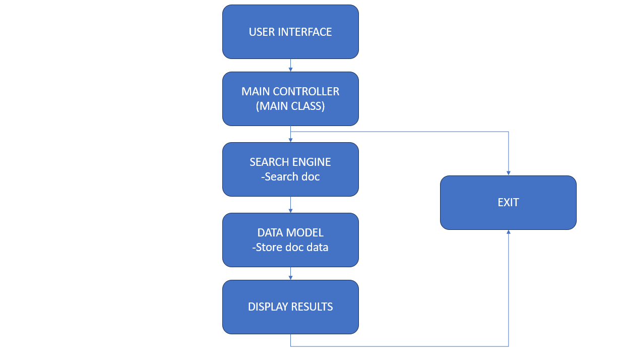
PROPOSED ARCHITECTURE
NO
YES
‹#›
CGB1201 – JAVA PROGRAMMING

Slide 7

LIST OF MODULES
Indexing Module
Search Module
GUI Module

Slide 8
MODULE DESCRIPTION
Indexing Module:
The Indexing Module is responsible for processing the text content from files and web pages to build an inverted index, which maps words to their occurrences across documents or URLs. This module ensures that data is organized efficiently for quick retrieval, using structures like HashMap to store word frequencies and document associations.

Slide 9
MODULE DESCRIPTION
Search Module:
The Search Module handles user queries by searching the indexed data for matching terms. It retrieves results from the index, sorts them based on frequency or relevance, and formats the output for display. This module is crucial for ensuring accurate and fast retrieval of information.

Slide 10
MODULE DESCRIPTION
GUI Module:
The GUI Module provides a user-friendly interface for interacting with the application. Built using Java Swing, it includes components like text fields for input, buttons for triggering actions, and text areas for displaying results. This module bridges the technical backend with an intuitive frontend, allowing users to perform tasks like indexing and searching without dealing with command-line operations.

Slide 11
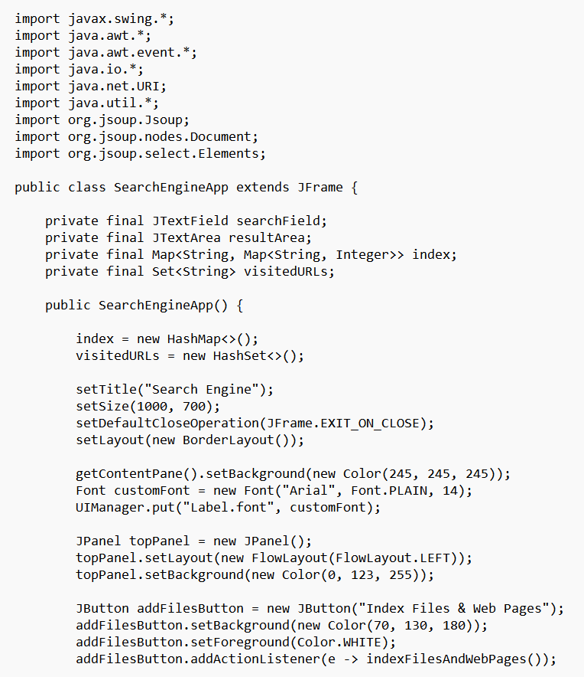
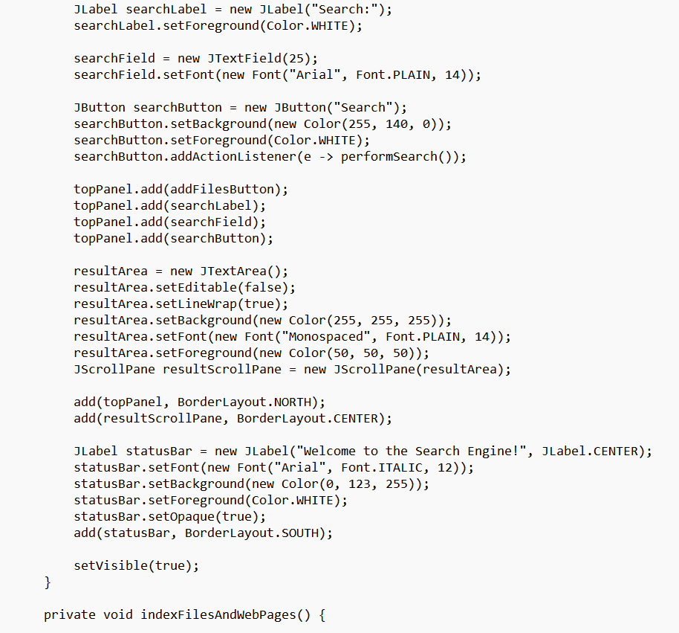
SOURCE CODE

Slide 12
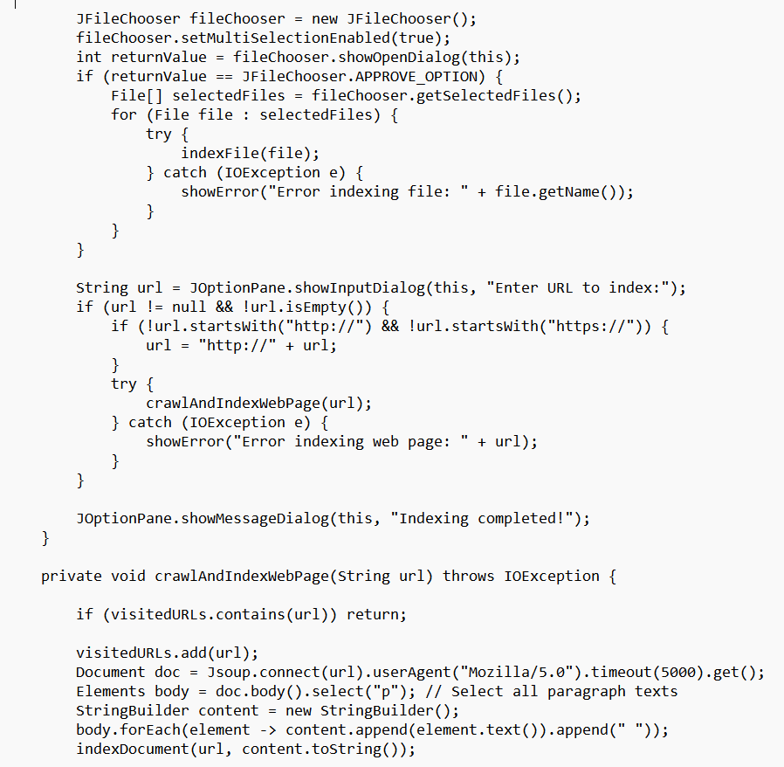
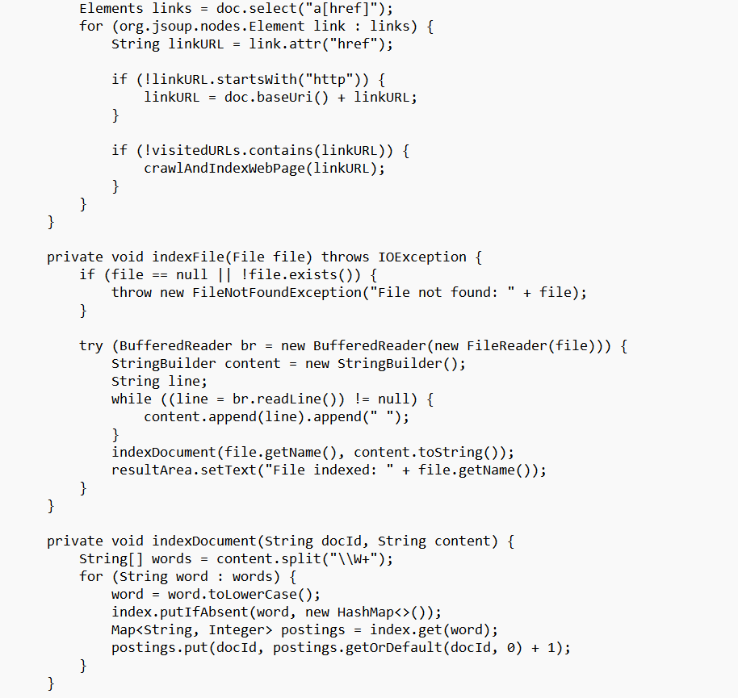
SOURCE CODE

Slide 13
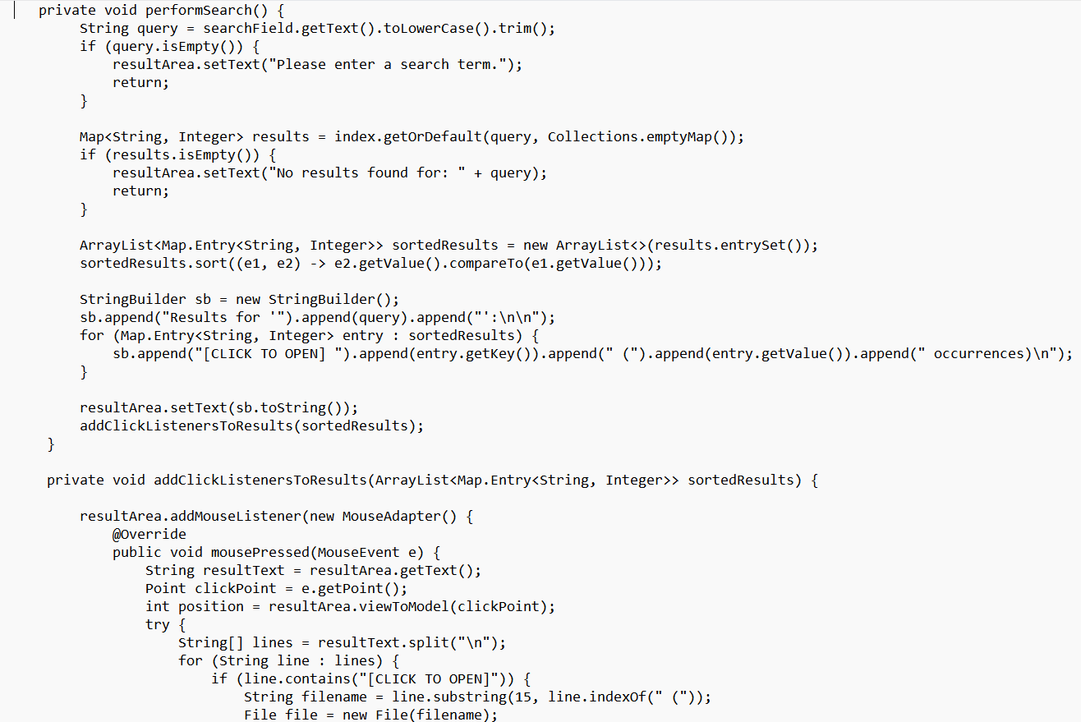
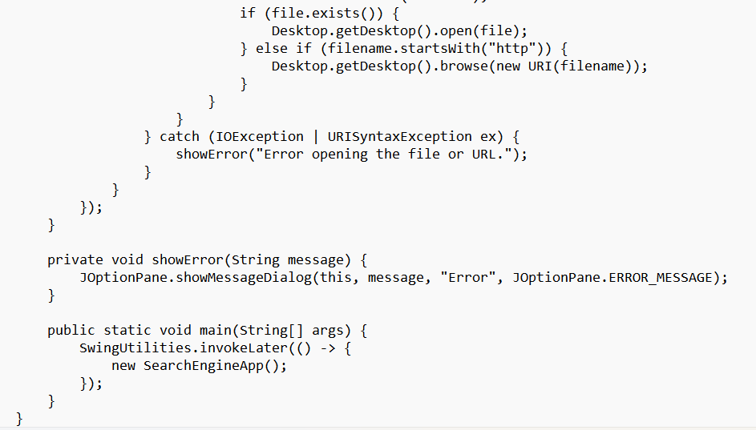
SOURCE CODE

Slide 14

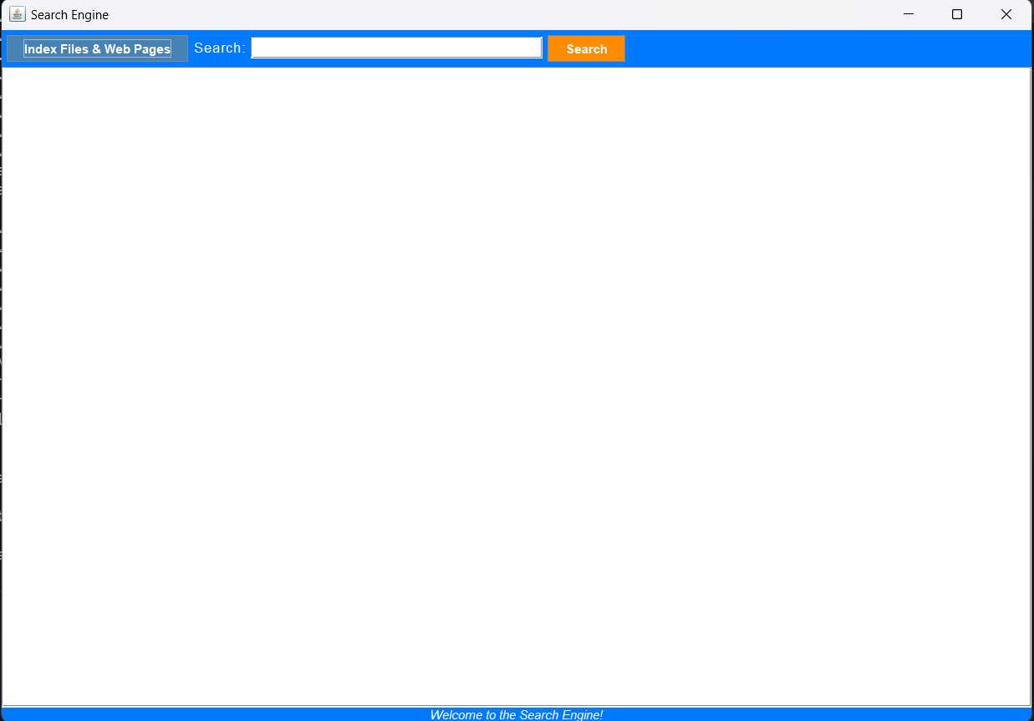
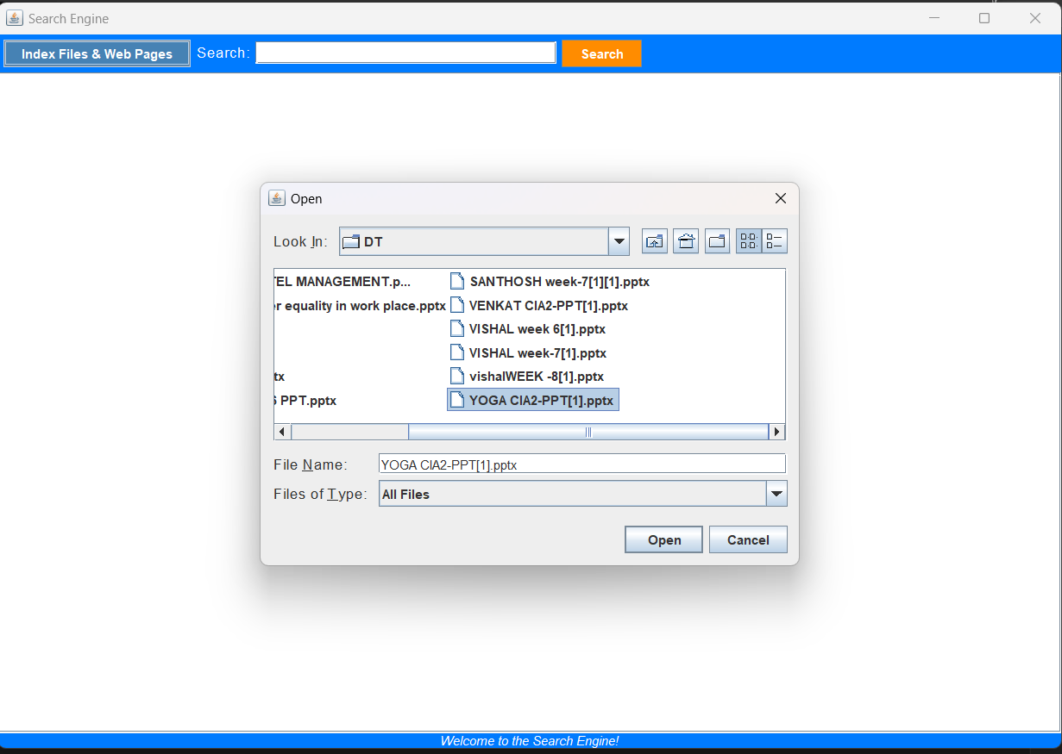
RESULTS AND DISCUSSION

Slide 15
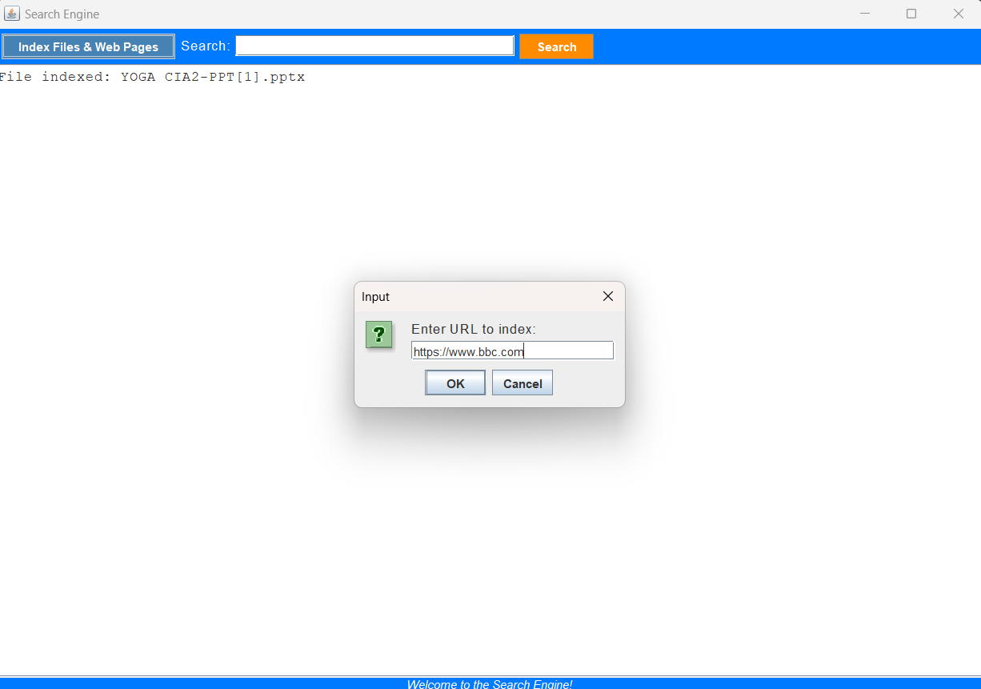
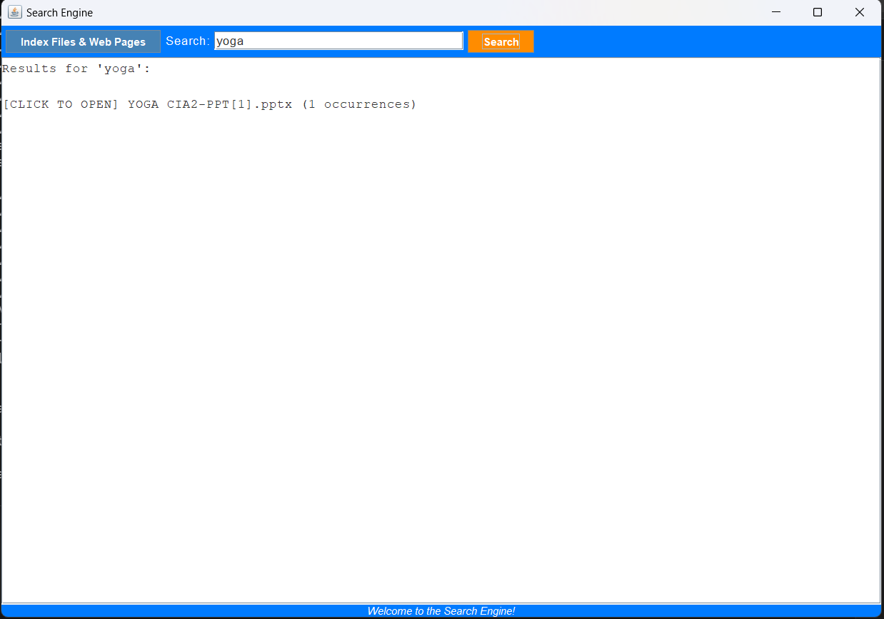
RESULTS AND DISCUSSION

Slide 16
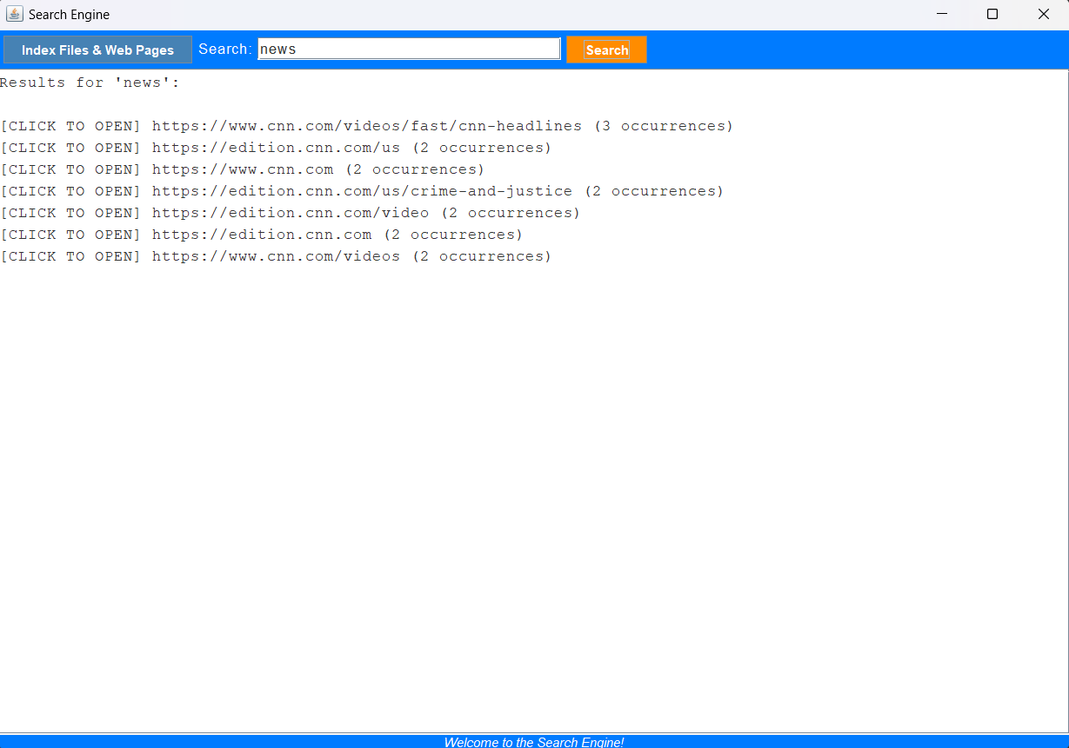
RESULTS AND DISCUSSION

Slide 17

CONCLUSION
Its clear and simple design, allows users to input queries and receive matching results based on contents.
Interactive User Interface.
Excellent starting point for understanding how search engines work.

Slide 18

THANK YOU

