Slide 1


K.RAMAKRISHNAN COLLEGE OF TECHNOLOGY (AUTONOMOUS), TRICHY
Visualizing Sports Data:
Runs Scored by Players in Cricket
PRESENTED BY
SIBI CHAKKARAVARTHI S- 2303811724321105

Slide 2
PRESENTATION OVERVIEW
Problem Identification
Objective
Proposed system
Block diagram of proposed system
R data structure used
Modules
Advantages

Slide 3
PROBLEM IDENTIFICATION
Analyzing cricket player performance is crucial for understanding trends and making strategic decisions.Cricket data (such as runs, strike rate, and centuries) is available but often unstructured, making it difficult to extract insights.Traditional methods like tables and text-based reports do not provide a clear understanding of performance trends.

Slide 4
OBJECTIVE
The objective of this project is to collect, preprocess, and visualize cricket player performance data using R. It aims to transform raw data into meaningful insights through interactive visualizations such as bar charts, scatter plots, and line graphs. By analyzing key metrics like total runs, strike rate, and batting average, the project helps in identifying top-performing players and trends over time. The system will assist cricket analysts, coaches, and fans in making data-driven decisions based on player statistics. Additionally, it provides a structured approach to compare player performances and recognize historical patterns in the game.

Slide 5
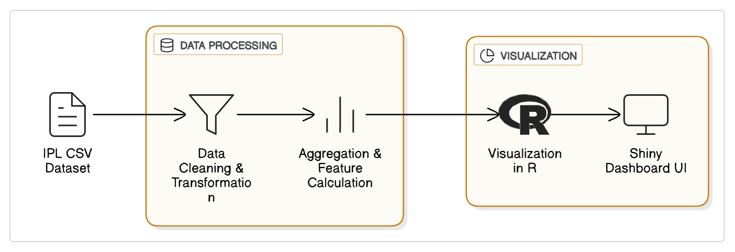
PROPOSED SYSTEM
BLOCK DIAGRAM
Visualizing Sports Data

Slide 6
R DATA STRUCTURE USED
Data Frames (data.frame) – Used to store and manipulate cricket data in a tabular format (rows and columns). Example: Player statistics like runs, matches, and strike rate.
Vectors (c()) – Used for handling individual data columns such as total runs, centuries, and batting averages.
Lists (list()) – Stores different objects like player details, match records, and statistical summaries.
Matrices (matrix()) – Used for numerical computations and structured data storage, such as runs scored by different players over multiple matches.

Slide 7
MODULES
Module 1: Data Collection & Preprocessing
Module 2: User Interface Design (UI)
Module 3: Server Logic & Data Processing
Module 4: Data Visualization
Module 5: Interactive Dashboard Deployment

Slide 8
MODULE DESCRIPTION
Module 1: Data Collection & Preprocessing
Description: This module handles the acquisition and cleaning of the IPL dataset. The data is taken from Kaggle and includes two files: matches.csv and deliveries.csv.
Module 2: User Interface Design (UI)
Description: Responsible for designing the layout and components that users interact with. Built using the shiny package with features

Slide 9
MODULE DESCRIPTION
Module 3: Server Logic & Data Processing
Description: Implements the core logic behind the application using dplyr, where user selections trigger
Module 4: Data Visualization
Description: Generates visual insights from the processed data using ggplot2 and plotly
Module 5: Interactive Dashboard Deployment
Description: Combines the UI and server logic using shinyApp() to deploy the dashboard.

Slide 10
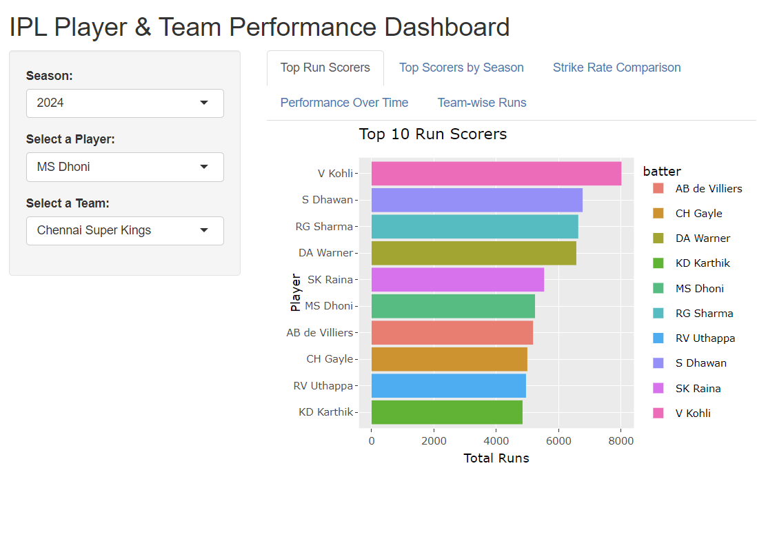
SCREENSHOT

Slide 11
ADVANTAGES OF PROPOSED SYSTEM
Effective Data Visualization – Converts raw cricket data into insightful charts and graphs for better understanding.
Automated Data Processing – Reduces manual effort by cleaning, transforming, and integrating data efficiently.
Comparative Player Analysis – Enables performance comparison of players based on key metrics like runs and strike rate.
Trend Identification – Helps in recognizing historical performance trends and predicting future patterns.

Slide 12
THANK YOU

