Slide 1
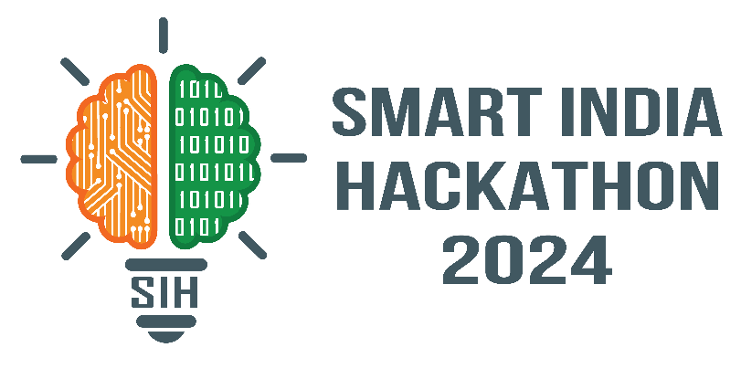
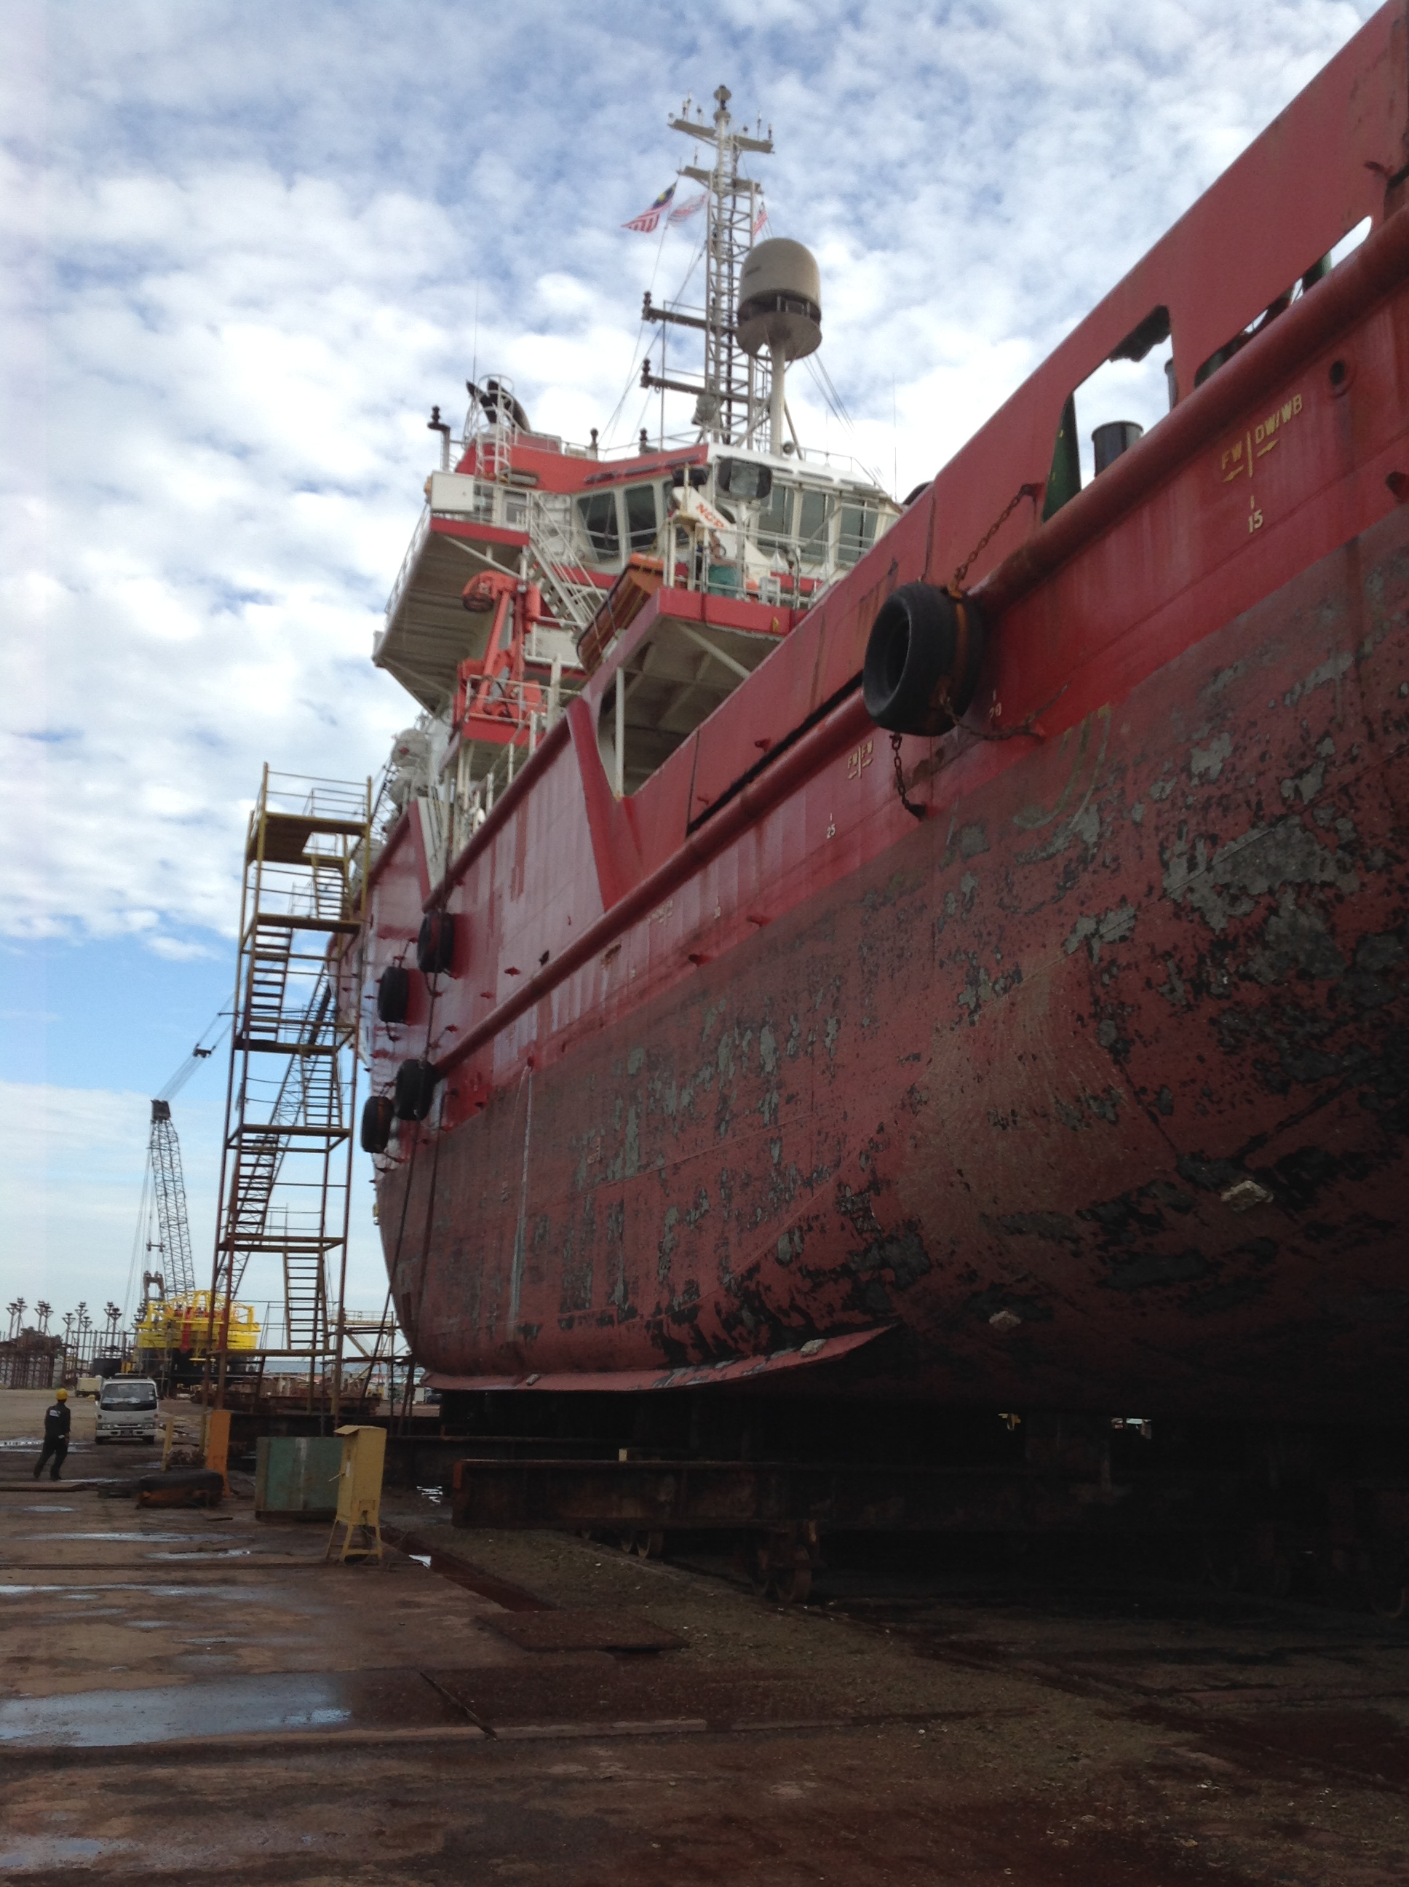
SMART INDIA HACKATHON 2024
PSID – 1655
Detecting oil spills at marine environment using AIS and
satellite datasets
Smart Automation
(SOFTWARE)
TEAM TECHEXAGON
MENTOR
Dr. R Senthamil Selvi, Professor.
TEAM MEMBERS
Sankaranarayanan M Hingsly Priya R
Sibiraj M Gayathri R
Sivakumar B Claribel Hermia P

Slide 2
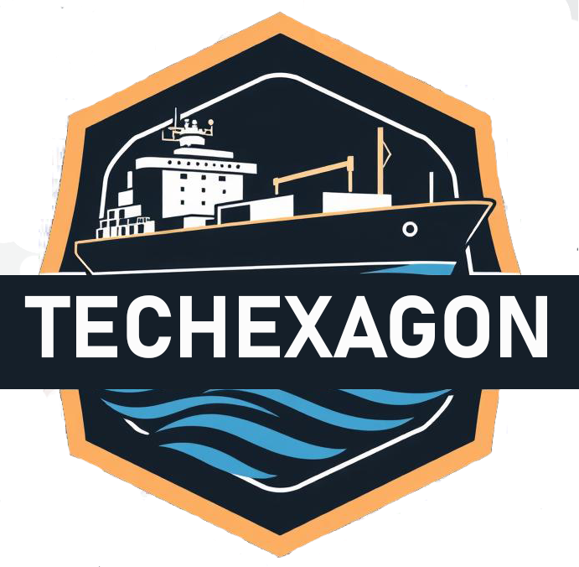
IDEA TITLE
The automatic identification of oil leaks and spills from ships using AIS (Automatic Identification System) and satellite datasets involves integrating real-time tracking and advanced remote sensing technologies to monitor marine environments effectively.
AIS provides crucial information of the vessel’s
Unique Identifiers [IMO number, call sign]
Real-time positional data [latitude, longitude]
Speed & Course Over Ground [SOG & COG]
Type of vessel , Dimensions & Draught
Heading, Destination & Estimated Time of Arrival (ETA)
Cargo details ,which thereby used to detect a vessel in distress.
AIS data have to be monitored for anomalies such as sudden changes in speed or course, erratic movements or unexpected stops. These irregularities can signal potential distress, prompting further investigation.
The integration of AIS data can help in the early detection of oil leaks from a ship or vessel. The information can be passed on to the regulatory authorities for a quicker and more efficient response.

Slide 3
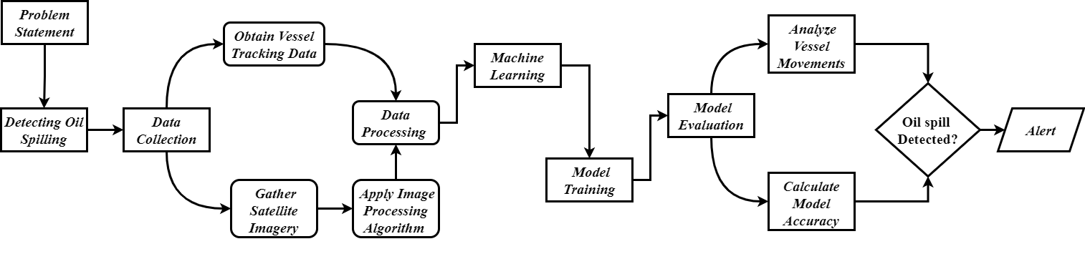
TECHNICAL APPROACH
What Technology Will Be Used ?
Programming Languages -> PYTHON
Isolaion Forest ML algorithm from sklearn.
Used to detect anomalies.
Sentinalhub (python module)
Used to access and integrate satellite data.
Opencv
Used for image processing.
.
Tools -> API’s from websites
Marinetrafffic
Provides access to real-time and historical vessel data.
Sentinalhub
Provides satellite images and data

Slide 4
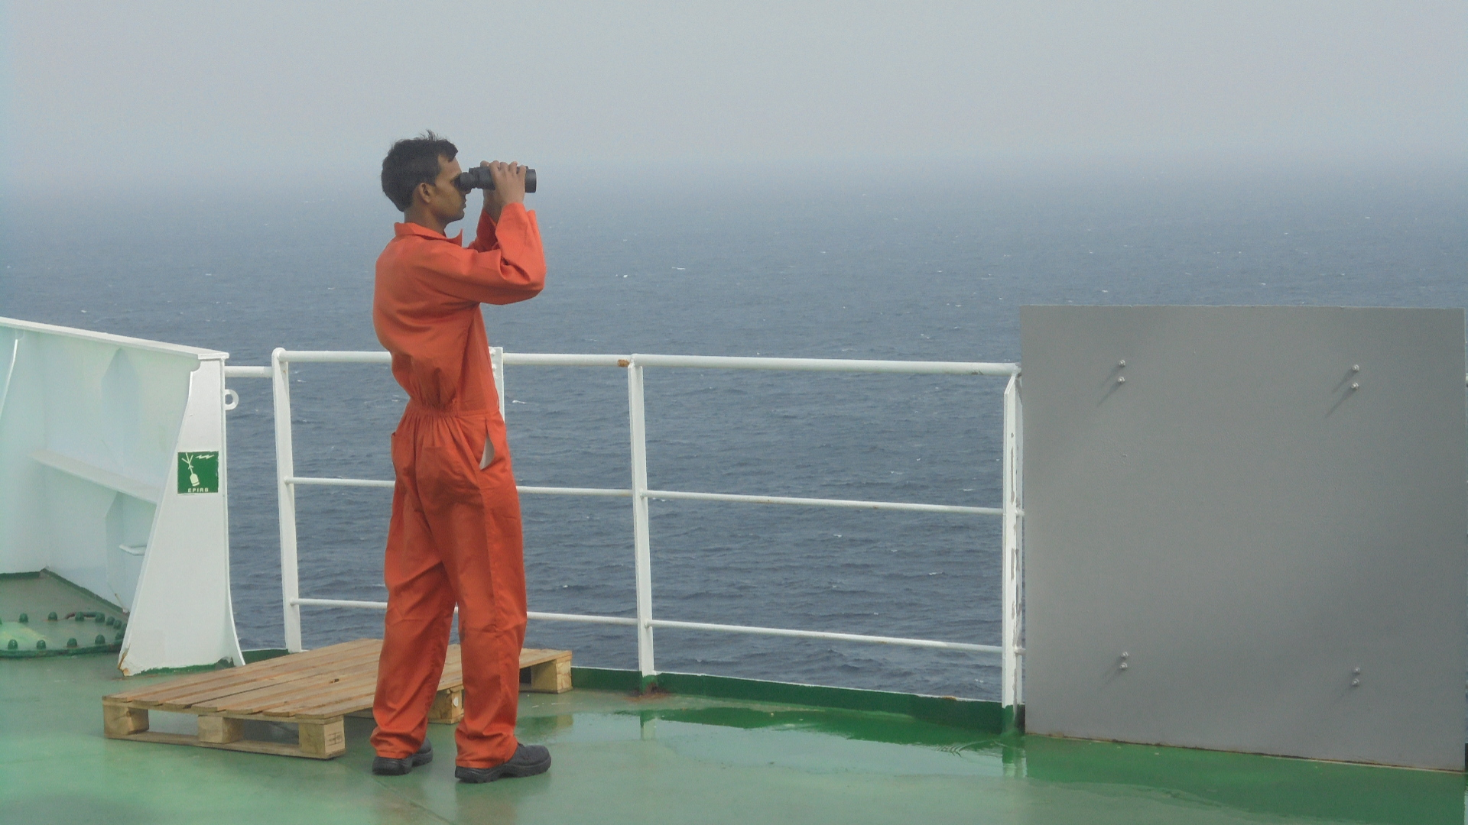
FEASIBILITY AND VIABILITY
Reliable APIs are used for data collecting.
The Python programming language has a rich ecosystem of libraries and packages for a variety of tasks, such as
Image processing
Visualization
Satellite imagery can be used to identify instances of piracy and unauthorized goods.
Risks and overcoming strategies:
Risk: AIS data noise and resolution constraints in satellite imagery.
Overcoming: Boost data dependability with AIML and cross-referencing information from several sources.
Risk: A behaviour's threshold for being labelled as abnormal is arbitrary.
Overcoming: Isolation forest is an accurate algorithm to find anomalies in data.
Risk: Possible failures in ship equipment and parts
Overcoming: A machine learning approach that uses maintenance records and historical data to forecast maintenance needs early.

Slide 5
RESEARCH AND REFERENCES
Study Area:
Off Mumbai:
https://drive.google.com/file/d/1HUisEfMA20ilODdeoRYVneG2i1ZbRBNB/view?usp=drive_link
https://www.imo.org/en/KnowledgeCentre/
Dataset Link:
AIS information:
https://www.marinetraffic.com/en/ais/home/centerx:73.8/centery:13.7/zoom:8
https://www.aishub.net/
Satellite datasets:
https://dataspace.copernicus.eu/ SNAP tool for processing SAR datasets
https://step.esa.int/main
Case Reference:
Mr. Prabakar R [ Marine Engineer ] – 35 yrs Of Shipping Experience in crude oil tankers

