Slide 1



CS 8811 - Project Work
TEA LEAVES DISEASE DETECTION USING VGG16 MODEL
12.04.2024
Batch No. :B11
Presented by
G.Sibisezhiyan
C.S.Suhaas Sabari Girish
M.Vel Murugan
A.C.Vishal
- 311020104078
- 311020104086
- 311020104101
- 311020104109
Supervisor
Sumithra Devi.K
Assistant professor
2023 - 2024

Slide 2
Objective
Main objectives we are looking to achieve
The objective is to deploy an advanced image recognition model that analyzes tea leaf diseases based on color, spots, and textures.
The system aims to deliver rapid results through a user-friendly interface.
Rigorously tested for precision, the system is designed to connect farmers with experts, providing personalized disease management advice and revolutionizing tea plant health maintenance
1

Slide 3
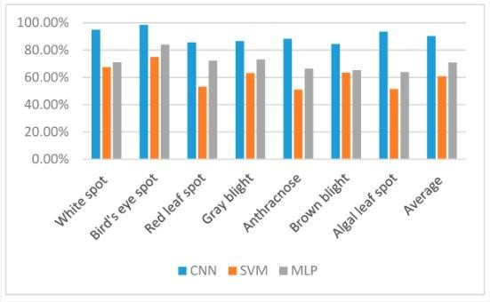
Motivation
The statistical data for disease classification for each of the three classification models for the seven candidate tea diseases. The main motivation for doing this research is to present a tea leaf disease prediction model for the prediction of tea leaf disease. Further, this research work is aimed at identifying the best classification algorithm for identifying the possibility of leaf disease in plants.

Slide 4
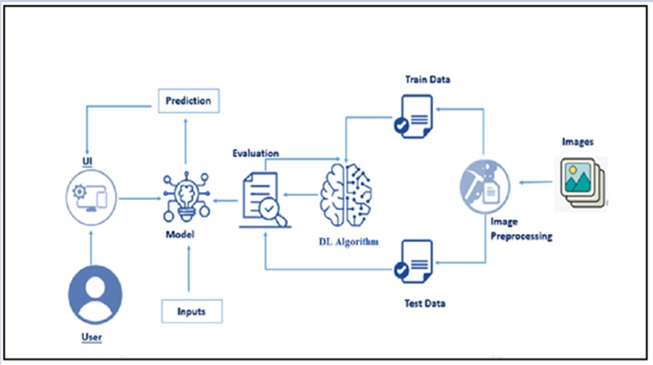
Introduction to the Domain
Deep learning is a method in artificial intelligence (AI) that teaches computers to process data in a way that is inspired by the human brain. Deep learning models can recognize complex patterns in pictures, text, sounds, and other data to produce accurate insights and predictions.

Slide 5
Project Description
What? How? Which?
The project aims at Leveraging advanced image recognition, our web-based tea leaf disease analysis system delivers swift and precise results through an intuitive interface.
This platform facilitates remote collaboration, connecting farmers with expert advice for personalized disease management, thereby promoting sustainable tea farming practices.
2

Slide 6
Base Paper
Jianping Yao, Son N. Tran, Samantha Sawyer, Saurabh Garg, 2023, “Machine learning for leaf disease classifcation: data, techniques and applications”, Artifcial Intelligence Review (2023) 56:S3571–S3616, https://doi.org/10.1007/s10462-023-10610-4
Contribution | The study on machine learning for leaf disease classification in agriculture contributes by providing a comprehensive view of current achievements and trends in the application of ML for leaf disease classification.
Methodology | Categorizes leaf disease classification approaches into traditional (shallow) ML, Deep Learning (DL), and Augmented Learning (AL)
Outcome | Highlights the importance of feature extraction in shallow learning, the potential of deep learning to reduce the cost of feature engineering, and the use of data augmentation methods to produce more training data and enhance model robustness.
Challenges | Lack of a comprehensive review of available datasets. Many datasets used in research are not up-to-date, and there is a scarcity of public datasets for leaf disease classification.
Future Scope | The potential future scopes for research and application of machine learning for smart agriculture and leaf disease classification include the need for comprehensive reviews of available datasets and machine learning approaches.

Slide 7
Supporting Paper 1
S. P. Raja , Barbara Sawicka et al., 2019 “Crop Prediction Based on Characteristics of the Agricultural Environment Using Various Feature Selection Techniques and Classifiers”, IEEE publication
Contribution | Utilize machine learning for crop yield prediction, emphasizing the significance of optimal feature selection to enhance model accuracy, reduce redundancies, and demonstrate that ensemble techniques outperform existing classification methods.
Methodology | The machine learning techniques employed include decision support system algorithms, artificial neural networks (ANN), Bayesian network classification, backpropagation network (BPN), random tree, CHAID, and ensemble models
Outcome | The outcomes of the study on crop prediction based on agricultural environment characteristics included the development of models for predicting specific crop yields in given circumstances.
Challenges | Complexity of crop prediction in agriculture due to the dependence on biotic and abiotic factors, the need for diverse datasets, and the influence of biotic factors such as living organisms and anthropogenic factors on crop yield.
Future Scope | Potential for developing a recommendation system for crop quality and fertilizer use, bridging the gap between the farming community and technological applications.

Slide 8
Supporting Paper 2
Md. Fahad Jubayer et al., 2020 “ Tea leaf disease detection and identification based on YOLOv7 (YOLO-T)”, Tea leaf disease detection YOLOv7 (YOLO-T)”, Scientific reports
Contribution | AI-driven tea leaf disease detection system using YOLOv7, achieving 97.3% accuracy and offering a rapid solution for identifying and managing diseases in the tea industry.
Methodology | Utilized a dataset of 4000 digital images of five types of leaf diseases collected from prominent tea gardens in Bangladesh. The dataset was manually annotated and augmented to address the issue of insufficient sample sizes.
Outcome | The proposed model automatically detected five distinct types of tea leaf diseases and differentiated between healthy and diseased leaves. The overall classification accuracy is 97.30%, with recall and precision at 96.4% and 96.7%, respectively.
Challenges | Limited labelled data availability for detecting tea leaf disease, Lack of established evaluation metrics or benchmarks specific to tea leaf disease detection
Future Scope | Nil

Slide 9
Inference of Literature Review
Base Paper | Categorizes leaf disease classification approaches into traditional (shallow) ML, Deep Learning (DL), and Augmented Learning (AL)
Supporting Paper 1 | The reference paper highlights an AI-driven system using YOLOv7 for tea leaf disease detection, achieving 97.3% accuracy. It emphasizes the importance of advanced models in rapid disease identification and management in the tea industry. This motivates leveraging similar AI techniques and models, such as VGG16, for improved disease detection systems.
Supporting Paper 2 | AI-driven tea leaf disease detection system using YOLOv7, achieving 97.3% accuracy and offering a rapid solution for identifying and managing diseases in the tea industry.

Slide 10
Extraction from the Literature Survey for the proposed system
Base Paper | The project can leverage traditional ML, Deep Learning (using VGG16), or Augmented Learning for tea leaf disease detection, incorporating features from the base paper.
Supporting Paper 1 | The paper emphasizes optimal feature selection in ML for crop yield prediction, showcasing ensemble methods' superiority. This concept can be applied to enhance accuracy and reduce redundancies in tea leaf disease detection with VGG16.
Supporting Paper 2 | Insights can be gained regarding the effectiveness of different feature extraction techniques employed by YOLOv7 and VGG16. While YOLOv7 uses a single-stage object detection approach, VGG16 relies on a deep convolutional architecture for feature extraction. Understanding which features are most relevant for tea leaf disease detection can inform future model development and optimization efforts.

Slide 11
Problem Definition
The problem definition of machine learning for leaf disease classification in agriculture is to develop effective and efficient approaches for the early detection and classification of plant leaf diseases. Traditional methods of disease detection and classification in plants have limitations such as being labor-intensive, subjective, and prone to human errors and bias. Machine learning (ML) approaches aim to address these challenges by automating the detection process, providing timely and accurate identification of plant diseases on a large scale.
ML techniques can analyze plant leaf images to identify various features such as species, healthy states, age, and disease categories, thereby improving the quality and quantity of agricultural production
The goal is to leverage ML technologies to automatically detect plant leaf diseases as early as possible, thereby contributing to the remedying of production losses in agriculture.

Slide 12
Proposed Solution
What Do We Want At Most The Basic Level?
The development of an automated Deep Learning Model for tea leaf disease detection utilizes color, spots, and texture characteristics, ensuring accurate disease identification and contributing to improved efficiency, objectivity, and timeliness in disease detection.
The user-friendly interface enables farmers and experts to easily capture tea leaf images, fostering increased tea production and quality through the enhanced capabilities of the automated system.
3

Slide 13
Proposed Solution
VGG16 MODEL
The VGG16 model is a convolutional neural network (CNN)
The VGG16 model is typically trained using the ImageNet dataset, which consists of millions of labeled images across 1000 different classes. During training, the model learns to recognize various visual patterns and features within the images.
4

Slide 14
Proposed Solution
The Algorithm to be Used?
Optimizations algorithms – Stochastic Gradient Descent, Adam and RMSprop
Learning rate schedulers – Cosine learning decay and Exponential learning decay
Regularization techniques – Dropout, L1 and L2 regularization and early stopping
8

Slide 15
Requirement Specification
Software
FRONT END TOOLS | HTML,CSS
BACK END TOOLS | Python
MARKUP LANGUAGES | HTML, CSS,BOOTSTRAP
SCRIPTING LANGUAGES | Java script
MIDDLEWARE TECHNOLOGIES | Python
IDE | VS Code
SIMULATION TOOLS | Nil
NETWORK/WIRELESS TECHNOLOGIES | Nil
ANY OTHER | Libraries - Tensor Flow, numpy, pillow ; Version Control – Git
9

Slide 16
Requirement Specification Justification
Python employed for backend development in the tea leaf disease detection system.
Flask utilized to create a user-friendly interface for seamless interaction.
Implementation of deep learning libraries, specifically TensorFlow, for the Convolutional Neural Network (CNN).
Integration of image processing tools, including OpenCV, to enhance image analysis capabilities.
Structuring the user interface through HTML and CSS, ensuring an organized and visually appealing design.
21

Slide 17
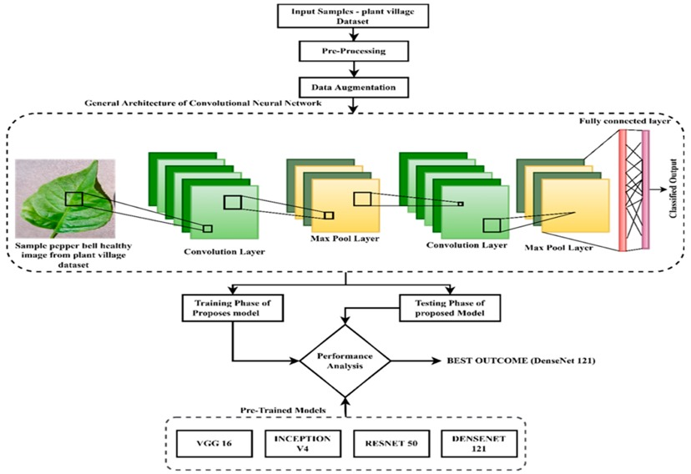
Architecture Diagram
10

Slide 18
Module Description
The "Tea Leaf Disease Detection" module is designed to identify and classify diseases affecting tea plants based on leaf images. This module integrates image processing techniques and machine learning algorithms to automate the diagnosis of tea plant diseases, thereby assisting farmers in early detection and timely intervention.
Image Preprocessing:
Image Acquisition: Retrieve images of tea leaves using digital cameras or smartphones.
Noise Reduction: Apply filters (e.g., Gaussian blur, median blur) to reduce noise and enhance image quality.
Image Enhancement: Adjust brightness, contrast, and sharpness to improve image clarity.
12

Slide 19
Module Description
Feature Extraction:
Texture Analysis: Compute textural features such as Haralick textures or local binary patterns (LBP) to capture disease-related patterns.
Color Analysis: Extract color-based features using color histograms or color moments to quantify color variations caused by diseases.
Machine Learning Model:
Model Training: Utilize a supervised learning approach to train a disease classification model.
Feature Selection: Identify relevant features that contribute to disease classification.
Model Evaluation: Assess model performance using metrics like accuracy, precision, recall, and F1-score.

Slide 20
Module Description
Disease Classification:
Input Processing: Prepare test images by applying the same preprocessing steps used during training.
Prediction: Deploy the trained model to predict the disease type based on input images.
Output Generation: Provide a detailed report indicating the detected disease along with relevant statistics.

Slide 21
Algorithm Explanation
A Convolutional Neural Network (CNN) is a type of artificial neural network designed specifically for processing structured grid-like data. It's particularly effective for tasks involving image recognition and classification, although it has been successfully applied to various other tasks such as natural language processing and signal processing.
1.Convolutional Layer: The core building block of a CNN is the convolutional layer. It applies a set of filters (also known as kernels) to the input data. Each filter performs a convolution operation by sliding across the input data, computing dot products between the filter weights and the corresponding input values at each position. This process captures spatial patterns in the input data. The output of this operation is called a feature map.
13

Slide 22
Algorithm Explanation
2.Activation Function: After the convolution operation, an activation function is applied element-wise to the feature map to introduce non-linearity into the network. Common activation functions include ReLU (Rectified Linear Unit), sigmoid, and tanh.
3.Fully Connected Layer: After several convolutional and pooling layers, the resulting feature maps are flattened into a vector and fed into one or more fully connected layers. These layers perform high-level reasoning on the spatial hierarchies learned by the convolutional layers. The output of the last fully connected layer is often passed through a softmax activation function to produce probabilities for each class in a classification task.

Slide 23
Algorithm Explanation
VGG16 MODEL
VGG16 is a convolutional neural network architecture that gained prominence for its simplicity and effectiveness in image classification tasks. Developed by the Visual Geometry Group at the University of Oxford, VGG16 is composed of 16 weight layers, including 13 convolutional layers and 3 fully connected layers.The key characteristic of VGG16 is its uniform architecture, where convolutional layers consist of 3x3 filters with a stride of 1, and max-pooling layers with 2x2 filters applied after every two convolutional layers. This design choice results in a deeper network while maintaining a simple and regular structure.The convolutional layers of VGG16 are designed to extract features of increasing complexity, starting from simple edges and textures in the early layers to more abstract features in the deeper layers. The fully connected layers at the end of the network utilize these features to perform high-level reasoning and make predictions.

Slide 24
Implementation
The "Tea Leaf Disease Detection" module is designed to identify and classify diseases affecting tea plants based on leaf images. This module integrates image processing techniques and machine learning algorithms to automate the diagnosis of tea plant diseases, thereby assisting farmers in early detection and timely intervention.
Image Preprocessing
Feature Extraction
Machine Learning
14

Slide 25
Implementation
Image preprocessing: Plays a crucial role in preparing images for deep learning models like VGG16 (or other convolutional neural networks). Here's a detailed explanation of image
preprocessing steps typically used with the VGG16 model:
Image Resizing: The VGG16 model typically requires input images of a fixed size. Commonly used sizes include 224x224 pixels or 256x256 pixels. Therefore, resize the input image to match the required dimensions before feeding it into the model. This can be done using libraries like OpenCV or PIL (Python Imaging Library).
Normalization: Normalize the pixel values of the resized image. Neural networks perform better when input data is standardized. For VGG16, subtract the mean RGB value of the training set from each pixel. This can be calculated using: mean_R,mean_G,mean_B=(123.68,116.779,103.939) mean_R,mean_G,mean_B=(123.68,116.779,103.939)
Then, subtract these mean values from the corresponding RGB channels of the image. This step helps center the data around zero-mean, making training more stable.

Slide 26
Implementation
Color Channel Order: Ensure that the color channels of the image are in the correct order. VGG16 expects images in RGB (Red, Green, Blue) format. If your image is loaded in BGR (Blue, Green, Red) format (common with OpenCV), convert it to RGB.
Data Type Conversion: Convert the image data into the appropriate data type expected by the model. Typically, VGG16 expects images as float32 arrays.
Batch Formation: Finally, prepare the image for prediction by adding an extra dimension to
represent the batch size. VGG16 expects input tensors of shape (batch_size, height, width,
channels). Therefore, expand the dimensions of the image to create a batch with a single image:
image_batch=np.expand_dims(image_normalized, axis=0)
image_batch=np.expand_dims(image_normalized, axis=0)
import cv2
import numpy as np
from keras.applications.vgg16 import preprocess_input image = cv2.imread('path_to_image.jpg')
image = cv2.resize(image, (224, 224)) # Resize to VGG16 input size (224x224)

Slide 27
Implementation
image = cv2.cvtColor(image, cv2.COLOR_BGR2RGB)
image = preprocess_input(image.astype(np.float32))
image_batch = np.expand_dims(image, axis=0)
Image preprocessing for VGG16 involves resizing the image to the model's input size, normalizing pixel values to center the data, ensuring correct color channel order, converting data types, and forming a batch of images ready for prediction. These steps ensure that the input images are properly prepared to be processed by the VGG16 model, optimizing performance and accuracy during inference.

Slide 28
Implementation
Feature Extraction: When performing feature extraction using VGG16, you typically use the convolutional base of the model (all layers except the fully connected layers). This part of the network serves as a powerful feature extractor.
Feature extraction using the VGG16 model involves leveraging the convolutional layers of the pretrained network to extract meaningful features from input images. VGG16 is a deep convolutional neural network architecture that is commonly used for tasks like image classification and feature extraction.
Extracting the Features From Convolutional Layer:
Pass the preprocessed image through the convolutional layers of VGG16. Each layer applies a series of filters (kernels) to the input image, transforming it into feature maps.
As the image propagates through the layers, higher-level features are extracted. Lower layers capture basic features like edges and textures, while deeper layers capture more complex patterns and object representations.

Slide 29
Implementation
from tensorflow.keras.preprocessing.image import ImageDataGenerator
train_datagen = ImageDataGenerator(rescale = 1./255, shear_range = 0.2, zoom_range = 0.2, horizontal_flip = True)
test_datagen = ImageDataGenerator(rescale = 1./255)
training_set = train_datagen.flow_from_directory(trainPath, target_size = (224, 224), batch_size = 32, class_mode = 'categorical')
test_set = test_datagen.flow_from_directory(testPath, target_size = (224, 224), batch_size
= 32, class_mode = 'categorical')

Slide 30
Implementation
Machine Learning Module: Creating a machine learning module using the VGG16 model involves leveraging transfer learning to build and train a custom classifier on top of the pretrained VGG16 convolutional base. This approach allows you to use the powerful feature extraction capabilities of VGG16 while adapting the model to a specific classification task. Here's a detailed explanation of building a machine learning module using VGG16,
Step 1: Loading and Configuring the VGG16 Module
Begin by loading the VGG16 model pretrained on ImageNet data. You can do this using TensorFlow/Keras.
from tensorflow.keras.layers import Dense, Flatten, Input from tensorflow.keras.models import Model
from tensorflow.keras.preprocessing import image
from tensorflow.keras.preprocessing.image import ImageDataGenerator, load_img
from tensorflow.keras.applications.xception import Xception, preprocess_input import numpy as np
import matplotlib.pyplot as plt

Slide 31
Implementation
Step 2: Adding Layers
Create a new model by adding custom fully connected layers on top of the VGG16 base.This custom part will serve as the classifier specific to your task.
x = Flatten()(vgg.output)
prediction = Dense(8, activation='softmax')(x)
Step 3: Defining the Model
Compile the model with an appropriate optimizer, loss function, and evaluation metric for your classification task.
model = Model(inputs=vgg.input, outputs=prediction)
model.compile(loss='categorical_crossentropy', optimizer='adam', metrics=['accuracy'], run_eagerly=True)
Implementation

Slide 32
Implementation
Step 4: Training the Model
Train the model using your dataset. This typically involves loading and preprocessing the dataset, then fitting the model to the data.
import sys
r=model.fit_generator(training_set,validation_data=test_set,epochs=150,steps_per_epo ch=len(training_set)//3, validation_steps=len(test_set)//3)
Step 5: Testing the Model
img=image.load_img(r'/content/Dataset/test/redleafspot/UNADJUSTEDNONRAW_thu mb_1b5.jpg',target_size=(224,224))
#convert image to array format x=image.img_to_array(img)

Slide 33
Implementation
import numpy as np
x=np.expand_dims(x,axis=0)
img_data=preprocess_input(x)
output=np.argmax(model.predict(img_data), axis=1)
index=['Anthracnose','algal leaf','bird eye spot’,’brown blight',’gray light’,'healthy','red leaf spot','white spot']
result = str(index[output[0]])
result

Slide 34
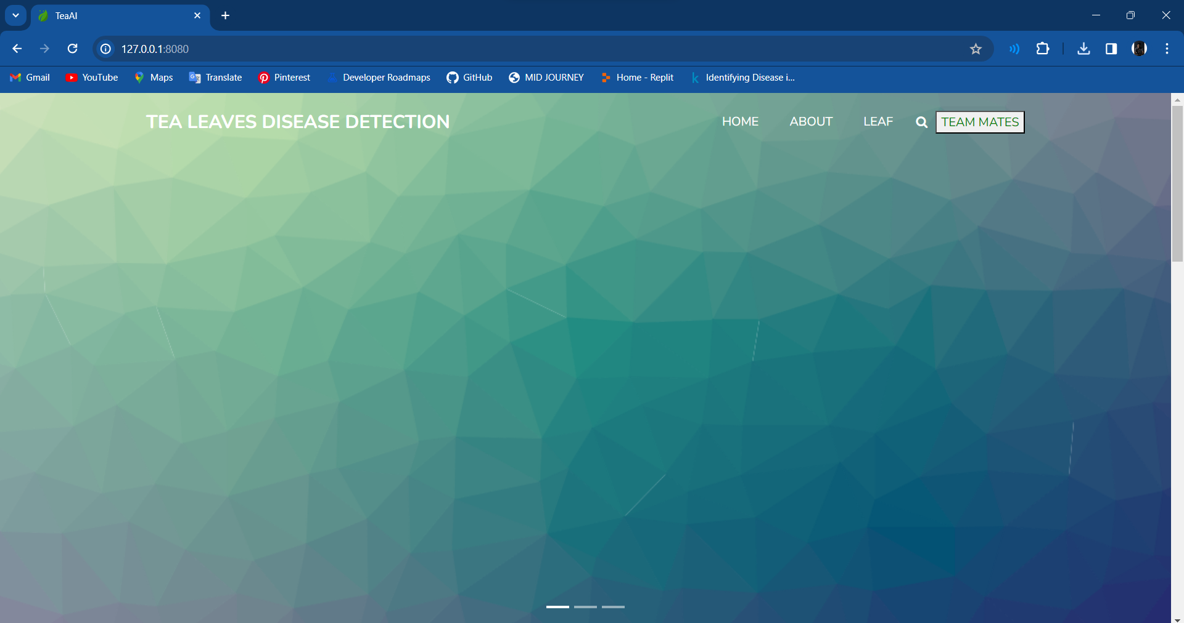
Screenshots
15

Slide 35
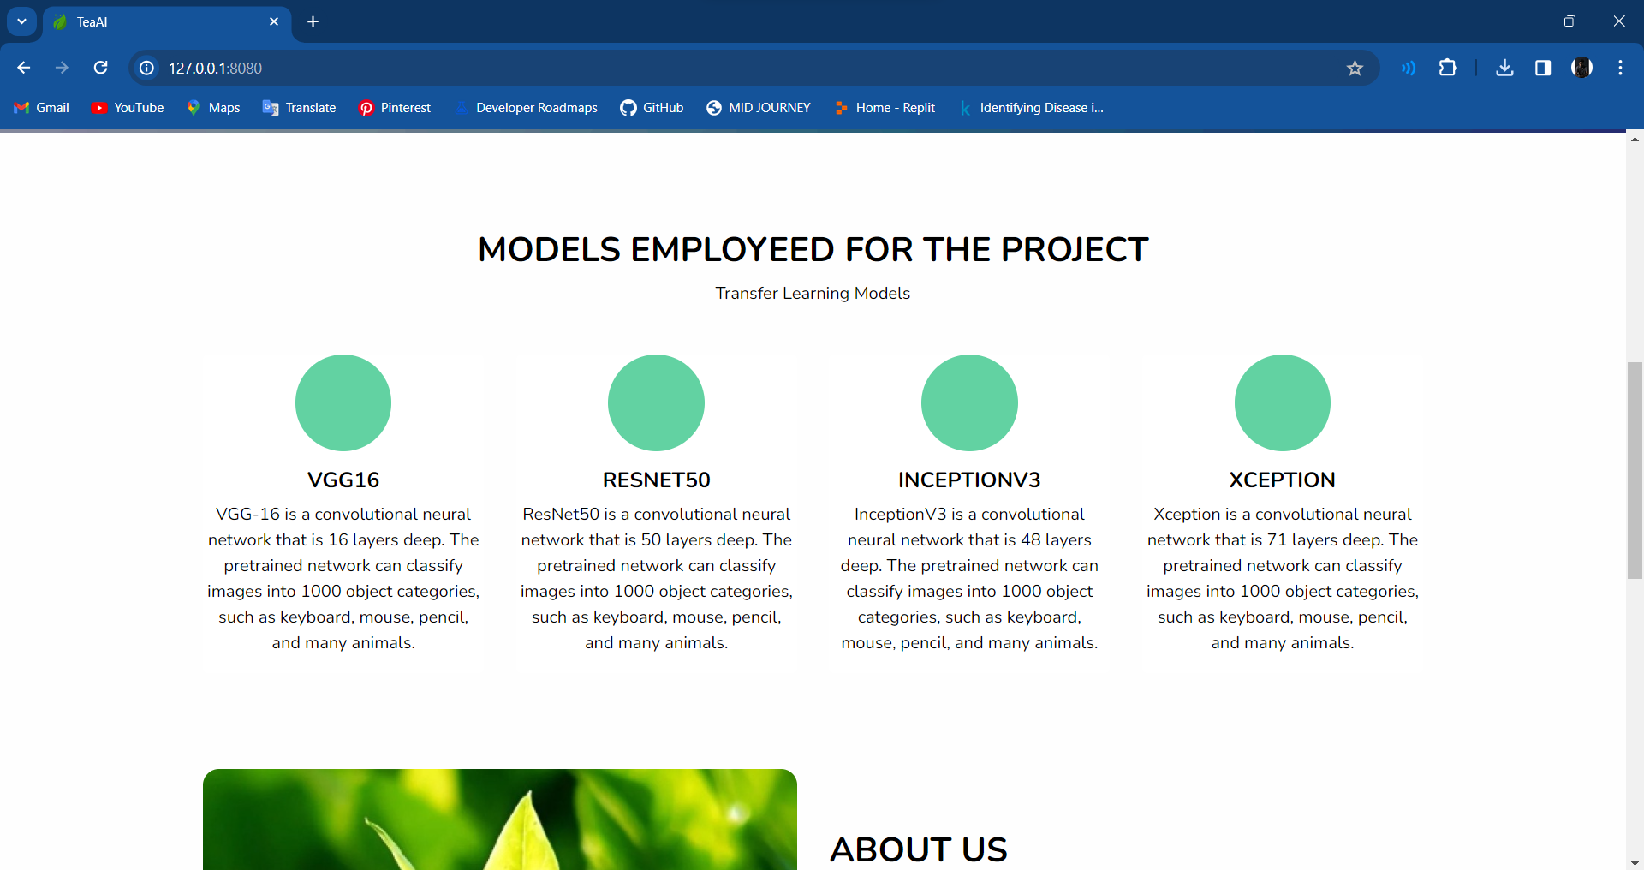
Screenshots
16

Slide 36
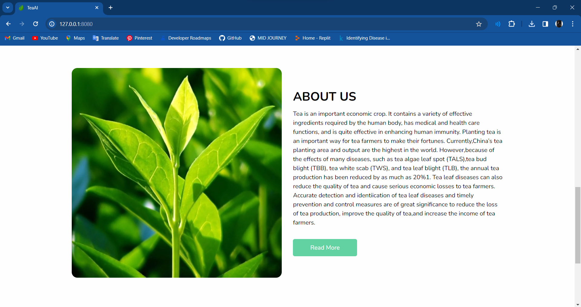
Screenshots
17

Slide 37

Screenshots
18

Slide 38
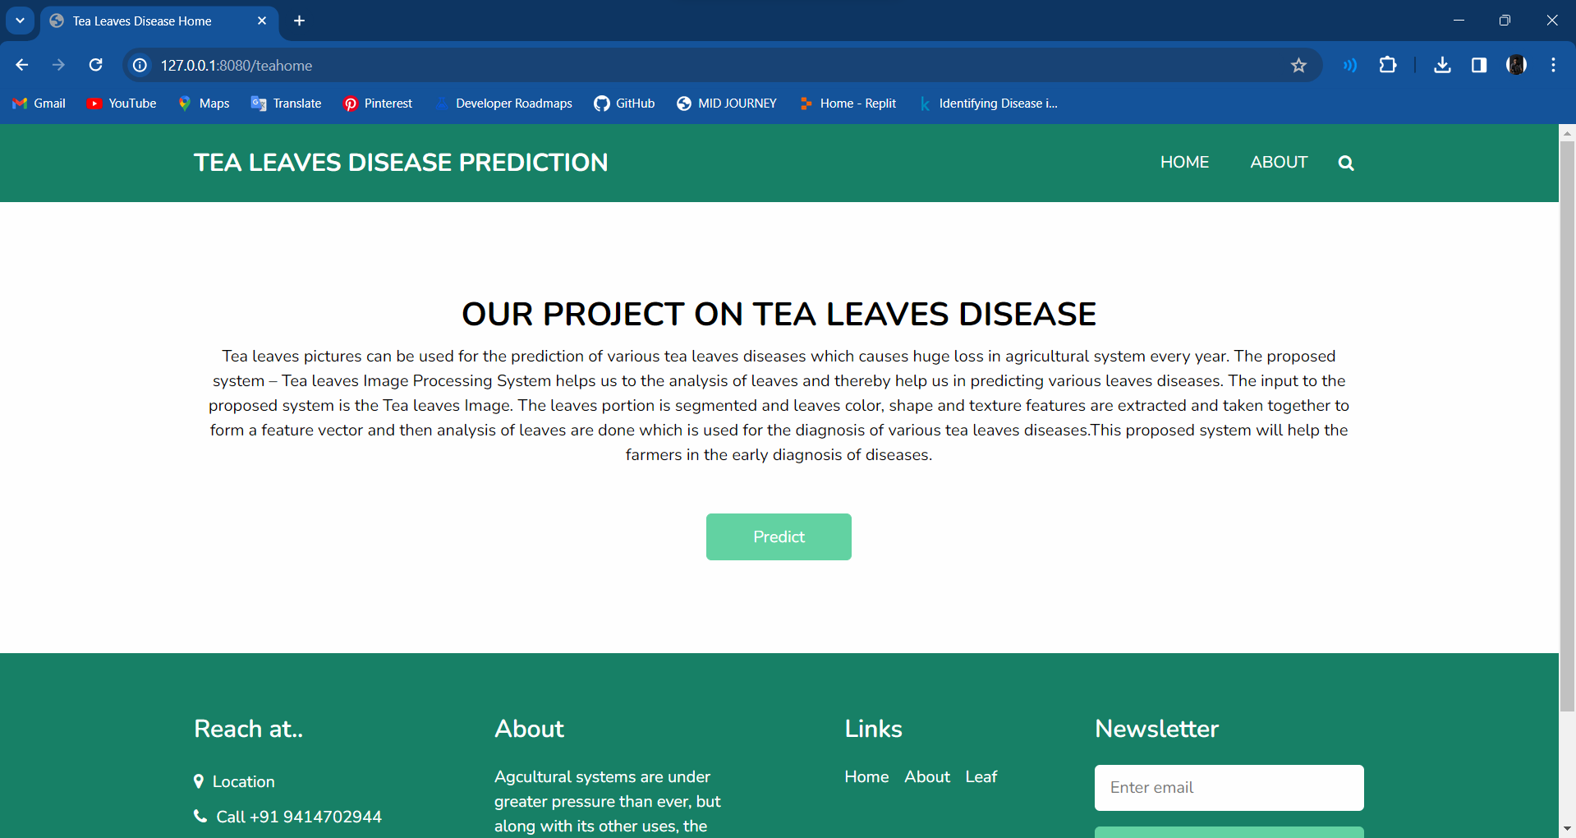
Screenshots
19

Slide 39
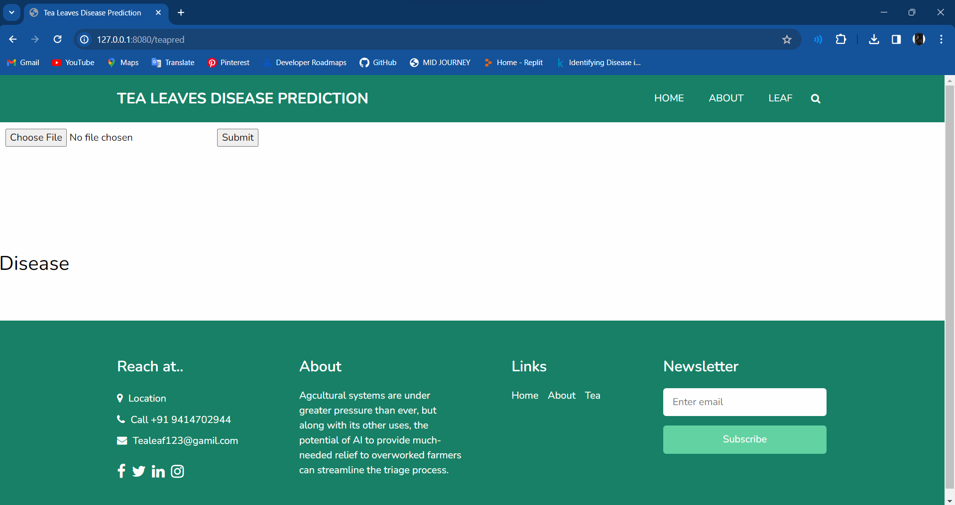
Screenshots
20

Slide 40
Conclusion and Future Scope
Finally, our integrated software stack, featuring Python, Flask, TensorFlow, OpenCV, HTML, CSS, and Pandas, delivers an efficient and user-friendly solution for tea leaf disease detection.
This approach, incorporating deep learning and image processing, ensures a precise Convolutional Neural Network implementation, revolutionizing efficiency and accessibility in agricultural practices.
22

Slide 41

Details of Technical Paper Presentation / Publication
This Paper titled “Tea Leaf Disease Detection Using VGG16 Model” communicated to ICEEICT 2024 International Conference on Electrical, Electronics, Information Communication And Technologies conducted by K.RAMAKRISHNAN COLLEGE OF ENGINEERING, TIRUCHIRAPPALLI, India on 14th of July 2024.

Slide 42
References
Andrew J, Jennifer Eunice, Daniela Elena Popescu, M. Kalpana Chowdary, and Jude Hemanth. 2022. "Deep Learning-Based Leaf Disease Detection in Crops Using Images for Agricultural Applications" Agronomy 12, no. 10: 2395.
Deepa Jose & Pavithra, M. & Sasipriya, S. & Santosh, M. & Cartegana, Jhonatan. (2022). “Effective Plant Leaf Disease Detection for Farmers”. 10.1007/978-981-16-8774-7_24.
Janibul Alam Soeb, Jubayer, M.F., Tarin, T.A. et al. “Tea leaf disease detection and identification based on YOLOv7 (YOLO-T)”. Sci Rep 13, 6078 (2023).
Jayanthy S, V. M. Sathyendraa, K. P. Sumedh and S. Suresh, "Tea Leaf Disease Classification and Tea Bud Identification," 2022 Fourth International Conference on Emerging Research in Electronics, Computer Science and Technology (ICERECT), Mandya, India, 2022, pp. 1-5, doi: 10.1109/ICERECT56837.2022.10059683.
Jiapping Yao, Son N. Tran. et al. “Machine learning for leaf disease classification: data, techniques and applications”. Artif Intell Rev 56 (Suppl 3), 3571–3616 (2023).
Karthikeyan, P & Arvind, K & Kumar, G & V, Ms. (2023). “Plant Disease Prediction Using Efficientnet”. 1155-1160. 10.1109/ICCPCT58313.2023.10245457.
Latha R. S et al., "Automatic Detection of Tea Leaf Diseases using Deep Convolution Neural Network", 2021 International Conference on Computer Communication and Informatics (ICCCI), Coimbatore, India, 2021, pp. 1-6, doi: 10.1109/ICCCI50826.2021.9402225.
23

Slide 43
References
Manasa J P and Nethravathi, "Mobile Based Application For Tea Leaf Disease Detection", 2023 IEEE 3rd International Conference on Technology, Engineering, Management for Societal impact using Marketing, Entrepreneurship and Talent (TEMSMET), Mysuru, India, 2023, pp. 1-5, doi: 10.1109/TEMSMET56707.2023.10149957.
Rahul Singh , N. Sharma and R. Gupta, "Proposed CNN Model for Tea Leaf Disease Classification", 2023 2nd International Conference on Applied Artificial Intelligence and Computing (ICAAIC), Salem, India, 2023, pp. 53-60, doi: 10.1109/ICAAIC56838.2023.10140680.
Raj M, P. Jha, M. G. Magar and V. Kukreja, "CNN and Random Forest Hybrid Model for Tea Leaf Diseases Multiclassification", 2024 International Conference on Automation and Computation (AUTOCOM), Dehradun, India, 2024, pp. 52-56, doi: 10.1109/AUTOCOM60220.2024.10486177.
Raja S. P, B. Sawicka, Z. Stamenkovic and G. Mariammal, "Crop Prediction Based on Characteristics of the Agricultural Environment Using Various Feature Selection Techniques and Classifiers," in IEEE Access, vol. 10, pp. 23625-23641, 2022, doi: 10.1109/ACCESS.2022.3154350.
Rajesh Kumar V, K. Pradeepan, S. Praveen, M. Rohith and V. Vasantha Kumar, "Identification of Plant Diseases Using Image Processing and Image Recognition," 2021 International Conference on System, Computation, Automation and Networking (ICSCAN), Puducherry, India, 2021, pp. 1-4, doi: 10.1109/ICSCAN53069.2021.9526493.
23

Slide 44
References
Srivastav S, K. Guleria and S. Sharma, "Tea Leaf Disease Detection Using Deep Learning-based Convolutional Neural Networks," 2023 IEEE World Conference on Applied Intelligence and Computing (AIC), Sonbhadra, India, 2023, pp. 569-574, doi: 10.1109/AIC57670.2023.10263835.
Tanwar V and S. Lamba, "Tea Leaf Diseases Classification and Detection using a Convolutional Neural Network," 2023 International Conference on Sustainable Computing and Smart Systems (ICSCSS), Coimbatore, India, 2023, pp. 498-502, doi: 10.1109/ICSCSS57650.2023.10169680.
Thangaraj R, B. Vadivel, T. Aravind, L. Chandhru, K. Harish and S. Eswaran, "Tea Leaf Disease Identification using Improved Convolution Neural Network," 2023 International Conference on Digital Applications, Transformation & Economy (ICDATE), Miri, Sarawak, Malaysia, 2023, pp. 1-5, doi: 10.1109/ICDATE58146.2023.10248508.
Xie S, C. Wang, C. Wang, Y. Lin and X. Dong, "Online Identification Method of Tea Diseases in Complex Natural Environments," in IEEE Open Journal of the Computer Society, vol. 4, pp. 62-71, 2023, doi: 10.1109/OJCS.2023.3247505.
23

Slide 45
THANK YOU

