Slide 1



CS 8811 - Project Work
TEA LEAVES DISEASE DETECTION
Review No.: 2
16.02.2024
Batch No. :B11
Presented by
Supervisor
Sumithra Devi.K
Assistant professor
G.Sibisezhiyan
C.S.Suhaas Sabari Girish
M.Vel Murugan
A.C.Vishal
- 311020104078
- 311020104086
- 311020104101
- 311020104109
2023 - 2024

Slide 2
Objective
Main objectives we are looking to achieve
The objective is to deploy an advanced image recognition model that analyzes tea leaf diseases based on color, spots, and textures.
The system aims to deliver rapid results through a user-friendly interface.
Rigorously tested for precision, the system is designed to connect farmers with experts, providing personalized disease management advice and revolutionizing tea plant health maintenance
1

Slide 3
Project Description
What? How? Which?
The project aims at Leveraging advanced image recognition, our web-based tea leaf disease analysis system delivers swift and precise results through an intuitive interface.
This platform facilitates remote collaboration, connecting farmers with expert advice for personalized disease management, thereby promoting sustainable tea farming practices.
2

Slide 4
Proposed Solution
What Do We Want At Most The Basic Level?
The development of an automated Deep Learning Model for tea leaf disease detection utilizes color, spots, and texture characteristics, ensuring accurate disease identification and contributing to improved efficiency, objectivity, and timeliness in disease detection.
The user-friendly interface enables farmers and experts to easily capture tea leaf images, fostering increased tea production and quality through the enhanced capabilities of the automated system.
3

Slide 5
Proposed Solution
VGG16 MODEL
The VGG16 model is a convolutional neural network (CNN)
The VGG16 model is typically trained using the ImageNet dataset, which consists of millions of labeled images across 1000 different classes. During training, the model learns to recognize various visual patterns and features within the images.
4

Slide 6
Proposed Solution
How Are You to Make the Models?
Just use pre-trained models!
What?! but Why?
Pre-trained models are off-the-shelf models that can directly be used
Creating models from scratch is hard
It requires large datasets, pre-processing datasets, feature engineering, training the model (requires a good GPU, lot of time, etc), evaluation and so on
5

Slide 7
Proposed Solution
How? And What Are The Requirements?
By 3 different ways,
1. Self-supervised 2. Supervised 3. Reinforcement learning
_______________________________________________________________
Requires,
1. Training dataset 2. Base Model (Pre-trained/ Fine-tuned)
3. Python libraries (Flask, Numpy, TensorFlow, Pillow)
6

Slide 8
Proposed Solution
From Where Are You to Get The Resources?
For datasets – Kaggle, UCI Machine learning Repository, Google Dataset Search, OpenML, TensorFlow Datasets and Hugging Face Datasets
For base models – Hugging Face Model Hub, TensorFlow Hub, PyTorch Hub, OpenAI Model Zoo and GitHub Repositories
7

Slide 9
Proposed Solution
The Algorithm to be Used?
Optimizations algorithms – Stochastic Gradient Descent, Adam and RMSprop
Learning rate schedulers – Cosine learning decay and Exponential learning decay
Regularization techniques – Dropout, L1 and L2 regularization and early stopping
8

Slide 10
Requirement Specification
Software
FRONT END TOOLS | HTML,CSS
BACK END TOOLS | Python
MARKUP LANGUAGES | HTML, CSS,BOOTSTRAP
SCRIPTING LANGUAGES | Java script
MIDDLE WARE TECHNOLOGIES | Python
IDE | VS Code
SIMULATION TOOLS | nil
NETWORK/WIRELESS TECHNOLOGIES | nil
ANY OTHER | Libraries - Tensor Flow ,numpy, pillow ; Version Control – Git
9

Slide 11
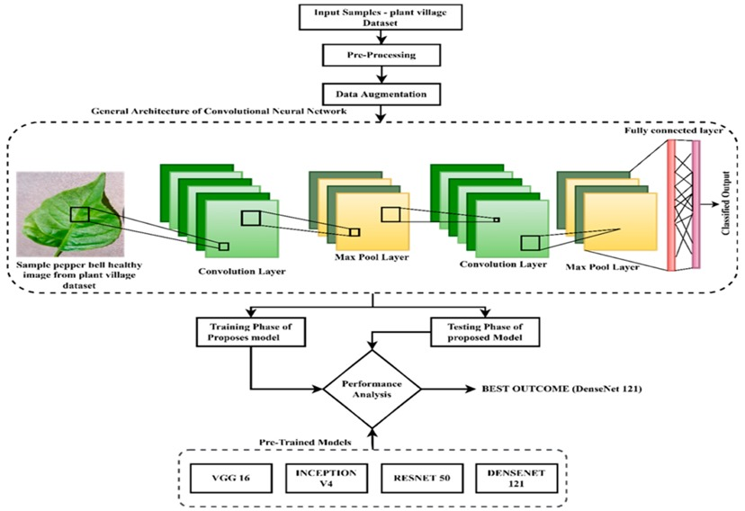
Architecture Diagram
10

Slide 12
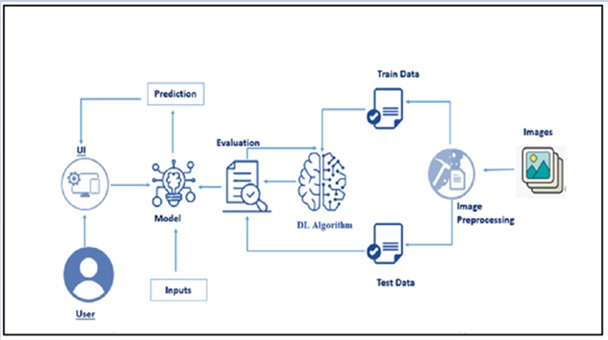
Architecture Diagram
11

Slide 13
Module Description
VGG16 MODEL
VGG16 is a convolutional neural network architecture that gained prominence for its simplicity and effectiveness in image classification tasks. Developed by the Visual Geometry Group at the University of Oxford, VGG16 is composed of 16 weight layers, including 13 convolutional layers and 3 fully connected layers.
The key characteristic of VGG16 is its uniform architecture, where convolutional layers consist of 3x3 filters with a stride of 1, and max-pooling layers with 2x2 filters applied after every two convolutional layers. This design choice results in a deeper network while maintaining a simple and regular structure.
The convolutional layers of VGG16 are designed to extract features of increasing complexity, starting from simple edges and textures in the early layers to more abstract features in the deeper layers. The fully connected layers at the end of the network utilize these features to perform high-level reasoning and make predictions.
12

Slide 14
Algorithm Explanation
A Convolutional Neural Network (CNN) is a type of artificial neural network designed specifically for processing structured grid-like data. It's particularly effective for tasks involving image recognition and classification, although it has been successfully applied to various other tasks such as natural language processing and signal processing.
Convolutional Layer: The core building block of a CNN is the convolutional layer. It applies a set of filters (also known as kernels) to the input data. Each filter performs a convolution operation by sliding across the input data, computing dot products between the filter weights and the corresponding input values
at each position. This process captures spatial patterns in the input data. The output of this operation is called a feature map.
2.Activation Function: After the convolution operation, an activation function is applied element-wise to the feature map to introduce non-linearity into the network. Common activation functions include ReLU (Rectified Linear Unit), sigmoid, and tanh.
3.Fully Connected Layer: After several convolutional and pooling layers, the resulting feature maps are flattened into a vector and fed into one or more fully connected layers. These layers perform high-level reasoning on the spatial hierarchies learned by the convolutional layers. The output of the last fully connected layer is often passed through a softmax activation function to produce probabilities for each class in a classification task.
13

Slide 15
Implementation
This Flask application provides a web interface for users to upload images of tea leaves and get predictions about any diseases present in those leaves using a pre-trained VGG-16 model. Here's a brief overview:
Imports: Necessary libraries and modules are imported, including Flask, numpy, TensorFlow, and PIL.
Loading the Model: A pre-trained VGG-16 model for tea leaf disease classification is loaded using Keras.
Flask App Initialization: An instance of the Flask class is created.
Routes: Several routes are defined for different pages like the home page, about page, and prediction page.
Processing Uploaded Image: When a user uploads an image, it's saved, resized, converted to a numpy array, and preprocessed for model input.
Making Predictions: The preprocessed image data is passed through the loaded model to make predictions about the presence of diseases.
Rendering Templates: HTML templates are rendered to display the web pages to the user.
Running the Application: The Flask application is run, listening for incoming requests on a specified port.
14

Slide 16
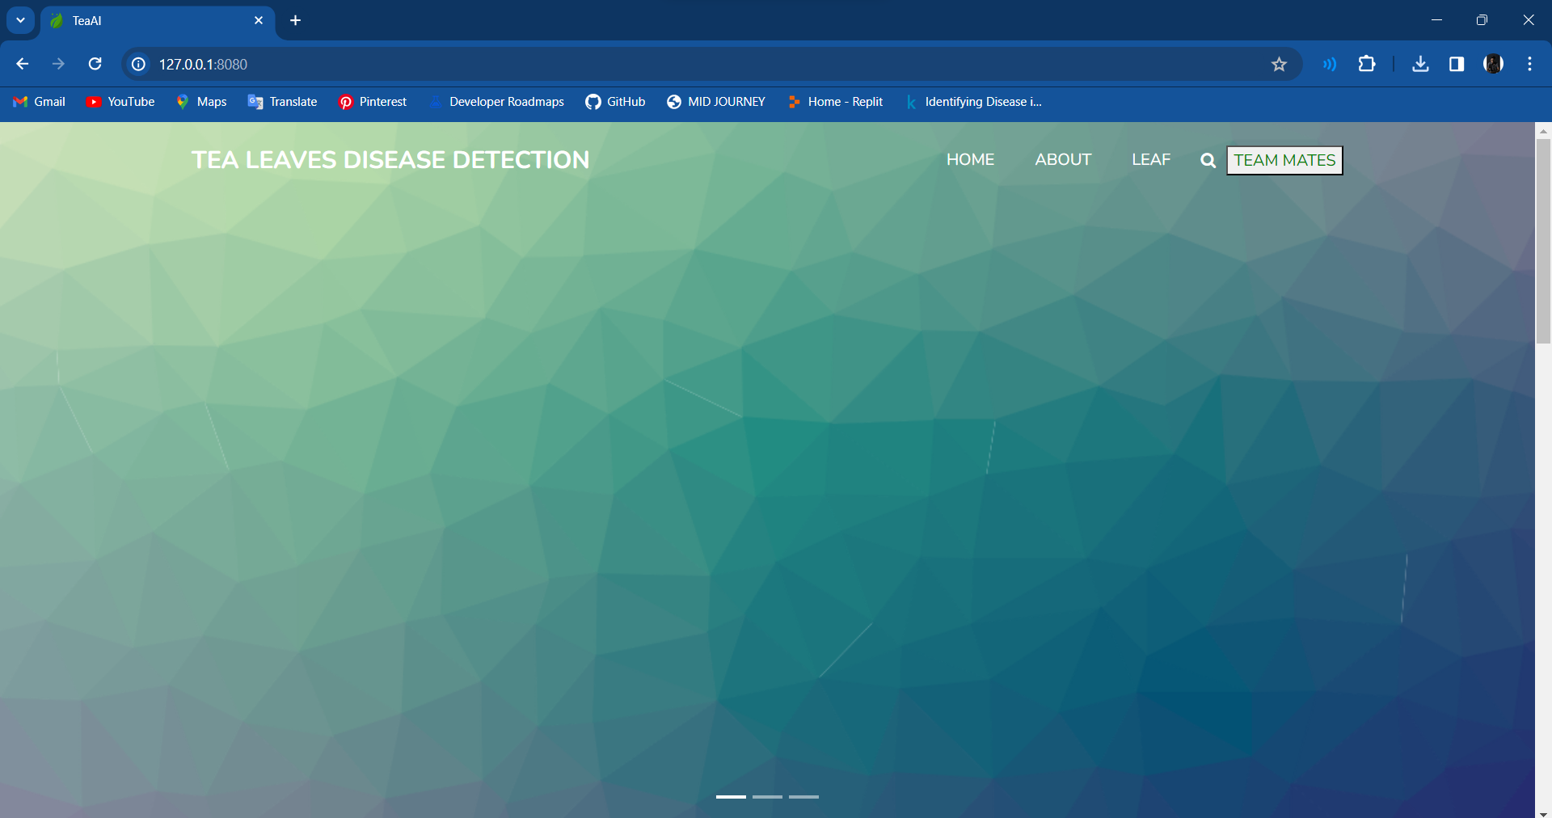
Screenshots
15

Slide 17
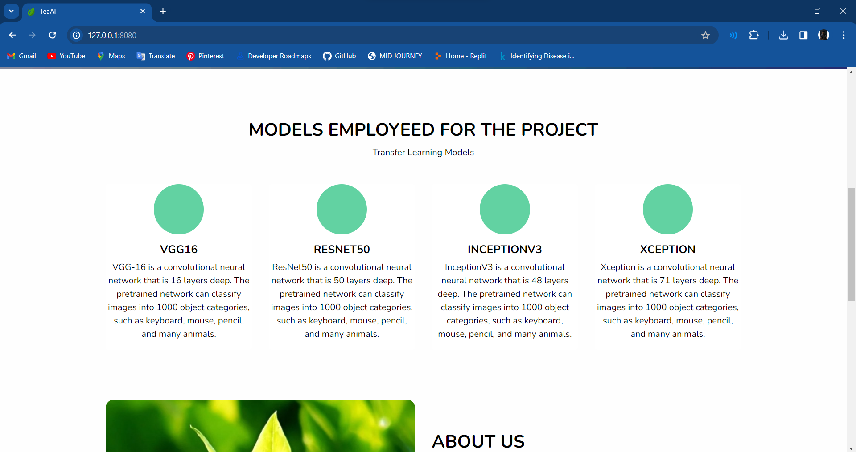
Screenshots
16

Slide 18
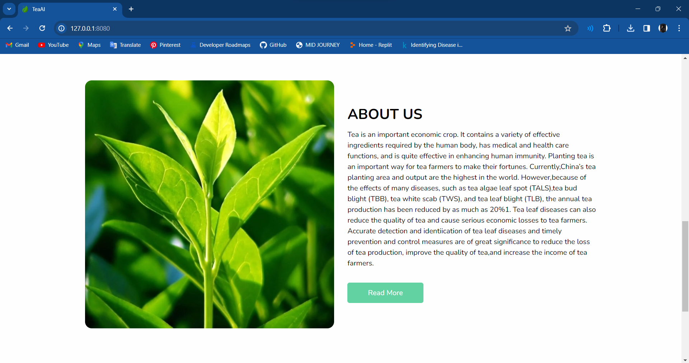
Screenshots
17

Slide 19
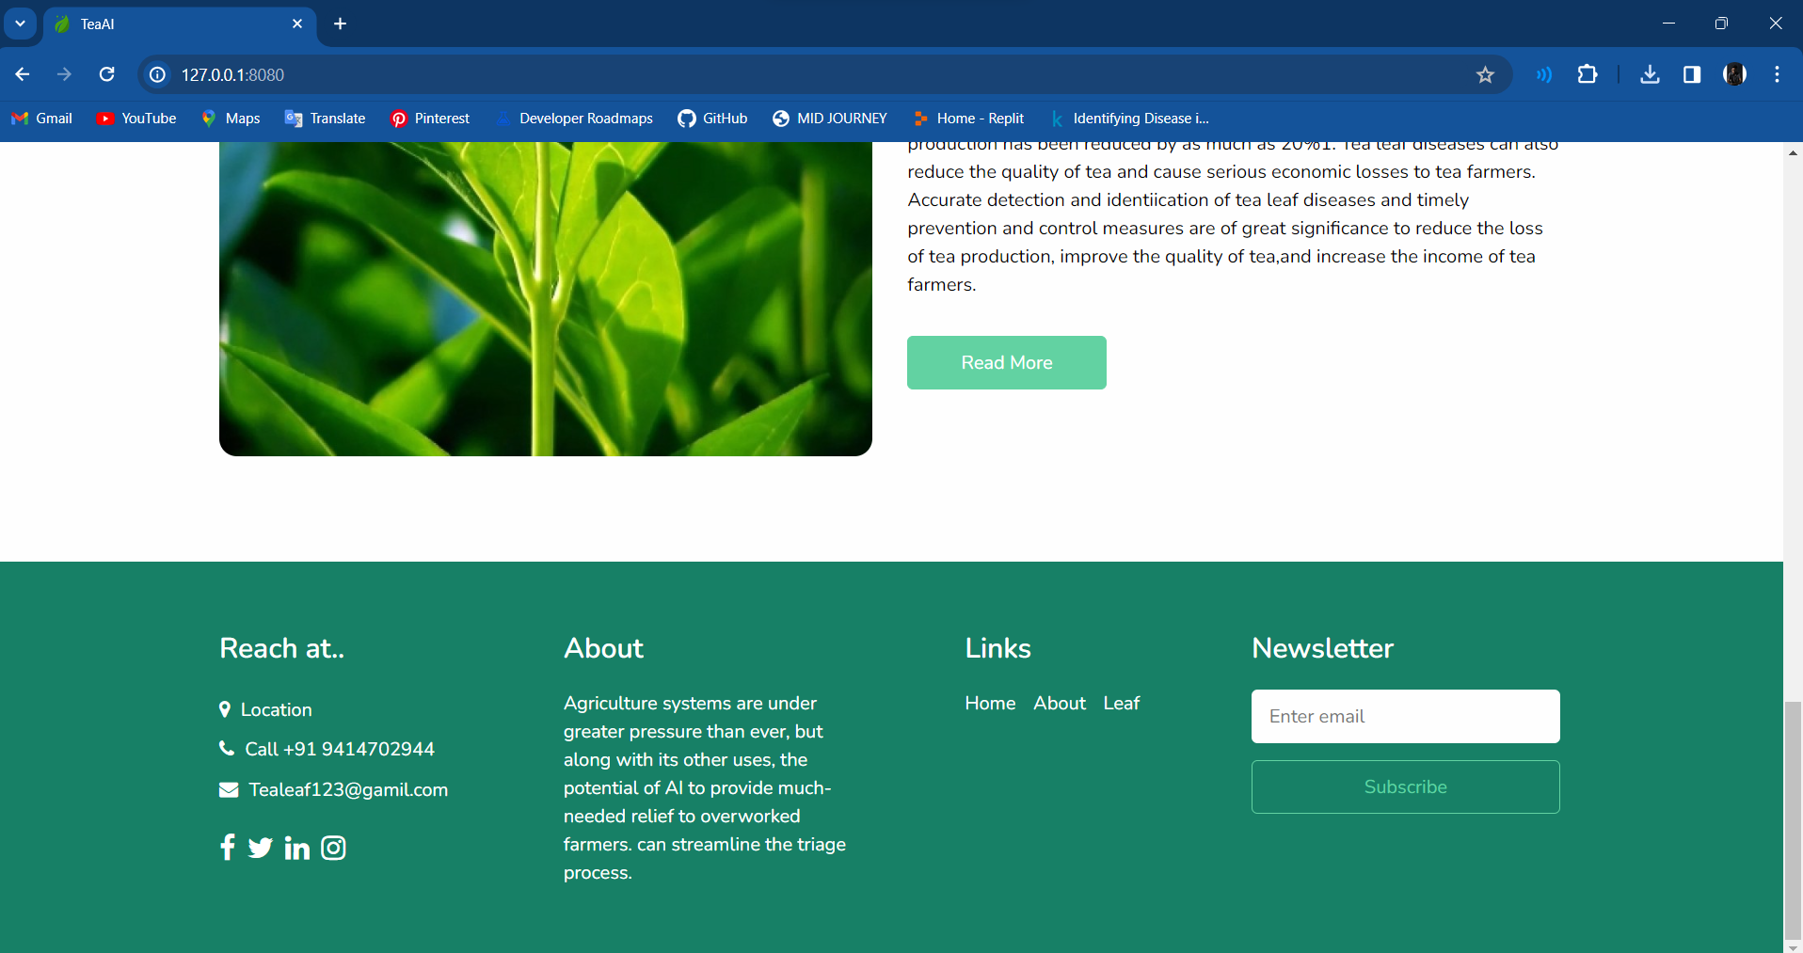
Screenshots
18

Slide 20
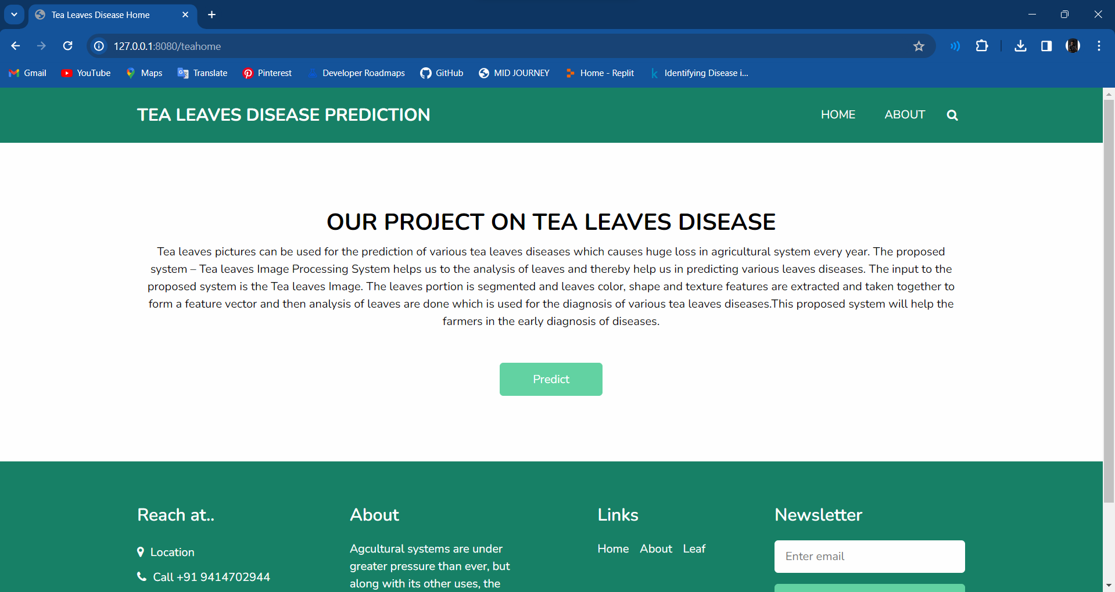
Screenshots
19

Slide 21
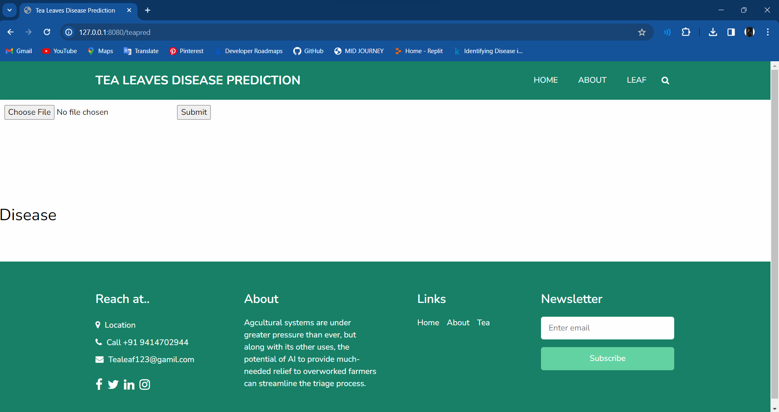
Screenshots
20

Slide 22
Software used
Python employed for backend development in the tea leaf disease detection system.
Flask utilized to create a user-friendly interface for seamless interaction.
Implementation of deep learning libraries, specifically TensorFlow, for the Convolutional Neural Network (CNN).
Integration of image processing tools, including OpenCV, to enhance image analysis capabilities.
Structuring the user interface through HTML and CSS, ensuring an organized and visually appealing design.
21

Slide 23
Conclusion
What Have We Done So Far?
Finally, our integrated software stack, featuring Python, Flask, TensorFlow, OpenCV, HTML, CSS, and Pandas, delivers an efficient and user-friendly solution for tea leaf disease detection.
This approach, incorporating deep learning and image processing, ensures a precise Convolutional Neural Network implementation, revolutionizing efficiency and accessibility in agricultural practices.
22

Slide 24
References
[1]JS. P. Raja , Barbara Sawicka et al., “ Crop Prediction Based on Characteristics of
the Agricultural Environment Using Various Feature
Selection Techniques and Classifiers” (IEEE).
[2] Jianping Yao, Son N. Tran et al., “Machine learning for leaf disease classification”, Springler, 2023.
[3] Md. Fahad Jubayer et al., “ Tea leaf disease detection and identification based on YOLOv7 (YOLO-T)”, Tea leaf disease detection YOLOv7 (YOLO-T)”
[4] S. Jayanthy et al., “Tea Leaf Disease Classification and Tea Bud Identification”
[5] Rahul Singh et al., “Proposed CNN Model for Tea Leaf Disease Classification”
[6] J P Manasa et al., “Mobile Based Application For Tea Leaf Disease Detection”
[7] Vishesh Tanwar et al., “Tea Leaf Diseases Classification and Detection using a Convolutional Neural Network”
23

Slide 25
THANK YOU

