Slide 1
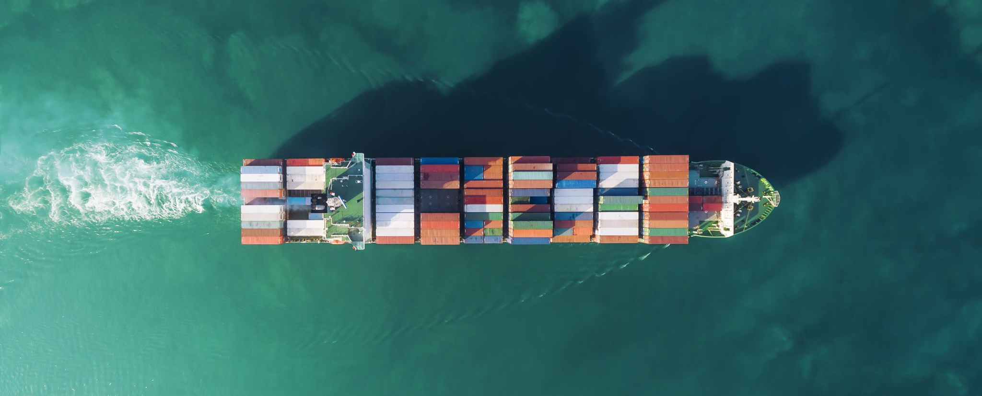
Beer Project
BENETEAU Marie-Christine
BHARATHI Sibish Ragul
ELIAS Jad
Yiming liu

Slide 2
OUTLINE
Our product
Our current transportation modes
Analysis of these transportation modes
Safety Stock and buffer inventory
Improvements

Slide 3
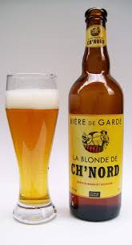
Product: Beers
330ml X 24 bottles
Dimensions：39cm X 26.5cm X 24.5cm
Weight：13.8kg
Unit cost: 20 euros
Yearly Volume : 15000 unit
Picture to show you the dimensions, not the real product.

Slide 4
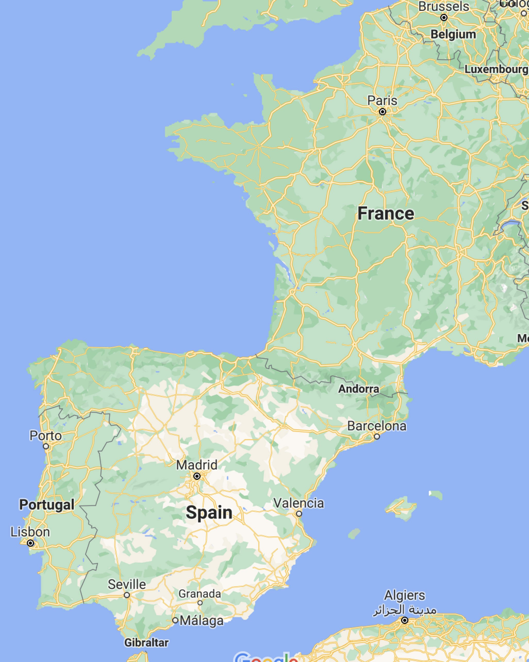
Transportation modes
Calais (France) Algeciras (Spain)
Manufacturing site Warehouse
MTS Storage
Mode 1: 100 % by truck
Mode 2: 90% by ship + 10% by truck
Both our manufacturing site (Calais, France) and our warehouse (Algeciras, Spain) are close to the port.
Mode 2
Mode 1
Notes:
We are shipping pallets of northern beer from Calais in France which is known for the great quality of production of beer.
As beers are not luxurious products, air transportation is not relevant for our company. An extremely short lead-time in transportation is not what we want, we can have some inventory.
Our pallets of beer will be transported to Port of Algeciras in Spain by 2 mode of transportations either 100 % by truck (from manufacture site to warehouse in Spain) or 90% by ship and 10% by truck (from manufacture site to the Port). The warehouse in Spain is found too at the Port.

Slide 5
Analysis of
transportation modes
Notes:
MC: So, first to analyse our different transportation modes, we search what were our total landed costs. All the details of the calculation are in annex, at the end of the presentation. It appearsthat the mode 2 is way more relevant in terms of costs. We may have more value in terms of inventory in transit but as it is beers, it is way less compare to what we would have payed by transporting it by trucks. 12 000€ in inventory in transit but 100 000€ of difference in terms of total landed costs. The may problem could have been regarding the inventory and the safety stock we should keep in addition when using mode 2 compare to mode 1.

Slide 6
Safety Stock and buffer inventory, with a service level of 95%
Notes:
MC: Actually it appears that the difference in terms of inventory in not so huge knowing that the beers have a very long expiration date. The forecasts will have to be accurate and we have to modify manually the safety stock if we do not want a bullwhip effect on all the supply chain. All the more that we have chosen to taken the longer lead time possible for the mode 1 as for the mode 2. Especially for mode 2 where there were 3 days of differences between cargo company. As it is possible we may need less safety stock, the mode 2 which combine sea and road may be the better for our company.

Slide 7
Mode 1: 100% by road
Change of ownership:
Our manufacturing site
Our warehouse
1 transporter: one type of transportation without stop.
Mode 2: 90% by sea + 10% by road
Change of ownership:
Our manufacturing site
The French port
The spannish port
Our warehouse
3 different transporters: more documentation to create before the shipment to be able to ship it and receive it via mode 2.

Slide 8
Improvements of our transportation modes
Mode 1 :
Use effiecient technology such as truck scales that allow us to load and unload goods and weigh them at the same time
Transfering to fuel with low carbon content
Priorotize maintenance of our trucks
Use advanced tracking tools to monitor truck during its journey
Always send full truck load to decrease the CO2 emissions

Slide 9
Annexe 1: details of calculation

Slide 10

Thank you for your attention

